Slide 1








Target Platform
Untrusted OS
Rerouted
Enclave
Enclave App
Network interface
Intel SGX processor
Network
Enclave
Enclave App
Extract data
Untrusted OS
Compromised SGX processor
Remote compromised platform
Notes:
Attack overview

Slide 2

Target platform
2
Untrusted OS
Rerouted
Enclave 1
Remote verifier
Enclave 2
1
Trusted processor
Untrusted OS
Enclave 1
Network
Enclave 2
Compromised processor
3
Remote compromised platform
Notes:
New system model

Slide 3


Relayed
OS
Enclave
Enclave
OS
Processor
Processor
Network
Remote attacker’s platform
1
3
Remote verifier
Target platform
2
Long-term attack
Untrusted
Trusted
Notes:
New system model revision Hybrid

Slide 4
A
OS
B
Relayed
Enclave
Enclave
OS
Processor
Network
Processor
1
Remote attacker’s platform
Remote verifier
Target platform
3
2
Fully Compromised
Trusted
Subject to side channels
A
Standard side channels
B
Enhanced side channels
Notes:
New system model revision Hybrid

Slide 5


Target platform 1
Target platform 2
Attestation
A
A
App
OS
Enclave
App
OS
Enclave
1
Processor
Processor
User
Relay
Service provider
Internet
App
B
OS
Enclave
Processor
Remote attacker’s platform
2
Fully Compromised
Trusted
Subject to side channels
A
Standard side channels
B
Enhanced side channels
Notes:
New system model revision Hybrid

Slide 6


C
OS
B
Relayed
Enclave
Enclave
OS
Secret data
Secret data
Network
A
Processor
Processor
1
Remote attacker’s platform
Attacker’s display
User
Target platform
4
User’s display
3
5
2
Replay
Fully Compromised
Trusted
A
Physical side channels
B
Enhanced side channels
C
Standard side channels
Notes:
New system model revision Hybrid

Slide 7
Relayed
OS
Enclave
Enclave
OS
Processor
Processor
Network
1
Remote attacker’s platform
Remote verifier
Target platform
3
2
Physical side-channel
Enclave side channel
Long term enclave attacks
Untrusted
Trusted
Notes:
New system model after relay analysis

Slide 8
OS
Attacker’s Enclave
Remote verifier
Diverted
Enclave
Emulated processor
1
Processor
Target platform
Untrusted
Trusted
2
Notes:
New system model revision Hybrid

Slide 9
OS
Rerouted
Remote verifier
Attacker’s Enclave
Emulated processor
1
Enclave
BIOS
Processor
Target platform
2
OS
Enclave
Processor
BIOS
Network
Remote attacker’s platform
3
Untrusted
Trusted
Notes:
Newest attacker model

Slide 10
Rerouted
OS
OS
Enclave
Remote verifier
Attacker’s Enclave
Emulated processor
Processor
BIOS
1
Network
Remote attacker’s platform
3
Enclave
Untrusted
Trusted
BIOS
Processor
Target platform
2
Notes:
Newest attacker model

Slide 11

I/O
Rerouted
OS
I/O manipulation
Enclave 2
Trusted processor
Enclave 1
1
User
2
Target platform
Notes:
New system model

Slide 12


Trusted embedded device
Verify
Connects
Distance
bounding
Enclave app
Remote verifier
Untrusted OS
Enclave 1
Trusted processor
Target platform
Notes:
Approach overview revised

Slide 13

Distance bounding
Verify
APP Enclave
OS
Remote verifier
PROXIMITEE API
PROXIMIKEY
SGX processor
Target platform
Notes:
Approach overview revised with the attacker model

Slide 14
Distance bounding
PROXIMITEE API
Enclave
OS
Remote verifier
SGX Processor
PROXIMIKEY
Target platform
Notes:
Approach overview revised with the attacker model

Slide 15



Local host System
Untrusted OS
Rerouted
Enclave 1
Enclave 2
Enclave App
Intel SGX processor
Notes:
Attack overview

Slide 16
Untrusted OS
Rerouted
Enclave 1
Enclave 2
Enclave App
Intel SGX processor
Target platform
Notes:
Attack overview

Slide 17

PROXIMITEEBRIDGE
PROXIMITEE protocol
3
Forward challenge
2
4
Response
1
Challenge
Enclave
Forward response
5
Enclave App
Intel SGX
processor
Untrusted OS
Trusted remote verifier
Client’s local host System

Slide 18
Forward
Forward
Local
Remote
Local
Remote
Local
Remote
Local
Remote
1
2
3
4
Base model
Untrusted
Trusted
TEE
Notes:
Old system settings

Slide 19




Validators
Verifiers
Verifiers
Validators
Leader
Validators
+
Notes:
Double col

Slide 20





Trusted embedded device
Validators
Verifiers
I/O
I/O
Verifiers
Verifiers
Bank
Customer’s
platform
User
Console
Data center
Validators
Leader
Validators
Identity attestation
Location attestation
+
1
2
3
Notes:
Double col

Slide 21
Trusted embedded device
Verifiers
I/O
I/O
Bank
Customer’s
platform
User
Console
Data center
Identity attestation
Location attestation
1
2
Validators
Verifiers
Verifiers
Validators
Leader
Validators
+
3
Notes:
col

Slide 22
Trusted remote verifier
1
Establish TLS
Intel Attestation Server
Network
8
Calculate latency
2
Spawns Enclave
9
Response to the verifier
3
Remote attestation
Enclave
4
Establish TLS
5
PROXIMITEE challenge
6
Compute
7
Response
PROXIMITEEBRIDGE
Enclave App
Untrusted OS
Intel SGX processor
Target platform
Notes:
Remove verifier setup phase

Slide 23
Trusted remote verifier
Intel Attestation Server
Network
2
Spawns Enclave
3
Remote attestation
4
Establish TLS
Enclave
1
Establish TLS
5
PROXIMITEE challenge
6
Compute
7
Response
Untrusted App
Intel SGX processor
Untrusted OS
Target platform
8
Calculate latency
PROXIMIKEY
9
Response to the verifier
Notes:
Remove verifier setup phase

Slide 24
Trusted remote verifier
Intel Attestation Server
Network
Establish
TLS
2
Spawns Enclave
1
3
Remote attestation
4
Establish TLS
Enclave
5
PROXIMITEE challenge
6
Compute
7
Response
PROXIMIKEY
Untrusted App
8
Calculate latency
Untrusted OS
Intel SGX processor
9
Response to the
verifier
Target platform
Notes:
Remove verifier setup phase

Slide 25

Intel Attestation Server
1
Spawns Enclave
9
Calculate latency
2
Establish TLS
3
Remote attestation
Enclave
6
Seal
4
PROXIMITEE challenge
Compute
5
7
Response
PROXIMITEEBRIDGE
Enclave App
Untrusted OS
Intel SGX processor
IO Devices
Local host System
Notes:
Set up phase

Slide 26
Intel Attestation Server
6
Remote attestation
1
Spawns Enclave
11
Calculate latency
2
Establish TLS
3
attestation challenge
Enclave
Seal
9
5
Report reply
4
Report
7
PROXIMITEE challenge
8
Compute
10
Response
PROXIMITEEBRIDGE
Enclave App
Untrusted OS
Intel SGX processor
IO Devices
Local host System
Notes:
Set up phase

Slide 27
1
Spawns Enclave
7
Check + calculate latency
8
Input
2
Establish TLS
Enclave
3
PROXIMITEE challenge
Compute
4
Unseal
5
6
Response
10
Decryption
9
Encrypted input transmission
PROXIMITEEBRIDGE
Enclave App
Untrusted OS
Intel SGX processor
IO Devices
Local host System
Notes:
Operation phase

Slide 28






















PROXIMITEEBRIDGE
Enclave
Challenge generation
$$r_{0}\underset{←}{rand}{\left\{0,1\right\}}^{n}$$
$$c_{0}←Enc_{k}(r_{0})$$
$$c_{0}$$
$k←TLS$ session key
$$r_{0}←Dec_{k}(c_{0})$$
Response generation
Setup phase
$$c_{0}^{′}←Enc_{k} (r_{0}+1)$$
$$c_{0}^{′}$$
$$sgx_seal_data(r_{0})$$
$$r_{0}^{′}←Dec_{k}(c_{0}^{′})$$
Verification
$$?$$
$$r_{0}^{′}= r_{0}+1$$
$$r_{1}\underset{←}{rand}{\left\{0,1\right\}}^{n}$$
Challenge generation
$$c_{1}←Enc_{r_{0}}(r_{1})$$
$$c_{1}$$
$$r_{0}←sgx_unseal_data()$$
Operation phase
$$r_{1}←Dec_{k}(c_{1})$$
Response generation
$$c_{1}^{′}←Enc_{k} (r_{1}+1)$$
$$c_{1}^{′}$$
$$sgx_seal_data(r_{1})$$
$$r_{1}^{′}←Dec_{k}(c_{1}^{′})$$
Verification
$$?$$
$$r_{1}^{′}= r_{1}+1$$

Slide 29






PROXIMITEEBRIDGE
Enclave
Challenge generation
$$r_{0}\underset{←}{rand}{\left\{0,1\right\}}^{n}$$
$$c_{0}←Enc_{k}(r_{0})$$
$$c_{0}$$
$k←TLS$ session key
$$r_{0}←Dec_{k}(c_{0})$$
Response generation
Setup phase
$$c_{0}^{′}←Enc_{k} (r_{0}+1)$$
$$c_{0}^{′}$$
$$sgx_seal_data(k)$$
$$r_{0}^{′}←Dec_{k}(c_{0}^{′})$$
Verification
$$?$$
$$r_{0}^{′}= r_{0}+1$$
$$r_{1}\underset{←}{rand}{\left\{0,1\right\}}^{n}$$
Challenge generation
$$c_{1}←Enc_{r_{0}}(r_{1})$$
$$c_{1}$$
$$k←sgx_unseal_data()$$
Operation phase
$$r_{1}←Dec_{k}(c_{1})$$
Response generation
$$c_{1}^{′}←Enc_{k} (r_{1}+1)$$
$$r_{1}^{′}←Dec_{k}(c_{1}^{′})$$
$$c_{1}^{′}$$
Verification
$$?$$
$$r_{1}^{′}= r_{1}+1$$

Slide 30











PROXIMITEEBRIDGE
Enclave
Challenge generation
$$r\underset{←}{rand}{\left\{0,1\right\}}^{n}$$
$$c←Enc_{k}(r)$$
$$c$$
$k←TLS$ session key
$$r←Dec_{k}(c)$$
Response generation
$$c′$$
$$c′←Enc_{k} (r+1)$$
$$r′←Dec_{k}(c′)$$
Verification
$$?$$
$$r′= r+1$$
…
$N$times

Slide 31
Intel Attestation Server
6
Remote attestation
1
Spawns Enclave
8
Input
7
Calculate latency
Enclave
2
Establish TLS
3
Send challenge
5
Measurement
Compute challenge
4
9
Encrypted input transmission
10
Decryption
Trusted Device
Enclave App
Untrusted OS
Intel SGX processor
IO Devices
Local host System

Slide 32



Remote
PROXIMIKEY
I/O
5
Establish TLS with remote PROXIMIKEY
1
2
PROXIMITEE protocol
3
Send enclave PK + response
4
Establish TLS with enclave
Enclave
Local
PROXIMIKEY
Transfer
Enclave App
6
Untrusted OS
Intel SGX
processor
Untrusted local terminal
IO Devices
Remote platform
Notes:
Remote host verification for trusted path

Slide 33


1
TLS with remote PROXIMITEEKEY
Remote
PROXIMITEEKEY
3
TLS with enclave
Untrusted local terminal
2
PROXIMITEE protocol + TLS
Enclave
Transfer
5
Enclave App
Local
PROXIMITEEKEY
Intel SGX
processor
Untrusted OS
I/O
Remote platform
4
IO Devices
Notes:
Remote host verification for trusted path

Slide 34


Remote
PROXIMIKEY
2
PROXIMITEE attestation
Local terminal
Enclave
Untrusted App
Intel SGX
processor
Local
PROXIMIKEY
Untrusted OS
Remote platform
1
User initialization
IO
IO Devices
3
Notes:
Remote host verification for trusted path revised

Slide 35
2
PROXIMITEE protocol
I/O
3
1
Establish TLS
Enclave
PROXIMITEEBRIDGE
Untrusted App
Untrusted OS
Intel SGX
processor
IO Devices
Local platform
Notes:
Local platform verification for trusted path

Slide 36


3
PROXIMITEE protocol
2
Establish TLS
PROXIMITEE Enclave
App Enclave
1
Establish TLS
Untrusted
App
PROXIMIKEY
I/O
Untrusted OS
4
IO Devices
Local platform
Notes:
Local platform verification for trusted path revised

Slide 37
1
User initialization
App Enclave
2
Attestation + TLS
Untrusted
App
PROXIMIKEY
I/O
Untrusted OS
3
IO Devices
Local platform
Notes:
Local platform verification for trusted path revised 1

Slide 38
ProximiTEEBridge
Enclave App
Enclave
sgx_create_enclave()
TLS handshake
TLS handshake
Attestation request
Attestation request
Attestation report
Intel Attestation server
Attestation result
Proximity Challenge
Proximity Challenge
Latency
Decrypt
Response
Response
Notes:
Interaction

Slide 39

















$$t_{0}^{′}$$
$$t_{1}^{′}$$
$$t_{2}^{′}$$
$$RTT_{H}= t_{3}−t_{0}$$
interaction in ideal scenario
$$t_{0}$$
$$t_{1}$$
$$t_{3}^{′}$$
$$RTT_{A}= t_{7}^{′}−t_{0}^{′}$$
Interaction while attacked
Enclave
Enclave
$$L_{EN}^{H}=t_{2}−t_{1}$$
$$t_{3}$$
$$t_{2}$$
$$t_{4}^{′}$$
Trusted
$$t_{7}^{′}$$
$$t_{6}^{′}$$
$$t_{5}^{′}$$
$$L_{EN}^{A}=t_{4}^{′}−t_{3}^{′}$$
Compromised
PROXIMITEEDEVICE
Target Platform
Remote compromised Platform
$$L_{APP}^{A}=t_{5}^{′}−t_{2}^{′}$$
Notes:
Latency timeline-double col

Slide 40













$$t_{0}^{′}$$
$$t_{1}^{′}$$
$$t_{2}^{′}$$
$$t_{0}$$
$$t_{1}$$
$$t_{3}^{′}$$
Enclave
Enclave
$$t_{3}$$
$$t_{2}$$
$$t_{4}^{′}$$
$$t_{7}^{′}$$
$$t_{6}^{′}$$
$$t_{5}^{′}$$
PROXIMIKEY
Target Platform
Attacker’s Platform
$$RTT_{H}= t_{3}−t_{0}$$
$$RTT_{A}= t_{7}^{′}−t_{0}^{′}$$
interaction in ideal scenario
$$L_{EN}^{H}=t_{2}−t_{1}$$
Interaction while attacked
$$L_{EN}^{A}=t_{4}^{′}−t_{3}^{′}$$
Trusted
$$L_{APP}^{A}=t_{5}^{′}−t_{2}^{′}$$
Compromised
Notes:
Latency timeline-single col

Slide 41

3
Store
File
Seal
Data
Enclave
f1
1
d1
PROXIMITEEBRIDGE
Send Hash
f2
d2
Enclave App
2
File
HASH
…
…
f1
0x232ba
fn
dn
Untrusted OS
Intel SGX
processor
f2
0xf4c56
Storage
…
…
fn
0x90a5d
PROXIMITEEBRIDGE
memory

Slide 42
ID
Counter
ID
Counter
i
c
i
c+1
4
Increment
Enclave
1
Establish TLS
Get counter
3
Seal
PROXIMITEEBRIDGE
2
Enclave App
Seal(d|i|c)
Untrusted OS
Intel SGX
processor
Storage
Target platform
Notes:
Rollback protection

Slide 43






Enclave Name Server
Enclave
Measurement
Public key
2
Check
$$E_{1}$$
0x232ba…
$${PK}_{1}$$
$$E_{2}$$
0xf4c56…
$${PK}_{2}$$
…
…
Enclave 1
$$E_{n}$$
0x90a5d…
$${PK}_{n}$$
Enclave 2
…
1
Measurement
Enclave n
PROXIMITEEBRIDGE
Intel SGX processor

Slide 44
Enclave Name Server
Enclave
Measurement
2
Check
App 1
0x232ba…
App 2
0xf4c56…
…
App 1
App n
0x90a5d…
App 2
…
1
Measurement
App n
PROXIMITEEBRIDGE
Intel SGX processor

Slide 45


1
PROXIMIKEY
Platform owner
Target Platform
Plug USB
Restart
Boot USB
BIOS
PROXIMITEE kernel
PROXIMITEE enclave
2
Boot
3
Press button
PROXIMITEE kernel
Key gen
Loads
4
Sends key
PROXIMITEE enclave
Seals key
Stores seal
Sends sealed key
5
6
Restart
Notes:
Boot time initialization revised

Slide 46
3
Local Attestation
PROXIMITEE Enclave
Emulated processor
Sealed key
App Enclave
Attacker’s Enclave
1
PROXIMIKEY
Trusted processor
4
Approve
Target platform
5
Communication
2
App enclave
Remote verifier

Slide 47
Sealed key
3
Local Attestation
1
PROXIMITEE Enclave
App Enclave
Attacker’s Enclave
PROXIMIKEY
4
Approve
Trusted processor
Emulated processor
5
Communication
Target platform
2
App enclave
Remote verifier

Slide 48
3
Local Attestation
4
Approve
Sealed key
1
PROXIMITEE Enclave
App Enclave
Attacker’s Enclave
Remote verifier
5
Data
PROXIMIKEY
Trusted processor
Emulated processor
App enclave
2
Target platform

Slide 49

CA
Boot Init
PROXIMITEE Enclave
Local Attestation
App Enclave
Remote verifier
PROXIMIKEY
X
X
PROXIMITEE Enclave
App
Enclave
Attacker
Attacker’s
PROXIMIKEY
Emulated processors

Slide 50
CA
Distance bounding
App Enclave
Remote verifier
PROXIMIKEY
1
Variant I: distance bounding
CA
Boot init
PROXIMITEE Enclave
Local attestation
App Enclave
Remote verifier
PROXIMIKEY
After attestation
2
Variant II: boot-time initialization

Slide 51
CA
Distance bounding
App Enclave
CA
Boot init
PROXIMITEE Enclave
Local attestation
App Enclave
Remote verifier
Remote verifier
PROXIMIKEY
PROXIMIKEY
After attestation
1
Variant I: distance bounding
2
Variant II: boot-time initialization

Slide 52

Offline TOFU
CA
Online TOFU
Our TOFU
Standard Kernel
Micro Kernel
PROXIMITEE Kernel
HW
HW
HW
Exposed to network
Offline modules

Slide 53
Strawman
Solution (TOFU)
Variant I
Distance bounding
Variant II
Boot-time Initialization
1
2
3
Online CA
Offline CA
Offline CA
Standard Kernel
Standard Kernel
PROXIMITEE Kernel
Standard Kernel
HW
HW
HW
Untrusted
Trusted
Trust on first use

Slide 54
Strawman
Solution (TOFU)
Variant I
Distance bounding
Variant II
Boot-time Initialization
1
2
3
Online CA
Offline CA
Offline CA
Standard Kernel
Standard Kernel
PROXIMITEE Kernel
Standard Kernel
HW
HW
BIOS
HW
Untrusted
Trusted
Trust on first use

Slide 55
Strawman
Solution (TOFU)
Boot-time Initialization +
attestation
Online CA
Offline CA
Standard Kernel
PROXIMITEE Kernel
Standard Kernel
HW
BIOS
HW
Untrusted
Trusted
Trust on first use

Slide 56
Strawman Solution (TOFU)
Boot-time Initialization + attestation
Online CA
Offline CA
Standard Kernel
PROXIMITEE Kernel
Standard Kernel
HW
BIOS
HW
Untrusted
Trusted
Trust on first use

Slide 57




Successful window
Failed window
$$≤T_{con}$$
$$T_{con}<$$
$$<T_{detach}$$
…
…
$$T_{detach}≤$$
Halt window
Platform disconnected

Slide 58




Successful window
Failed window
$$≤T_{con}$$
…
…
$$T_{con}<$$
$$<T_{detach}$$
$$T_{detach}≤$$
Halt window
Platform disconnected

Slide 59




Successful window
Failed window
…
…
Halt window
Platform disconnected
$$≤T_{con}$$
$$T_{con}<$$
$$<T_{detach}$$
$$T_{detach}≤$$

Slide 60
Attacks
Electro-magnetic radiation
Acoustic
Before Relay
After relay
Digital side channel
Physical side channel
Power monitoring
Protected
Protected under certain conditions
Not protected

Slide 61
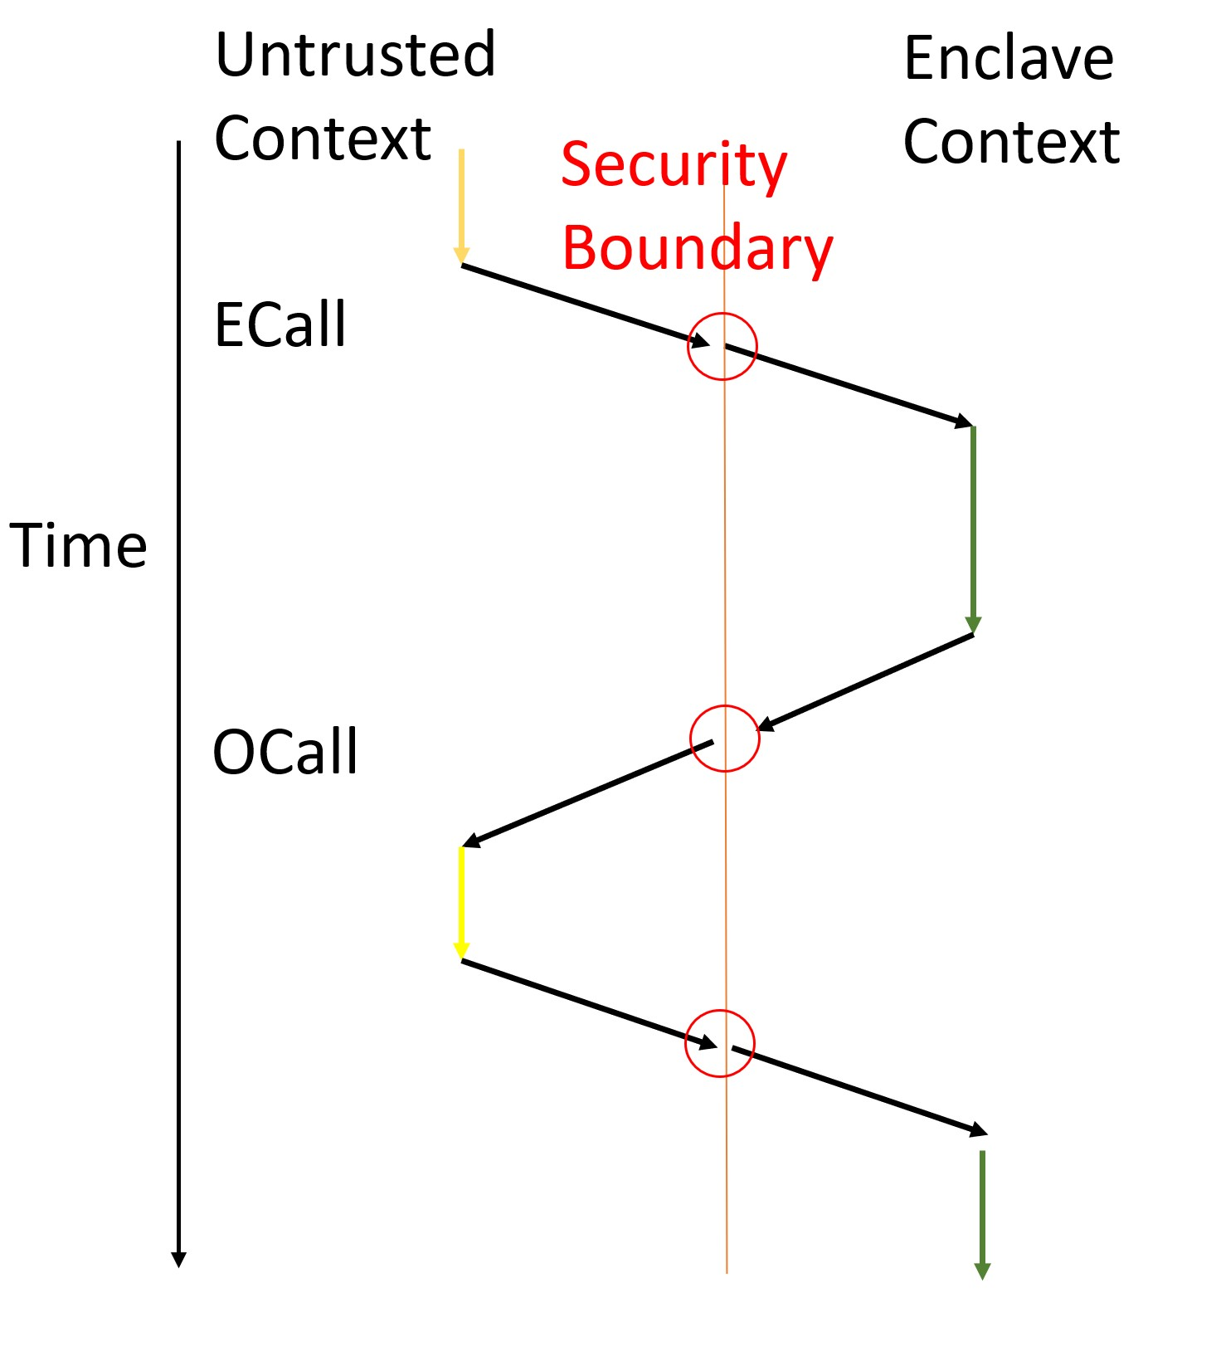
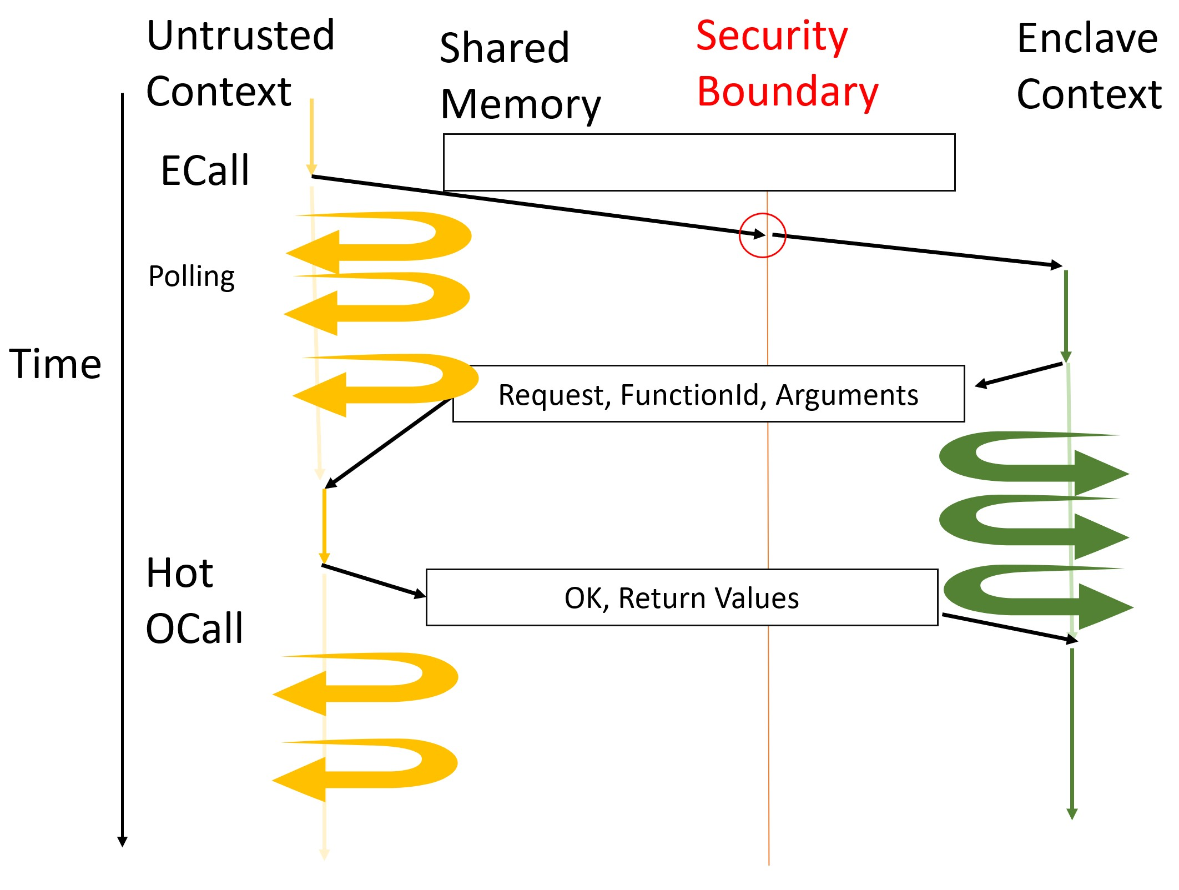
(a)
(b)

Slide 62
Untrusted
context
Security
boundary
Enclave
context
Time
ECall
OCall
(a)

