Slide 1
3
OS
Trusted path application
Driver
1
Peripheral
2
CPU
Platform

Slide 2









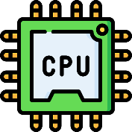




IntegriKey (2017, eprint: 2017/1245)
ProtectION (NDSS 2020)
PIE (2020, arXiv:2010.10416)
IntegriScreen (2018, arXiv:2011.13979)
Remote system
Remote trusted path application
Dedicated Security Chips in the Age of Secure Enclaves (IEEE S&P magazine 2020)
Platform identitity
ProximiTEE (CODASPY 2020)

Slide 3





User
IO devices
Host
Remote System
Notes:
Trusted path is an umbrella term that denotes the integrity and confidentiality of the channel between the user IO devices and the target TCB, remote trusted path is an extension where all the communication goes over the untrusted local platform and the network that is also attacker controlled.

