Slide 1
3
OS
Trusted path application
Driver
1
Peripheral
2
CPU
Platform

Slide 2










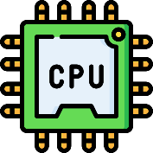



PIE (2020, arXiv:2010.10416)
IntegriKey (2017, eprint: 2017/1245)
ProtectION (NDSS 2020)
IntegriScreen (2018, arXiv:2011.13979)
Remote system
Remote trusted path application
Dedicated Security Chips in the Age of Secure Enclaves (IEEE S&P magazine 2020)
Platform identitity
ProximiTEE (CODASPY 2020)

