Slide 1




Host system
Secure USB Device
Extractor
Incoming message
BX7878ADKLSK_HSNKA3+K=
a1 Parse
a2 Connect
a3 Transfer
a4 Decrypt
a5 Transfer
Display
XTMP_93+HAJSQKL927AB=
b6 Write
b5 Connect
b4 Transfer
b3 Encrypt
b2 Transfer
b1 Input
Messenger interface
WebUSB/WebBT
interface

Slide 2


Host system
Secure USB Device
Extractor
Incoming message
BX7878ADKLSK_HSNKA3+K=
a1 Parse
a2 Connect
a3 Transfer
a4 Decrypt
a5 Transfer
Display
XTMP_93+HAJSQKL927AB=
b6 Write
b5 Connect
b4 Transfer
b3 Encrypt
b2 Transfer
b1 Input
Messenger interface
WebUSB/WebBT
interface

Slide 3






Trusted embedded device
Keyboard
Channel 1
Channel 2
Channel 1
Compromised host
Remote server

Slide 4




Keystroke
Trusted embedded device
Keyboard
Forwarded
keystroke
Keystroke via
Secure channel
Application level
payload
Input trace match
Compromised host
Remote server

Slide 5

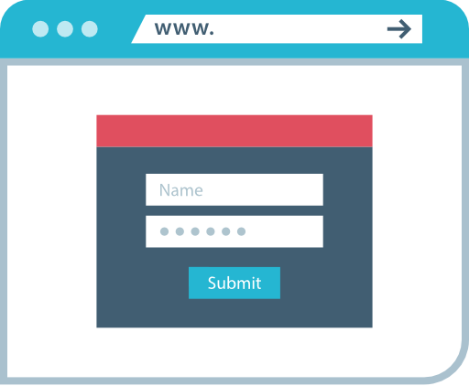
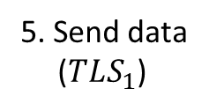
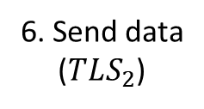
INTEGRIKEY bridge
Host system/ Browser
Remote server + INTEGRIKEY server-side component
a
4. Forward
keystrokes
5. Send data
($TLS_{1}$)
2. Transfer
6. Send data
($TLS_{2}$)
1. Input
3. Captures input
7. Match data
WebUSB/WebBT
Network

Slide 6

BRIDGE
Host system/ Browser
Send fields
Remote server
1
Autofill data
HTTP payload
2
3
Signed data
5
Fetch
4

Slide 7



BRIDGE
Host system/ Browser
Remote server + INTEGRIKEY server-side component
2
Setup $TLS_{1}$
WebUSB trigger
1
Open web app
4
3
JavaScript
5
Setup $TLS_{2}$
Input
(labeling)
App payload
6
8
7
Forward keystroke
WebUSB/WebBT
10
Match data
Network
9
BRIDGE trace

Slide 8
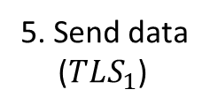
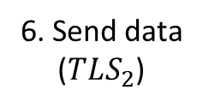
INTEGRIKEY bridge
Host system/ Browser
Remote server + INTEGRIKEY server-side component
a
4. Forward
keystrokes
5. Send data
($TLS_{1}$)
2. Transfer
6. Send data
($TLS_{2}$)
1. Input
3. Captures input
7. Match data
WebUSB/WebBT
Network

Slide 9






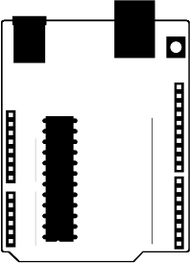
Trusted
Compromised
Trusted
Input
Protected
input
Network
Signals
User
Embedded Device
Console
PLC
Automation

Slide 10





Trusted
Compromised
Trusted
Signals
Server + INTEGRIKEY component
Web-enabled pacemaker
Programmer
Input
Protected
input
Signals
INTEGRIKEY
device
Console
Internet
PLC + INTEGRIKEY component
User
Automation
INTIGIKEY components

Slide 11
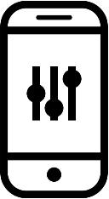


Trusted
Compromised
Trusted
Signals
Programmer
Server + INTEGRIKEY component
Web-enabled pacemaker
Input
Protected
input
Signals
INTEGRIKEY
device
PLC + INTEGRIKEY component
Automation
Console
Internet
User
Signals
Home automation
Phone app
Web enabled controller + INTEGRIKEY component
INTIGIKEY modules

Slide 12

Trusted
Compromised
Trusted
Signals
Programmer
Server
Web-enabled pacemaker
Input
Signals
Input
Console
PLC
Automation
Internet
Signals
Home automation
Browser
Web enabled controller

Slide 13
Server
Web-enabled pacemaker
Browser
Keyboard
Internet
PLC
Automation
Host
Home automation
Web enabled controller

Slide 14


Trusted
Compromised
Trusted
Input
User
input
INTEGRIKEY
bridge
PLC + INTEGRIKEY component
User
Host
Network
Cloud

Slide 15









Configuration
webpage
$$f_{1}$$
$$f_{2}$$
INTEGRIKEY tool
$$f_{3}$$
$$f_{1}$$
Label
$$f_{2}$$
Label
$$f_{3}$$
Transformed
webpage
Specifications

Slide 16
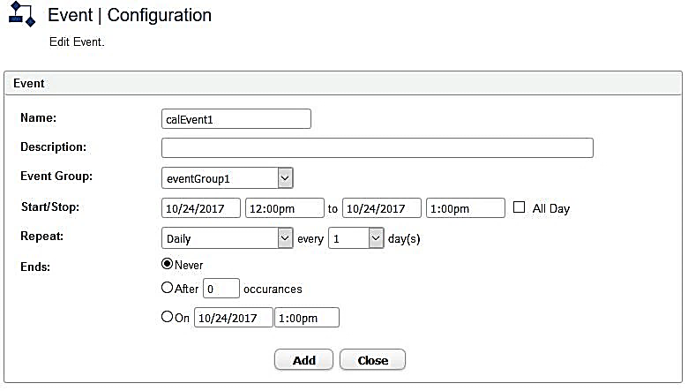

Slide 17
swappable
Relay 1
Decimal places1
Temp relay 1
Relay 2
Decimal places2
Temp relay 2
Unit
swappable
Distinct field

Slide 18
INTERGIKEY Device trace
Relay 1
Decimal places1
Temp relay 1
Relay 2
Decimal places2
Temp relay 2
Unit
Relay 1
Decimal places1
Temp relay 1
Relay 2
Decimal places2
Temp relay 2
Unit
Application level payload

Slide 19
Application level payload
INTERGIKEY Bridge trace
POST / HTTP/1.1
Content-Type: form-data
Relay1=rel1:r1 &
Type=typ1:float &
Decimal places 1=dp1:2&
Relay temp 1=tem1:20&
Relay2=rel2:r2 &
Type=type2:float &
Decimal places 2=dp2:4&
Relay temp 2=tem2:65&
Units=deg
r
e
l
1
:
r
1
tab
t
y
p
1
:
f
l
o
a
t
.
.
.

Slide 20
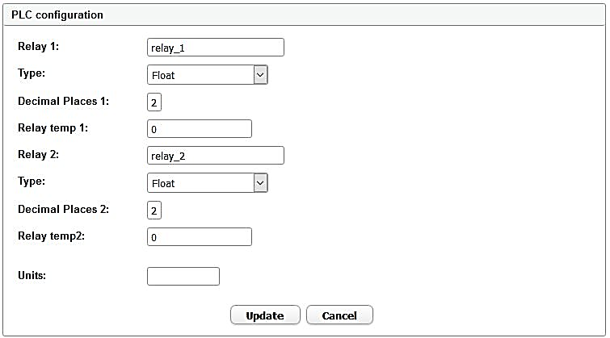
Groups of swappable fields
Group 1
Group 2
Group 3
Group 4

Slide 21
Groups of swappable fields
Group 1
Group 2
65
Group 3
swapped
Group 4
20
User Interface
POST / HTTP/1.1
Content-Type: form-data
Relay temp 1=65 &
…
Relay temp 2=20
Value Swapped
HTTP Response packet

Slide 22
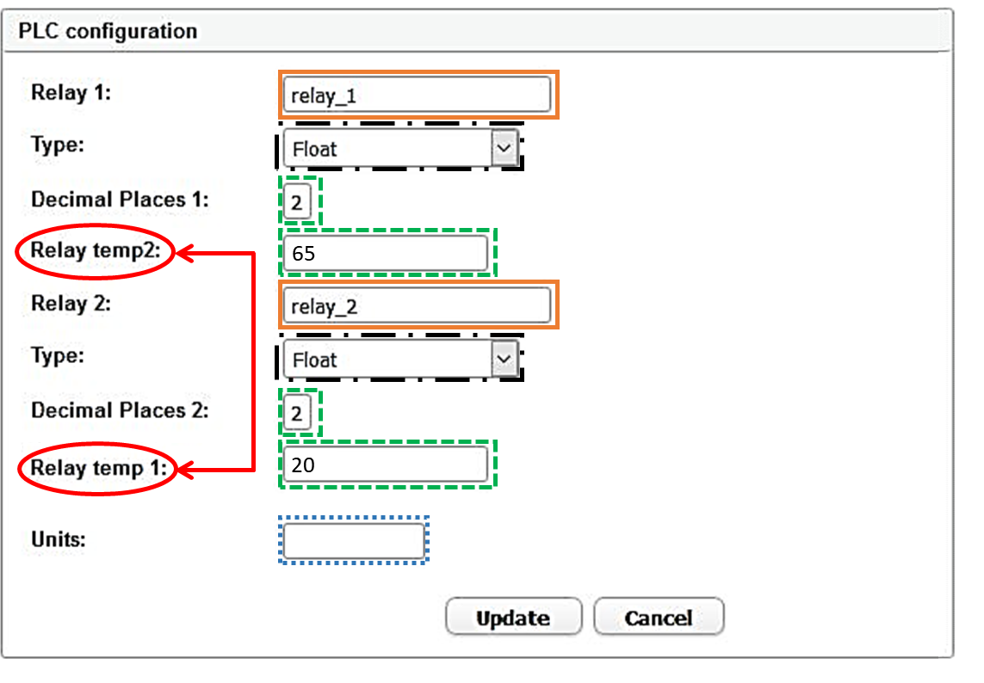
Groups of swappable fields
Group 1
Group 2
Group 3
swapped
Group 4
User Interface
POST / HTTP/1.1
Content-Type: form-data
Relay temp 1=65 &
…
Relay temp 2=20
Value Swapped
HTTP Response packet

Slide 26
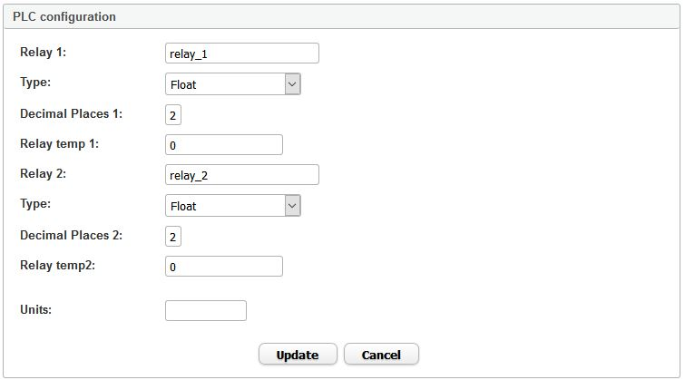

Slide 27
Groups of swappable fields
Group 1
Group 2
Group 3

Slide 28

relay 1:relay_1
dp 1:2
temp 1:20
relay 2:relay_2
dp 2:4
temp 2:65

Slide 29

relay 1:relay_1
dp 1:2
temp 1:20
relay 2:relay_2
dp 2:4
temp 2:65

Slide 30
rel1:r1
Add rel1:
typ1:float
Add typ1: (float, int, bool)
decpla1:2
Add decpla1:
reltem1:20
Add reltem1:
rel2:r2
Add rel2:
typ2:float
Add typ2: (float, int, bool)
decpla2:4
Add decpla1:
reltem2:65
Add reltem2:

Slide 31
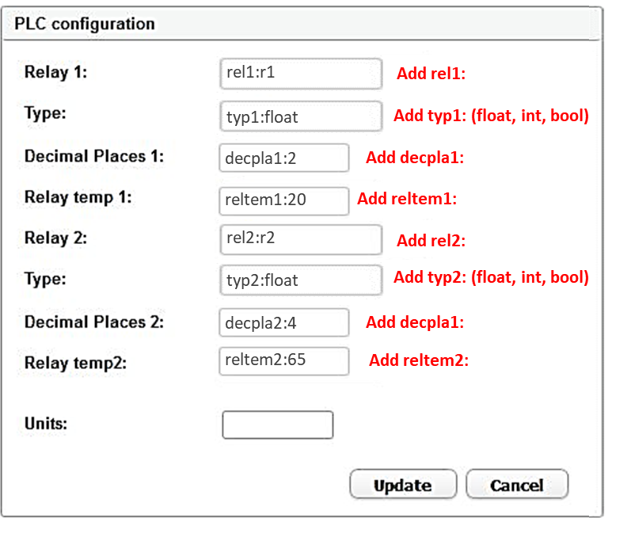

Slide 32





Radio
Instruction
Available
On, off
On
Radio
Off
Menu
Instruction
Available
A,B,C
A
B
C
Menu
Slider
Instruction
Range
0-100
Slider

Slide 33
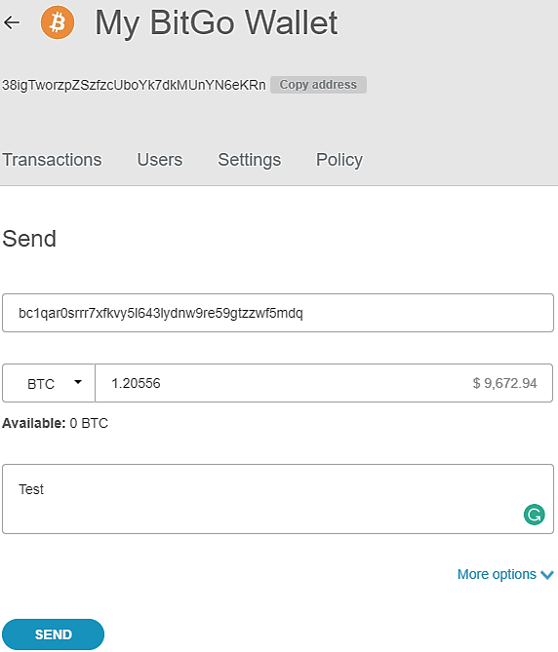
(a)
(b)

Slide 35



$${\left[base64bt addr\right]}^{+}$$
tab
$${\left[0−9\right]}^{+}\left[.\right]{\left[0−9\right]}^{+}$$
tab
$${\left[a−z\left|A−Z\right|0−9\right]}^{+}$$

