Slide 1
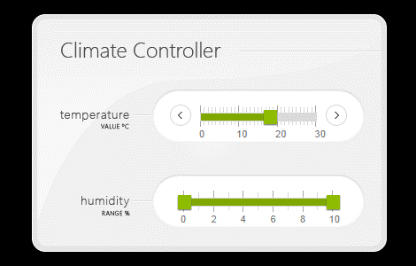
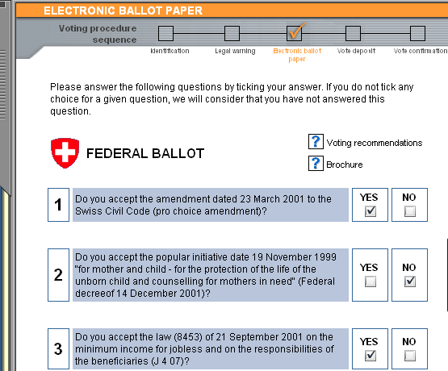

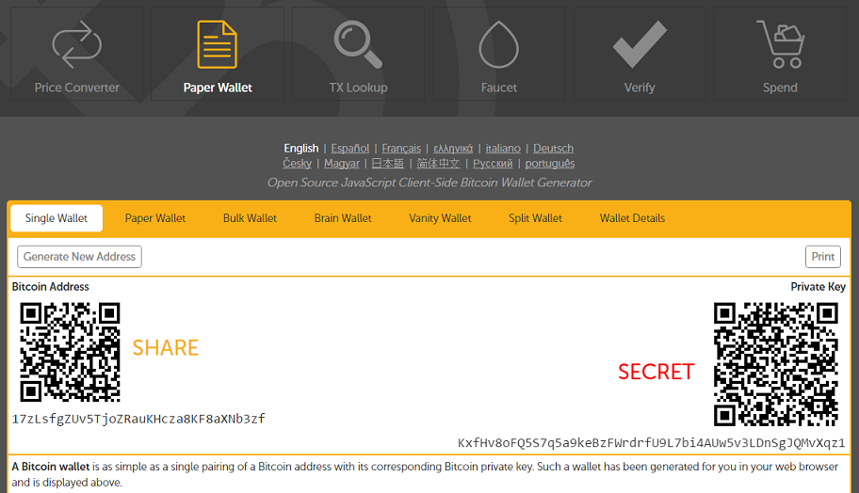
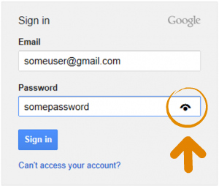
1) Slider
2) E-voting
3) Bitcoin wallet
4) Web credential

Slide 2
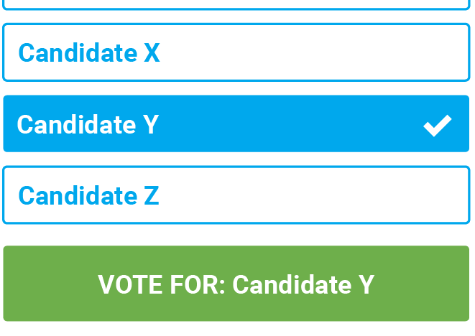
1) Slider
2) E-voting
3) Bitcoin wallet
4) Web credential

Slide 3








Trusted path
User
HIDs
Host
Remote server

Slide 4
Trusted path
User
HIDs
Host
Remote server

Slide 5
1
TEE
2
User
HIDs
Host
Remote server

Slide 6
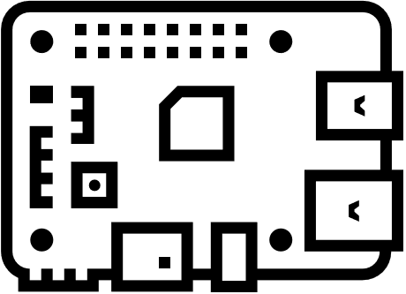



Network
Server
Application level payload
IO second factor
Frames
Input forward
Host
Input
Bridge
Overlay
IO signals
Input
Output

Slide 7






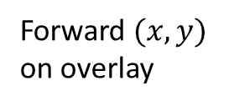
9
Verify
Remote server
7
HTTP data
8
Overlay action
1
Browser render
3
Decode + Overlay
Frame + overlay UI
Send frame
4
2
Forward $(x,y)$
6
Forward $(x,y)$
on overlay
6
Host
Bridge
Display
5
Input

Slide 8


Integrity for mouse movement
Overlaid UI
Integrity + privacy for all IO
Overlaid cursor
Actual cursor
Display

Slide 9






$$(x_{1},y_{1})$$
$$(x_{1},y_{1})$$
$$(x_{2},y_{2})$$
$$(x_{2},y_{2})$$
$$(x_{n},y_{n})$$
$$(x_{n},y_{n})$$
Device side mouse trace
Incoming frames + mouse detection

Slide 10

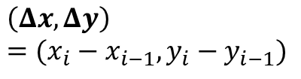
$$(x_{1},y_{1})$$
$$\left(Δx, Δy\right)=(x_{i}−x_{i−1}, y_{i}−y_{i−1})$$
$$(x_{1},y_{1})$$
$$(x_{2},y_{2})$$
$$(x_{2},y_{2})$$
$$(x_{n},y_{n})$$
OK
$$(x_{n},y_{n})$$
OK
1
Bridge side mouse trace
2
Incoming frames + mouse detection

Slide 11
Sensitive form
Sensitive field 1
Sensitive field 2
OK
Cancel

Slide 12
Sensitive form
Sensitive field 1
Sensitive field 2
Mouse pointer
UI snapshot
OK
Cancel

Slide 13
Sensitive form
Sensitive form
0
100
0
100
Slider
35
Slider
35
Mouse pointer
UI snapshot
UI snapshot
Extracted value
Mouse pointer
OK
Cancel
OK
Cancel
1
2

Slide 14
Sensitive form
Sensitive field 1
Sensitive field 2
Parsed UI
Tracked mouse pointer
OK
Cancel

Slide 15
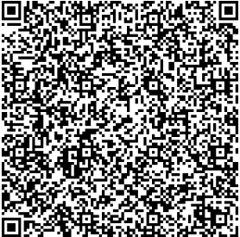
Sensitive form
Sensitive form
Sensitive form
1
2
3
Sensitive field 1
Verified UI from secure_site.io
Sensitive field 1
Data_1
Sensitive field 2
Transformation
Overlay
Sensitive field 2
Data_2
OK
Cancel
OK
Cancel
Integrity protected
Normal field
Normal field
Normal field
<form action="/some_action">
Sensitive field 1: <input type="text" name=“tb_1” protect=“true”><br>
Sensitive field 2: <input type="text" name=“tb_2” protect=“true”><br>
<button type="submit" value="Submit” protect=“true”>Submit</button> <button type="reset" value="Reset” protect=“true”>Reset</button>
Normal field: <input type="text" name=“textbox_3"><br>
</form>
Sensitive field 1:Data_1
Sensitive field 2:Data_2
Action:OK
Sign(payload)
Payload

Slide 16

Host
Device
Display
Server
Mouse trace
Frames
Track + record
Movement
Frame + overlay
Click
Frames
HTTP
Data + UI info
Click
Verify
Response
Frame + overlay

Slide 17
Send encrypted input
2
Encrypt
3
Frame + input overlay
4
ABC
4
Frame
Host
Device
Display
1
Input

Slide 18
Server
1
Webpage + encrypted data
3
Decrypt
2
Frame
Frame + overlay
4
ABC
Host
Device
Display

Slide 19

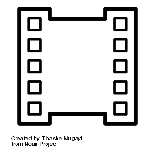
OS
CPU
Host
Output
Input

Slide 20
Text box 1
Text box 2
Option 1
Option 2
Oblivious window
OK
Cancel
Render at host’s side
Server side static image
Text box 1
Text box 2
HTML + overlay on device
Option 1
Option 2
OK
Cancel

Slide 21
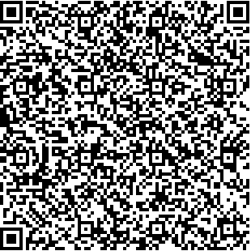
Pointer information to the host
Text box 1
Verified UI from secure_site.io
Option 1
Text box 2
Option 2
OK
Cancel
QR code with encrypted UI specification
Decoded and Decrypted UI
Render at host’s side + disabled pointer
Text box 1
rendered pointer overlaid by the Bridge
Static pointer
Text box 2
Verified UI from secure_site.io
Option 1
Option 2
OK
Cancel
Overlay
HTML + overlay on Bridge + rendered pointer

Slide 22
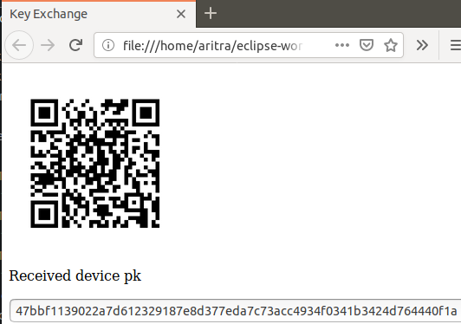
Remote server’s certificate
(Downstream channel)
Certificate of the Bridge
(Upstream channel)

Slide 23
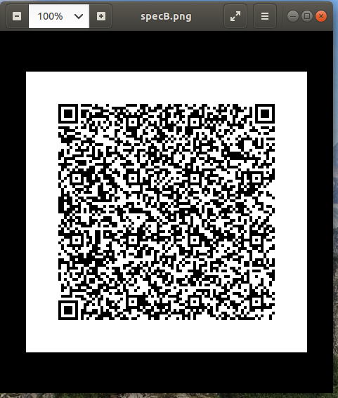
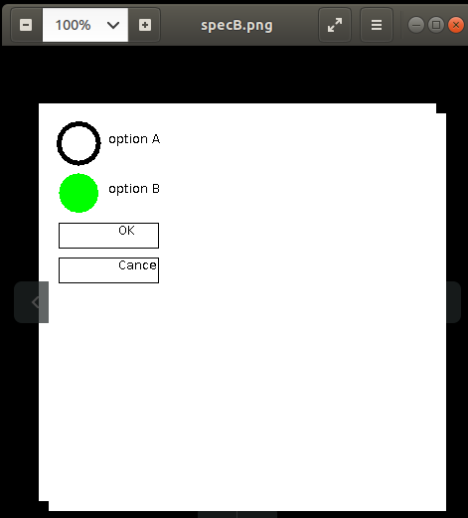
Render at host’s side
HDMI frames + overlay

