Slide 1

CAPSTONE PROJECT
WALMART - SALES FORECASTING
Mentored by:
Vidhya K
Presented by:
Aditya Govind Ravikrishnan
Annie Nesa Chanda L
Aritra Dutta
Divyajeet Thakur
Mohammad Shad Anwar

Slide 2

Introduction
Walmart Inc is an American multinational retail corporation that operates a chain of
hypermarkets
discount department stores
grocery stores
Headquarters - Bentonville, Arkansas.
ABOUT THE DATASET
Dataset –Historical Weekly Sales Data of 45 stores located in various regions.
Shape – (421570, 16) | 13 Continuous, 2 Categorical, 1 Date Features
Features –
The categorical columns have been dummy encoded
Store | Dept | Date | Weekly_Sales
IsHoliday | Type | Size | Temperature
Fuel_Price | MarkDown1 | MarkDown2 | MarkDown3
MarkDown4 | MarkDown5 | CPI | Unemployment

Slide 3
Problem statement
1.Analyzing the effect of Markdowns, Temperature, CPI, Unemployment and Size of the store on the sales
How does the various factors such as markdowns(discounts), temperature(weather), CPI (Consumer Price Index), unemployment and the store size affect the increase or decrease of sales in various stores? Which departments are more affected with these factors, and which departments never fail to perform?
2.Weekly Sales prediction
Predicting the weekly sales across various stores, and finding out which factors are more significant in the prediction of the sales.

Slide 4
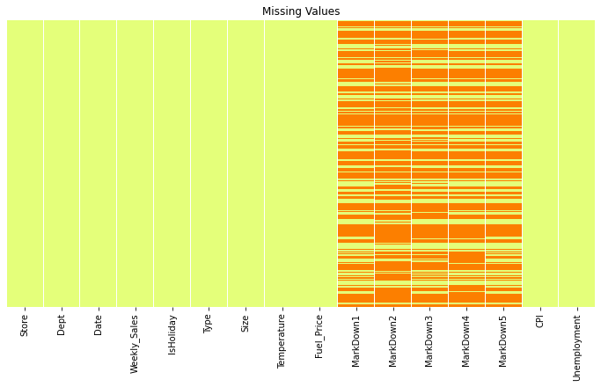
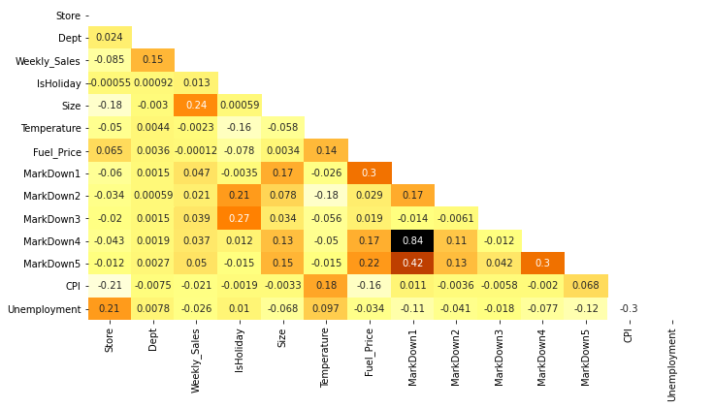
Exploratory data analysis
Missing Values
There are missing values in Markdown (1-5), which indicates no discounts on those weeks. The missing values have been imputed with 0.
Correlation Matrix
Markdown 4 & Markdown 1 have high correlation of 0.84. Other independent features have moderate to low correlation among them

Slide 5
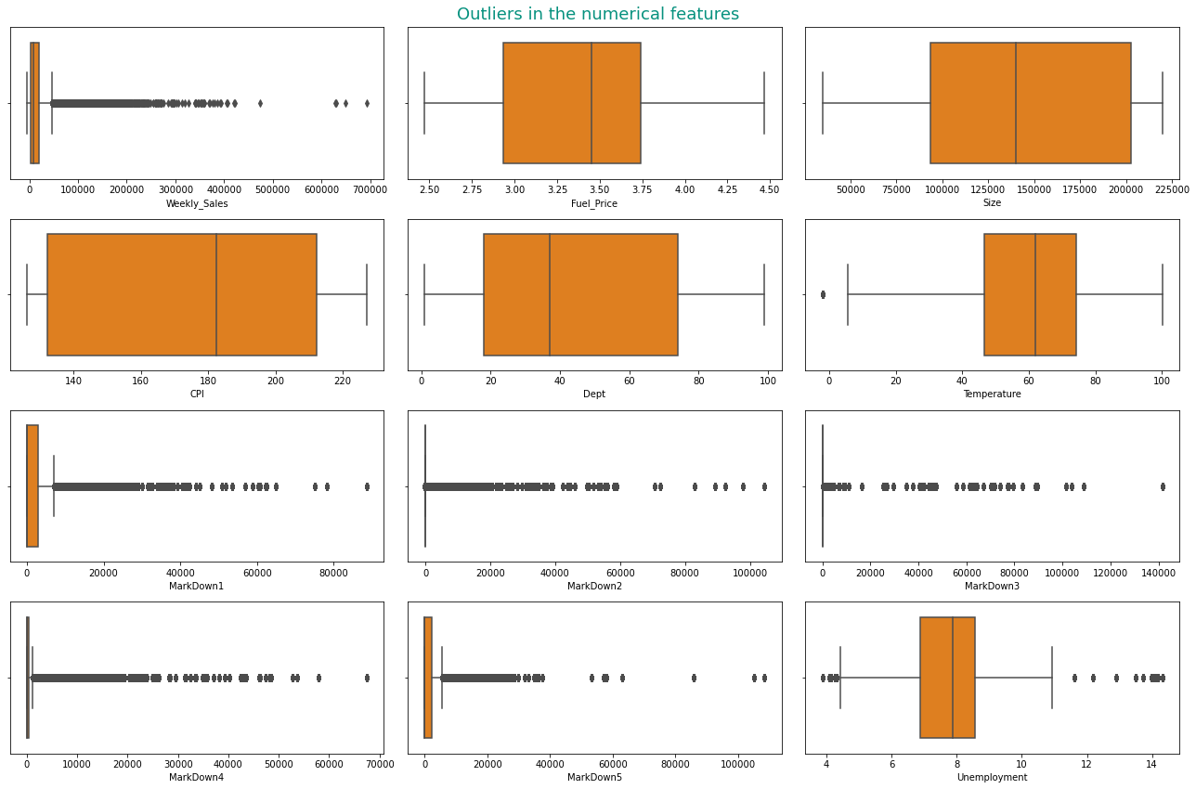
Exploratory data analysis
Outliers in the Numerical Features

Slide 6
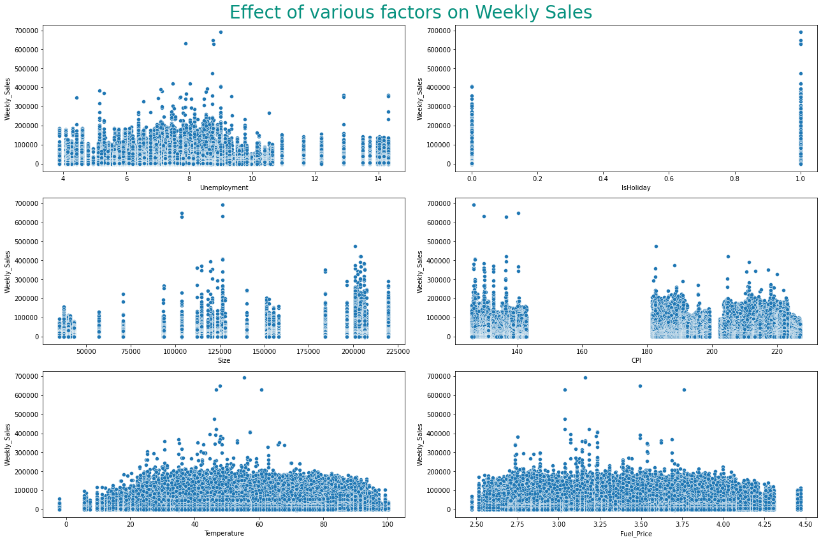
Exploratory data analysis
Effect of Various Factors on Weekly Sales
The Sales are higher on Holidays
Larger sized stores have higher average sales
When CPI increases, the Sales go down
When the temperature goes extreme, the Sales go down
The average sale reduces with increase in fuel price

Slide 7
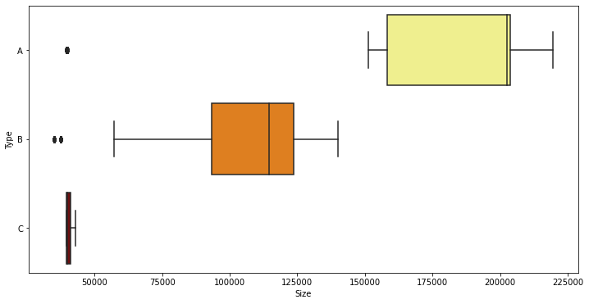
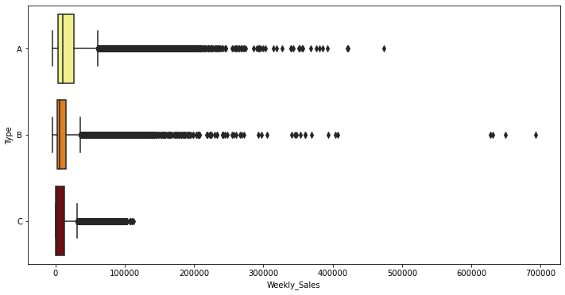
Exploratory data analysis
Size of the Store with respect to Type
Size of the Stores
Type A – 202505
Type B – 114533
Type C - 39910
Type Wise Weekly Sales
Median Weekly Sales
Type A -10105
Type B - 6188
Type C - 1150

Slide 8
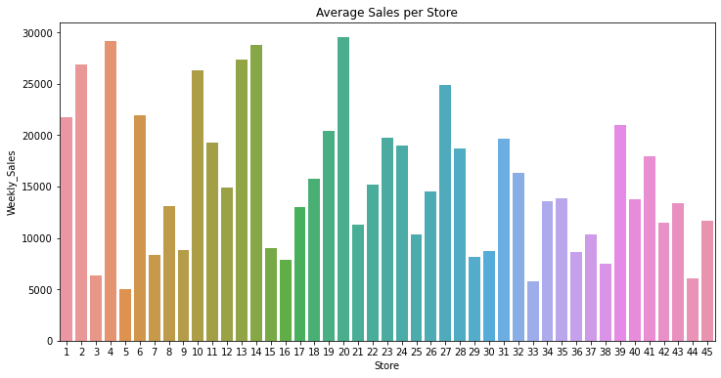
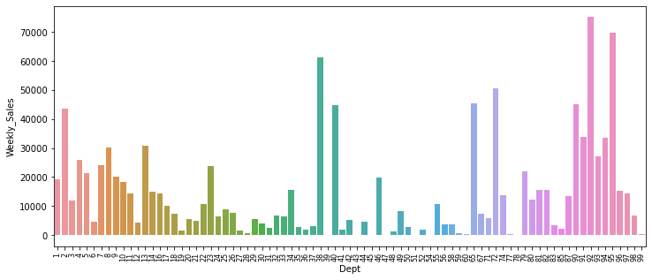
Exploratory data analysis
Store wise Average Sales
Store 20 has the highest average weekly sales, and Store 5 has the lowest weekly sales
Department wise Average Sales
Department 92 has the highest average sales, where as Departments 39,43,45,47,51,78 have almost no sales
Notes:
20,4,14,13,2 – Top 5; 38,3,44,33,5 – Bottom 5
A –20100, B – 12237, C – 9520 → Mean
A – 10105, B – 6187, C – 1150 → Median

Slide 9
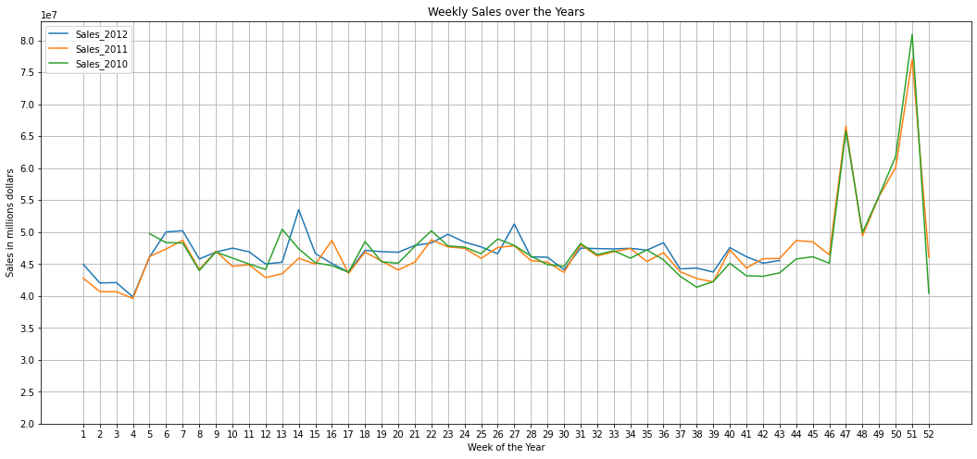
Exploratory data analysis
Weekly Sales over the Years
The Weekly Sales peak during the 47th Week (Black Friday) and
51st Week(Christmas)
Notes:
51 – 26396; 47 – 22221; 50 – 20413; 49 - 18669

Slide 10
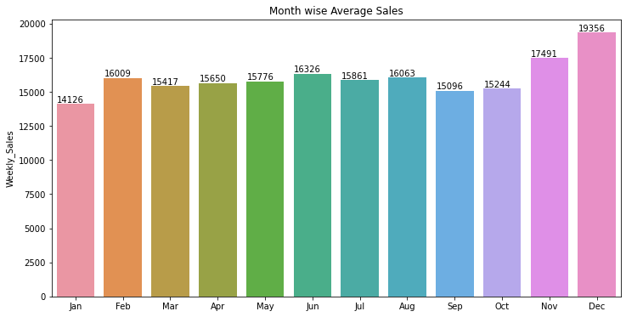
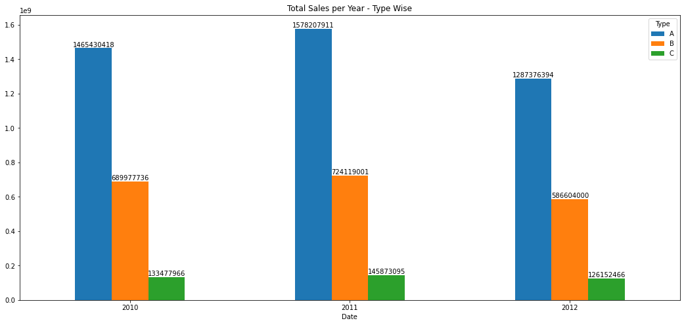
Exploratory data analysis
Month wise Average Sales
The Average Sales Increases during the end of the year. These months also offers various Markdowns (Black Friday, Christmas), which also helps in increasing the sales
Yearly Type Wise Total Sales
The Sale of Stores is directly correlated to it’s size, as it also offers more departments, which increases the scope of the sales.

Slide 11




XGBR
GBR
LGBMR
ETR
RFR
DTR
MODEL BUILDING

Slide 12
DECISION TREE REGRESSOR
 | R² | RMSE
Train | 1.00 | 0
Test | 0.91 | 6930
OVERFIT
BASE
XGBR
GBR
LGBMR
ETR
RFR
DTR
 | R² | RMSE
Train | 0.82 | 9558
Test | 0.82 | 9643
TUNED PARAMETERS
max_depth : 12
min_samples_leaf : 40
min_samples_split : 8
TUNED
We have Decision Tree as our base model

Slide 13
RANDOM FOREST REGRESSOR
 | R² | RMSE
Train | 0.99 | 1964
Test | 0.93 | 5113
OVERFIT
BASE
XGBR
GBR
RFR
LGBMR
ETR
DTR
 | R² | RMSE
Train | 0.90 | 7251
Test | 0.89 | 7499
TUNED PARAMETERS
max_depth : 15
max_features : 8
min_samples_leaf : 15
min_samples_split : 3
n_estimators : 90
TUNED
The base model is overfit, and tuned model has a better performance with similar train and test scores

Slide 14
EXTRA TREES REGRESSOR
 | R² | RMSE
Train | 1 | 0.2
Test | 0.94 | 5339
OVERFIT
BASE
XGBR
GBR
RFR
LGBMR
ETR
DTR
 | R² | RMSE
Train | 0.92 | 6574
Test | 0.91 | 6956
TUNED PARAMETERS
max_depth : 19
max_features : 11
min_samples_leaf : 13
min_samples_split : 2
n_estimators : 71
TUNED
The Extra Trees model has better performance than RF model, and it is one of the best models

Slide 15
GRADIENT BOOST REGRESSOR
 | R² | RMSE
Train | 0.75 | 11457
Test | 0.74 | 11582
XGBR
GBR
LGBMR
RFR
ETR
DTR
The performance of Gradient Boosting Model is worse than other models

Slide 16
XGBOOST REGRESSOR
 | R² | RMSE
Train | 0.89 | 7688
Test | 0.83 | 9485
GBR
LGBMR
XGBR
RFR
ETR
DTR
XGBoost Model has a better performance than Gradient Boost Model

Slide 17
LIGHTGBM REGRESSOR
 | R² | RMSE
Train | 0.89 | 7439
Test | 0.89 | 7597
LGBMR
GBR
XGBR
RFR
ETR
DTR
LightGBM is the best among the boosting models. Tuned model performed worse than the base model.

Slide 18
Stacked model
+
Light gbm
+
+
Random forest
EXTRA TREES
XGBOOST
RF | R² | RMSE
Train | 0.90 | 7251
Test | 0.89 | 7499
LGBM | R² | RMSE
Train | 0.89 | 7439
Test | 0.89 | 7597
STACKED MODEL | R² | RMSE
Train | 0.924 | 6398
Test | 0.916 | 6733
ETR | R² | RMSE
Train | 0.915 | 6574
Test | 0.906 | 6956
XGB | R² | RMSE
Train | 0.89 | 7688
Test | 0.83 | 9485

Slide 19

CONCLUSION
Type A stores have the highest weekly sales
Size of the store has a positive correlation with the sales
Weekly sales on Holidays are higher than other days
Markdown has a significant positive impact on the weekly sales
Type A and B stores record higher sales during the Black Friday and Christmas, whereas Type C stores record lowest sales in December.
On the contrary, Type A and B stores record lowest sales in January, whereas Type C stores record the highest sales in January.
Department #65 is among top 5 in terms of average weekly sales, but it is available in very few stores, whereas departments with no sales, 39 & 43, are available in 5 stores, and departments 45,47,51,78 are available in 20+ stores.

Slide 20
Thank you!
Any questions?

