Slide 1
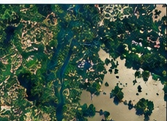
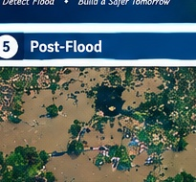
Before Flood vs After Flood
Multi-temporal satellite imagery used for flood detection
→
BEFORE FLOOD
AFTER FLOOD
Before → After → Change Detection

Slide 2
FLOOD DETECTION
Satellite Imagery Analysis with NDVI & NDWI in C
Pre Flood
Post Flood
Flood Map
Before → After → Detection

Slide 3
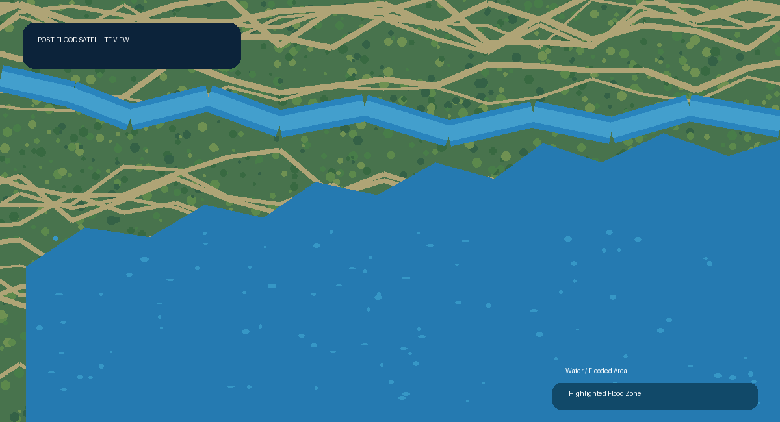
PROJECT PRESENTATION
Flood Detection
Using Digital Image Processing
Satellite Imagery Analysis with NDVI & NDWI in C
Aritra Halder
Roll: BSSE 1704
Supervisor: Dr. Emon Kumar Dey
Before → After → Flood Map
Department of Software Engineering • University of Dhaka

Slide 4
Background & Objectives
What the system takes in and why
Introduction
System Input → Output
Floods are a major natural hazard in Bangladesh. This project analyzes pre- and post-flood satellite imagery using digital image processing and spectral indices to detect newly flooded areas and estimate flood impact.
PRE-FLOOD
POST-FLOOD
FLOOD
MAP
Satellite image
Satellite image
Objectives
• Read and process multispectral satellite bands: Red, Green, Blue, NIR.
• Apply image enhancement and basic filtering operations.
• Compute NDVI and NDWI for vegetation and water analysis.
• Compare pre-flood and post-flood images to identify newly flooded areas.
• Generate a flood map and calculate flooded area and percentage.
• Implement the complete workflow in C with approximately 4,000 lines of code.
Expected Outputs
• Flood map with highlighted flooded regions
• Total flooded area (km²)
• Flood percentage and flooded-pixel count
• NDVI / NDWI before vs. after averages
• Flood severity indicator
Flood pixels
Flood area
Flood %
Severity
N
km²
%
Level

Slide 5
System Workflow
From satellite pixels to flood map
1
2
3
4
5
6
Satellite Input
Pixel / Band Data
Index Calculation
Thresholding
Pre vs Post
Flood Analysis
R, G, B, NIR
Pre + Post
Store bands as
matrices
NDVI + NDWI
for each pixel
Water = 1
Non-water = 0
0 → 1 =
newly flooded
Map + area +
percentage + severity
Flood Detection Logic
Pre-flood
Water Map
Post-flood
Water Map
Compare
Matrices
0 → 1
Change
Newly
Flooded Area
Water pixels are identified from NDWI thresholding; newly flooded pixels are detected where pre-flood = 0 and post-flood = 1.

Slide 6
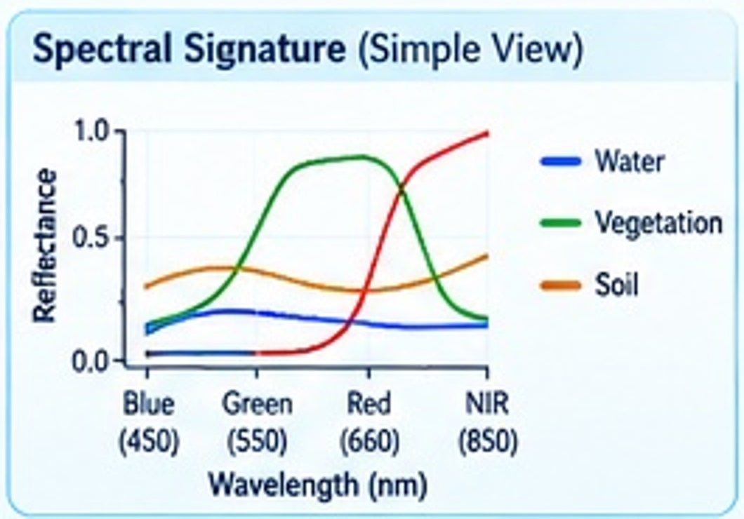
Spectral Indices & Flood Logic
NDVI — Vegetation Index
NDWI — Water Index
NDVI = (NIR − Red) / (NIR + Red)
NDWI = (Green − NIR) / (Green + NIR)
• High NDVI → healthy vegetation
• Lower NDVI → less vegetation / possible impact
• High NDWI → water presence
• Lower NDWI → land / vegetation
NDVI / NDWI spectral signature
Pixel-Level Water Classification
Newly Flooded Pixel Rule
Water Map
Post-Flood Water
Pre = 0 AND Post = 1
0
0
0
0
0
0
1
0
0
0
→ mark pixel as NEWLY FLOODED
0
1
1
0
0
0
1
1
1
0
0
1
1
1
0
0
1
1
1
1
Then count flooded pixels and convert the count into area, percentage and severity.
0
0
0
0
0
0
0
1
0
0

Slide 7
Algorithms to be Used
Selected from the proposal + flood-region detection
Image File Handling
Region Labeling / Connected Components
1
Read / write image data (BMP / PGM / RAW).
2
Identify separate flood regions.
Thresholding
Flood Area Calculation
3
Classify water vs. non-water pixels.
4
Count flood pixels and convert to km².
NDVI & NDWI Calculation
Pixel-wise Difference / Change Detection
5
Compute spectral indices from band values.
6
Measure pre vs. post changes.
Multi-temporal Comparison
BFS / DFS Flood Region Detection
7
Compare pre- and post-flood index / water maps.
8
Traverse connected flooded pixels and extract regions.
Design focus: keep the algorithms directly connected to the pixel → water map → region → area pipeline.

Slide 8
Tools, Technologies & Implementation
Development plan
Programming Language
IDE / Compiler
Image Data
C
Approx. 4,000 lines of code
VS Code + GCC
or Code::Blocks + GCC
BMP / PGM / RAW
Multi-band or separate-band inputs
Data Source
Core Data Structure
Implementation Style
Landsat / Sentinel
Red, Green, Blue, NIR bands
2D matrices / arrays
for per-pixel band values
Modular C functions
Clear comments + test cases
Implementation Breakdown
Input & I/O
Band + Index Processing
Threshold + Comparison
Flood Regions
Area + Severity + Output
15%
25%
20%
20%
20%
Target: a complete, modular C implementation that produces both visual and numerical flood results.

