Slide 1
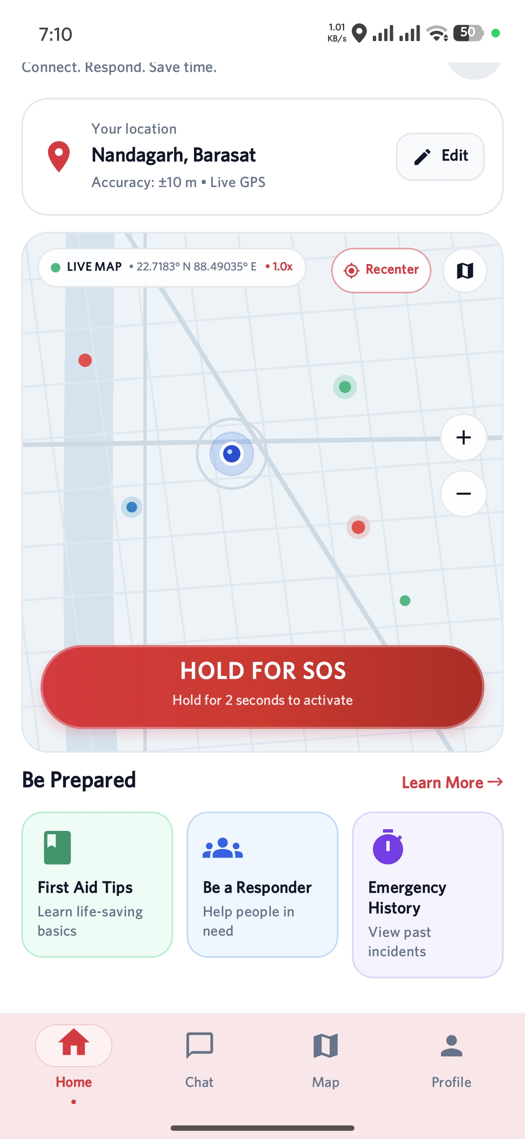
Project Introduction ( Problem Statement)
NearHelp AI
Community emergency assistance on Android
When an emergency occurs, bystanders need quick guidance and clear location context while professional responders are on the way.
The current prototype brings an SOS entry point, a location map, emergency protocols and AI chat into one mobile experience.
Team: Aritra, Adil, Dishari, Abhisikta, Plaban and Sayantan
Notes:
Project team names and roles come from README.md. Screenshot is from the SS folder in the repository. College, department and faculty mentor were not supplied, so they are omitted.

Slide 2
Existing Emergency Response Challenges
The critical gap is what a person can do before organized help arrives.
01
Time and distance
02
Bystander uncertainty
Professional responders may be several minutes away when an incident begins.
People nearby may be willing to help but may not know a safe first step.
03
Location friction
04
Fragmented tools
Describing an exact location during stress can slow a request for help.
Calling, maps and guidance are often separate interactions for the user.
NearHelp AI / Project review
02
Notes:
WHO emphasizes the need for timely emergency care: https://www.who.int/health-topics/emergency-care . 112 India provides a location-enabled SOS system, so this slide does not claim location sharing is absent from existing systems: https://112.gov.in/ . The challenges frame the user experience and are not measured outcomes for NearHelp AI.

Slide 3
Proposed Solution
NearHelp AI places the first emergency actions in a single Android app.
01
SOS access
A prominent control starts the emergency journey.
02
Location context
GPS and the map help users understand where they are.
03
Immediate guidance
Protocol screens and AI chat provide information while help is sought.
04
Community foundation
The design can later connect users with verified nearby responders.
NearHelp AI / Project review
03
Notes:
The first three solution elements are visible in screenshots from the repository. Responder connection is future scope, not demonstrated here.

Slide 4
System Workflow and Methodology
The prototype follows a short path from opening the app to choosing an informed next action.
Open app
→
Select help
→
Use GPS
→
View map
→
Ask AI
→
Act
01
Input
02
Processing
User opens the app, chooses a topic or starts an SOS action.
Device location informs the map; the chat sends a question to the AI service.
Output: the screen presents local context, a protocol step or an AI response for the user to review.
NearHelp AI / Project review
04
Notes:
This is a simplified user workflow. The SOS control, location map and assistant screens are visible in repository screenshots. It does not represent a verified end-to-end dispatch.

Slide 5
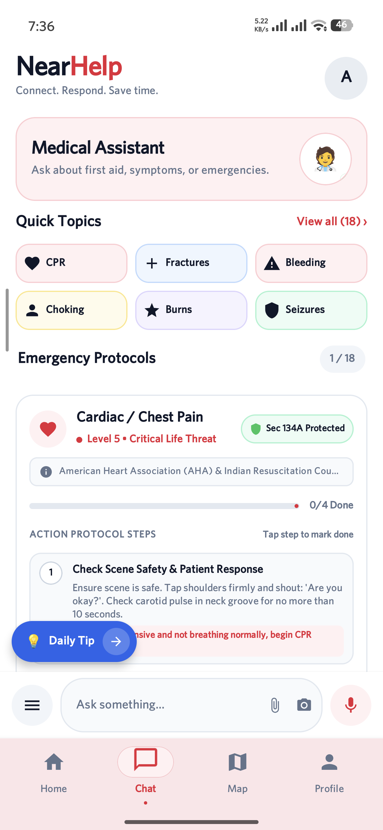
Implemented Features of NearHelp AI
Emergency entry
The home screen presents a hold-to-activate SOS control.
Location and map
The app shows the current GPS position and a live map view.
Emergency protocols
The interface displays topic-based steps for common emergencies.
AI conversation
The assistant accepts a question and displays a response.
Current Android build
NearHelp AI / Project review
05
Notes:
Features are supported by project screenshots in SS/. The visible SOS control does not prove an alert was dispatched. The protocol and assistant screen show UI behavior, not clinical validation.

Slide 6
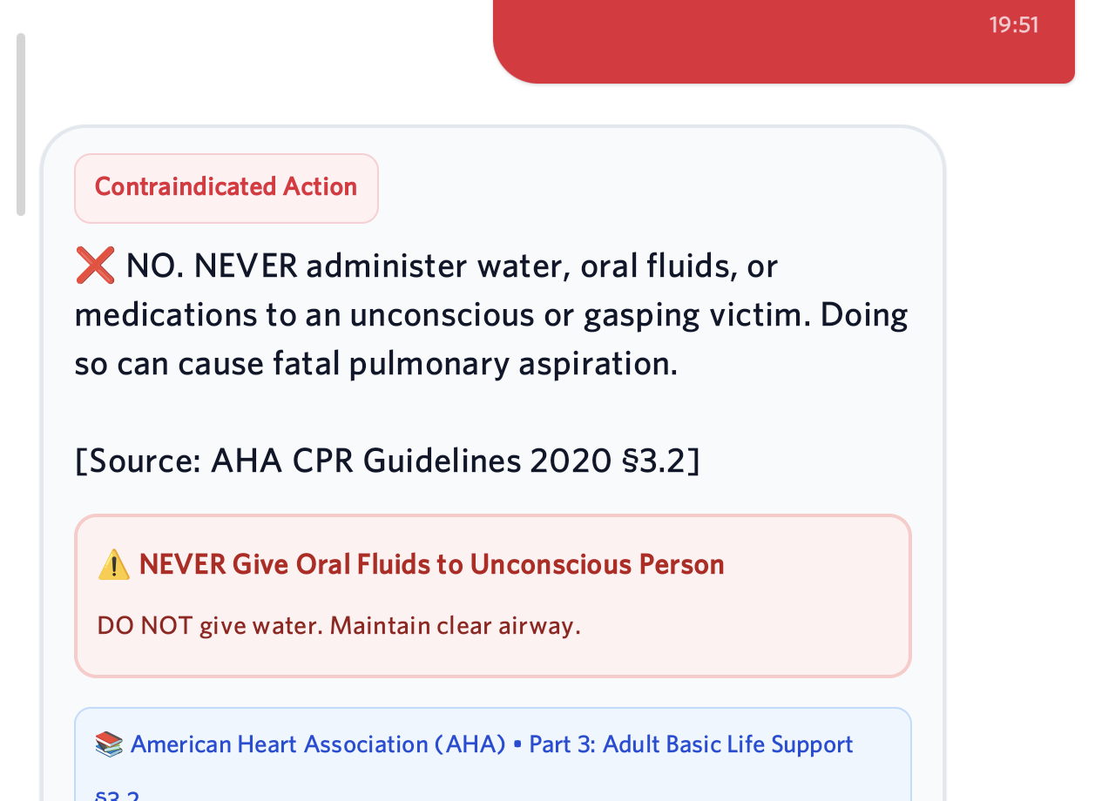
AI Chatbot & Google Maps Integration
Gemini-assisted chat
Location map
The user enters an emergency question. The app sends it to the AI service and presents the returned answer.
Device GPS provides position context. Google Maps displays the area around the user.
The captured reply includes a source label. Medical reliability still requires systematic validation.
The map supports orientation before an SOS action or a request for guidance.
NearHelp AI / Project review
06
Notes:
Screenshots are from the project SS folder. The repository includes a Google Maps view and an AI agent integration. The screenshot demonstrates a reply; it does not establish clinical accuracy or production readiness.

Slide 7
System Architecture and Technology Stack
The Android client is the user-facing layer. It connects the location map and AI interaction.
Android app
Kotlin + Jetpack Compose
Google Maps SDK
Gemini AI service
Backend API foundation
Implemented app layer
Integration path
Maps and AI are visible in the current demo.
FastAPI and data services support the wider project design; connected rescue flow still needs validation.
NearHelp AI / Project review
07
Notes:
Architecture is simplified from README.md and the Android source. FastAPI is in the repository, but this slide does not claim an end-to-end rescue workflow or production database integration.

Slide 8
Application Demo, Testing & Current Results
Current evidence comes from device screenshots of the working Android interface.
Demo check
Observed result
Launch + navigation
Home and major tabs appear
Location map
GPS area and SOS control shown
Emergency content
Protocol topic and steps shown
AI conversation
Question and response captured
These checks confirm visible interface behavior. Dispatch reliability, response time and medical accuracy need separate evaluation.
NearHelp AI / Project review
08
Notes:
Evidence comes from project screenshots 29917.jpg, screen_test.png and screen_check2.png. The checks summarize what is visible, not formal automated test results or real-world rescue performance.

Slide 9
Research Contribution
01
02
03
Emergency care
Existing digital systems
Community response
WHO emphasizes access to quality, timely emergency care. This motivates support during the early response period.
India’s 112 system already combines SOS requests with location data. NearHelp studies the user-facing guidance layer.
A randomized trial found that phone alerts increased CPR started by nearby trained volunteers before EMS arrival.
Project contribution: a prototype that places map context, emergency content and AI interaction in one mobile journey.
Sources: WHO emergency care; 112 India; Ringh et al., NEJM (2015)
NearHelp AI / Project review
09
Notes:
[1] WHO, Emergency care, https://www.who.int/health-topics/emergency-care
[2] Government of India, Emergency Response Support System, https://112.gov.in/
[3] M. Ringh et al., Mobile-Phone Dispatch of Laypersons for CPR in Out-of-Hospital Cardiac Arrest, New England Journal of Medicine 372 (2015), 2316–2325, https://www.nejm.org/doi/full/10.1056/NEJMoa1406038 . The project contribution is a prototype integration and research direction, not a measured improvement over existing systems. 112 India also offers a SHOUT volunteer feature for women and children.

Slide 10
Limitations, Future Scope & Conclusion
Current limitations
Future scope
The screenshots do not establish successful real-world dispatch or improved response time.
Validate protocol retrieval and medical safety guardrails.
AI answers need systematic checks against verified medical sources before wider use.
Connect and verify nearby responders, then add live rescue tracking.
The current demo does not evaluate responder availability or field performance.
Expand access with Bengali, Hindi and English support.
Conclusion: NearHelp AI now demonstrates the mobile foundation for location-aware emergency assistance.
NearHelp AI / Project review
10
Notes:
Limitations are framed around the evidence available in repository screenshots. Future scope follows ppt_instruction.md. No claim of clinical validation or real-world rescue performance is made.

