Slide 1
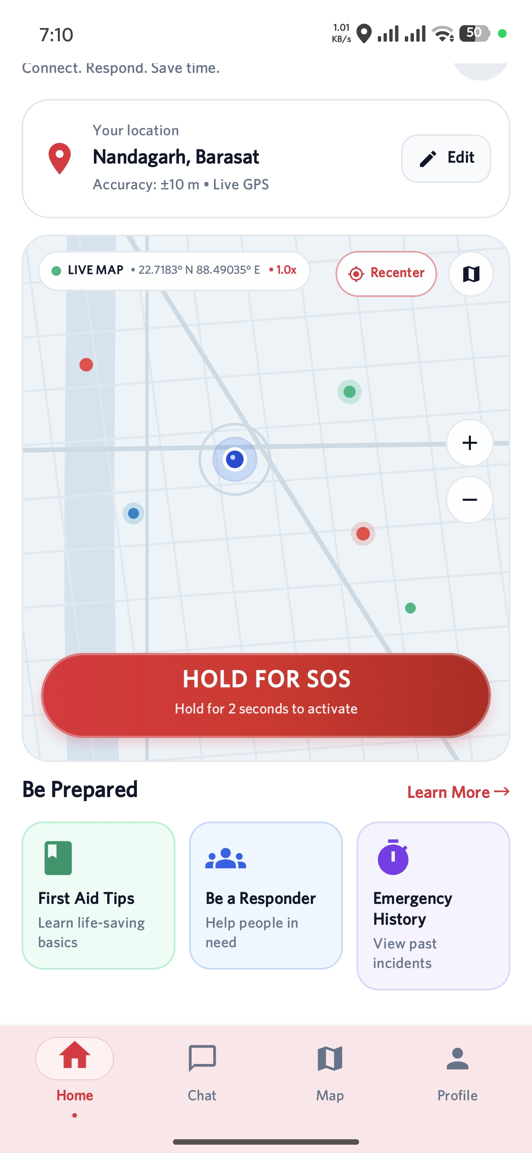
NearHelp AI
AI-powered community emergency response
A working Android prototype with location, map and AI assistance
Aritra · Adil · Dishari · Abhisikta · Plaban · Sayantan
Second academic project presentation
Notes:
Project team names and roles come from README.md. Screenshot is from the SS folder in the repository. College, department and faculty mentor were not supplied, so they are omitted.

Slide 2
The problem
In the first minutes of an emergency, people need a clear next step and usable location information.
Emergency occurs
Uncertainty
Response delay
Opportunity
→
→
→
A person needs help
A bystander may not know what to do
Professional help may take time
Offer immediate digital guidance
NearHelp AI explores a mobile starting point for faster, more informed action.
NearHelp AI / Project review
02
Notes:
WHO emphasizes timely emergency care: https://www.who.int/health-topics/emergency-care . This slide describes a general problem, not a measured performance claim for NearHelp AI.

Slide 3
Project objectives
01
Fast access
Make emergency actions easy to find.
02
Location context
Show the user’s position and map.
03
AI interaction
Let users ask emergency-related questions.
04
Extensible base
Prepare for future community coordination.
NearHelp AI / Project review
03
Notes:
The objectives follow ppt_instruction.md and refer to the current prototype or an explicitly future foundation.

Slide 4
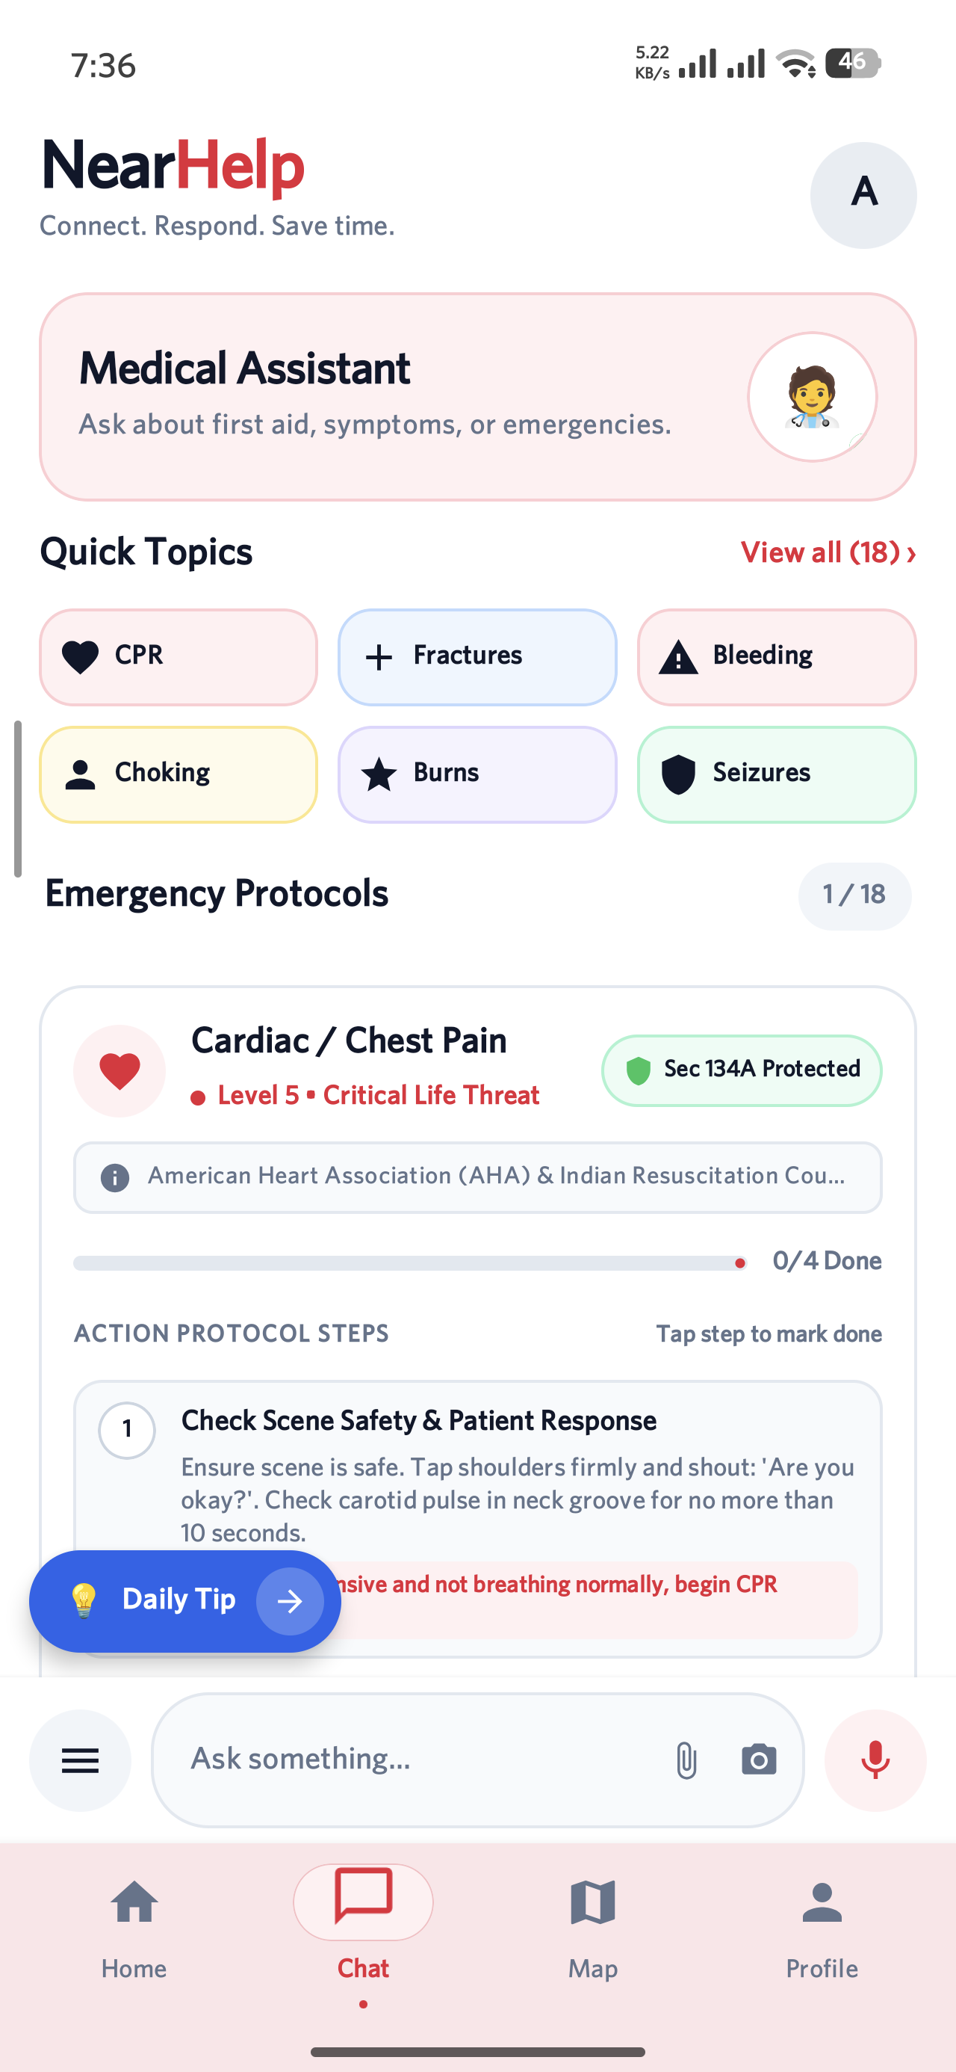
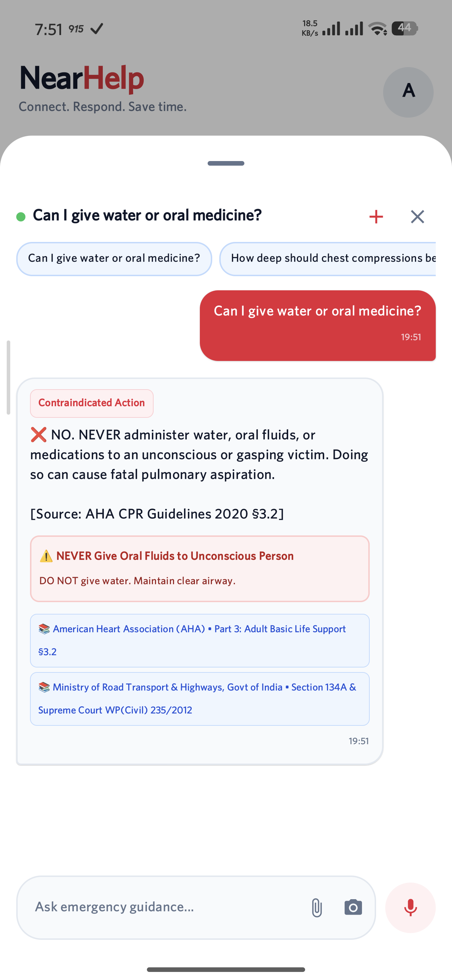
App flow
Open app
→
Choose help
→
Use location
→
View map
→
Ask AI
→
Take action
Working screens in the current prototype
Home + SOS
Protocols
AI guidance
NearHelp AI / Project review
04
Notes:
The app flow is simplified from the user-facing screens shown in the repository SS folder. The screenshots are direct project assets, not mockups.

Slide 5
Core features in the prototype
Emergency access
Home screen exposes a prominent SOS control.
Location + map
The app displays live GPS context on a map.
Guidance
The chat and protocol screens offer next-step information.
NearHelp AI / Project review
05
Notes:
Feature descriptions are limited to visible project screenshots. SOS control visibility does not establish successful dispatch or responder matching.

Slide 6
AI and maps
Gemini-assisted chat
Location map
Question → App → AI reply
GPS → Map → Local context
The current screen shows an emergency question and a response.
The home screen presents a live map and an SOS action.
NearHelp AI / Project review
06
Notes:
Screenshots are from the project SS folder. The repository includes a Google Maps view and an AI agent integration. The screenshot demonstrates a reply; it does not establish clinical accuracy or production readiness.

Slide 7
System architecture
Android app
Kotlin + Compose
Google Maps SDK
Gemini AI service
Backend API foundation
Current app integrations
Broader coordination and data services remain an integration path.
NearHelp AI / Project review
07
Notes:
Architecture is simplified from README.md and current Android source. Backend API is shown as a foundation; this slide does not claim an end-to-end rescue workflow.

Slide 8
Demo and observed results
Captured app screens
Observation
Evidence
App opens
Home screen captured
Map shown
GPS and map visible
Protocol shown
Emergency steps visible
AI reply
Question and response captured
Screenshots document interface behavior; field performance remains to be evaluated.
NearHelp AI / Project review
08
Notes:
Evidence comes from repository screenshot files 29917.jpg, screen_test.png and screen_check2.png. These are observations from captured screens, not a formal test report or measured rescue outcome.

Slide 9
Research context
01
02
03
Timely care matters
Location is established
Nearby help has evidence
WHO calls timely emergency care an essential health service.
India’s 112 system uses location data and a mobile SOS app.
A trial found phone alerts increased bystander CPR before EMS arrival.
Research direction: combine location context with clear emergency guidance in one app.
Sources: WHO emergency care; 112 India; Ringh et al., NEJM (2015)
NearHelp AI / Project review
09
Notes:
[1] WHO, Emergency care, https://www.who.int/health-topics/emergency-care
[2] Government of India, Emergency Response Support System, https://112.gov.in/
[3] M. Ringh et al., Mobile-Phone Dispatch of Laypersons for CPR in Out-of-Hospital Cardiac Arrest, New England Journal of Medicine 372 (2015), 2316–2325, https://www.nejm.org/doi/full/10.1056/NEJMoa1406038 . The research direction is the team’s synthesis, not a claim that 112 lacks volunteers: 112 India has a SHOUT volunteer alert feature for women and children.

Slide 10
Future scope
Next development steps
1
→
2
→
3
→
4
Validate AI guidance
Nearby responder matching
Live rescue coordination
Multilingual access
Test retrieval and responses against verified protocols.
Connect appropriate trained helpers to an SOS.
Track accepted responses and handoffs.
Support Bengali, Hindi and English.
Current prototype: emergency UI, visible map and AI conversation
NearHelp AI / Project review
10
Notes:
Future items are drawn from ppt_instruction.md and the broader README vision. This slide separates planned validation and connected rescue features from the demonstrated UI.

