Slide 1

Soft Graph Matching: Submodular Relaxation and Lovasz Extension
Aritra Konar
and
Nicholas D. Sidiropoulos
Department of Electrical and Computer Engineering
IEEE International Conference on Data Mining 2020
Virtual Event

Slide 2
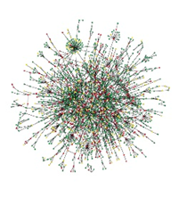
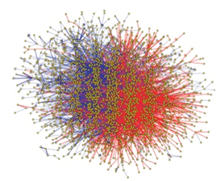







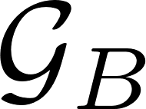
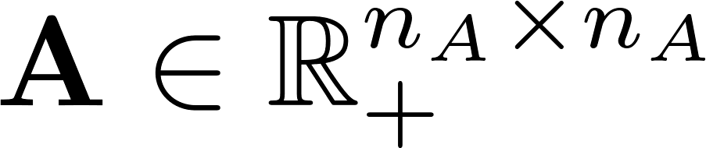
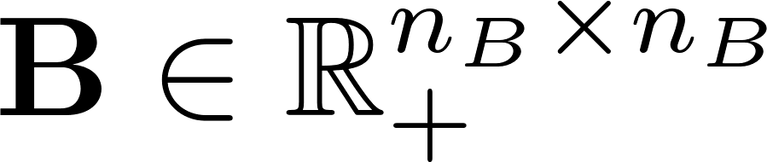
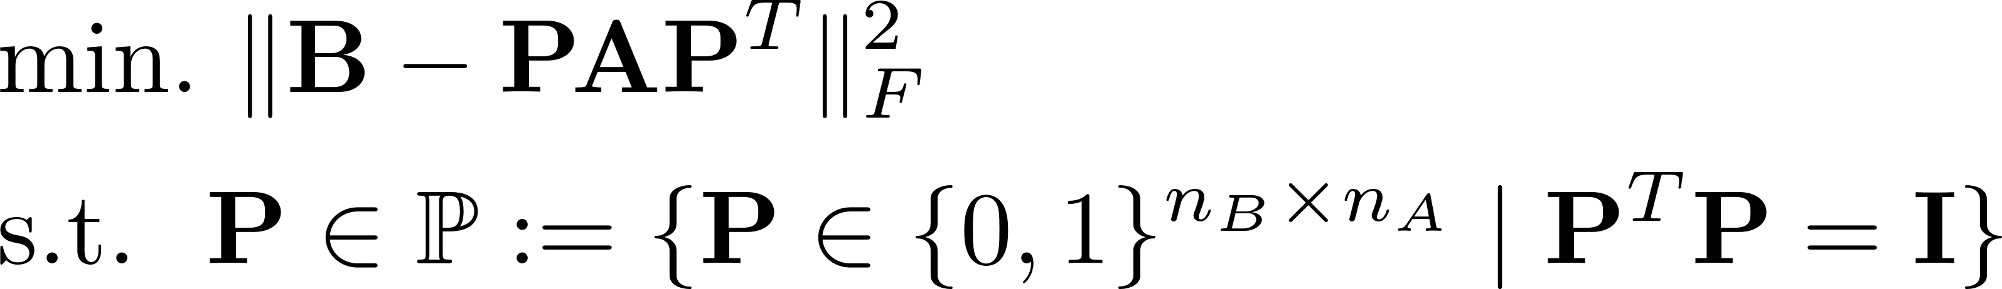
Graph Matching
Problem: Find 1-1 correspondence mapping between vertex sets that best preserves adjacency relations
Given: Adjacency matrices and
Minimize edge disagreements
Correspondence mappings

Slide 3
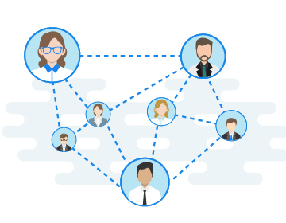

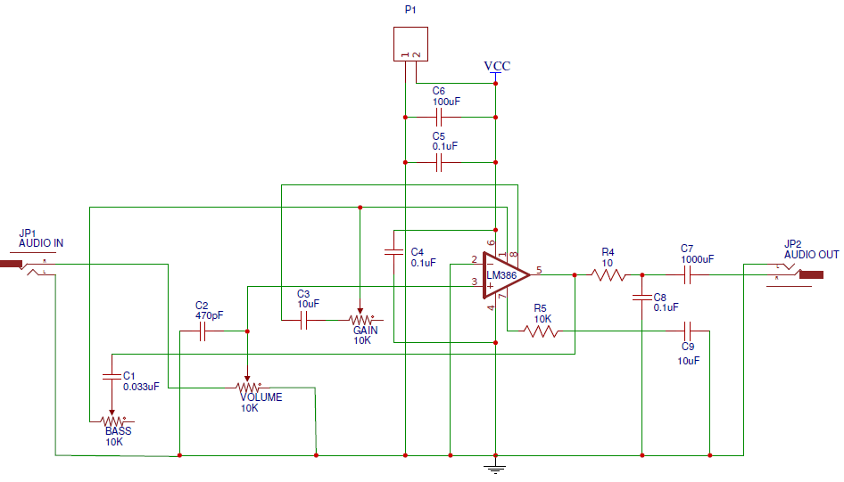
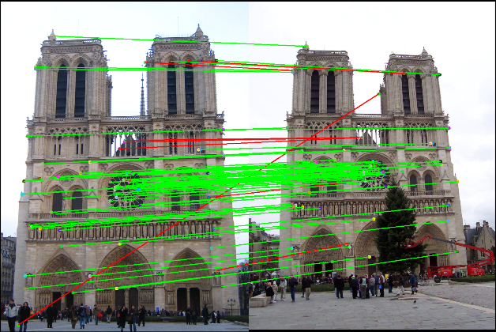


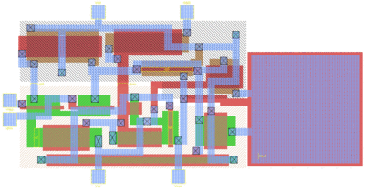


Applications
Scene matching
Network de-anonymization
Electronic circuit design
Ontology alignment

Slide 4
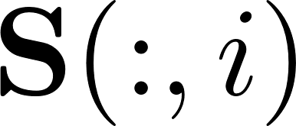
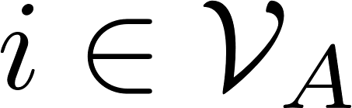
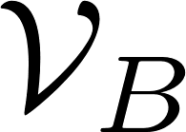
Soft Graph Matching
Graph Matching is difficult [Sahni-Gonzalez 76]
NP-hard (contains subgraph isomorphism as a special case)
NP-hard to approximate within constant-factor of optimum
Popular approximation approach:
Relax hard matching constraints to soft matching constraints
Set of doubly-stochastic matrices
:PMF defining how likely vertex
corresponds to a vertex in

Slide 5
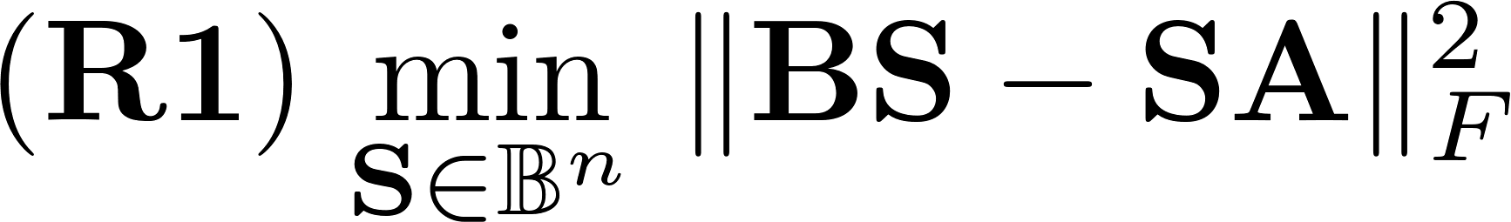
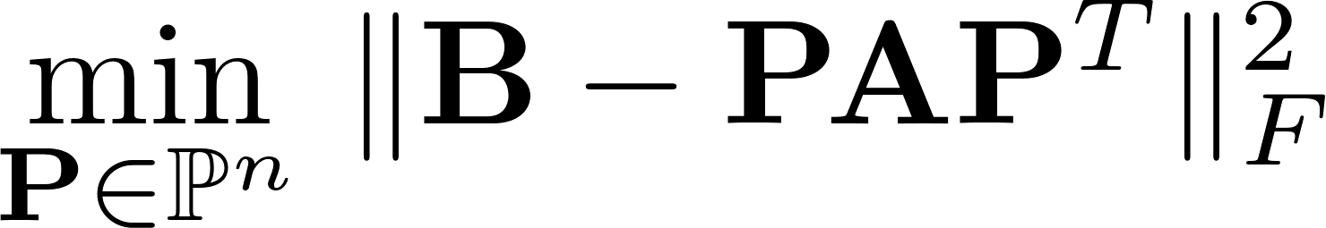
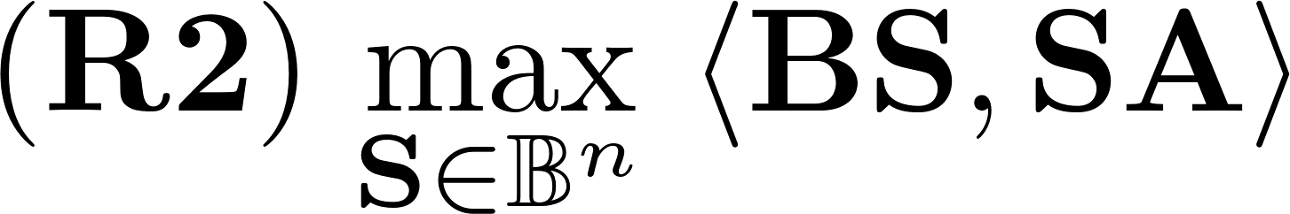
Soft Graph Matching: Prior Art
Multiple ways to relax the hard matching problem
Apply Frank-Wolfe algorithm [Frank-Wolfe 1956]
Entails solving sequence of Linear Assignment problems (cubic complexity)
Project soft solution onto set of hard constraints
In practice, (R2) initialized with solution of (R1) works best
Convex QP
[Aflalo et. al 2015]
Non-convex QP
[Vogelstein et. al 2015, Lyzinski et. al 2016]

Slide 6
Contributions
Prevailing motivation for soft matching
A means to an end (hard matching)
When does soft matching make more sense than hard matching?
A new convex formulation for soft matching
Cost function of graph matching problem is submodular [Konar-Sidiropoulos 2019]
Construct continuous, convex extension as cost function in soft matching formulation
An algorithm for solving the soft matching problem at scale
Nesterov’s dual averaging algorithm [Nesterov 2009]

Slide 7
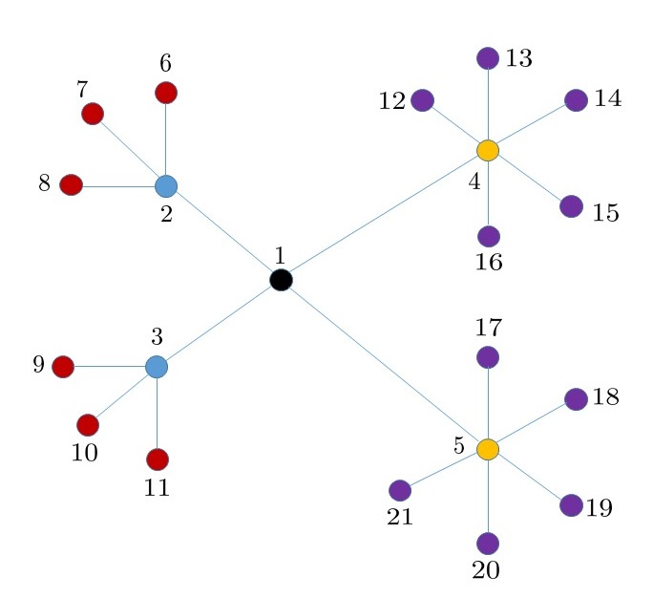
Motivation for Soft Matching
Toy example:
Swapping labels between a pair of vertices of the same color together with their descendants (if any) does not affect the topology of the graph.

Slide 8
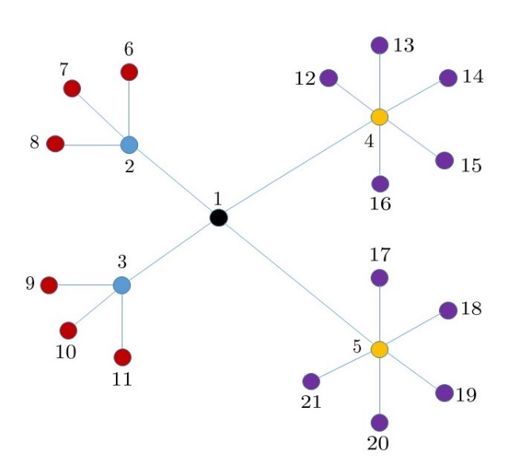
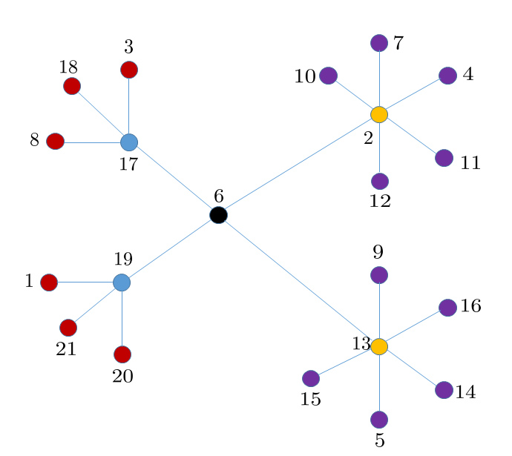
Motivation for Soft Matching
Toy example:
The isomorphism problem is in P (graphs are trees) [Kelly 1957]
Hard matching cannot reveal invariance classes!
Goal of soft matching:
Reveal the invariance classes in a graph

Slide 9
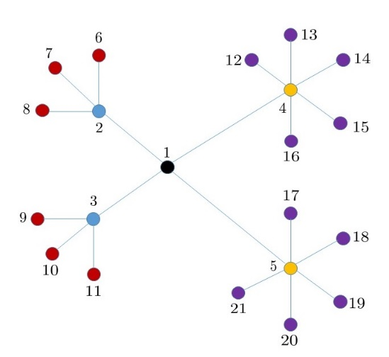
Motivation for Soft Matching
Toy example:
Prevailing convex relaxation
Proposed convex relaxation

Slide 10
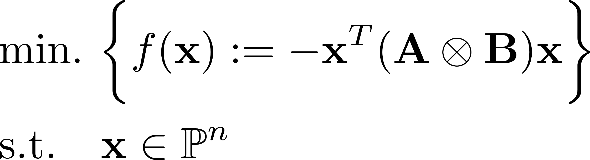

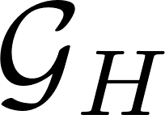
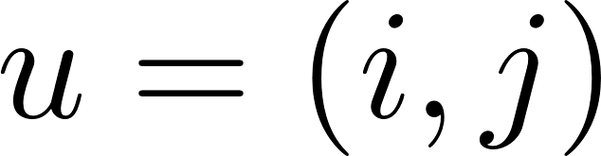
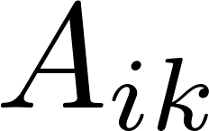

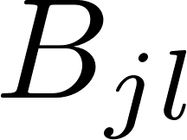

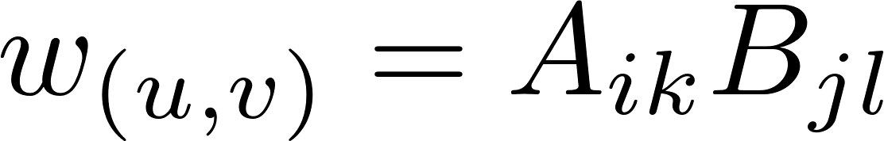

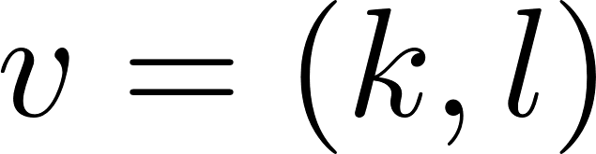
New formulation for Soft Matching
Step I:
Hard matching problem can be expressed as
Observation:
is the adjacency matrix of a “higher-order’’ graph

Slide 11
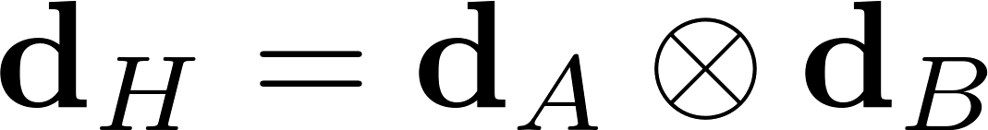
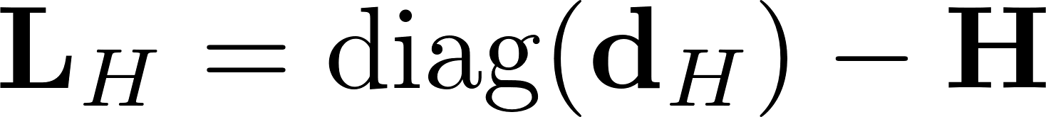
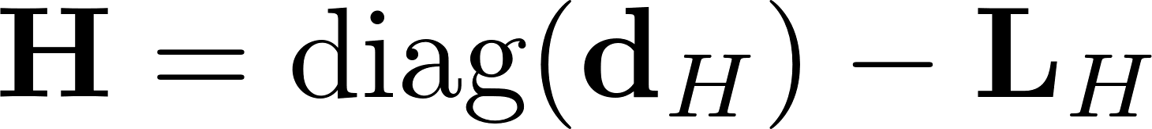
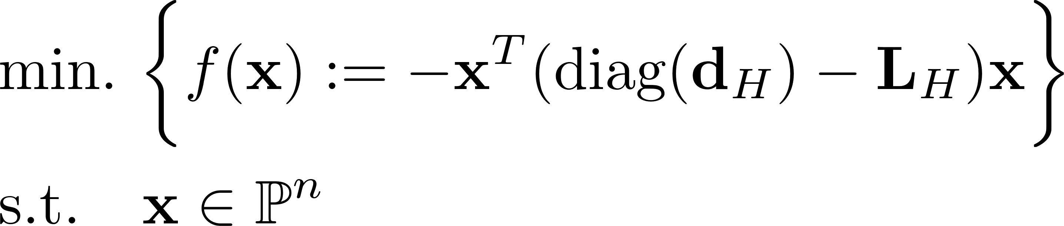
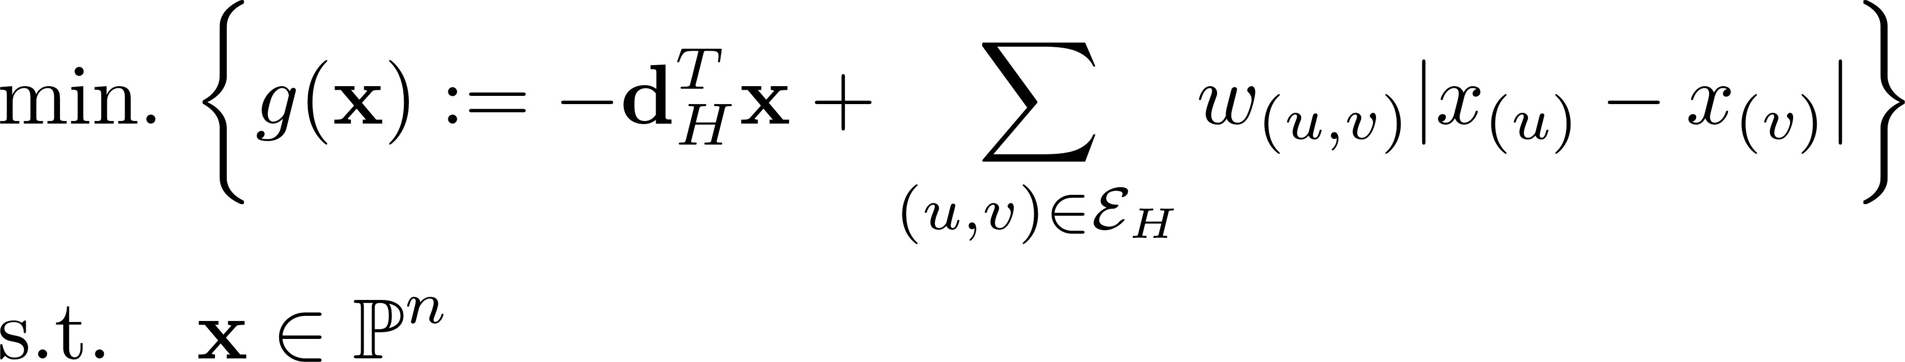
New formulation for Soft Matching
More observations about
Degree vector:
Graph Laplacian:
So:
Step II: Reformulate hard matching problem
after some algebra….

Slide 12
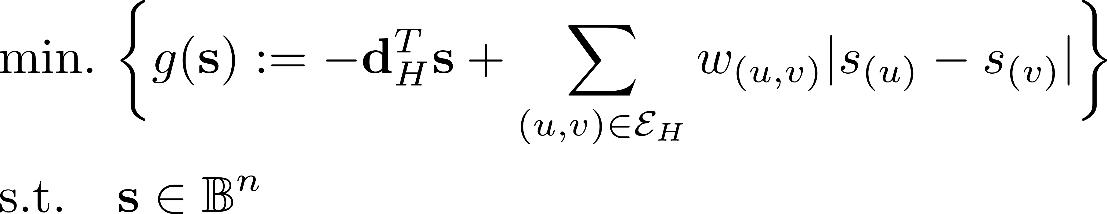
New formulation for Soft Matching
Step III: Relax constraints
A new convex relaxation for soft graph matching
Can be reformulated as a linear programming problem
What’s so special about it?
Graph total-variation

Slide 13
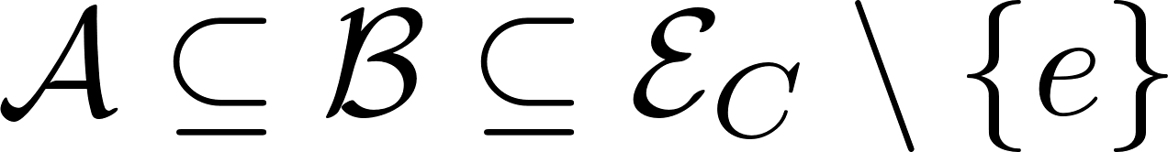


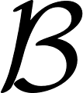
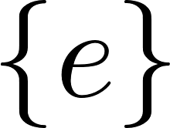


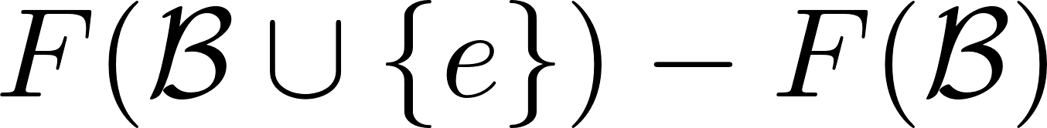
Submodularity and Graph Matching
Starting point: quadratic cost function of hard graph matching is submodular [Konar-Sidiropoulos 2019]
Submodularity: For all
What is the link to convexity?
A diminishing returns property
A. Konar and N. D. Sidiropoulos, “Iterative graph alignment via supermodular approximation”, Proc. IEEE ICDM 2019.

Slide 14
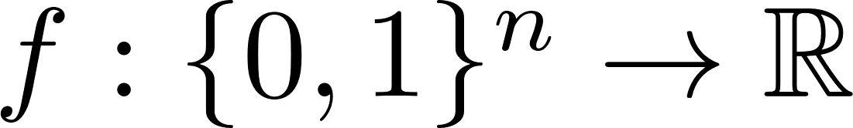
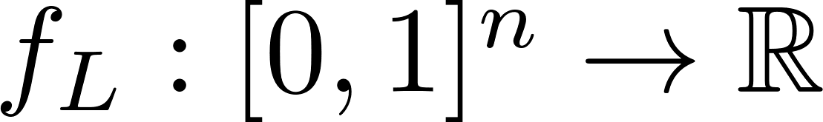


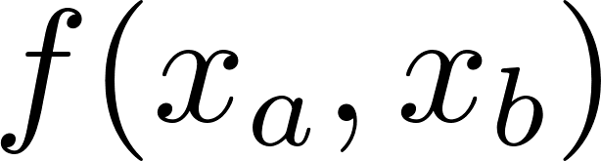

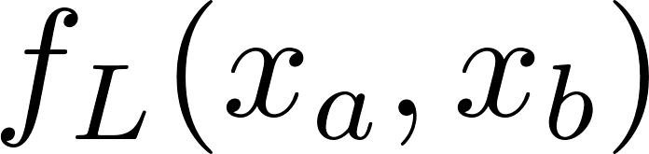


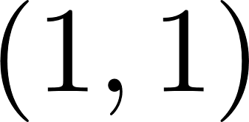
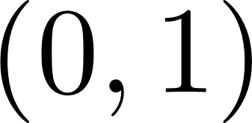
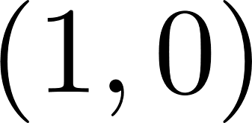


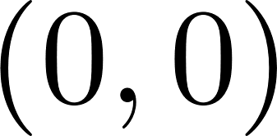
The Lovasz Extension
Key Fact:
Every submodular function possesses a continuous, convex extension [Lovasz 1983]
Tightest convex under-estimator of the submodular function (in a certain sense)
What is the Lovasz Extension for graph matching?

Slide 15

The Lovasz Extension for Graph Matching
Main result: The Lovasz extension of the submodular graph matching cost function is
Corollary:
L-relaxation corresponds to minimizing the Lovasz extension over the set of soft matching constraints
The L-relaxation

Slide 16
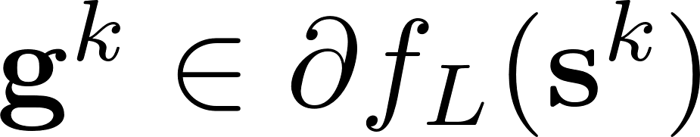
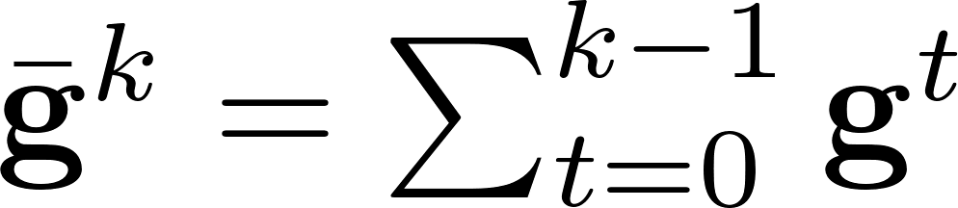
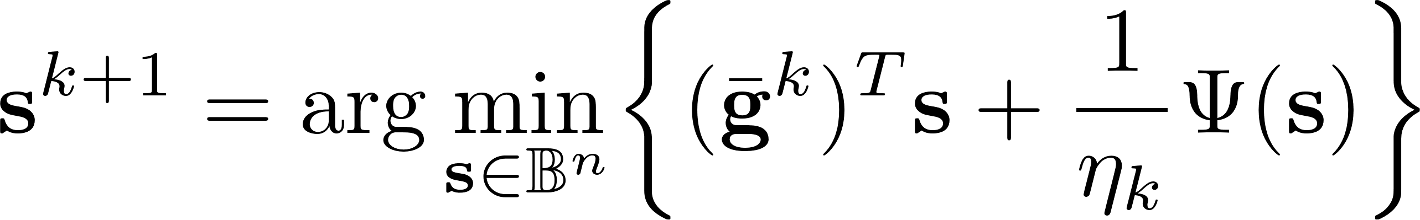
Solving the L-relaxation
Challenges:
Non-Euclidean geometry
Difficult to compute projections onto soft matching set
Solution: Nesterov’s Dual Averaging Algorithm [Nesterov 2009]
Compute subgradient
Accumulate past subgradients
Perform update
Negative Entropy

Slide 17
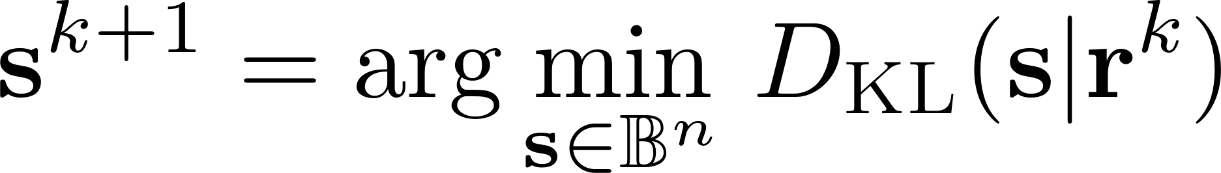
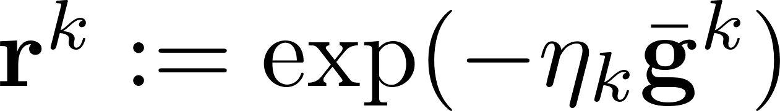


Solving the L-relaxation
Solution: Nesterov’s Dual Averaging Algorithm
Simplified update:
Attuned to non-Euclidean geometry (results in faster convergence)
KL projection can be solved in near-linear time
Sinkhorn-Knopp Matrix Balancing Algorithm [Sinkhorn 1967, Cuturi 2013]
Convergence: Choosing results in convergence (in terms of cost function)
Kullback-Leibler Divergence

Slide 18



Solving the L-relaxation
But wait…..
Running the algorithm requires instantiating
Apply stochastic NWDA:
Write L-relaxation as
Can sample edges uniformly at random to form unbiased estimate of subgradient
Important: Does not require computing
Use mini-batch stochastic subgradient in NWDA
Important: Convergence rate remains (in expectation)
Ouch!
average of finite sums

Slide 19



Experiments
Setup:
Given real world graph , generate noisy graph
where is a random Erdos-Renyi noise graph
Add 20% extra edges
No prior information
Benchmarks:
(FW-C) Convex QP: Franke-Wolfe with diminishing step-size [Aflalo et. al 2015]
(FW-NC) Non-convex QP: Frank-Wolfe with exact line search [Vogelstein et. al 2015, Lyzinski et. al 2016]
(Spectral) Umeyama’s spectral alignment algorithm [Umeyama1988]
Ground-truth correspondence
Add extra edges

Slide 20

Experiments
Setup:
Apply edge weights:
High weight = edge participates in many triangles
Use greedy matching to obtain final alignment
Evaluation Metric:
Edge correctness = (number of edges aligned) / (number of edges in A)
Datasets:
Vertex (i) + One-hop neighborhood of (i)
Exact NDA
Stochastic NDA

Slide 21


Results
Average edge-correctness
NDA is superior to FW-C and Spectral, and better initialization for FW-NC

Slide 22

Results
Average edge-correctness
Performance of S-NDA degrades (does not obtain high accuracy solution within maximum iteration counter)
Still capable of providing high quality initialization to FW-NC, which attains superior results

Slide 23
Conclusions
Submodular Soft Graph Matching
Soft matching can reveal invariance classes
A new convex relaxation for soft matching
Uses Lovasz extension of submodular cost function
Solve using Nesterov’s Dual Averaging algorithm
Works well in practice
Future Work:
Effective visualization of soft correspondence matrices for large graphs
Joint node embedding + submodular matching
Extend framework to multi-relational graphs

Slide 24
Thank you!

