Slide 1
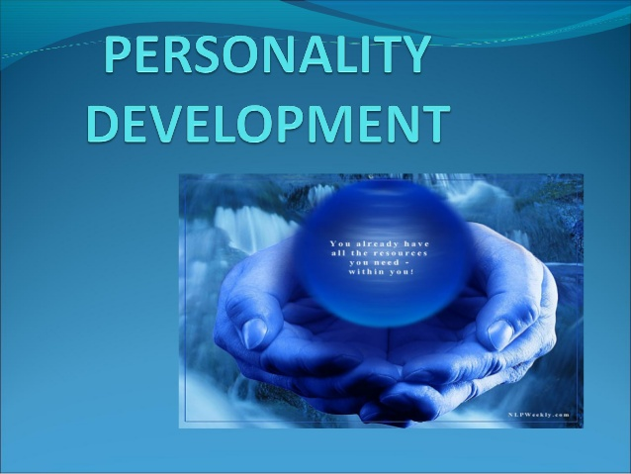

Slide 2

INTRODUCTION
Personality Development is a key factor in every phase of our lives
It enables us to face the competitive world with more positivity and Self believe
Concentration and Patience is the key factor
Personality Development will help us to enhance our efficiency at our work as well as in maintaing personal lives

Slide 3

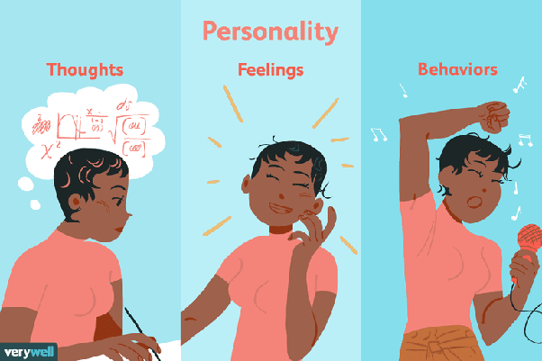
Personality Development can be broadly categorized into
Development of Thinking Process
Emotional Development
Behavioural Development

Slide 4

Development Of Thinking Process Overview
It helps in CO-ORDINATION.
It helps in Making Good relation
It helps in Decision making
It increases Work Efficiency
Tips
Self Education and Regular updating yourself are the key to achieve the epitome of Thoughts development. “Learning Never Stops”

Slide 5

Emotional Development Overview
It helps in building Concentration
It helps in lead a Healthy Fun life
It helps in maintaining mental stability and well being
Tips
Exercise Regularly
Meditation

Slide 6
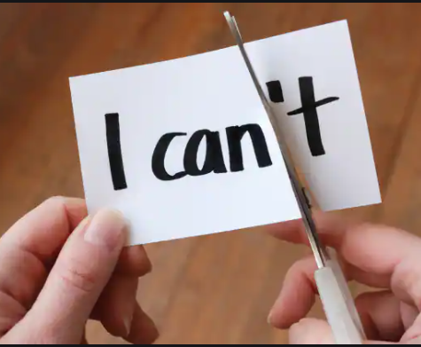
Behavioural Development Overview
It helps in getting a Positive Attitude
It enables you to connect to anyone Easily
Tips
Exercise Regularly
Meditation

Slide 7
Thank You.
Stay Happy Stay Safe.
References
Google Images
Creator :
Aritra Roy
aritraroy@kpmg.com

