Slide 1
Exercise
Let us use Jenkins to
Setup a pipeline
Auto trigger compilation based on changes to the code

Slide 2
Maven Installation(if not already in docker image)
In terminal,
docker container ls -a
docker exec –it <<container id>> /bin/bash
Go to lib
Run apk add maven
mvn --version

Slide 3
Tomcat Installation(if not already in docker image)
In terminal,
docker container ls -a
docker exec –it <<container id>> /bin/bash
wget http://mirrors.estointernet.in/apache/tomcat/tomcat-9/v9.0.24/bin/apache-tomcat-9.0.24.zip -O /tmp/apache-tomcat-9.0.24.zip
Note: if above tomcat version version does not work, use another version from
http://mirrors.estointernet.in/apache/tomcat/
Go to /tmp
unzip apache-tomcat-9.0.24.zip
Go to apache-tomcat-9.0.24/bin
Give access by below command:
chmod +x *.sh

Slide 4
Tomcat Installation(Cont…)
In terminal,
Edit server.xml under conf:
vi server.xml
edit port 8080 to 8089
press esc > write :wq > press enter
Go to /tmp/apache-tomcat-9.0.24/bin
To start server:
sh startup.sh
To stop server:
sh shutdown.sh

Slide 5
Jenkins Hands-on
In next set of slides we will
Download a Docker image which has Jenkins, maven, tomcat installed
Create a pipeline to do following tasks in sequence
Download sources from a GitHub repository and use maven to build it
Clean Reports
Perform PMD
Code Compile
Run JUnit based tests on it
Perform Code coverage
Generate WAR
Tomcat server up
Deploy war on tomcat
Run the system test

Slide 6
Docker Image with Preinstalled Jenkins
For windows, make sure you have created a folder (e.g. devopstraining) under C:\Users\<username>\
Run the following command in cmd
Windows
docker run --rm -u root -p 8089:8089 -p 8080:8080 -v jenkins-data:/var/jenkins_home -v /var/run/docker.sock:/var/run/docker.sock -v c:\\"%HOMEPATH%"\devopstraining:/home veritycorp/devops
Linux/Mac/AWS
sudo docker run --rm -u root -p 8089:8089 -p 8080:8080 -v jenkins-data:/var/jenkins_home -v /var/run/docker.sock:/var/run/docker.sock -v $HOME:/home veritycorp/devops
Note:
For AWS, Make sure you have created security groups for Jenkins, Tomcat servers for Ubuntu instance on AWS

Slide 7
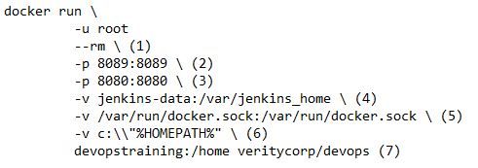
Understanding the Command
1. Automatically removes the Docker container when it is shut down
2. Maps port 8089 on the host machine to port 8089 of the
veritycorp/devops container for tomcat server
3. Maps port 8080 on the host machine to port 8080 of the
veritycorp/devops container for jenkins server
4. Let’s not worry about it right now
5. (But highly recommended) Maps the /var/jenkins_home directory in the
container to the Docker volume with the name jenkins-data
(automatically created if non-existen). Makes Jenkins state to persist
each time you restart Jenkins
6. Allows veritycorp/devops container to communicate with the Docker
daemon when we use “agent” command in pipeline code
7. Maps the %HOMEPATH% directory on the host machine to the /home
directory in the container.
Note: Linux/Mac has slightly different syntax

Slide 8
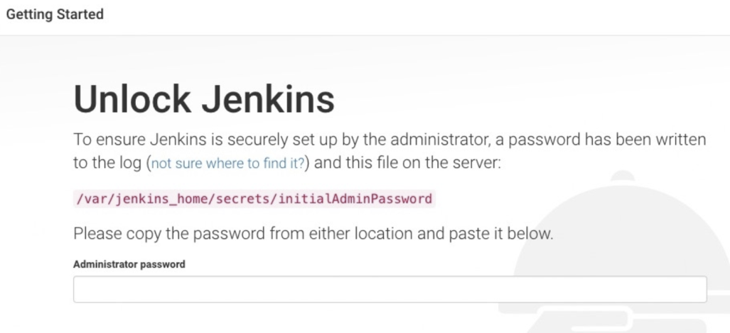
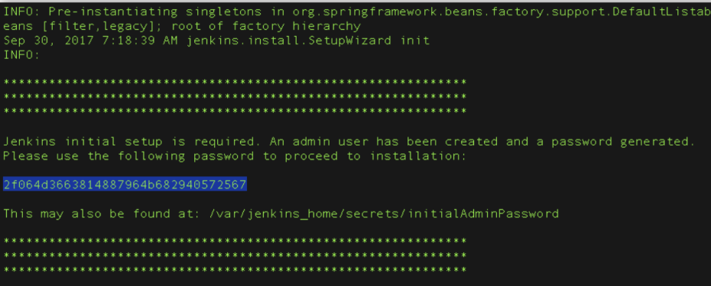
Unlocking Jenkis
After the 2 sets of asterisks appear in the terminal/command prompt window, browse to http://localhost:8080 and wait until the Unlock Jenkins page appears
From the terminal/command prompt window again, copy the automatically-generated alphanumeric password (between the 2 sets of asterisks)
On Customize Jenkins page click Install suggested plugins

Slide 9
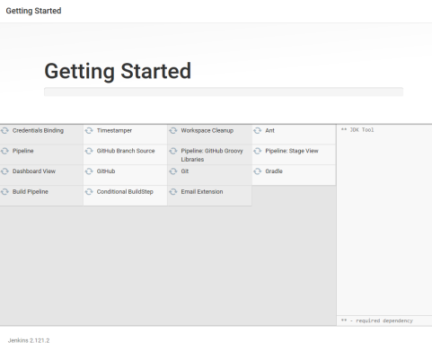
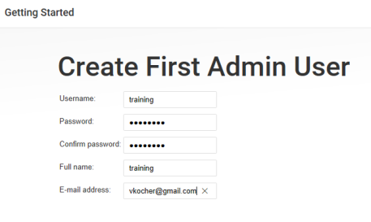
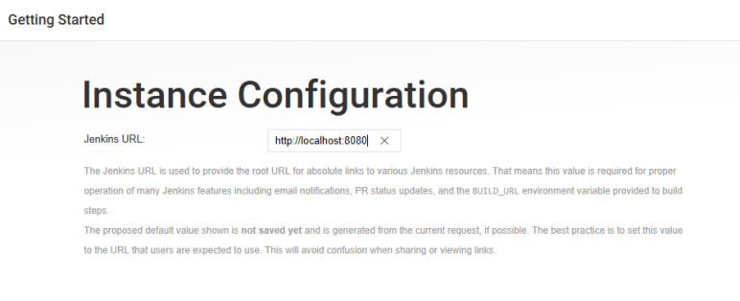
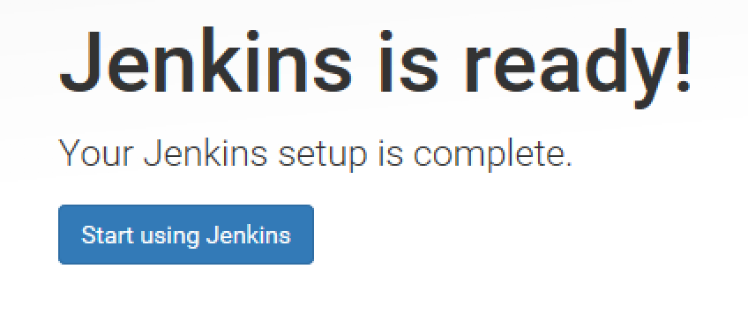
Getting Started
When the Create First Admin User page appears, specify your details in the respective fields and click Save and Finish.
When the Jenkins is ready page appears, click Start using Jenkins.
Please note
This page may indicate Jenkins is almost ready! instead and if so, click Restart.
If the page doesn’t automatically refresh after a minute, use your web browser to refresh the page manually.
If required, log in to Jenkins with the credentials of the user you just created and you’re ready to start using Jenkins!
you can stop the verity/devops docker container by typing Ctrl-C

Slide 10
Step 1 - Getting Sample Code(App & System Tests)
Open the browser and go to https://github.com/login
Login to your account
Launch URL https://github.com/umangsaltuniv/verity-devops
Click Fork at right top section
"verity-devops" repository will be added on your GitHub account
Launch URL https://github.com/umangsaltuniv/EMSystemTests
Click Fork at right top section
“EMSystemsTests” repository will be added on your GitHub account
Note: verity-devops project has Expense Manager sample app & some unit tests those will run on the app to do unit testing of the app. EMSystemTests project has system test that will run on the app to do system testing of the app

Slide 11
Step 2 - Cloning Sample Code(App)
After forking “verity-devops” repository on GitHub Web, Click “Clone or download”
Click “Open in Desktop”
Click “Open GitHubDesktop”
In GitHub Desktop, before clicking Clone on the Clone a Repository dialog box, ensure Local Path is set to C:\DO-United\GitHubRepo\verity-devops
Click Clone
Note down the URL where you forked (https://github.com/<Your username>/verity-devops.git)
GitHub Desktop will be opened in cloned repository

Slide 12
Step 2 - Cloning Sample Code(System Tests)
After forking EMSystemTests on GitHub Web, Click “Clone or download”
Click “Open in Desktop”
Click “Open GitHubDesktop”
In GitHub Desktop, before clicking Clone on the Clone a Repository dialog box, ensure Local Path is set to C:\DO-United\GitHubRepo\EMSystemTests
Click Clone
Note down the URL where you forked (https://github.com/<Your username>/EMSystemTests.git)
GitHub Desktop will be opened in cloned repository

Slide 13
Step 3 - Create Pipeline Project
Go to Jenkins Dashboard
Click “New Item” at top left section
Enter project name(e.g. verity-devops) > Select Pipeline > Click OK
Go to Pipeline section
Choose the ”Pipeline script from SCM” option from the ”Definition” field
Choose the ”Git” option from the ”SCM” field
Enter your Repository URL(e.g. https://github.com/<Your username>/verity-devops.git)
Enter “Jenkinsfile.txt” under “Script Path” section
Click Apply > Save

Slide 14
Step 4 - Create Jenkinsfile
Create and save new text file with the name Jenkinsfile.txt at the root of your local verity-devops Git repository
Write the pipeline code (see next pages) into your empty Jenkinsfile stage by stage

Slide 15
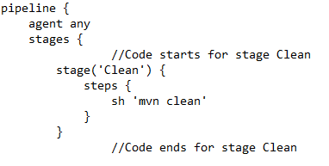
Add Stage – Clean
Clean defines a stage that appears on the Jenkins UI
sh runs the Maven command to cleanly target folder that includes code compiled classes, unit test reports, war files etc
Note: It will delete target folder from var/jenkins_home/workspace/<your pipeline project name>

Slide 16
Saving Jenkinsfile/Commit
Save the edited Jenkinsfile and commit it to GitHub Web by following steps:
Open GitHub Desktop
Jenkinsfile will be selected & displayed under Current repository “verity-devops”
Select Current branch as “master”
Enter Summary under “Summary” section
Click “Commit to master”
Click “Fetch origin”
Go to your repository on GitHub Web & Refresh the page
Jenkinsfile will be displayed there

Slide 17
Running The Pipeline
Go to Jenkins Dashboard
Click “Open Blue Ocean” at left section
Click your pipeline project
Click Run
Then quickly click the ”OPEN” link which appears at the lower right section to see running progress of your Pipeline project
Jenkins Initially queues the project to be run on the agent
Code will be available inside container’s location var/jenkins_home/workspace/<your pipeline project name>
Docker commands:
docker images: List all of the images that are currently stored on the system
docker container ls –a: List all of the containers
docker ps: List all of the containers that are currently running
docker exec -it <<container id>> /bin/bash : Enter inside the running container

Slide 18
Exercise
Let us understand
Static analysis
Dynamic analysis
Let us include PMD and JaCoCo in the pipeline

Slide 19
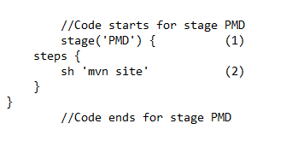
Add Stage – PMD
PMD defines a stage that appears on the Jenkins UI
sh runs the Maven command to detect programming mistake detector
Saving Jenkinsfile/Commit
Running The Pipeline

Slide 20
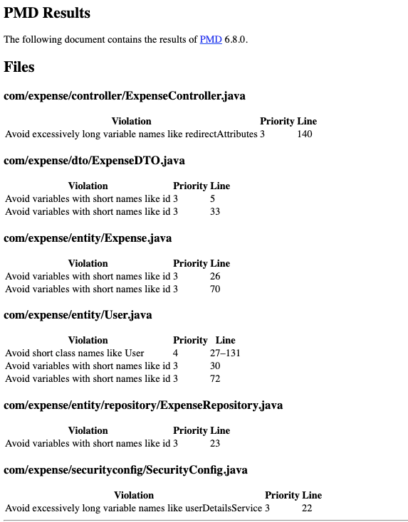
PMD Result
You can see result in pmd.html

Slide 21
Get PMD report
Local Machine:
Launch another cmd instance, then hit below command
docker cp <<container id >>: var/jenkins_home/workspace/<your pipeline project name>/target/site/pmd.html D:\
Note: Above command will move pmd.html from container to your local machine’s D drive
AWS:
Launch another putty instance, then hit below command
sudo docker cp <<container id>>:var/jenkins_home/workspace/<your pipeline project name/target/site/pmd.html mypmd.html
Note: Above command will move mypmd.html from container to Ubuntu machine (mypmd.html)

Slide 22
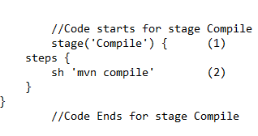
Add Stage – Compile
Compile defines a stage that appears on the Jenkins UI
sh runs the Maven command to compile the source code
Saving Jenkinsfile/Commit
Running The Pipeline

Slide 23
Exercise
Let us include JUnit tests in the pipeline

Slide 24
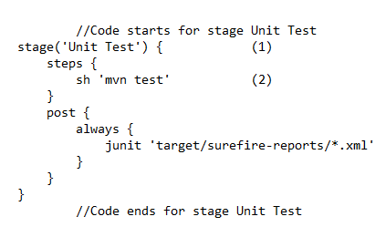
Add Stage – Unit Test
Unit Test defines a stage that appears on the Jenkins UI
sh runs the Maven command to run the unit tests
Saving Jenkinsfile/Commit
Running The Pipeline
Junit command generates a junit xml reports
If junit tests get failed then pass them by making changes in source code
Notes:
Path for buggy files:
verity-devops\src\main\java\com\expense\service\impl
ExpenseServiceImpl
UserServiceImpl

Slide 25
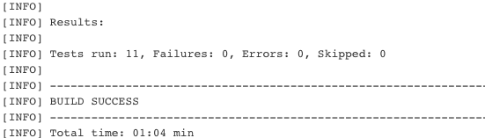
Unit Test Result
You can see result at below location in container:
/var/jenkins_home/workspace/<your pipeline project name>/target/surefire-reports/

Slide 26
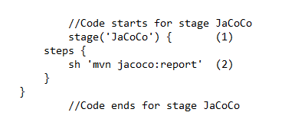
Add Stage – JaCoCo
JaCoCo defines a stage that appears on the Jenkins UI
sh runs the Maven command to perform the code coverage
Saving Jenkinsfile/Commit
Running The Pipeline

Slide 27
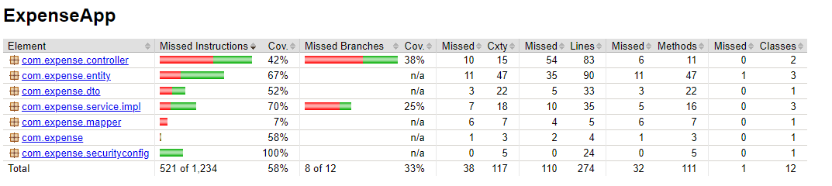
JaCoCo Reports
You can JaCoCo report at below location in container:
/var/jenkins_home/workspace/<your pipeline project name> /target/site/jacoco/index.html

Slide 28
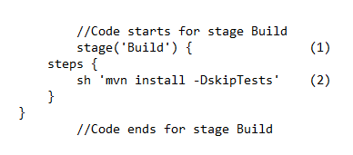
Add Stage – Generate war file
Build defines a stage that appears on the Jenkins UI
sh runs the Maven command to build the web application without running the unit tests
Saving Jenkinsfile/Commit
Running The Pipeline

Slide 29
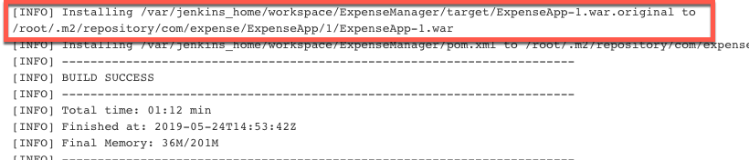
Result
The ExpenseApp-1.war file would be generated
You can find war at below location in container: /var/jenkins_home/workspace/<your pipeline project name>/target/

Slide 30
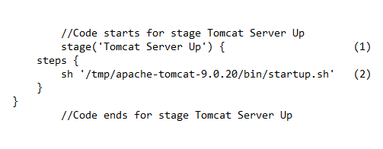
Add Stage – Tomcat Server Up
Tomcat Server Up defines a stage that appears on the Jenkins UI
sh runs the command launch Tomcat server
Saving Jenkinsfile/Commit
Running The Pipeline

Slide 31
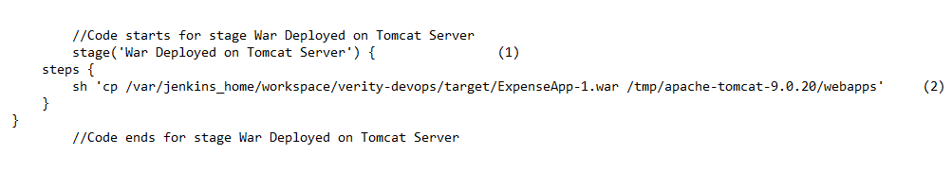
Add Stage – War Deployed on Tomcat Server
War Deployed on Tomcat Server defines a stage that appears on the Jenkins UI
sh runs the command to move war file from code project location to Tomcat’s location
Saving Jenkinsfile/Commit
Running The Pipeline

Slide 32
Exercise
Let us include automated system tests using Selenium in the pipeline.

Slide 33
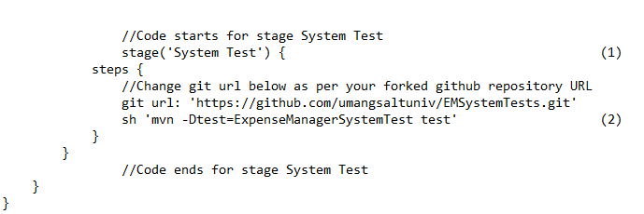
Add Stage – System Test
System Test defines a stage that appears on the Jenkins UI
sh runs the Maven command to run the system tests
Saving Jenkinsfile/Commit
Running The Pipeline
If system tests get failed then pass them by making changes in source code

Slide 34
Complete Pipeline
Now run complete pipeline

Slide 35
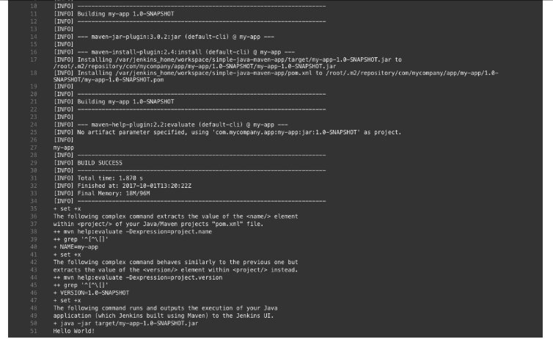
Output
Jenkins will show output of Deliver stage by showing execution results of your web application

Slide 36
Docker Cheat Sheet
docker create [image]: Create a new container from a particular image.
docker login: Log into the Docker Hub repository.
docker pull [image]: Pull an image from the Docker Hub repository.
docker push [username/image]: Push an image to the Docker Hub repository
Running Docker Containers
docker start [container]: Start a particular container.
docker stop [container]: Stop a particular container.
docker run -ti — rm — image [image] [container] [command]: Create and start a container at the same time, run a command inside it, and then remove the container after executing the command.
docker pause [container]: Pause all processes running within a particular container.
Using Docker Utilities
docker version: Display the version of Docker that is currently installed on the system.
docker images: List all of the images that are currently stored on the system.
docker container ls –a: List all of the containers.
docker ps: List all of the containers that are currently running.
docker exec -it <<container id>> /bin/bash : Enter inside the running container
Cleaning Up Your Docker Environment
docker kill [container]: Kill a particular container.
docker kill $(docker ps -q): Kill all containers that are currently running.
docker rm [container]: Delete a particular container that is not currently running.
docker rm $(docker ps -a -q): Delete all containers that are not currently running

