Slide 1
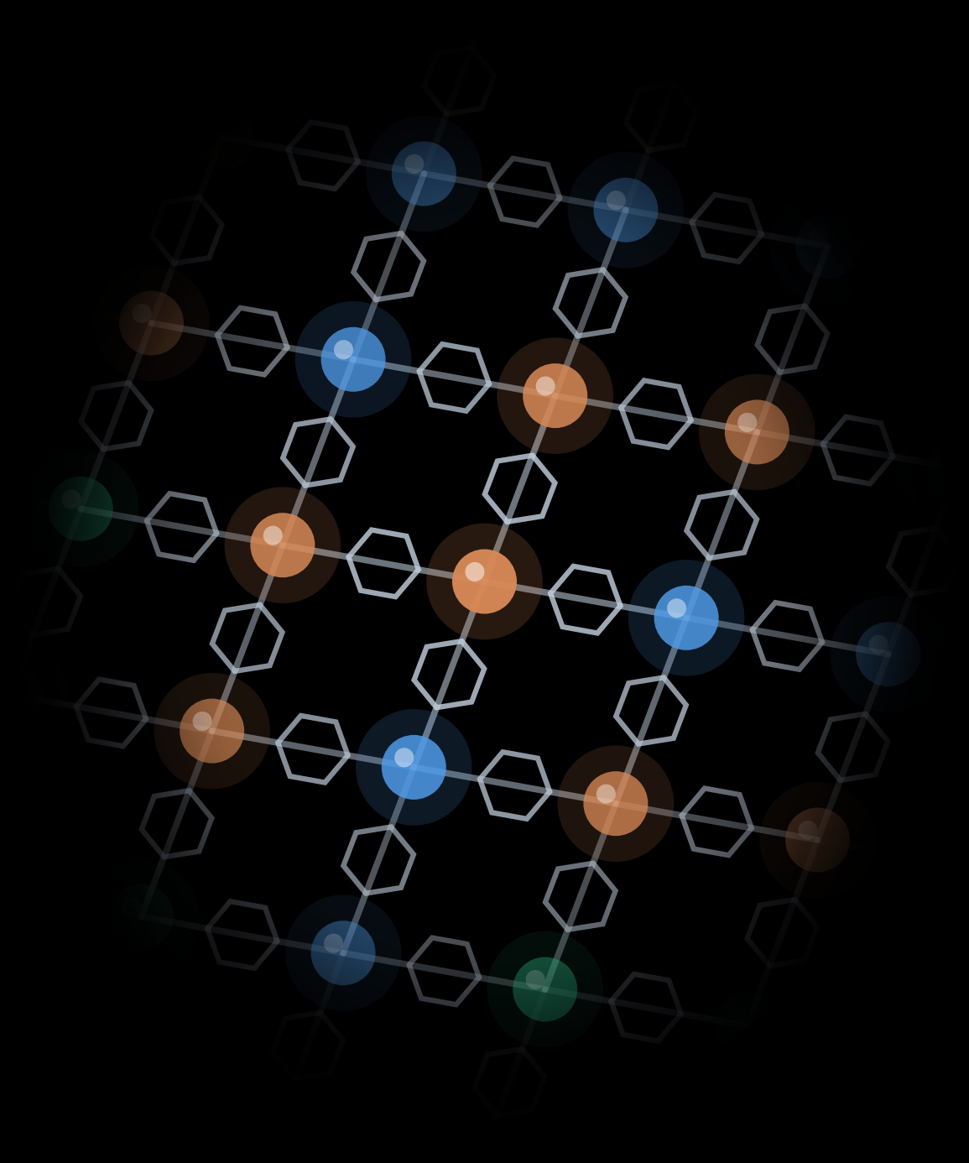
Automated Exploration of
Co–Ni–Cu BDC
Coordination Polymers
Co
Ni
Cu
Team MOFKeKing | Project M3-MOF
Aritra Roy, Piyush Ranjan Maharana, Tarak Nath Das
SDL Hackathon, UZH HTEL | 30 October 2026
Notes:
Hi everyone, we're team MOFKeKing, and we used OT2 to mix cobalt, nickel and copper with a common linker BDC to see whether we could make a ternary solid.

Slide 2
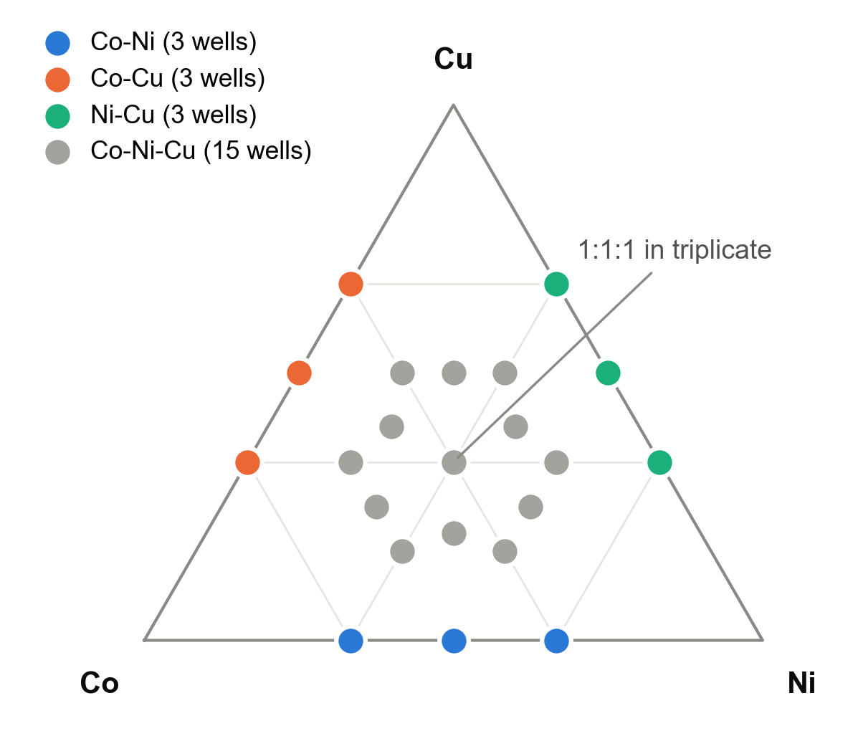
Can a UV–Vis screen spot mixed-metal Co–Ni–Cu species?
Hypothesis
At least one composition shows a UV–Vis band that no simpler composition shows: a sign of a mixed-metal cluster worth sending to HPLC–MS and PXRD.
24
× 4
96
Co:Ni:Cu compositions,
every one with ≥ 2 metals
metal : ligand ratios
(1:1, 1:2, 1:3, 1:4)
reactions, 300 µL DMF,
18 mM total metal
Reaction: 13 h at 120 °C. Screening: UV–Vis on every vial, then HPLC–MS and PXRD on the leads.
Notes:
We picked 24 different metal mixes, each with at least two metals, and tried each one with four amounts of linker, so that's 96 reactions in total.

Slide 3








From Python design to 96 spectra in one robot day
1. Design
2. Stocks
3. OT-2 dispensing
4. Reaction
5. UV–Vis
6. HPLC–MS + PXRD
Python: compositions, per-vial volumes, stock masses
450 mM metal acetates, 180 mM BDC → 90 mM (HTEL staff)
P20 + P300, 420 transfers, BDC added last, 8 tips
Capped GC vials, 13 h at 120 °C
96/96 spectra, 400–900 nm, Tecan Infinite 200Pro
Mass and structure of the leads
Done
Done
Done
Done
Done
Pending
What changed on the day
UV–Vis used 50 µL aliquots in DMF-safe glass inserts (planned: 200 µL).
No DMF blank was recorded, so absolute absorbance includes the vessel background.
HPLC–MS and PXRD are not done yet, so everything here comes from UV–Vis.
Notes:
Our code planned everything, the robot did the pipetting, the oven did the heating and a plate reader measured every vial, and the mass spec and X-ray steps are still to come.

Slide 4
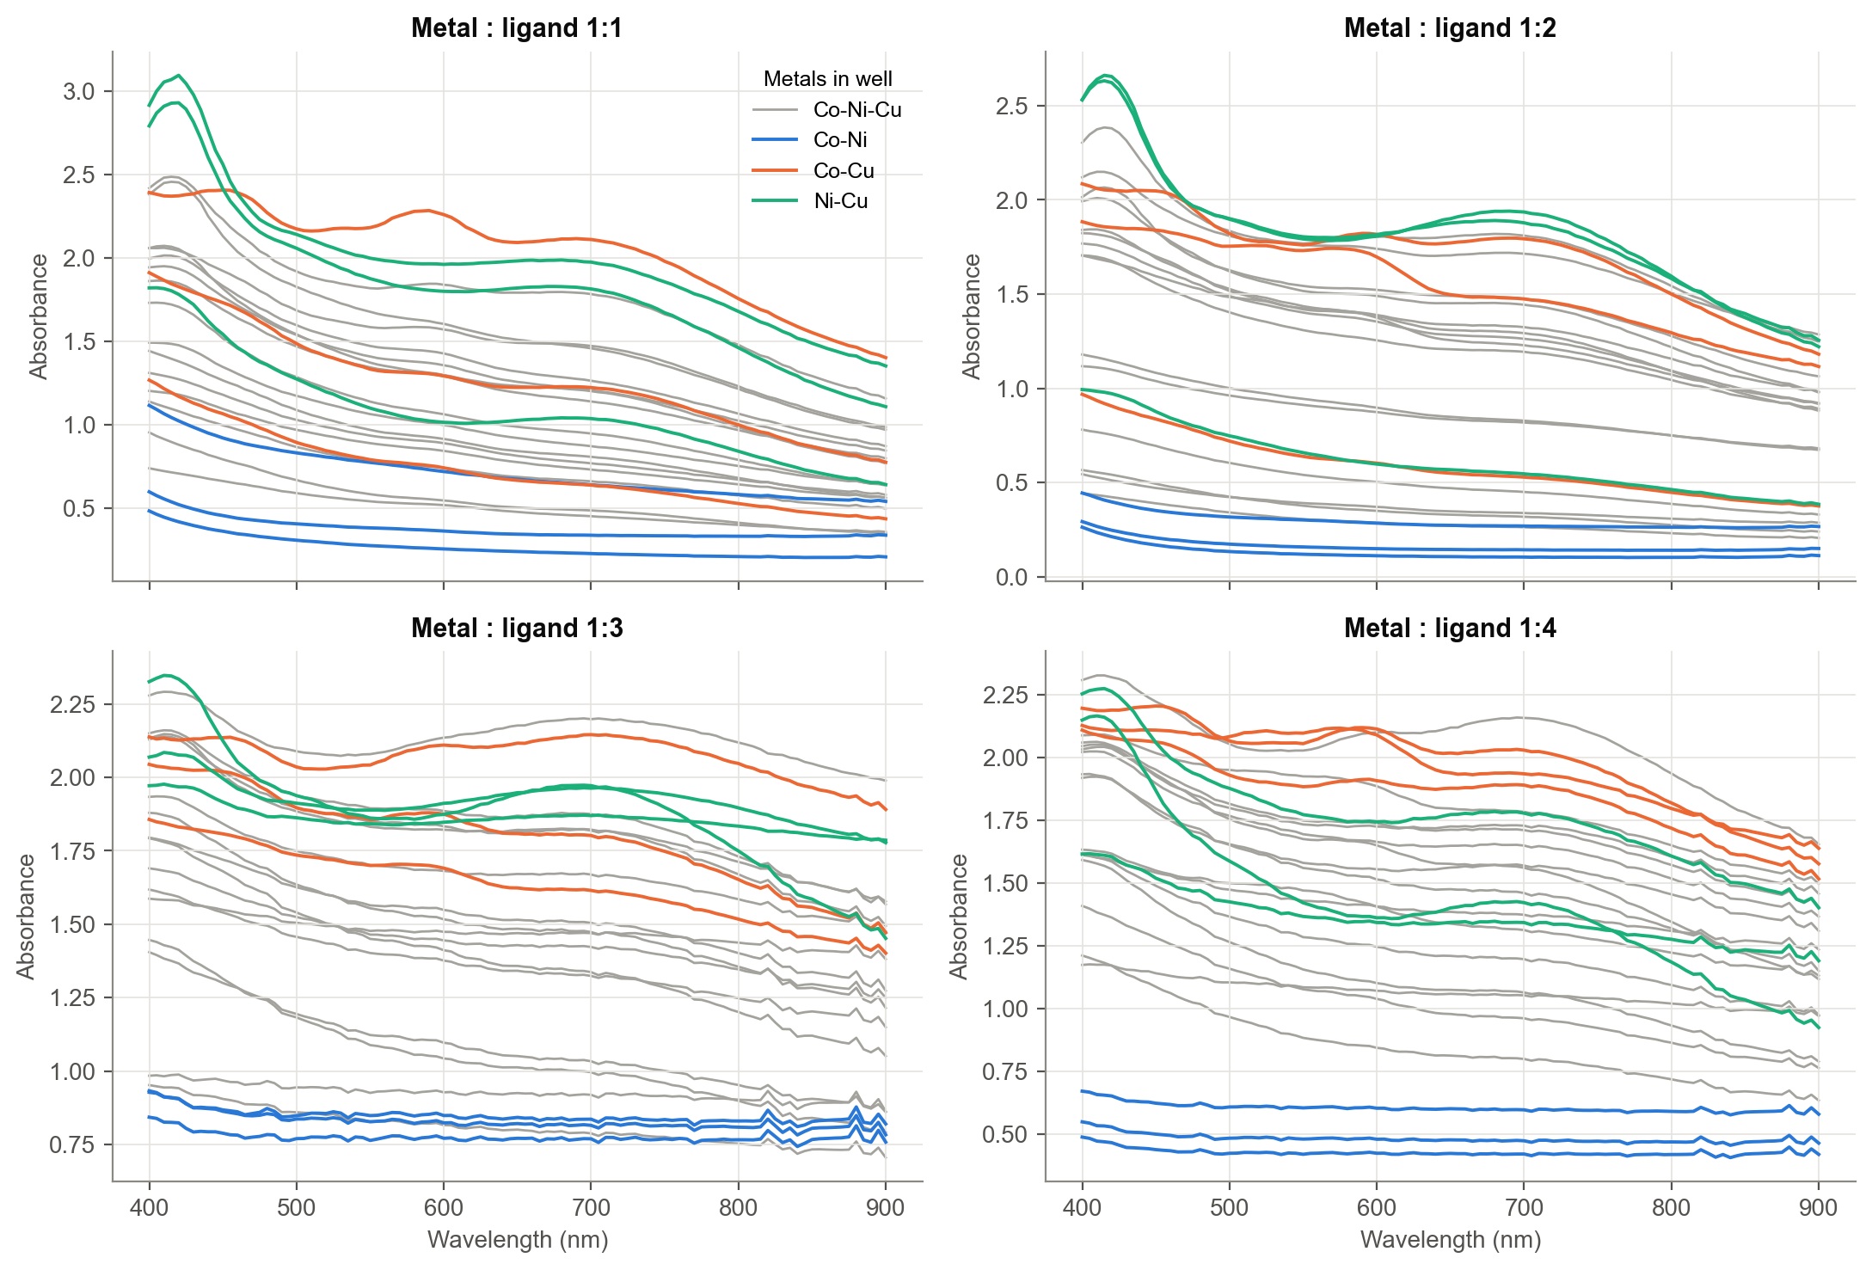
Raw spectra: weak bands on a strong scattering background
96 / 96
spectra collected
Absorbance stays at 0.2–2 even at 900 nm: suspended solid scatters light.
Co–Ni wells (blue) are the clearest.
Bands sit on top near 420, 590 and 700 nm.
Notes:
Here are all 96 spectra, and they never drop to zero because the solid in the vials scatters light, while the small bumps on top towards larger wavelengths are the real signals.

Slide 5
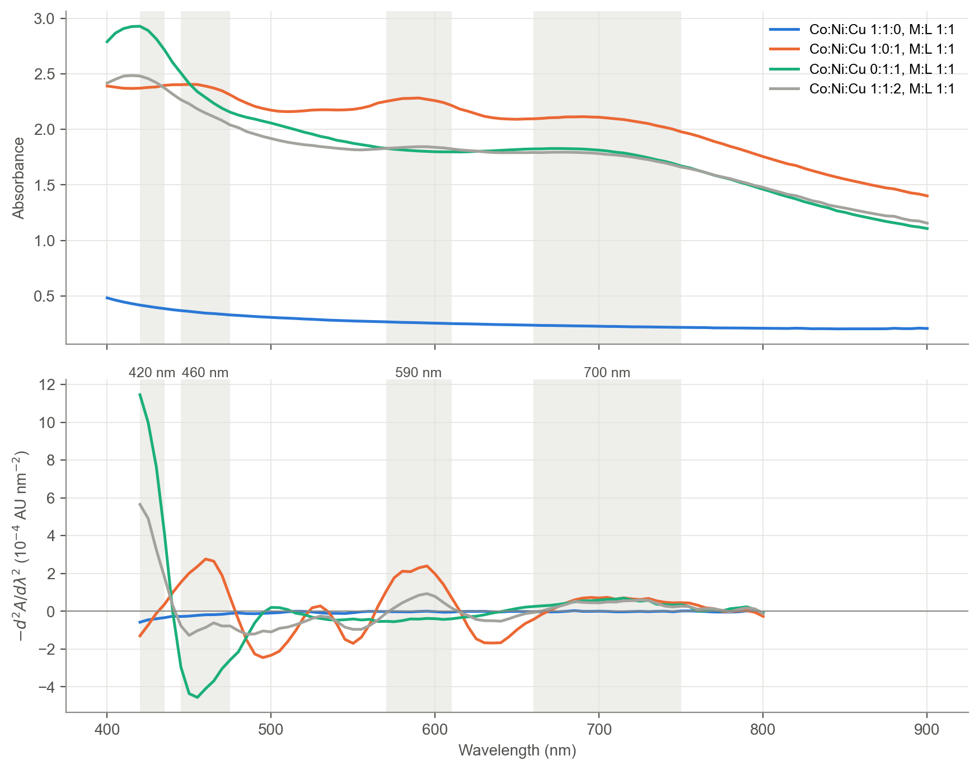
Second derivatives separate bands from scattering
1
Remove the background
Savitzky–Golay second derivative (40 nm window): smooth scattering drops out, bands become peaks.
2
Measure four bands
Mean signal in windows at ~420, ~460, ~590 and ~700 nm.
3
Measure our own noise
The 1:1:1 triplicates at each ratio give the noise at every wavelength.
Notes:
To pull out those small bumps, we took the second derivative, which flattens the smooth background and turns each bump into a clear peak.

Slide 6
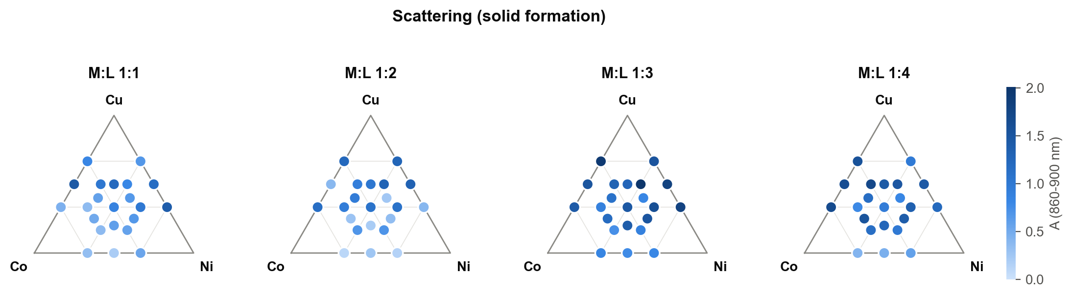
Copper drives solid formation
How to read it: dissolved metal ions barely absorb at 860–900 nm, so absorbance there comes from light scattered by suspended solid. Darker dot = more solid product. Bottom edge Co–Ni, left edge Co–Cu, right edge Ni–Cu, ternaries inside.
Co–Ni wells
Co–Cu wells
Ni–Cu wells
more BDC
0.17–0.80
0.91–1.63
1.00–1.71
1:3, 1:4
least scattering at every ratio
strong scattering
strong scattering
more solid in every family
Notes:
Darker dots mean more solid, so you can see that anything with copper makes a lot of solid, and adding more linker makes even more.

Slide 7
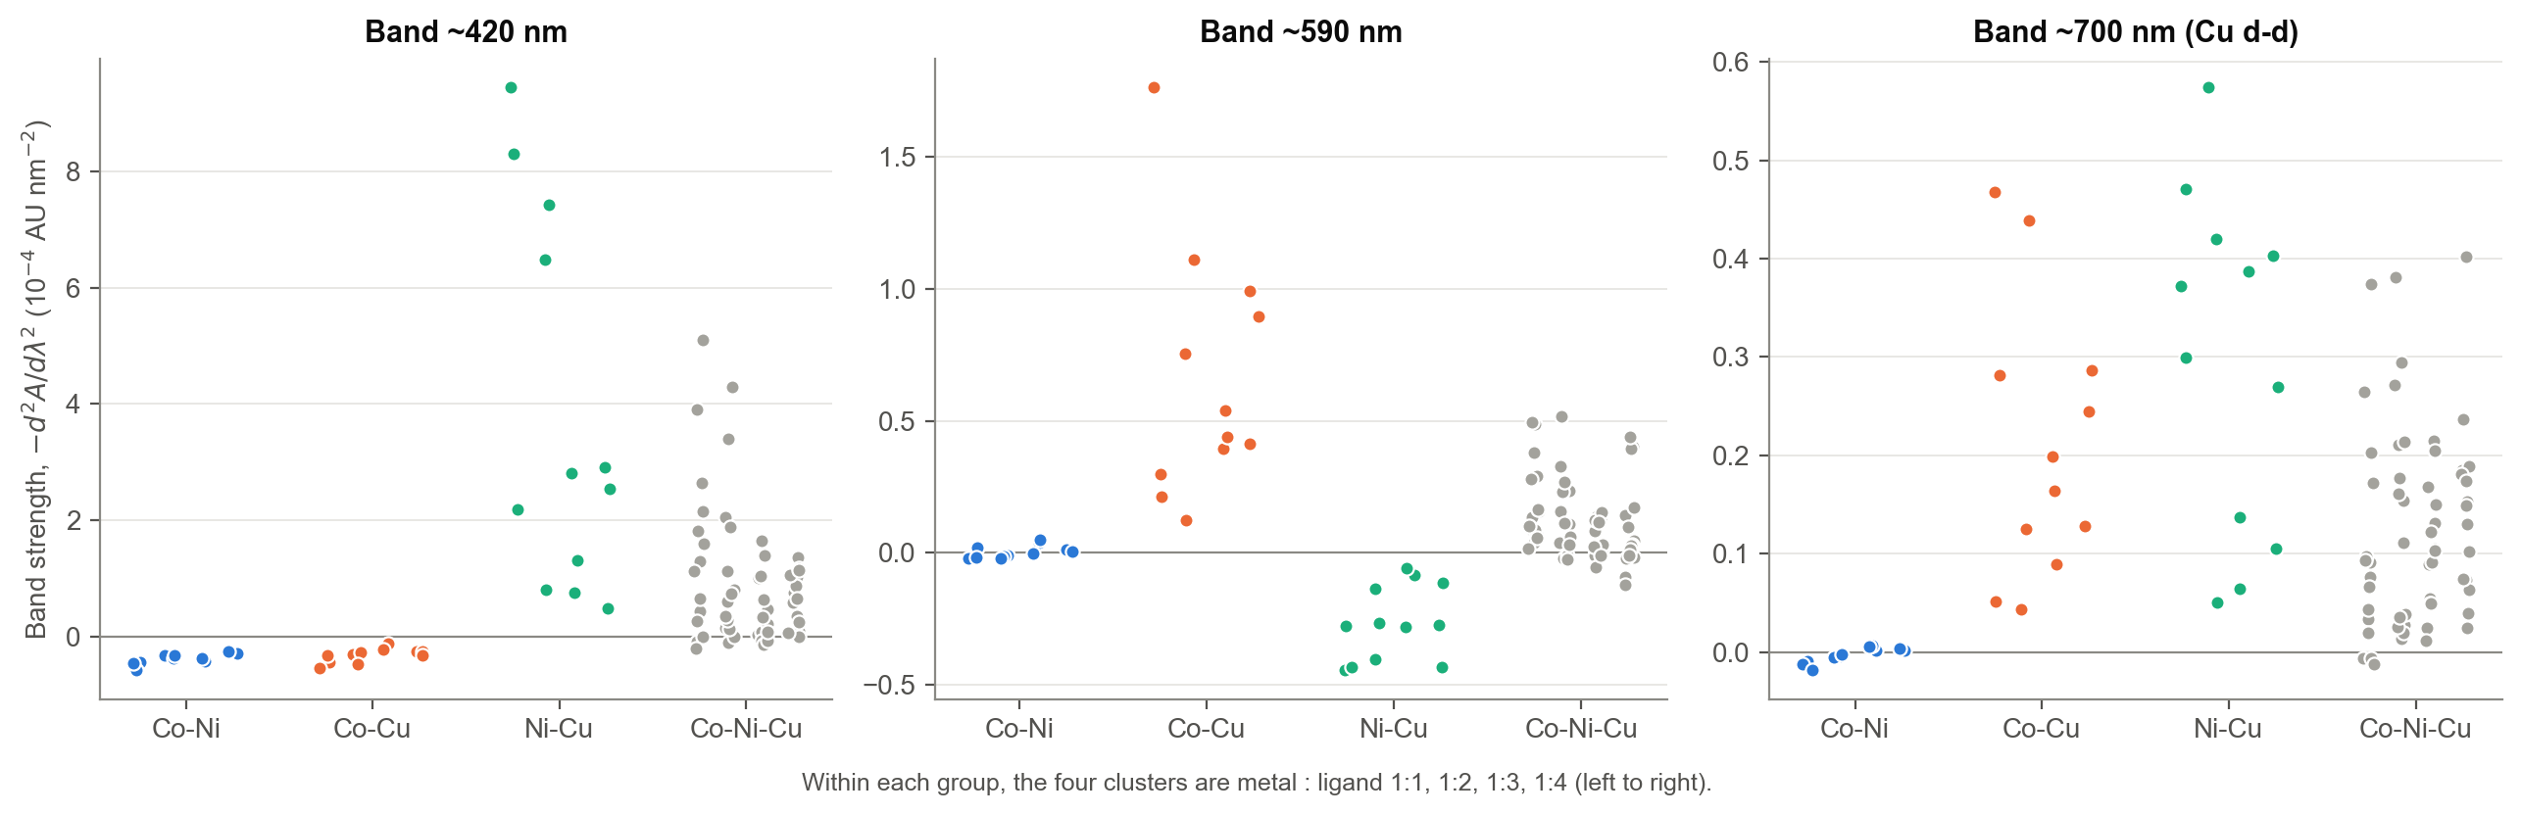
Two bands appear only when copper meets a specific partner
~420 nm needs Ni + Cu
~590 nm needs Co + Cu
~700 nm: Cu(II) d–d
Strongest at Ni:Cu 1:1, 2:1 and 1:2 with little BDC; absent from Co–Ni and Co–Cu.
Strongest at Co:Cu 1:1 and 2:1; absent from Co–Ni mixes with the same Co content.
In every Cu-containing mix (685–750 nm); zero without Cu.
Notes:
This is our main result: one band only shows up when nickel and copper are together, and another one only when cobalt and copper are together.

Slide 8
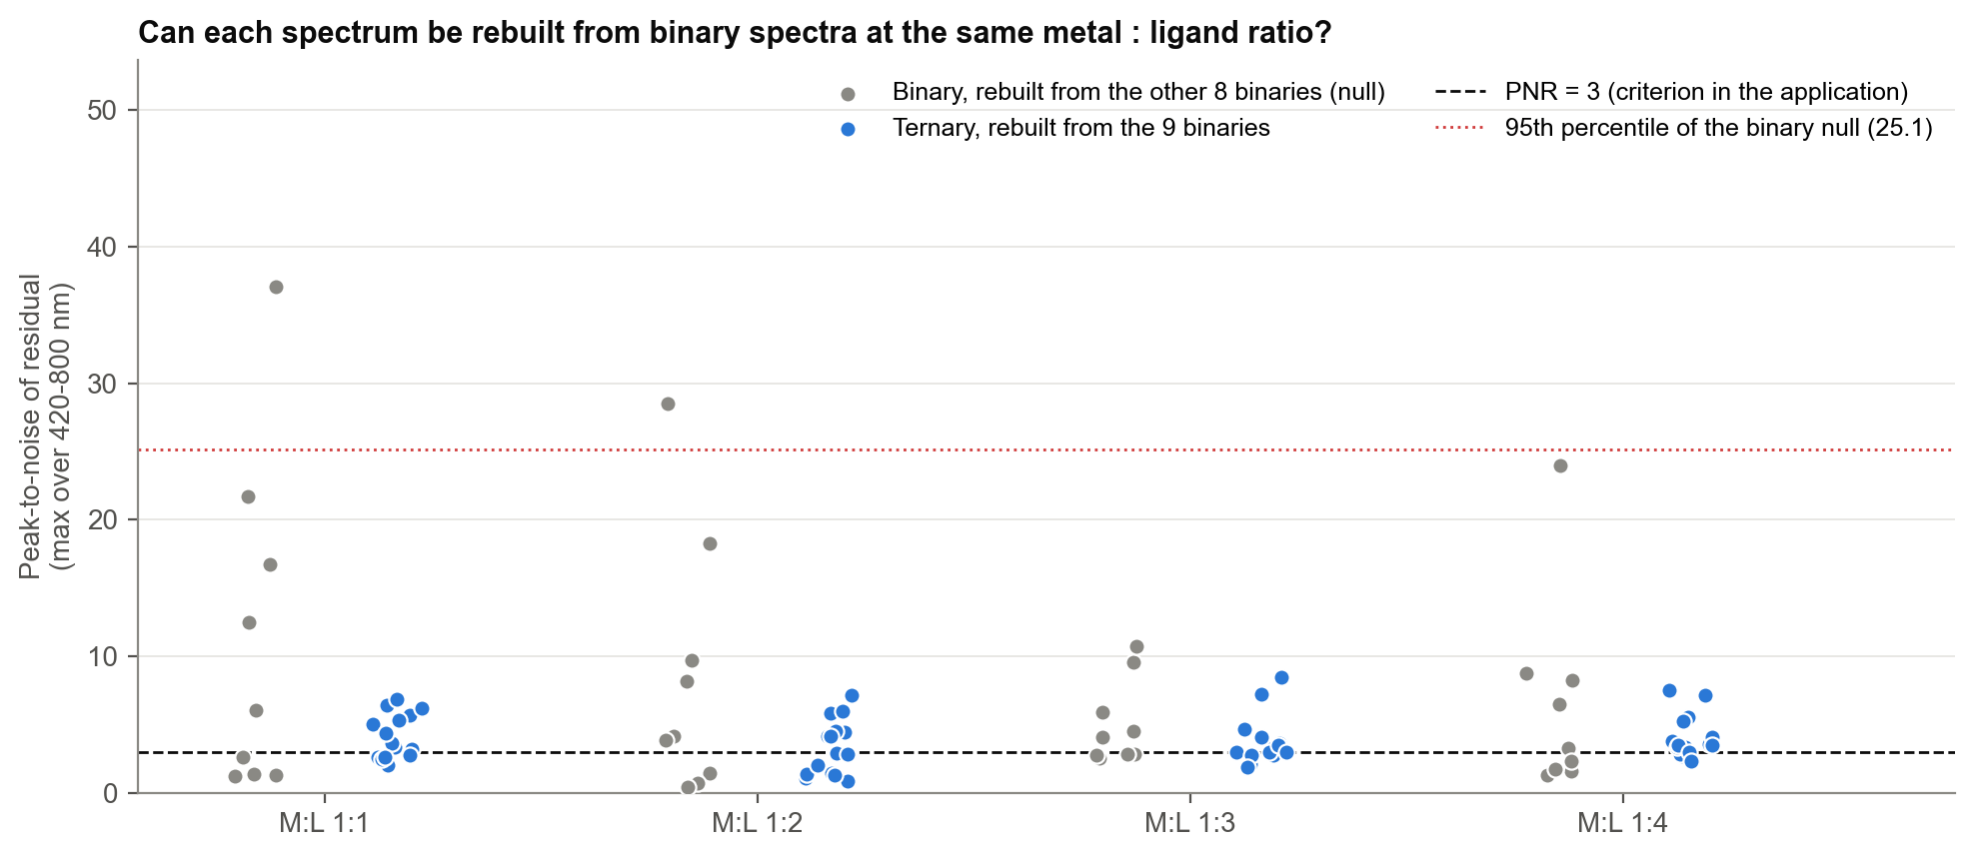
No ternary well shows a feature the binaries cannot explain
0 / 60
ternary wells beyond the binary null
PNR (peak-to-noise ratio) = biggest leftover signal ÷ our replicate noise. 35 / 60 ternaries pass PNR > 3, but so do 21 / 36 binaries: the threshold alone is not enough.
Largest ternary residual 8.4, against 25.1 for the binary null.
How we tested it: each ternary spectrum is rebuilt from the best non-negative mix of the nine binary spectra at the same ratio. Whatever is left is a three-metal feature. As a null, each binary is rebuilt from the other eight.
Notes:
We then checked if any three-metal mix showed something new, and every one of them could be explained by the two-metal mixes.

Slide 9

Scorecard against our success criteria
1. UV–Vis spectra for all 96 wells
96 / 96 spectra, 400–900 nm
Met
2. A new band versus simpler mixes, PNR > 3
Bimetallic bands at 420 nm (Ni–Cu) and 590 nm (Co–Cu); no ternary-only band.
Partly met
3. MS ion with a mixed-metal stoichiometry
Waiting for HPLC–MS
Pending
4. Ternary map with wells of interest
Scattering and band maps at all four ratios; leads identified
Met
Notes:
So against our own goals, we met two, partly met one, and the mass spec one is still waiting for data.

Slide 10
What we learned and what comes next
Learned
Copper drives solid formation across the triangle.
Ni–Cu (420 nm) and Co–Cu (590 nm) give bimetallic signatures.
At UV–Vis level, ternary spectra behave like mixtures of binaries.
The OT-2 workflow ran 96 reactions with 8 tips and reproducible spectra.
Next
HPLC–MS and PXRD on the leads: mixed-metal ions, and a new phase or a physical mixture?
Leads: Co:Cu 1:1 and 2:1, Ni:Cu 1:1, 2:1 and 1:2, and the 1:1:1, 3:2:1 and 2:1:3 ternaries at high BDC.
Record a DMF blank and centrifuge before UV–Vis.
Iterate on the Co–Cu and Ni–Cu edges, varying temperature and time.
Code, data and figures: M3-MOF repository (analysis/analyse_uvvis.py)
Notes:
In short, copper is the key metal, two metal pairs give their own signal, and next we'll run mass spec and powder X-ray on our best samples to see what they really are.

Slide 11
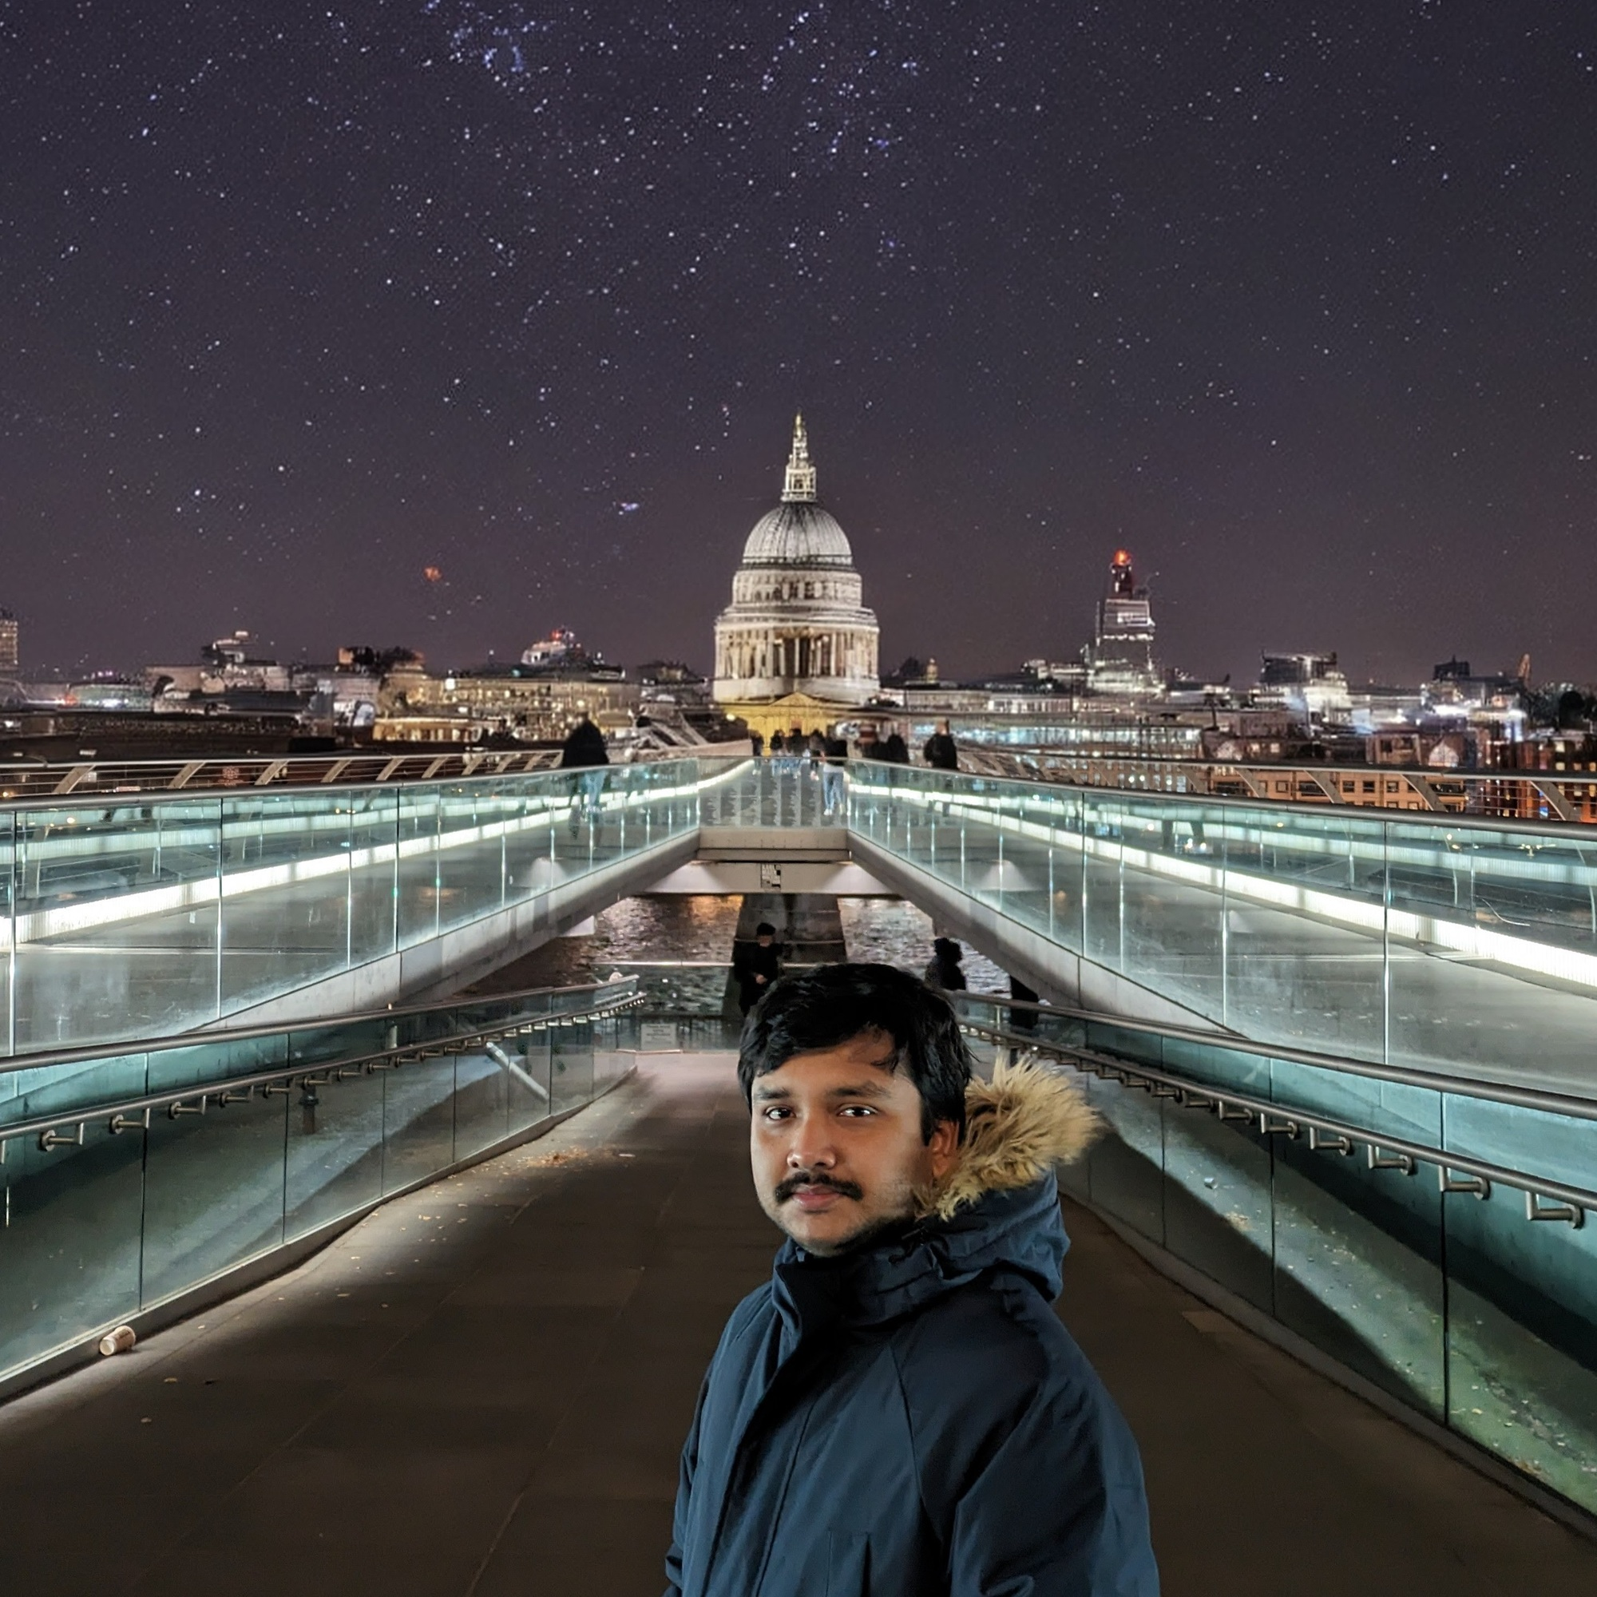

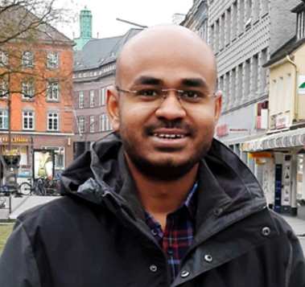
Thank you
Team MOFKeKing | Project M3-MOF
Aritra Roy
Piyush Ranjan Maharana
Tarak Nath Das
contact@aritraroy.live
aritraroy.live
GitHub: aritraroy24
piyushmaharana15@gmail.com
catastropiyush.github.io
GitHub: catastropiyush
dastaraknath4@gmail.com
Thanks to the UZH HTEL team for running the OT-2, oven and UV–Vis steps.
Notes:
Thanks a lot for listening, and a big thanks to the HTEL team for running everything on site, we're happy to take your questions.

