Slide 1
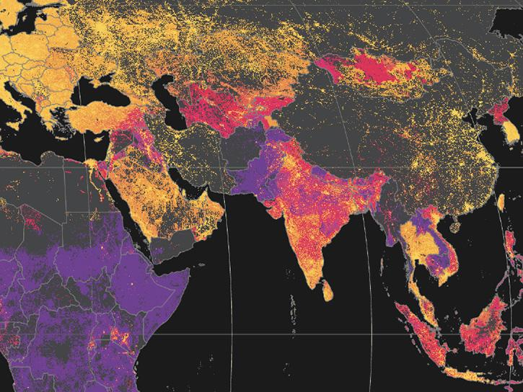
ET AI HACKATHON 2.0
ROUND 2 – BUILD SPRINT
AQI-Sentinel
AI-Powered Urban Air Quality Intelligence for Smart City Intervention
Transforming Environmental Data into Actionable Intelligence

Slide 2
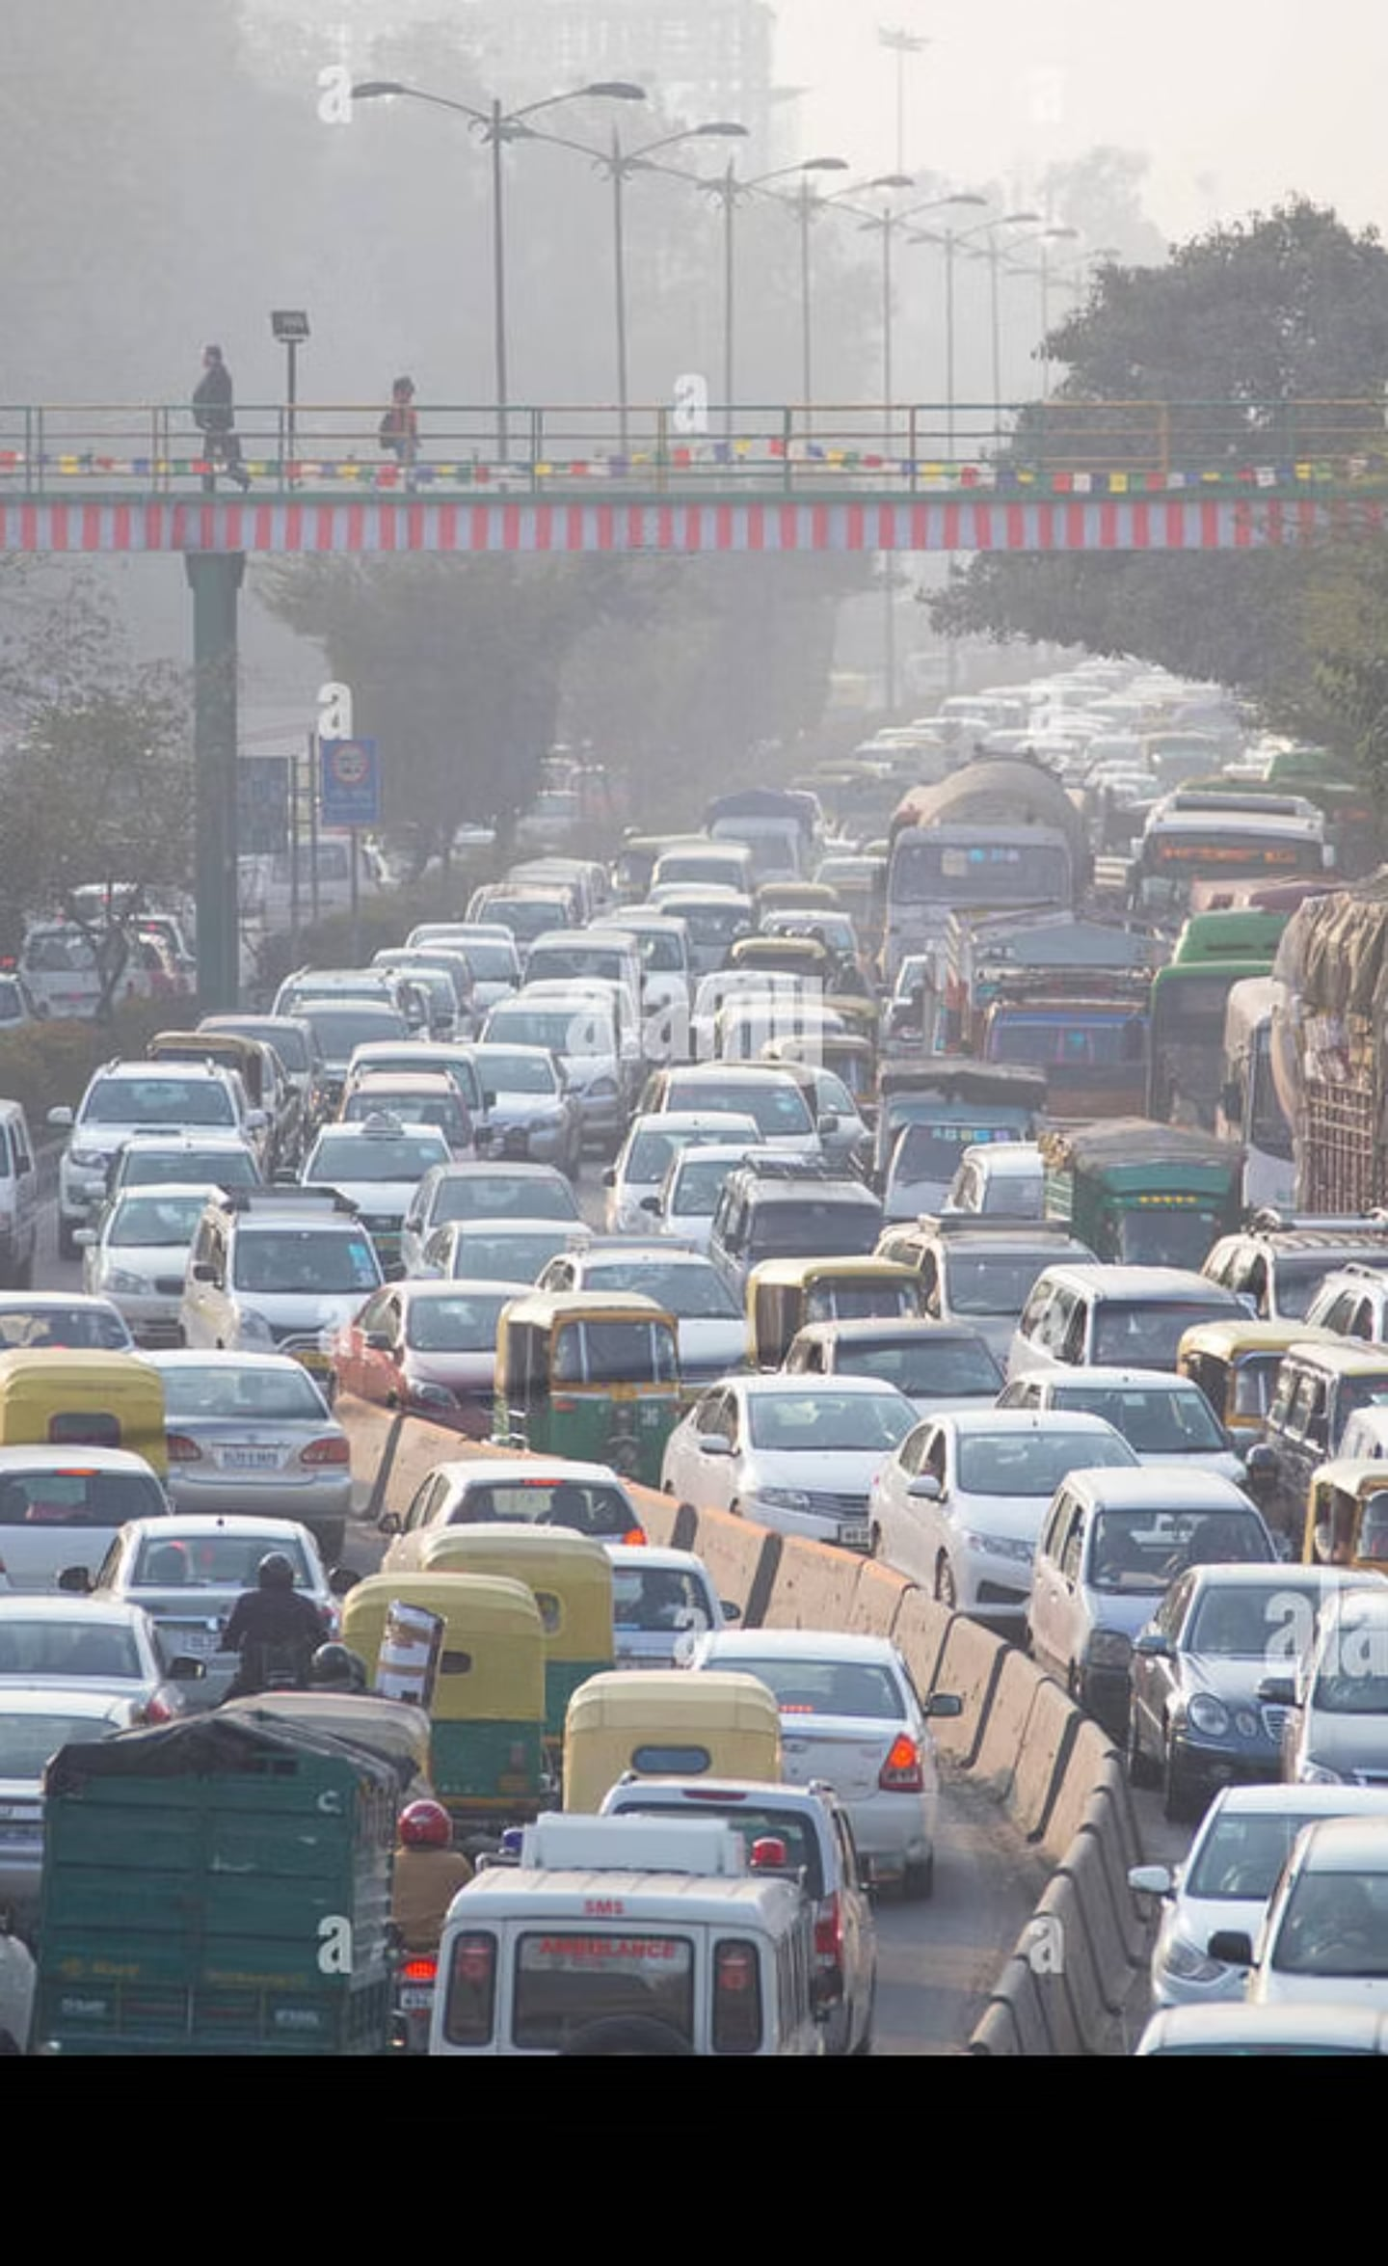
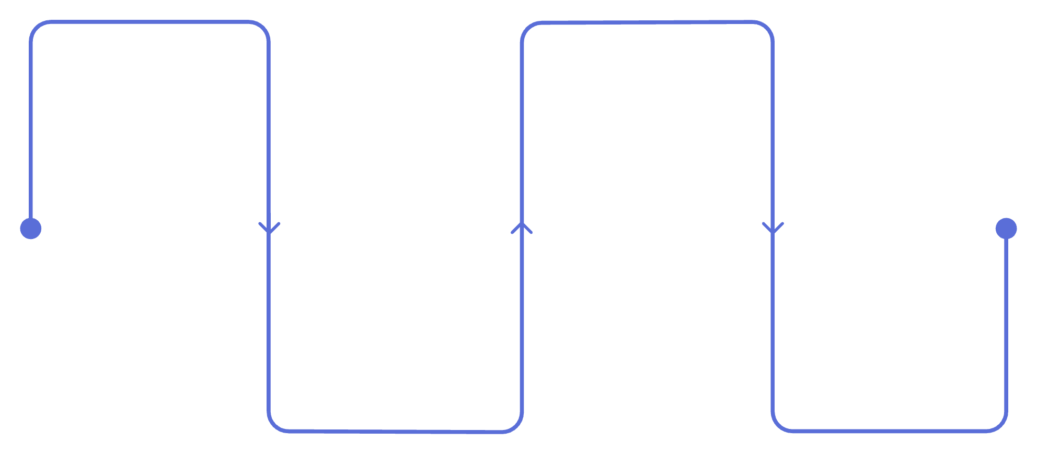
India's Urban Air Quality Challenge
900+
Air Quality Monitoring Stations
1.67M
Premature Deaths Annually
24
of India's 50 Most Polluted Cities are Urban
31%
of Cities Have Actionable Response Protocols
Current Workflow
Sensors
Manual Interpretation
Collect real-time air data
Human analysis of trends
Dashboard
Delayed Action
Centralize readings for review
Slow or absent response
"The data exists. Actionable intelligence does not."

Slide 3

From Monitoring to Decision Intelligence
AQI-Sentinel is a Multi-Agent AI platform.
Source Attribution
AQI Forecasting
Enforcement Intelligence
Citizen Health Advisory
Ground Truth Validation
Response Time Benchmarking
Multi-Source Data
Explainable Intelligence
Smart City Decisions
AI Agents

Slide 4
System Architecture
Frontend Dashboard
FastAPI Backend
Request Orchestrator
Specialized AI Agents
Shared Models
Real Public APIs
Modular Design
Concurrent Processing
Real-Time APIs
Explainable AI
Fault Tolerance
Scalable Architecture

Slide 5
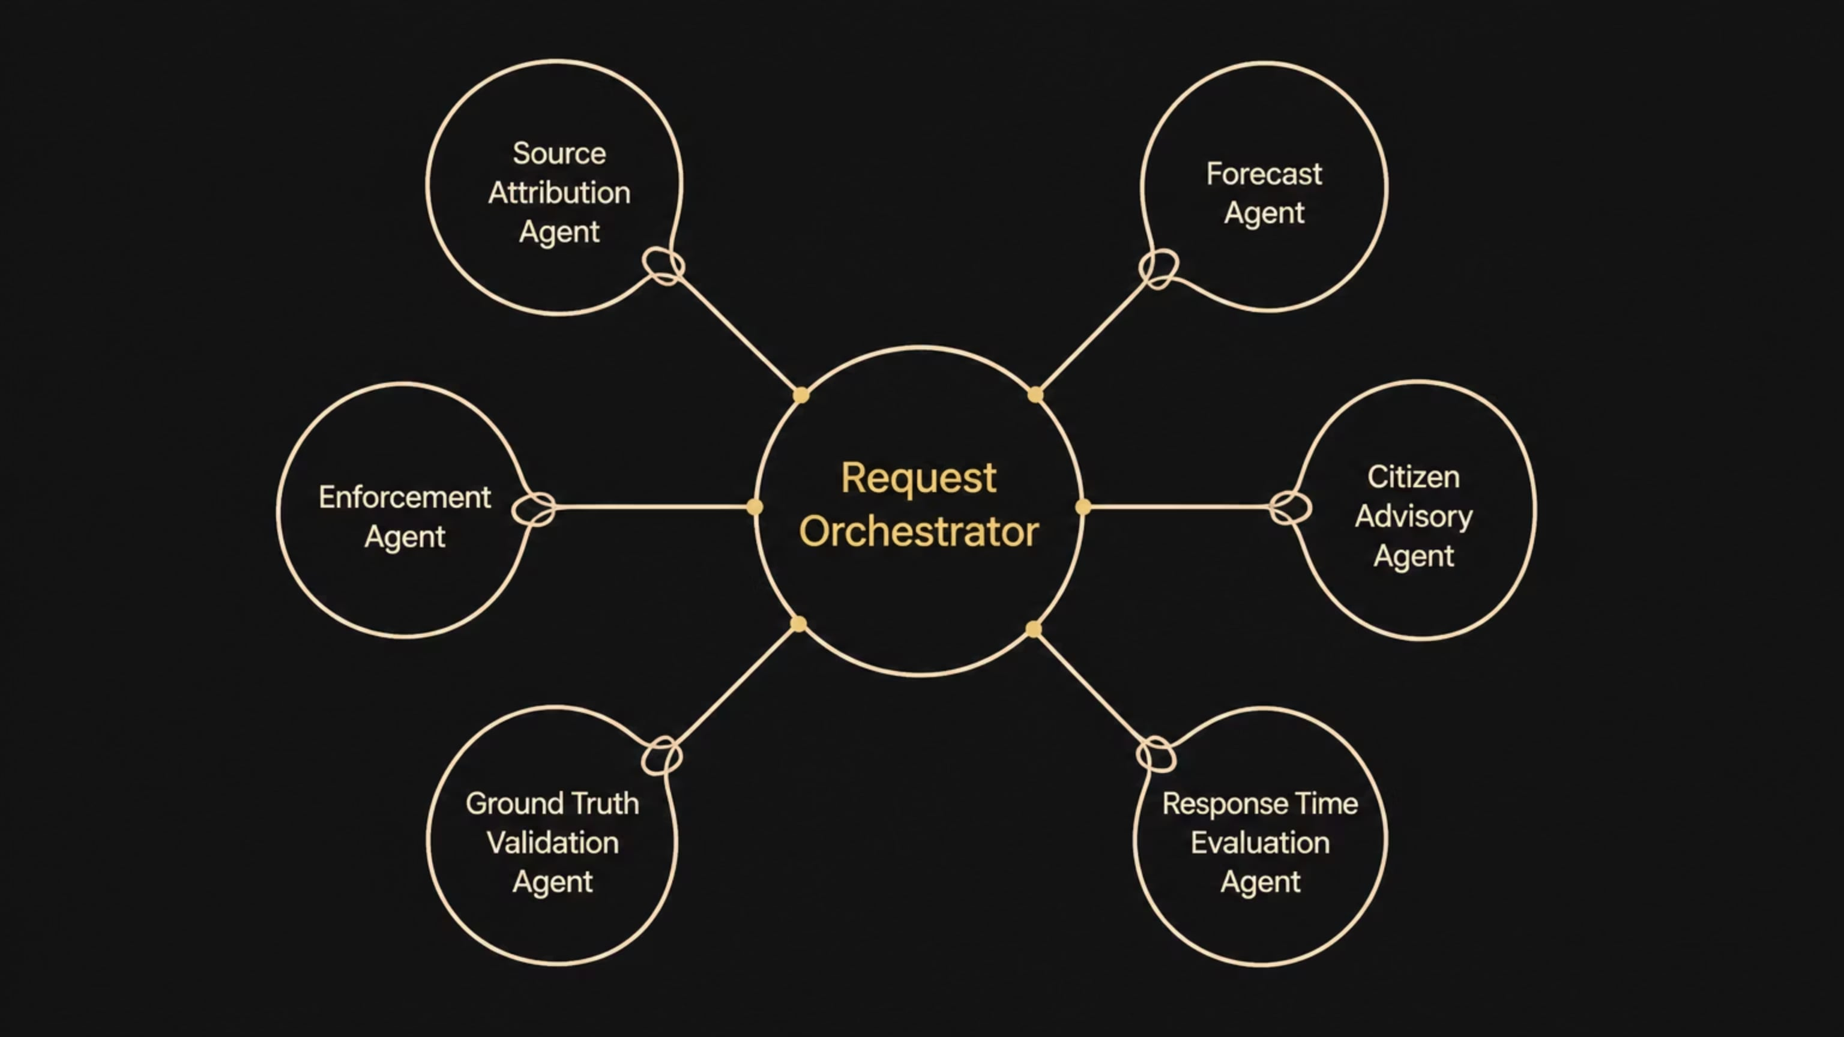
Multi-Agent Intelligence
Source Attribution Agent
Forecast Agent
Enforcement Agent
Citizen Advisory Agent
Ground Truth Validation Agent
Response Time Evaluation Agent

Slide 6
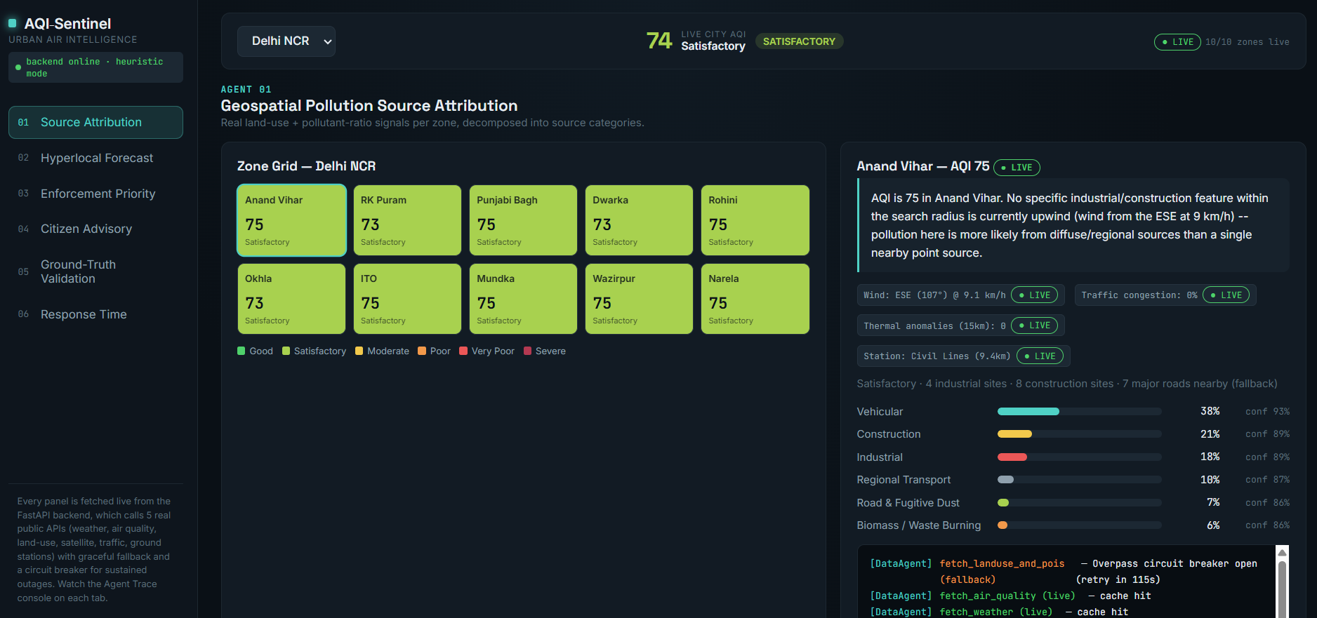
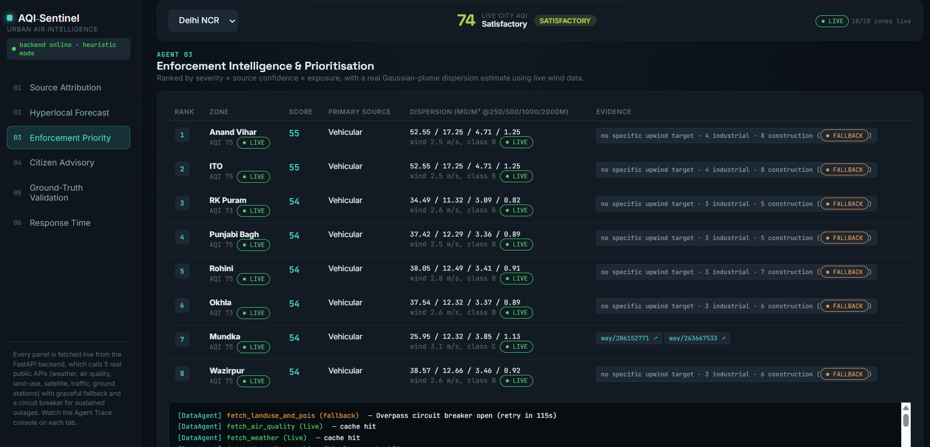
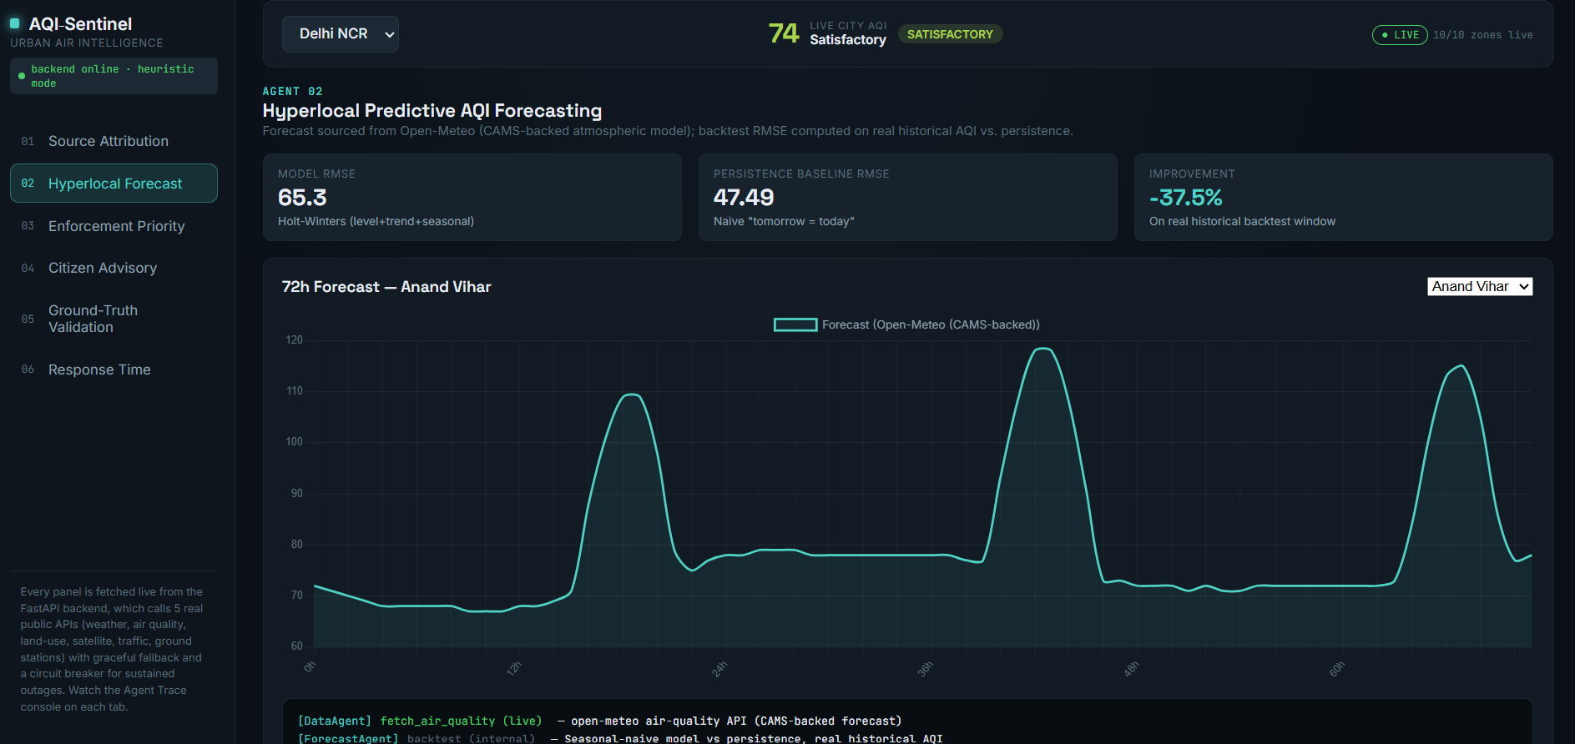
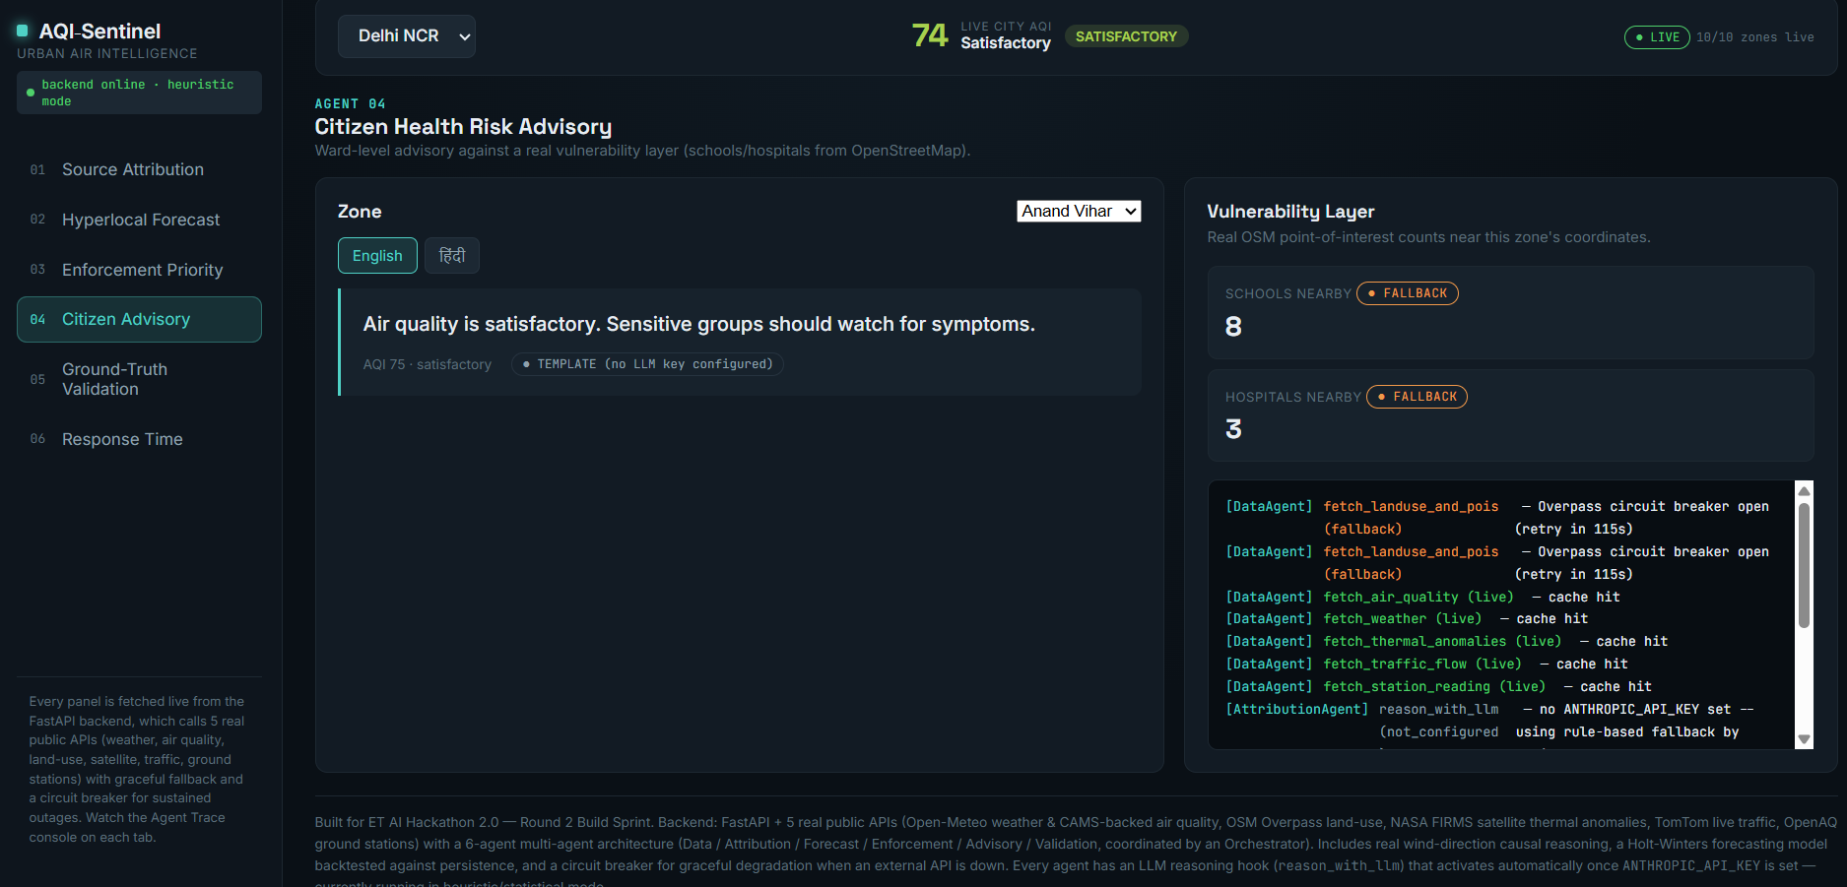
Live Platform Demo
Dashboard Overview
Source Attribution
Forecast Dashboard
Enforcement Dashboard
Citizen Advisory
"One Unified AI Platform for Municipal Decision-Making"

Slide 7
Technical Excellence
Highlight the engineering behind AQI-Sentinel.
Backend
AI
FastAPI
Python
REST APIs
Multi-Agent Architecture
Holt-Winters Forecasting
LLM Integration
Explainable AI
Data Sources
System Features
OpenAQ
Open-Meteo
NASA FIRMS
TomTom Traffic
OpenStreetMap
Concurrent Execution
Live APIs
Fallback Modes
Confidence Scoring
Evidence Tracing

Slide 8
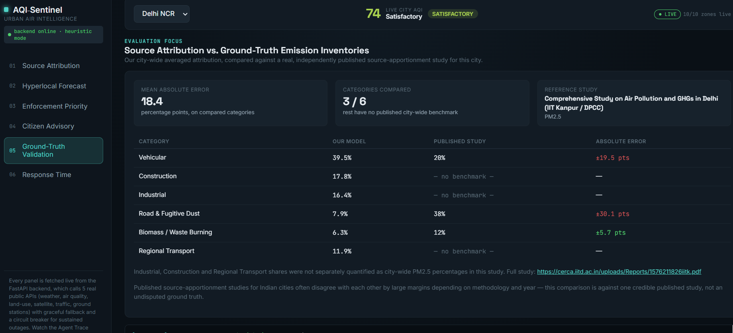
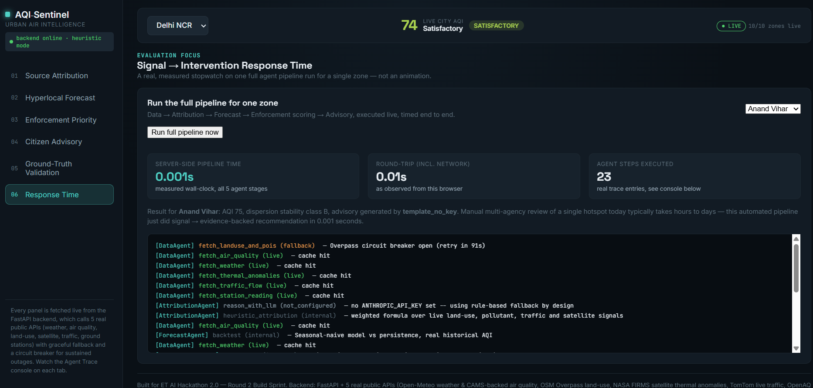
Validation & Results
Ground Truth Validation
Forecast Accuracy
Transparent Evaluation
Measured Response Time
Confidence Scores
"Designed with measurable performance rather than black-box predictions."

Slide 9

Real-World Impact
Environmental
Reduced emissions
Better interventions
Public Health
Hyperlocal advisories
Lower exposure
Governance
Faster inspections
Data-driven enforcement
Scalability
Deployable across Indian cities
Easily extensible
"From reactive monitoring to proactive intervention."

Slide 10
Beyond Monitoring. Towards Smarter Cities.
Future Roadmap
01
02
03
IoT Sensor Expansion
Drone-Based Monitoring
Digital Twin Integration
04
05
Reinforcement Learning for Policy Optimization
Smart City Command Center Integration
AQI-Sentinel transforms fragmented environmental signals into explainable, evidence-backed intelligence, enabling cities to predict, prioritise, and prevent urban air pollution.
Thank You

