Slide 1
K.R.S Project
Made by:
Aashman Sarkar Aritro Dutta Agnidhra Das

Slide 2
Project Topic/Problem Statement: The goal of this project is to develop a robotic arm that can be used to move objects in the comfort of your bed. For disabled people who are only able to use one of their arms.
Solution: A robotic arm has to be build so that it be used to move objects in the comfort of your bed. The arm should be able to reach a variety of objects, including drinks, food, remote controls, and other personal belongings. It should also be able to move objects quickly and accurately, without posing a safety hazard to the user. The arm will be controlled by robotic glove. The glove will allow the user to control each part of the robotic arm with the use of only one arm.

Slide 3
Overview
This is a six-axis Robot controlled by Hand gestures using a Robotic Glove. And by mimicking natural human gestures such as a pinch, or a wrist rotation to the left, You’ll be able to open/close or rotate the robotic arm left and right respectively. In effect, manually controlling a Robotic Arm.

Slide 4
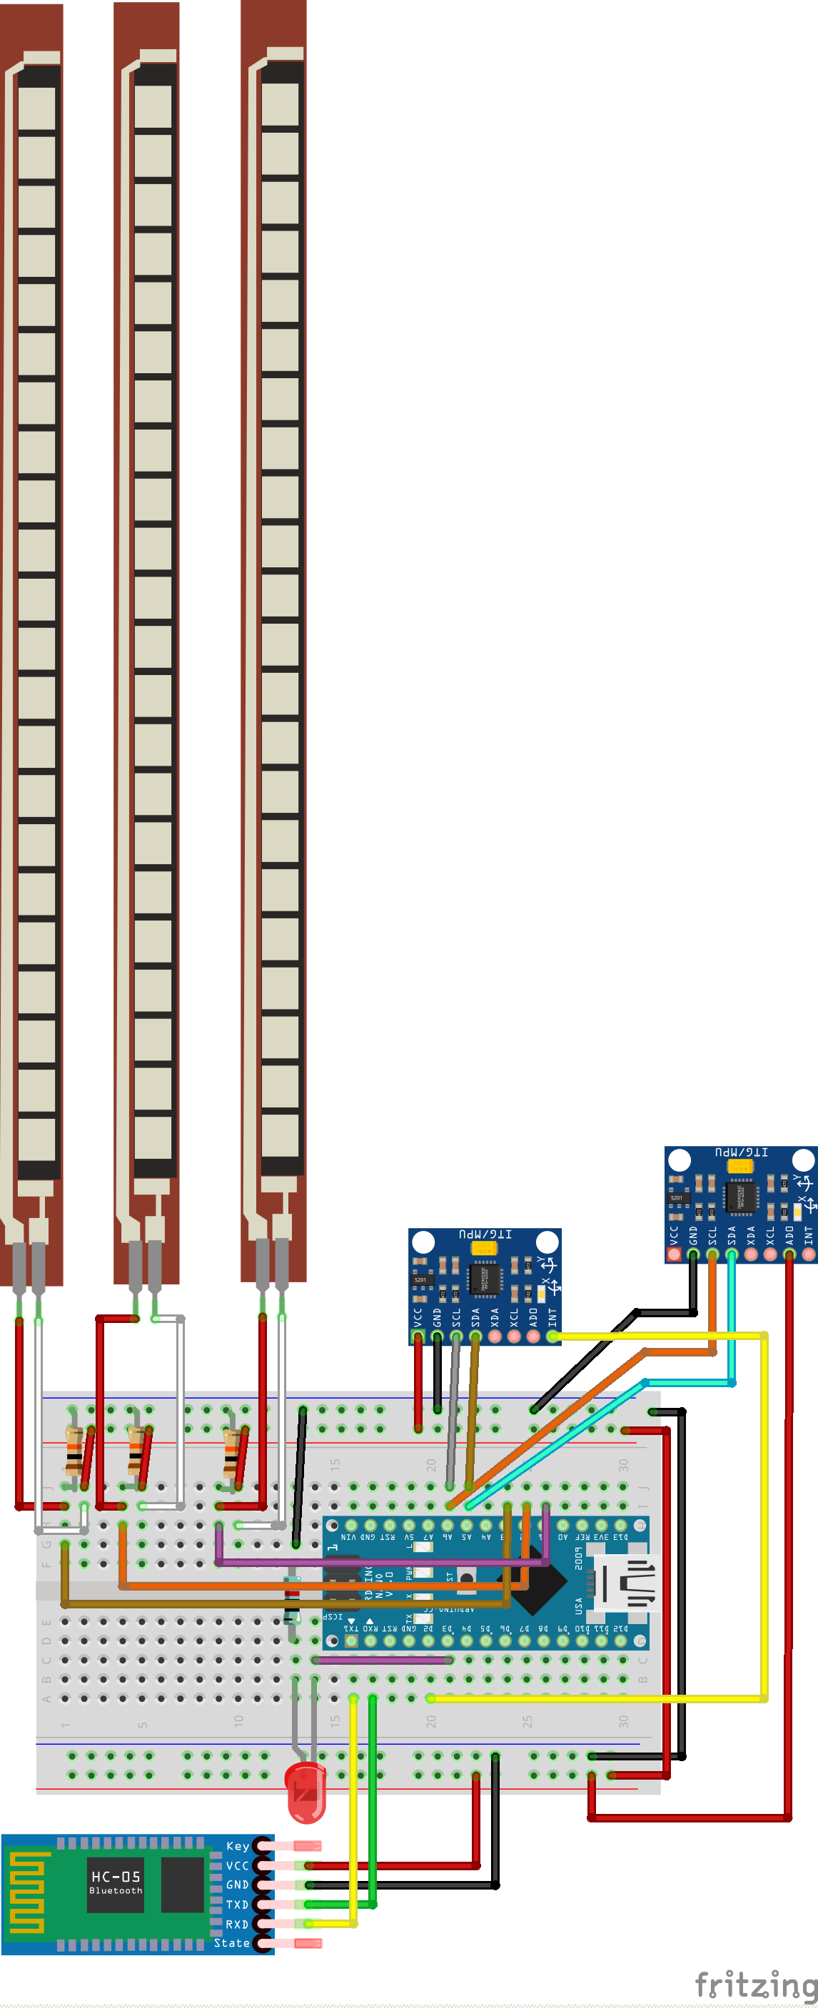
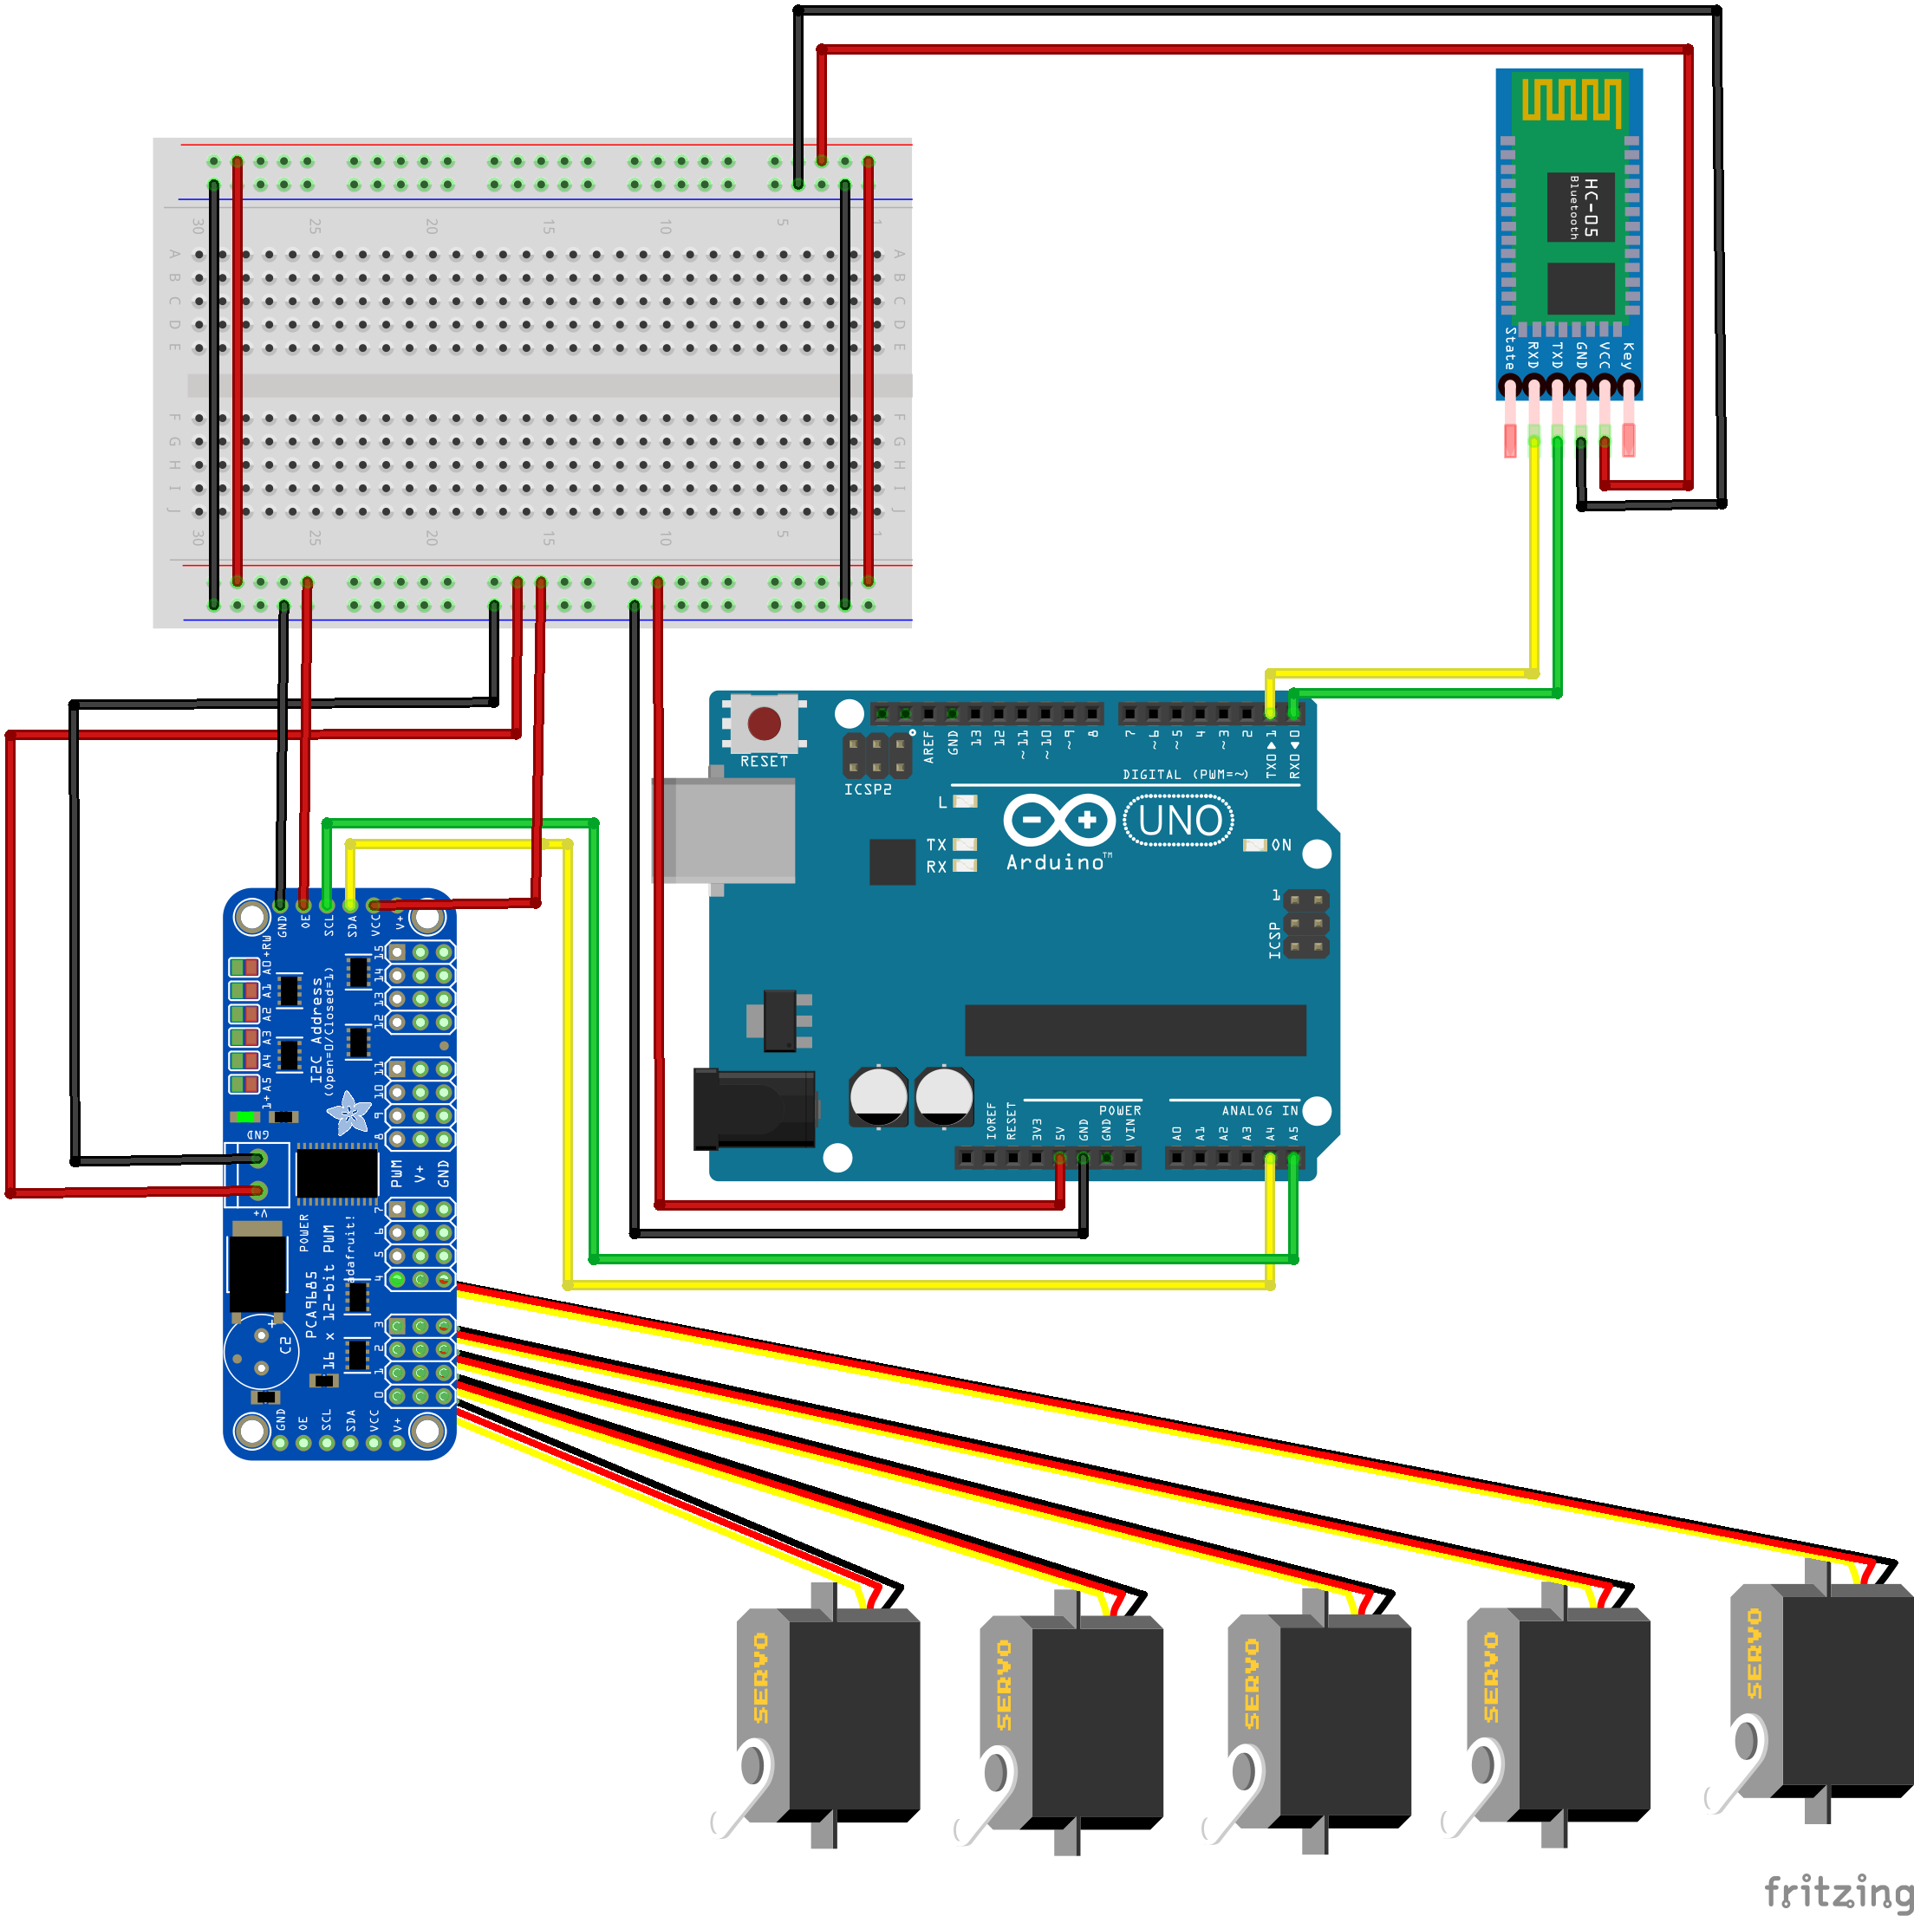
Schematic Diagram
Robotic arm
Robotic glove

Slide 5
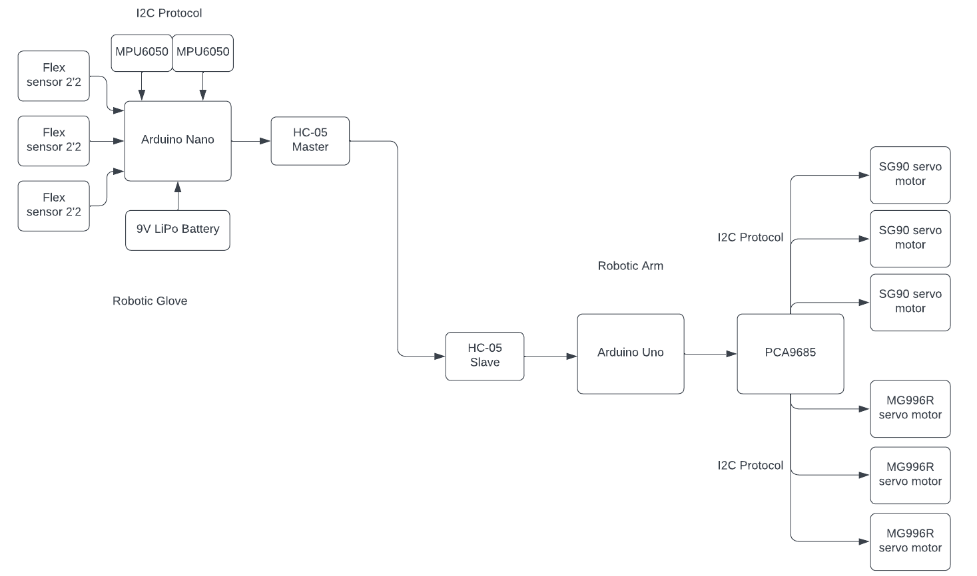
Block Diagram

Slide 6
Functioning
This robotic arm is operates via a robotic glove.
We use use two HC-05 Bluetooth modules to communicate between the glove and the arm.
The glove is equipped with Flex sensors and MPU 6050 accelerometers.
It works on basis that when output from the sensors reaches past a certain threshold condition it send a signal according to the condition which then controls the corresponding servo motor hooked up to the sever driver PCA9685.
The flex sensor is a resistor which changes resistance based on the direction it being bent.
We use the accelerometer to find the coordinates of the displacement of the glove from the position of initialization.
When a condition is met the master Bluetooth module of the glove send a signal like “T” to the slave in the arm which will control the motor with condition to rotate if the signal is “T’.

Slide 7
Applications
The robotic arm has a wide range of applications in various fields, including:
1. Rehabilitation and Assistive Technology:
Assisting individuals with limited mobility or paralysis in performing daily tasks such as eating, dressing, and grooming.
Enabling people with disabilities to interact with their environment more independently.
2. Industrial Automation and Manufacturing:
Performing repetitive tasks in hazardous or high-precision environments.
Assembling components in complex manufacturing processes.
Handling delicate or fragile objects without damaging them.
3. Education and Research:
Teaching STEM concepts to students in a hands-on and engaging manner.
Conducting research in robotics, human-computer interaction, and artificial intelligence.
4. Healthcare and Medical Assistance:
Assisting surgeons in minimally invasive procedures.
Performing delicate surgeries that require high precision and dexterity.
5. Household Applications and Robotics:
Automating household chores such as cleaning, cooking, and organizing.
Providing companionship and assistance to elderly or disabled individuals.
Enhancing entertainment and gaming experiences with interactive robots.

Slide 8
Thank You

