Slide 1
Binary Classification
Alan Ritter
(many slides from Greg Durrett and Vivek Srikumar)

Slide 2
Administrivia
Readings on course website
Homework 1 is due August 30.

Slide 3
This Lecture
Linear classification fundamentals
Naive Bayes, maximum likelihood in generative models
Three discriminative models: logistic regression, perceptron, SVM
Different motivations but very similar update rules / inference!

Slide 4
Classification

Slide 5

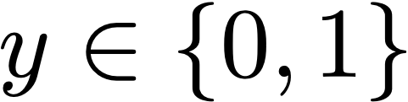
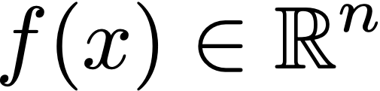
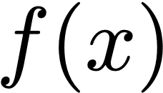
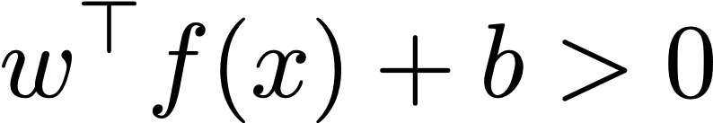
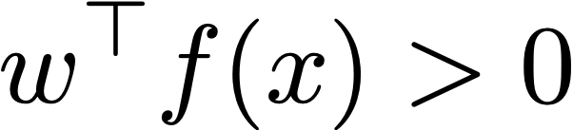
Classification
Datapoint with label
Embed datapoint in a feature space
but in this lecture and are interchangeable
+
+
+
+
+
+
+
Linear decision rule:
+
-
-
-
Can delete bias if we augment feature space:
-
-
-
-
-
-
= [0.5, 1.6, 0.3]
[0.5, 1.6, 0.3, 1]

Slide 6
Linear functions are powerful!
x²
+
+
+
+
+
+
-
-
+
+
+
+
-
-
-
-
+
+
+
+
-
-
x
x

Slide 7
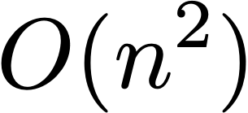
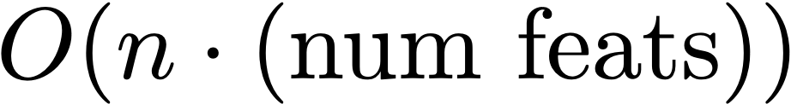
Linear functions are powerful!
x2
x1x2
+
+
-
-
???
+
+
-
+
+
+
+
+
-
-
-
+
+
+
+
+
-
-
+
+
+
+
+
-
+
+
+
+
+
-
-
x1
x1
-
-
-
-
-
-
+
+
-
-
-
-
-
-
-
+
+
-
-
-
-
-
-
-
+
+
-
-
-
-
+
+
-
f(x) = [x1, x2]
f(x) = [x1, x2, x1², x2², x1x2]
“Kernel trick” does this for “free,” but is too expensive to use in NLP applications, training is instead of

Slide 8
Classification: Sentiment Analysis
this movie was great! would watch again
Positive
that film was awful, I’ll never watch again
Negative
Surface cues can basically tell you what’s going on here: presence or absence of certain words (great, awful)
Steps to classification:
Turn examples like this into feature vectors
Pick a model / learning algorithm
Train weights on data to get our classifier

Slide 9
Feature Representation
this movie was great! would watch again
Positive
Convert this example to a vector using bag-of-words features
[contains the] [contains a] [contains was] [contains movie] [contains film]
…
position 0
position 1
position 2
position 3
position 4
f(x) = [
0
0
1
1
0
…
Very large vector space (size of vocabulary), sparse features
Requires indexing the features (mapping them to axes)
More sophisticated feature mappings possible (tf-idf), as well as lots of other features: character n-grams, parts of speech, lemmas, …
Notes:
Boolean functions…

Slide 10
Naive Bayes

Slide 11
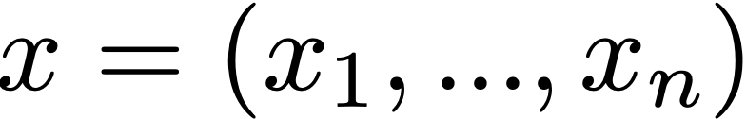
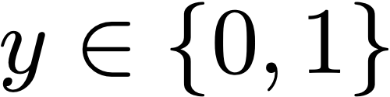
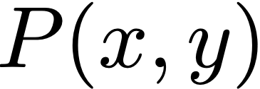
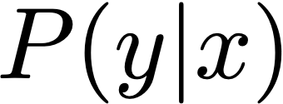
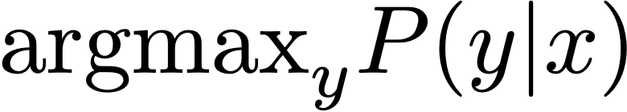
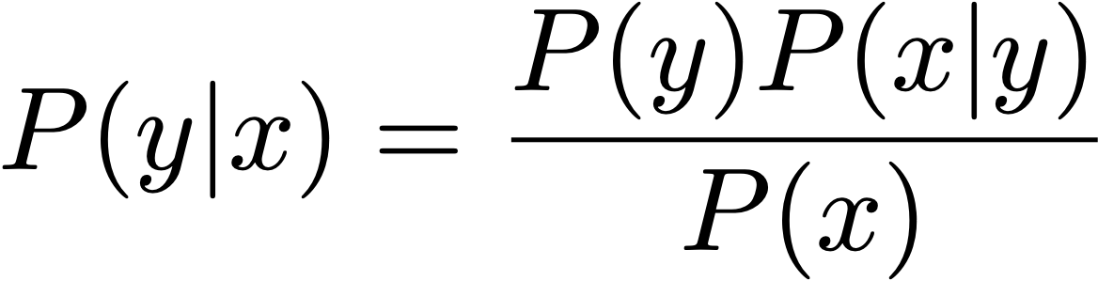

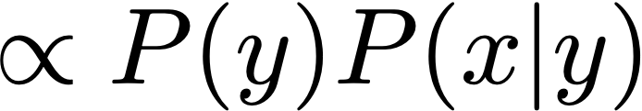

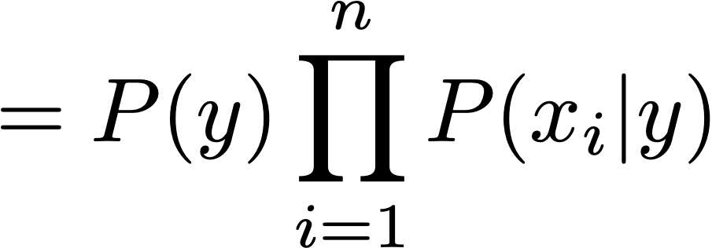
Naive Bayes
Data point , label
Formulate a probabilistic model that places a distribution
Compute , predict to classify
Bayes’ Rule
constant: irrelevant for finding the max
“Naive” assumption:
n
linear model!
Notes:
\textrm{argmax}_y P(y|x) = \textrm{argmax}_y \log P(y|x) = \textrm{argmax}_y \left[\log P(y) + \sum_{i=1}^n \log P(x_i|y)\right]

Slide 12


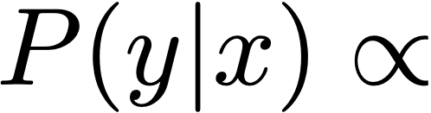
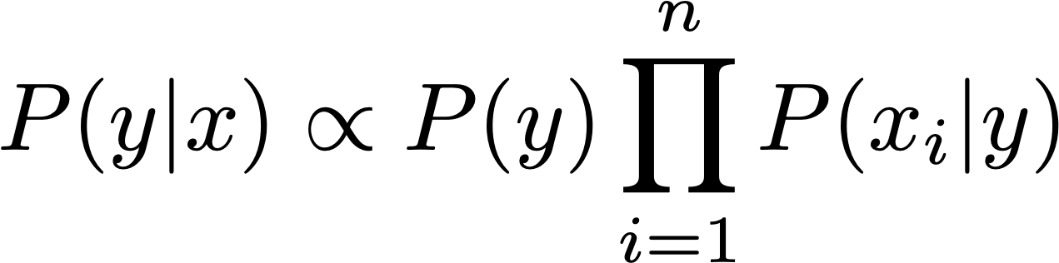
Naive Bayes Example
it was great
Notes:
TODO: WORK OUT EXAMPLE WITH NUMBERS

Slide 13
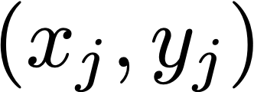
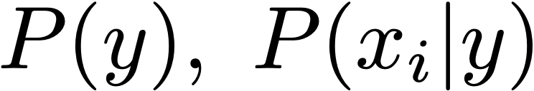
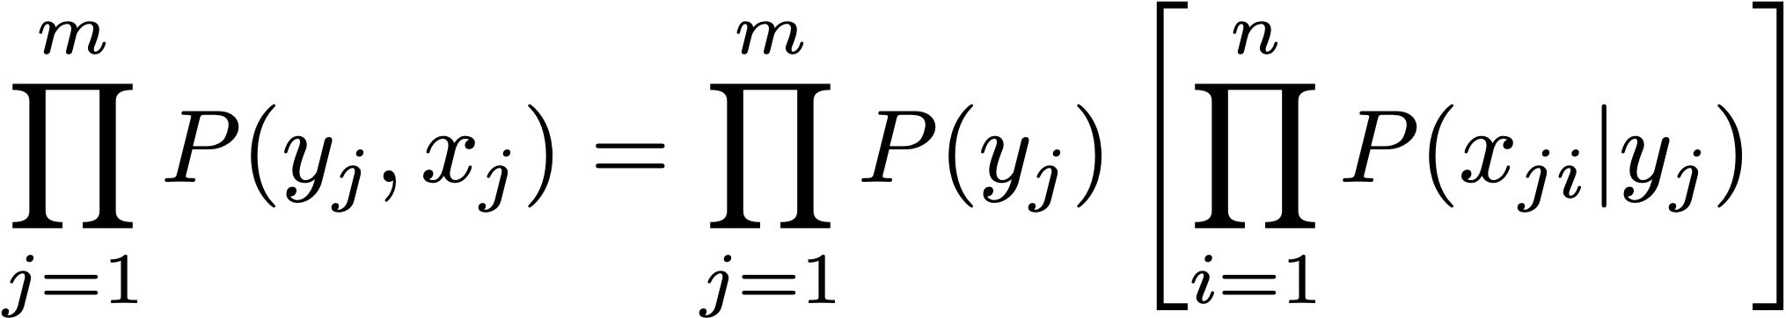
Maximum Likelihood Estimation
Data points provided (j indexes over examples)
Find values of that maximize data likelihood (generative):
data points (j)
features (i)
ith feature of jth example
Notes:
%\sum_{j=1}^m \log P(y_j, x_j) = \sum_{j=1}^m \left[ \log P(y_j) + \sum_{i=1}^n \log P(x_{ji}|y_j) \right]

Slide 14
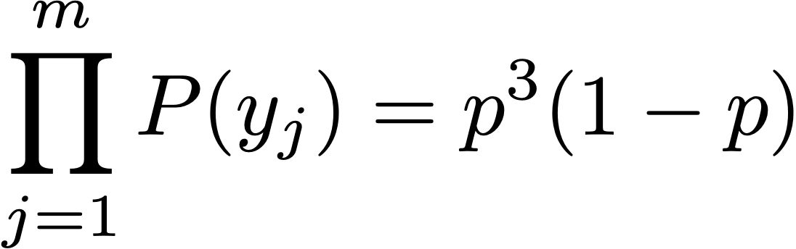
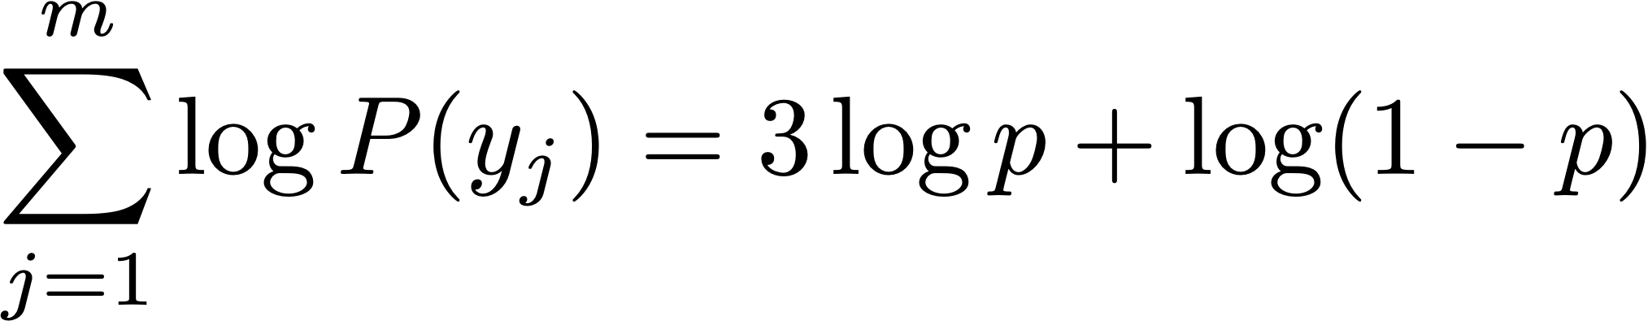
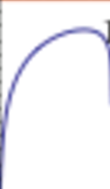
Maximum Likelihood Estimation
Imagine a coin flip which is heads with probability p
Observe (H, H, H, T) and maximize likelihood:
Easier: maximize log likelihood
log likelihood
P(H) = 0.75
p
0
1
Maximum likelihood parameters for binomial/multinomial = read counts off of the data + normalize
Notes:
\prod_{j=1}^m P(y_j) = p^3 (1-p)

Slide 15
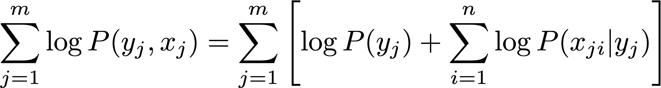
Maximum Likelihood Estimation
Data points provided (j indexes over examples)
Find values of that maximize data likelihood (generative):
data points (j)
features (i)
ith feature of jth example
Equivalent to maximizing logarithm of data likelihood:
Notes:
%\sum_{j=1}^m \log P(y_j, x_j) = \sum_{j=1}^m \left[ \log P(y_j) + \sum_{i=1}^n \log P(x_{ji}|y_j) \right]

Slide 16
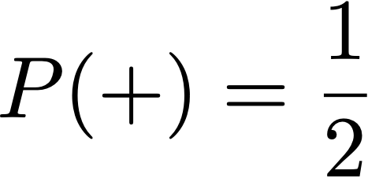
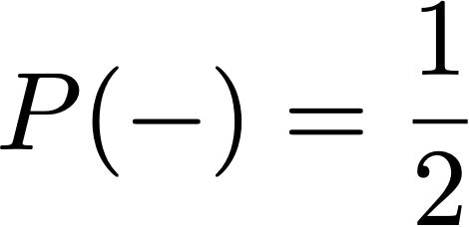
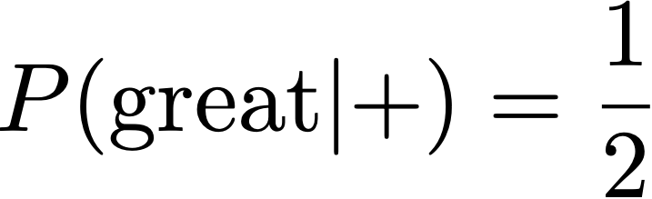
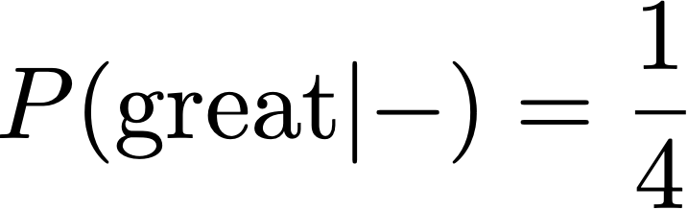

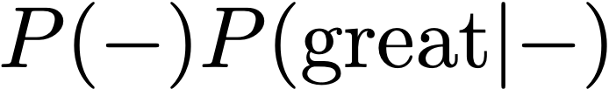
Maximum Likelihood for Naive Bayes
this movie was great! would watch again
+
I liked it well enough for an action flick
+
I expected a great film and left happy
+
brilliant directing and stunning visuals
+
that film was awful, I’ll never watch again
—
I didn’t really like that movie
—
dry and a bit distasteful, it misses the mark
—
great potential but ended up being a flop
—
1/4
2/3
it was great
=
=
1/8
1/3
Notes:
%P(-) = \frac{1}{2}
%P(\textrm{great}|+) = \frac{1}{2}
%P(\textrm{great}|-) = \frac{1}{4}
%P(y|x) \propto \left[\frac{1}{2} \cdot \frac{1}{2}, \frac{1}{2} \cdot \frac{1}{4}\right]
%P(y|x) \propto
%P(-) P(\textrm{great}|-)

Slide 17
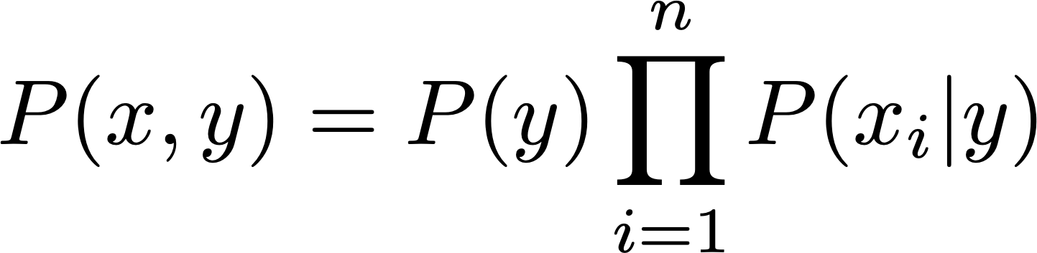
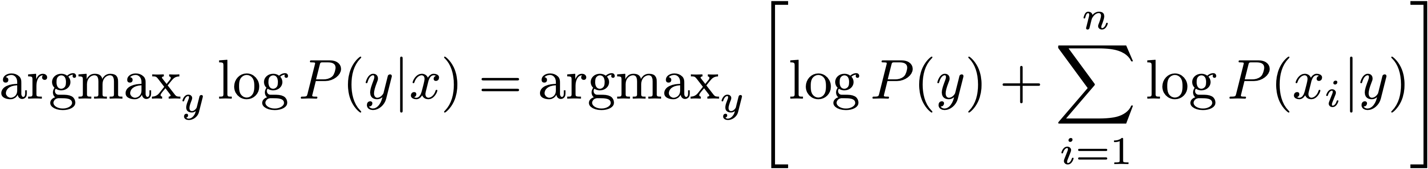
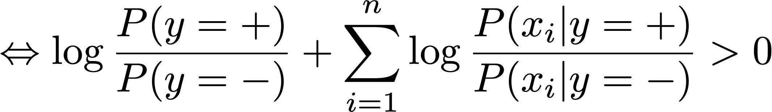
Naive Bayes: Summary
Model
n
Inference
Alternatively:
Learning: maximize by reading counts off the data
Notes:
%\log P(y=+|x) - \log P(y=-|x) > 0
\Leftrightarrow \log \frac{P(y=+|x)}{P(y=-|x)} + \sum_{i=1}^n \log \frac{P(x_i|y=+)}{P(x_i|y=-)} >0

Slide 18
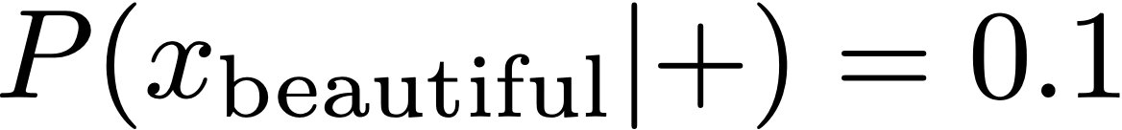
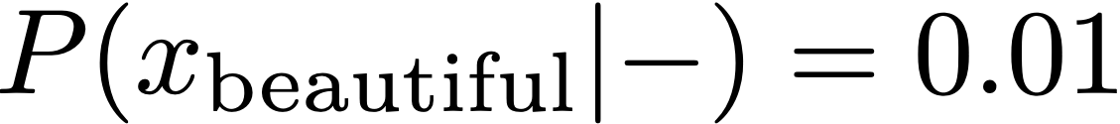
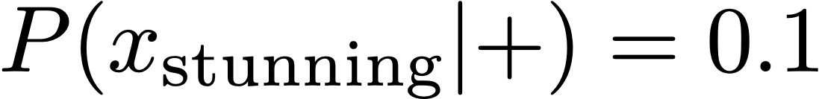
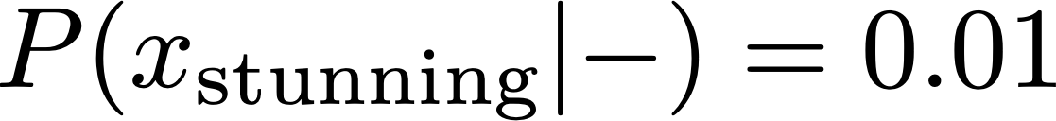
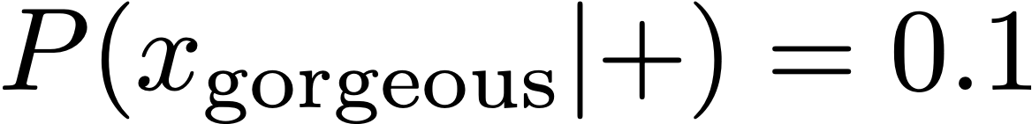
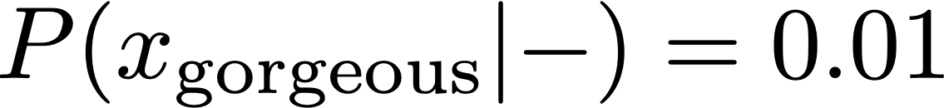
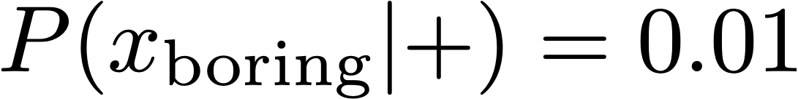
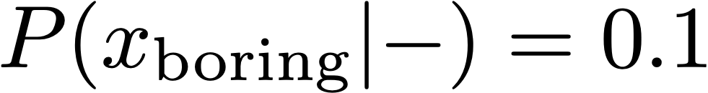
Problems with Naive Bayes
—
the film was beautiful, stunning cinematography and gorgeous sets, but boring
Correlated features compound: beautiful and gorgeous are not independent!
Naive Bayes is naive, but another problem is that it’s generative: spends capacity modeling P(x,y), when what we care about is P(y|x)
Discriminative models model P(y|x) directly (SVMs, most neural networks, …)
Notes:
P(x_\textrm{boring} | +) = 0.01

Slide 19
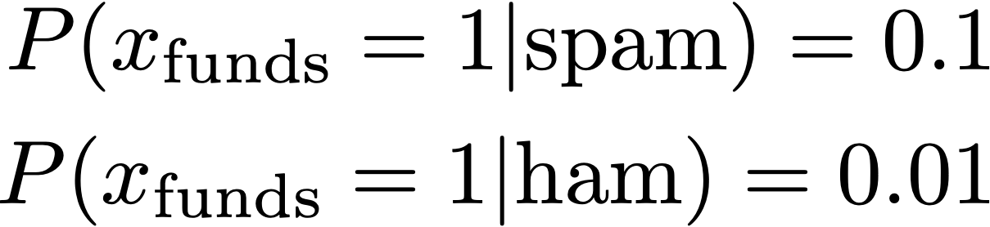
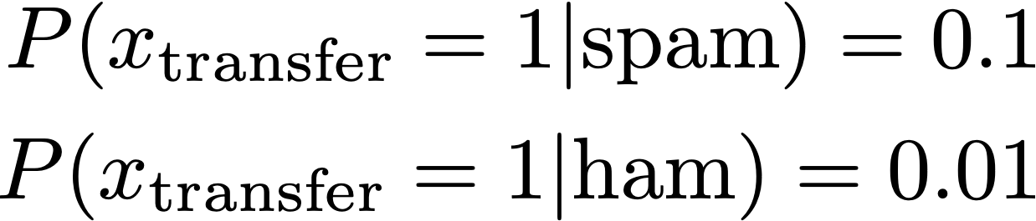
Problems with Naive Bayes
Features are correlated
Hi, in order to close on the house we need you to transfer the requested funds to the escrow account.
Ham
Spam
???
This one sentence will make the probability of spam very high!
Ham
Bad independence assumption in NB: these words are not independent!
Solution: better model, algorithms that explicitly minimize loss rather than maximizing data likelihood
Notes:
%P(x_\textrm{funds} = 0|\textrm{spam}) = 0.01
%P(x_\textrm{funds} = 1|\textrm{spam}) = 0.99

Slide 20
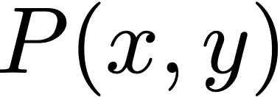
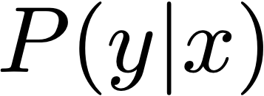
Generative vs. Discriminative Models
Generative models:
Bayes nets / graphical models
Some of the model capacity goes to explaining the distribution of x; prediction uses Bayes rule post-hoc
Can sample new instances (x, y)
Discriminative models:
SVMs, logistic regression, CRFs, most neural networks
Model is trained to be good at prediction, but doesn’t model x
We’ll come back to this distinction throughout this class
Break!
Notes:
%P(x_\textrm{funds} = 0|\textrm{spam}) = 0.01
%P(x_\textrm{funds} = 1|\textrm{spam}) = 0.99

Slide 21
Generative vs. Discriminative Models
Generative models:
Bayes nets / graphical models / Naive Bayes
Some of the model capacity goes to explaining the distribution of x; prediction uses Bayes rule post-hoc
Discriminative models:
SVMs, logistic regression, CRFs, most neural networks
Model is trained to be good at prediction, but doesn’t model x
Up next: discriminative classifiers
We’ll come back to this distinction throughout this class
Break!
Notes:
%P(x_\textrm{funds} = 0|\textrm{spam}) = 0.01
%P(x_\textrm{funds} = 1|\textrm{spam}) = 0.99

Slide 22
Homework 1 Demo (Numpy)

Slide 23
Logistic Regression

Slide 24
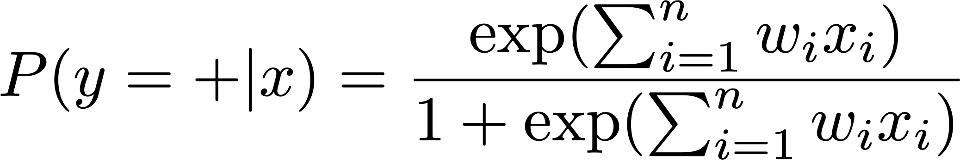
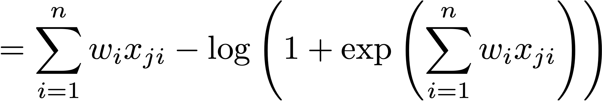
Logistic Regression
To learn weights: maximize discriminative log likelihood of data P(y|x)
sum over features
Notes:
%P(y=+|x) = \textrm{logistic}(w^\top x)
%P(y=+|x) = \frac{\exp(\sum_{i=1}^n w_i x_i)}{1+\exp(\sum_{i=1}^n w_i x_i)}
%\mathcal{L}(x_j,y_j=+) = \log P(y_j=+|x_j)
= \sum_{i=1}^n w_i x_{ji} - \log\left(1+ \exp \left(\sum_{i=1}^n w_i x_{ji}\right)\right)

Slide 25
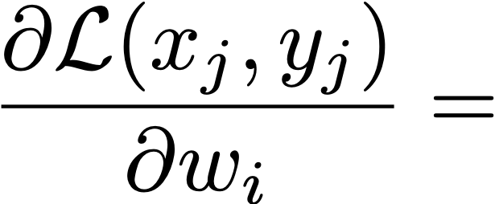
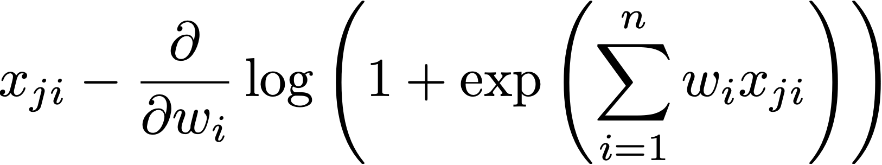
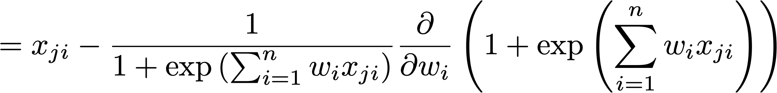
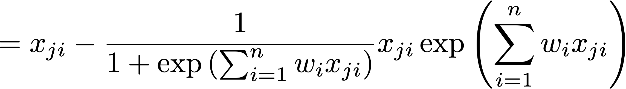


Logistic Regression
deriv
of log
deriv
of exp
Notes:
\mathcal{L}(x_j,y_j=+) = \log P(y_j=+|x_j) = \sum_{i=1}^n w_i x_{ji} - \log\left(1 + \exp \left(\sum_{i=1}^n w_i x_{ji}\right) \right)
%\frac{\partial \mathcal{L}(x_j,y_j)}{\partial w_i} =
%x_{ji} - \frac{\partial}{\partial w_i} \log\left(1+ \exp \left(\sum_{i=1}^n w_i x_{ji}\right)\right)
%= x_{ji} - \frac{1}{1+ \exp \left(\sum_{i=1}^n w_i x_{ji}\right)} \frac{\partial}{\partial w_i} \left(1 + \exp \left(\sum_{i=1}^n w_i x_{ji}\right) \right)
%= x_{ji} - \frac{1}{1+ \exp \left(\sum_{i=1}^n w_i x_{ji}\right)} x_{ji} \exp \left(\sum_{i=1}^n w_i x_{ji}\right)
%= x_{ji} - \frac{1}{1+ \exp \left(\sum_{i=1}^n w_i x_{ji}\right)} x_{ji} \exp \left(\sum_{i=1}^n w_i x_{ji}\right)
%= x_{ji} - x_{ji} \frac{\exp \left(\sum_{i=1}^n w_i x_{ji}\right)}{1+ \exp \left(\sum_{i=1}^n w_i x_{ji}\right)}
%=x_{ji} (1 - P(y_j=+|x_j))

Slide 26


Logistic Regression
Recall that yj = 1 for positive instances, yj = 0 for negative instances.
Gradient of wi on positive example
1
If P(+) is close to 1, make very little update
Otherwise make wi look more like xji, which will increase P(+)
Gradient of wi on negative example
If P(+) is close to 0, make very little update
Otherwise make wi look less like xji, which will decrease P(+)
Can combine these gradients as
Notes:
x_j (y_j - P(y_j = \textrm{spam} | x_j))

Slide 27

Regularization
Regularizing an objective can mean many things, including an L2-norm penalty to the weights:
Keeping weights small can prevent overfitting
For most of the NLP models we build, explicit regularization isn’t necessary
Early stopping
Large numbers of sparse features are hard to overfit in a really bad way
For neural networks: dropout and gradient clipping

Slide 28
Regularization
Can end up making extreme updates to fit the training data
wfunds = +1000
wtransfer = -900
wsend = +742
wthe = +203
All examples have P(correct) > 0.999, but classifier does crazy things on new examples

Slide 29


Regularization
Can end up making extreme updates to fit the training data
Rather than optimizing likelihood alone, impose a penalty on the norm of the weight vector (can also view as a Gaussian prior)
w2
Maximize
w1

Slide 30

Logistic Regression: Summary
Model
Inference
fundamentally same as Naive Bayes
Learning: gradient ascent on the (regularized) discriminative log-likelihood

Slide 31
Perceptron/SVM

Slide 32
Perceptron
Invented in 1958
By Frank Rosenblatt
At the Cornell Aeronautical Laboratory
Implemented in custom-built hardware
Connected to a camera with 20×20 cadmium sulfide photocells to make a 400-pixel image.
Weights were encoded in potentiometers, and weight updates during learning were performed by electric motors.
Source: Wikipedia

Slide 33




Perceptron
Simple error-driven learning approach similar to logistic regression
Decision rule:
Logistic Regression
If incorrect: if positive,
if negative,
Guaranteed to eventually separate the data if the data are separable

Slide 34
Support Vector Machines
Many separating hyperplanes — is there a best one?
+
+
+
+
+
+
+
+
-
-
-
-
-
-
-
-
-

Slide 35
Support Vector Machines
Many separating hyperplanes — is there a best one?
+
+
+
+
+
+
+
+
-
-
margin
-
-
-
-
-
-
-

Slide 36



Support Vector Machines
Constraint formulation: find w via following quadratic program:
Minimize
minimizing norm with fixed margin <=> maximizing margin
s.t.
As a single constraint:
Generally no solution (data is generally non-separable) — need slack!
Notes:
%\forall j\ \ &w^\top x_j > 1 \textrm{ if } y_j = 1\\
%&w^\top x_j < -1 \textrm{ if } y_j = 0
%\forall j \ \ y_j (w^\top x_j) + (1 - y_j) (-w^\top x_j) \geq 1
%\forall j\ \ (2 y_j - 1) (w^\top x_j) \geq 1

Slide 37





N-Slack SVMs
Minimize
s.t.
The are a “fudge factor” to make all constraints satisfied
Take the gradient of the objective:
Looks like the perceptron! But updates more frequently
Notes:
%\lambda \Vert w \Vert_2^2 + \sum_{j=1}^m \xi_j
%\forall j\ \ (2 y_j - 1) (w^\top x_j) \geq 1 - \xi_j

Slide 38




Gradients on Positive Examples
Logistic regression
Hinge (SVM)
Perceptron
Loss
SVM (ignoring regularizer)
0-1
Logistic
Perceptron
*gradients are for maximizing things, which is why they are flipped
Notes:
%x(1 - P(y=1|x)) = x(1 - \textrm{logistic}(w^\top x))
%x \textrm{ if } w^\top x < 0,\ \textrm{else } 0
x \textrm{ if } w^\top x < 1 (\xi > 0),\ \textrm{else } 0

Slide 39




Comparing Gradient Updates (Reference)
Logistic regression (unregularized)
y = 1 for pos,
0 for neg
=
Perceptron
if classified incorrectly
0 else
SVM
if not classified correctly with margin of 1
0 else
Notes:
%\lambda \Vert w \Vert_2^2 + \sum_{j=1}^m \xi_j
%\forall j\ \ (2 y_j - 1) (w^\top x_j) \geq 1 - \xi_j

Slide 40
Loss Functions
Hinge (SVM)
Loss
0-1 (ideal)
Logistic
Perceptron

Slide 41
Optimization — next time…
Range of techniques from simple gradient descent (works pretty well) to more complex methods (can work better)
Most methods boil down to: take a gradient and a step size, apply the gradient update times step size, incorporate estimated curvature information to make the update more effective

Slide 42
Optimization — next time…
Stochastic gradient descent
Newton’s method, Quasi-Newton methods (LBFGS)
Adagrad, Adadelta, etc.

Slide 43
Adagrad
Haven’t talked about optimization at all
Stochastic gradient descent
Newton’s method, Quasi-Newton methods (LBFGS)
Adagrad, Adadelta, etc.

Slide 44
Sentiment Analysis
this movie was great! would watch again
+
the movie was gross and overwrought, but I liked it
+
this movie was not really very enjoyable
—
Bag-of-words doesn’t seem sufficient (discourse structure, negation)
There are some ways around this: extract bigram feature for “not X” for all X following the not
Bo Pang, Lillian Lee, Shivakumar Vaithyanathan (2002)

Slide 45

Sentiment Analysis
Simple feature sets can do pretty well!
Bo Pang, Lillian Lee, Shivakumar Vaithyanathan (2002)

Slide 46

Sentiment Analysis
Naive Bayes is doing well!
Ng and Jordan (2002) — NB can be better for small data
Before neural nets had taken off — results weren’t that great
Kim (2014) CNNs
81.5 89.5
Wang and Manning (2012)

Slide 47




Recap
Logistic regression:
Decision rule:
Gradient (unregularized):
SVM:
Decision rule:
(Sub)gradient (unregularized): 0 if correct with margin of 1, else
Notes:
P(y=1|x) = \frac{\exp \left(\sum_{i=1}^n w_i x_i\right)}{\left(1+ \exp \left(\sum_{i=1}^n w_i x_i\right)\right)}
P(y=1|x) \geq 0.5 \Leftrightarrow w^\top x \geq 0.5

Slide 48
Recap
Logistic regression, SVM, and perceptron are closely related
SVM and perceptron inference require taking maxes, logistic regression has a similar update but is “softer” due to its probabilistic nature
All gradient updates: “make it look more like the right thing and less like the wrong thing”

