Slide 1
Junction Trees
And Belief Propagation

Slide 2
Junction Trees: Motivation
What if we want to compute all marginals, not just one?
Doing variable elimination for each one
in turn is inefficient
Solution: Junction trees
(a.k.a. join trees, clique trees)

Slide 3
Junction Trees: Basic Idea
In HMMs, we efficiently computed all marginals using dynamic programming
An HMM is a linear chain, but the same method applies if the graph is a tree
If the graph is not a tree, reduce it to one by clustering variables

Slide 4
The Junction Tree Algorithm
Moralize graph (if Bayes net)
Remove arrows (if Bayes net)
Triangulate graph
Build clique graph
Build junction tree
Choose root
Populate cliques
Do belief propagation

Slide 5
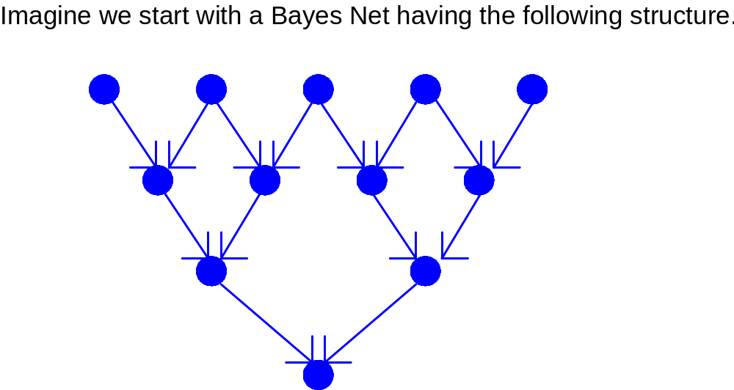
Example

Slide 6
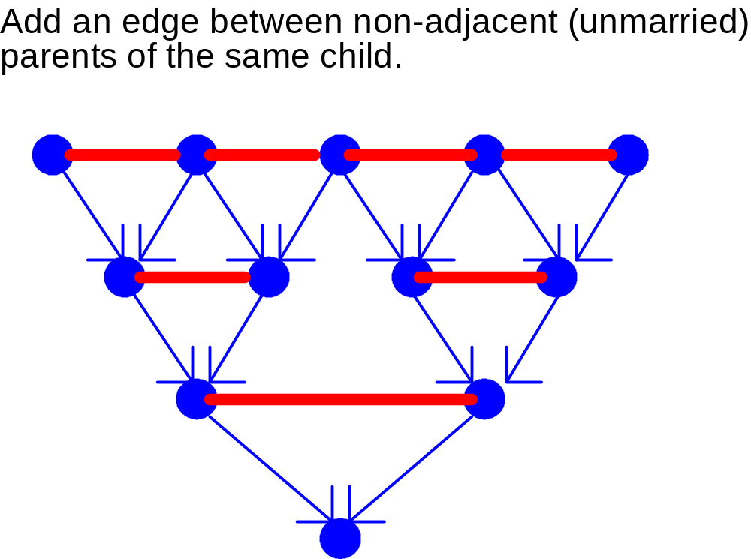
Step 1: Moralize the Graph

Slide 7
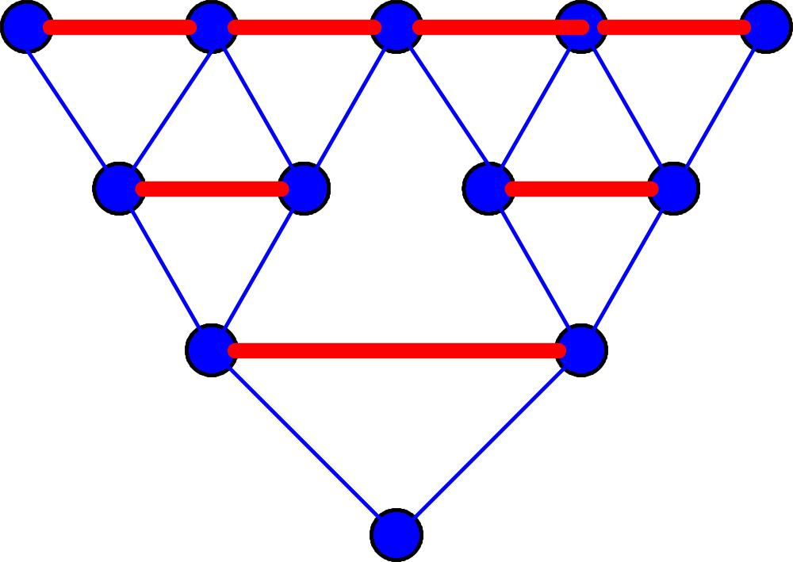
Step 2: Remove Arrows

Slide 8
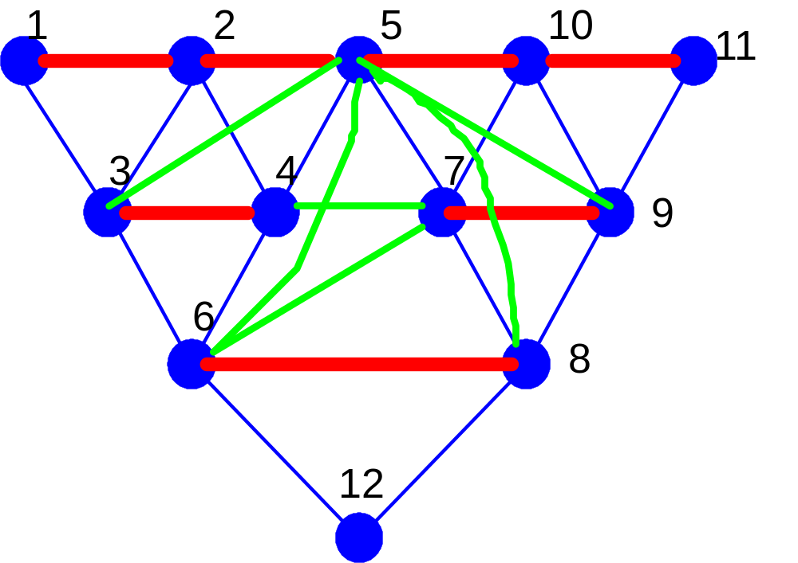
Step 3: Triangulate the Graph

Slide 9
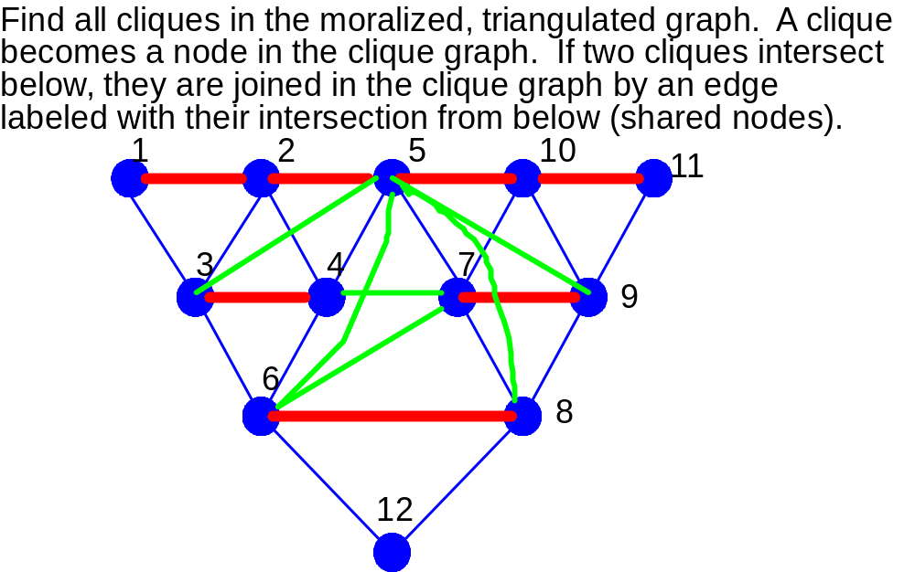
Step 4: Build Clique Graph

Slide 10
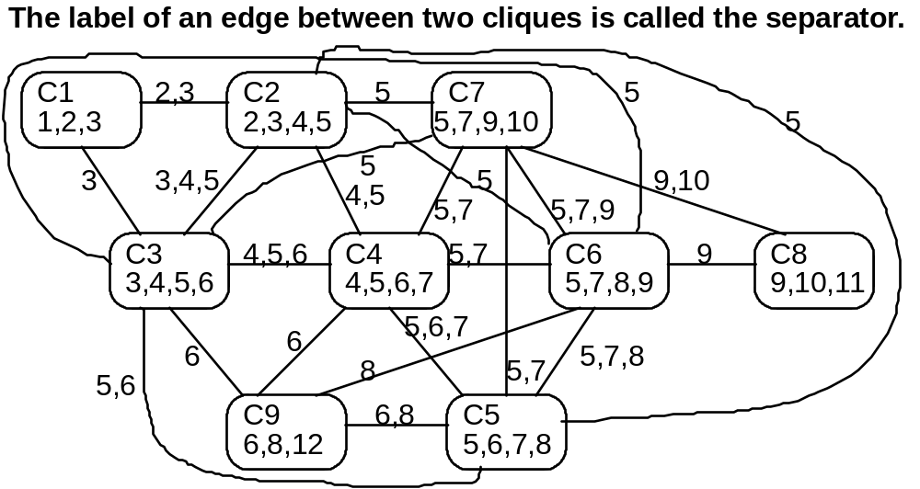
The Clique Graph

Slide 11
Junction Trees
A junction tree is a subgraph of the clique graph that:
1. Is a tree
2. Contains all the nodes of the clique graph
3. Satisfies the running intersection property.
Running intersection property:
For each pair U, V of cliques with intersection S, all cliques on the path between U and V contain S.

Slide 12
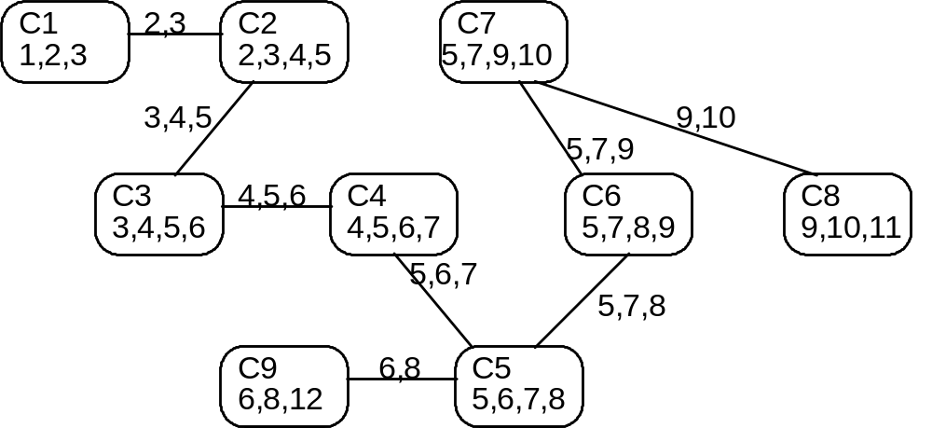
Step 5: Build the Junction Tree

Slide 13
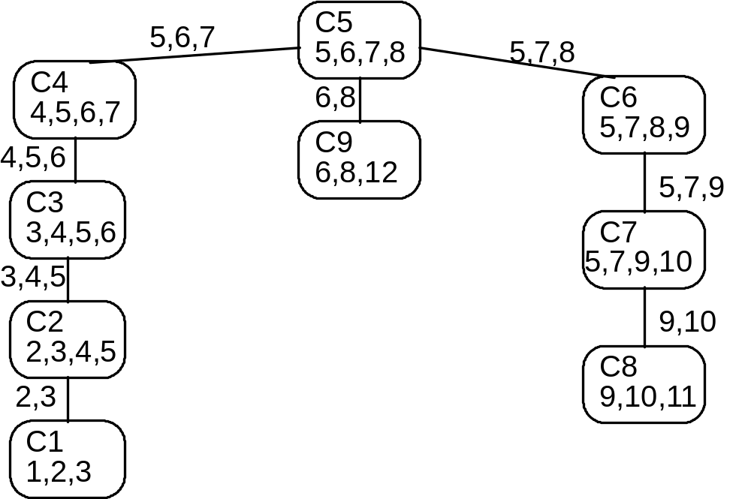
Step 6: Choose a Root

Slide 14
Step 7: Populate the Cliques
Place each potential from the original network in a clique containing all the variables it references
For each clique node, form the product
of the distributions in it (as in variable elimination).

Slide 15

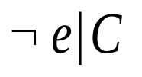
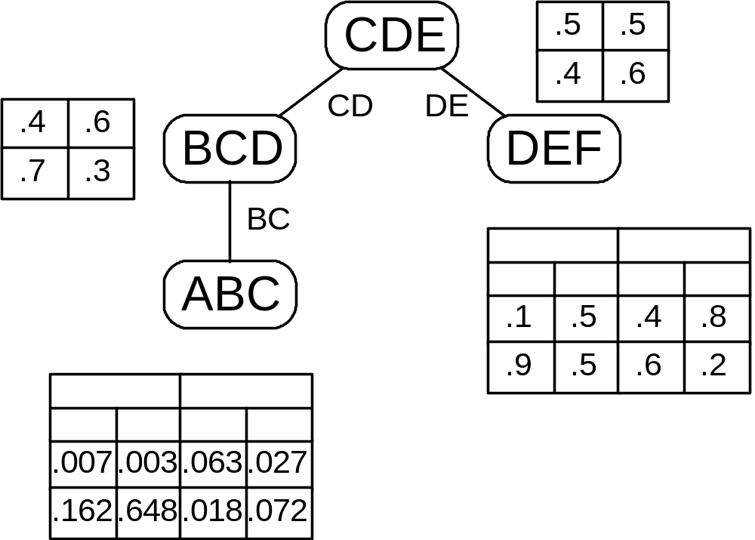

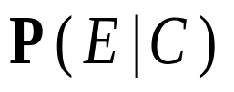

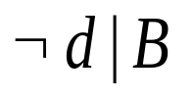



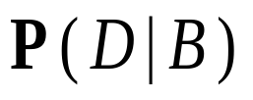






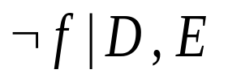
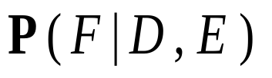


Step 7: Populate the Cliques

Slide 16
Step 8: Belief Propagation
Incorporate evidence
Upward pass:
Send messages toward root
Downward pass:
Send messages toward leaves

Slide 17
Step 8.1: Incorporate Evidence
For each evidence variable, go to one table that includes that variable.
Set to 0 all entries in that table that disagree with the evidence.

Slide 18
Step 8.2: Upward Pass
For each leaf in the junction tree, send a message to its parent. The message is the marginal of its table, summing out any variable not in the separator.
When a parent receives a message from a child,
it multiplies its table by the message table to obtain its new table.
When a parent receives messages from all its children, it repeats the process (acts as a leaf).
This process continues until the root receives messages from all its children.

Slide 19
Step 8.3: Downward Pass
Reverses upward pass, starting at the root.
The root sends a message to each of its children.
More specifically, the root divides its current table by the message received from the child, marginalizes the resulting table to the separator, and sends the result to the child.
Each child multiplies its table by its parent’s table and repeats the process (acts as a root) until leaves are reached.
Table at each clique is joint marginal of its variables; sum out as needed. We’re done!

Slide 20
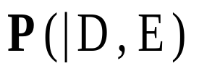

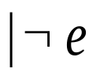


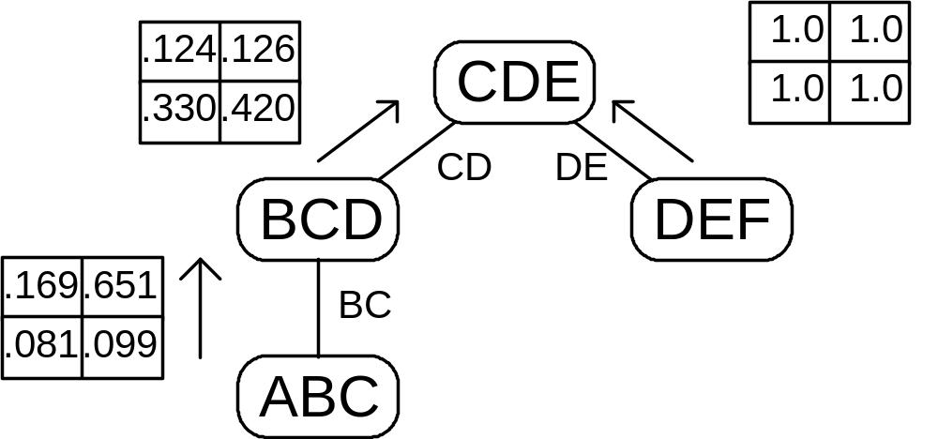


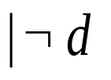

Inference Example: Going Up
(No evidence)

Slide 21
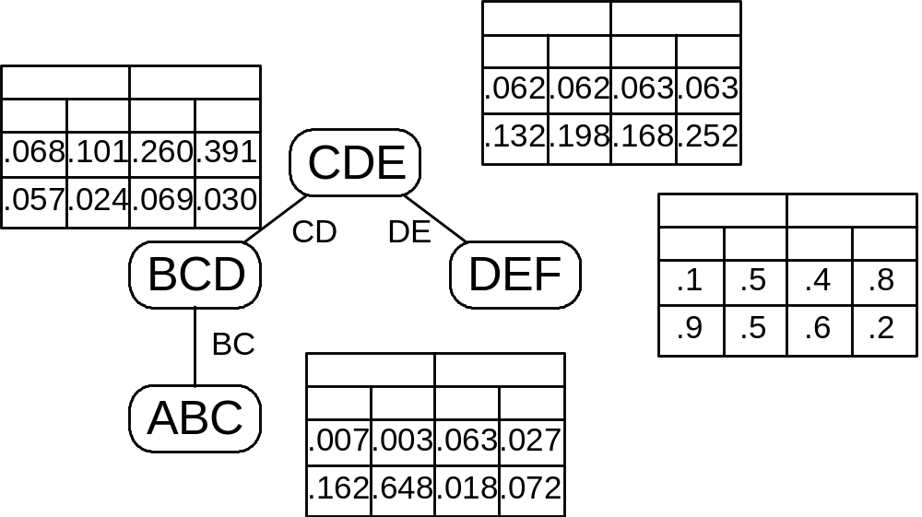


Status After Upward Pass

Slide 22
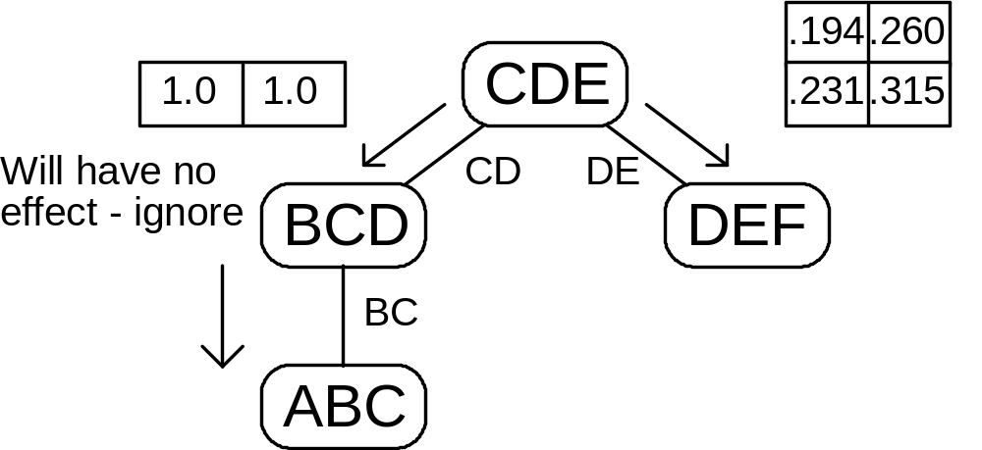


Going Back Down

Slide 23
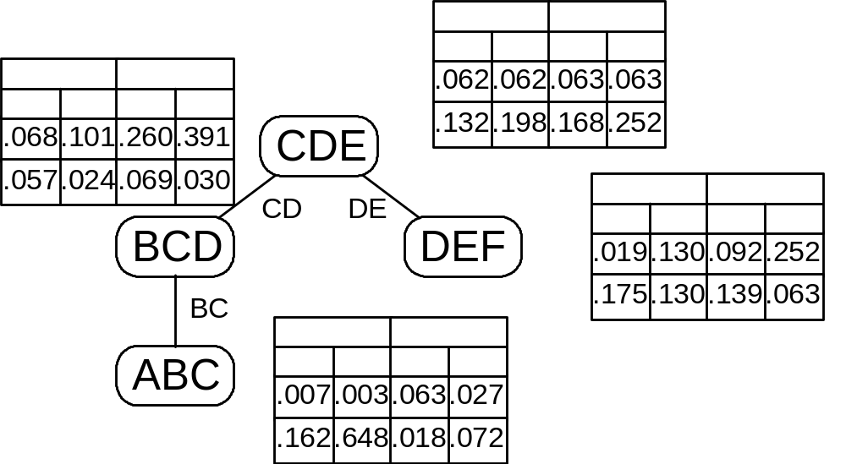

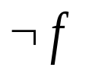



Status After Downward Pass

Slide 24
Why Does This Work?
The junction tree algorithm is just a way to do variable elimination in all directions at once, storing intermediate results at each step.

Slide 25
The Link Between Junction Trees and Variable Elimination
To eliminate a variable at any step,
we combine all remaining tables involving
that variable.
A node in the junction tree corresponds to the variables in one of the tables created during variable elimination (the other variables required to remove a variable).
An arc in the junction tree shows the flow of data in the elimination computation.

Slide 26
Junction Tree Savings
Avoids redundancy in repeated variable elimination
Need to build junction tree only once ever
Need to repeat belief propagation only when new evidence is received

Slide 27
Exact Inference is Intractable in the worst case
Exponential in the treewidth of the graph
  Treewidth can be O(number of nodes) in the worst case…
  These algorithms can be exponential in the problem size
  Could there be a better algorithm?

Slide 28
Exact Inference is NP-Hard
Can encode any 3-SAT problem as a DGM
Use deterministic CPTs

Slide 29
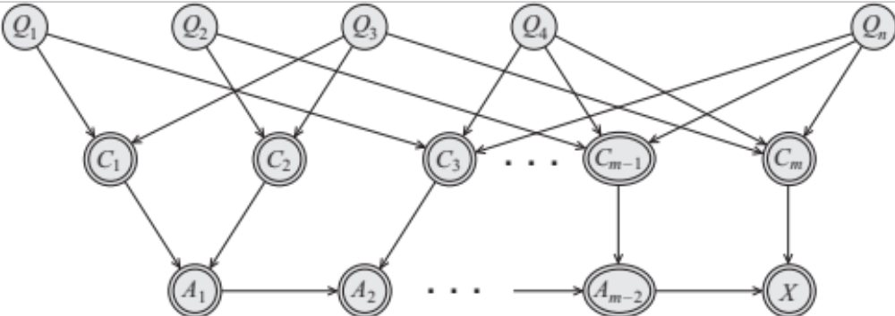
Exact Inference is NP-Hard
(3-SAT)
Q’s are binary random variables
C’s are (deterministic) clauses
A’s are a chain of AND gates

Slide 30
Actually even worse…
#P complete
To compute the normalizing constant we have to count the # of satisfying clauses.

