Slide 1
Automatic Speech Recognition
Many Slides from Julia Hirschberg

Slide 2
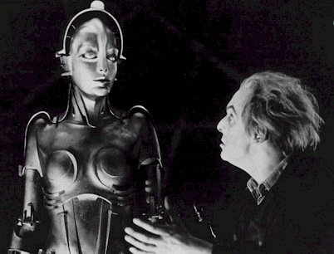
Recreating the Speech Chain
DIALOG
SEMANTICS
SPOKEN
LANGUAGE
UNDERSTANDING
SPEECH
RECOGNITION
SYNTAX
LEXICON
MORPHOLOGY
SPEECH
SYNTHESIS
PHONETICS
DIALOG
MANAGEMENT
INNER EAR
ACOUSTIC NERVE
VOCAL-TRACT
ARTICULATORS
Notes:
Metropolis (1927)
Directed By: Fritz Lang

Slide 3
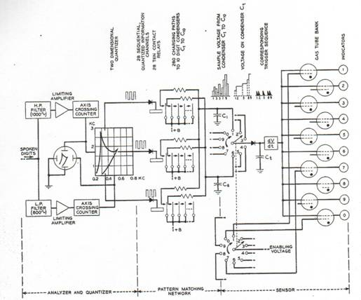
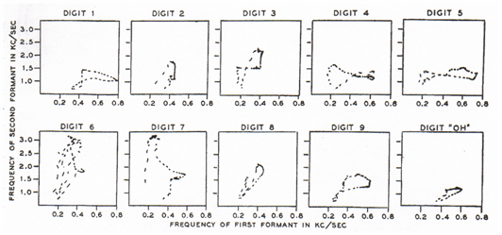
Speech Recognition: the Early Years
1952 – Automatic Digit Recognition (AUDREY)
  Davis, Biddulph, Balashek (Bell Laboratories)
Notes:
The first serious speech recognizer was developed in 1952 by Davis, Biddulph, and Balashek of Bell Labs. Analog circuit using filters, amplifiers and integrators. Using a simple frequency splitter, it generated plots of the first two formants, which it identified by matching them against prestored patterns in an analog memory. With training, it was reported, the machine achieved 97 percent accuracy on the spoken forms of ten digits.
Thus an utterance of an unknown digit could be recognized if its pattern on the formant-one/formant-two plane was compared with those of all digits plotted during the experimental phase. That was the principle on which Audrey was based. Rather than comparing the whole patterns point by point, twenty numbers were computed and stored for each digit, characterizing the corresponding average pattern on the formant-one/formant-two plane. Those twenty characteristic numbers were then computed, in the same way, for any incoming utterance to be recognized, and compared with the stored sets. The digit with the stored set of twenty numbers more similar to the newly computed one was the digit that most probably was uttered. Speaker dependent.

Slide 4
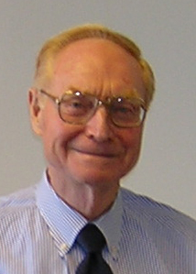
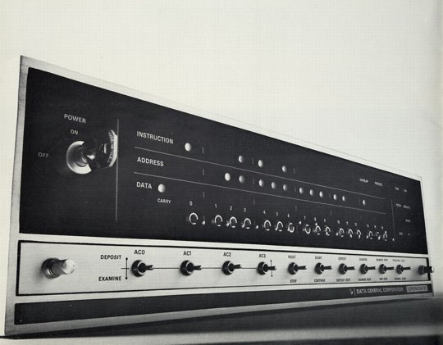
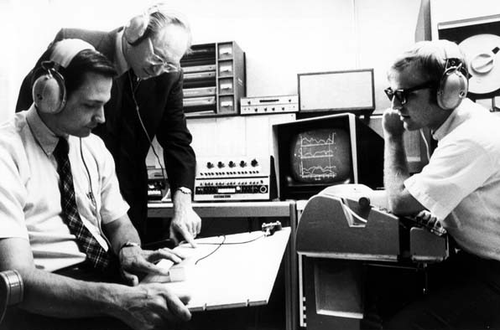
1960’s – Speech Processing and Digital Computers
AD/DA converters and digital computers start appearing in the labs
James Flanagan
Bell Laboratories
Notes:
Flanagan joined Bell Labs in 1957. Although there was already some work done in speech processing it was mostly using analog circuits. Jim helped to introduce AD/DA and start pioneering new research in speech processing using computers. Much easier, more flexible and cheaper than building electric circuits. Much larger experiments possible altho not in real time for quite a while.

Slide 5
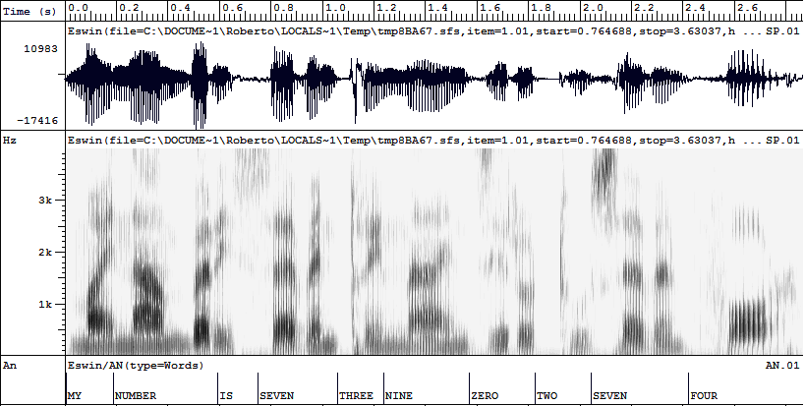
The Illusion of Segmentation... or...
Why Speech Recognition is so Difficult
(user:Roberto (attribute:telephone-num value:7360474))
VP
NP
NP
MY
IS
THREE
ZERO
SEVEN
NUMBER
SEVEN
NINE
TWO
FOUR
m
I
n
&
m
&
i
s
e
th
I
z
&
n
n
E
o
t
s
r
v
n
r
ü
e
&
f
O
r
b
E
r
v
n
Notes:
Phone segmentation → word identification → syntactic structure → semantic representation

Slide 6
The Illusion of Segmentation... or...
Ellipses and Anaphors
Why Speech Recognition is so Difficult
Limited vocabulary
Multiple Interpretations
Speaker Dependency
(user:Roberto (attribute:telephone-num value:7360474))
Word variations
VP
NP
NP
Word confusability
Context-dependency
MY
IS
THREE
ZERO
SEVEN
NUMBER
SEVEN
NINE
TWO
FOUR
Coarticulation
Noise/reverberation
m
I
n
&
m
&
i
s
e
th
I
z
&
n
n
E
o
t
s
n
Intra-speaker variability
r
v
r
ü
e
&
f
O
r
b
E
r
v
n

Slide 7
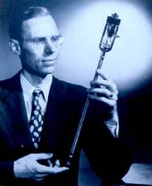
1969 – Whither Speech Recognition?
General purpose speech recognition seems far away. Social-purpose speech recognition is severely limited. It would seem appropriate for people to ask themselves why they are working in the field and what they can expect to accomplish…
It would be too simple to say that work in speech recognition is carried out simply because one can get money for it. That is a necessary but not sufficient condition. We are safe in asserting that speech recognition is attractive to money. The attraction is perhaps similar to the attraction of schemes for turning water into gasoline, extracting gold from the sea, curing cancer, or going to the moon. One doesn’t attract thoughtlessly given dollars by means of schemes for cutting the cost of soap by 10%. To sell suckers, one uses deceit and offers glamour…
Most recognizers behave, not like scientists, but like mad inventors or untrustworthy engineers. The typical recognizer gets it into his head that he can solve “the problem.” The basis for this is either individual inspiration (the “mad inventor” source of knowledge) or acceptance of untested rules, schemes, or information (the untrustworthy engineer approach).
The Journal of the Acoustical Society of America, June 1969
J. R. Pierce
Executive Director,
Bell Laboratories
Notes:
Every technology has its own negative people. Never believed. He was right that he never saw good performance.

Slide 8
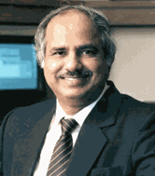
1971-1976: The ARPA SUR project
Despite anti-speech recognition campaign led by Pierce Commission ARPA launches 5 year Spoken Understanding Research program
Goal: 1000-word vocabulary, 90% understanding rate, near real time on 100 mips machine
4 Systems built by the end of the program
  SDC (24%)
  BBN’s HWIM (44%)
  CMU’s Hearsay II (74%)
  CMU’s HARPY (95% -- but 80 times real time!)
Rule-based systems except for Harpy
  Engineering approach: search network of all the possible utterances
LESSON LEARNED:
Hand-built knowledge does not scale up
Need of a global “optimization” criterion
Raj Reddy -- CMU
Notes:
the objective of ASR is, properly, speech understanding, not simply correct identification of words in a spoken message. Systems, therefore, should be evaluated in terms of their ability to respond correctly to spoken messages about such pragmatic problems as travel budget management. Limited domain, somewhat speaker tuned, quiet room. The objective goal of ARPA SUR was a recognition system with 90 percent sentence accuracy for continuous-speech sentences, using thousand-word vocabularies, not in real time. Of four principal ARPA SUR projects, the only one to meet the stated goal was Carnegie Mellon University's Harpy system, which achieved a 5 percent error rate on a 1,011-word vocabulary on continuous speech. One of the ways the CMU team achieved the goal was clever: they made the task easier by restricting word order; that is, by limiting spoken words to certain sequences in the sentence.

Slide 9
Lack of clear evaluation criteria
  ARPA felt systems had failed
  Project not extended
Speech Understanding: too early for its time
Need a standard evaluation method

Slide 10
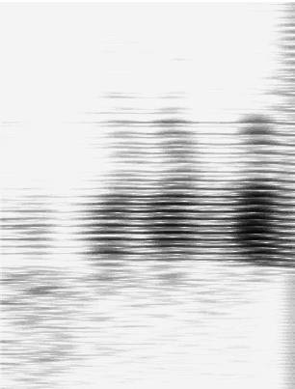
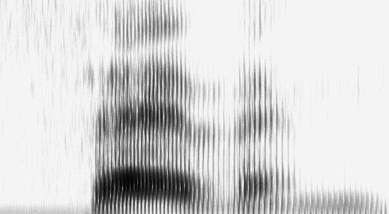
1970’s – Dynamic Time Warping
The Brute Force of the Engineering Approach
T.K. Vyntsyuk (1968)
H. Sakoe,
S. Chiba (1970)
TEMPLATE (WORD 7)
Isolated Words
Speaker Dependent
Connected Words
Speaker Independent
Sub-Word Units
UNKNOWN WORD
Notes:
Compare input to word templates. What features discriminate between one word and another? Spectrograms? Divided into frames? With avg intensity computed over that frame. Word is seven.
Compute the least cost path of best matches of feature vectors between unknown word and templates, using dynamic programming. Recognizing one word could take seconds to hours, depending on vocabulary size and word length. Isolated word recognition.

Slide 11
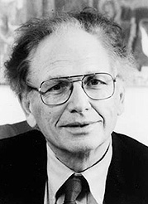

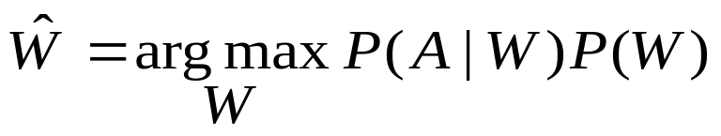
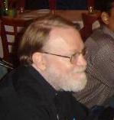

1980s -- The Statistical Approach
Based on work on Hidden Markov Models done by Leonard Baum at IDA, Princeton in the late 1960s
Purely statistical approach pursued by Fred Jelinek and Jim Baker, IBM T.J.Watson Research
Foundations of modern speech recognition engines
Fred Jelinek
Acoustic HMMs
Word Tri-grams
a11
a22
a33
Jim Baker
No Data Like More Data
Whenever I fire a linguist, our system performance improves (1988)
Some of my best friends are linguists (2004)
a12
a23
S1
S2
S3
Notes:
Harpy represented all possible sentences as a finite state machine with 15K nodes of acoustic templates. Problem of finding best path thru network much like finding best path comparing word templates. Again, dynamic programming. IBM added probabilities to the mix, estimating statistical models of phonemes automatically from data. Performance went from 35% with hand-estimated models to 75%.

Slide 12
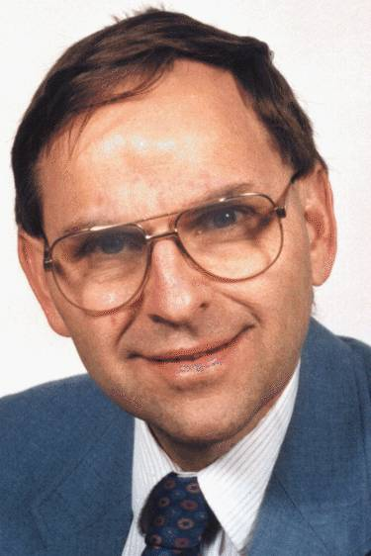
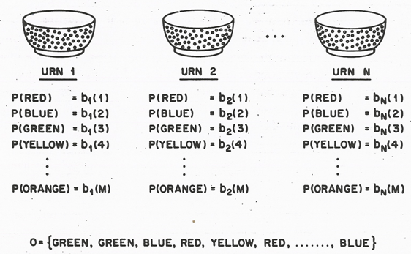
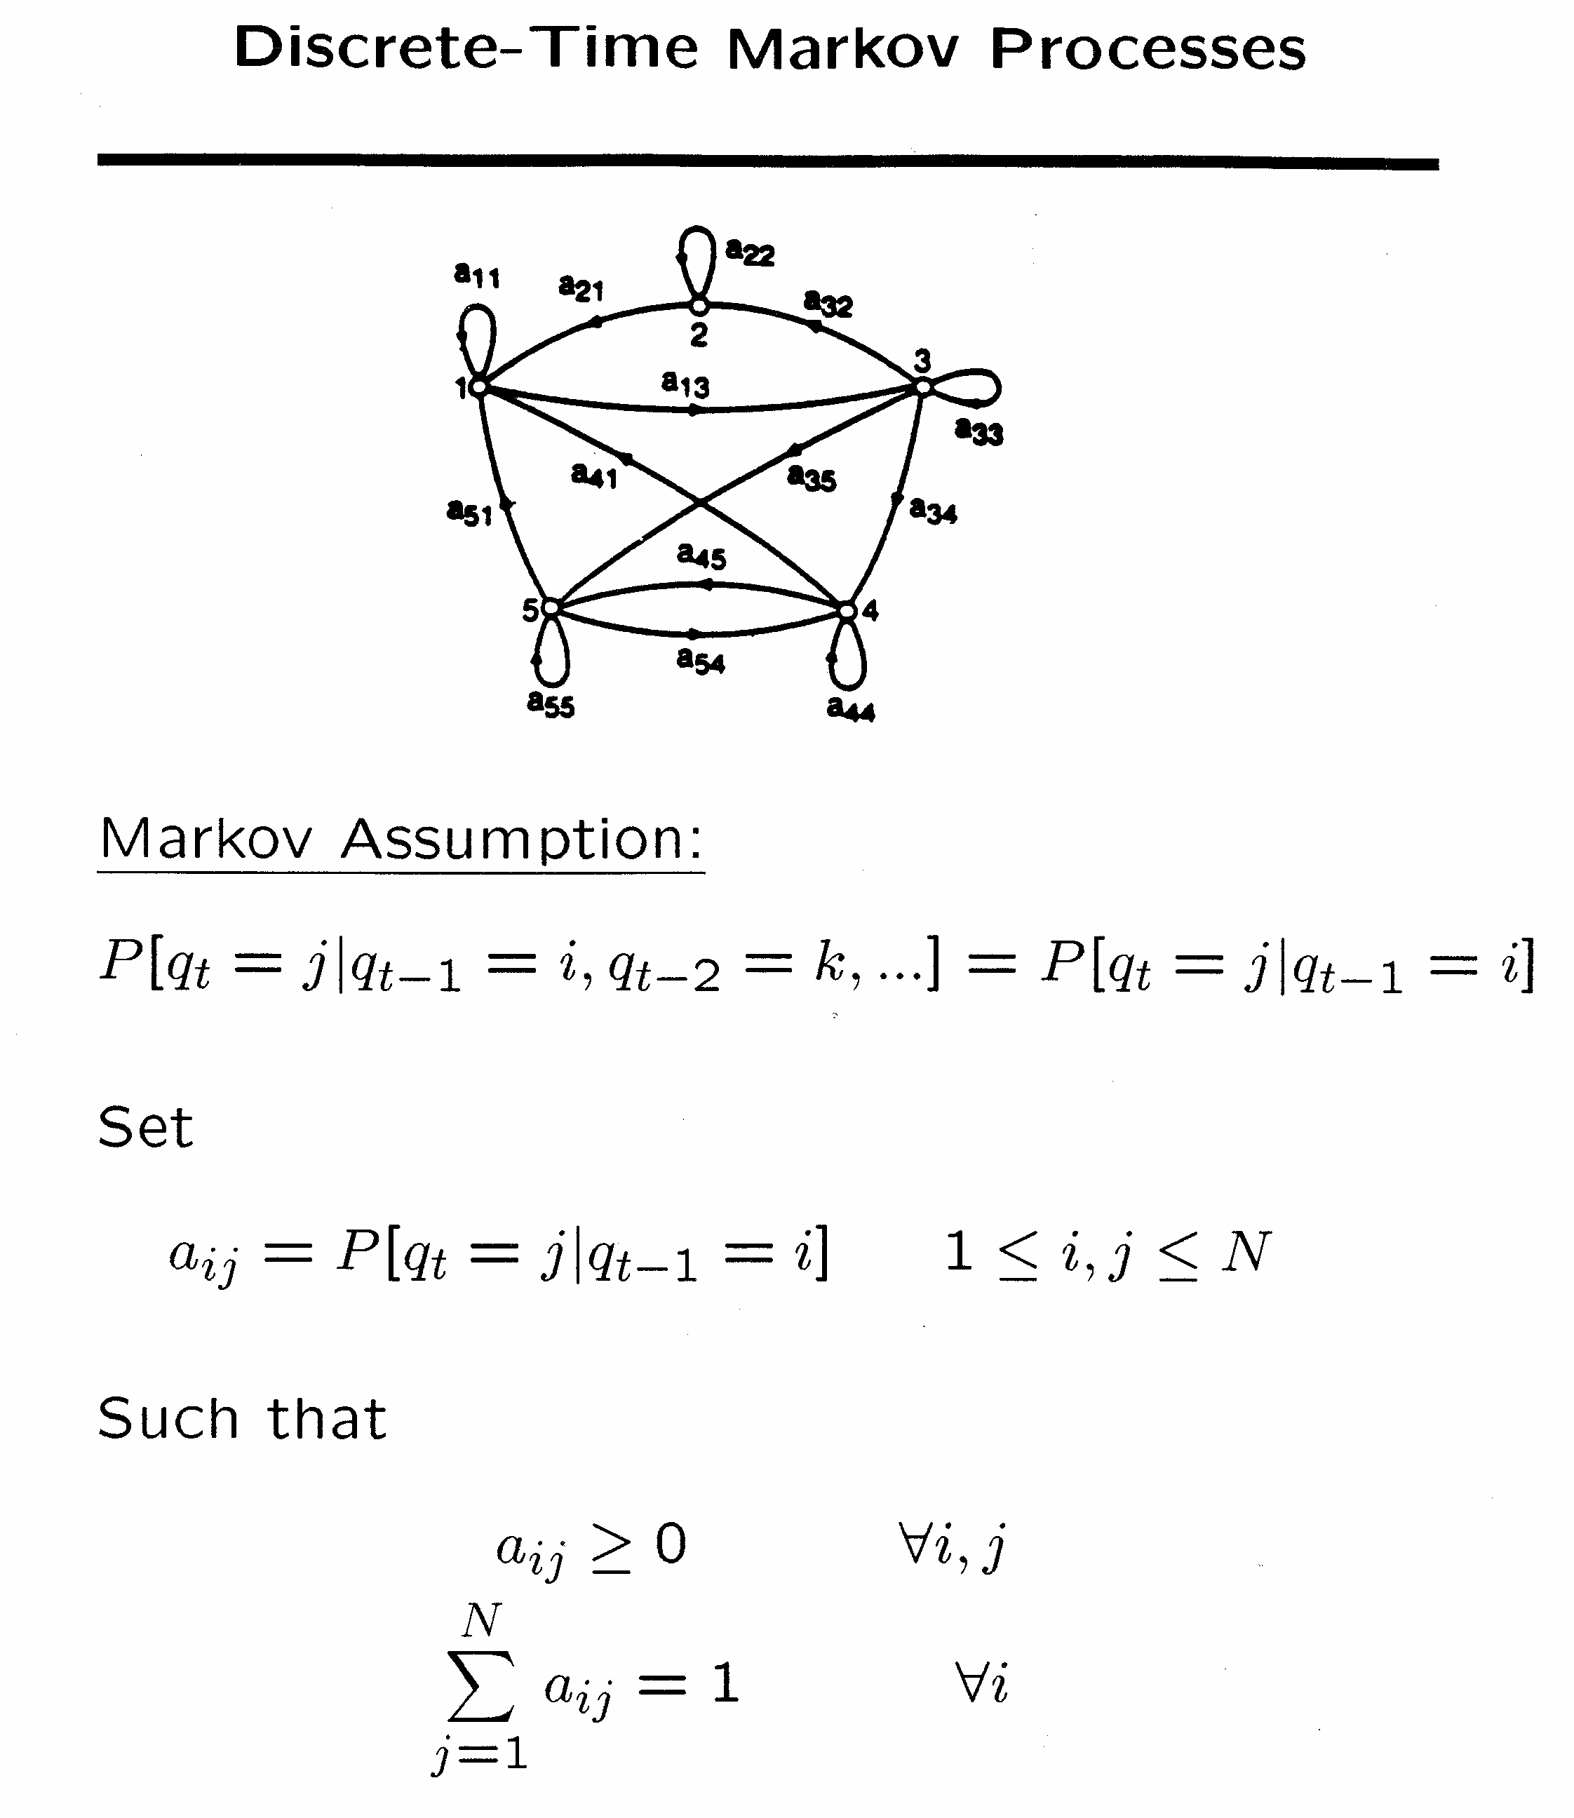
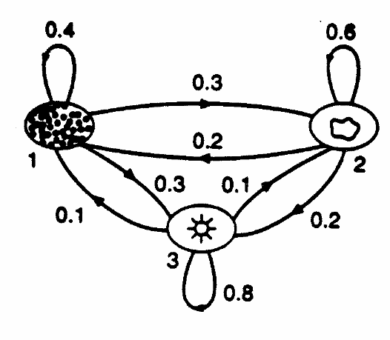
1980-1990 – Statistical approach becomes ubiquitous
Lawrence Rabiner, A Tutorial on Hidden Markov Models and Selected Applications in Speech Recognition, Proceeding of the IEEE, Vol. 77, No. 2, February 1989.
Notes:
HMMs represent sequential constraints of language. Actual processes of the vocal tract in producing a particular phone are ‘hidden states’ – but we can observe their result in the acoustic signal.

Slide 13
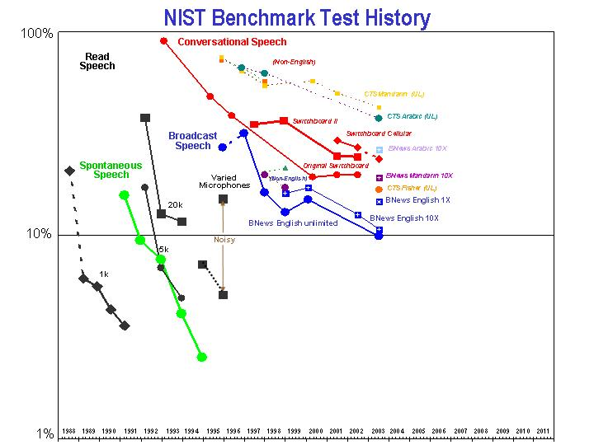
1980s-1990s – The Power of Evaluation
1995
1996
1997
1998
1999
SPOKEN
DIALOG
INDUSTRY
2000
2001
2002
2003
MIT
2004
…
HOSTING
SPEECHWORKS
APPLICATION
DEVELOPERS
STANDARDS
SRI
TOOLS
NUANCE
Pros and Cons of DARPA programs
+ Continuous incremental improvement
- Loss of “bio-diversity”
PLATFORM
INTEGRATORS
STANDARDS
TECHNOLOGY
VENDORS
STANDARDS

Slide 14
Today’s State of the Art
Low noise conditions
Large vocabulary
  ~20,000-60,000 words or more…
Speaker independent (vs. speaker-dependent)
Continuous speech (vs isolated-word)
Multilingual, conversational
World’s best research systems:
    Human-human speech: ~13-20% Word Error Rate (WER)
    Human-machine or monologue speech: ~3-5% WER

Slide 15
Building an ASR System
Build a statistical model of the speech-to-words process
  Collect lots of speech and transcribe all the words
  Train the model on the labeled speech
Paradigm:
  Supervised Machine Learning + Search
  The Noisy Channel Model

Slide 16
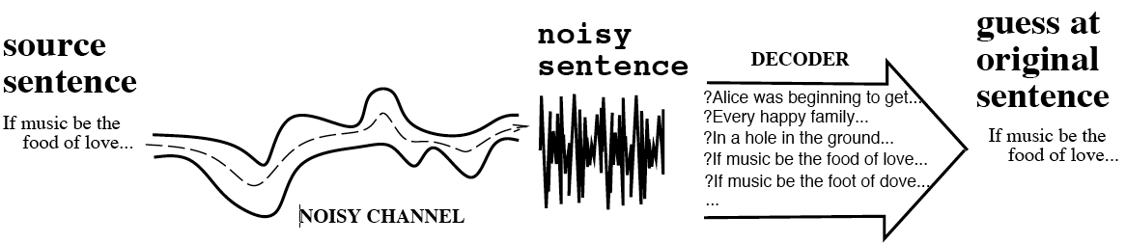
The Noisy Channel Model
Search through space of all possible sentences.
Pick the one that is most probable given the waveform

Slide 17
The Noisy Channel Model (II)
What is the most likely sentence out of all sentences in the language L, given some acoustic input O?
Treat acoustic input O as sequence of individual acoustic observations
  O = o₁,o₂,o₃,…,o_{t}
Define a sentence as a sequence of words:
  W = w₁,w₂,w₃,…,w_{n}

Slide 18
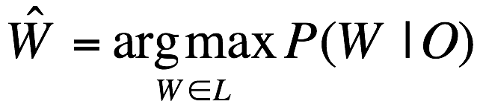
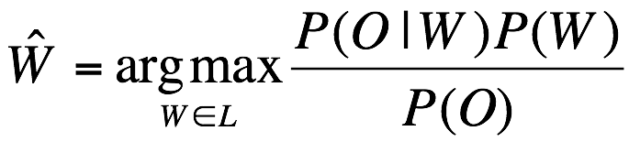
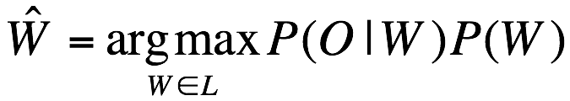
Noisy Channel Model (III)
Probabilistic implication: Pick the highest probable sequence:
We can use Bayes rule to rewrite this:
Since denominator is the same for each candidate sentence W, we can ignore it for the argmax:

Slide 19
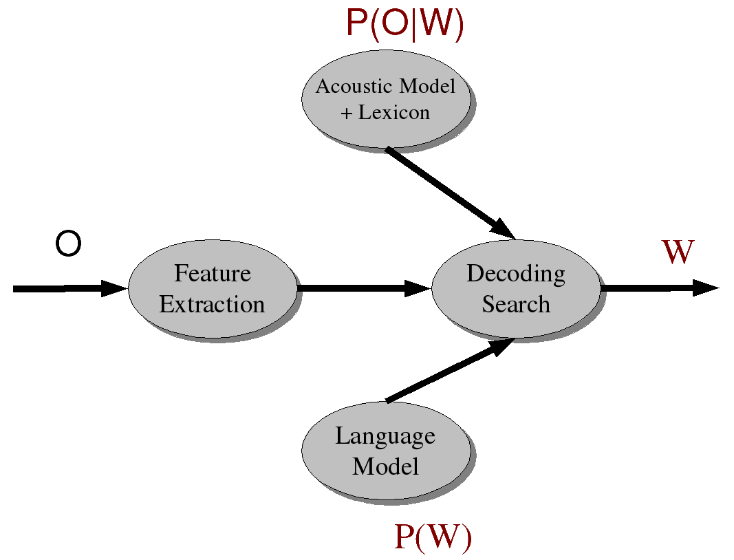
Speech Recognition Meets Noisy Channel: Acoustic Likelihoods and LM Priors

Slide 20
Components of an ASR System
Corpora for training and testing of components
Representation for input and method of extracting
Pronunciation Model
Acoustic Model
Language Model
Feature extraction component
Algorithms to search hypothesis space efficiently

Slide 21
Training and Test Corpora
Collect corpora appropriate for recognition task at hand
  Small speech + phonetic transcription to associate sounds with symbols (Acoustic Model)
  Large (>= 60 hrs) speech + orthographic transcription to associate words with sounds (Acoustic Model)
  Very large text corpus to identify ngram probabilities or build a grammar (Language Model)

Slide 22
Building the Acoustic Model
Goal: Model likelihood of sounds given spectral features, pronunciation models, and prior context
Usually represented as Hidden Markov Model
  States represent phones or other subword units
  Transition probabilities on states: how likely is it to see one sound after seeing another?
  Observation/output likelihoods: how likely is spectral feature vector to be observed from phone state i, given phone state i-1?

Slide 23
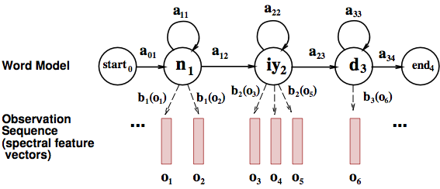
Word HMM

Slide 24
Initial estimates from phonetically transcribed corpus or flat start
  Transition probabilities between phone states
  Observation probabilities associating phone states with acoustic features of windows of waveform
Embedded training:
  Re-estimate probabilities using initial phone HMMs + orthographically transcribed corpus + pronunciation lexicon to create whole sentence HMMs for each sentence in training corpus
  Iteratively retrain transition and observation probabilities by running the training data through the model until convergence

Slide 25
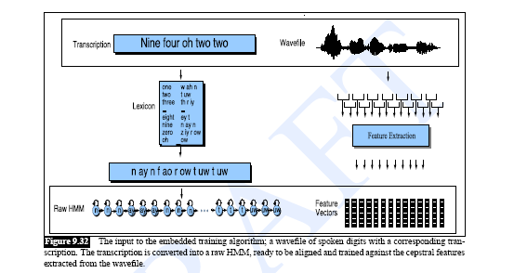
Training the Acoustic Model

Slide 26
Building the Pronunciation Model
Models likelihood of word given network of candidate phone hypotheses
  Multiple pronunciations for each word
  May be weighted automaton or simple dictionary
Words come from all corpora (including text)
Pronunciations come from pronouncing dictionary or TTS system

Slide 27
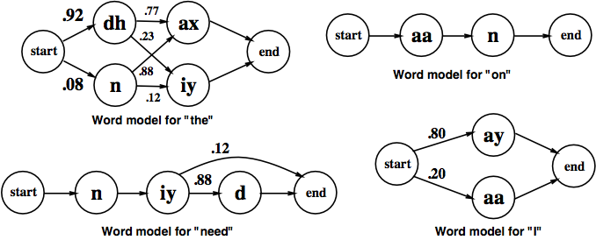
ASR Lexicon: Markov Models for Pronunciation

Slide 28
Building the Language Model
Models likelihood of word given previous word(s)
Ngram models:
  Build the LM by calculating bigram or trigram probabilities from text training corpus: how likely is one word to follow another? To follow the two previous words?
  Smoothing issues
Grammars
  Finite state grammar or Context Free Grammar (CFG) or semantic grammar
Out of Vocabulary (OOV) problem

Slide 29
Search/Decoding
Find the best hypothesis P(O|W) P(W) given
  A sequence of acoustic feature vectors (O)
  A trained HMM (AM)
  Lexicon (PM)
  Probabilities of word sequences (LM)
For O
  Calculate most likely state sequence in HMM given transition and observation probs
  Trace back thru state sequence to assign words to states
  N best vs. 1 best vs. lattice output
Limiting search
  Lattice minimization and determinization
  Pruning: beam search

Slide 30
Evaluating Success
Transcription
  Low WER (Subst+Ins+Del)/N * 100
  Thesis test vs. This is a test. 75% WER
  Or That was the dentist calling. 125% WER
Understanding
  High concept accuracy
    How many domain concepts were correctly recognized?
      I want to go from Boston to Baltimore on September 29

Slide 31
  Domain concepts Values
  source city Boston
  target city Baltimore
  travel date September 29
  Score recognized string “Go from Boston to Washington on December 29” vs. “Go to Boston from Baltimore on September 29”
  (1/3 = 33% CA)

Slide 32
Summary
ASR today
  Combines many probabilistic phenomena: varying acoustic features of phones, likely pronunciations of words, likely sequences of words
  Relies upon many approximate techniques to ‘translate’ a signal
  Finite State Transducers
ASR future
  Can we include more language phenomena in the model?

