Slide 1
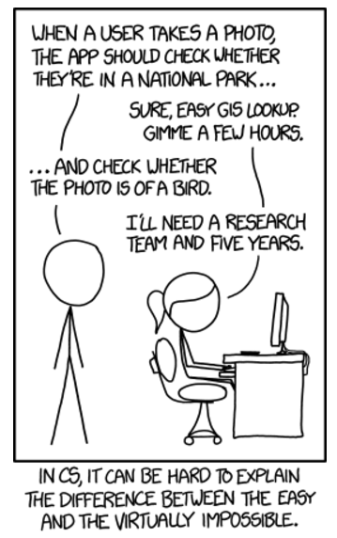
CSE 5523: Machine Learning and Statistical Pattern Recognition
Instructor: Alan Ritter

Slide 2
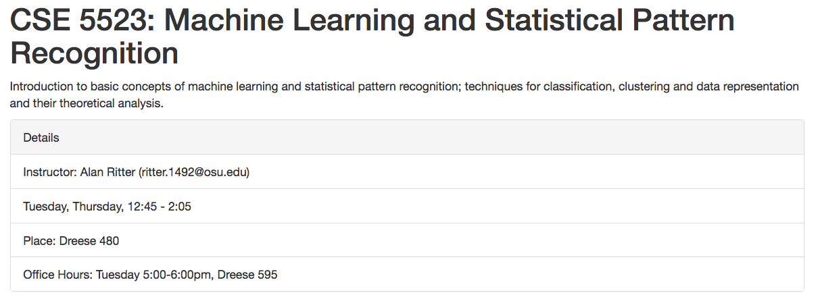
Administrative Details
Course Webpage
  http://aritter.github.io/courses/5523_spring17.html

Slide 3
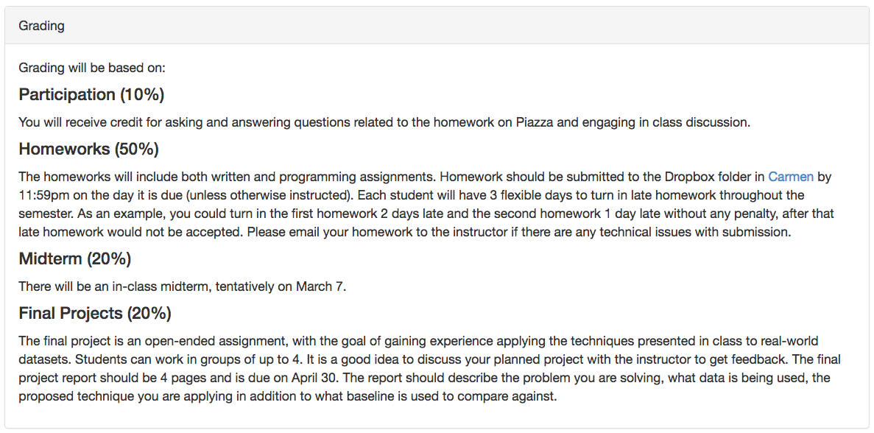
Administrative Details

Slide 4
Administrative Details
Piazza (discussion and resources)
  https://piazza.com/class/ix8mu2qajn75mb
Carmen (homework submission and grades)
  https://osu.instructure.com/courses/14167

Slide 5
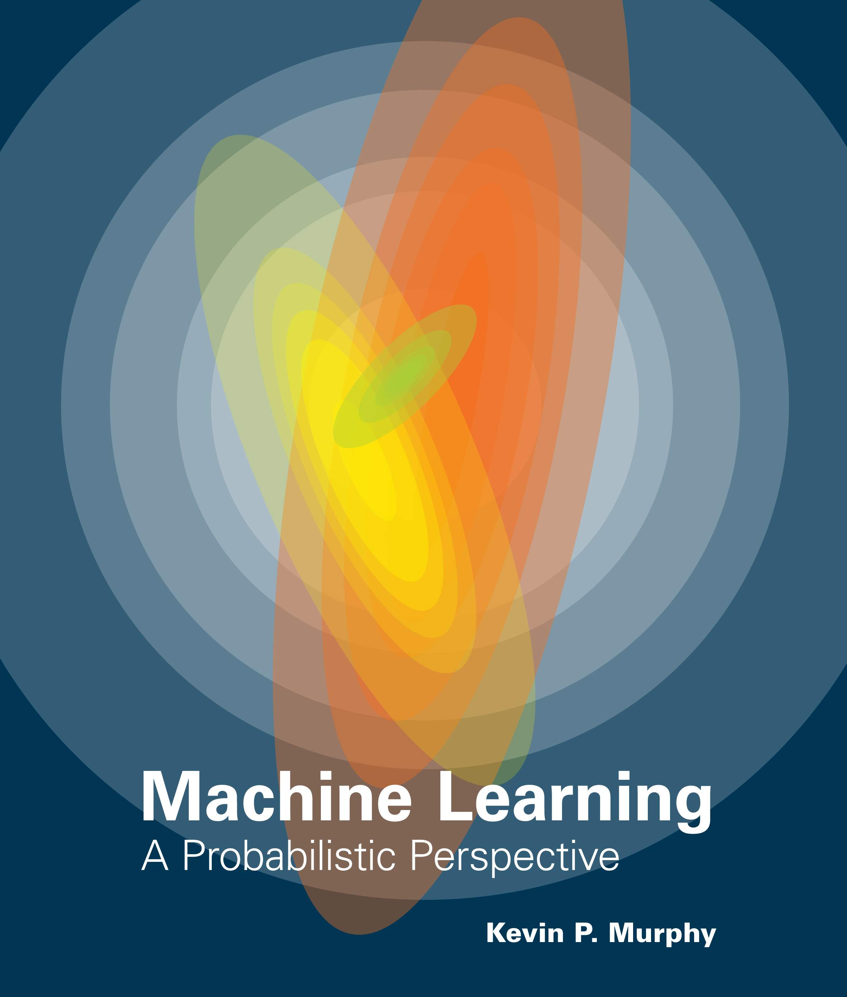
Course Details
Book
  Kevin Murphy’s ML book
    https://www.cs.ubc.ca/~murphyk/MLbook/
  Some other readings as well
Prerequisits / Assumptions
  Basic Probability
  Basic Linear Algebra
  Python or ability to learn Python quickly
  Numpy/scipy
  Linux/Unix (For windows users: https://www.cygwin.com/)

Slide 6
What to Expect
Lots of math and programming
Machine learning algorithms often difficult to debug
  Need to think creatively about simple test cases.
  We recommend you start early.
Questions?

Slide 7


Evaluation

Slide 8
A Few Quotes
“A breakthrough in machine learning would be worth
ten Microsofts” (Bill Gates, Chairman, Microsoft)
“Machine learning is the next Internet”
(Tony Tether, Director, DARPA)
Machine learning is the hot new thing”
(John Hennessy, President, Stanford)
“Web rankings today are mostly a matter of machine learning” (Prabhakar Raghavan, Dir. Research, Yahoo)
“Machine learning is going to result in a real revolution” (Greg Papadopoulos, Former CTO, Sun)
“Machine learning is today’s discontinuity”
(Jerry Yang, Founder, Yahoo)
“Machine learning today is one of the hottest aspects of computer science” (Steve Ballmer, CEO, Microsoft)

Slide 9
So What Is Machine Learning?
Automating automation
Getting computers to program themselves
Writing software is the bottleneck
Let the data do the work instead!

Slide 10
Traditional Programming
Machine Learning
Data
Computer
Output
Program
Data
Computer
Program
Output

Slide 11

Magic?
No, more like gardening
Seeds = Algorithms
Nutrients = Data
Gardener = You
Plants = Programs

Slide 12
Sample Applications
Web search
Computational biology
Finance
E-commerce
Space exploration
Robotics
Information extraction
Social networks
Debugging
[Your favorite area]

Slide 13
ML in a Nutshell
Tens of thousands of machine learning algorithms
Hundreds new every year
Every machine learning algorithm has three components:
  Representation
  Evaluation
  Optimization

Slide 14
Representation
Decision trees
Sets of rules / Logic programs
Instances
Graphical models (Bayes/Markov nets)
Neural networks
Support vector machines
Model ensembles
Etc.

Slide 15
Evaluation
Accuracy
Precision and recall
Squared error
Likelihood
Posterior probability
Cost / Utility
Margin
Entropy
K-L divergence
Etc.

Slide 16
Optimization
Combinatorial optimization
  E.g.: Greedy search
Convex optimization
  E.g.: Gradient descent
Constrained optimization
  E.g.: Linear programming

Slide 17
Types of Learning
Supervised (inductive) learning
  Training data includes desired outputs
Unsupervised learning
  Training data does not include desired outputs
Semi-supervised learning
  Training data includes a few desired outputs
Reinforcement learning
  Rewards from sequence of actions

Slide 18
Inductive Learning
Given examples of a function (X, F(X))
Predict function F(X) for new examples X
  Discrete F(X): Classification
  Continuous F(X): Regression
  F(X) = Probability(X): Probability estimation

Slide 19
What We’ll Cover
Supervised learning
  Decision tree induction
  Rule induction
  Instance-based learning
  Bayesian learning
  Neural networks
  Support vector machines
  Model ensembles
  Learning theory
Unsupervised learning
  Clustering
  Dimensionality reduction

Slide 20
ML in Practice
Understanding domain, prior knowledge, and goals
Data integration, selection, cleaning,
pre-processing, etc.
Learning models
Interpreting results
Consolidating and deploying discovered knowledge
Loop

