Slide 1
Learning Bayesian Networks

Slide 2
Dimensions of Learning
Model | Bayes net | Markov net
Data | Complete | Incomplete
Structure | Known | Unknown
Objective | Generative | Discriminative

Slide 3
Learning Bayes nets from data
Bayes net(s)
data
X₁
true
false
false
true
X₂
1
5
3
2
X₃
0.7
-1.6
5.9
6.3
X₁
X₂
Bayes-net
learner
...
X₃
X₄
X₅
.
.
.
X₆
.
.
.
X₇
+
prior/expert information
X₈
X₉

Slide 4
From thumbtacks to Bayes nets
Thumbtack problem can be viewed as learning
the probability for a very simple BN:
X
heads/tails
Θ
X₁
X₂
...
X_{N}
toss 1
toss 2
toss N

Slide 5
The next simplest Bayes net
X
Y
heads/tails
heads/tails
heads
tails
“heads”
“tails”

Slide 6
The next simplest Bayes net
X
Y
heads/tails
heads/tails
?
Θ_{X}
Θ_{Y}
X₁
Y₁
case 1
X₂
Y₂
case 2
X_{N}
Y_{N}
case N

Slide 7
The next simplest Bayes net
X
Y
heads/tails
heads/tails
"parameter
independence"
Θ_{X}
Θ_{Y}
X₁
Y₁
case 1
X₂
Y₂
case 2
X_{N}
Y_{N}
case N

Slide 8
The next simplest Bayes net
X
Y
heads/tails
heads/tails
"parameter
independence"
Θ_{X}
Θ_{Y}
X₁
Y₁
case 1
⇓
two separate
thumbtack-like
learning problems
X₂
Y₂
case 2
X_{N}
Y_{N}
case N

Slide 9
A bit more difficult...
X
Y
heads/tails
heads/tails
Three probabilities to learn:
θ_{X=heads}
θ_{Y=heads|X=heads}
θ_{Y=heads|X=tails}

Slide 10
A bit more difficult...
X
Y
heads/tails
heads/tails
Θ_{X}
Θ_{Y|X=heads}
Θ_{Y|X=tails}
X₁
heads
Y₁
case 1
X₂
tails
Y₂
case 2

Slide 11
A bit more difficult...
X
Y
heads/tails
heads/tails
Θ_{X}
Θ_{Y|X=heads}
Θ_{Y|X=tails}
X₁
Y₁
case 1
X₂
Y₂
case 2

Slide 12
A bit more difficult...
X
Y
heads/tails
heads/tails
?
?
Θ_{X}
Θ_{Y|X=heads}
Θ_{Y|X=tails}
?
X₁
Y₁
case 1
X₂
Y₂
case 2

Slide 13
A bit more difficult...
X
Y
heads/tails
heads/tails
Θ_{X}
Θ_{Y|X=heads}
Θ_{Y|X=tails}
X₁
Y₁
case 1
X₂
Y₂
case 2
3 separate thumbtack-like problems

Slide 14
In general …
Learning probabilities in a Bayes net
is straightforward if
Complete data
Local distributions from the exponential family (binomial, Poisson, gamma, ...)
Parameter independence
Conjugate priors

Slide 15
Incomplete data makes parameters dependent
X
Y
heads/tails
heads/tails
Θ_{X}
Θ_{Y|X=heads}
Θ_{Y|X=tails}
X₁
Y₁
case 1
X₂
Y₂
case 2

Slide 16
Solution: Use EM
Initialize parameters ignoring missing data
E step: Infer missing values using
current parameters
M step: Estimate parameters using completed data
Can also use gradient descent

Slide 17
Learning Bayes-net structure
Given data, which model is correct?
model 1:
X
Y
model 2:
X
Y

Slide 18




Bayesian approach
Given data, which model is correct? more likely?
model 1:
X
Y
Data d
model 2:
X
Y

Slide 19
Bayesian approach:
Model averaging
Given data, which model is correct? more likely?
model 1:
X
Y
Data d
model 2:
X
Y
average
predictions

Slide 20
Bayesian approach:
Model selection
Given data, which model is correct? more likely?
model 1:
X
Y
Data d
model 2:
X
Y
Keep the best model:
- Explanation
- Understanding
- Tractability

Slide 21
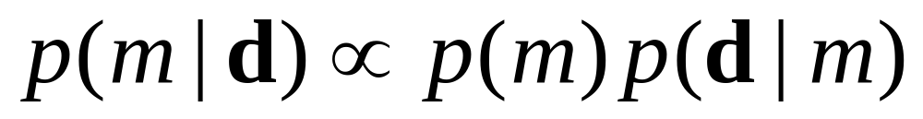
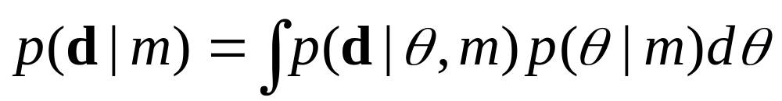
To score a model, use Bayes’ theorem
Given data d:
model
score
"marginal
likelihood"
likelihood

Slide 22
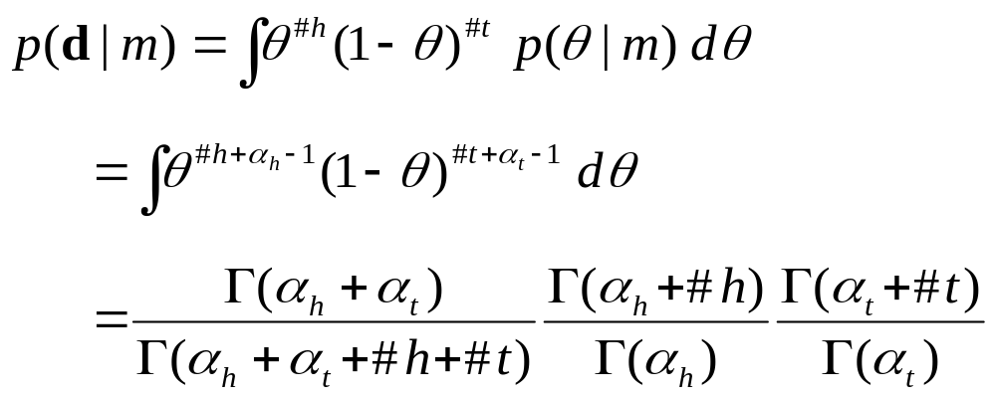
Thumbtack example
X
heads/tails
conjugate
prior

Slide 23
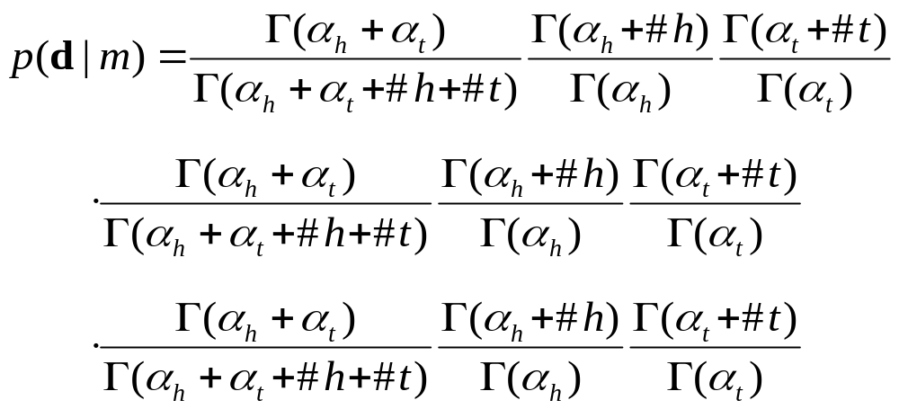
More complicated graphs
X
Y
heads/tails
heads/tails
3 separate thumbtack-like learning problems
X
Y|X=heads
Y|X=tails

Slide 24
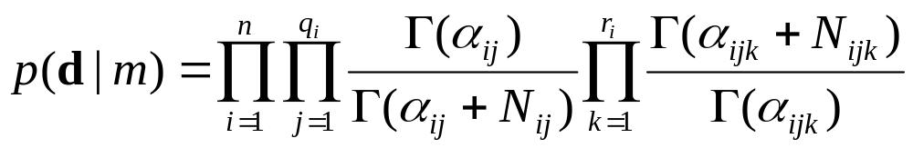
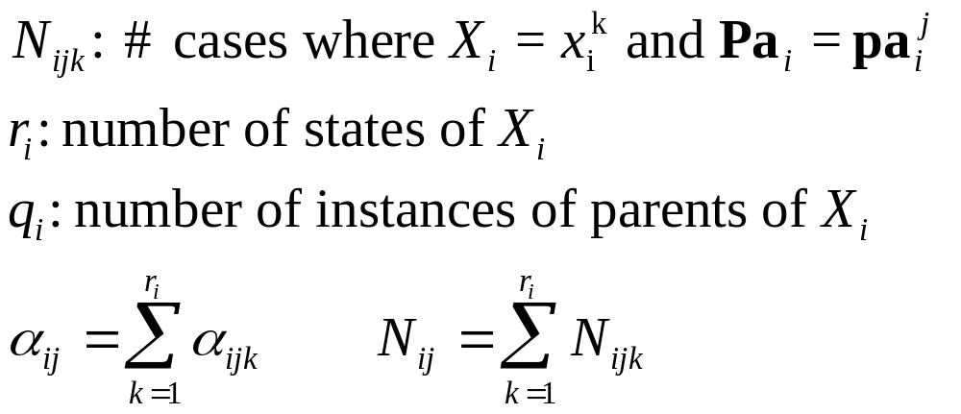
Model score for a discrete Bayes net

Slide 25
Computation of marginal likelihood
Efficient closed form if
Local distributions from the exponential family (binomial, poisson, gamma, ...)
Parameter independence
Conjugate priors
No missing data (including no hidden variables)

Slide 26
Structure search
Finding the BN structure with the highest score among those structures with at most k parents is NP hard for k>1 (Chickering, 1995)
Heuristic methods
  Greedy
  Greedy with restarts
  MCMC methods
initialize
structure
score
all possible
single changes
perform
best
change
any
changes
better?
yes
no
return
saved structure

Slide 27
Structure priors
1. All possible structures equally likely
2. Partial ordering, required / prohibited arcs
3. Prior(m) α Similarity(m, prior BN)

Slide 28
Parameter priors
All uniform: Beta(1,1)
Use a prior Bayes net

Slide 29
Parameter priors
Recall the intuition behind the Beta prior for the thumbtack:
The hyperparameters α_{h} and α_{t} can be thought of as imaginary counts from our prior experience, starting from "pure ignorance"
Equivalent sample size = α_{h} + α_{t}
The larger the equivalent sample size, the more confident we are about the long-run fraction

Slide 30
Parameter priors
x₁
x₂
imaginary
count
for any
variable
configuration
x₃
equivalent
sample
size
x₄
+
x₅
x₆
x₇
x₈
x₉
parameter
modularity
parameter priors for any Bayes net structure for X₁…X_{n}

Slide 31
Combining knowledge & data
prior network+equivalent sample size
x₁
x₂
improved network(s)
x₃
x₄
x₅
x₆
x₁
x₇
x₂
x₃
x₄
x₈
x₉
x₅
data
x₆
x₇
x₁
true
false
false
true
x₂
false
false
false
true
x₃
true
true
false
false
x₈
x₉
...
.
.
.
.
.
.

Slide 32
Example: College Plans Data (Heckerman et. Al 1997)
Data on 5 variables that might influence high school students’ decision to attend college:
  Sex: Male or Female
  SES: Socio economic status (low, lower-middle, middle, upper-middle, high)
  IQ: discritized into low, lower middle, upper middle, high
  PE: Parental Encouragement (low or high)
  CP: College plans (yes or no)
128 possible joint configurations
Heckerman et. al. computed the exact posterior over all 29,281 possible 5 node DAGs
  Except those in which Sex or SAS have parents and/or CP have children (prior knowledge)

Slide 33
