Slide 1
Information theory -Practice-
National Institute of Technology, Anan College, JAPAN
Yoshiki Satotani

Slide 2
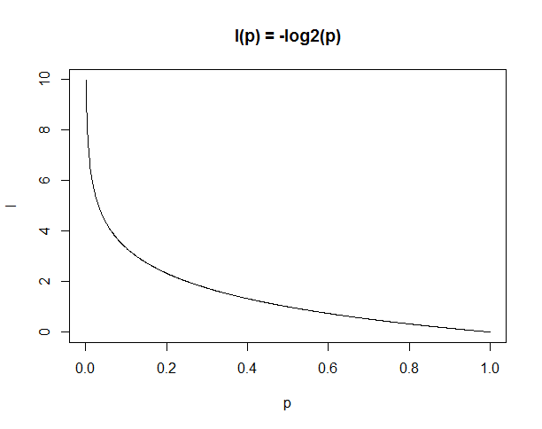

Practice 1
Draw a graph of $I\left(p\right)=−\log_{2}(p)$

Slide 3
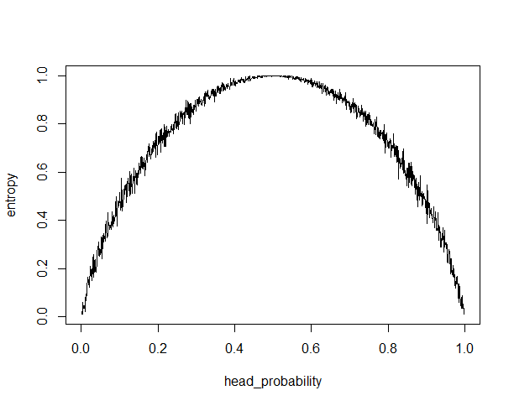
Practice 2
Flip a coin many times and find average information quantity (entropy)

Slide 4
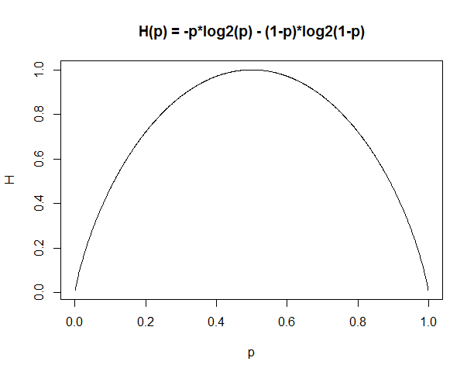

Practice 3
Draw a graph of Entropy function (i.e. $H\left(p\right)=−p\log_{2}\left(p\right)−\left(1−p\right)\log_{2}\left(1−p\right)$ )

Slide 5
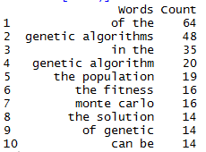
Practice 4
Alter the sample program (word_counter.R), find the entropy of a text file.
Any differences between scientific paper and present day literature? And if there is, why?
Running word_counter.R against
the article ‘Genetic algorithm’ from Wikipedia

Slide 6

Practice 5
The sample program (word_counter.R) find frequency of each words in a text file.
Alter the sample program, find probability of each words and generate text from the probabilities

