Slide 1
Basic use of R -Practice-
National Institute of Technology, Anan College, JAPAN
Yoshiki Satotani

Slide 2
Basic operation

Slide 3
Practice 1
Convert minutes into hours and minutes
E.g. 123 -> 2:03, 255 -> 4:15
Hint: use division and modulation
Find the number of digits of a number
E.g. 12345 -> 5, 654321 -> 6
Hint: 1-(10-1) -> 1 digit 10-(100-1) -> 2 digits ...
Hint2: log10(1) = 0, log10(10) = 1, log10(100) = 2 ...
Find how many numbers which
Divisible by three
Smaller than or equal to1000
Hint: colon operator (see help(‘:’))
Hint2: length(): get length of a vector (see help(length))

Slide 4
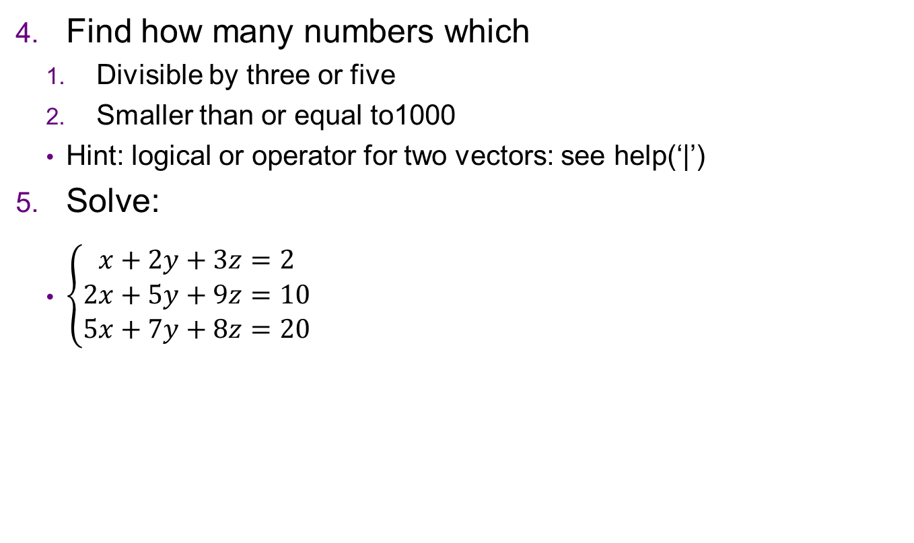
Practice 1
Find how many numbers which
Divisible by three or five
Smaller than or equal to1000
Hint: logical or operator for two vectors: see help(‘|’)
Solve:
$\left\{\begin{aligned}x+2y+3z=2 \\ 2x+5y+9z=10 \\ 5x+7y+8z=20\end{aligned}\right.$

Slide 5
Practice 1
Load data frame from “apple_juice.csv” by
aj = read.csv(“apple_juice.csv”) # take a look at "Load an Excel(csv) file"
and run these commands
summary(aj); summary(aj$pH) # summary function
mean(aj$pH)
median(aj$pH)
range(aj$pH)
var(aj$pH)
sd(aj$pH)

Slide 6
Graph

Slide 7
Practice 2
Draw these graphs:
y = x
y = cos(x)
y = asin(x)
y = atan(x)
y = log(x)
y = exp(x)
y = floor(x)
y = trunc(x / 60)
y = trunc(x %% 60)
y = floor(log10(x)) + 1

Slide 8
Practice 2
To draw multiple graphs, run
same axis:
plot(x, y1, type=‘l’)
lines(x, y2, type=‘l’) # just draw line over the graph
multiple axis:
par(mfrow=c(1,2)) # create two graphs on a window
plot(x, y1, type=‘l’) # draw first graph
plot(x, y2, type=‘l’) # draw second graph
par(mfrow=c(1,1)) # reset layout(single graph)
Try 1. and 2. for x=seq(0,1,len=1000), y1=x^2, y2=exp(x)-1

Slide 9
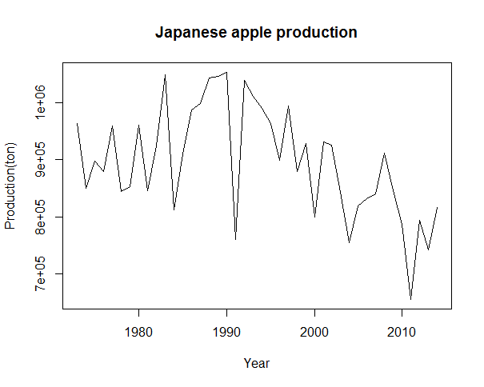
Practice 2
From apple_production.csv, make a chart of apple production by years, like

Slide 10
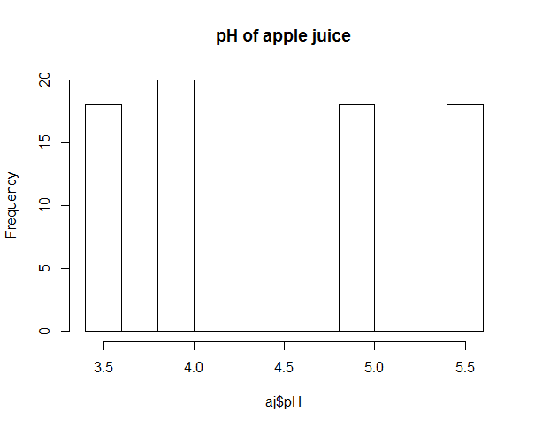
Practice 2
From apple_juice.csv, make a historgram of pH

Slide 11
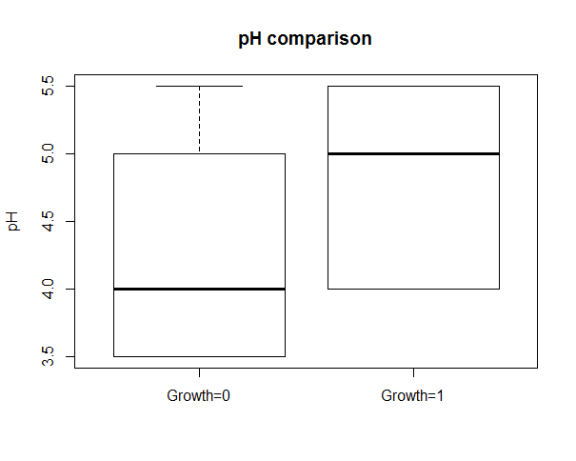
Practice 2
From apple_juice.csv, make a boxplot that
y axis: pH
two boxes(first: Growth=0, second: Growth=1)

Slide 12
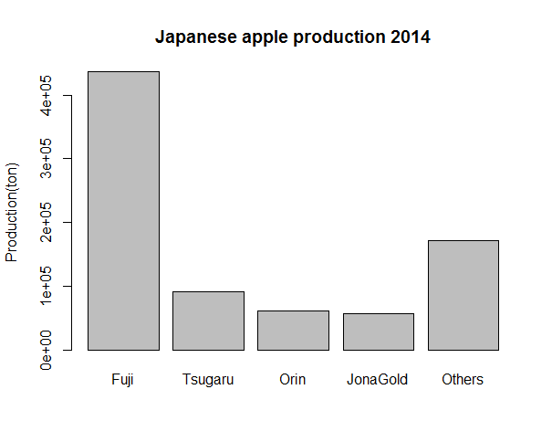
Practice 2
From apple_production.csv, make a bar chart of four varieties (Fuji, Tsugaru, Orin, Jona Gold) and Others (Production – four variety) in 2014

Slide 13
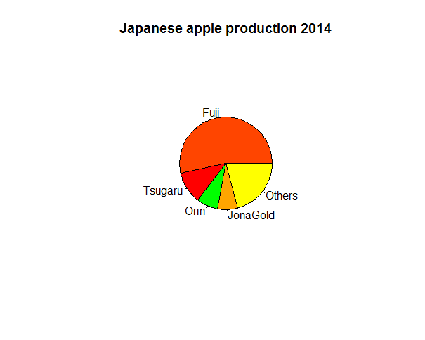
Practice 2
From apple_production.csv, make a pie chart of four varieties (Fuji, Tsugaru, Orin, Jona Gold) and Others (Production – four variety) in 2014

Slide 14
Programming

Slide 15
Practice 3
Scan a number and find whether the number is divisible by three or not
if so, print 'divisible by three‘
if not, print 'not divisible by three‘
Scan a number and find if the number is divisible by three and five
if divisible by only three, print 'divisible by three‘
if divisible by only five, print 'divisible by five‘
if divisible by three and five, print 'divisible by three and five‘
if divisible by neither three nor five, print 'not divisible by three and five‘

Slide 16
Practice 3
With for statement and vector c('fuji', 'orin'), print 'delicious fuji' and 'delicious orin'.
Hint: for string concatenation, use paste('foo', 'bar').
With while statement, ask a number till it is divisible by 3
(FizzBuzz) For number smaller than or equal to 100,
print fizz if it is divisible by 3
print buzz if it is divisible by 5
print fizzbuzz if it is divisible by both 3 and 5
print the number if is not divisible by both 3 and 5
i.e. 1 2 fizz 4 buzz fizz 7 8 fizz buzz...

Slide 17
Practice 3(advanced)
Make a function which you pass a word and returns 'delicious <your word>'. And try the function with some words.
Hint: use paste(‘delicious’, ‘your word’)
For vector, c('fuji', 'orin', ...), create a vector c('delicious fuji', 'delicious orin', 'delicious ...')
with function f = paste('delicious', x)
sapply function(see help(sapply))

Slide 18
References & Acknowledgements
from http://stackoverflow.com/questions/8145694/solving-simultaneous-equations-with-r
http://www.stat.ufl.edu/~winner/data/apple_juice.dat
http://www.stat.ufl.edu/~winner/data/apple_juice.txt
http://www.ringodaigaku.com/study/statistics/production_kind.html

