Slide 1
Basic use of R -Practice-
National Institute of Technology, Anan College, JAPAN
Yoshiki Satotani

Slide 2
How to use these practices

Slide 3
Basic operation

Slide 4
Practice 1
Convert minutes into hours and minutes
E.g. 123 -> 2:03, 255 -> 4:15
Hint: use division and modulation
Find the number of digits of a number
E.g. 12345 -> 5, 654321 -> 6
Hint: 1-(10-1) -> 1 digit 10-(100-1) -> 2 digits ...
Hint2: log10(1) = 0, log10(10) = 1, log10(100) = 2 ...
Find how many numbers which
Divisible by three
Smaller than 1000
Hint: colon operator (see help(‘:’))
Hint2: length(): get length of a vector (see help(length))

Slide 5
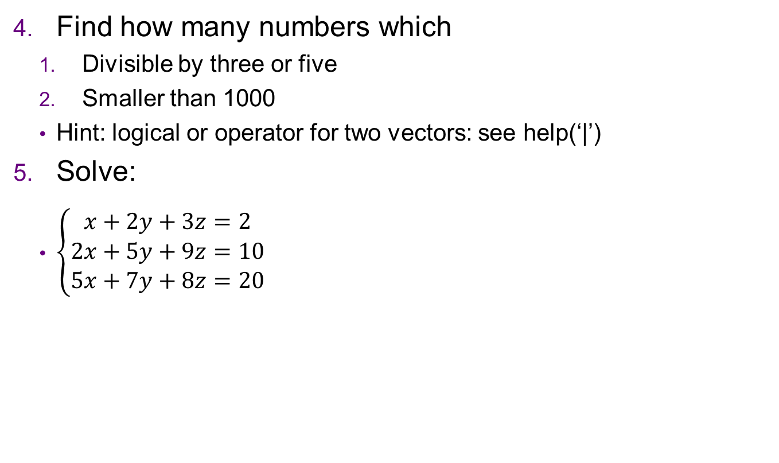
Practice 1
Find how many numbers which
Divisible by three or five
Smaller than 1000
Hint: logical or operator for two vectors: see help(‘|’)
Solve:
$\left\{\begin{aligned}x+2y+3z=2 \\ 2x+5y+9z=10 \\ 5x+7y+8z=20\end{aligned}\right.$

Slide 6
Practice 1
Load data frame from “apple_juice.csv” by
aj = read.csv(“apple_juice.csv”) # take a look at "Load an Excel(csv) file"
and run these commands
summary(aj); summary(aj$pH) # summary function
mean(aj$pH)
median(aj$pH)
range(aj$pH)
var(aj$pH)
sd(aj$pH)

Slide 7
Graph

Slide 8
Practice 2
Draw these graphs:
y = x
y = cos(x)
y = asin(x)
y = atan(x)
y = log(x)
y = exp(x)
y = floor(x)
y = trunc(x / 60)
y = trunc(x %% 60)
y = floor(log10(x)) + 1

Slide 9
Practice 2
To draw multiple graphs, run
same axis:
plot(x, y1, type=‘l’)
lines(x, y2, type=‘l’) # just draw line over the graph
multiple axis:
par(mfrow=c(1,2)) # create two graphs on a window
plot(x, y1, type=‘l’) # draw first graph
plot(x, y2, type=‘l’) # draw second graph
par(mfrow=c(1,1)) # reset layout(single graph)
Try 1. and 2. for x=seq(0,1,len=1000), y1=x^2, y2=exp(x)-1

Slide 10
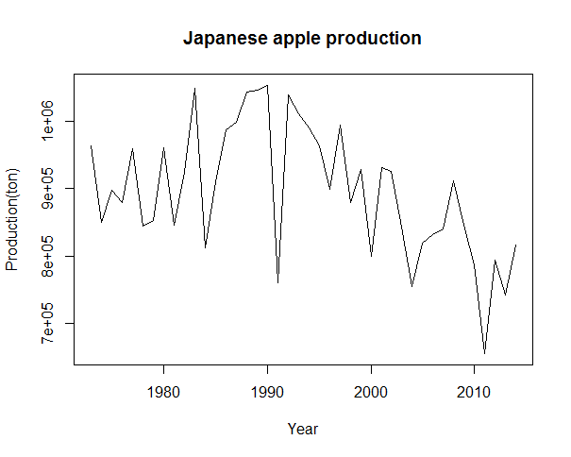
Practice 2
From apple_production.csv, make a chart of apple production by years, like

Slide 11
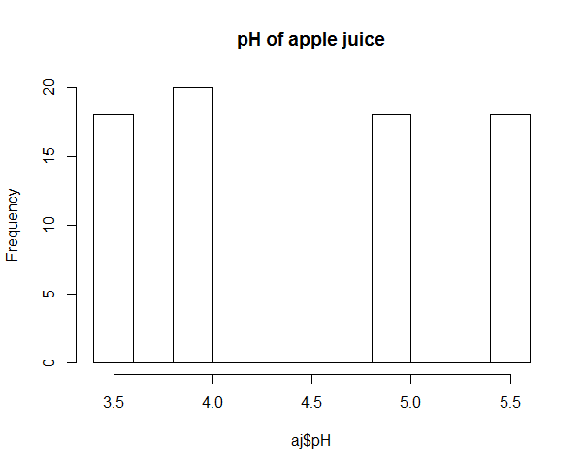
Practice 2
From apple_juice.csv, make a historgram of pH

Slide 12
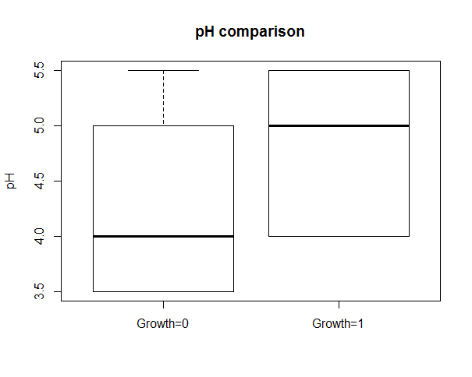
Practice 2
Form apple_juice.csv, make a boxplot that
y axis is pH.
two boxes(first: Growth=0, second: Growth=1)

Slide 13
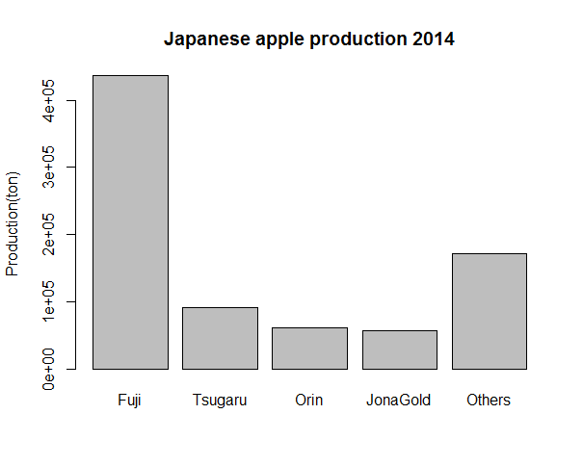
Practice 2
From apple_production.csv, make a bar chart of each variety (Fuji, Tsugaru, Orin, Jona Gold) and Others (Production – four variety) in 2014

Slide 14
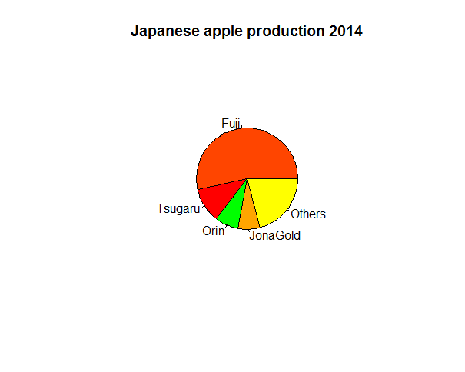
Practice 2
From apple_production.csv, make a pie chart of each variety (Fuji, Tsugaru, Orin, Jona Gold) and Others (Production – four variety) in 2014

Slide 15
Programming

Slide 17
References & Acknowledgements
from http://stackoverflow.com/questions/8145694/solving-simultaneous-equations-with-r
http://www.stat.ufl.edu/~winner/data/apple_juice.dat
http://www.stat.ufl.edu/~winner/data/apple_juice.txt
http://www.ringodaigaku.com/study/statistics/production_kind.html

