Slide 1
Digital Signage
Team JEDi
Jared Miller
Eric Batsaikhan
Darien Clay
i

Slide 2
Overview
Current solution
Goal solution
Technology stack
Persona
Use Cases
Architecture
Class hierarchy
Sequence Diagram
Product Demo

Slide 3
What’s Signage???

Slide 4
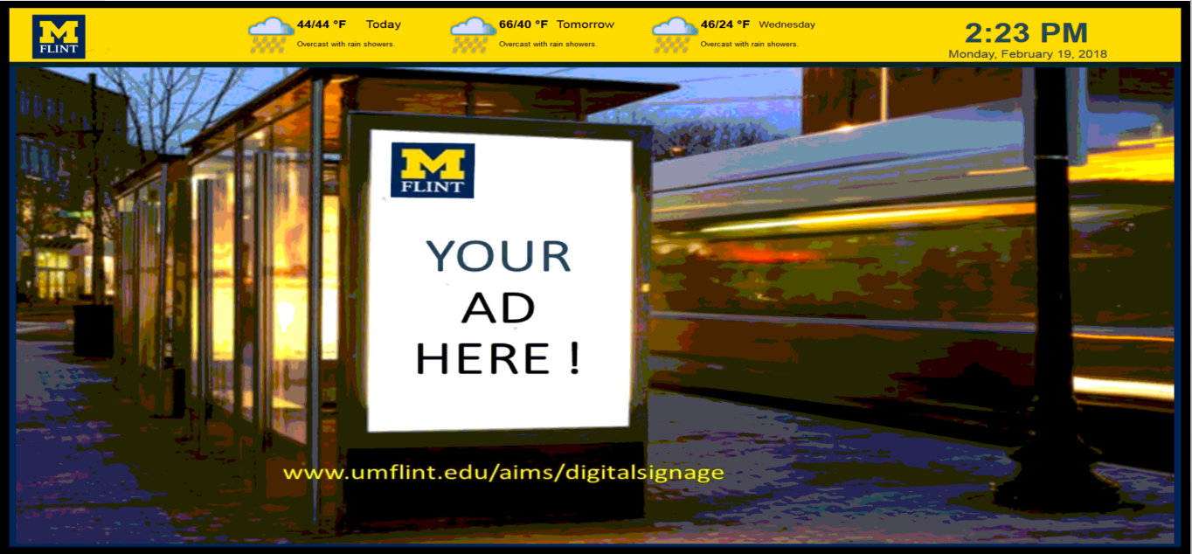

You may have seen...
Provide information to passers-by
Advertising space for student groups
Promoting special events

Slide 5
So what’s new?

Slide 6
Limitations of existing system
Prohibited by (ethernet) network access
Requires a full Windows installation
Temperamental licensing system (NIC locked)
No (stable) previewing feature
Inevitably using aging hardware

Slide 7
Target features
Integrated wireless access
Linux based players
OS-agnostic management interface
Preview sign display
Solid state hardware (no moving parts)
Lightweight, low energy use

Slide 8
Technologies - Management Interface
Front-end
Browser-based
Vue.js
Bootstrap
Back-end
Node.js (platform agnostic)
Local sqlite3 database
Sequelize ORM layer
Express webapp framework

Slide 9
Technologies - Player
Raspberry Pi 3 Model B
Chromium rendering
On-board 802.11 (Wi-Fi) networking
SSH control and data transfer
HDMI output

Slide 10
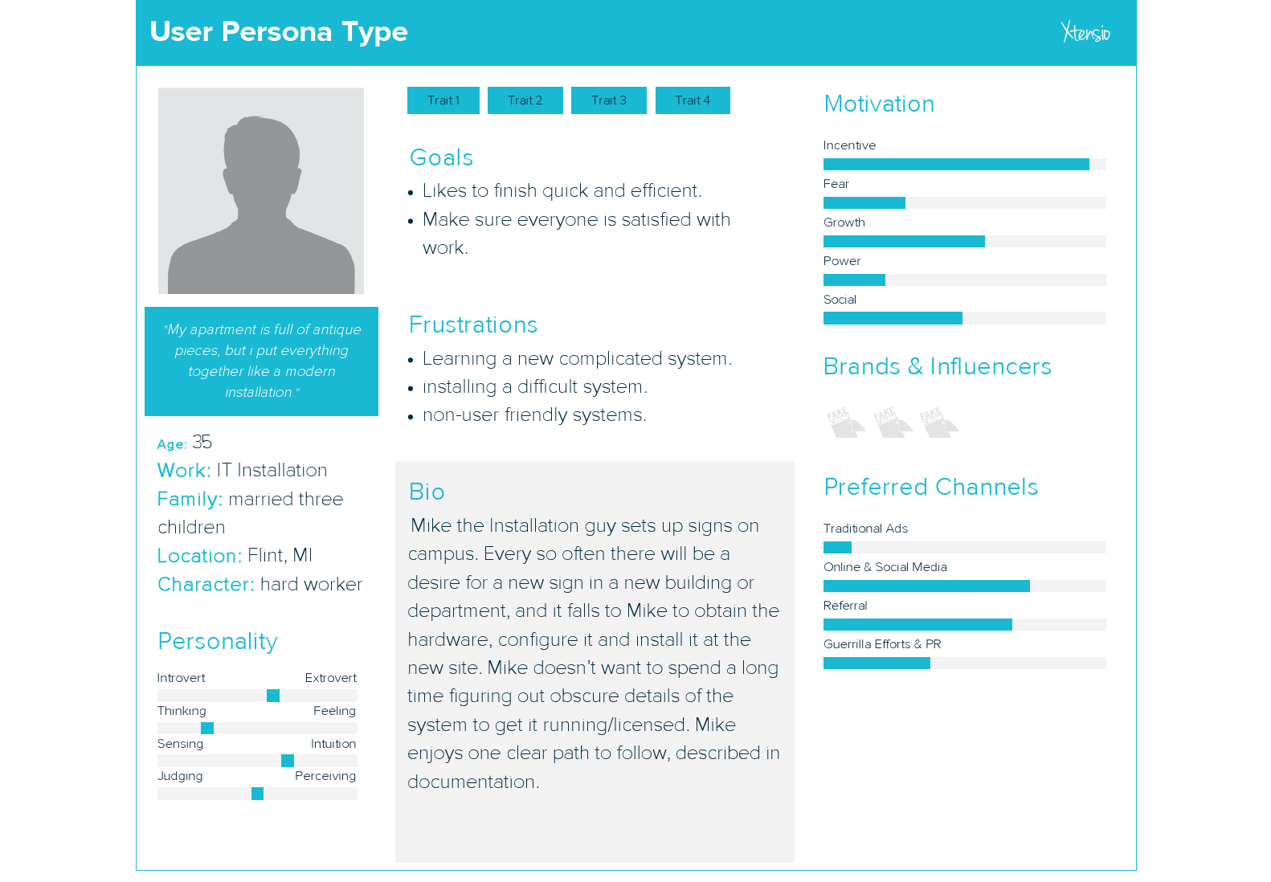

Slide 11
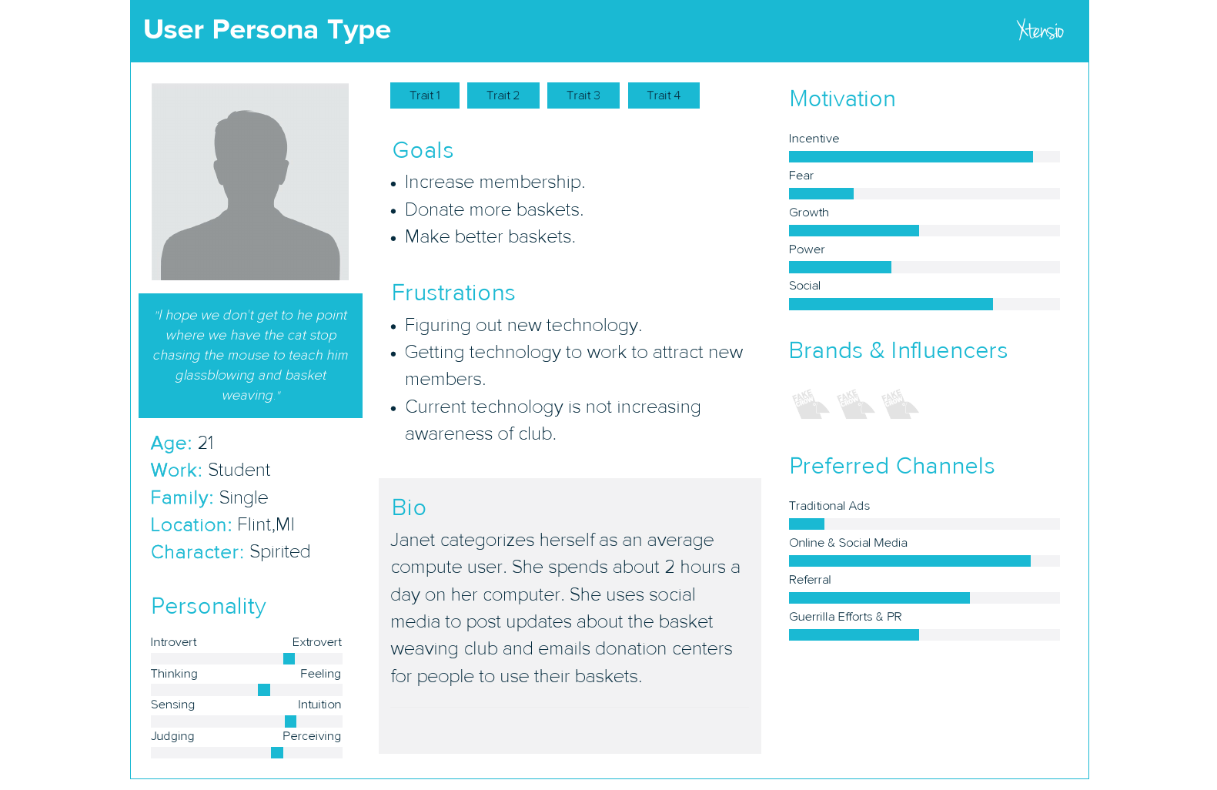

Slide 12
Use Cases

Slide 13
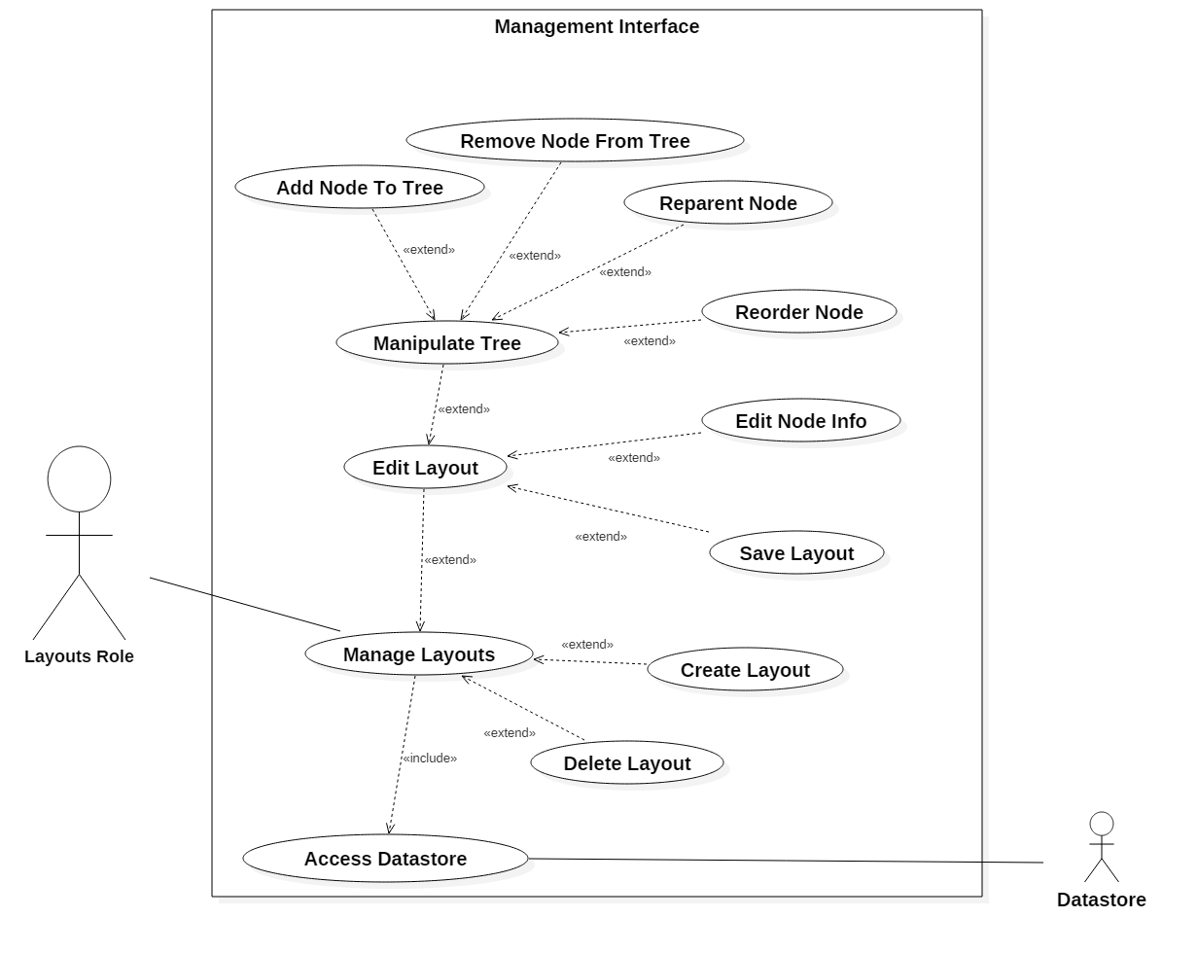

Slide 14
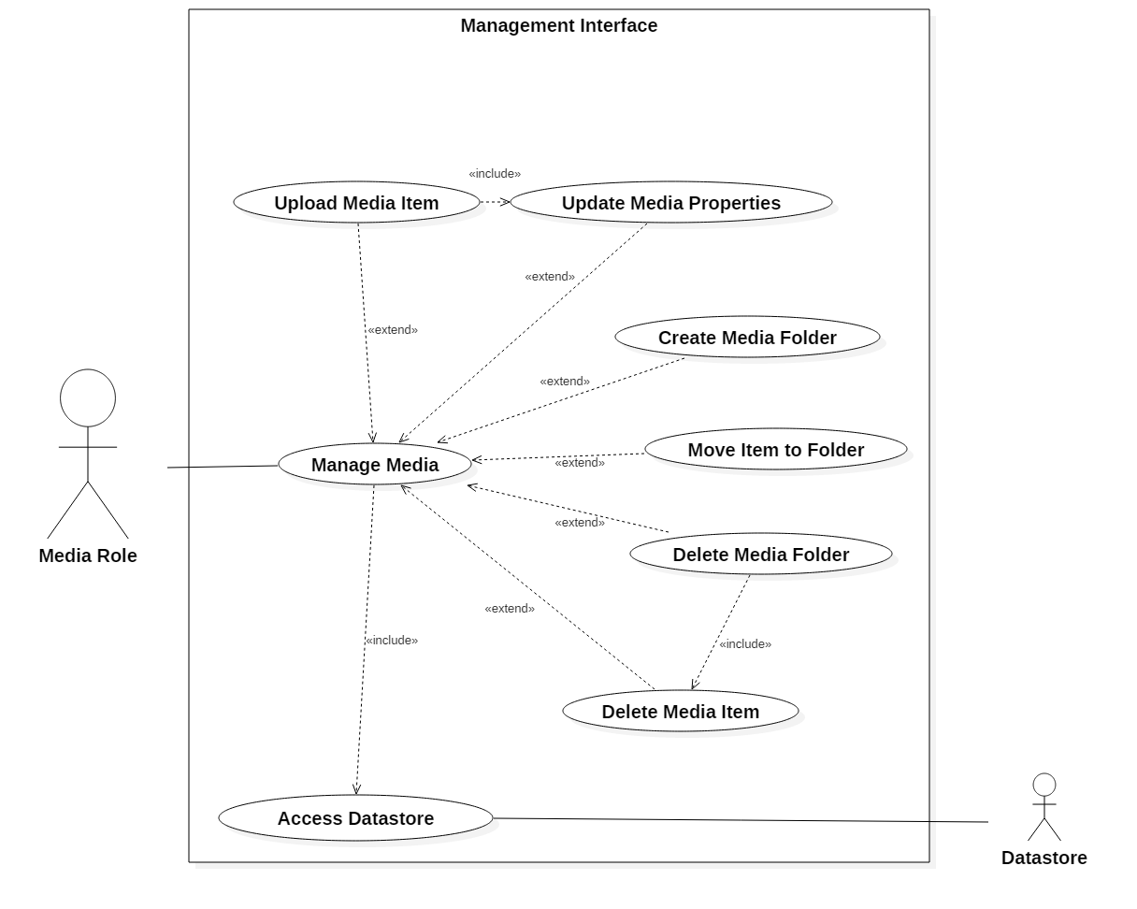

Slide 15
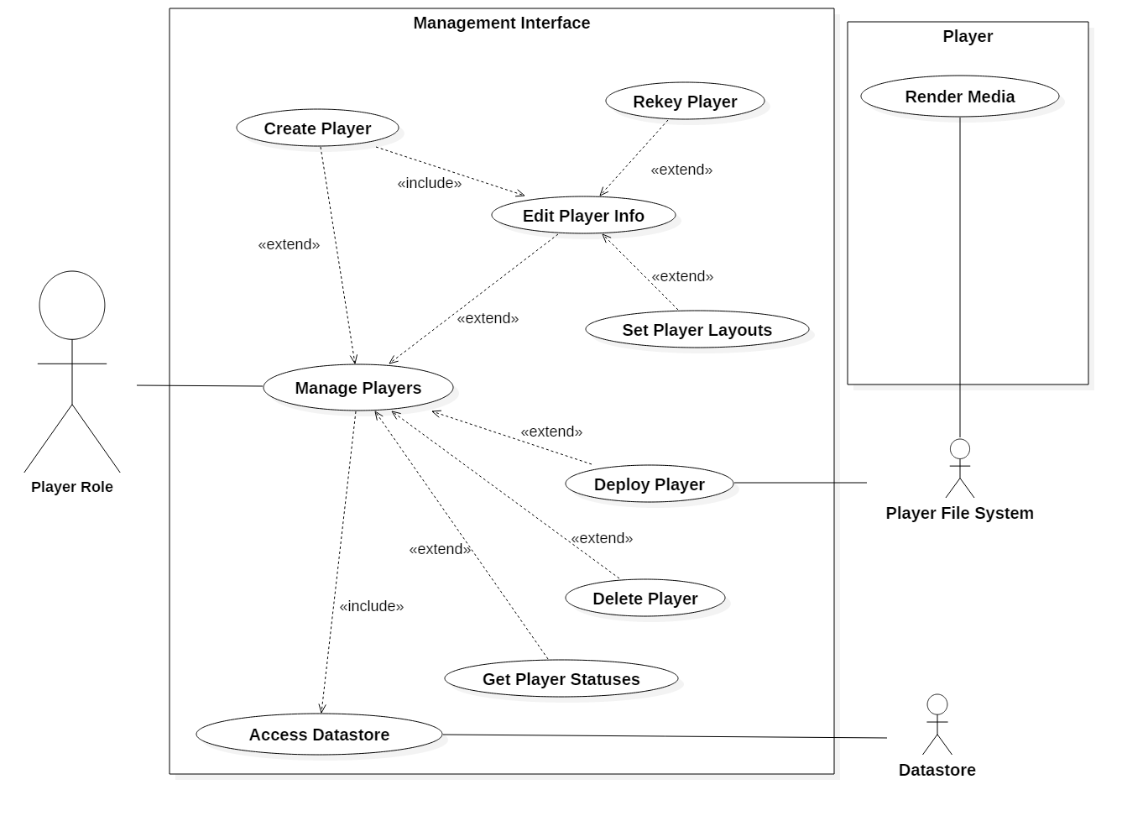

Slide 16
Use Case: Upload media (UPLD)
Actor: Media Role Pre-conditions
User is at the Media listing screen
Post-Conditions
New Media Item exists in the system data store
User remains on the Media Info screen for the new item

Slide 17
Use Case: Upload media (UPLD)
Use case begins when the user is on the media listing screen
System presents user with an "uploads" button
User selects the "uploads" button
System presents the user with a list of pending uploads
System presents the user with a "Select Files" button
User selects the "Select Files" button
System prompts user to select files off of their machine
User submits files
System saves the submitted files and prompts the user to input their information (Same as use case "Update Media Properties")
User sets the information for the new files (name, default duration, schedule) and selects "Save"
Use case ends when the system commits the new media item and its information

Slide 18
Use Case: Upload media (UPLD)
Alternative courses of Action
The user may drag files from their computer to a specific folder in the media listing in (1), the file(s) uploads and they are prompted to finalize the item information, continuing in (9). The item is placed in the designated folder after commit
The user may drag files from their computer for upload instead of (5-8)
The user may choose to skip (10-11) and return to enter the information later
Exceptions
If the user inputs an invalid file in (8) (e.g. not an image), an appropriate message is displayed and the file is discarded
In the event of a transmission or other error in (9) an appropriate message is displayed

Slide 19
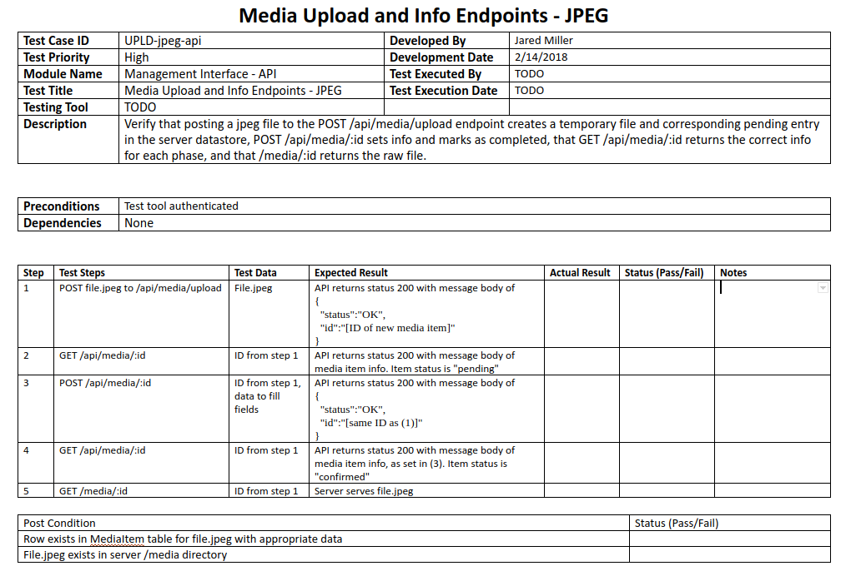

Slide 20
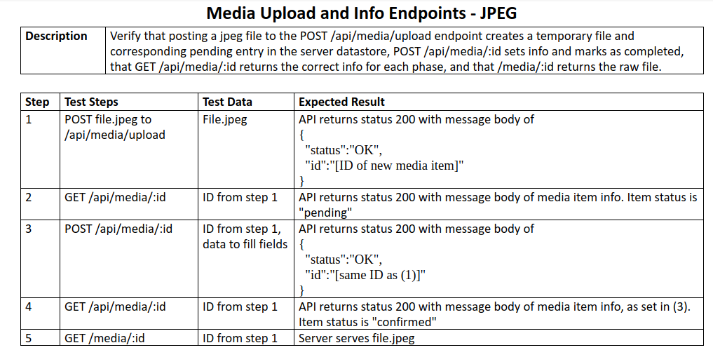

Slide 21
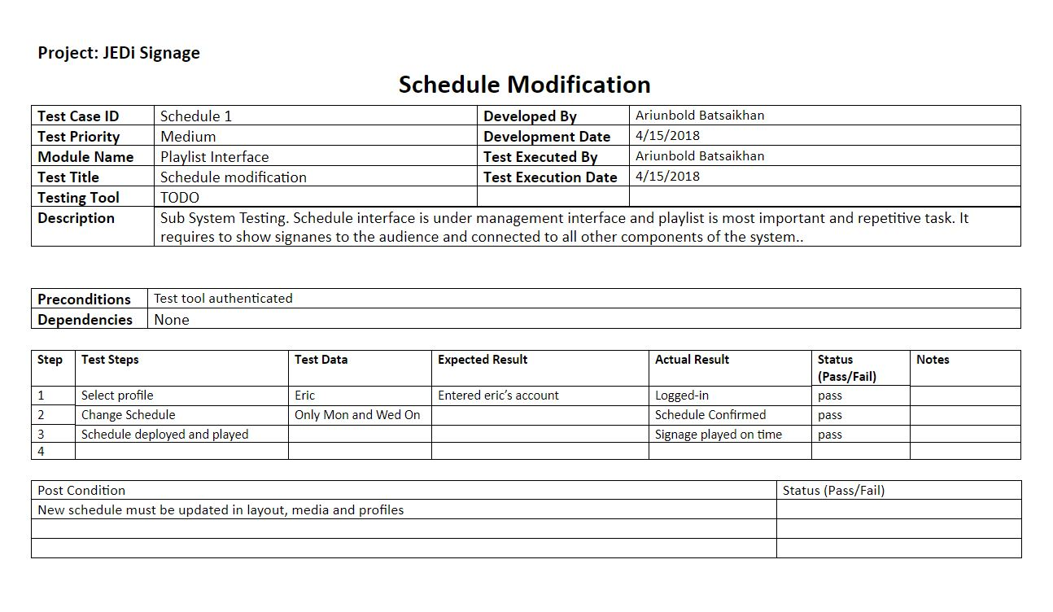

Slide 22
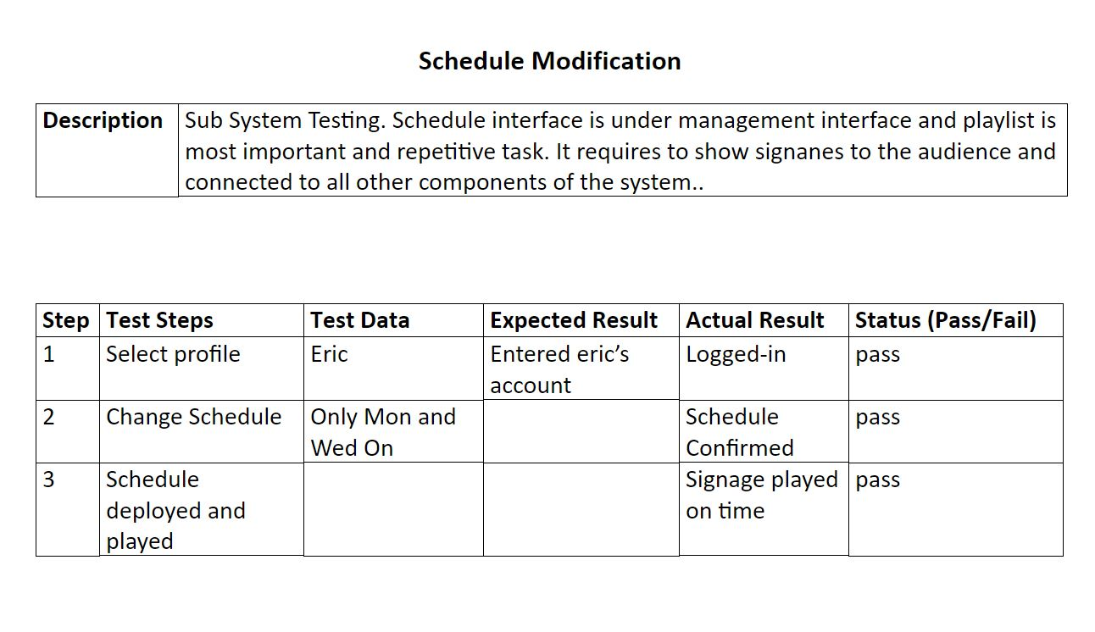

Slide 23
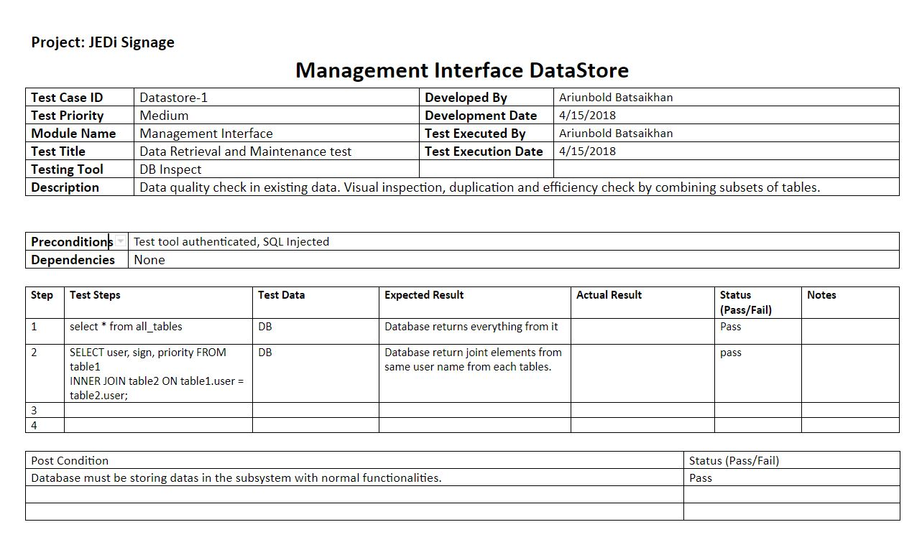

Slide 24
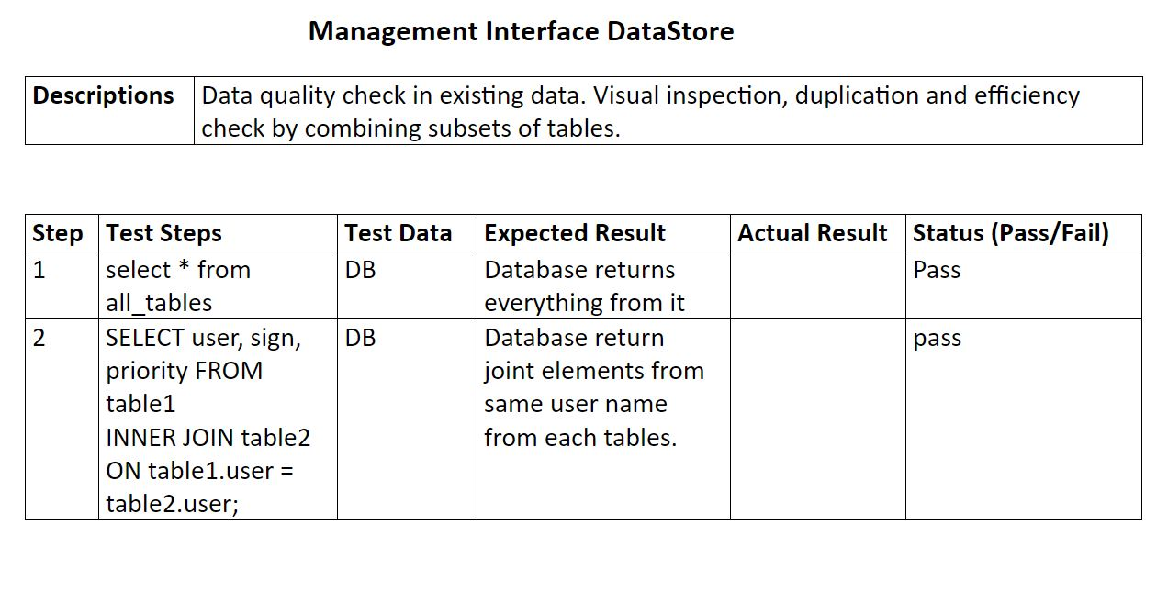

Slide 25
Classes - persistent

Slide 26
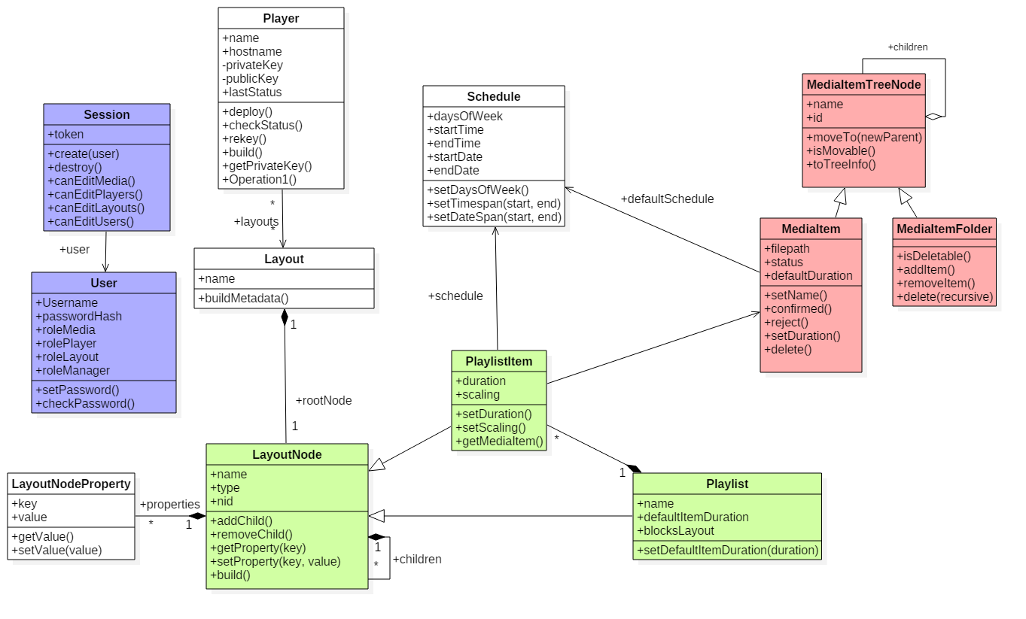
Notes:
Red piece of media
Green layout.

Slide 27
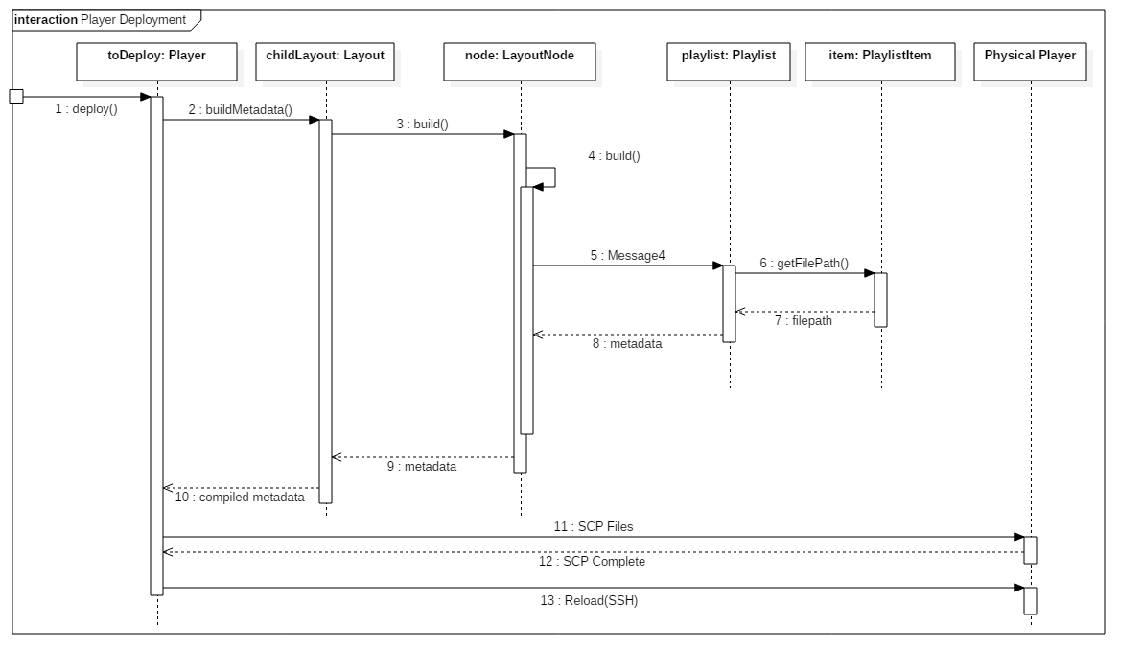

Slide 28
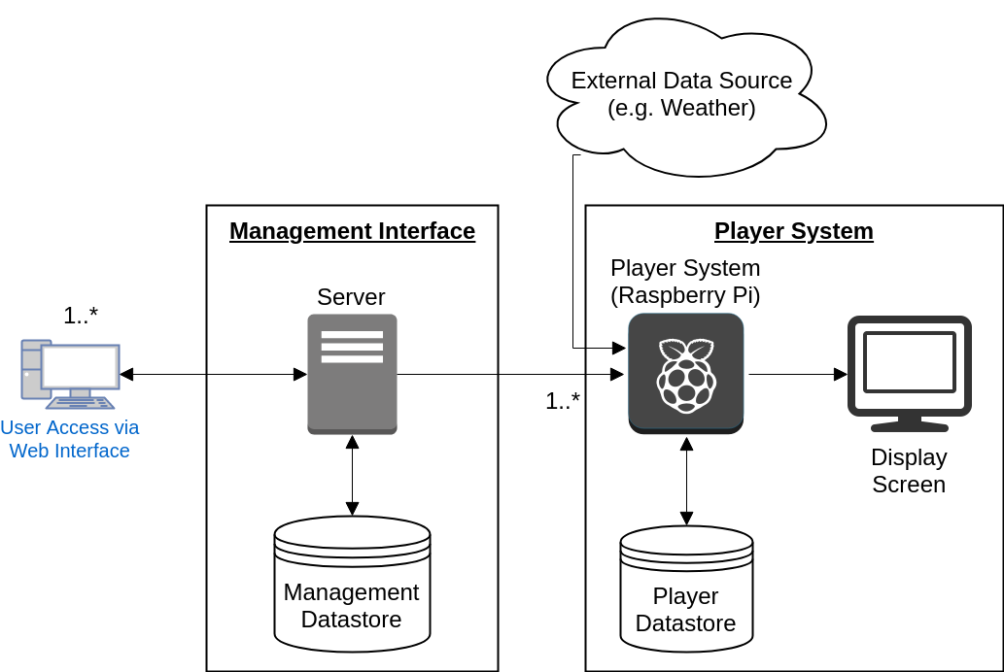
Architecture
Notes:
Scratch this

Slide 29
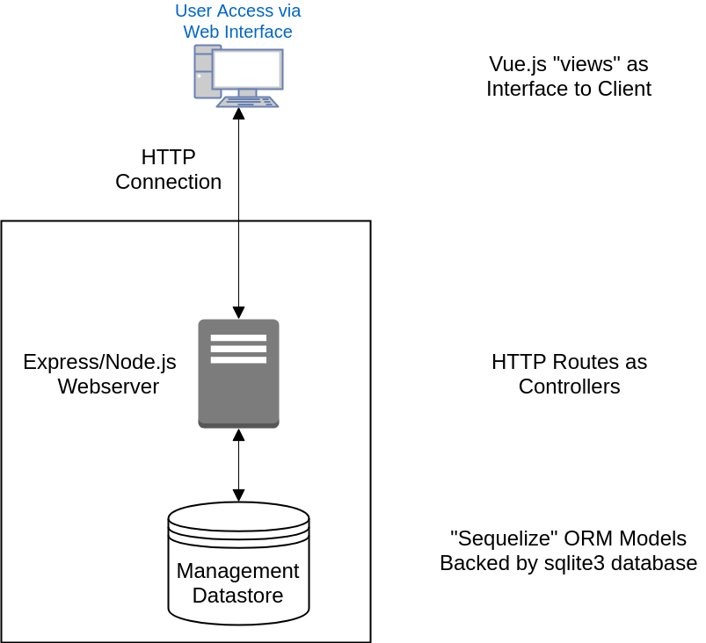
Architecture
Notes:
Scratch this

Slide 30
Product Demo

Slide 31
Questions

