Slide 1
Digital Signage
Team JEDi
Jared Miller
Eric Batsaikhan
Darien Clay
i

Slide 2
Overview
Current solution
Goal solution
Technology stack
Persona
Use Cases
Architecture
Class hierarchy
Sequence Diagram
Storyboard

Slide 3
What’s Signage???

Slide 4


You may have seen...
Provide information to passers-by
Advertising space for student groups
Promoting special events

Slide 5
So what’s new?

Slide 6
Limitations of existing system
Prohibited by (ethernet) network access
Requires a full Windows installation
Temperamental licensing system (NIC locked)
No (stable) previewing feature
Inevitably using aging hardware

Slide 7
Target features
Integrated wireless access
Linux based players
OS-agnostic management interface
Preview sign display
Solid state hardware (no moving parts)
Lightweight, low energy use

Slide 8
Technologies - Management Interface
Front-end
Browser-based
Vue.js
Bootstrap
Nightwatch e2e/integration testing
Back-end
Node.js (platform agnostic)
Local sqlite3 database
Sequelize ORM layer
Express webapp framework
Mocha unit testing

Slide 9
Technologies - Player
Raspberry Pi 3 Model B
Chromium rendering
Investigating custom SDL/Libav rendering
Better leverages onboard GPU
On-board 802.11 (Wi-Fi) networking
SSH control and data transfer

Slide 10
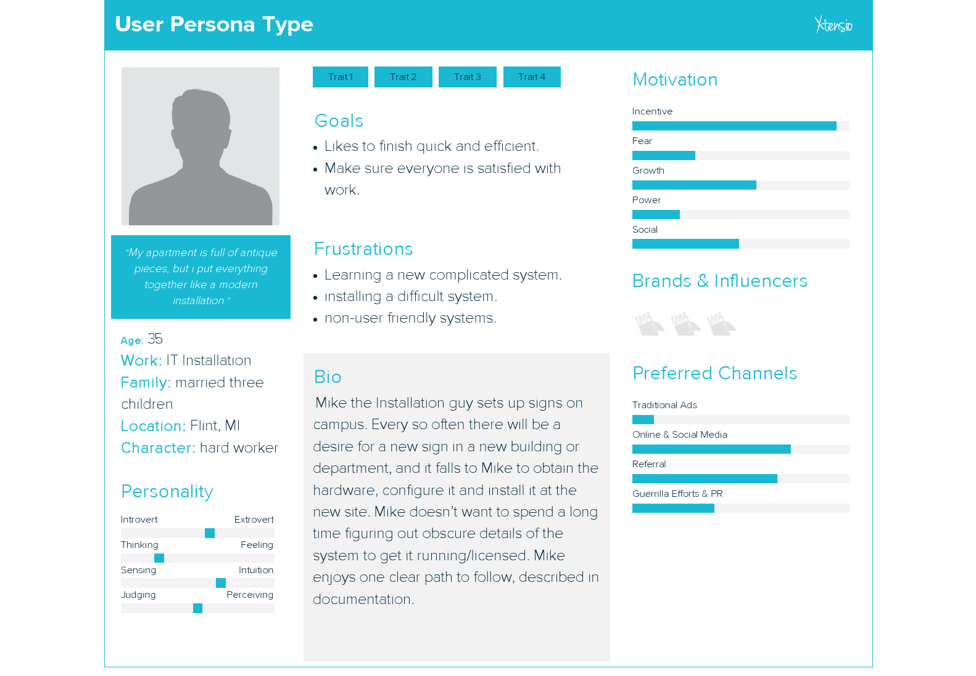

Slide 11
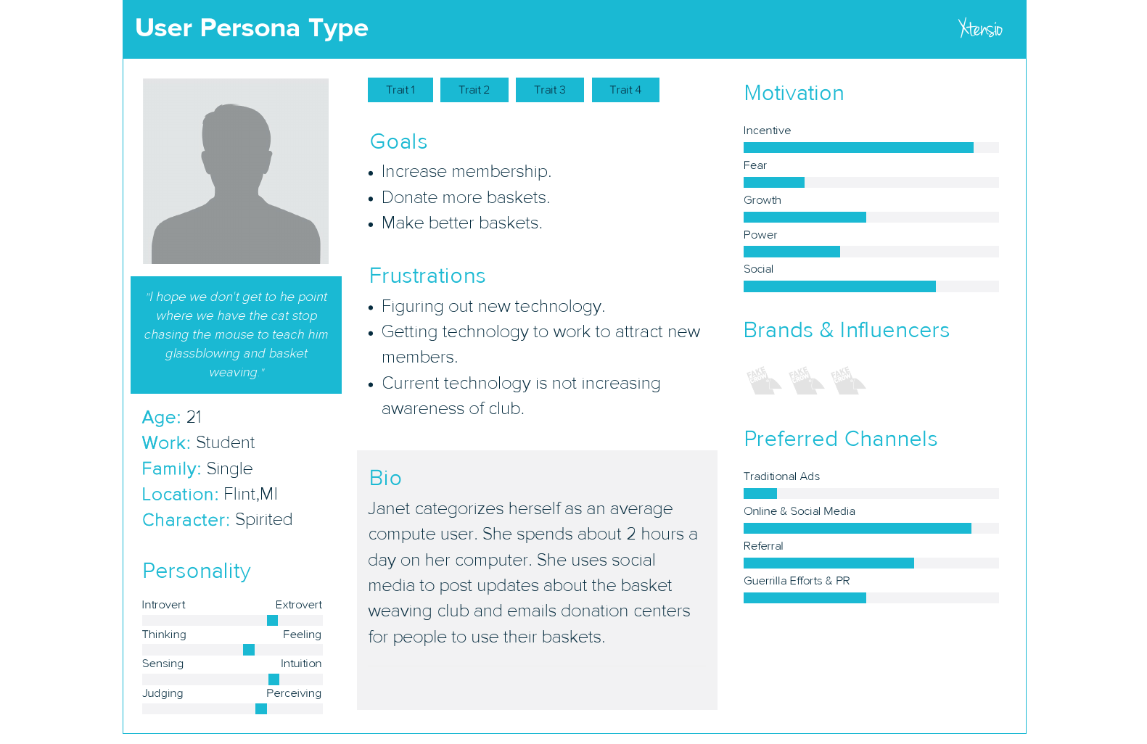

Slide 12
Use Cases

Slide 13
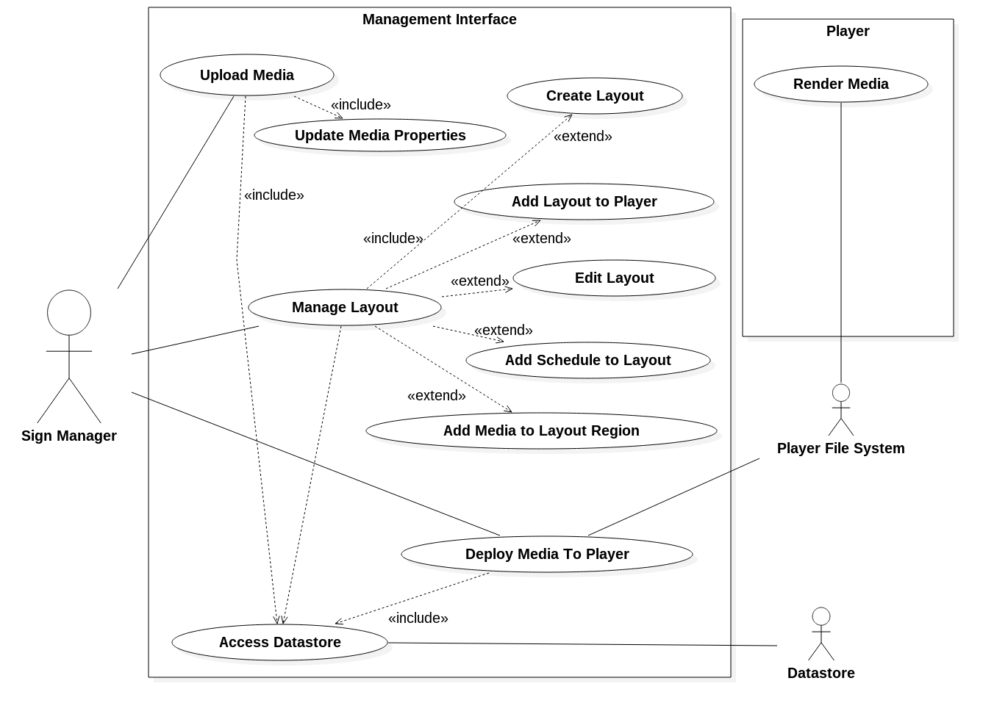

Slide 14
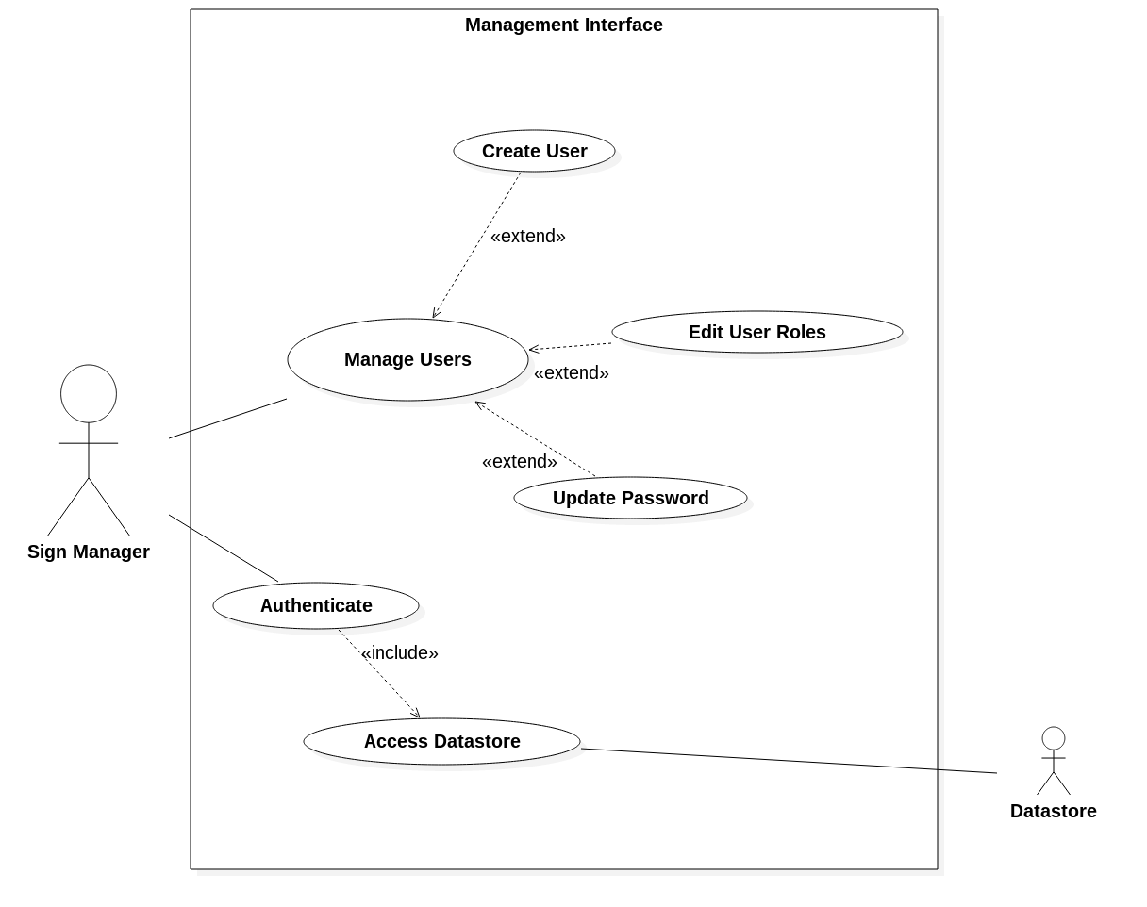

Slide 15
Use Case: Upload media (UPLD)
Actor: sign manager Pre-conditions
Sign manager has authenticated with the management interface
Page with navigation menu active
Media available on managers local computer

Slide 16
Use Case: Upload media (UPLD)
Use case begins when the manager activates the “Upload media” menu option
System shall display an interface prompting for the upload of files
System shall retrieve and display a list of pending uploads (missing info/not confirmed)
Manager shall provide one or more media files either via a “choose file” flow (browser agent provided functionality) or via a “drag and drop” interface (if supported)
System shall receive files, save to a temporary location and add to the list of pending files
System shall prompt manager to add info to pending media files
Manager shall select a pending media file to add info to (name, orientation, distortion allowed, et al)
System shall prompt manager for info, providing defaults (name from file name, orientation from image dimensions, etc)
Manager shall enter appropriate info and select submit button
Use case ends when system saves submitted info and marks media file as no longer pending

Slide 17
Use Case: Upload media (UPLD)
Alternative courses of Action
Manager may choose to not immediately add info to a file in D.7, and instead return later to add info (skipping D.4-D.5)
Exceptions
If an invalid file is submitted to the system in D.5, upload should fail, file should be discarded and manager should be presented with an appropriate error message
If an upload is interrupted in D.5, upload should fail, partial file should be discarded, and manager should be presented with an appropriate error message

Slide 18
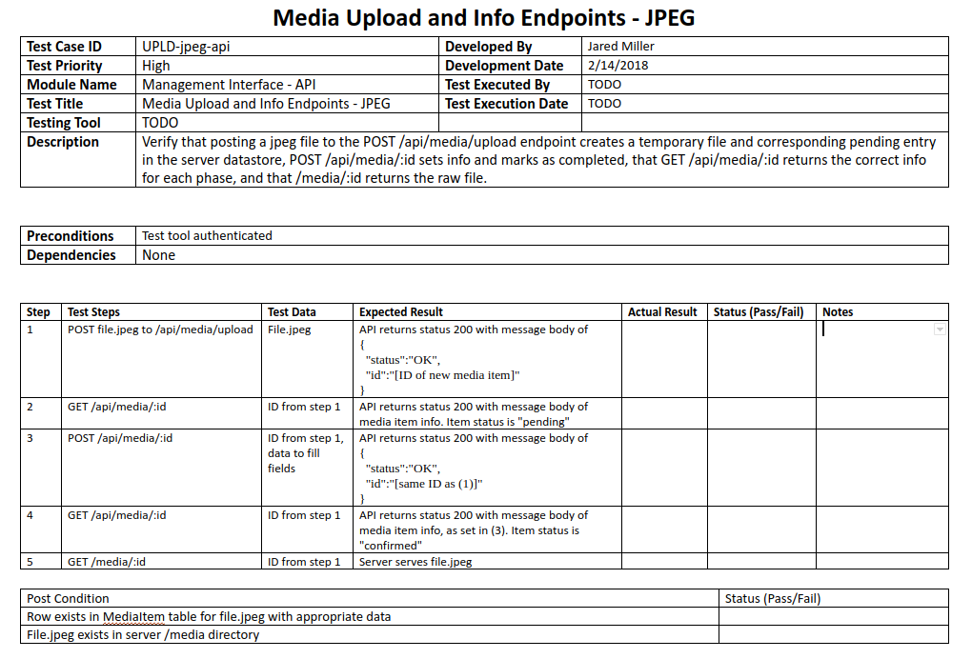

Slide 19
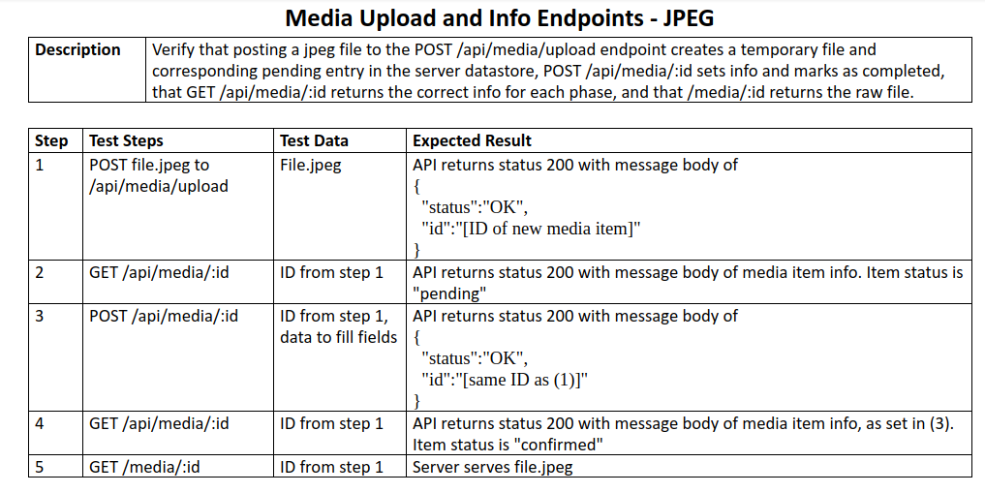

Slide 20
Classes - persistent

Slide 21
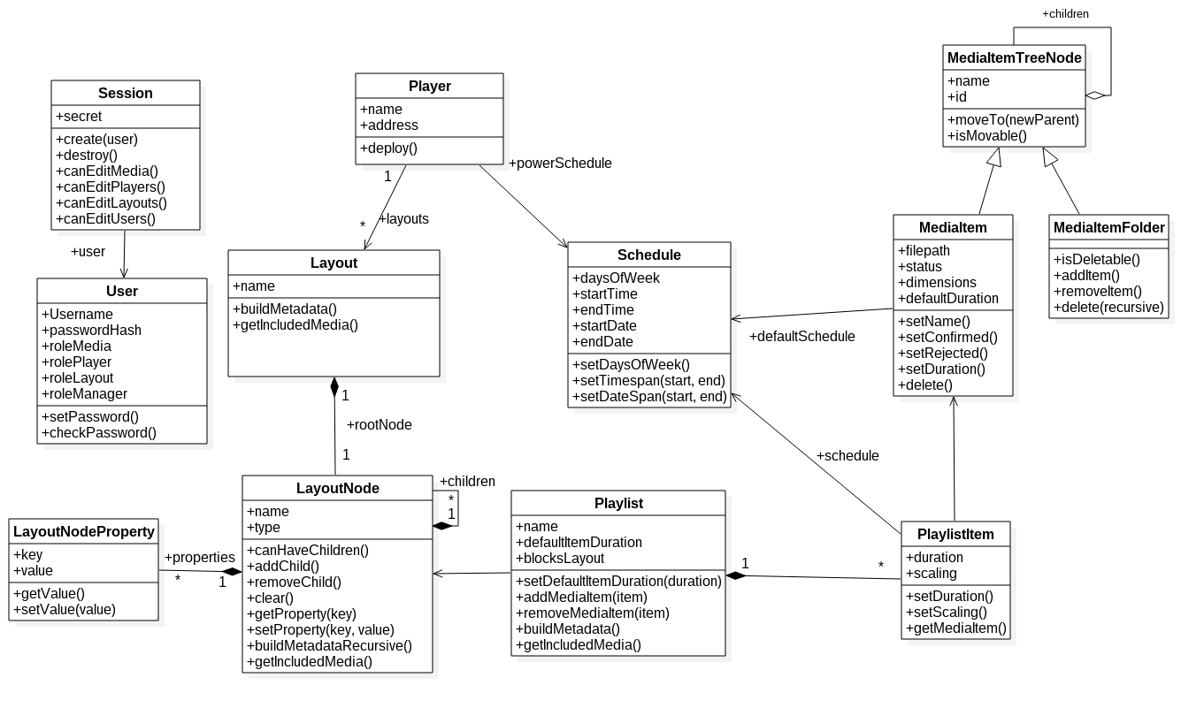

Slide 22
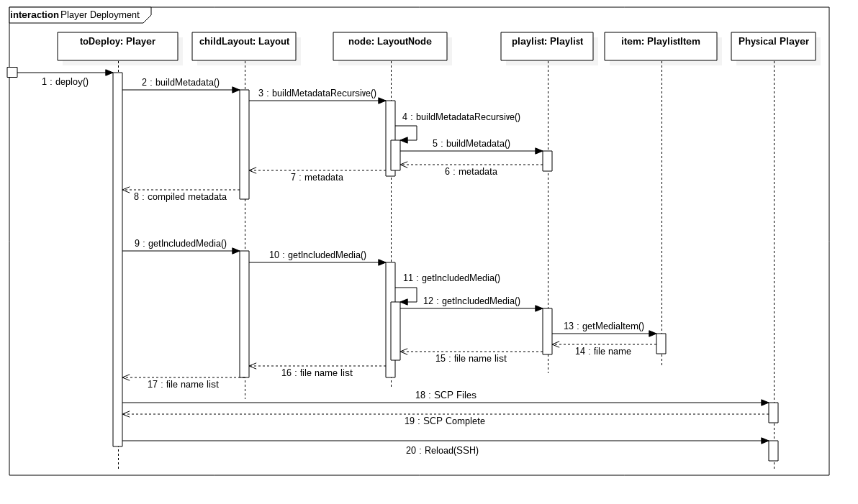

Slide 23
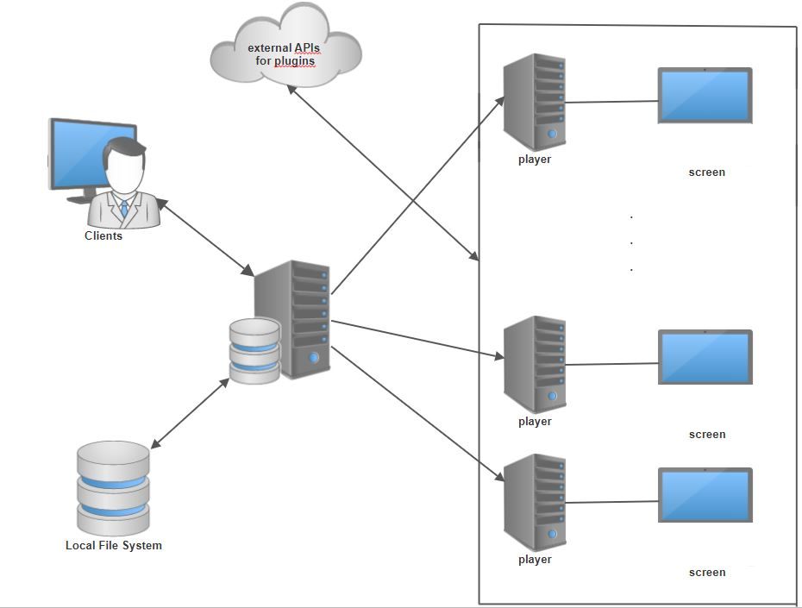
Architecture
Notes:
Scratch this

Slide 24
Storyboard

Slide 25
Questions

