Slide 1

2022 Commencement Plan
James Poterba
Chair, Commencement Committee
Mitsui Professor of Economics
15 December 2021

Slide 2
The Warrant for Change
Friday graduation ceremony was too long
2,456 degrees presented in Killian Court in 2019, with expected future growth
5 ½ hours for graduates, 4 ½ for faculty, from assembly to closing
Doctoral Hooding (536 degrees) on Thursday was another 4 ¼ hours
Inclement weather plans would exclude many would-be participants

Slide 3
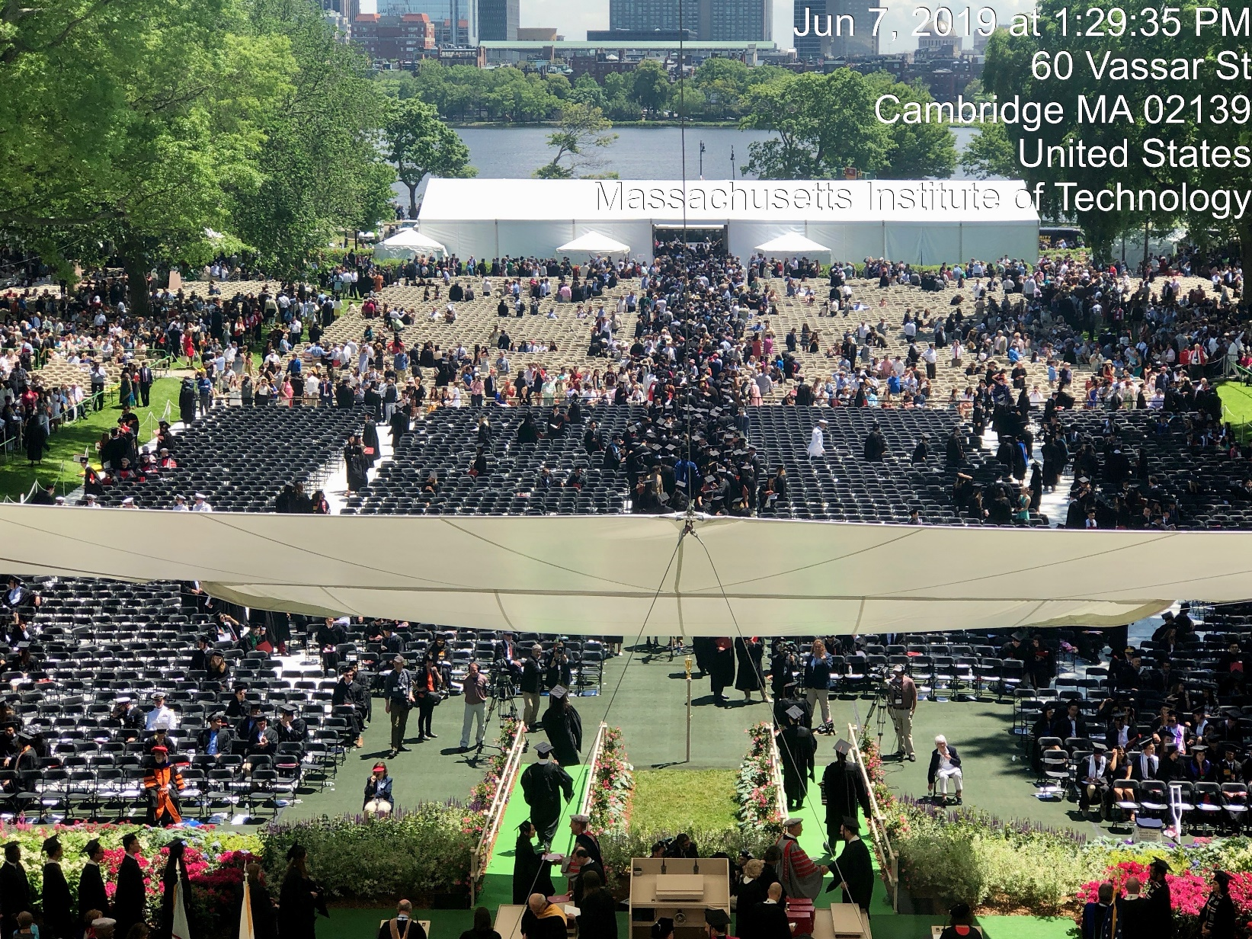
End of 2019 Commencement
Jim, we’ll add the photo!

Slide 4
MIT Community: Preferences and Values
All students would like a Killian Court experience
Important for family and friends to attend
Undergraduates would like to graduate together
More personal experience for all advanced degree candidates

Slide 5
Commencement of the Future
OneMIT Ceremony in Killian Court for all degree recipients
Morning of Friday, May 27
Commencement speaker
Charge to the graduates from President Reif
Undergraduate degrees presented in a tent on athletic fields
Afternoon of Friday, May 27
For undergraduates receiving a Bachelor’s degree

Slide 6
Commencement of the Future (cont’d)
Advanced degree presentations: Multiple ceremonies
Master’s and Doctoral graduates recognized at ceremonies held by the Schools and College.
Doctoral hoods presented at these ceremonies.
Multiple locations based on group size.

Slide 7
Advanced Degree Ceremonies
Thursday, May 26 events
School of Architecture and Planning
School of Engineering and Schwarzman College of Computing
School of Humanities, Arts, and Social Sciences
School of Science
Sloan School of Management will announce their ceremony schedule at a later date.
Times and locations are expected in January.

Slide 8
Commencement Committee’s Charge
Design the OneMIT ceremony for the morning of Friday, May 27, 2022
Oversee coordination across multiple events
Guide the creation of new traditions

Slide 9
What about the 2020 and 2021 graduates?
Members of both classes will be invited to campus for a special ceremony on Saturday, May 28.
This will be their chance to wear regalia, hear their names called, and cross the stage.
Institute Events and the MIT Alumni Association are partnering to present the special celebration as part of Tech Reunions.

