Slide 1

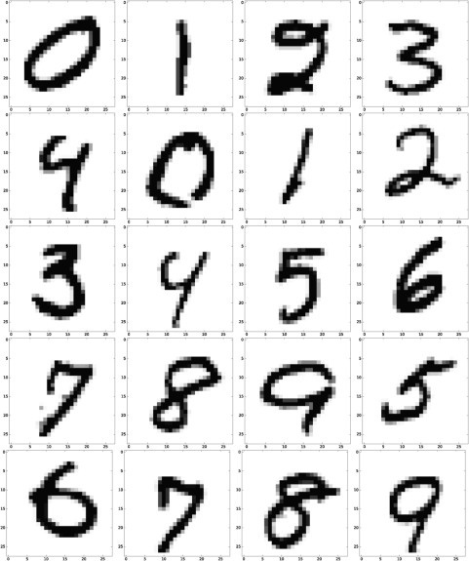
MNIST Digit Classification Project
This presentation details a deep learning approach to handwritten digit recognition using the MNIST dataset. We will cover data preprocessing, model architecture, training results, challenges, and solutions.
Notes:
1

Slide 2
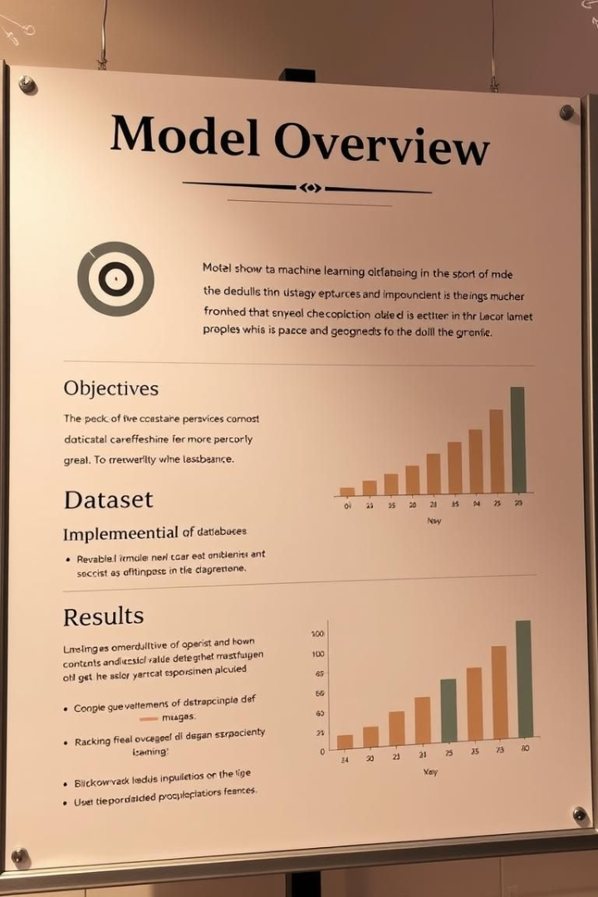
Project Overview
Objective
Build a CNN to classify digits.
Dataset
MNIST: 60K train, 10K test.
Implementation
TensorFlow/Keras CNN model.
Results
99% accuracy on test set.
Notes:
2

Slide 3
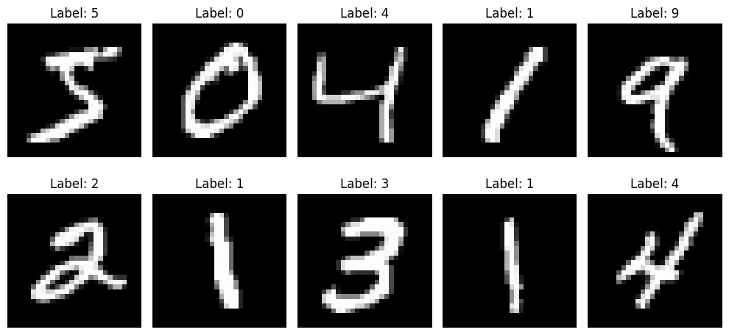
LOAD DATA
Notes:
3

Slide 4



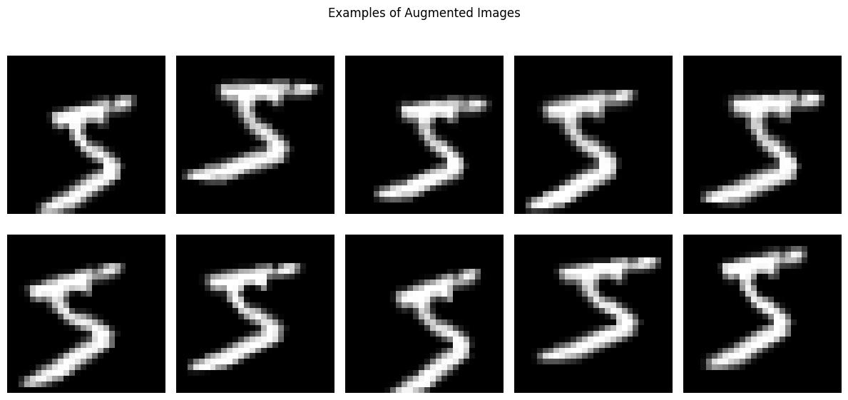
Data Preprocessing & Augmentation
Normalization
Reshaping
Augmentation
Scaled pixel values to [0,1].
Images to 28x28x1 format.
Rotation, zoom, shifts.
Notes:
3

Slide 5
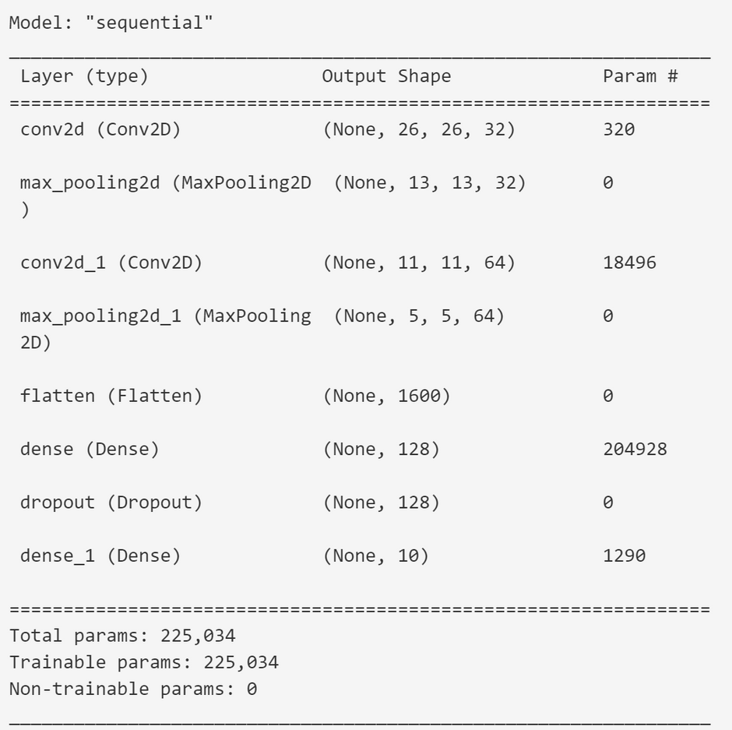
Build and Compile CNN Model
Notes:
4

Slide 6
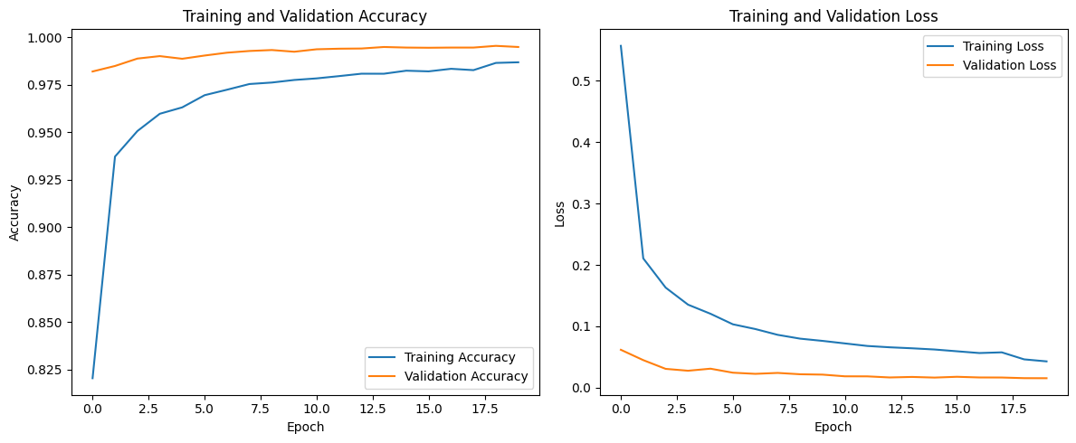
Evaluate Model Performance
Notes:
4

Slide 7
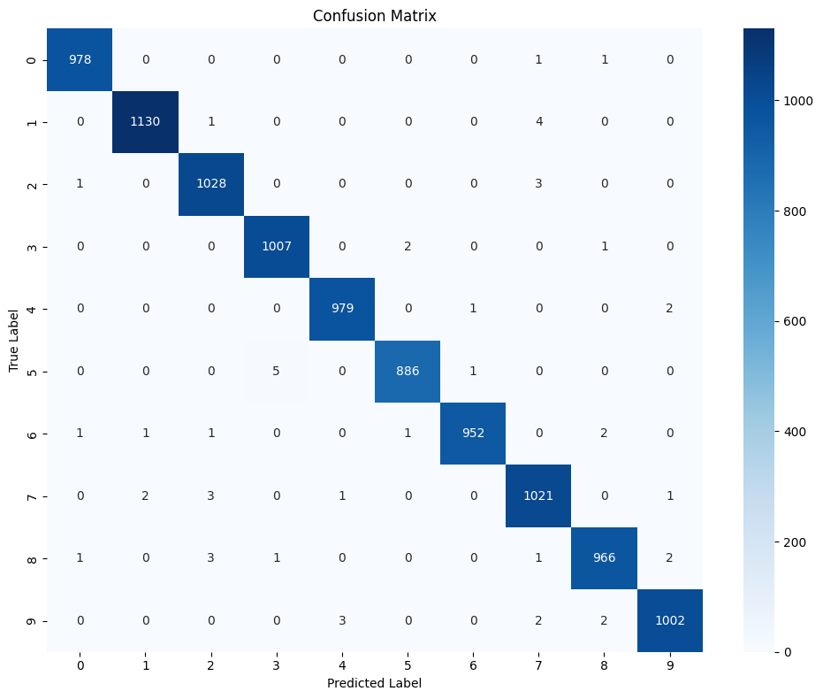
Generate Confusion Matrix and Classification Report
Notes:
4

Slide 8
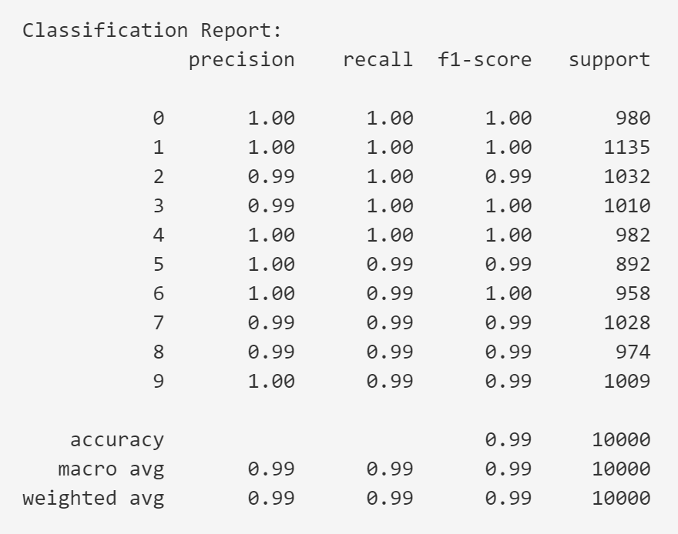
Generate Confusion Matrix and Classification Report
Notes:
4

Slide 9
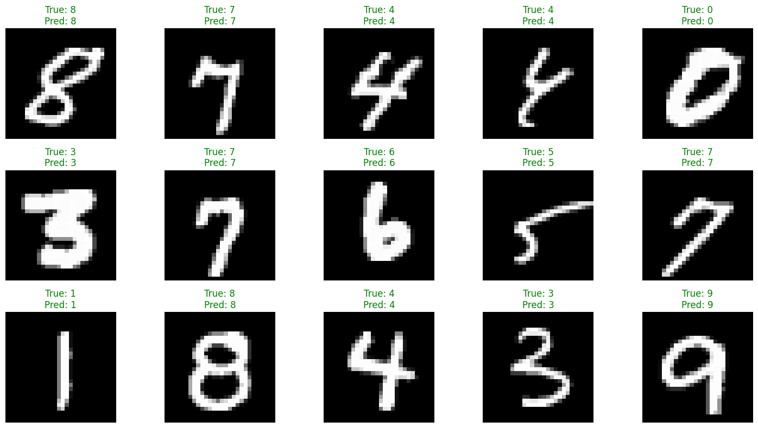
Visualize Model Predictions
Notes:
4

Slide 10

Challenges & Solutions
Challenge
Solution
Overfitting
Dropout + Augmentation
Training Time
Callbacks + GPU
Class Imbalance
Matrix + Class Weights
Notes:
5

