Slide 1


AI Sales Agent: Solution Presentation
This presentation introduces an AI Sales Agent solution.
It covers key functionalities, technical details, and achievements. We will explore how this AI agent simulates sales conversations effectively.
Notes:
1

Slide 2

Objective: Conversational AI Agent
Conversational AI
Product Inquiries
Create an AI agent that simulates sales conversations.
Handle product inquiries and recommendations.
Conversation Scenarios
Demonstrate multiple conversation scenarios.
Notes:
2

Slide 3
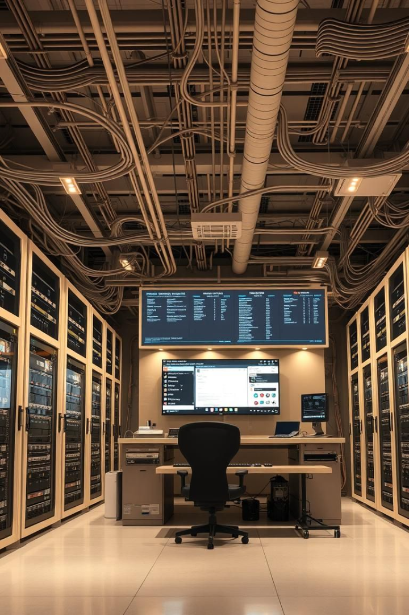
Technical Approach Overview
Architecture
sales_agent.py
main.py: UI and application flow
AI conversation logic
config.py: API configuration
.env: API key storage
product_catalog.py: Product data
Technologies
Streamlit (UI Framework)
Google Gemini API (Conversational AI)
Python (Backend Logic)
Notes:
3

Slide 4
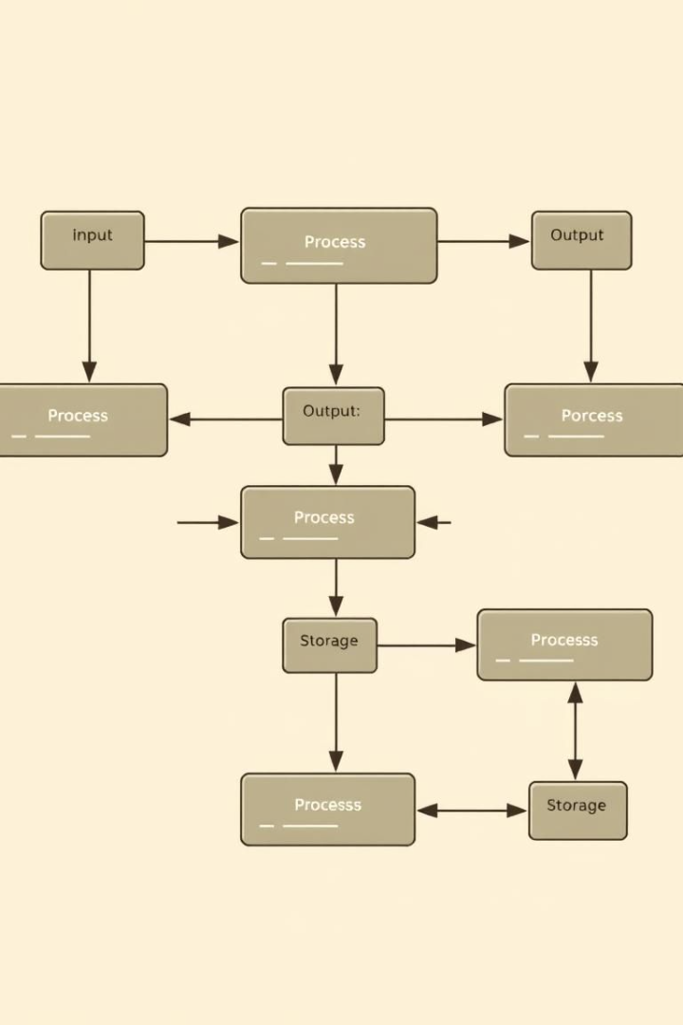



Modular Code Structure
Separation of Concerns
Divided concerns into logical components.
Maintainability
Improved maintainability and readability.
Testing
Enabled easier testing and debugging.
Notes:
4

Slide 5
Conversational UI & AI
Conversational UI
AI Integration
Chat-based interface for natural interactions
Custom prompt engineering
Context preservation
Error handling for API robustness
Dynamic category buttons
Conversation history formatting
Notes:
5

Slide 6
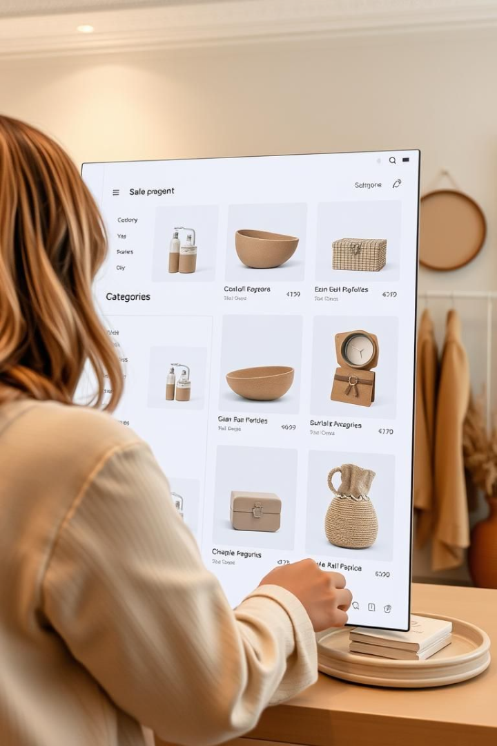




Product Category Exploration
User Inquiry
Category Detection
Category Buttons
User asks about a product category.
Category buttons appear.
System detects category mentions.
Product Display
System displays available products.
Notes:
6

Slide 7





Budget-Based Recommendations
Budget Mention
Price Requirement
User mentions budget constraints.
2
AI processes price requirements.
Recommendations
4
Product Filtering
3
Recommendations match criteria.
System filters products.
Notes:
7

Slide 8



Product Comparison
Comparison Request
User asks to compare products.
Product Identification
AI identifies specific products.
Comparative Analysis
System provides comparative analysis.
Notes:
8

Slide 9

Challenges and Solutions
Challenge
Solution
Context Management
Implemented chat history tracking
Dynamic UI
Used Streamlit session state
Notes:
9

Slide 10
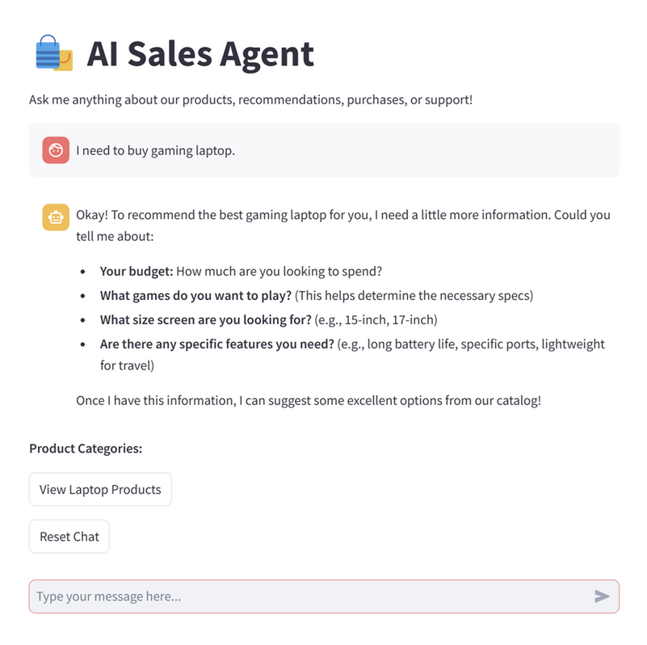
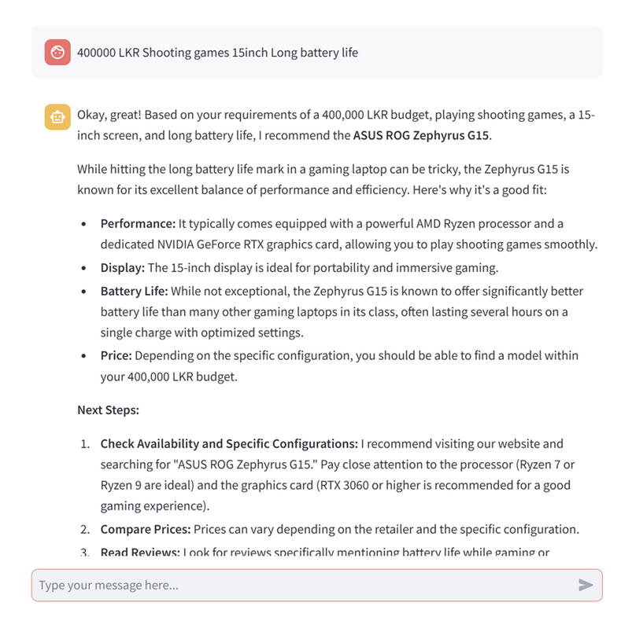
Notes:
9

Slide 11
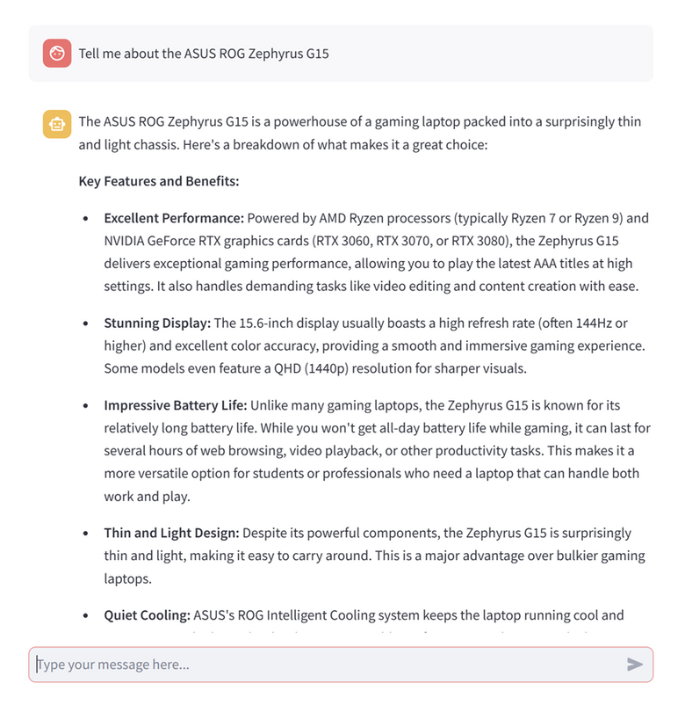
Notes:
9

