Slide 1



Space Explorer Flutter App
Embark on an interstellar journey with the Space Explorer Flutter App, a comprehensive exploration tool designed for enthusiasts and developers alike. This presentation will guide you through the app’s development process, showcasing its features, architecture, and the challenges overcome during its creation.
Notes:
1

Slide 2
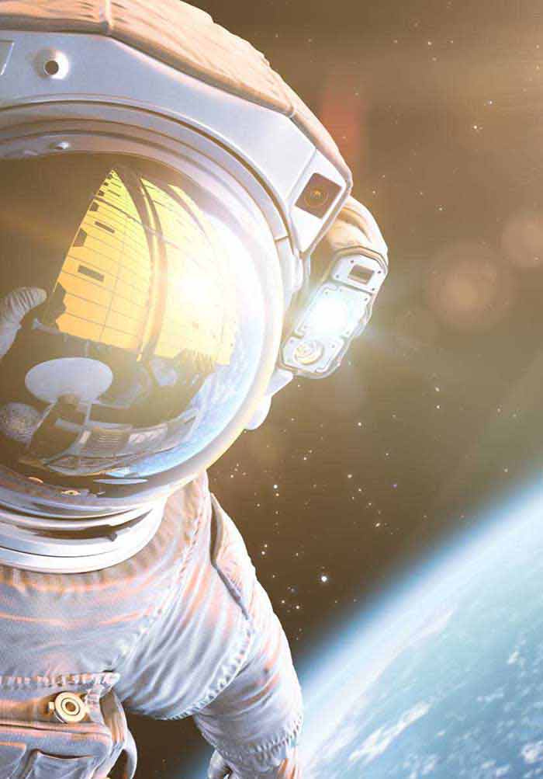
Project Overview
Browse Celestial Bodies
View Detailed Information
Explore a vast catalog of planets, stars, galaxies, and other cosmic entities, each with unique properties and fascinating details.
Access in-depth information, including size, mass, orbital characteristics, and historical significance, for each celestial body.
Learn Interesting Facts
Discover intriguing facts and trivia about the universe, expanding your knowledge of astronomy and space exploration.
Notes:
2

Slide 3

Project Requirements
Flutter Application
Multi-Screen Design
Develop a fully functional Flutter application, leveraging the framework's capabilities for cross-platform deployment.
Implement at least two screens: a home screen for browsing and a details screen for in-depth information.
State Management
Standard Architecture
Use a robust state management solution to handle data flow and UI updates efficiently.
Adhere to industry best practices and maintain a clear, scalable project structure.
Notes:
3

Slide 4
Application Architecture
space_explorer/
├── lib/
│ ├── main.dart
│ ├── models/
│ │ └── celestial_body.dart
│ ├── providers/
│ │ └── space_provider.dart
│ ├── screens/
│ │ ├── home_screen.dart
│ │ └── details_screen.dart
│ └── widgets/
│ └── celestial_body_card.dart
└── assets/
└── images/
The application architecture is structured into distinct layers to promote modularity and maintainability. The models directory defines data structures, while providers manage the application state. The screens directory houses the UI components, and widgets contains reusable UI elements.
This organization facilitates clear separation of concerns, making it easier to test, debug, and extend the application’s features. Adhering to a consistent architecture ensures that the codebase remains manageable as the project evolves.
Notes:
4

Slide 5
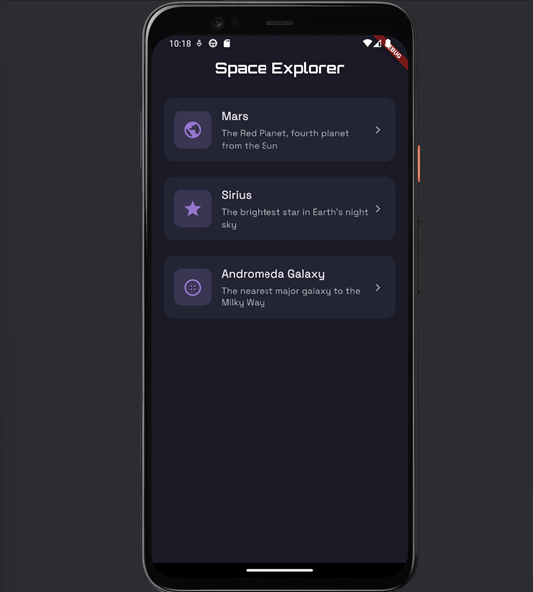




Home Screen
Celestial List
Displays a scrollable list of celestial bodies, providing an overview of available space objects.
Custom Icons
Uses unique icons based on celestial body types, enhancing visual appeal and recognition.
Description Preview
Presents a concise description for each item, enticing users to explore further details.
Smooth Animations
Incorporates subtle animations for a polished and engaging user experience.
The home screen provides an intuitive and visually appealing way to browse the cosmos, making it easy for users to discover and learn about different celestial bodies. Responsive layouts ensure the app looks great on various screen sizes and orientations.
Notes:
5

Slide 6
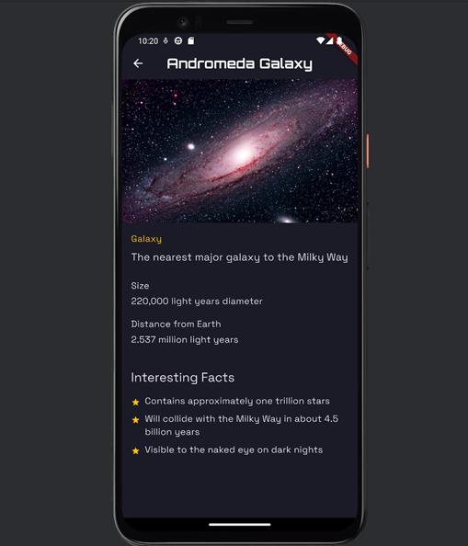
Details Screen
High-Quality Image
Presents a stunning, high-resolution image of the selected celestial body.
Complete Description
Provides a detailed narrative describing the object's characteristics and significance.
Interesting Facts
Showcases intriguing and lesser-known facts, enhancing the user’s learning experience.
Technical Specs
Displays key technical specifications such as size, mass, and orbital parameters.
The details screen offers an immersive learning experience, combining visual appeal with comprehensive information to captivate users and deepen their understanding of space. Animated content further enhances engagement and provides a dynamic view of each celestial body.
Notes:
5

Slide 7

Challenges & Solutions
Animation Performance
Optimized animation library with minimal overhead for smooth transitions.
The development of Space Explorer presented several challenges, each requiring innovative solutions to ensure optimal performance and user experience. These challenges ranged from animation performance and dynamic icon selection to image source handling and state management structure.
Notes:
7

