Slide 1



Virtual Travels:
This presentation details the Virtual Travels project. It showcases a responsive landing page built with React. We will explore key features and design choices. Learn about responsive design implementation and challenges. Understand the component architecture and solutions applied.
Notes:
1

Slide 2

Project Overview: Virtual Travels
Virtual Travels offers immersive virtual tours. It lets users experience destinations from home. Save time and money on physical travel. Enjoy 360-degree views and guided tours.
Immersive Experience
Saves Money
Saves Time
360-degree tours
No travel costs
Tours from home
Notes:
2

Slide 3
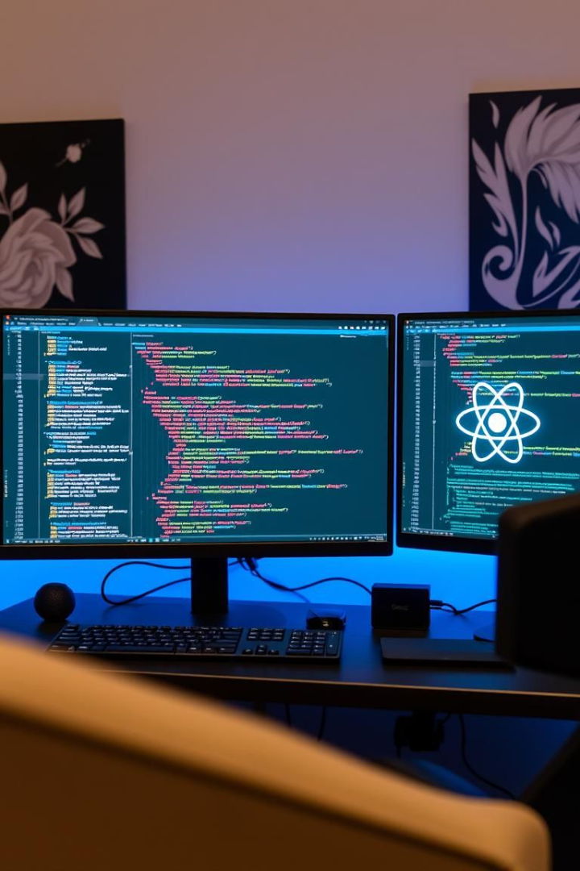



Technology Stack for Development
The project utilizes a modern technology stack. This ensures performance and maintainability. React.js handles the frontend framework. Tailwind CSS provides utility-first styling.
React.js
Tailwind CSS
useState Hook
Notes:
3

Slide 4
Key Features of Virtual Travels
The landing page includes responsive navigation. It has engaging content sections. These elements improve user experience. They ensure accessibility on all devices.
Responsive Navigation
Engaging Content Sections
Desktop horizontal menu
Hero section
Mobile hamburger menu
Features highlighting benefits
Smooth scrolling
About section
Contact section
Notes:
4

Slide 5



Responsive Design Implementation Details
The design adapts to different screen sizes. Desktop view uses multi-column layouts. Mobile view uses single-column layouts. This provides an optimal viewing experience.
Desktop View
Mobile View
Notes:
5

Slide 6
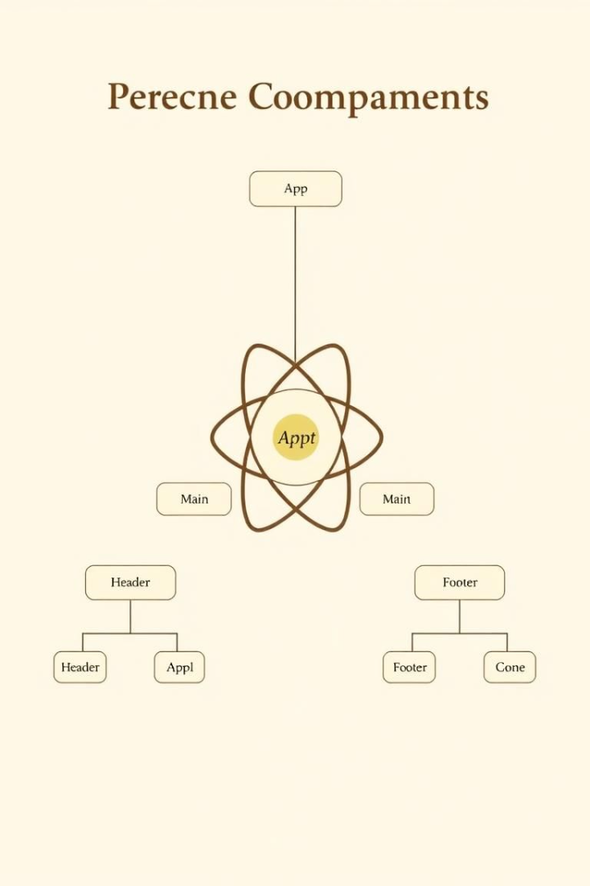
Component Architecture Breakdown
The architecture utilizes modular components. It separates concerns for better organization. Reusable styling patterns enhance maintainability. Key components include Navbar and Home.
Modular Components
Separation of Concerns
For maintainability
For better organization
Reusable Styling
Via Tailwind classes
Notes:
6

Slide 7
Challenges and Solutions During Development
Responsive navigation was a significant challenge. Consistent styling required reusable patterns. Content layout needed flexible solutions.
1
Responsive Navigation
2
Consistent Styling
Notes:
7

Slide 8
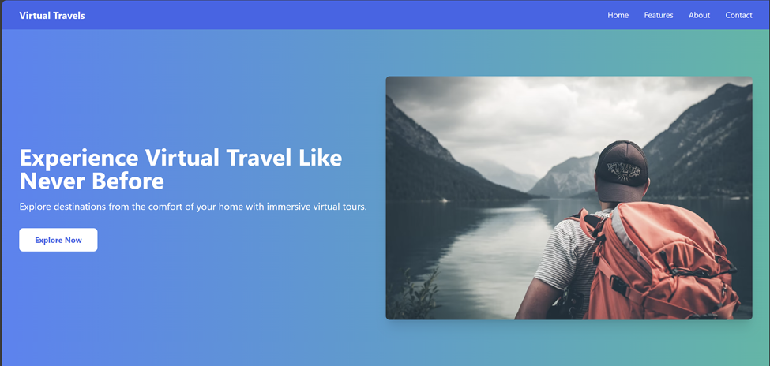
Demonstration
Desktop View
Notes:
7

Slide 9
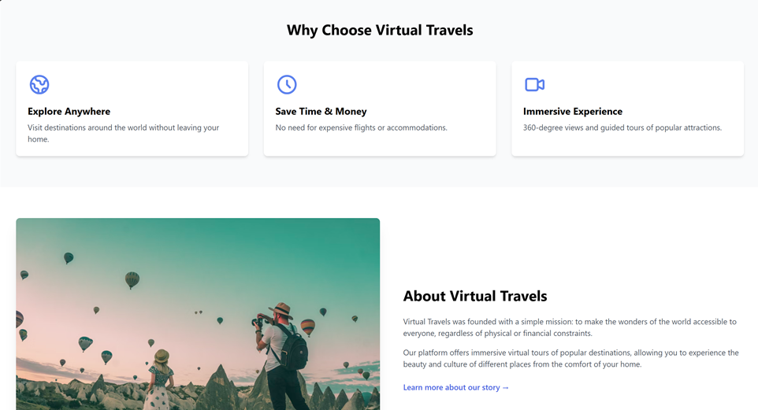
Demonstration
Desktop View
Notes:
7

Slide 10

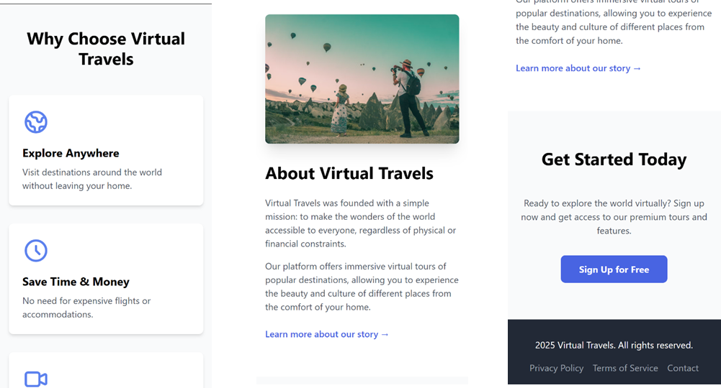
Demonstration
Mobile View
Notes:
7

