Slide 1
Exploring Traditional CNNs with Different Activation Functions and Convolutional Layers
Name: Ariyan Hossain
ID: 20101099
Sec: 01
Course: CSE425

Slide 2
01
Introduction

Slide 3
What is CNN?
A Convolutional Neural Network (CNN) is a subset of Machine Learning (ML) and is a kind of network architecture for deep learning algorithms and is specifically used for image recognition and tasks that involve the processing of pixel data.
In CNN, computation is faster as there is
Fewer Parameters
Shared Weights

Slide 4
CNN Layers
Pooling
Layer
Convolutional layer
Fully Connected Layer
Filters applied to the image to form a feature map
Reduces parameters to improve the efficiency
Image Classification happens based on the features extracted

Slide 5
02
Dataset Selection

Slide 6
CIFAR-10 Dataset
The CIFAR-10 dataset (Canadian Institute for Advanced Research, 10 classes) is used which is a subset of the Tiny Images dataset and consists of 60000 32x32 color images. The images are labeled with one of 10 mutually exclusive classes: airplane, automobile, bird, cat, deer, dog, frog, horse, ship, and truck.
There are 6000 images per class with 5000 training and 1000 testing images per class.

Slide 7
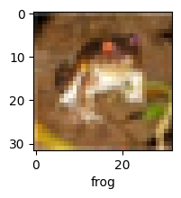
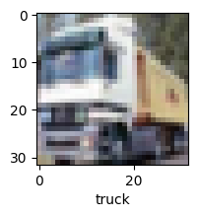
Example Images of
Training Data

Slide 8
03
Implementing CNN

Slide 9
Choosing Layers
2 bundles of Convolutional Layer and Pooling Layer is used.
Convolutional Layer
(32 filters, 3x3 kernel size and stride 1)
Pooling Layer
(Max Pooling with 2x2)
Convolutional Layer
(32 filters, 3x3 kernel size and stride 1)
Pooling Layer
(Max Pooling with 2x2)
Flatenning
Fully Connected Network
(64 neurons in 1st layer and 10 neurons in output layer)

Slide 10
Choosing Activation Functions
ReLU
Softmax
Outputs the input if it's positive, otherwise outputs zero.
Used in Convolutional Layers and 1st Layer in Fully Connected Network
Converts vectors into probabilities for each class.
Used in the Output Layer in Fully Connected Network

Slide 11
Varying Layer Configuration and Activation Functions
To compare how CNN performs with different configuration and activation functions, the model is trained with a combination of different number of filters, kernel sizes, strides and activation functions
Number of filters = 32, 64
Kernel Sizes = 3x3, 5x5
Strides = 1, 2
Activation Functions = ReLU, Tanh, Sigmoid

Slide 12
Training Code
for activation, num_filters, kernel_size, stride in combinations:
cnn_model = models.Sequential([
layers.Conv2D(filters=num_filters, kernel_size=kernel_size, ………………….strides=stride, activation=activation, input_shape=(32, 32, 3)),
layers.MaxPooling2D((2, 2)),
layers.Conv2D(filters=num_filters, kernel_size=kernel_size, ……………………strides=stride, activation=activation),
layers.MaxPooling2D((2, 2)),
layers.Flatten(),
layers.Dense(64, activation=activation),
layers.Dense(10, activation='softmax')
])
cnn_model.compile(optimizer='adam',
loss='sparse_categorical_crossentropy',
metrics=['accuracy'])
cnn_model.fit(X_train, y_train, epochs=10, verbose=0)

Slide 13
04
Results & Analysis

Slide 14
Performance Evaluation
activation | filters | kernel | stride | accuracy | macro avg precision | macro avg recall | macro avg f1-score
relu | 32 | (3, 3) | (1, 1) | 0.680 | 0.682 | 0.680 | 0.675
relu | 64 | (3, 3) | (1, 1) | 0.710 | 0.709 | 0.710 | 0.709
relu | 32 | (5, 5) | (1, 1) | 0.685 | 0.689 | 0.685 | 0.683
relu | 32 | (3, 3) | (2, 2) | 0.502 | 0.513 | 0.502 | 0.504
tanh | 32 | (3, 3) | (1, 1) | 0.654 | 0.654 | 0.654 | 0.652
tanh | 64 | (3, 3) | (1, 1) | 0.646 | 0.645 | 0.646 | 0.642
tanh | 32 | (5, 5) | (1, 1) | 0.635 | 0.635 | 0.635 | 0.632
tanh | 32 | (3, 3) | (2, 2) | 0.502 | 0.510 | 0.502 | 0.501
sigmoid | 32 | (3, 3) | (1, 1) | 0.580 | 0.58 | 0.580 | 0.575
sigmoid | 64 | (3, 3) | (1, 1) | 0.601 | 0.601 | 0.601 | 0.597
sigmoid | 32 | (5, 5) | (1, 1) | 0.586 | 0.597 | 0.586 | 0.585
sigmoid | 32 | (3, 3) | (2, 2) | 0.382 | 0.395 | 0.382 | 0.374

Slide 15
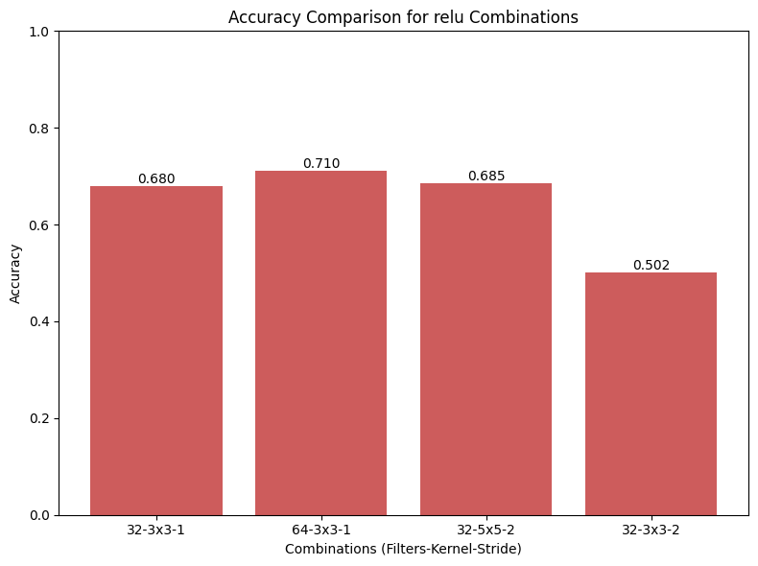
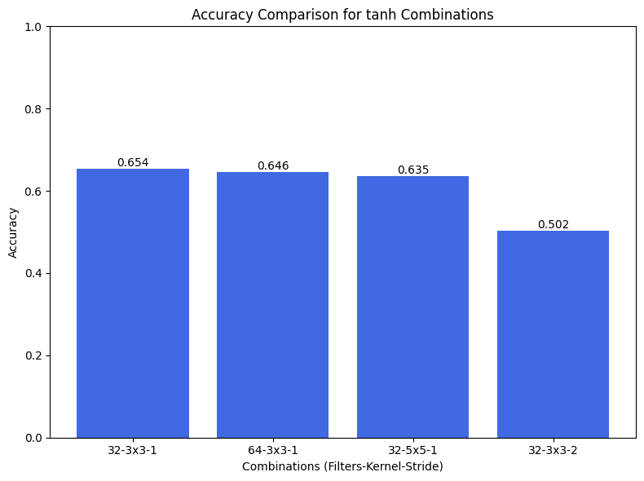
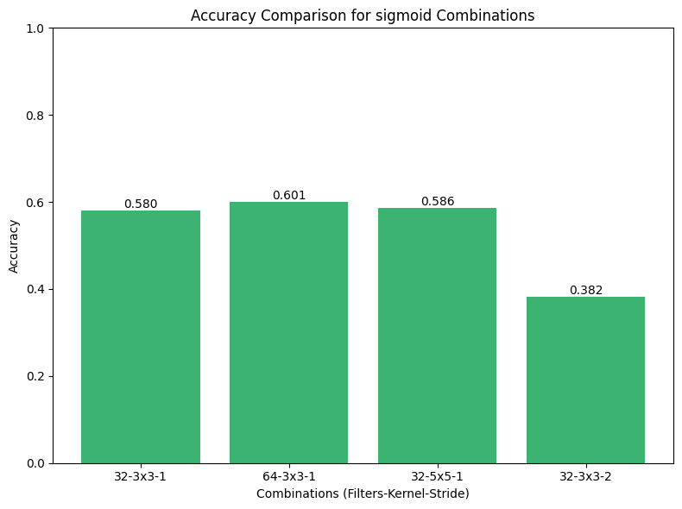
Comparison of filter-kernel-stride
ReLU
Tanh
Sigmoid

Slide 16
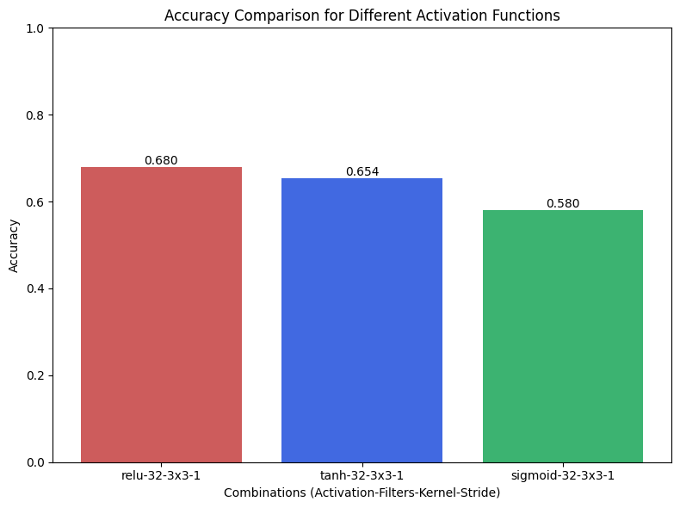
Comparison of Activation Functions

Slide 17
Analysis
For a fixed activation function:
As number of filters increases, accuracies increases (0.680 to 0.710 for relu)
As kernel size increases, accuracies slightly increases (0.680 to 0.685 for relu)
As stride increases, accuracies decreases (0.680 to 0.502 for relu)
For fixed combination of filters-kernel-stride:
ReLU gives the most accuracy (0.680 for filters=32, kernel=3x3, stride=1)
Tanh gives a lower accuracy (0.654 for filters=32, kernel=3x3, stride=1)
Sigmoid gives the lowest accuracy (0.580 for filters=32, kernel=3x3, stride=1)

Slide 18
05
Conclusion

Slide 19
Key Findings
Activation functions considerably affect CNN convergence and effectiveness. Tanh and sigmoid were effective in some circumstances, while ReLU was competitive with fast convergence.
Filters determine the model's ability to capture complicated properties. Filters improve network representation but increase computational complexity. The network's receptive field depends on kernel size. Blarger kernels capture broader patterns, whereas smaller kernels focus on finer details. These must be balanced for optimal performance. Stride affects downsampling and data preservation. Stride values must be set carefully to preserve important qualities.

Slide 20
Future Work
Hyperparameter Tuning
Data Augmentation
Architecture Variations
Tune learning rate, regularization, batch size
Increase dataset size to improve generalization
Experiment with residual networks or inception networks
Transfer Learning
Regularization
Transfer learning by modifying pre-trained models
To avoid overfitting, use batch normalization or dropout

Slide 21
References
Sharma, P. (2022). Basic Introduction to Convolutional Neural Network in Deep Learning. Analytics Vidhya. https://www.analyticsvidhya.com/blog/2022/03/basic-introduction-to-convolutional-neural-network-in-deep-learning/
Image classification using CNN: Introduction and tutorial. (2023, May 22). Datagen. https://datagen.tech/guides/image-classification/image-classification-using-cnn/#

Slide 22
Thank You!!

