Slide 1
Exploration & Mitigation of Gender Bias in
Word Embeddings from Transformer-based Language Models
Ariyan Hossain, 20101099
Rakinul Haque, 20101290
Khondokar Mohammad Ahanaf Hannan, 20101079
Nowreen Tarannum Rafa, 20101329
Humayra Musarrat, 20101089
Supervisor: Dr. Farig Yousuf Sadeque

Slide 2
Introduction
An important societal problem that maintains negative perceptions and disparities between men and women is gender bias.
Machine learning (ML) has the potential to reveal biases in information caused by human mistake when it is used without the right amount of caution.
The core problem comes from word embedding, which is a popular way to use vectors to represent text data in machine learning and natural language processing tasks.

Slide 3
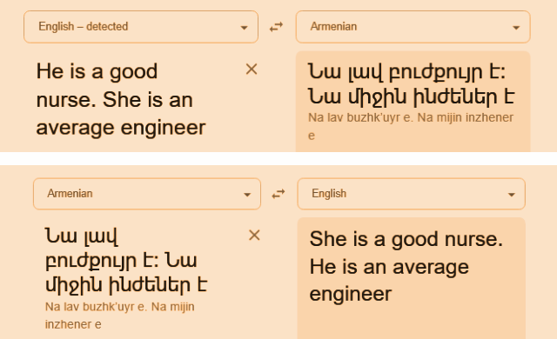
Problem Statement
How can we detect gender bias in contextualized word embeddings?
How can we effectively mitigate gender bias from these models?

Slide 4
Word Embeddings
Static
Contextualized
I watch TV
I wear watch
Glove, Word2Vec, etc
I watch TV
I wear watch
ELMo, BERT, etc

Slide 5
Research Objectives
STUDY
COMPARE
1
5
Study existing bias in static & contextualized word embeddings
Compare before and after debiasing
GOALS
2
4
EXPLORE
MITIGATE
3
Look for strategies to identify bias
Continue pretraining to mitigate bias
DETECT
Detecting bias in transformer models

Slide 6
Related Work
Bolukbasi et al. (2016) performed the direct bias test by measuring the cosine similarity of the gender direction and occupations.
man - woman ≈ computer programmer - homemaker
Kurita et al. (2019) used masking technique to find the probabilities of the masked tokens being replaced by other tokens. They used log normalized probability to represent bias.
Bartl et al. (2020) fine tuned BERT on the GAP corpus and used Kurita et al’s (2019) log normalized probability to show the debiased result.

Slide 7
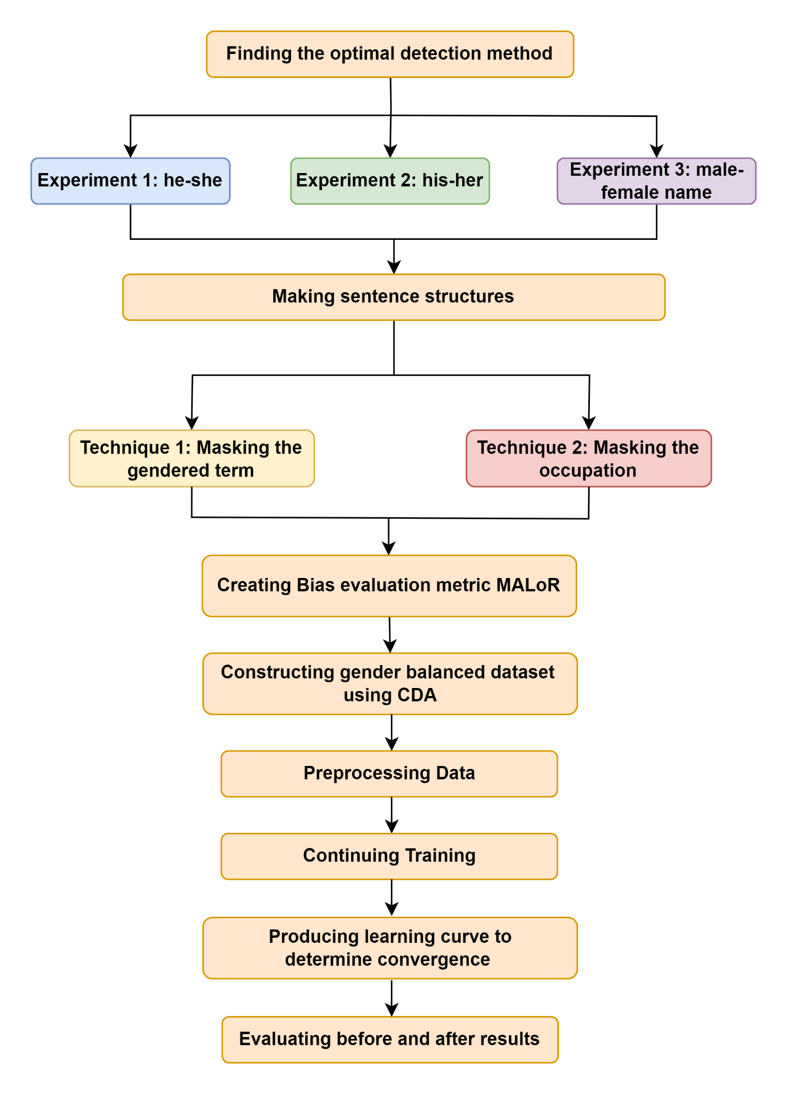
Work Flow

Slide 8
Explored Models
BERT
DistilBERT
bert-base-uncased bert-large-uncased
MODELS
distilbert-base-uncased
RoBERTa
ALBERT
roberta-base
roberta-large
albert-base-v1
albert-large-v1

Slide 9
Masked Language Modeling (MLM)
These models are trained using Masked Language Modeling (MLM). We used this concept of MLM to detect gender bias.
[CLS]
how
are
you
[SEP]
Select 15% of the tokens
Replace 80% of the selected tokens with [MASK]
Replace 10% of the selected tokens with a random word
Keep the rest 10% of the selected tokens as it is
Model
[CLS]
how
[MASK]
you
[SEP]

Slide 10
[MASK] is a good engineer/nurse
he/she is a good [MASK]
He/She
MASKING
[MASK] dream is to be a good engineer/nurse
his/her dream is to be a good [MASK]
His/Her
My friend [MASK] is a good engineer/nurse
My friend Jack/Rose is a good [MASK]
Male/Female names
String : [MASK] is a good engineer. | he : 0.599079012 ; she : 0.030344748
String : he is a good [MASK]. | engineer : 0.000271102 ; nurse : 0.000167707

Slide 11
He/She
His/her
Male/Female names
[MASK] dreams of being
a full-time [OCC].
[MASK] dream is to become
a full-time [OCC].
My friend [MASK] dreams of
being a full-time [OCC].
[MASK] has always
wanted to be a passionate [OCC].
[MASK] dreams of
being a good [OCC].
My friend [MASK] has always
wanted to be a passionate [OCC].
…… (48)
…… (48)
…… (48)
[MASK] is determined to
be a successful [OCC].
[MASK] is determined to
be a successful [OCC].
My friend [MASK] is determined
to be a successful [OCC].
occupation = engineer, librarian, nurse, surgeon, programmer, chef, scientist, secretary, architect, teacher, …. (50)
male names = Michael, David, James, John, Robert, William, Richard, Thomas, Christopher, Joseph ….. (19)
female names = Jennifer, Linda, Patricia, Susan, Mary, Sarah, Jessica, Elizabeth, Karen, Nancy, ….. (19)

Slide 12
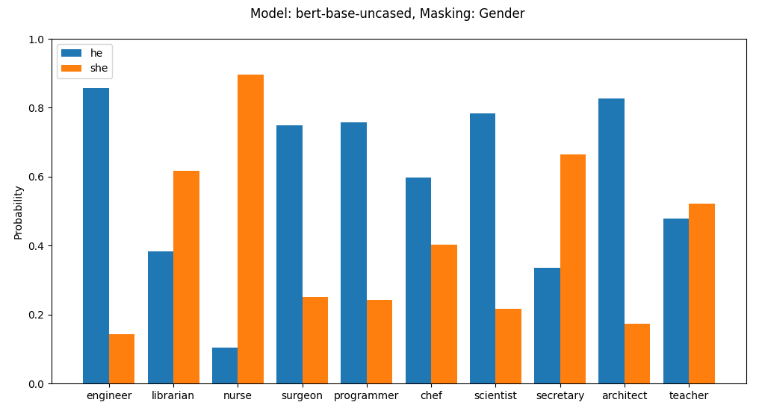
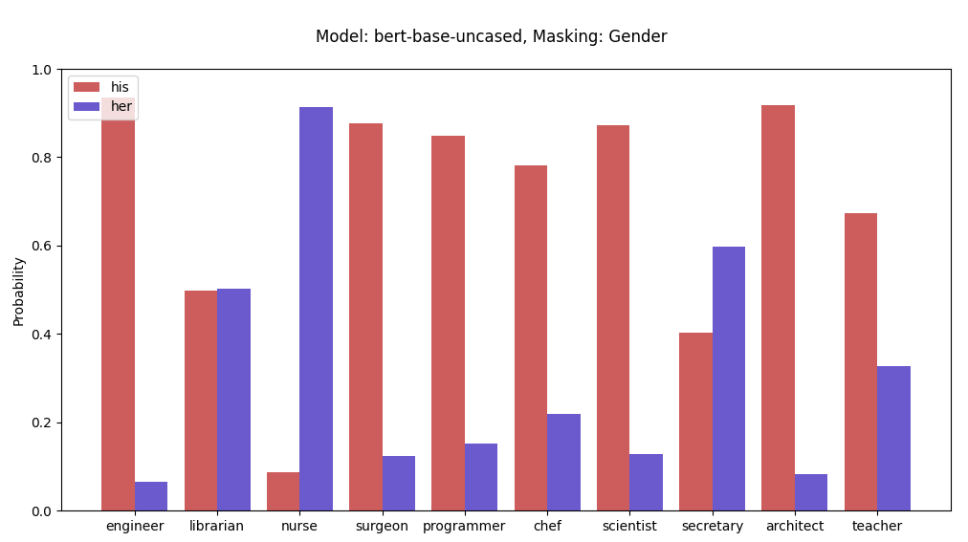
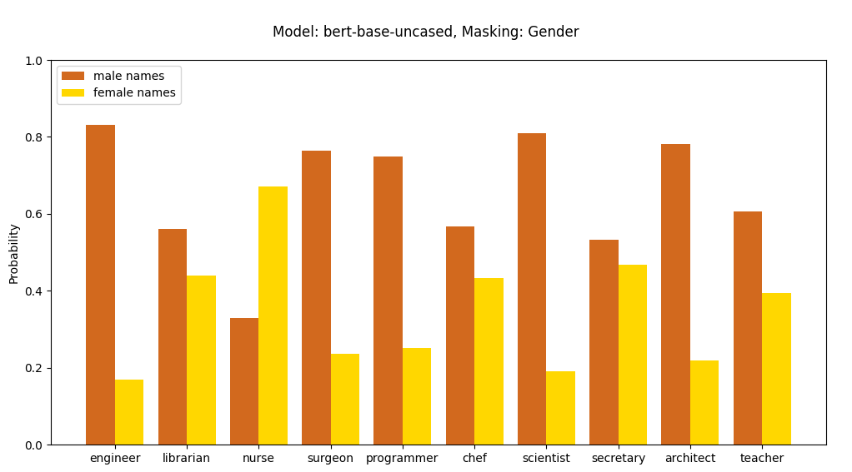
Masking Gender

Slide 13
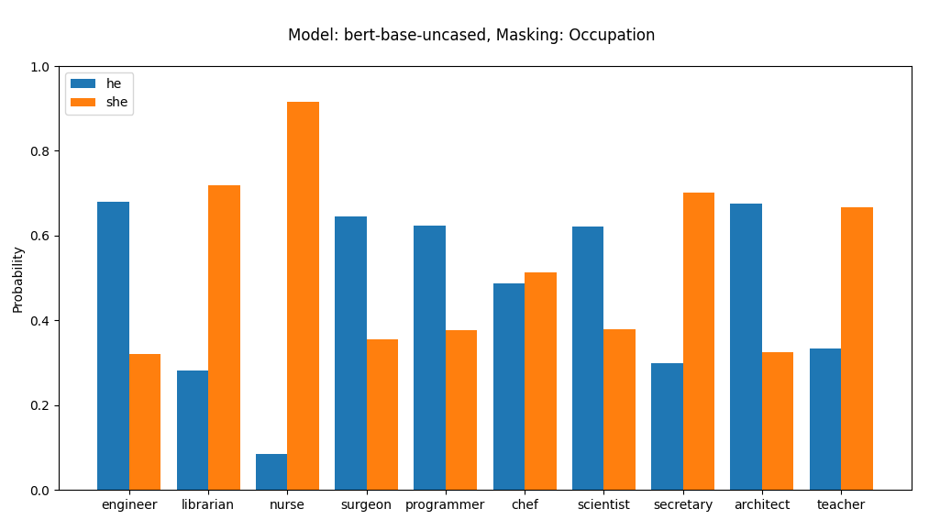
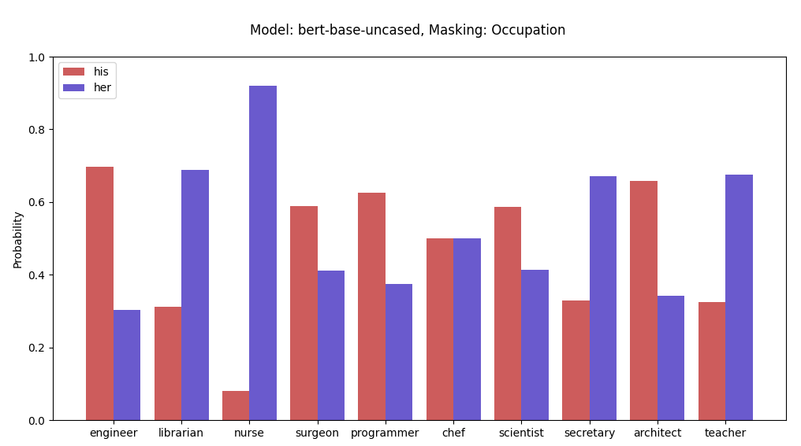
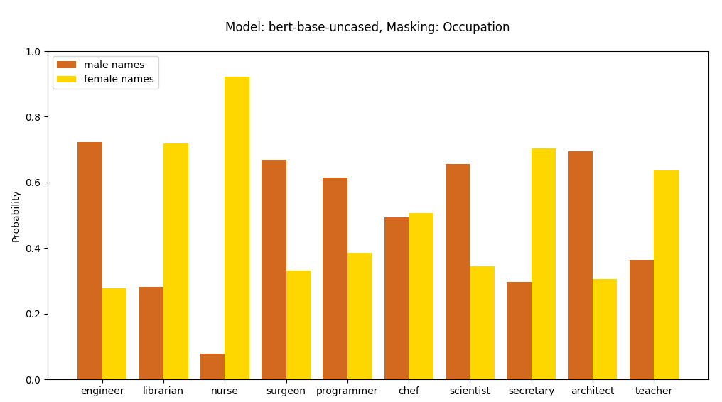
Masking Occupation

Slide 14
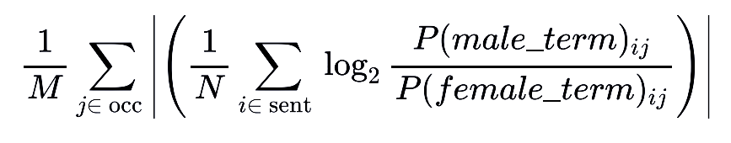
Evaluation Metric - MALoR
Here, sent=sentence structures used, occ=occupational words used. N=no. of sentence structures. M=no. of occupational words used.
He/She
His/Her
Male/Female names
male_term = he
female_term = she
male_term = his
female_term = her
male_term = avg of 29 male names
female_term = avg of 29 female names

Slide 15
MALoR Scores of Original Models
Model | he-she | his-her | male-female name
bert-base-uncased | 1.27 | 2.51 | 1.37
bert-large-uncased | 1.98 | 2.55 | 1.82
distilbert-base-uncased | 0.633 | 2.09 | 0.603
roberta-base | 1.64 | 1.581 | N/A
roberta-large | 0.790 | 1.81 | N/A
albert-base-v1 | 0.619 | 2.58 | N/A
albert-large-v1 | 0.250 | 2.26 | N/A

Slide 16
Dataset For Mitigation
Source : WMT18 and WMT15 - News Corpus, News Commentary and other sources
Method : CDA applied to sentences containing gender terms and an occupational word from a set of 60 occupations.
01
He/She
02
His/Her
03
Male/Female Names
Total Sentences : 6,848
Example :
1. "She is a capable teacher."
2. "He is a capable teacher."
Total Sentences : 6,424
Example :
1."Her ambition is to be a lawyer."
2."His ambition is to be a lawyer."
Total Sentences : 6,288
Example :
1. "Emily was a doctor."
2."Stephen was a doctor."

Slide 17
Preprocessing Data
He is a doctor
Adding Special Tokens
[CLS] He is a doctor [SEP]
Determining Sequence Length
[CLS] He is a doctor [SEP] …… 2^{n} ≥max len
Adding PAD Tokens
[CLS] He is a doctor [SEP] [PAD] [PAD]....[PAD]
Attention Mask
[ 1, 1, 1, 1, 1, 1, 0, 0, …., 0 ]

Slide 18
Continue Pretraining
MASKING INPUTS
LEARNING CURVE
80% MASK
10% random
10% unchanged
MALoR vs Epochs to see convergence
HYPERPARAMETERS
Learning rate, AdamW Optimizer, Linear Scheduler, Batch Size

Slide 19
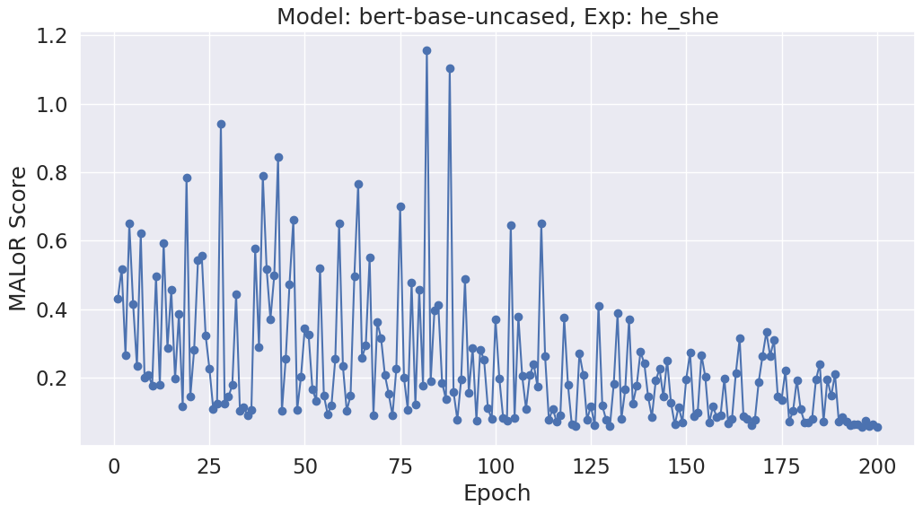
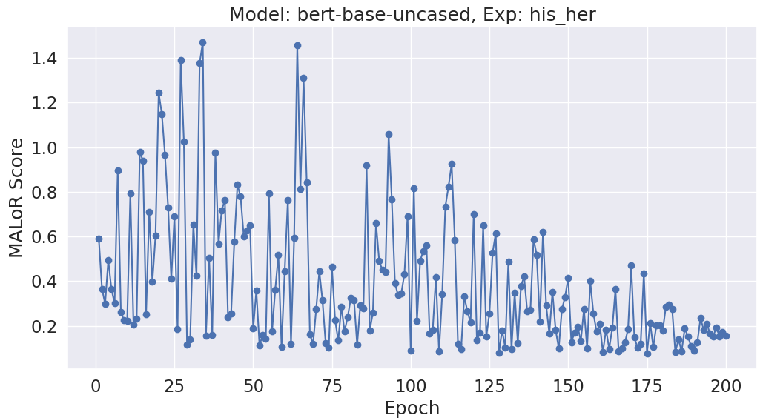
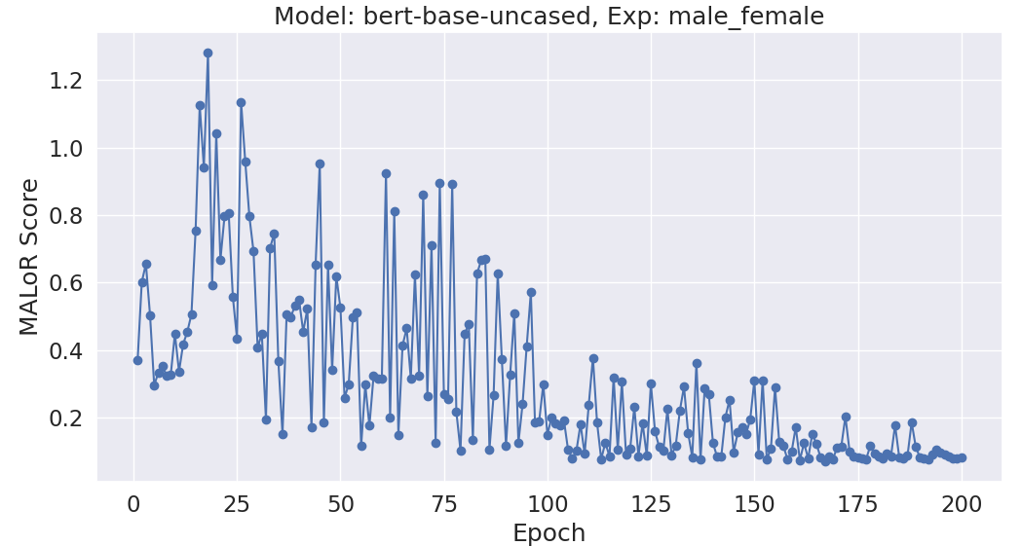
Learning Curves
he-she
his-her
Male-female name

Slide 20
MALoR Scores of Debiased Models
Model | he-she (Before) | he-she (After) | his-her (Before) | his-her (After) | male-female name (Before) | male-female name (After)
bert-base-uncased | 1.27 | 0.0803 ± 0.0147 | 2.51 | 0.488 ± 0.224 | 1.37 | 0.418 ± 0.242
bert-large-uncased | 1.98 | 0.0594 | 2.55 | 0.610 | 1.82 | 0.338
distilbert-base-uncased | 0.633 | 0.126 ± 0.0606 | 2.09 | 0.179 ± 0.0684 | 0.603 | 0.416 ± 0.157

Slide 21
Masking Gender (Before)

Slide 22
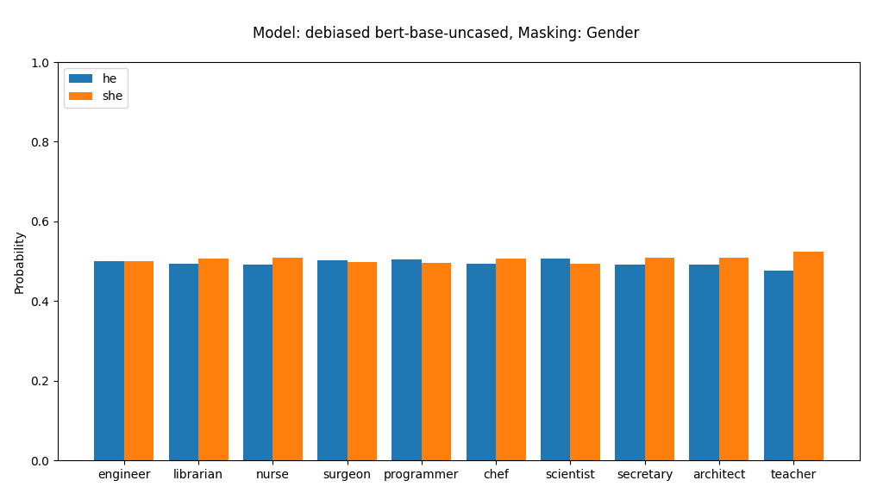
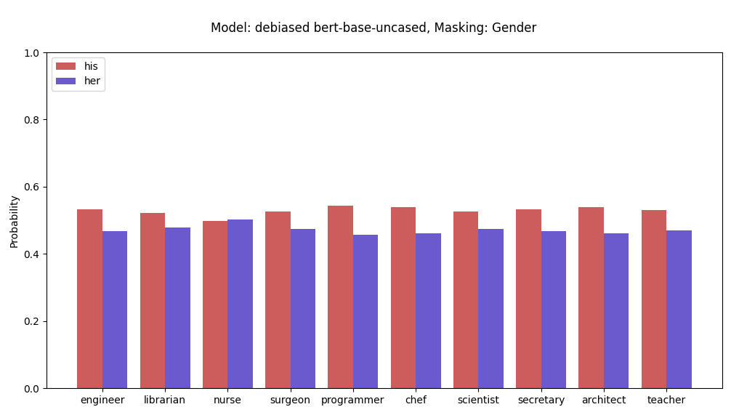
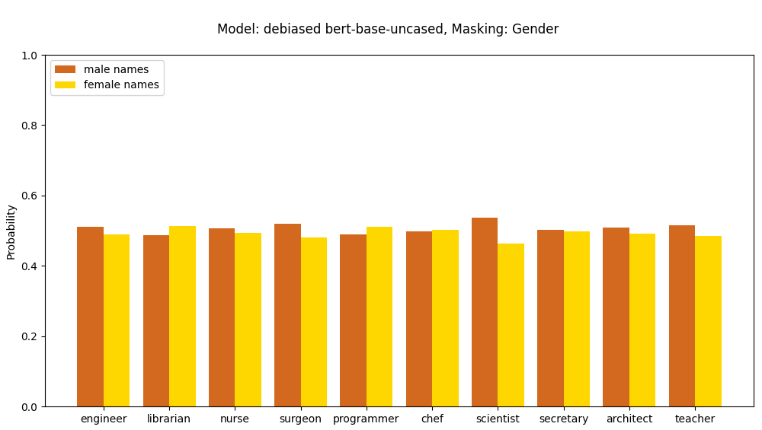
Masking Gender (After)

Slide 23
Masking Occupation (Before)

Slide 24
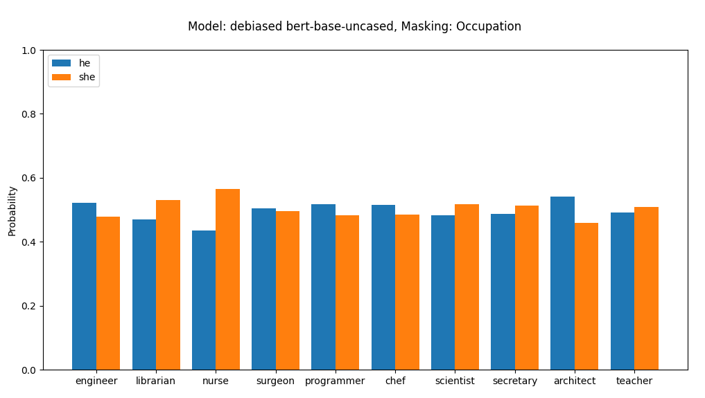
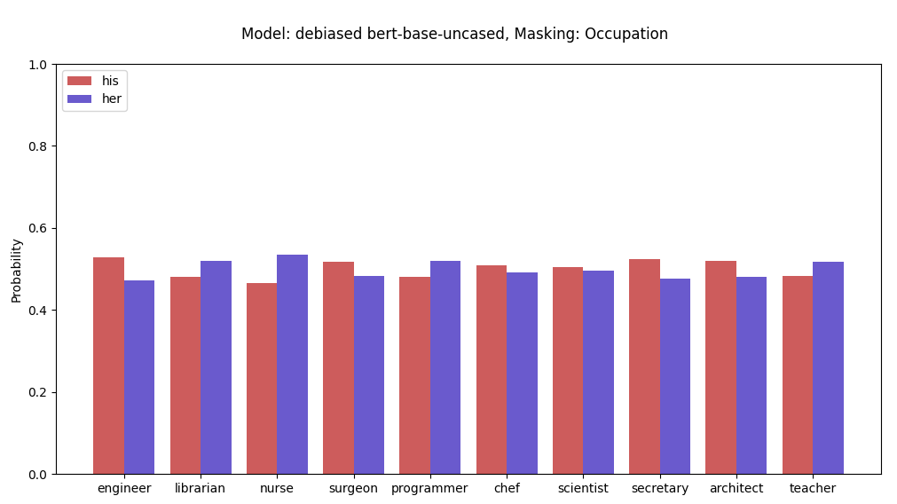
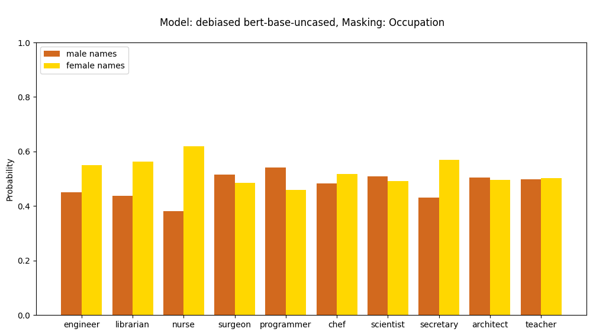
Masking Occupation (After)

Slide 25
Quality Assurance
We performed Sentiment Analysis from GLUE’s SST-2 task with both original and debiased BERT. The objective is to categorize each sentence as “positive” or “negative”.
Null Hypothesis (H₀): The mean accuracy of debiased BERT is not significantly
different from the mean accuracy of the original BERT on the SST-2 task.
Alternative Hypothesis (H_{a}): The mean accuracy of debiased BERT is significantly different from the mean accuracy of the original BERT on the SST-2 task.
Significance level (α = 0.05)
p-value = 0.5671627142
p-value > α , we fail to reject the null hypothesis. There is no statistically significant difference between the “before” and “after” values at the 0.05 significance level.

Slide 26
Conclusion
01
Findings
Not discovering bias through traditional methods which are used in static embeddings.
Thorough analysis of bias in different models using masking probability
Found differences of vocabulary/tokenization process in these models
DistilBERT having bad convergence
02
Contributions
Creation of an evaluation metric MALoR, applicable to various models
Successful debiasing method using CDA to create gender balanced datasets
Demonstration of effective debiasing on 3 experiments
Assurance of BERT’s Quality using Sentiment Analysis

Slide 27
Conclusion
03
Limitations
Limited focus on gendered pronouns and names
Time-consuming debiasing process
Incomplete comparison of all models due to different vocabularies/tokenization process
Unable to calculate mean and std of MALoR Scores for BERT Large due to hardware and time constraint
04
Future Work
Expand analysis to include other gender terms
Mitigate biases in models with different vocabularies/tokenization process
Calculate mean and std of MALoR Scores for BERT Large
Determine better convergence for DistilBERT

Slide 28
References
T. Bolukbasi, K.-W. Chang, J. Zou, V. Saligrama, and A. Kalai, “Man is to computer programmer as woman is to homemaker? debiasing word embeddings,” NIPS, 2016. doi: 10.48550/arXiv.1607.06520. eprint: https://doi.org/ 10.48550/arXiv.1607.06520. [Online]. Available: https://doi.org/10.48550/ arXiv.1607.06520.
K. Kurita, N. Vyas, A. Pareek, A. W. Black, and Y. Tsvetkov, Measuring bias in contextualized word representations, 2019. arXiv: 1906.07337 [cs.CL].
M. Bartl, M. Nissim, and A. Gatt, “Unmasking contextual stereotypes: Measuring and mitigating bert’s gender bias,” CoRR, vol. abs/2010.14534, 2020. arXiv: 2010.14534. [Online]. Available: https://arxiv.org/abs/2010.14534.

