Slide 1
Tiny Tapeout 6 (423)
Cyclic Redundancy Check
Justin Xu

Slide 2
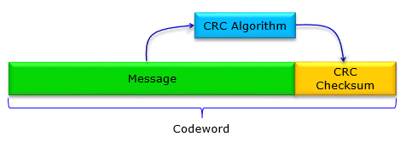
How a does a CRC work?
A Cyclic Redundancy Check is an error detecting code which is used to check for bit flips in a data package.
A checksum is calculated and appended onto the sent data which is recalculated on the receiver end to check if there is an error.
A 128 bit message might have 8 bits appended onto the end of it as a checksum.
Difference CRCs have different polynomial representations which change how the checksum is computed.
Notes:
https://www.sharetechnote.com/html/Handbook_Communication_CRC.html

Slide 3
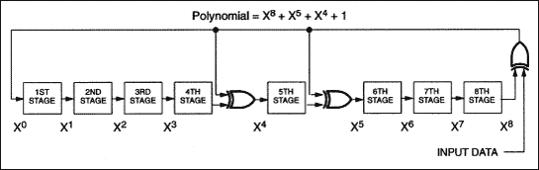
The Dallas Maxim CRC
The Dallas Maxim CRC uses a polynomial of x⁸ + x⁵ + x⁴ + 1.
The design has an XOR at the output between x⁰, x⁴,x⁵ and x⁸.
The placement of the XORs determine what the polynomial is.

Slide 4
The Tiny Tapout Chip
The Tiny Tapeout chip takes single bit inputs with a clock and outputs an 8 bit checksum for each value clocked.
The final value is the final checksum after all the data is submitted to the CRC.
There is the data input, the clock and 8 bits of data output.
Notes:
https://tinytapeout.com/runs/tt06/tt_um_wokwi_394830069681034241

Slide 5
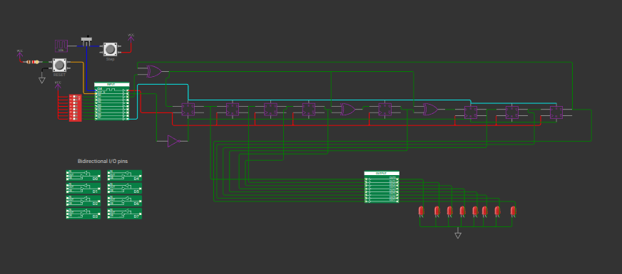
Wokwi Comparison
The Wokwi design simulation was compared to the chip manually through manually clocking the input switch on the chip and copying the operations on the Wokwi.
The outputs were matched so the design was confirmed to be valid
Notes:
https://wokwi.com/projects/394830069681034241

Slide 6
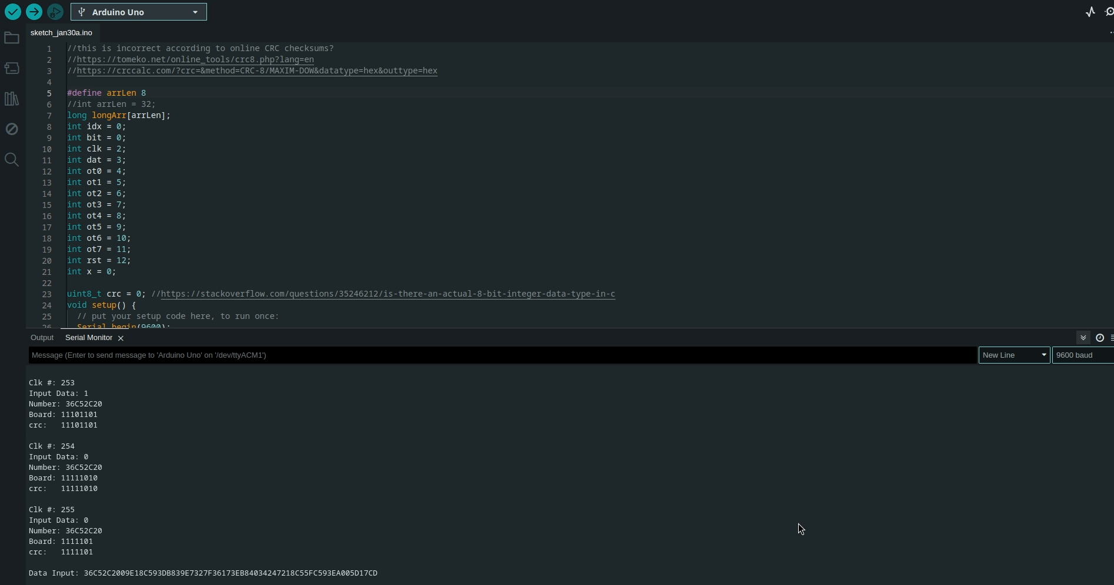
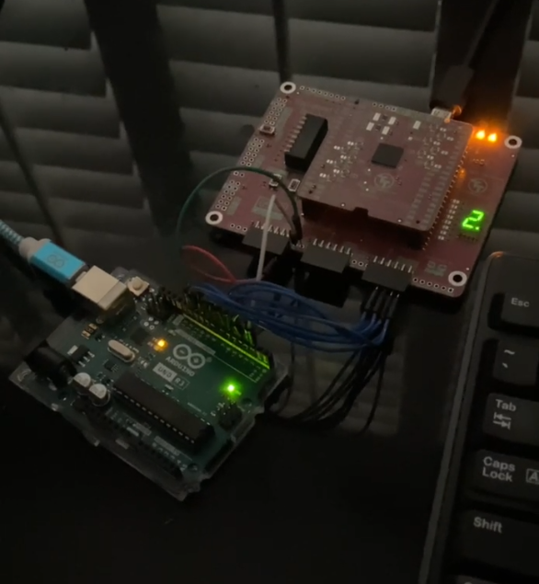
Arduino as Input
The arduino was used to test the chip by sending 128 bits of data into the CRC and calculating the CRC output to see if the two data outputs match.
Through the entire calculation the data outputs matched

Slide 7
Changing a Single Bit (simulating an error)
A single bit change can simulate a bitflip in the message sent
The CRC checksum before the bitflip can be compared to determine if the output changes with the message
When an error happens in a real message the message will change but the checksum will not, causing a discrepancy in the calculated checksums (the checksum send by messenger and recalculated by receiver)
The checksum is a way to add redundancy to the message, therefore if the checksum is different the message has an error.

Slide 8
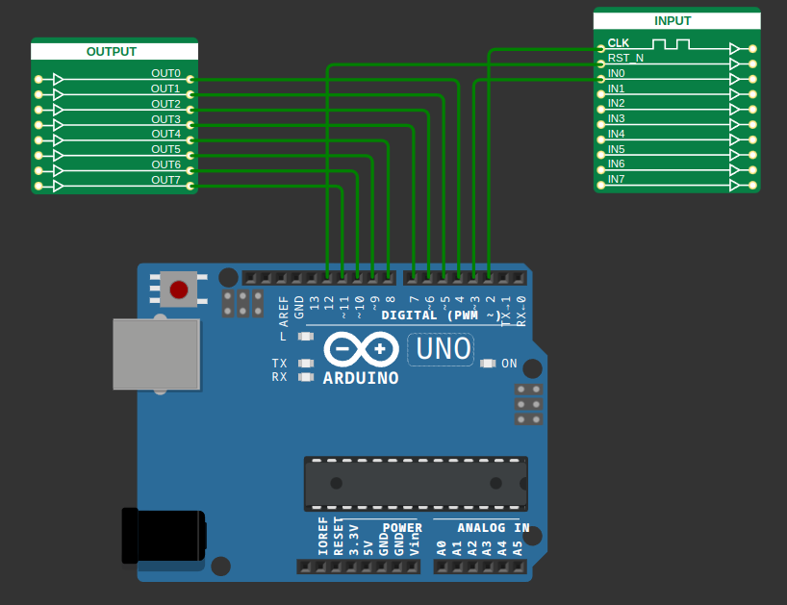
Code Overview
The code generates 8 random longs in an array and cycles through them
The longs are then converted to binary and each inputted bit by bit from right to left.
Then the array is duplicated and a single bit is changed
The new array is run through the CRC and the arduino and tested to see if the outputs match again and the checksum is checked for change on the serial terminal in the Arduino IDE

Slide 9

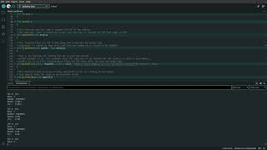
Video of Arduino
Comparison

