Slide 1

Cluster-enhanced injection in Laser Wakefield Acceleration
Ariz Akhtar UROP 2026

Slide 2
Outline
Introduction and Background
LWFA
Cluster-enhanced injection
Studies
Aims of the project
Heating mechanisms & convergence tests
Cluster expansion under the laser pre-pulse
Conclusion & Outlook

Slide 3
Outline
Introduction and Background
LWFA
Cluster-enhanced injection
Studies
Aims of the project
Heating mechanisms & convergence tests
Cluster expansion under the laser pre-pulse
Conclusion & Outlook

Slide 4
Laser wakefield acceleration (LWFA)
Conventional RF accelerators:
Peak acceleration gradients limited to ~100 MV/m
Often require large-scale facilities
Laser-plasma accelerators:
Use intense laser pulses to drive plasma waves
Can sustain accelerating fields of up to ~100 GV/m
Are a potential route towards compact high-energy accelerators
Used in QED experiments, radiation therapy, medical imaging etc.​
Notes:
Radiation therapy: Delivering ultra-high dose-rate beams potentially useful for advanced cancer treatments.
Medical imaging: Generating compact, high-brightness X-rays for sharp internal diagnostics.
QED experiments
Compton sources (all of these are Laser-plasma accelerator uses)

Slide 5
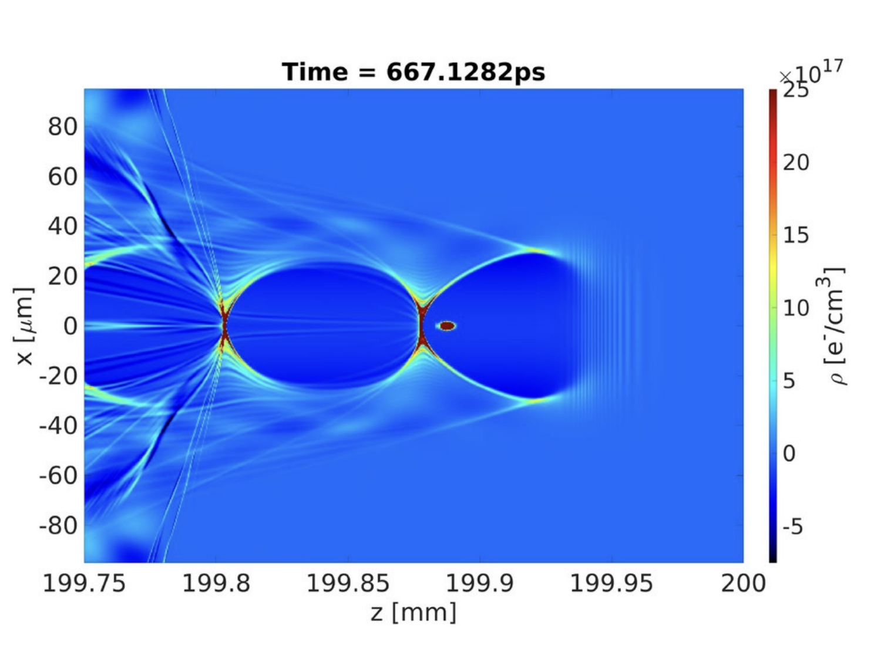
[1]
Notes:
Charge density plot for LWFA (from a laser-based acceleration scheme for muon production)

Slide 6
Cluster-enhanced injection
Dense molecular clusters embedded within the plasma locally modify the plasma's response to the laser pulse​
Laser interaction will ionise and expand the cluster targets, forming charge separation and strong electric fields
Electrons get heated and expelled from the cluster
Leads to enhanced charge yield compared to uniform targets
These energetic electrons then interact with the LWFA wake and hence increase electron injection
Notes:
We’re using methane because it easily forms nanoscale molecular clusters when expanded through high backing pressures through a nozzle into a vacuum. Dense molecular clusters introduce localised gradients that help with coupling laser energy directly to the accelerating electrons.

Slide 7
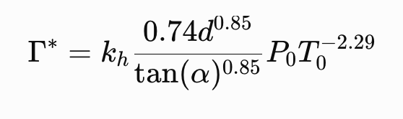
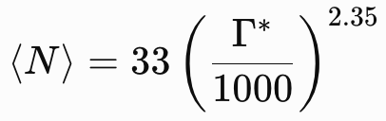
Cluster formation
In gas jet targets, high-pressure gas undergoes adiabatic expansion through a nozzle
The rapid cooling leads to the gas condensing into molecular clusters
Hagena’s semi-empirical scaling gives a prediction of average cluster size [2]:
Notes:
kh is a parameter related to the condensation properties of the gas, α is the half angle of the nozzle, d is the critical diameter in micrometers, P0 is the backing pressure in millibar, T0 is the initial temperature of the gas in kelvin and ⟨N⟩is the average number of atoms in a cluster.

Slide 8
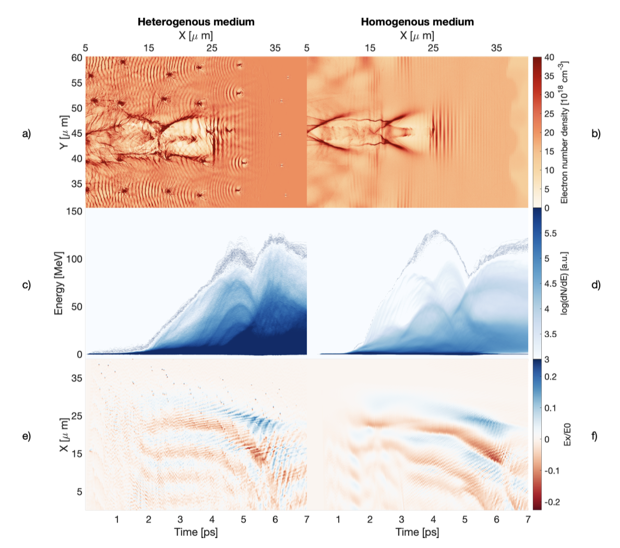
[2]

Slide 9
Outline
Introduction and Background
LWFA
Cluster-enhanced injection
Studies
Aims of the project
Heating mechanisms & convergence tests
Cluster expansion under the laser pre-pulse
Conclusion & Outlook

Slide 10
Aims of the project
Develop and validate 2D simulation namelists for modelling cluster-enhanced LWFA experiments
Use Smilei to simulate methane cluster behaviour using the measured Gemini experiment prepulse
Determine the extent to which clusters expand under the laser pre-pulse
Take pre-pulse results into LWFA simulations to compare injection results with and without clustered methane targets

Slide 11
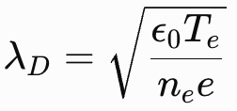

CH4 cluster heating mechanism
Molecular clusters expand significantly during their interaction with the laser:
The laser prepulse ionises the cluster via field/tunnel ionisation, stripping electrons from the CH4
These electrons get heated by the laser field (above-threshold heating during ionisation), gaining KE and escaping the cluster
A positive space charge electric field develops in the cluster
CH4 ions get pushed outwards by this electrostatic field (Coulomb/Hydrodynamic expansion)
Numerical heating exaggerates expansion if the Debye length is not well-resolved (need $λ_{D}≫ Δx$)
Notes:
Laser field primarily acts on the electrons since the methane has q=Ze compared to q=e for electrons so the electron response time is much faster to the laser (as they are singly charged). Electrons escape if their potential exceeds the cluster potential. Coulomb expansion effect visible in vacuum, not sure if it will be the case in plasma.
Field ionization - Strong electric field lowers an atom’s internal Coulomb potential barrier
Tunnel ionization – Intense electric field drastically tilts and narrows the potential barrier, allowing an electron to quantum-mechanically tunnel through it

Slide 12
Gemini pre-pulse a0 evolution
Gemini prepulse measurement used within simulations
A 12 ps segment of the prepulse is used, with the peak at 10 ps
Ionisation occurs roughly when the barrier suppression ionisation of CH4 is reached
Notes:
Focusing in on only part of the prepulse where the cluster gets ionized. Barrier Suppression Ionisation threshold — the laser intensity (or electric-field strength) at which the laser field becomes strong enough to suppress the Coulomb potential barrier binding an electron, allowing it to escape without tunnelling.

Slide 13
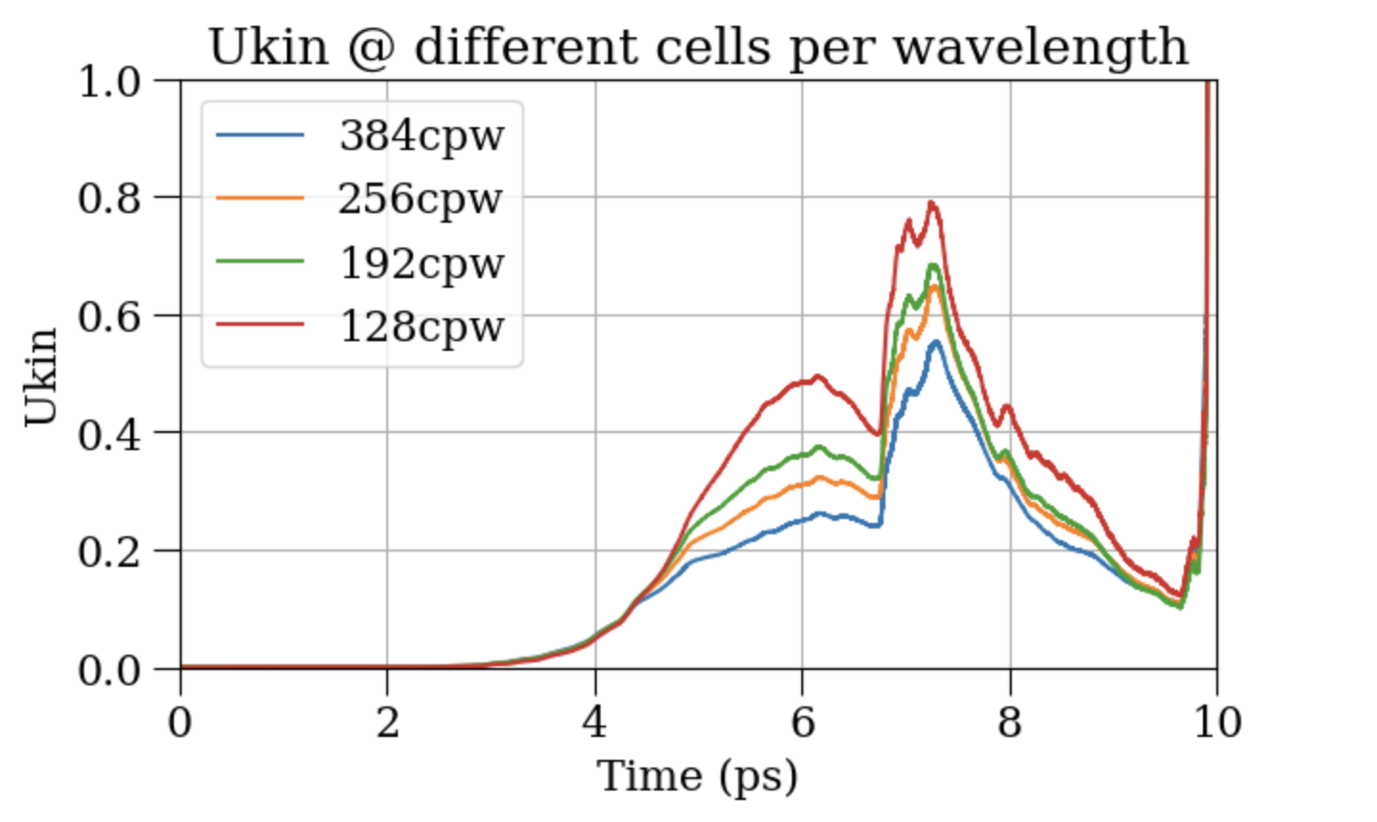

Heating convergence tests
Debye length of ~ 0.6 nm found in simulations, at a temperature of ~ 45 eV
Cluster radius 50 nm, at a density of 130 $n_{c}$
Laser $λ$ = 800 nm, so a resolution of >1000 cells-per-wavelength (cpw) is required
Results at lower cpws show signs of numerical heating
Notes:
Temperature of 40eV. Ukin is total kinetic energy of all particles in simulation, summed over particle weights (gamma-1)mc^2. Simulation is at 130nc, cluster radius 50nm.

Slide 14

Heating convergence tests
Simulation speed increased using lower resolution, with a lower cluster density (91 $n_{c}$) and radius (10 nm) [3]
Debye length increased, to ~ 0.9 nm, at a temperature of ~ 74 eV
At 768 cpw, the kinetic energy diagnostic no longer shows signs of numerical heating
Notes:
After some adaptations have been made to the setup (e.g. a slight decrease in number density, smaller box size). Lower number density has reduced Ukin from what I had before. Temperature increased potentially because electrons now receive higher energy each from the laser pulse (as there is less of them). There is also a smaller cluster

Slide 15
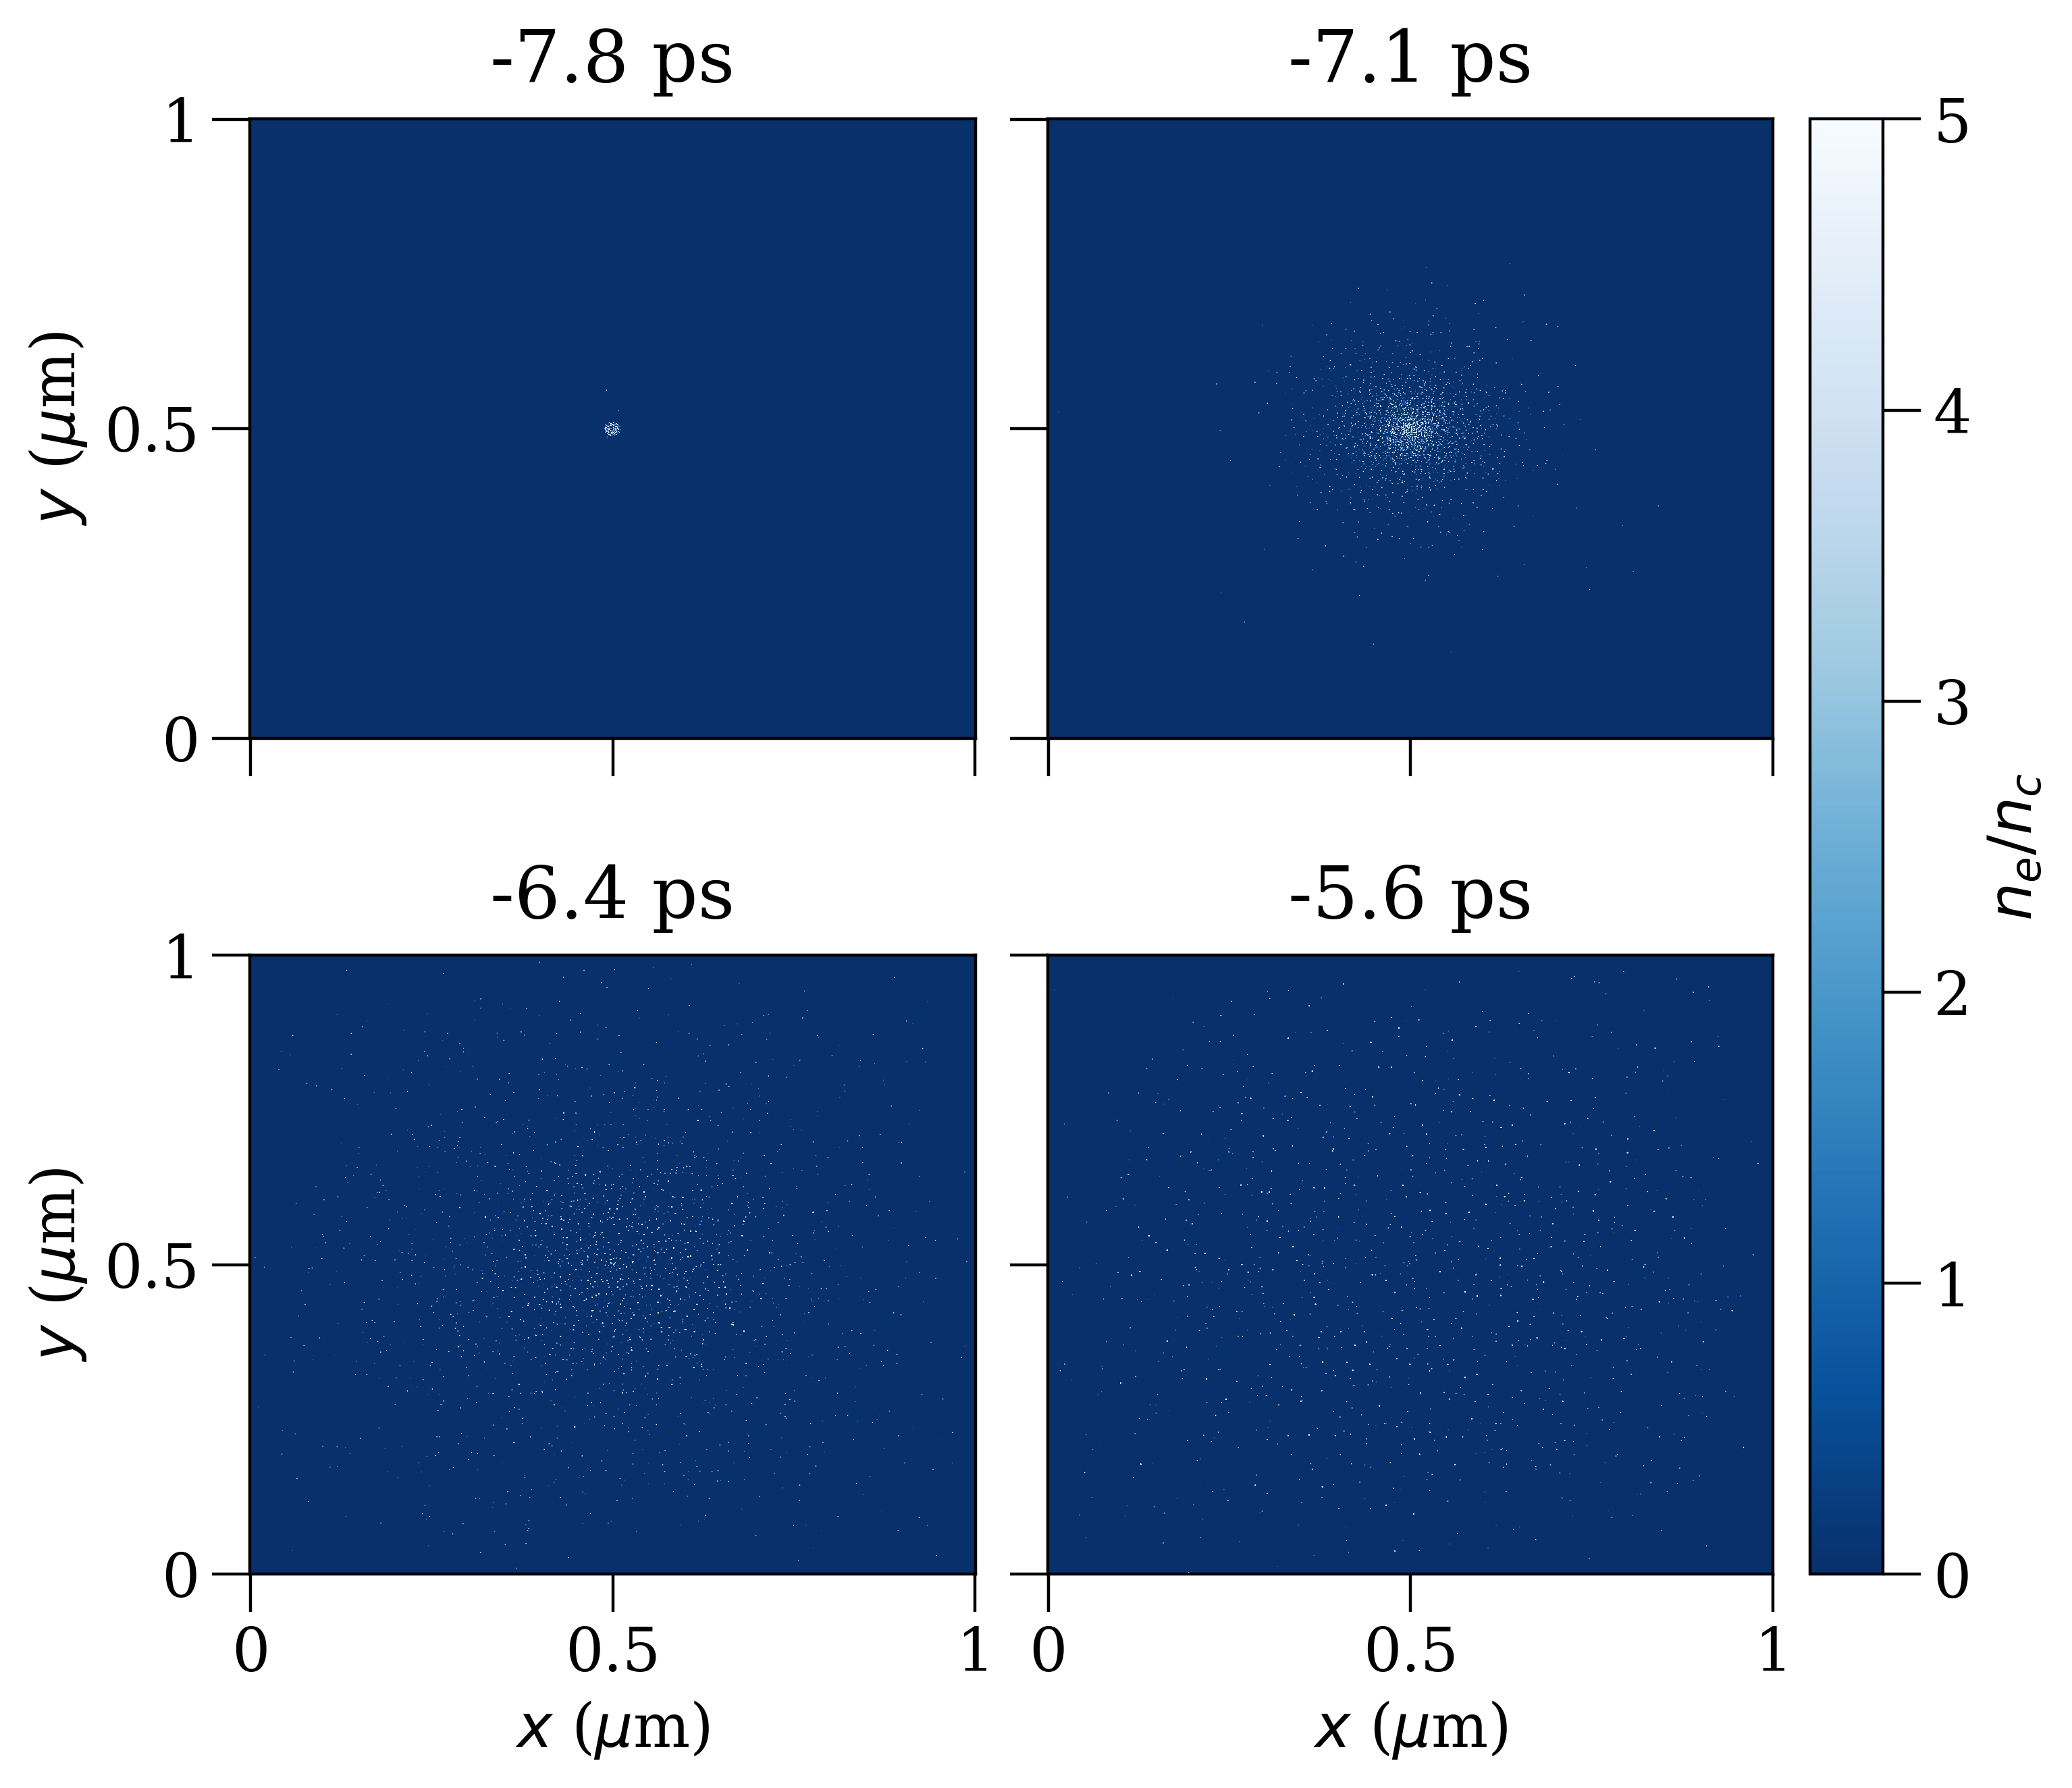

CH4 cluster expansion under pre-pulse
Simulation of a 10 nm radius cluster initialised at 91$n_{c}$
Signs of declustering 7 ps before the main pulse arrives
Suggests a density decrease to a greater extent than expected
Notes:
91 ncrit obtained by assuming cluster is liquid methane density roughly

Slide 16
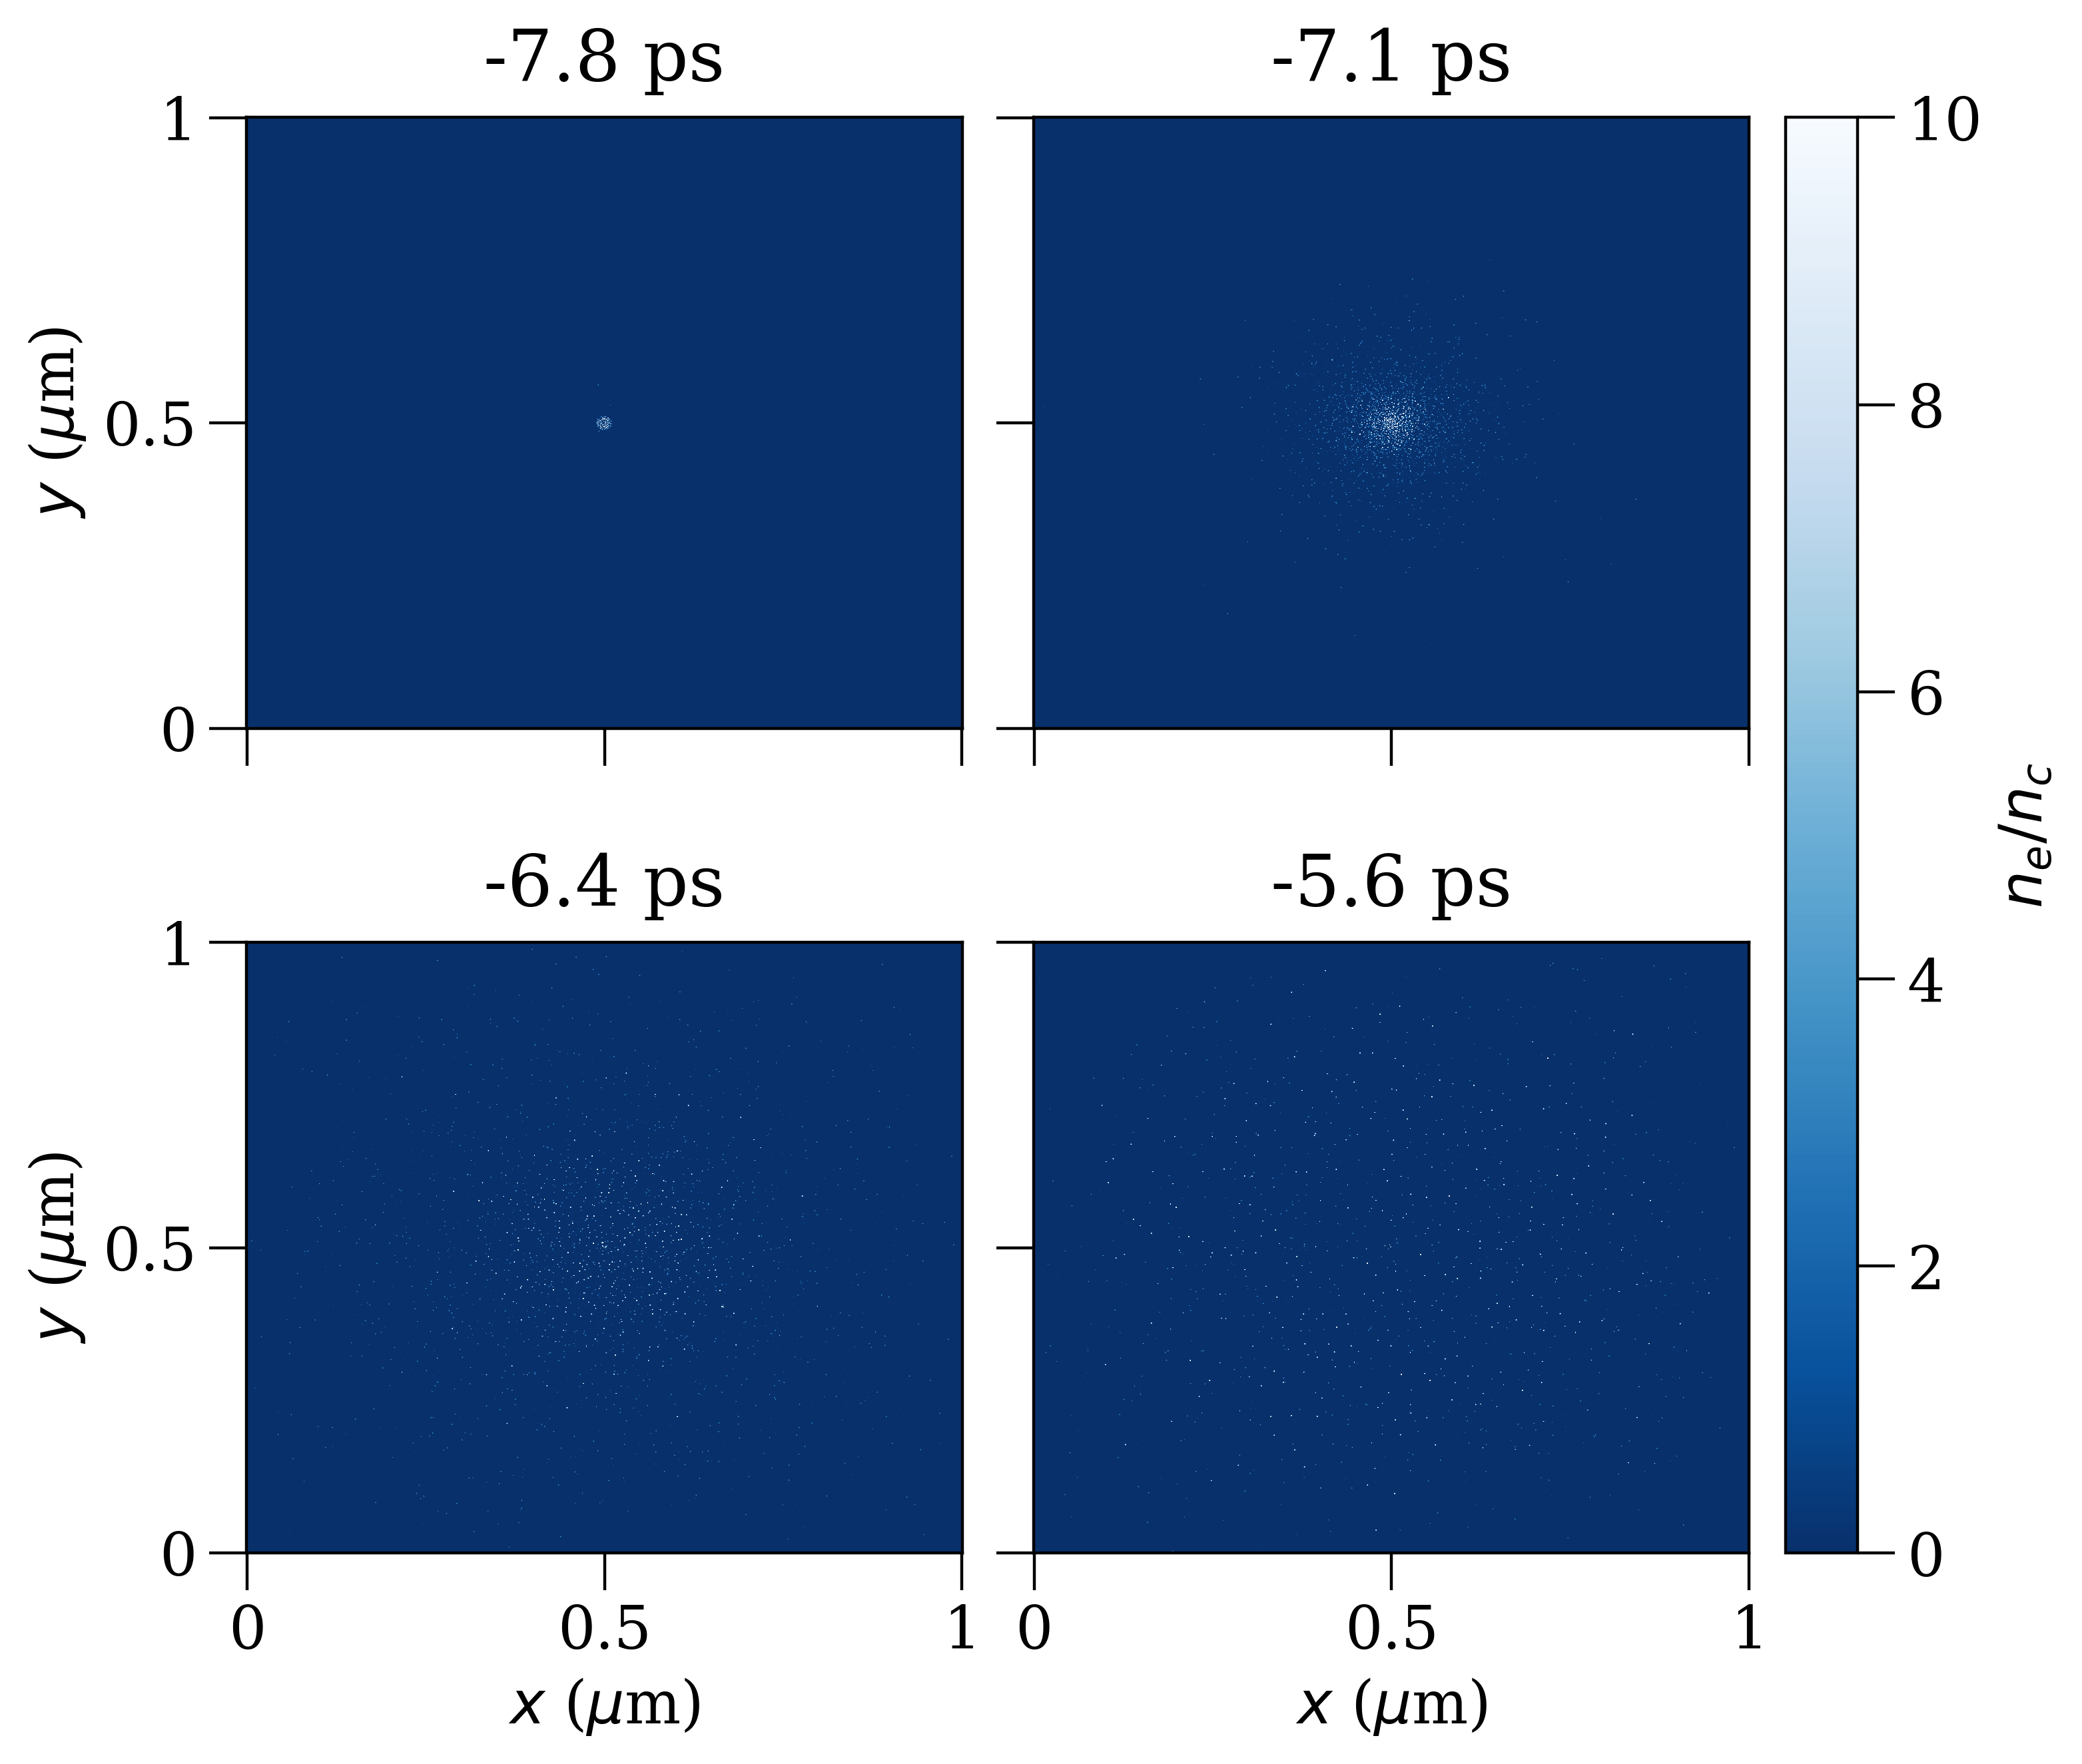
CH4 cluster expansion under pre-pulse
Simulation of a 10 nm radius cluster initialised at 91$n_{c}$
Signs of declustering 7 ps before the main pulse arrives
Suggests a density decrease to a greater extent than expected

Slide 17
Outline
Introduction and Background
LWFA
Cluster-enhanced injection
Studies
Aims of the project
Heating mechanisms & convergence tests
Cluster expansion under the laser pre-pulse
Conclusion & Outlook

Slide 18
Conclusions & Outlook
Results indicate that CH4 cluster expansion under the laser pre-pulse is much greater than expected
Simulations with the inclusion of background plasma may indicate a less aggressive cluster expansion, due to Debye shielding
Further simulation of pre-pulse expansion is required, with a higher particle density and a larger simulation box size
Compare un-clustered and clustered CH4 LWFA simulations over a range of cluster densities
Notes:
Debye shielding is the tendency of a plasma to screen out an electric charge or electric field over a short distance because the mobile plasma particles rearrange themselves.

Slide 19
References
J. D. Ludwig et al., Laser based 100 GeV electron acceleration scheme for muon production, Scientific Reports, 15, 25902 (2025). DOI: 10.1038/s41598-025-95440-w
S. V. Rozario, Novel Injection and Targetry in Laser Wakefield Acceleration, PhD thesis, Imperial College London (2019)
M. W. von der Leyen, Study of Novel Electron Injection Mechanisms for Laser-Wakefield Accelerators, University of Oxford, (2021)

Slide 20
Questions

Slide 21
Additional slides

Slide 22
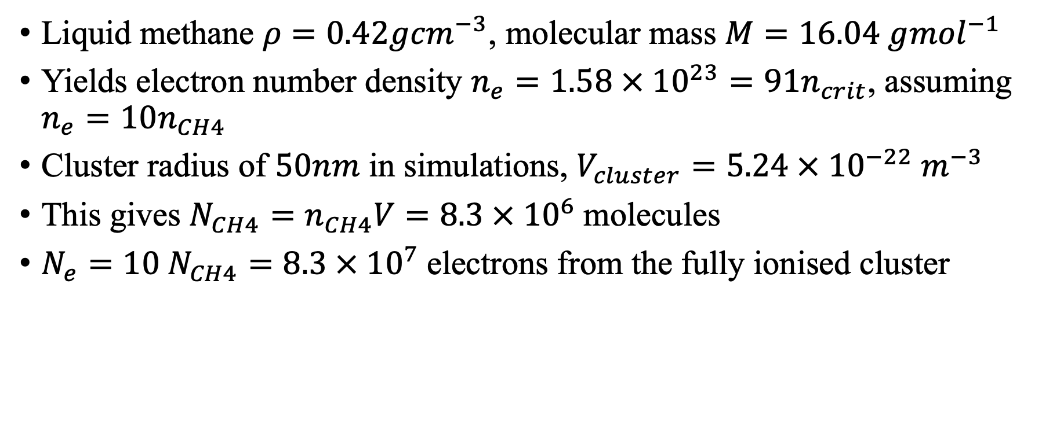
Liquid CH4 cluster density calculation
Liquid methane $ρ=0.42g{cm}^{−3}$, molecular mass $M=16.04 g{mol}^{−1}$
Yields electron number density $n_{e}=1.58 × {10}^{23}=91n_{crit}$, assuming $n_{e}=10n_{CH4}$
Cluster radius of $50nm$ in simulations, $V_{cluster}=5.24 × {10}^{−22}{ m}^{−3}$
This gives $N_{CH4}=n_{CH4}V=8.3 × {10}^{6}$molecules
$N_{e}=10 N_{CH4}=8.3 × {10}^{7}$electrons from the fully ionised cluster

Slide 23
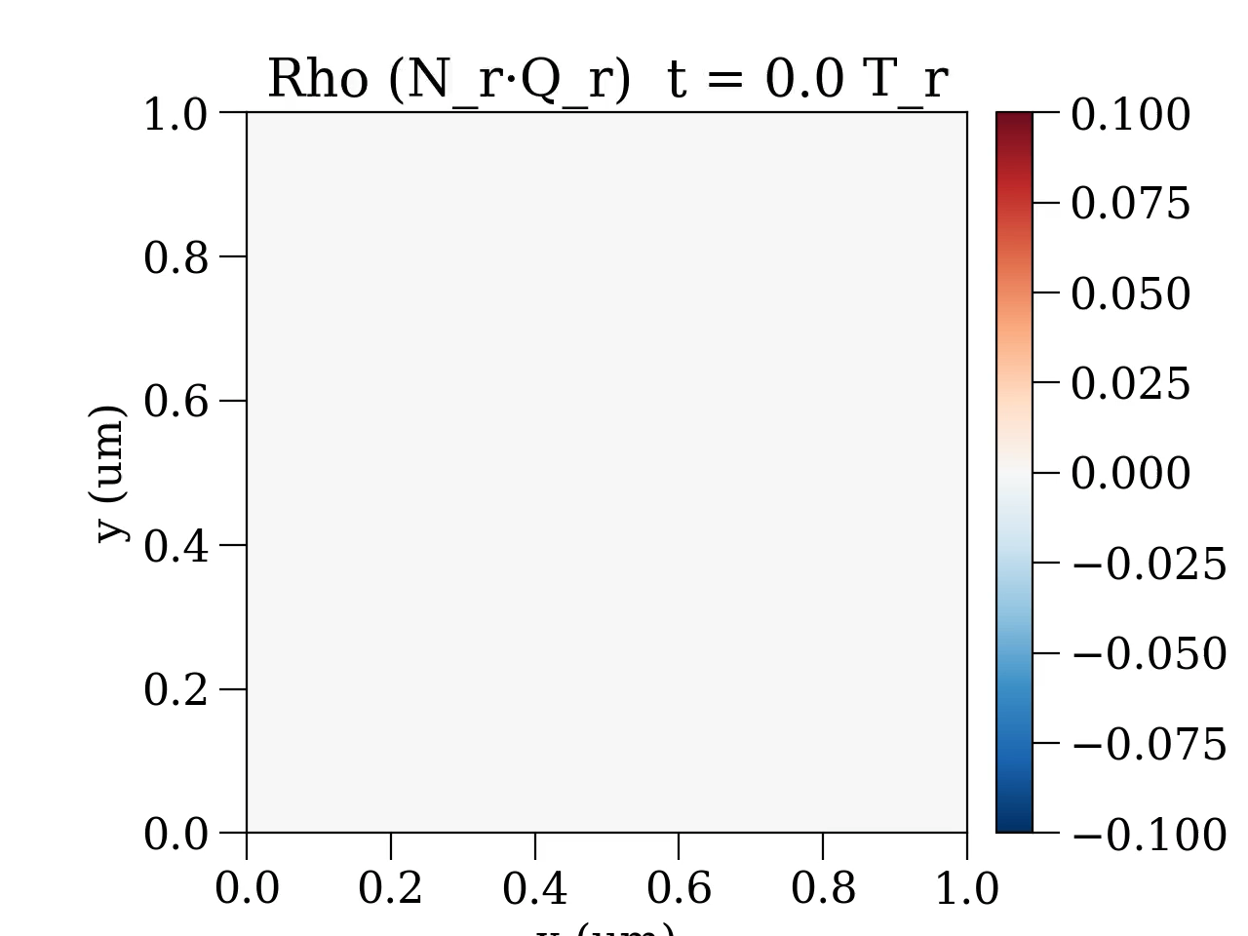
Pre-pulse expansion animation

Slide 24
Measurement of cluster density change

Slide 25
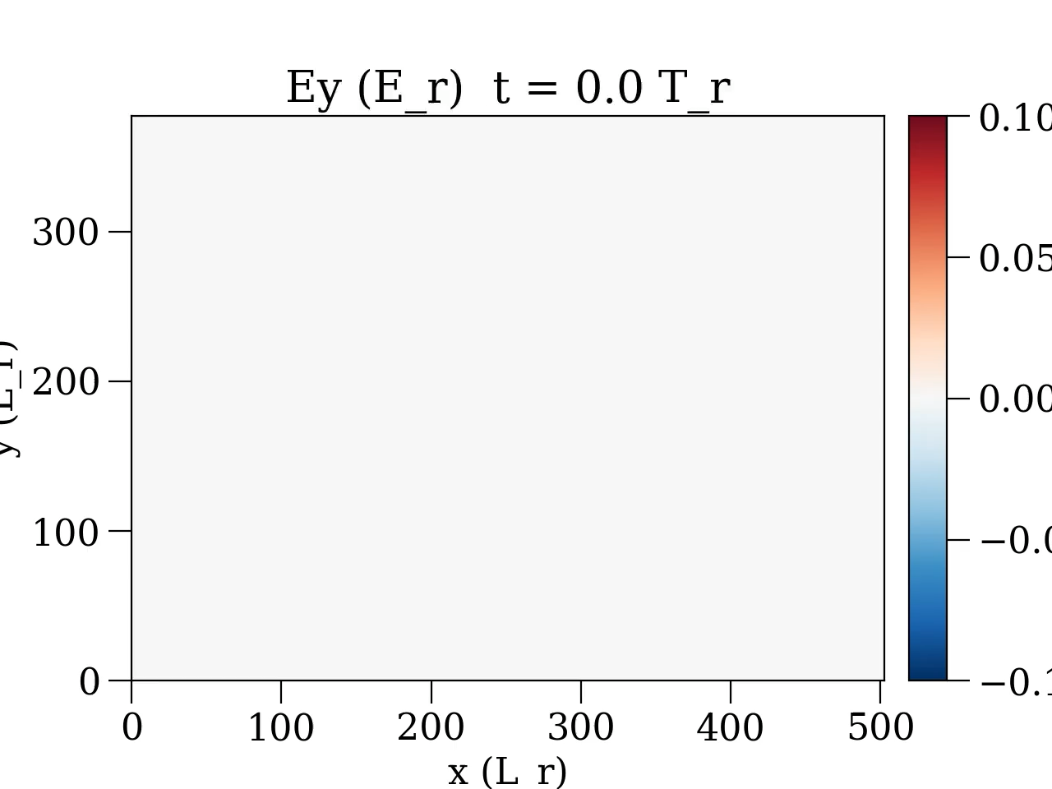
Unclustered LWFA

