Slide 1
Progress Update
Cluster-Enhanced Injection in LWFA

Slide 2
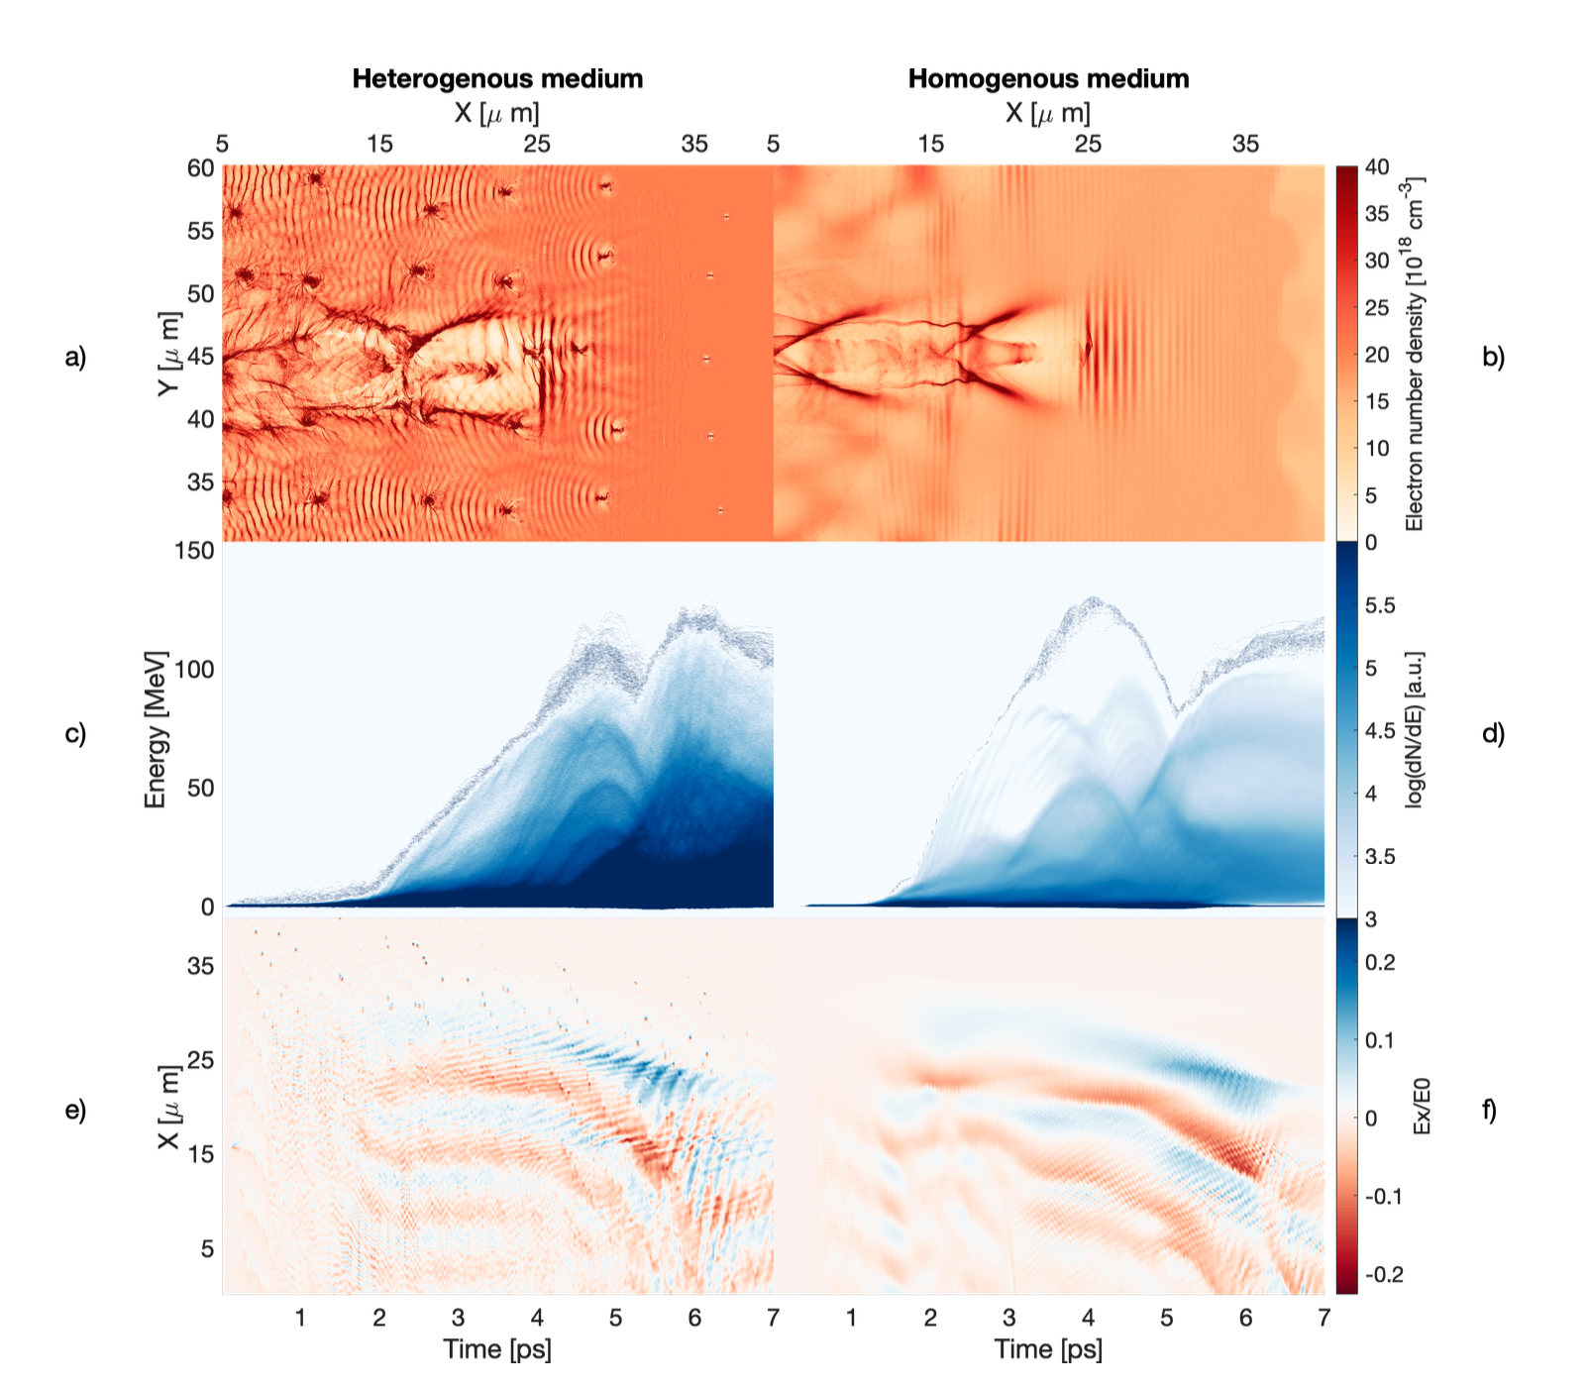
Clustered vs Unclustered medium
Aim is to investigate how the use of CH4/He clusters impacts LWFA
Specific focus on measuring cluster impact on electron beam energy spectrum, beam divergence and laser a0 evolution
Rozario, S.V. (2019). Novel injection and targetry in laser wakefield acceleration. PhD thesis, Imperial College London.

Slide 3
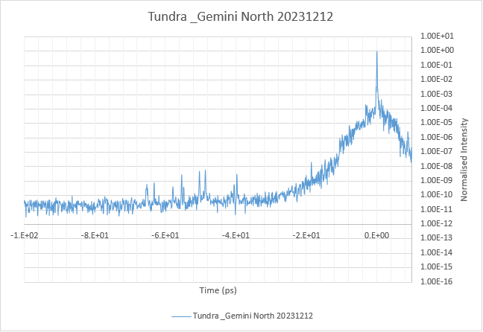
Gemini North Prepulse measurement
Previously was assumed this prepulse leads to expansion of the CH4 clusters to ~ 5 n_crit
Ionises once the intensity surpasses the BSI of CH4
Notes:
Roughly ionizes at this point. Currently running the prepulse simulation with methane clusters, and then using that to inform the cluster density and size in the lwfa simulations (which will use the 45fs main pulse).

Slide 4
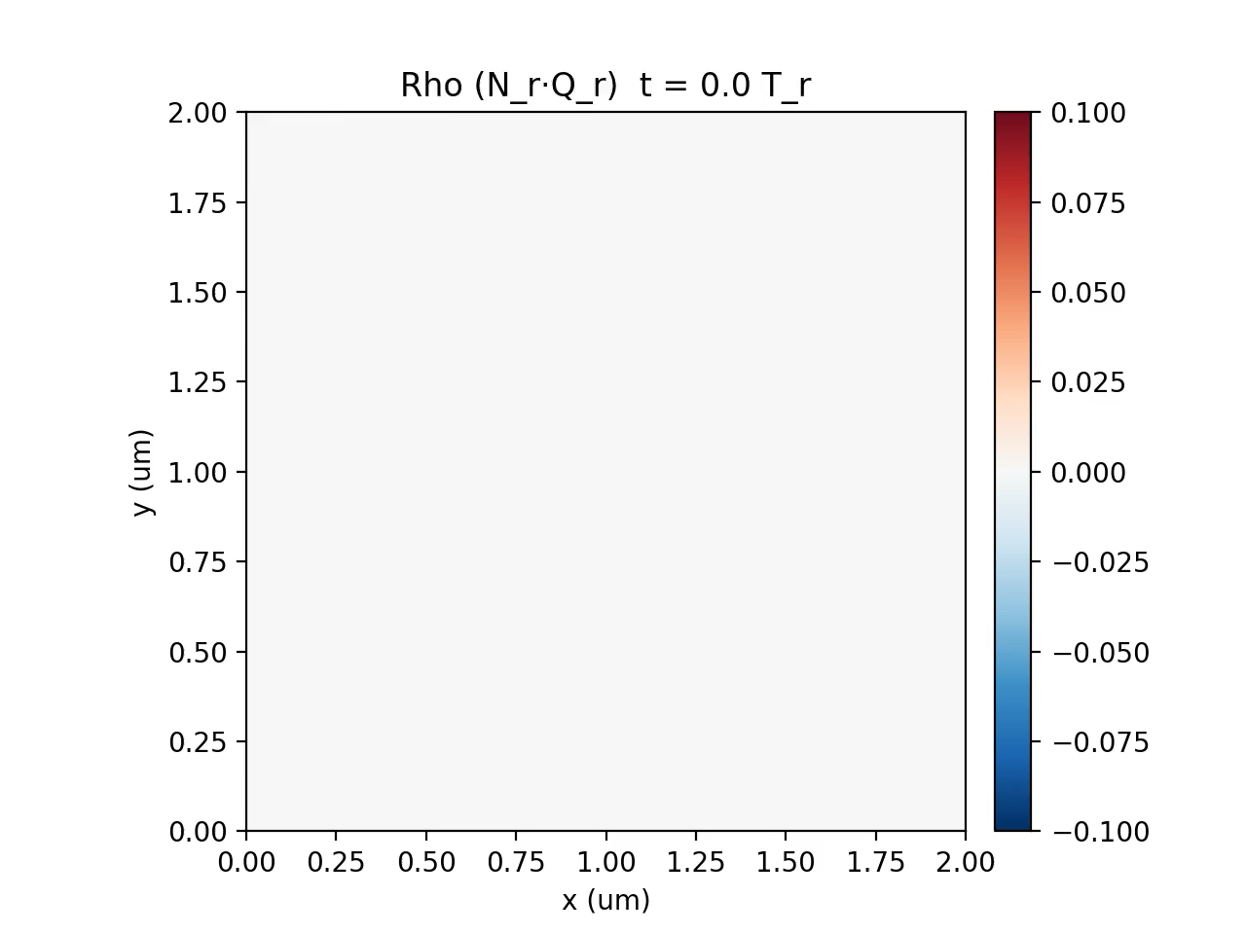
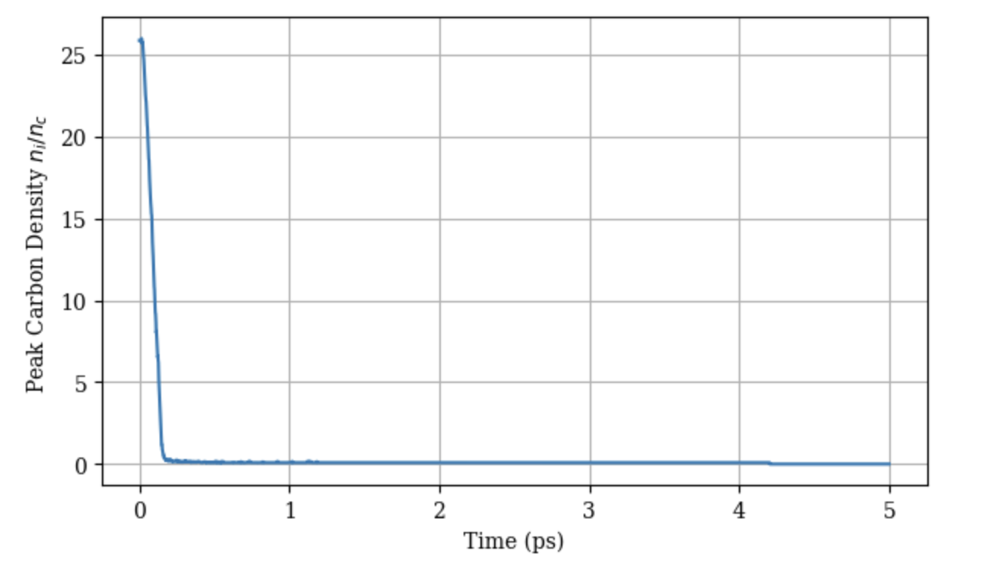
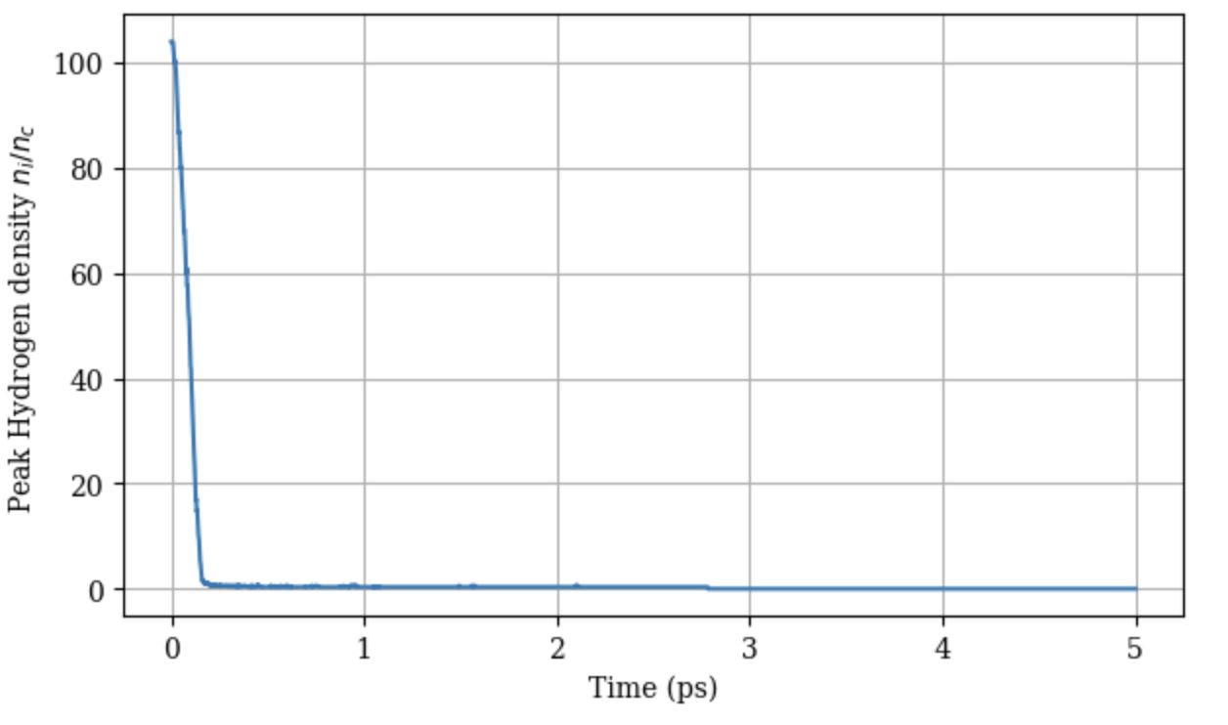
Prepulse cluster density profile
Notes:
Ionises almost instantly, need to start sim from earlier on. Clusters initially at 130 n_crit, 10nm sigma.

Slide 5
Gemini North Prepulse measurement
Previously was assumed this prepulse leads to expansion of the CH4 clusters to ~ 5 n_crit
Ionises once the intensity surpasses the BSI of CH4
Notes:
Roughly ionizes at this point. Currently running the prepulse simulation with methane clusters, and then using that to inform the cluster density and size in the lwfa simulations (which will use the 45fs main pulse).

Slide 6
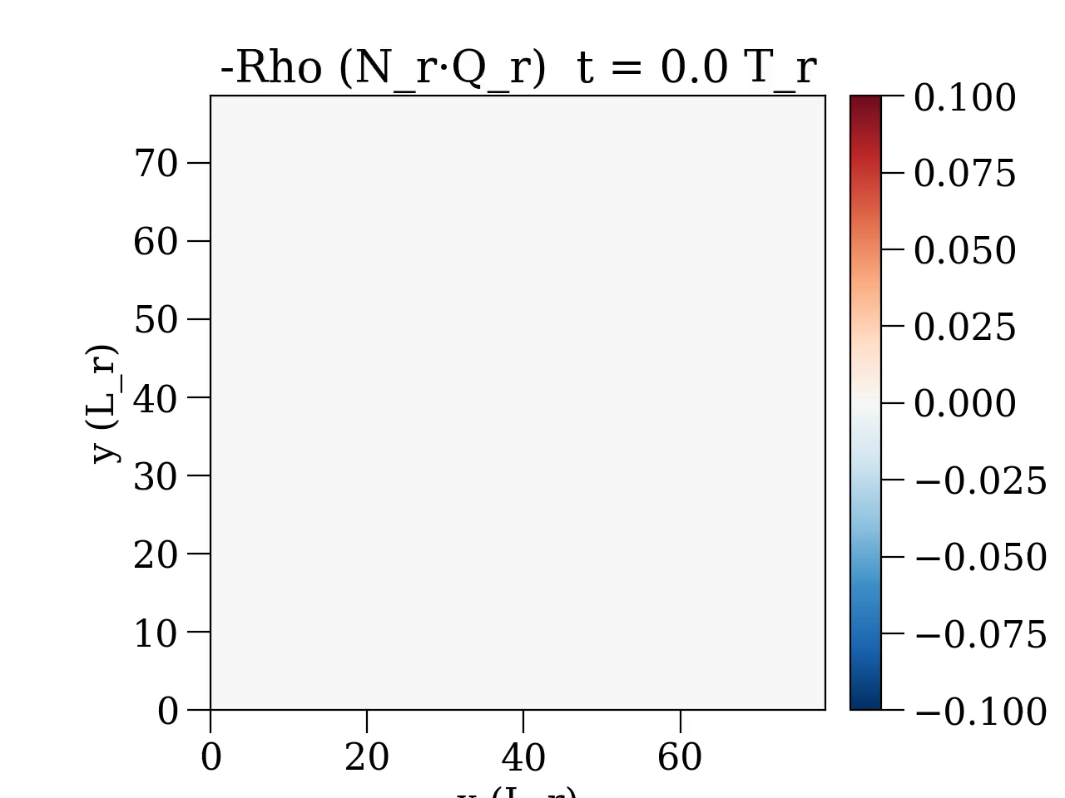
Prepulse cluster density profile

Slide 7
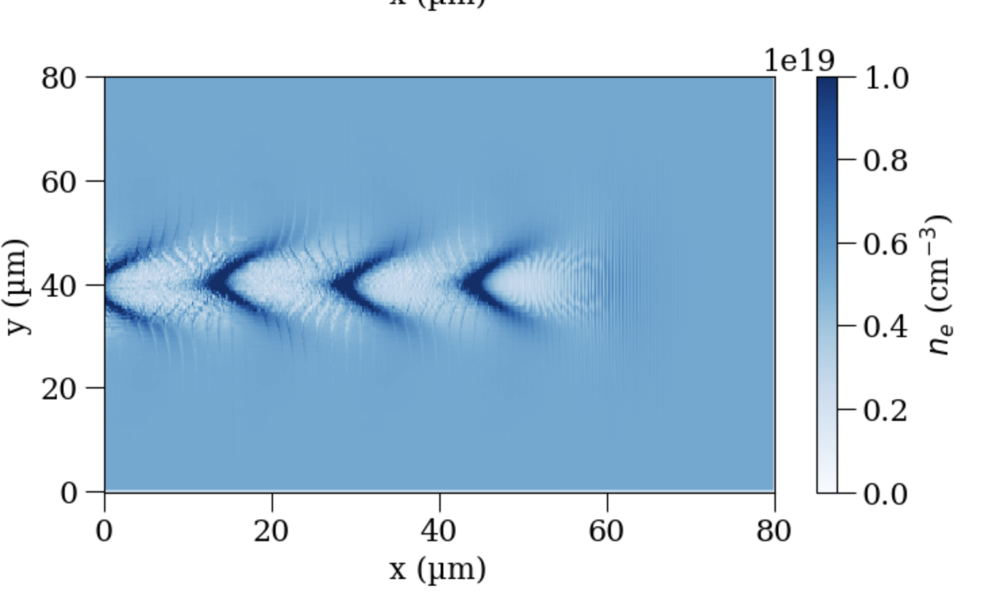
Unclustered LWFA Baseline Density Profile

Slide 8
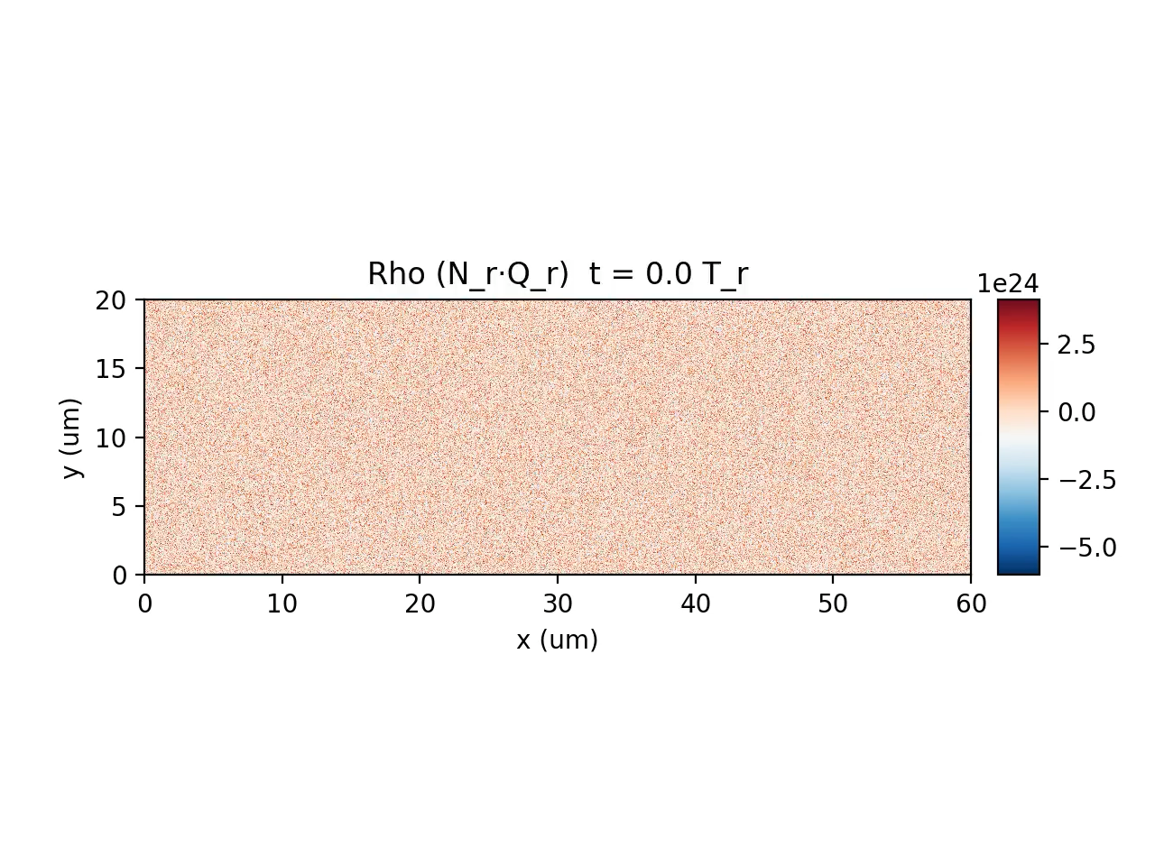
Unclustered LWFA Baseline Density Profile

Slide 9
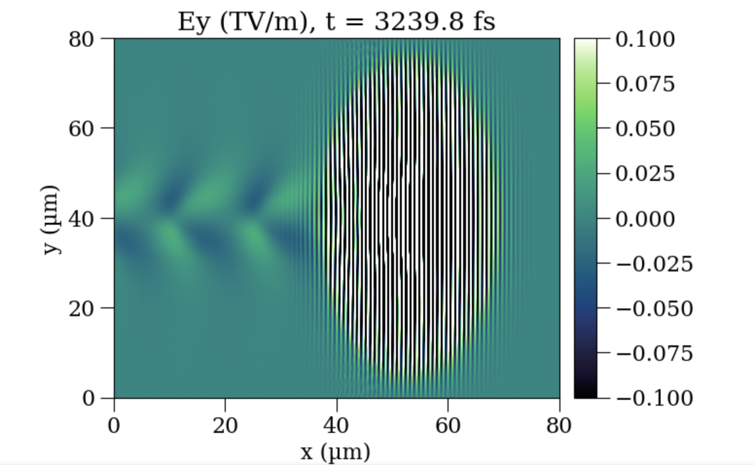
Electric field (laser)

Slide 10
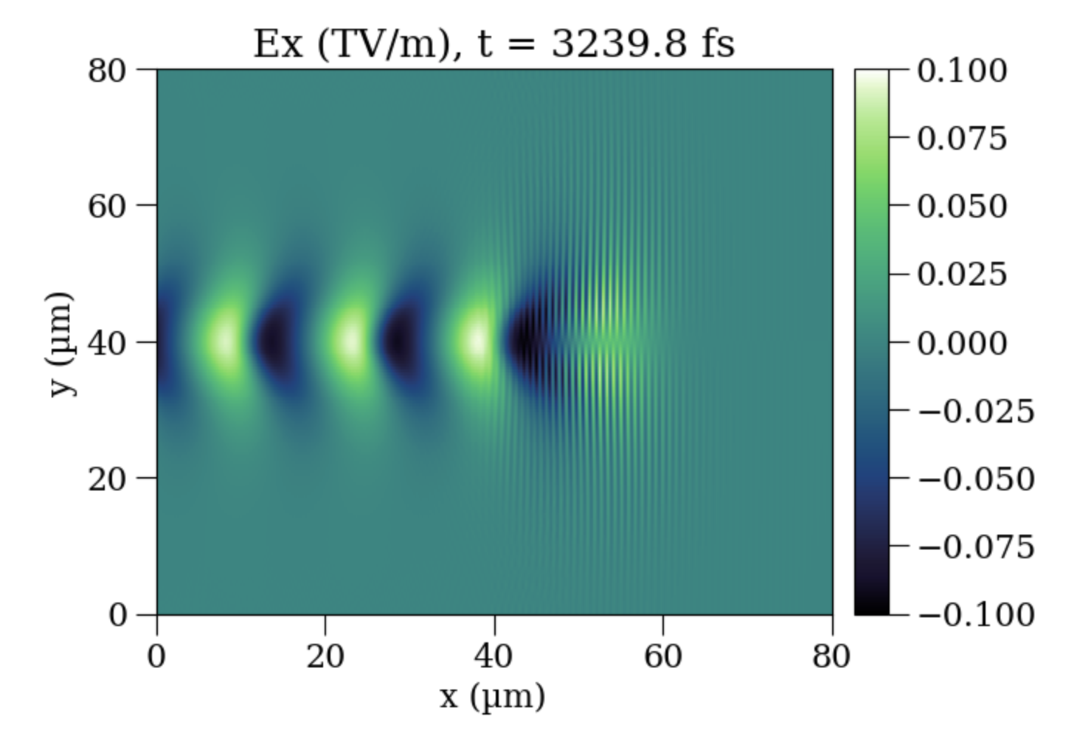
Electric field along propagation direction
Notes:
Comes from charge separation during ionisation

Slide 11
