Slide 1
Progress update
Cluster-enhanced injection in LWFA

Slide 2
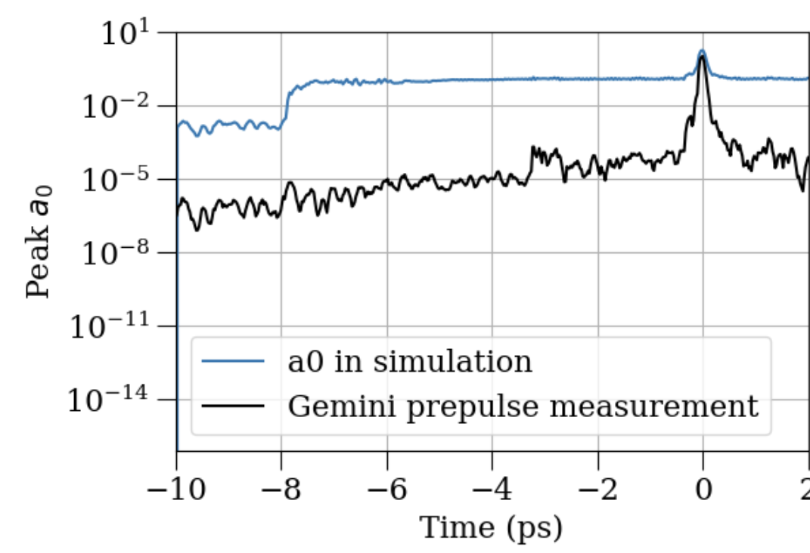
Prepulse a0 mistake
Previously used sqrt of the intensity by mistake
Led to ionization 8ps ahead of main pulse
Mistake has now been corrected

Slide 3
Prepulse a0 mistake
Previously used sqrt of the intensity by mistake
Led to ionization 8ps ahead of main pulse
Mistake has now been corrected

Slide 4
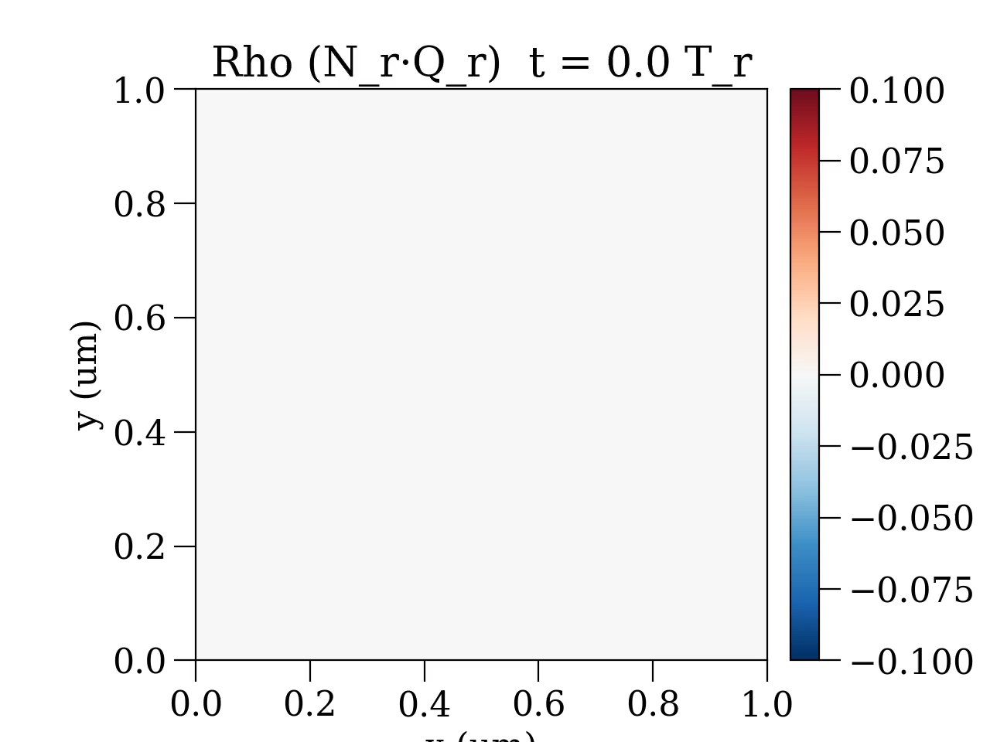
Prepulse expansion of CH4 cluster
Notes:
Simulation starts 0.5ps before main pulse, ends 0.5ps after main pulse, lasts 1ps in total.

Slide 5
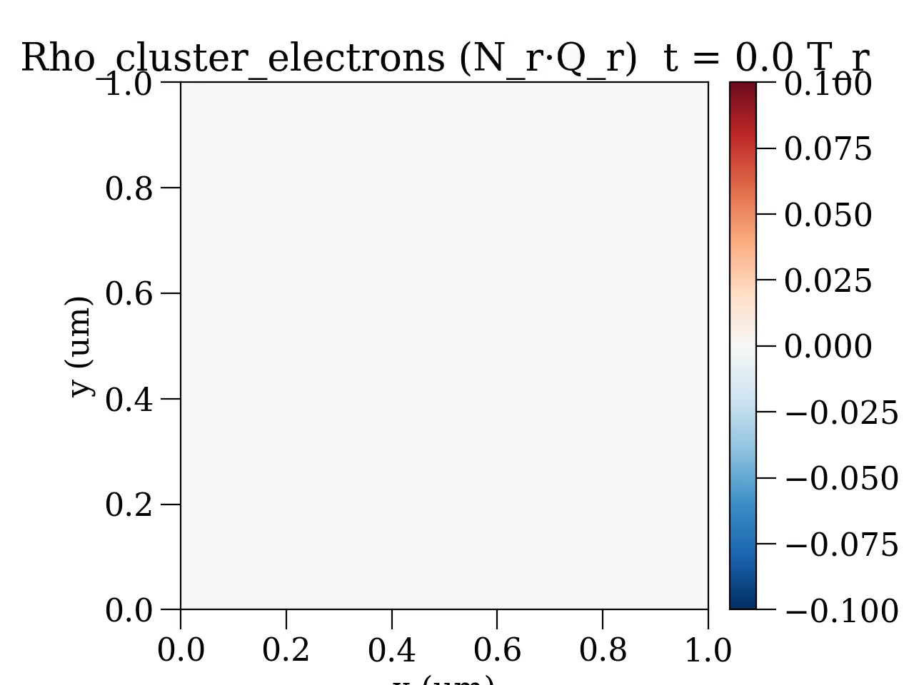
Prepulse expansion of CH4 cluster
Notes:
Simulation starts 0.5ps before main pulse, ends 0.5ps after main pulse, lasts 1ps in total.

Slide 6
Prepulse expansion of CH4 cluster
Notes:
Simulation starts 0.5ps before main pulse, ends 0.5ps after main pulse, lasts 1ps in total.

Slide 7
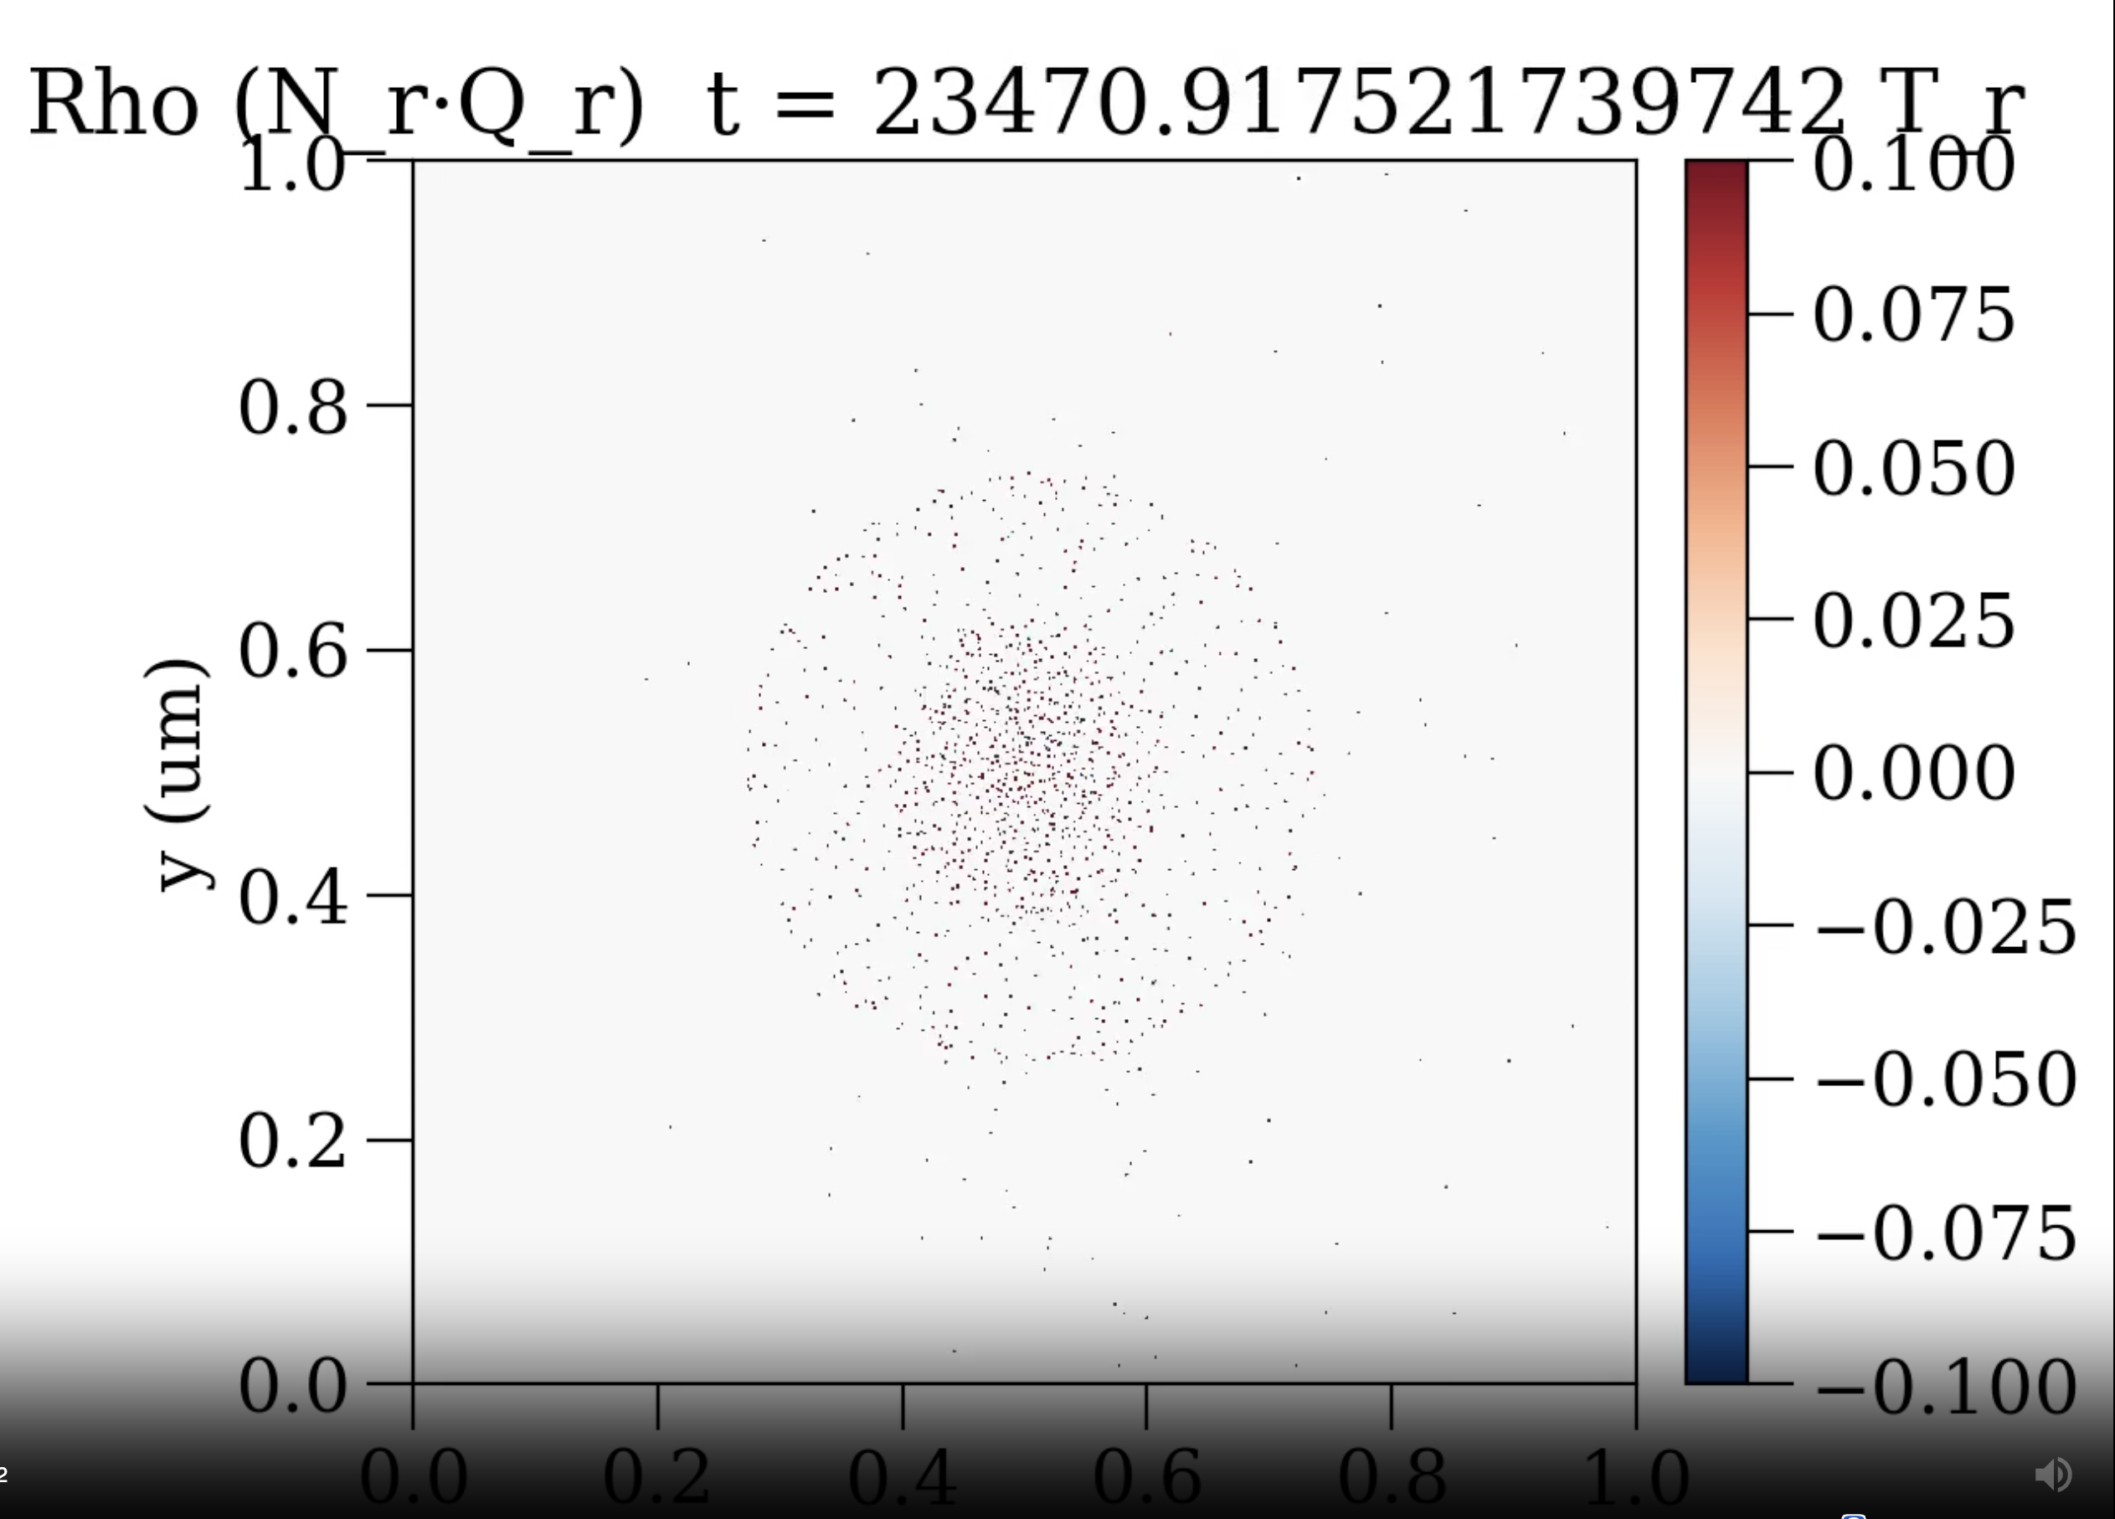
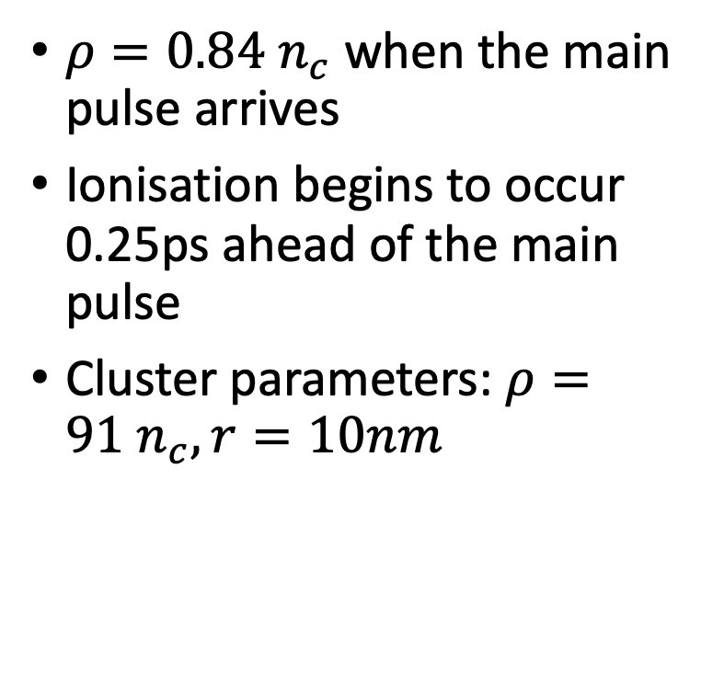
Prepulse expansion of CH4 cluster
$ρ=0.84 n_{c}$when the main pulse arrives
Ionisation begins to occur 0.25ps ahead of the main pulse
Cluster parameters: $ρ=91 n_{c}, r=10nm$

Slide 8
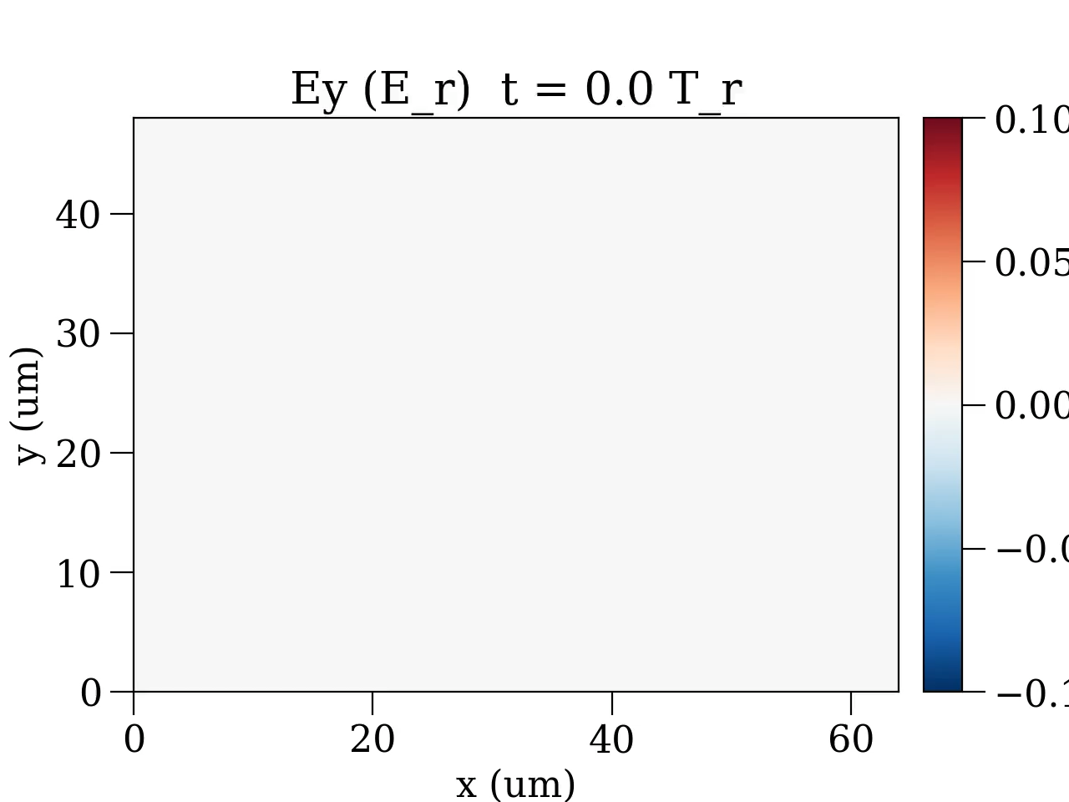

LWFA baseline: Clustered vs Unclustered
Clustered Unclustered

Slide 9
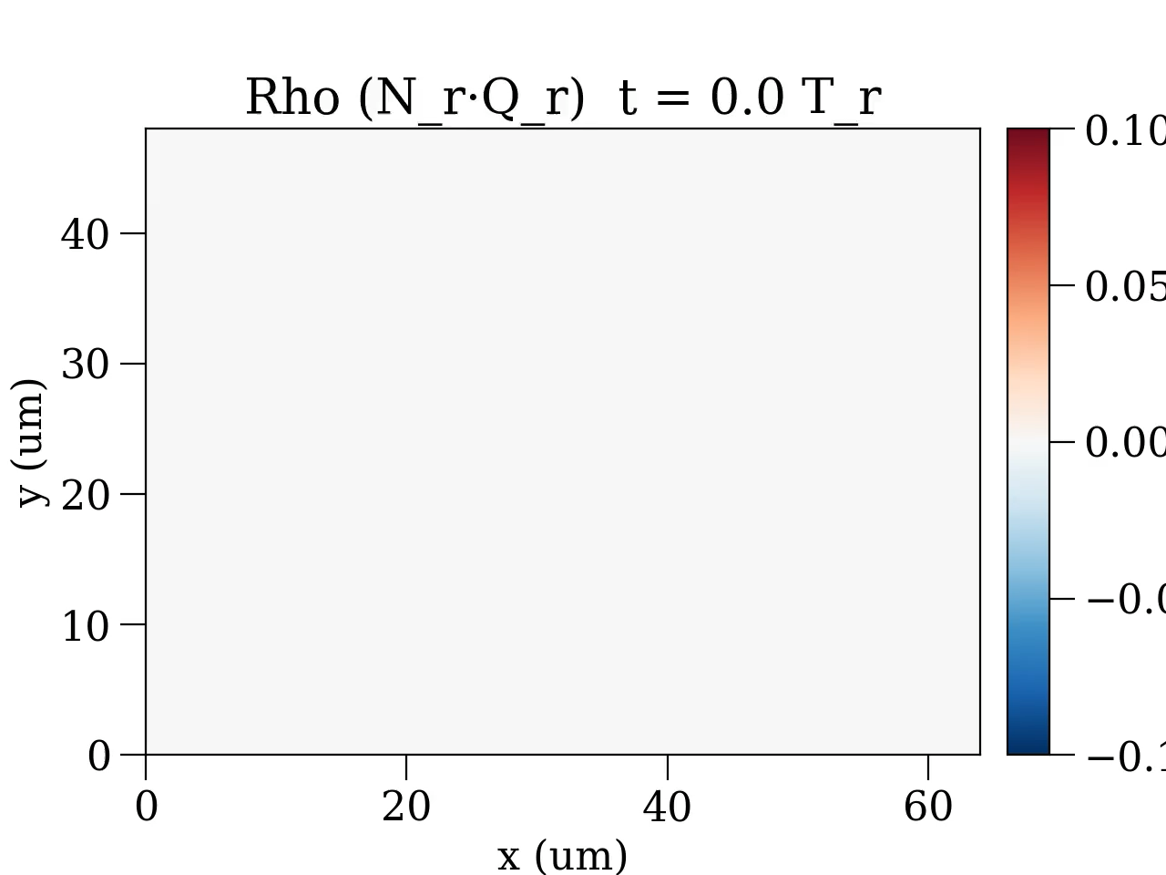
LWFA with Clustered CH4 (Rho)

Slide 10
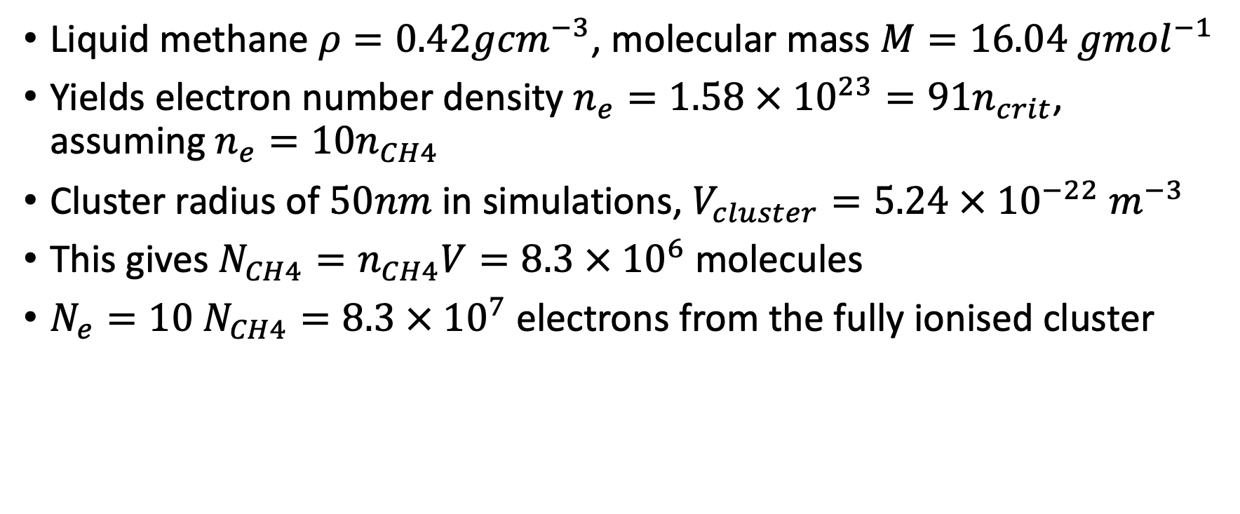
Liquid CH4 cluster density calculation
Liquid methane $ρ=0.42g{cm}^{−3}$, molecular mass $M=16.04 g{mol}^{−1}$
Yields electron number density $n_{e}=1.58 × {10}^{23}=91n_{crit}$, assuming $n_{e}=10n_{CH4}$
Cluster radius of $50nm$ in simulations, $V_{cluster}=5.24 × {10}^{−22}{ m}^{−3}$
This gives $N_{CH4}=n_{CH4}V=8.3 × {10}^{6}$molecules
$N_{e}=10 N_{CH4}=8.3 × {10}^{7}$electrons from the fully ionised cluster

