Slide 1
LeNet
Convolutional Neural Network

Slide 2
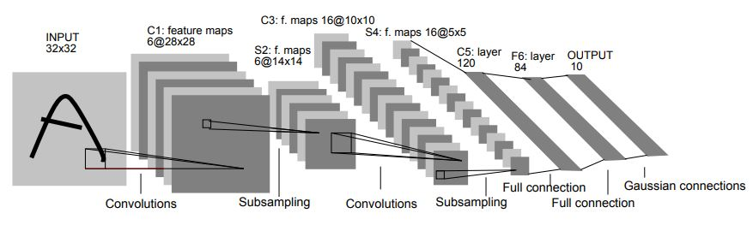

Slide 3
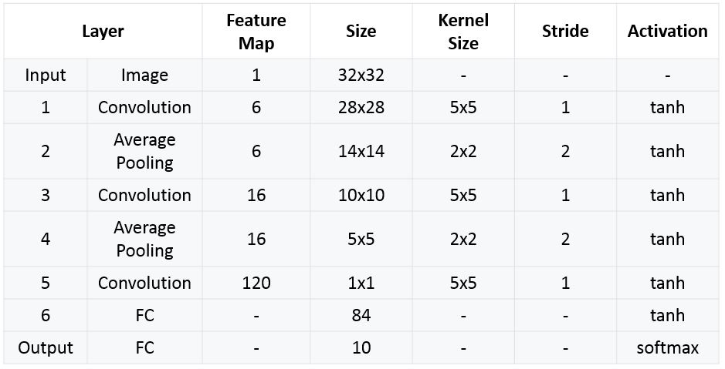

Slide 4
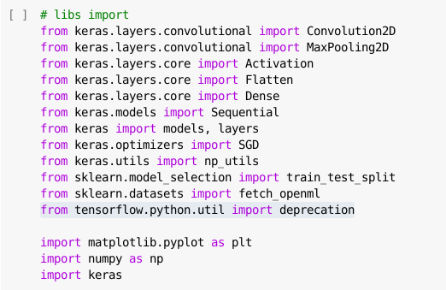
Library Import

Slide 5

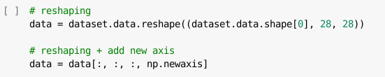

Fetching dataset MNIST
Reshaping
Pengubahan skala dataset

Slide 6
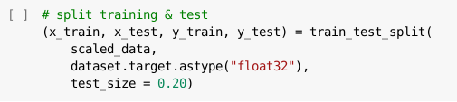
Pembagian data training & testing

Slide 7
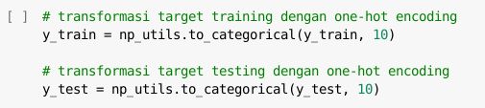

Transformasi data target/label
Instansiasi model network

Slide 8
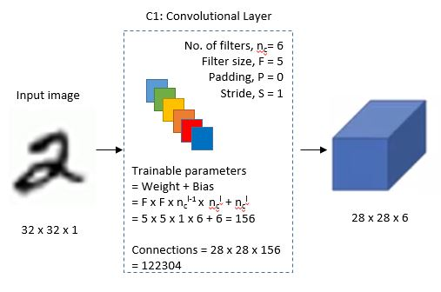
C1: Convolutional Layer

Slide 9
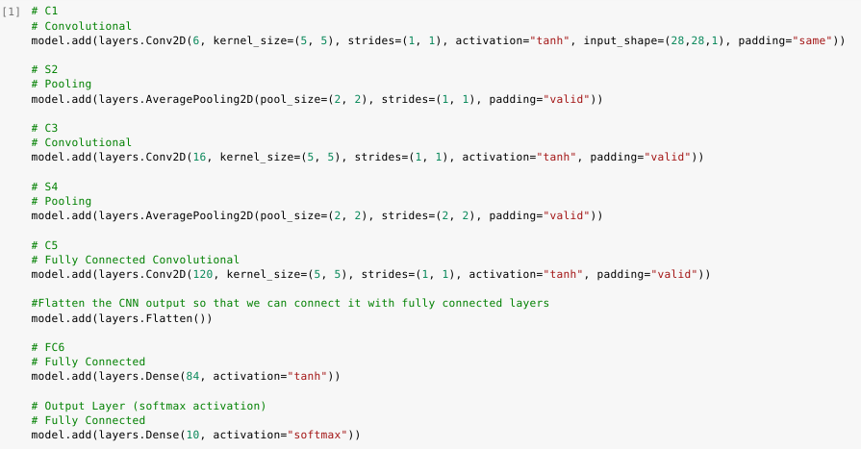

Slide 10
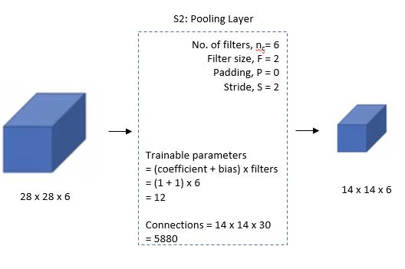
C2: Pooling Layer

Slide 12
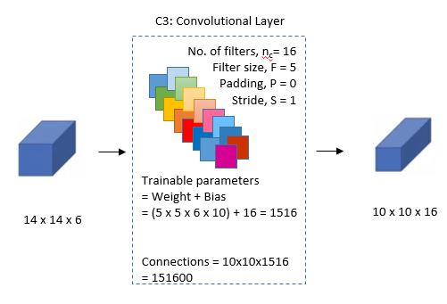
C3: Convolutional Layer

Slide 14
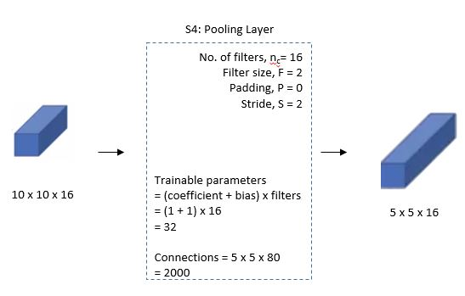
C4: Pooling Layer

Slide 16
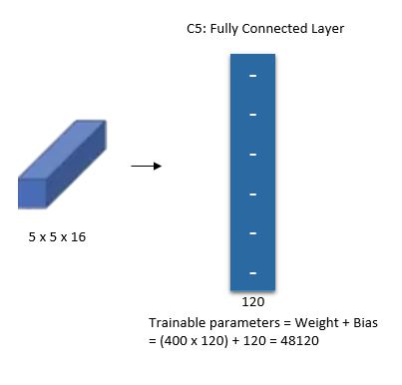
C5: Fully Connected Convolutional Layer

Slide 18
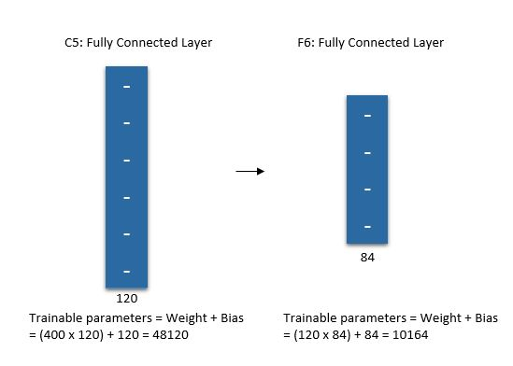
F6: Fully Connected

Slide 20
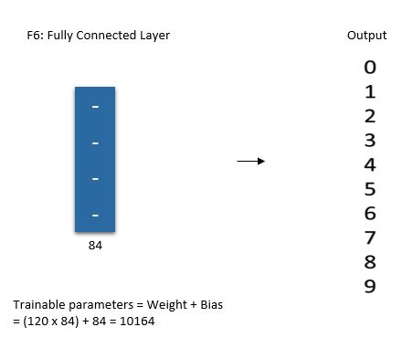
F7: Output

Slide 22
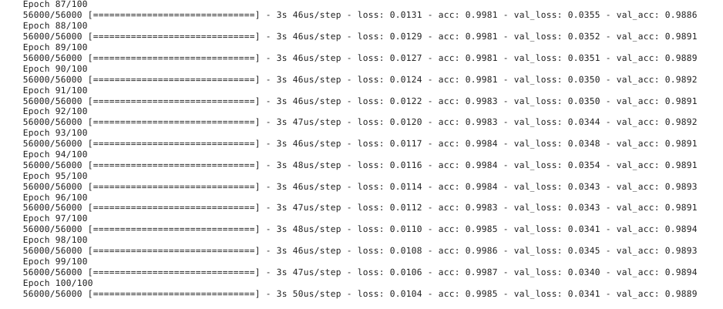

Slide 23
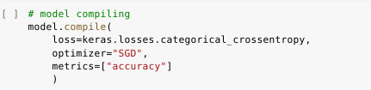
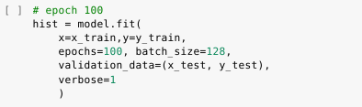
Compiling Model
Fitting

Slide 24

Skor

Slide 25
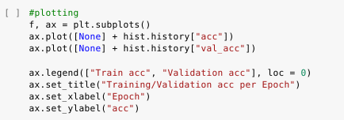
Plotting akurasi

Slide 26
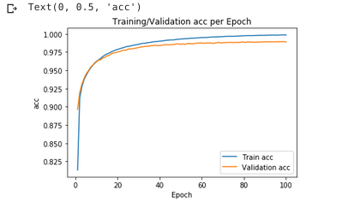

Slide 27
VggNet

