Slide 2






$$z^{pre}$$
$$z^{post}$$
$$z^{∗}$$
$$x$$
$$y$$
$$f_{θ}$$

Slide 3














$$Train−one−epoch$$
$$EPL$$
$$x$$
$$z_{3}^{∗}$$
$$\hat{y}$$
$$θ$$
$$x$$
$$z_{init}^{∗}$$
$$\hat{y}$$
$$x$$
$$z_{2}^{∗}$$
$$\hat{y}$$
$$O_{eep}$$
$$back−$$
$$propagation$$
$$x$$
$$z_{1}^{∗}$$
$$\hat{y}$$

Slide 4
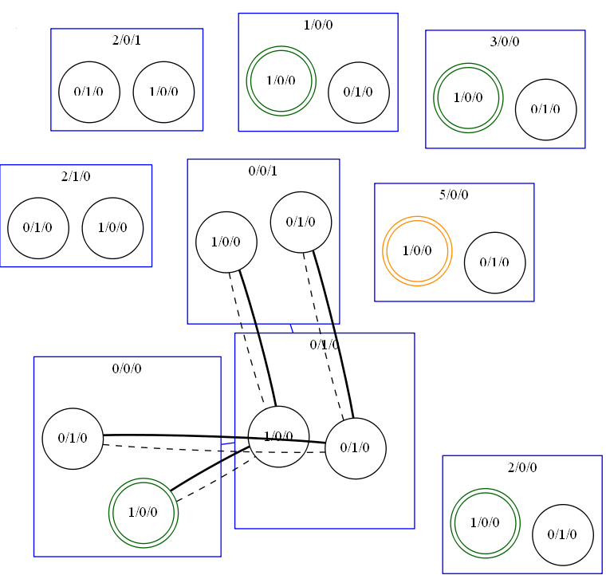

Slide 5
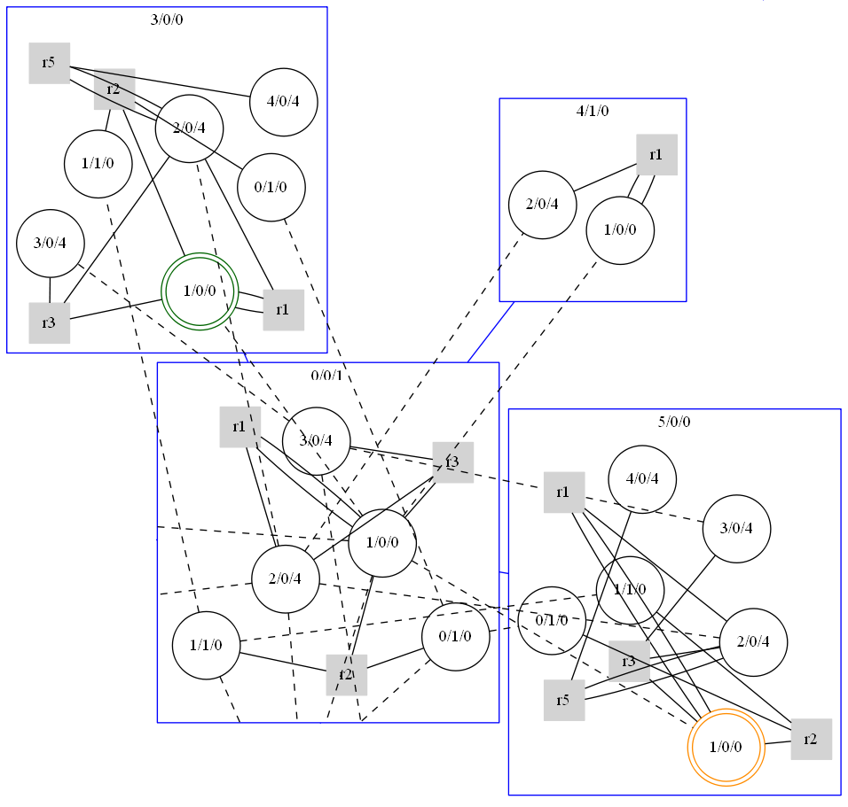

Slide 6
























$$s_{0}$$
$$g_{1}$$
$$Extracellular space$$
$$g_{i}$$
$$voltage−gate$$
$$s_{1}$$
$$g_{1}$$
$$s_{v}$$
$$g_{i}$$
$$s_{2}$$
$$g_{1}$$
$$r_{1}$$
$$g_{activated}$$
$$s_{3}$$
$$g_{1}$$
$$cell membrane$$
$$g_{running}$$
$$r_{2}$$
$$r_{3}$$
$$g_{activator}$$
$$g_{o}$$
$$s_{n}$$
$$g_{1}$$
$$g_{\begin{aligned}not− \\ activated\end{aligned}}$$
$$s_{n+1}$$
$$g_{1}$$
$$interacellular space$$
$$g_{o}$$

Slide 8











Externel
$$s_{1}$$
$$g_{1}$$
$$s_{1}$$
$$g_{2}$$
$$s_{2}$$
$$g_{1}$$
$$r_{2}$$
$$g_{3}$$
CPPN
$$s_{2}$$
$$g_{2}$$
$$r_{1}$$
$$g_{3}$$
$$g_{4}$$
$$s_{3}$$
$$g_{4}$$
$$g_{3}$$
Local
Dynamical System

Slide 9


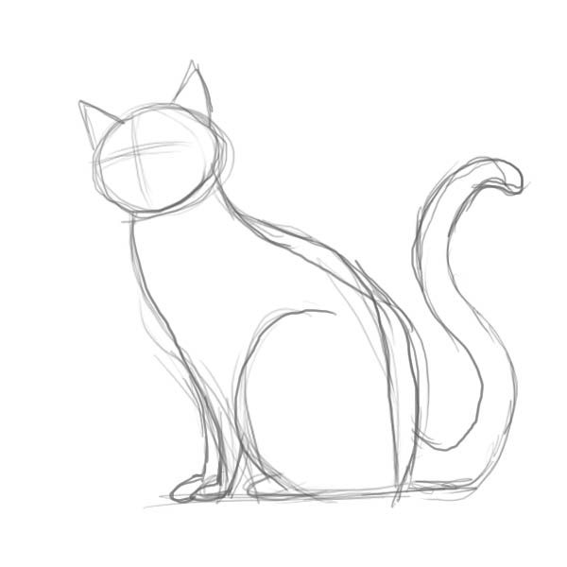
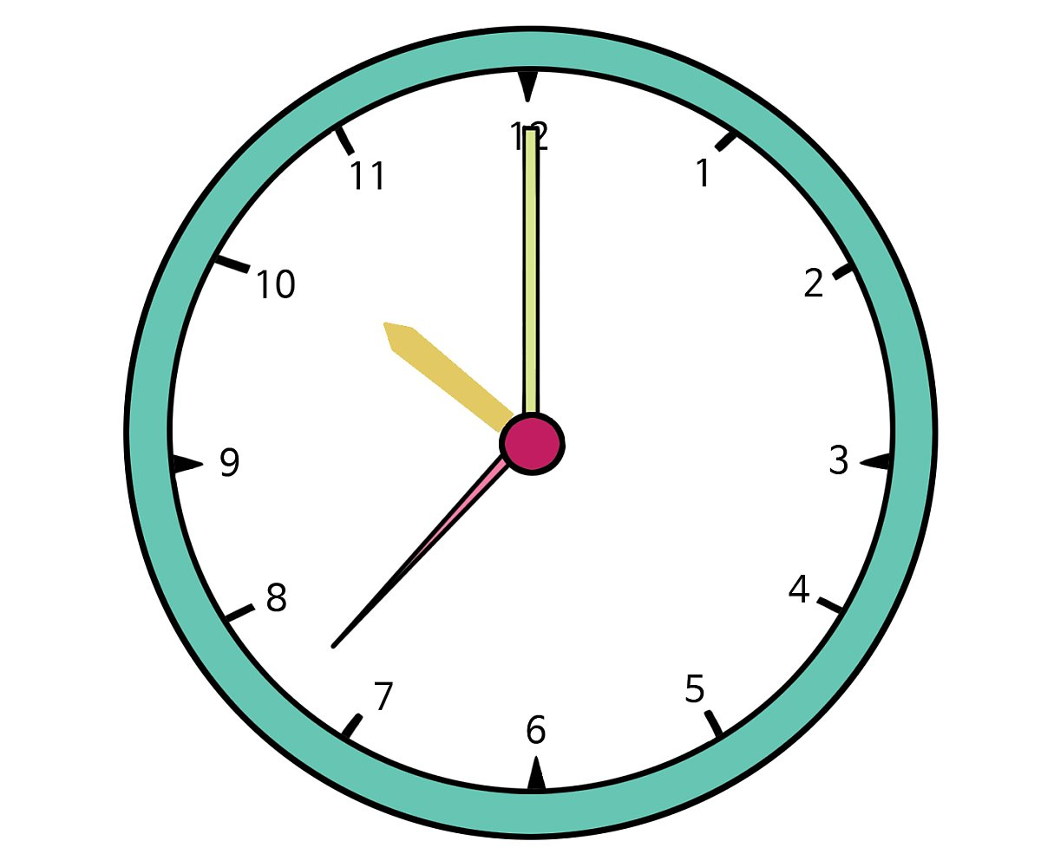
Implicit Layer Path
Implicit Layer Path
Energy
Input
Input
Param
Input & Feedback
Equilibrium Point Space

Slide 10
Energy
Equilibrium Point

