Slide 1
Equilibrium Point Learning
ACML 2023
Baik Dowoo , Ji Won Yoon
Naval Academy , Korea University

Slide 2
Concept - learning information
Learning Direction is not Dependable Variable
?

Slide 3
Concept - learning stratege
There is Lots of Learning Stratege ,
And there is not exist "best learning algorithm"
The Purpose of Learning is what?
if the short learning time is in Purpose,
There is Best "efficiency" way to Learning
but 학습목표 에는 그것 외에 상황에 따라 다양한 지표들이 요구될수있다.

Slide 4










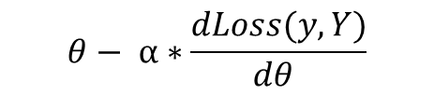

Concept - these structure exist?
$$θ− α∗\frac{dLoss(y,Y)}{dθ }$$
$z$*,$θ$
$θ$ + d$θ$
update
$$X$$
$$θ$$
$$y$$
$$x$$
$$θ$$
$$y, dθ$$
$$x$$
$$z,θ$$
$z$*, $y$
Back-propagation
EPL-learning
self-learning structure

Slide 5

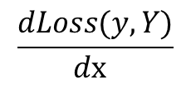

$$x$$
$θ$alg
$$\frac{dLoss(y,Y)}{dx }$$
A self-learning structure capable of learning through the back-propagation algorithm

Slide 6




$$θ− α∗\frac{dLoss(y,Y)}{dθ }$$
$θ$ + d$θ$
update
$$X$$
$$θ$$
$$y$$
$$x$$
$$θ$$
$$y, dθ$$
Back-propagation
self-learning structure

Slide 7









$\frac{d\text{ℓ}}{dz\text{*}} \left(I−\frac{d\text{f}}{dz\text{∗}}\right)$⁻¹$\frac{d\text{f}}{dθ}$
$$θ− α∗\frac{d\text{ℓ}}{dθ }$$
$z$*,$θ$
update
$$x$$
$$θ$$
$$z\text{*}$$
$$x$$
$$z,θ$$
$z$*, $y$
DEQ
Back-propagation
EPL-learning

Slide 8
$$θ− α∗\frac{d\text{ℓ}}{dθ }$$
$z$*,$θ$
update
$$x$$
$$θ$$
$$z\text{*}$$
$$x$$
$$z,θ$$
$z$*, $y$
DEQ
EPL-learning

Slide 9




update (overwrite)
$z$*,$θ$
θ
θ
θ
θ
θ
I_{z}
z
...
$$x$$
$$z,θ$$
$z$*, $y$
x
*
+
z*
(Input)
O₁
O₂
O₃
O₄
O₅
y
(output)
environ

Slide 10
update (overwrite)
θ
θ
θ
θ
θ
I_{z}
z
...
x
*
+
z*
(Input)
O₁
O₂
O₃
O₄
O₅
F_{z}
*
y
(output)
Loss
Or
Reward
environ
(feedback)

Slide 11
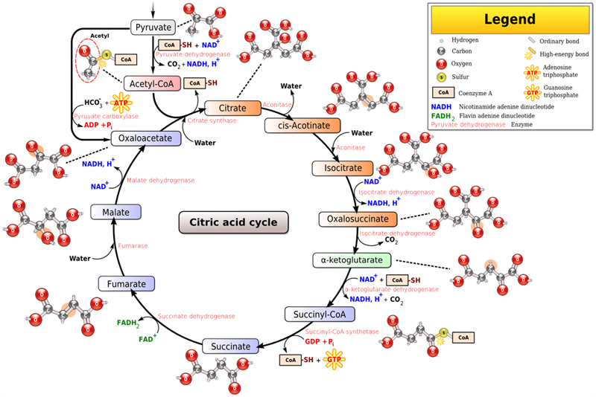
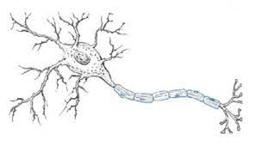
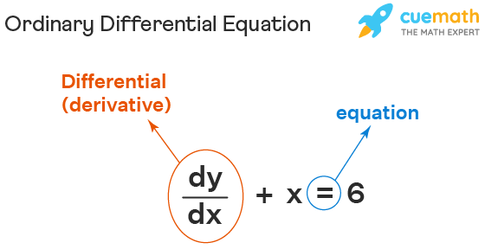

Slide 12
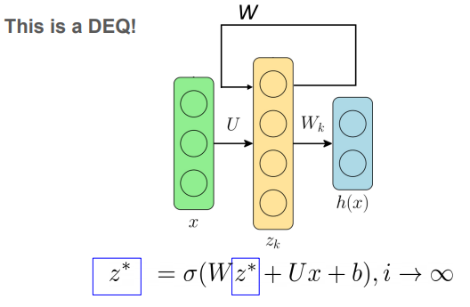
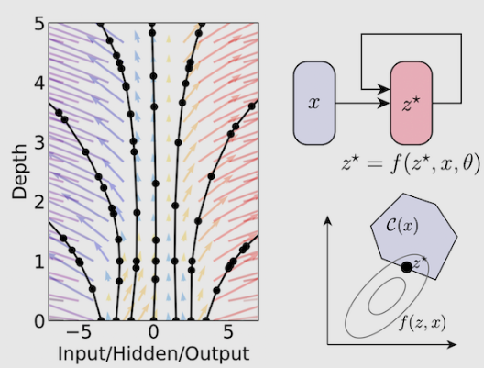

Slide 13
θ
Back-propagation
Q-Learning
Real neuron
learning algorithm
Self Learnable Area

Slide 14
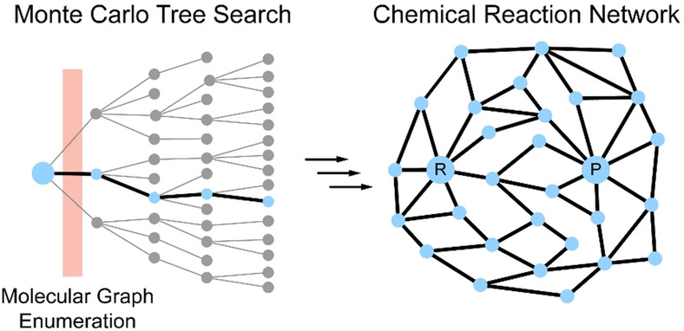



$$A$$
r
$$C$$
$$B$$

Slide 15
Actually, EPL Learning expect θ..
z
update
x
y
Loss
y*
(expected output)
- $\frac{dLoss}{dz}$ or to be learning direction of "z"
θ
z+x
z'
z-z'
If we find the appropriate θ,
we expect these two vector will be same direction
DEQ

Slide 16
Concept - these is must exist
biological neuron learning these way

Slide 17














EPL learning - exploration learning alg.
$$Train−one−epoch$$
$$EPL$$
$$x$$
$$z_{3}^{∗}$$
$$\hat{y}$$
$$θ$$
$$x$$
$$z_{init}^{∗}$$
$$\hat{y}$$
$$x$$
$$z_{2}^{∗}$$
$$\hat{y}$$
$$O_{eep}$$
$$back−$$
$$propagation$$
$$x$$
$$z_{1}^{∗}$$
$$\hat{y}$$

Slide 18
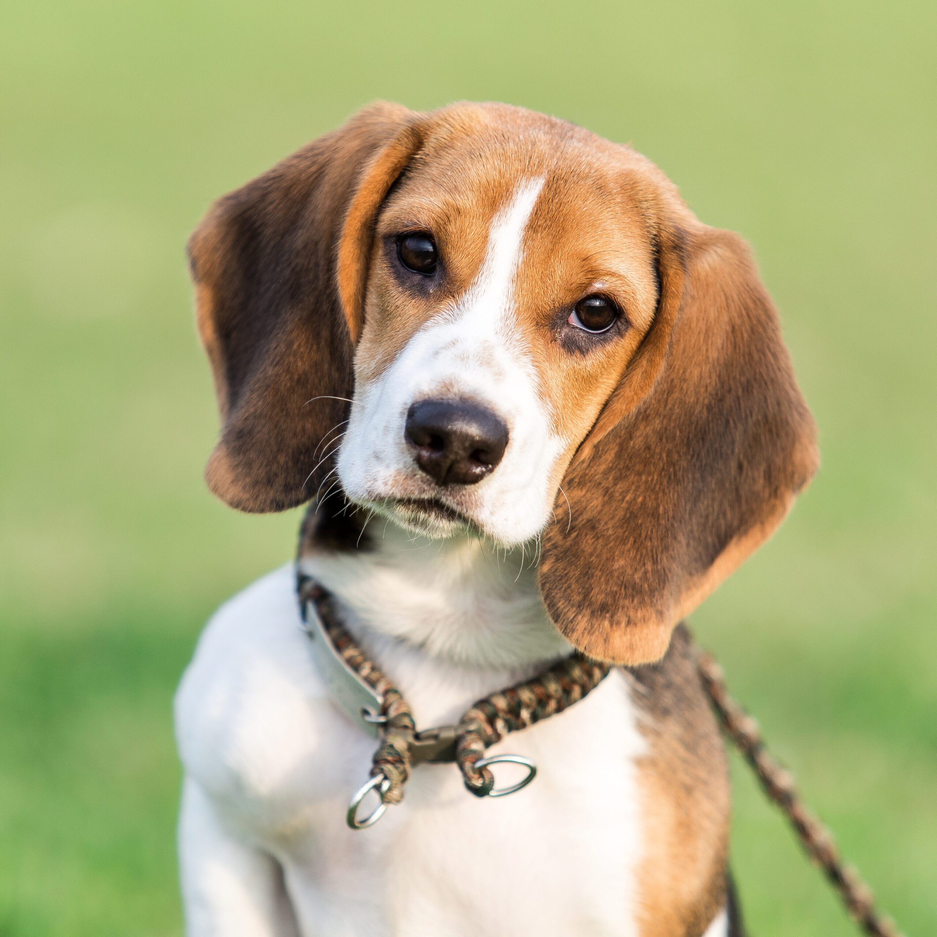
EPL Learning
2 eyes, long ears
it is pet, dog
my puppy is cute

Slide 19
Energy
Equilibrium Point

Slide 20

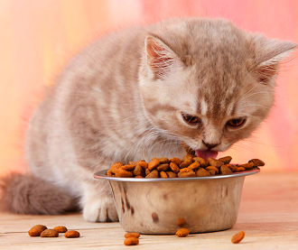
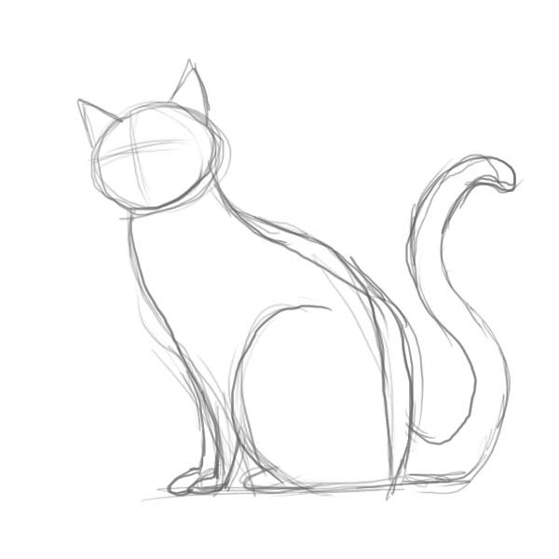
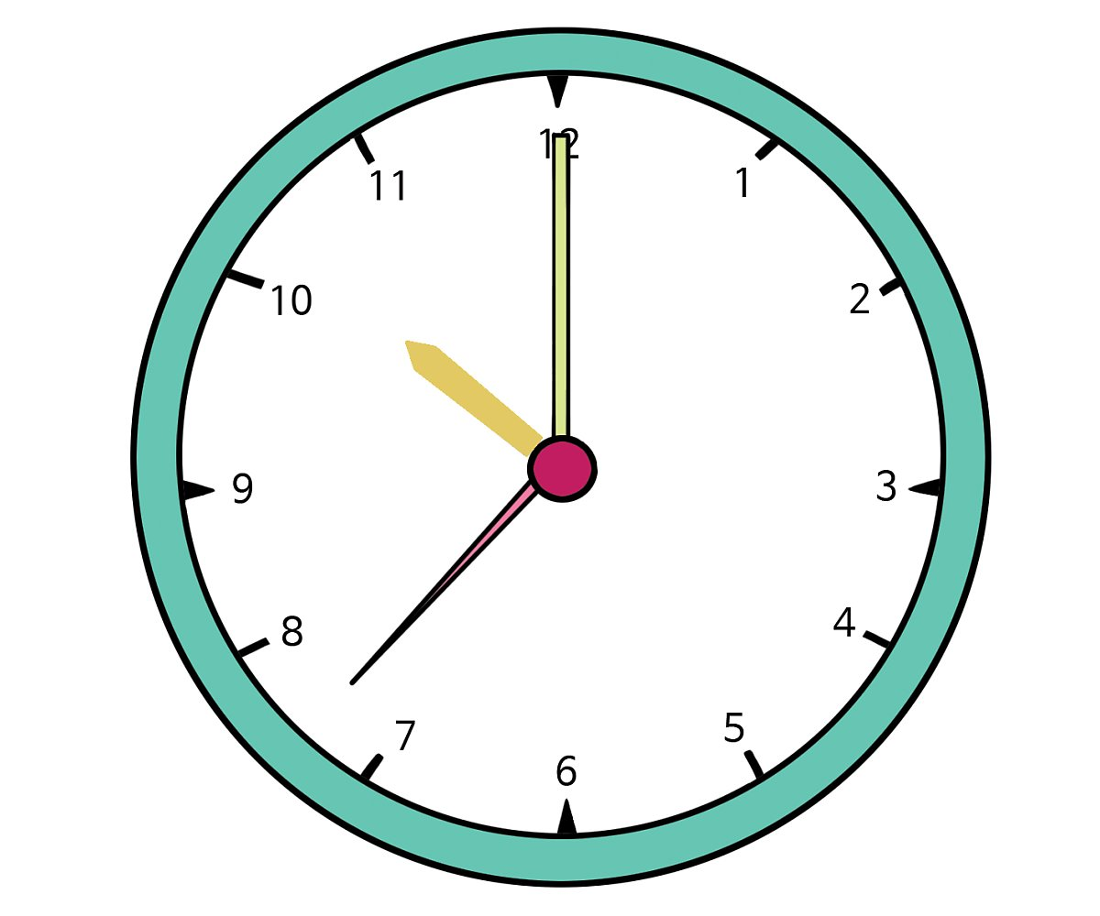
Implicit Layer Path
Implicit Layer Path
Energy
Input
Input
Param
Input & Feedback
Equilibrium Point Space

Slide 21
Design Implicit Layer

Slide 22
Local - DS system
DS system
z
z
z*
z*
Energy
Energy

Slide 23
Design Implicit Layer - 화학반응

Slide 24
Design Implicit Layer - 화학효소반응

Slide 25
Design Implicit Layer - 전압 게이트

Slide 26
Design Implicit Layer - 막전위

Slide 27
























Design Implicit Layer - HH model
$$s_{0}$$
$$g_{1}$$
$$Extracellular space$$
$$g_{i}$$
$$voltage−gate$$
$$s_{1}$$
$$g_{1}$$
$$s_{v}$$
$$g_{i}$$
$$s_{2}$$
$$g_{1}$$
$$r_{1}$$
$$g_{activated}$$
$$s_{3}$$
$$g_{1}$$
$$cell membrane$$
$$g_{running}$$
$$r_{2}$$
$$r_{3}$$
$$g_{activator}$$
$$g_{o}$$
$$s_{n}$$
$$g_{1}$$
$$g_{\begin{aligned}not− \\ activated\end{aligned}}$$
$$s_{n+1}$$
$$g_{1}$$
$$interacellular space$$
$$g_{o}$$

Slide 28




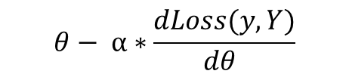





How do we find $θ$?
어$떤 θ 일$ 때, back-propagation 알고리즘과 동일해지는가?
$$θ− α∗\frac{dLoss(y,Y)}{dθ }$$
$θ$ + d$θ$
update
$$X$$
$$θ$$
$$y$$
$$x$$
$$θ$$
$$y, dθ$$
Back-propagation
self-learning structure

Slide 29
transform
EPL-learning DEQ
Traditional DEQ by back-propagation
update (overwrite)
update
update
θ
θ
θ
θ
θ
θ
θ
θ
θ
θ
I_{z}
z
...
I_{z}
z
...
x
*
+
z*
x
*
+
z*
(Input)
(Input)
O₁
O₂
O₃
O₄
O₅
O₁
O₂
O₃
O₄
O₅
Active Layer
Active Layer
cosine-similarity
survival
y
y
- $\frac{dLoss}{dz}$
(output)
(output)
Loss
environ
z-z*
Loss
environ
feedback

Slide 30














Lets Find $θ by 진$화 알고리즘 - hyperneat
Externel
$$s_{1}$$
$$g_{1}$$
$$s_{1}$$
$$g_{2}$$
$$s_{2}$$
$$g_{1}$$
$$r_{2}$$
$$g_{3}$$
CPPN
$$s_{2}$$
$$g_{2}$$
$$r_{1}$$
$$g_{3}$$
$$g_{4}$$
$$s_{3}$$
$$g_{4}$$
$$g_{3}$$
Local
Dynamical System

Slide 31
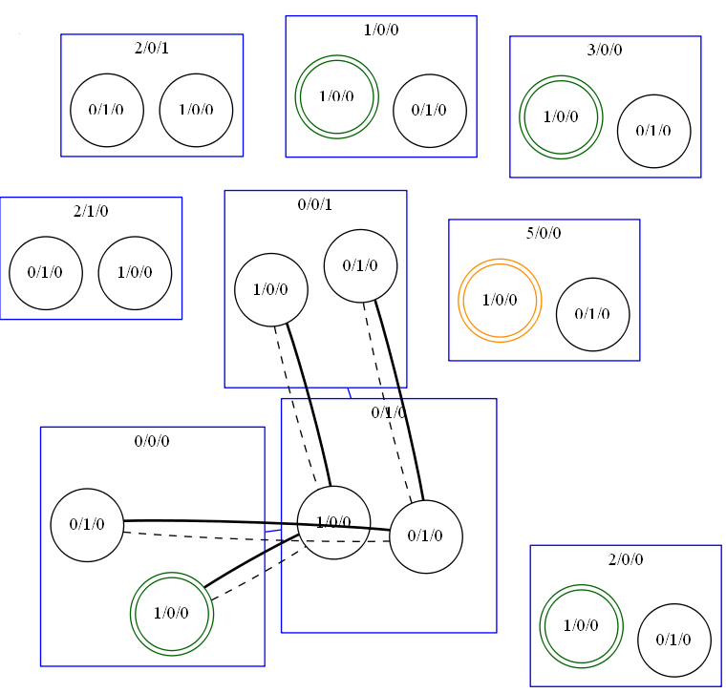
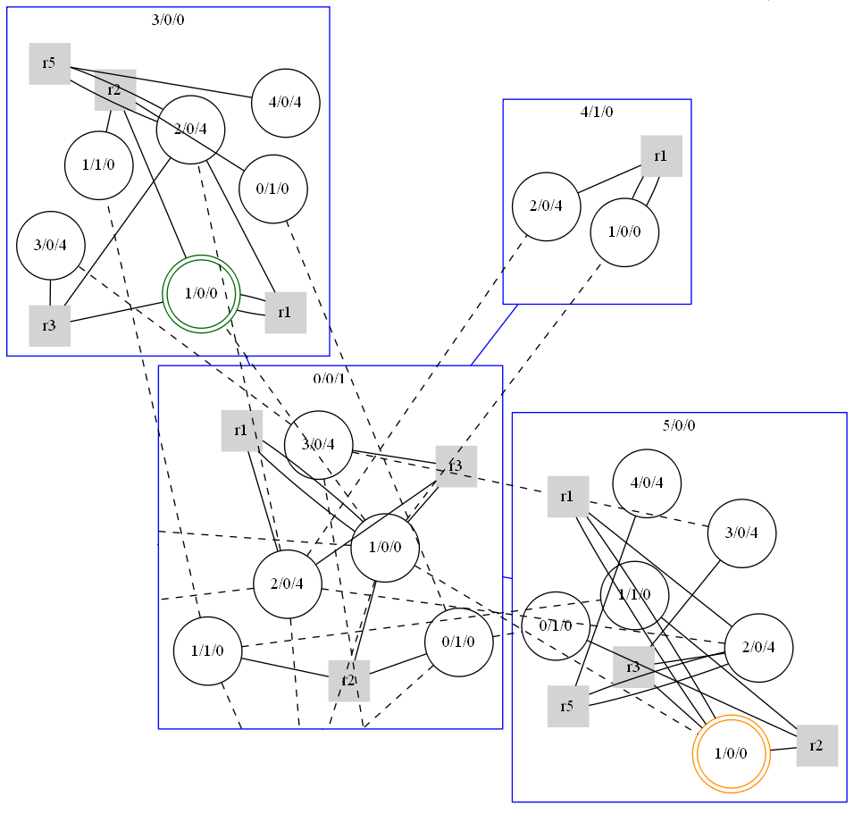
Result ex)

