Slide 1






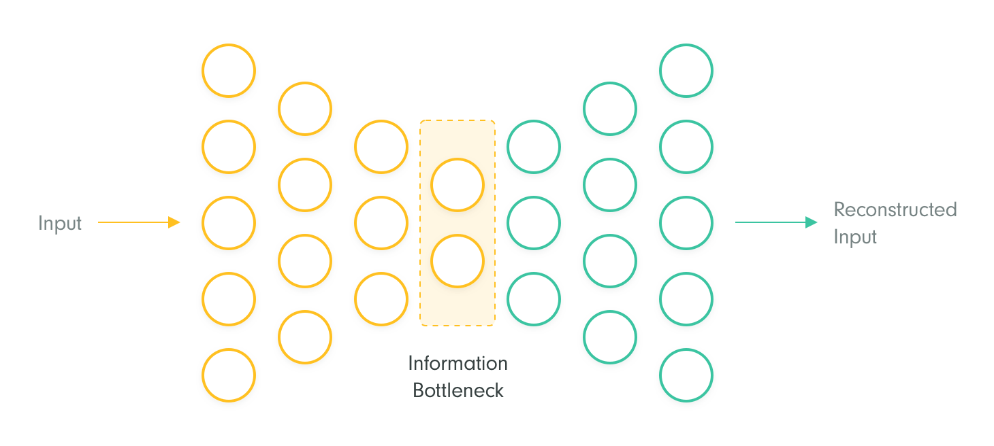

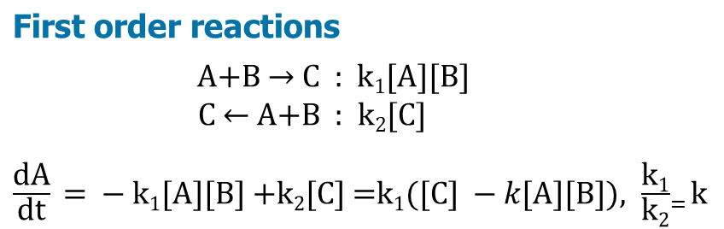






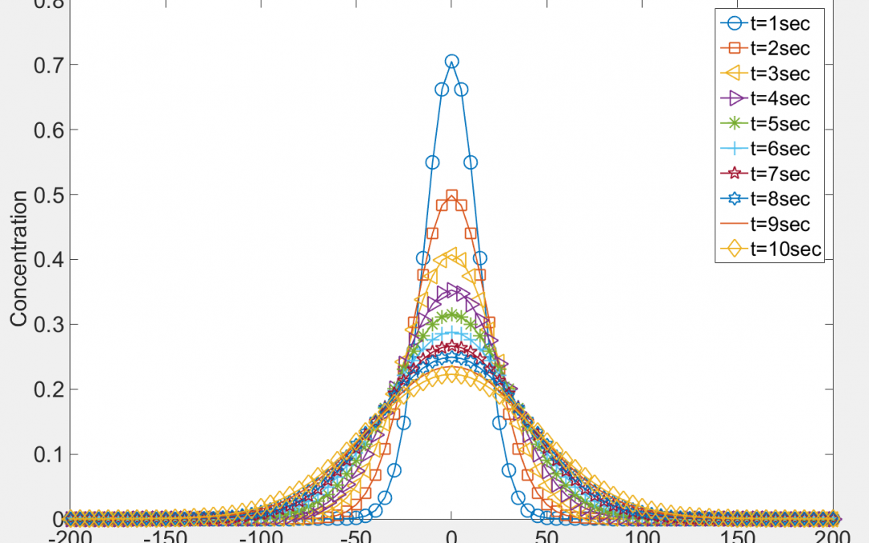
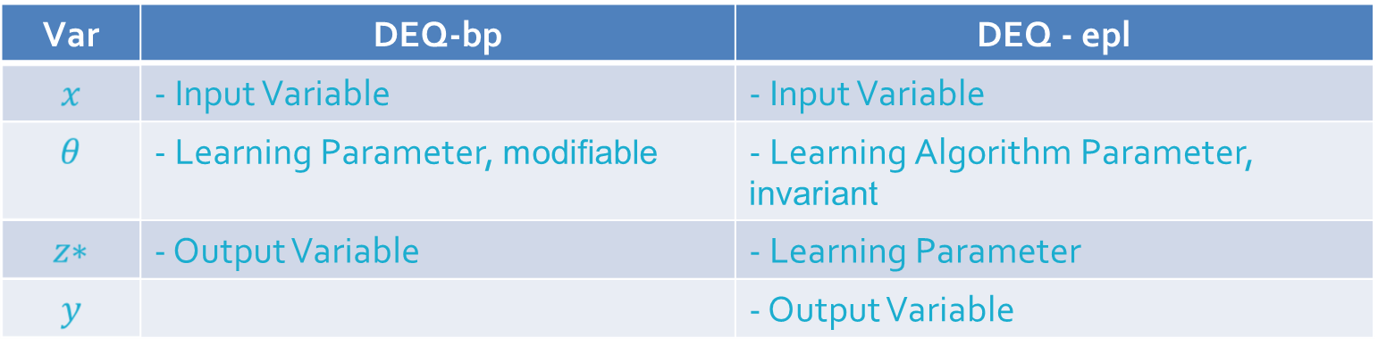


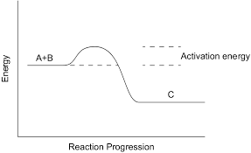
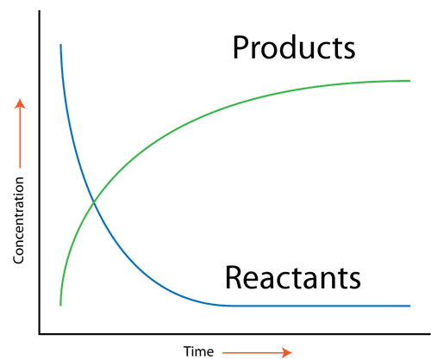









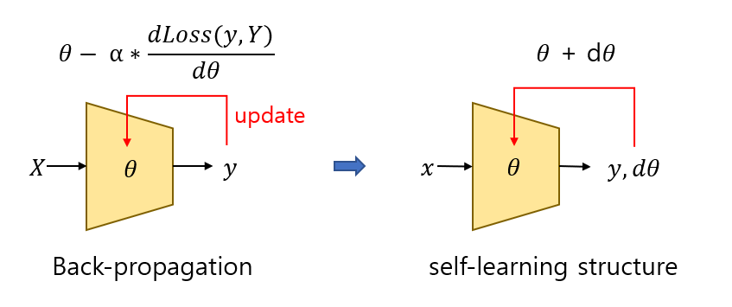

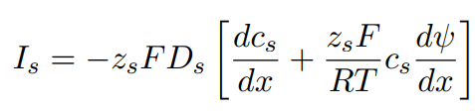
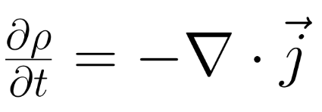


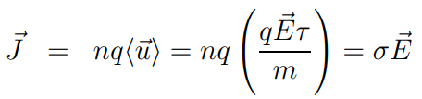

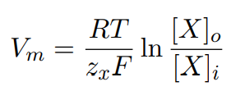
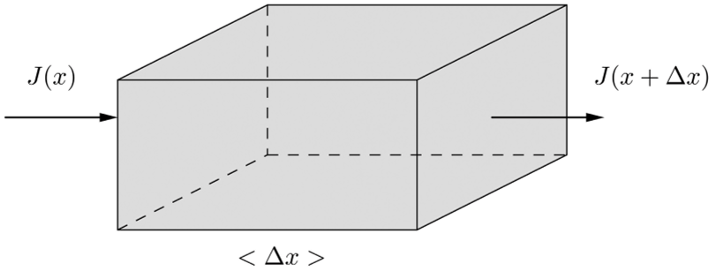








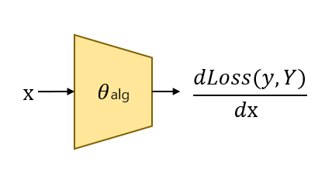



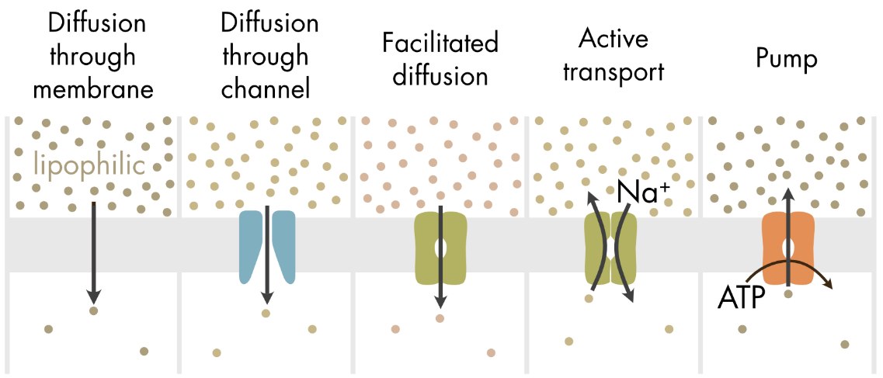
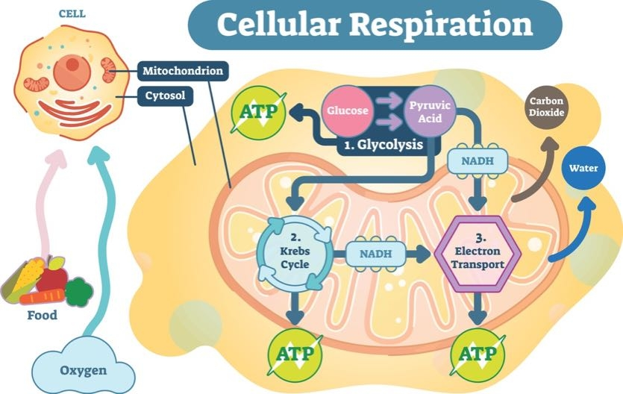
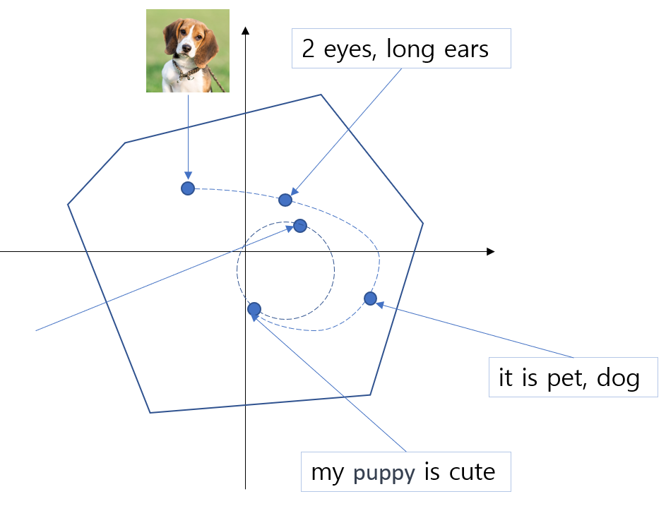
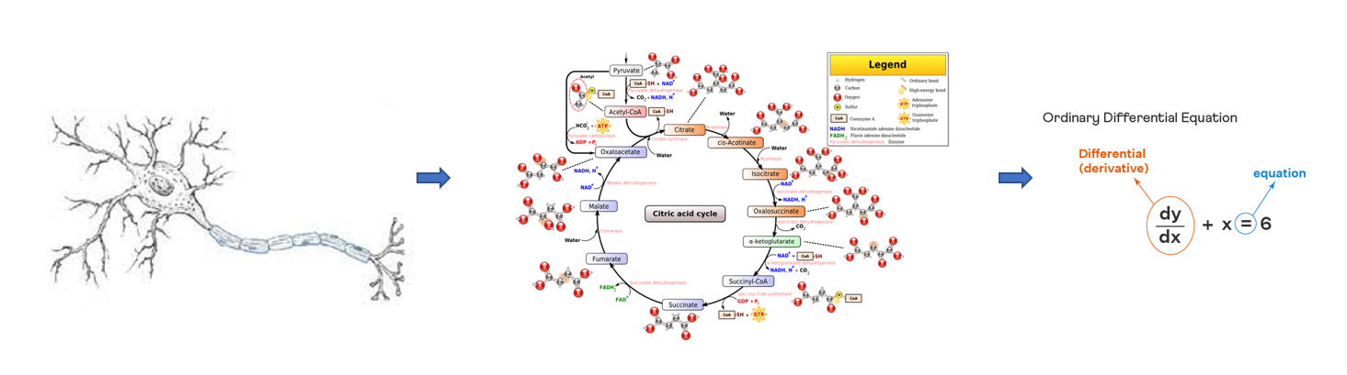
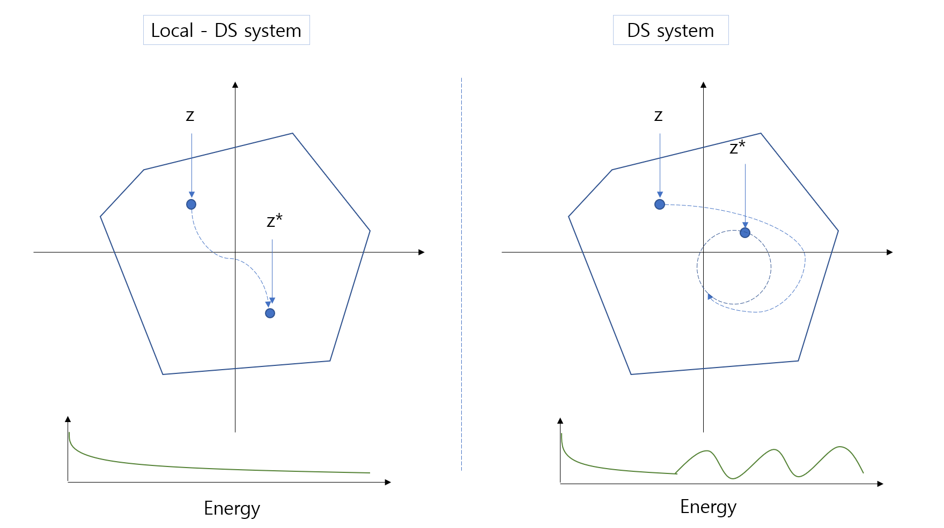










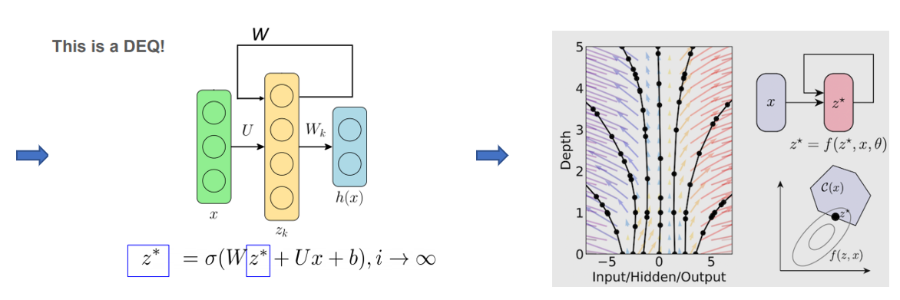


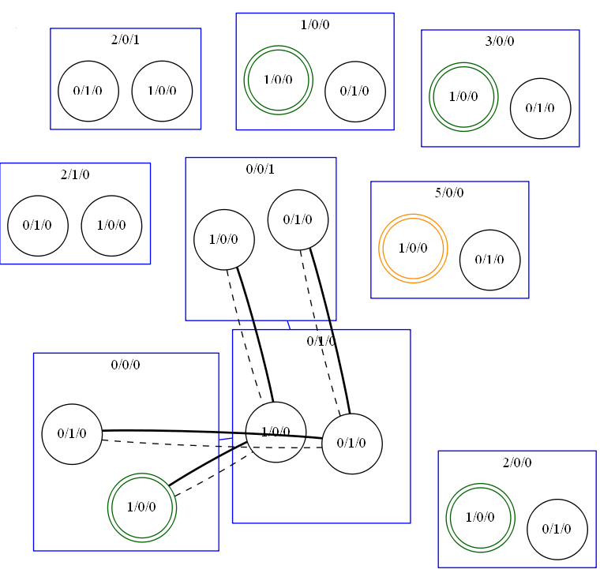
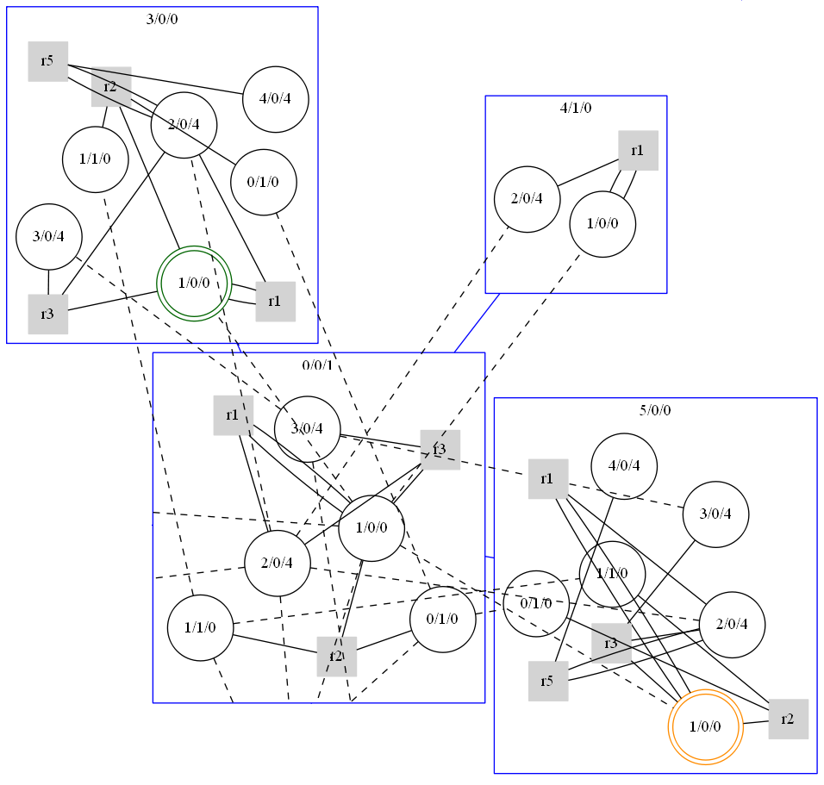
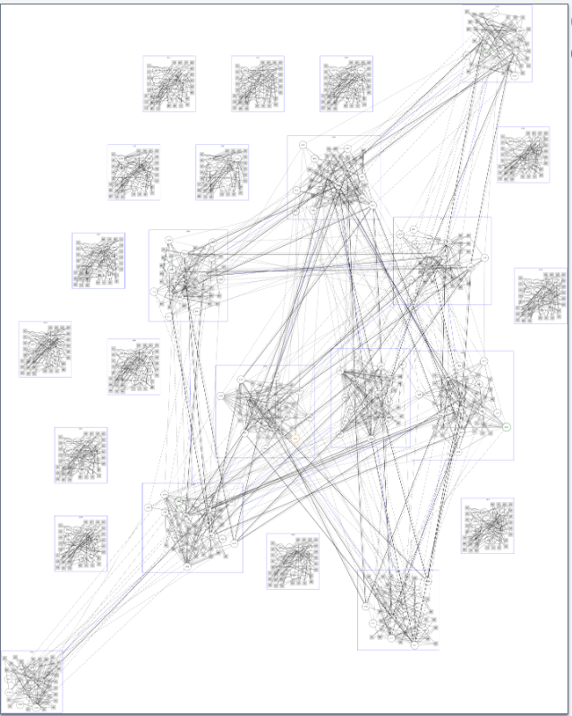

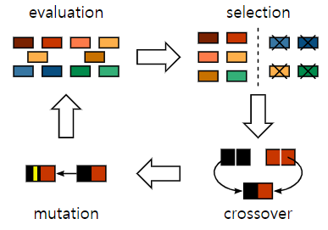
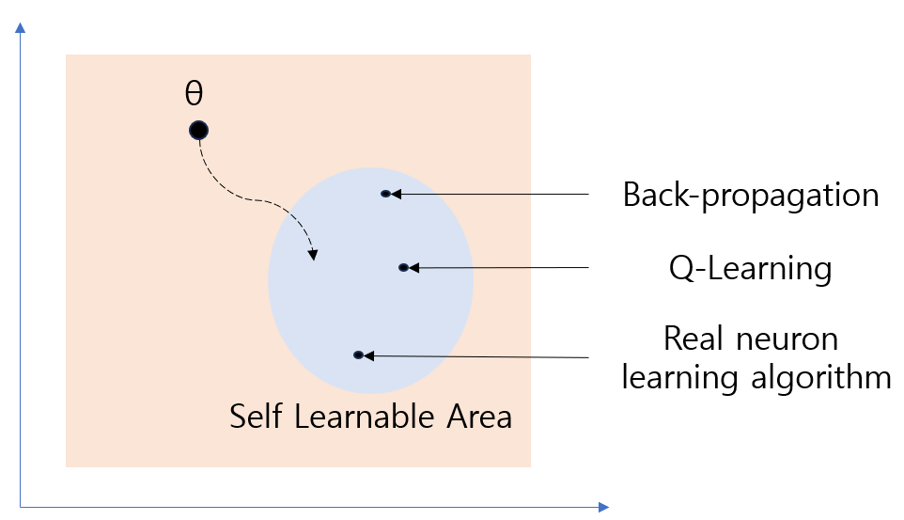

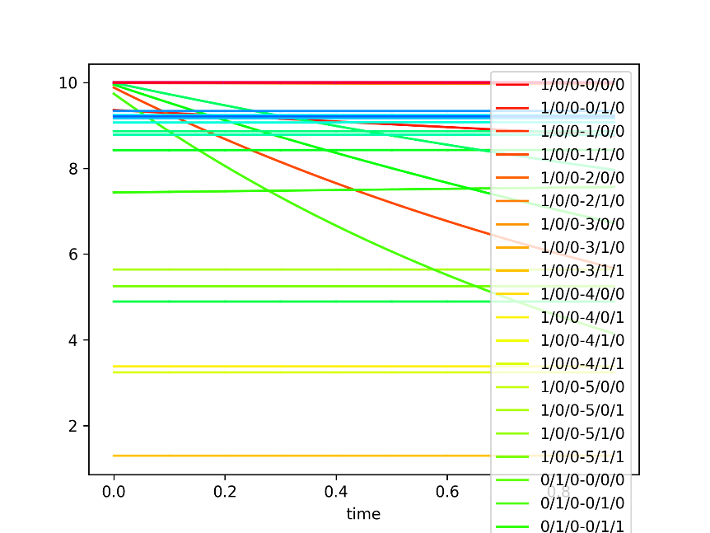
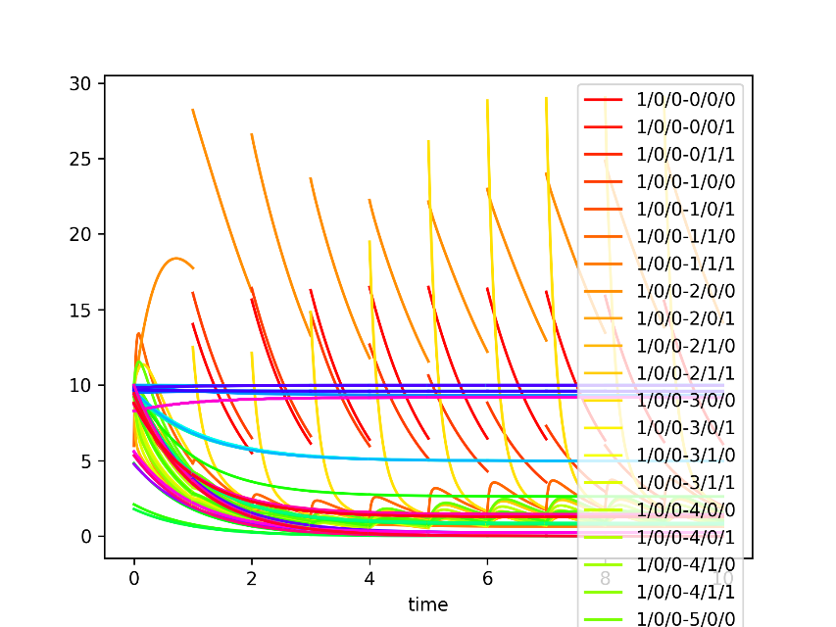
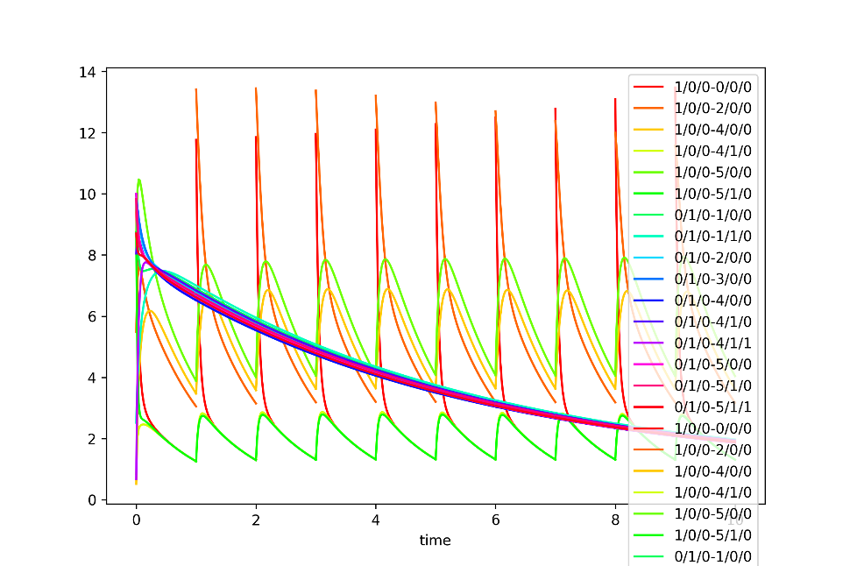
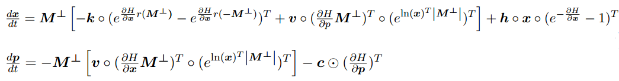
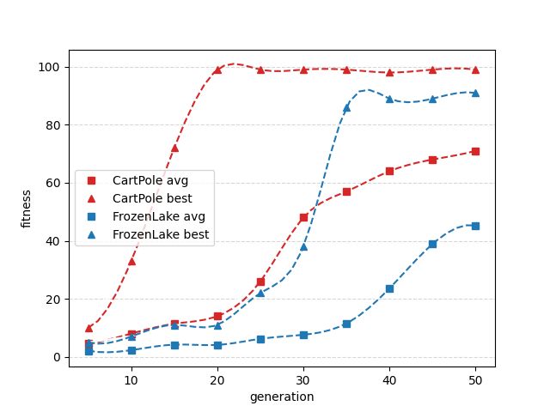
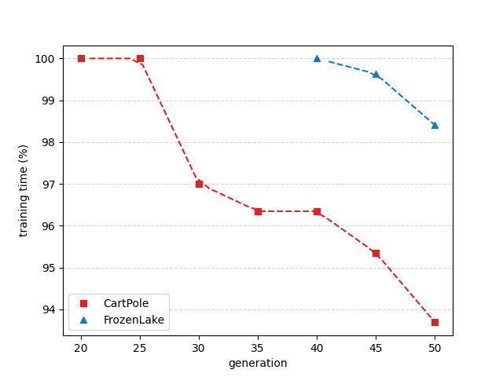
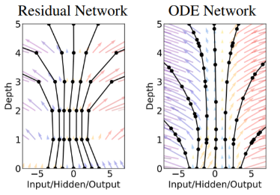




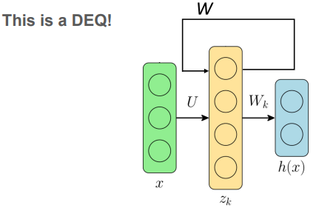



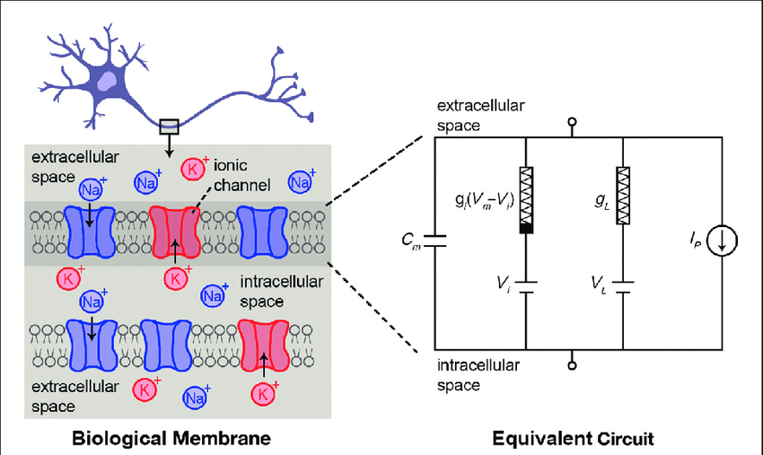




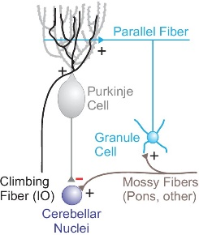







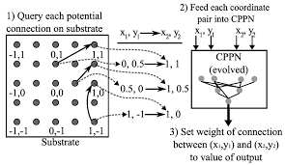




ACML
INSERT
LOGO HERE
INSERT
LOGO HERE
2023
Equilibrium Point Learning
ACML 2023
Dowoo Baik , Ji Won Yoon
Naval Academy , Korea University
The 15th Asian Conference on Machine Learning
Motivation
EPL Method
Design Implicit Layer – Flow
Learning is “summary information”
The "self-learning" version of DEQ
Chemical Flow
- Information Bottleneck -
What is the minimum useful information required from the input information to derive the output?
- Hebbian learning -
If something happen, The probability of it happening again is higher than before.
And the Energy of input is more Lower
Z
update
Fick’s Law
X
Y
(X ,Y)
Energy
(Loss)
DEQ
Back-propagation
EPL-learning
(X ,y) ← Is this Low energy Input?
(summarizable, not strange)
r
DNN Can it be changed to a self-learning structure?
Like Hebbian Learning..
Diffusion
Chemical Reaction
Hamiltonian Flow & Collision Flow
1. Learning by “Input” - Unsupervised
2. Learning by “feedback” - Supervised
Microscopic Model of Current
Nernst–Planck equation
update (overwrite)
Continuity Equation of Current
I_{z}
z
θ
θ
θ
θ
θ
...
Implicit Layer ( These [ Implicit Layer , θ ] really exist? )
Ohm’s Law
By Collision
z*
Input Constant Matrix
diffusion properties
= 0
electrophoretic effects
x
*
+
New Equilibrium Point
I want to get Self-Learning (self-summary) structure of DNN !!!
(Input)
F_{z}
O₁
O₂
O₃
O₄
O₅
Activation Layer
equilibrium
This means...
- Can the [ back-propagation algorithm , the goal(Y) ]
be represented by a parameter?
*
y
Output of Exploration Equilibrium Point
Diffusion
Chemical Reaction
Loss
Or
Reward
(output)
External Homeostasis Flow (Not maintained for free)
environ
ATP - ADP
EPL Method – Non-diverging Property
A self-learning structure just like the
"back-propagation algorithm“
Of course, It doesn't necessarily have to be a learning method like back-propagation
x
θ
x’
Passing through a single Implicit layer,
even if repeated infinitely, should not diverge.
Our goal is make continuous Homeostatis flow! (survival)
Introduction
Diffusion
It cannot be certain.. However,.
we can find real-life examples of learning about survival,
which is a fixed goal in the DEQ model.
At first, we designed an implicit layer with the stricter condition of convergence.
Experiment
There is Energy function H(x) for x
H(x) > H(x’)
For all x, H(x) is bounded from above
Using HyperNEAT, it is specialized in generating graphs of repetitive, symmetrical structures, and it is expected to efficiently implement modules of the learning algorithm.
x
θ
x’
Externel
real neuron
system biology
ODE
( ex: HH model )
Local
(lose-energy)
External
(lose or add-energy)
CPPN
Here, by adding an External layer, we design a layer where energy can increase, but it satisfies the non-divergence property.
Local
External layer can added finite energy
The vector x is composed of always positive elements.
The energy always decreases in the local implicit layer, and this decrease is directly proportional to x.
For all x, H(x) is bounded from above
Dynamical System
DEQ
continuous DEQ
( neural-ODE )
With each increase in the gene, this evolution shows a firing graph similar to the adaptive leaky integrate-and-fire (LIF) model.
biological neuron "Encoding"
[ Something learning algorithm that we dont know , Survival ]
by "Parameters" that "Amount of Molecules"
EPL Method – Design Implicit Layer
Therefore, our goal is...
our goal is to design a DEQ (design implicit layer)
that can represent the movements of molecules in actual living organisms with parameters.
we will train the parameters of such DEQs using evolutionary methods (HyperNeat)
and this process will ultimately signify an act of searching for the optimal learning method.
X
θ
X‘
x, p
Energy
Local
(lose-energy)
External
(lose or add-energy)
Gen 1
Gen 10
Gen 50
Summary of Related Works
Can this structure fully explain the movement of molecules in a neuron?
Design Implicit Layer – Example of neuron model
NIPS, 2018
Chen, Ricky TQ et al. Neural ODE
NIPS, 2019
“The DNN structure of the residual connection can be transformed into a neural net of an ODE structure.”
Shaojie Bai et al. Deep equilibrium models
Conclusion & Contact Information
IEEE,
“A new structure of a DNN that endlessly passes through weight-tying layers. The back-propagation of these can be efficiently computed.”
C. Zhang et al. Training of Spiking Neural Network
Conclusion
We explored neural biology and introduced a novel approach in ANNs where model parameters inherently encode the learning algorithm, initiating an evolutionary search for alternative training methods devoid of back-propagation.
Contact Information
Baik Dowoo ( Naval Academy / arizona9506@gmail.com )
IEEE,
2011
- Hodgkin-Huxley (HH) model
- Spike-Timing-Dependent Plasticity (STDP)
- Bienenstock-CooperMunro(BCM) theory
Y. Hao et al. Training of Biological Neural Network
IEEE,
“Neural Activation and Diminishing Feedback Signals in Learning , Potential Embedding of Q-Learning Algorithm in Cerebellar Biomodels.”
X. Lin et al. HyperNeat
“A specialized evolutionary method that maintains a balance between species diversity and adaptability, leveraging geometric properties of networks to design patterns within the structure.

