Slide 1
Equilibrium Point Learning
ACML 2023
Baik Dowoo , Ji Won Yoon
Notes:
123

Slide 2
Table of Contents
Motivation
Introduction
Summary of Related Works
EPL Method
Design Implicit Layer
Experiment
Result
Conclusion & Future Work
Appendix
Contents

Slide 3
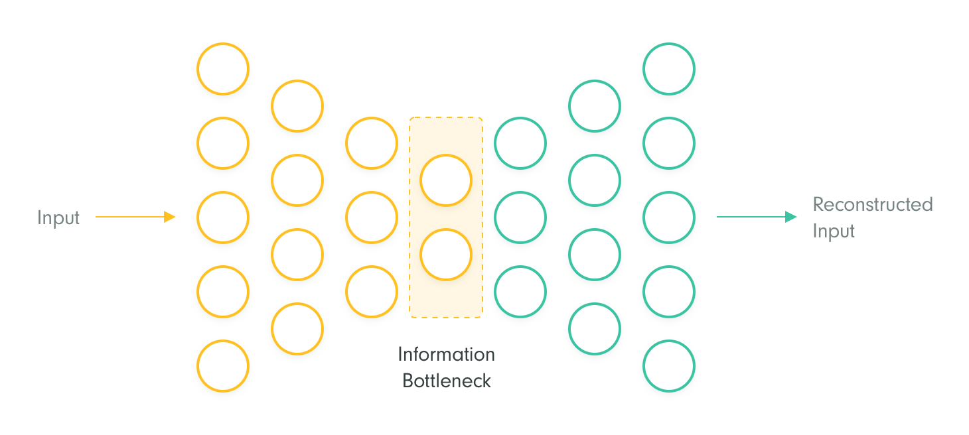
Motivation
Learning is “summary information”
- Information Bottleneck -
What is the minimum useful information required from the input information to derive the output?
- Hebbian learning -
If something happen, The probability of it happening again is higher than before.
And the Energy of input is more Lower
Z
(X ,Y)
Energy
(Loss)
X
Y
(X ,y) ← Is this Low energy Input?
(summarizable, not strange)

Slide 4
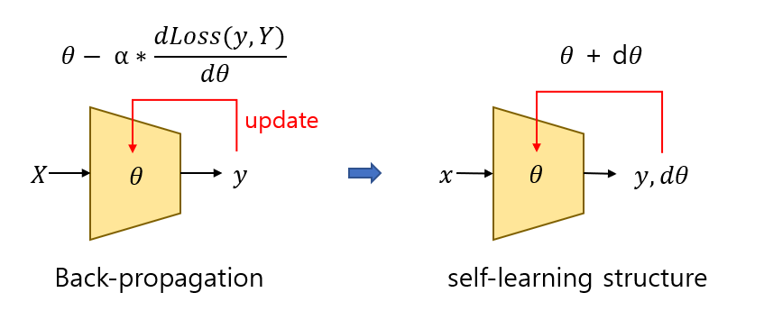
Motivation
DNN Can it be changed to a self-learning structure?
Like Hebbian Learning..
I want to get Self-Learning (self-summary) structure of DNN !!!

Slide 5
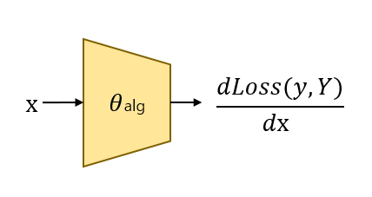
Motivation
This means...
- Can the [ back-propagation algorithm , the goal(Y) ]
be represented by a parameter?
A self-learning structure just like the
"back-propagation algorithm“
Of course, It doesn't necessarily have to be a learning method like back-propagation

Slide 6
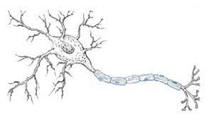
Motivation
It cannot be certain.. However,.
we can find real-life examples of learning about survival,
which is a fixed goal in the DEQ model.
biological neuron "Encoding"
[ Something learning algorithm that we dont know , Survival ]
by "Parameters" that "Amount of Molecules"

Slide 7
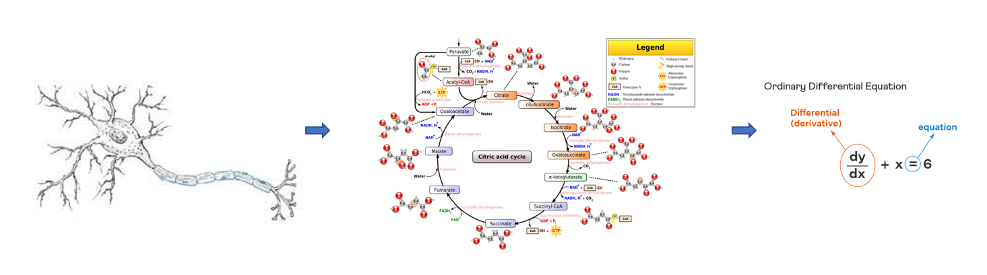
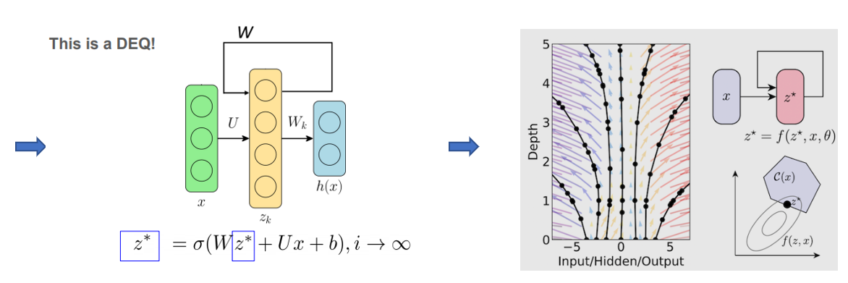
Introduction
how cat neuron can be represet to DEQ
ODE
( ex: HH model )
real neuron
system biology
continuous DEQ
( neural-ODE )
DEQ

Slide 8
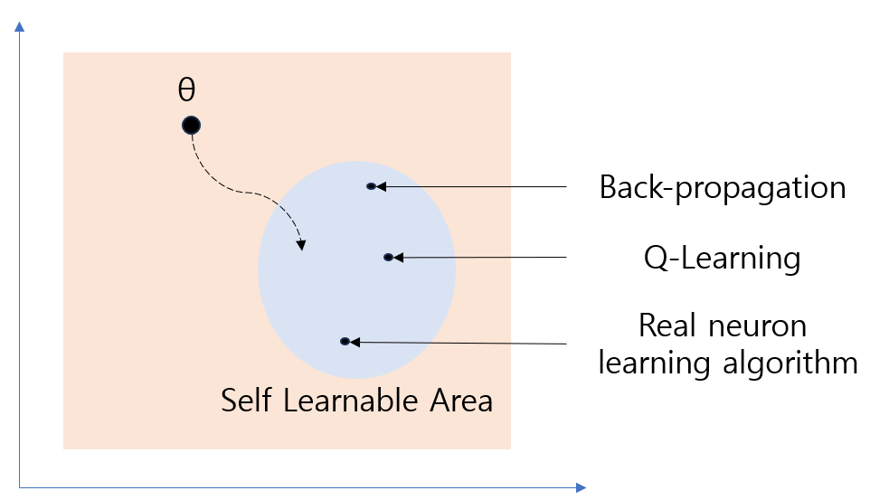
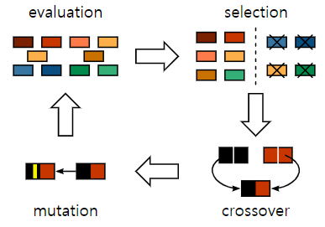
Introduction
Therefore, our goal is...
our goal is to design a DEQ (design implicit layer)
that can represent the movements of molecules in actual living organisms with parameters.
we will train the parameters of such DEQs using evolutionary methods (HyperNeat)
and this process will ultimately signify an act of searching for the optimal learning method.

Slide 9
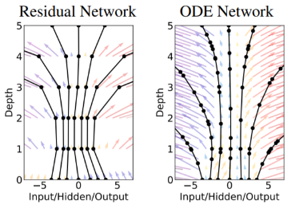
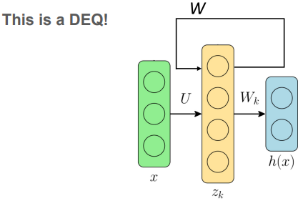
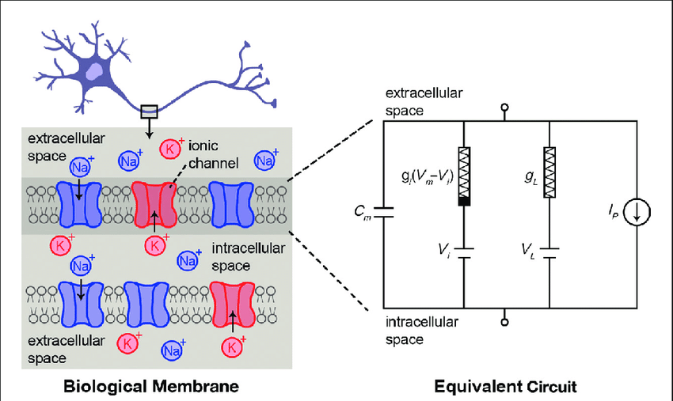
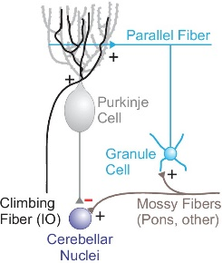
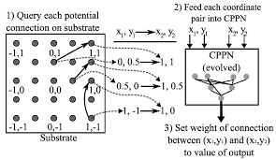
Summary of Related Works
NIPS, 2018
Chen, Ricky TQ et al. Neural ODE
“The DNN structure of the residual connection can be transformed into a neural net of an ODE structure.”
NIPS, 2019
Shaojie Bai et al. Deep equilibrium models
“A new structure of a DNN that endlessly passes through weight-tying layers. The back-propagation of these can be efficiently computed.”
IEEE,
C. Zhang et al. Training of Spiking Neural Network
- Hodgkin-Huxley (HH) model
- Spike-Timing-Dependent Plasticity (STDP)
- Bienenstock-CooperMunro(BCM) theory
IEEE,
2011
Y. Hao et al. Training of Biological Neural Network
“Neural Activation and Diminishing Feedback Signals in Learning , Potential Embedding of Q-Learning Algorithm in Cerebellar Biomodels.”
IEEE,
X. Lin et al. HyperNeat
“A specialized evolutionary method that maintains a balance between species diversity and adaptability, leveraging geometric properties of networks to design patterns within the structure.

Slide 10









EPL Method
The "self-learning" version of DEQ
$\frac{d\text{ℓ}}{dz\text{∗}} \left(I−\frac{d\text{f}}{dz\text{∗}}\right)$⁻¹$\frac{d\text{f}}{dθ}$
$$θ− α∗\frac{d\text{ℓ}}{dθ }$$
$z$*,$θ$
update
$$x$$
$$θ$$
$$z\text{∗}$$
$$x$$
$$z,θ$$
$z$*, $y$
DEQ
Back-propagation
EPL-learning

Slide 11

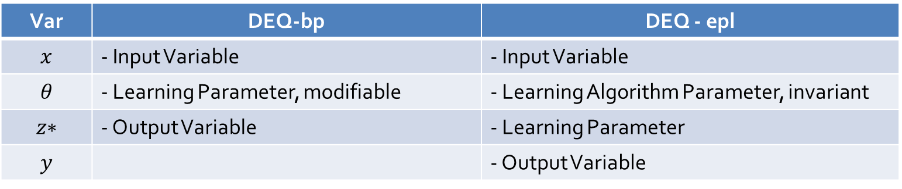







EPL Method – meaning of variable
$$θ− α∗\frac{d\text{ℓ}}{dθ }$$
$z$*,$θ$
update
$$x$$
$$θ$$
$$z\text{∗}$$
$$x$$
$$z,θ$$
$z$*, $y$
DEQ
EPL-learning
Var | DEQ-bp | DEQ - epl
$$x$$ | - Input Variable | - Input Variable
$$θ$$ | - Learning Parameter, modifiable | - Learning Algorithm Parameter, invariant
$$z\text{∗}$$ | - Output Variable | - Learning Parameter
$$y$$ |  | - Output Variable

Slide 12




EPL Method – overall
$z$*,$θ$
update (overwrite)
$$x$$
$$z,θ$$
$z$*, $y$
θ
θ
θ
θ
θ
Implicit Layer ( These [ Implicit Layer , θ ] really exist? )
I_{z}
z
...
Input Constant Matrix
x
*
+
z*
New Equilibrium Point
(Input)
O₁
O₂
O₃
O₄
O₅
Activation Layer
y
Output of Exploration Equilibrium Point
(output)
environ

Slide 13

EPL Method – Supervised, Unsupervised learning
update (overwrite)
θ
θ
θ
θ
θ
I_{z}
z
...
1. Learning by “Input” - Unsupervised
z*
2. Learning by “feedback” - Supervised
x
*
+
(Input)
O₁
O₂
O₃
O₄
O₅
Learning occurs in the following sequence :
$z$* → $z$*_{self-learn} → $z$*_{supervised-learn}
F_{z}
*
y
(output)
Loss
Or
Reward
environ
(feedback)

Slide 14
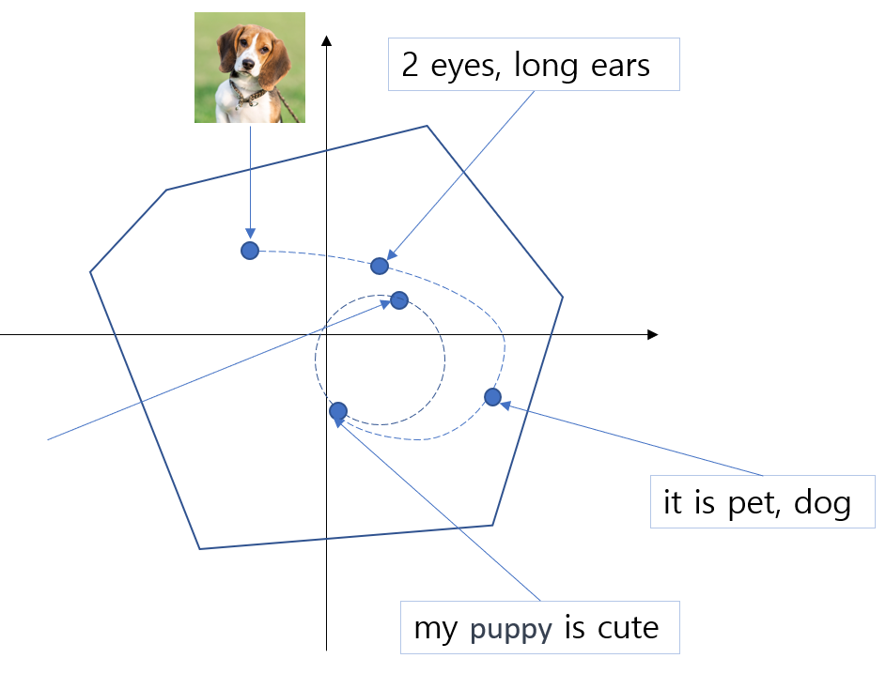
EPL Method – Non-diverging Property
θ
x
x’
Passing through a single Implicit layer,
even if repeated infinitely, should not diverge.
At first, we designed an implicit layer with the stricter condition of convergence.
There is Energy function H(x) for x
H(x) > H(x’)
For all x, H(x) is bounded from above

Slide 15
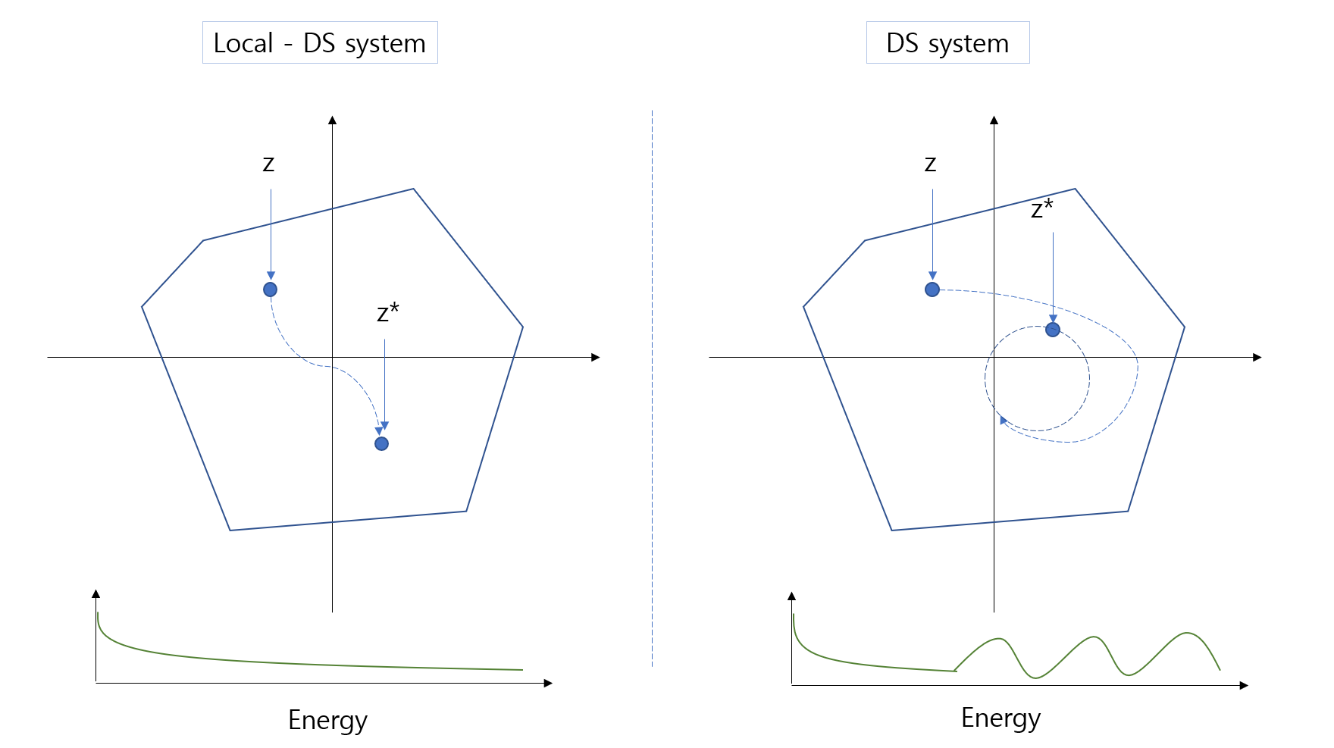
EPL Method – Local, External Layer
θ
x
x’
Local
(lose-energy)
External
(lose or add-energy)
Here, by adding an External layer, we design a layer where energy can increase, but it satisfies the non-divergence property.
External layer can added finite energy
The vector x is composed of always positive elements.
The energy always decreases in the local implicit layer, and this decrease is directly proportional to x.
For all x, H(x) is bounded from above

Slide 16

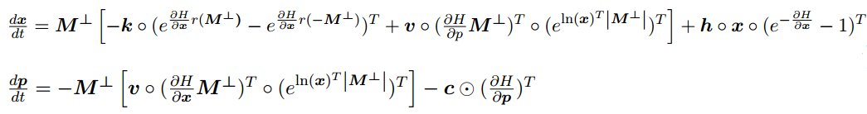

EPL Method – Design Implicit Layer
θ
X
X‘
x, p
x + $\frac{d\text{x}}{dt }$ dt , p + $\frac{d\text{x}}{dt }$ dt
Energy
Local
(lose-energy)
External
(lose or add-energy)
Can this structure fully explain the movement of molecules in a neuron?

Slide 17


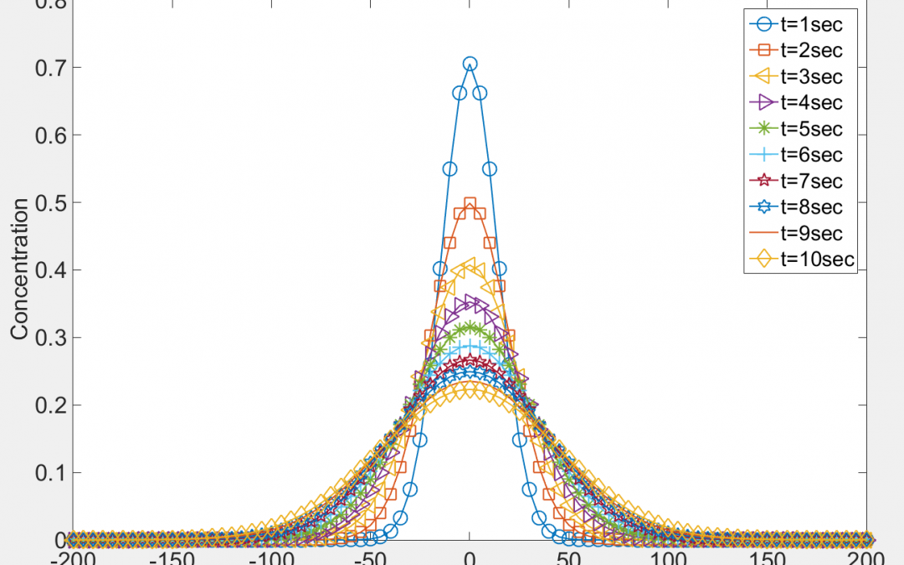
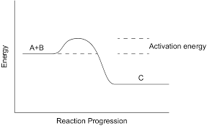
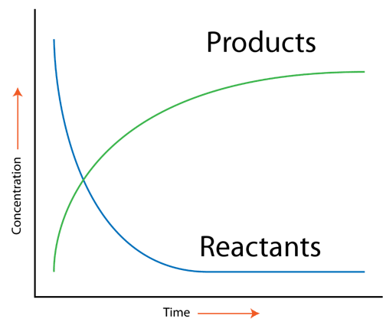







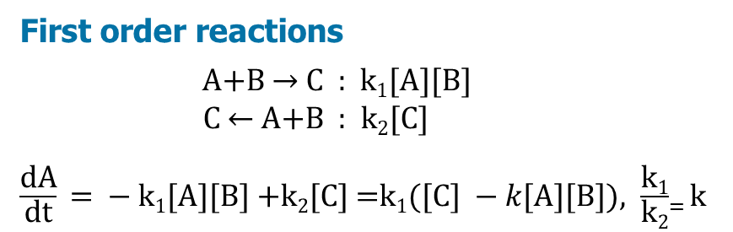


Design Implicit Layer – Flow
Chemical Flow
Fick’s Law
First order reactions
A+B → C : k₁[A][B]
C ← A+B : k₂[C]
$\frac{\text{d}\text{A}}{\text{dt}}\text{ = − }\text{k}\text{1}\text{[}\text{A}\text{][}\text{B}\text{]} \text{+}\text{k}\text{2}\text{[}\text{C}\text{] =}\text{k}\text{1}(\text{[}\text{C}\text{]} −k\text{[}\text{A}\text{][}\text{B}\text{]}), \frac{\text{k}\text{1}}{\text{k}\text{2}}$₌ k
$$A$$
r
$$C$$
$$g_{1}$$
$$g_{2}$$
$$g_{3}$$
$$g_{4}$$
$$g_{5}$$
$$g_{6}$$
$$B$$
Diffusion
Chemical Reaction

Slide 18



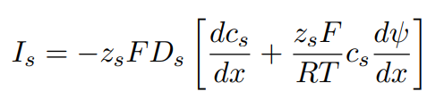
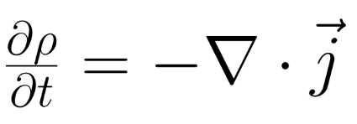
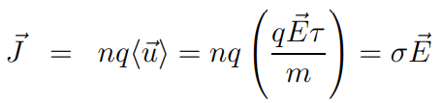
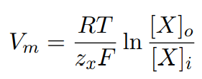
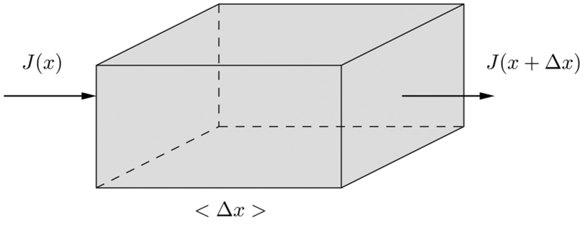









Design Implicit Layer – Flow
Hamiltonian Flow & Collision Flow
Microscopic Model of Current
Nernst–Planck equation
Continuity Equation of Current
$$Extracellular space$$
$$cell membrane$$
I$nteracellular space$
Ohm’s Law
By Collision
diffusion properties
electrophoretic effects
= 0
equilibrium
$$g_{pre}$$
$$g$$
$$g_{post}$$
$$g_{1}$$
$$g_{2}$$
$$g_{3}$$
$$g_{4}$$
$$g_{5}$$
$$g_{6}$$
Diffusion
Chemical Reaction

Slide 19


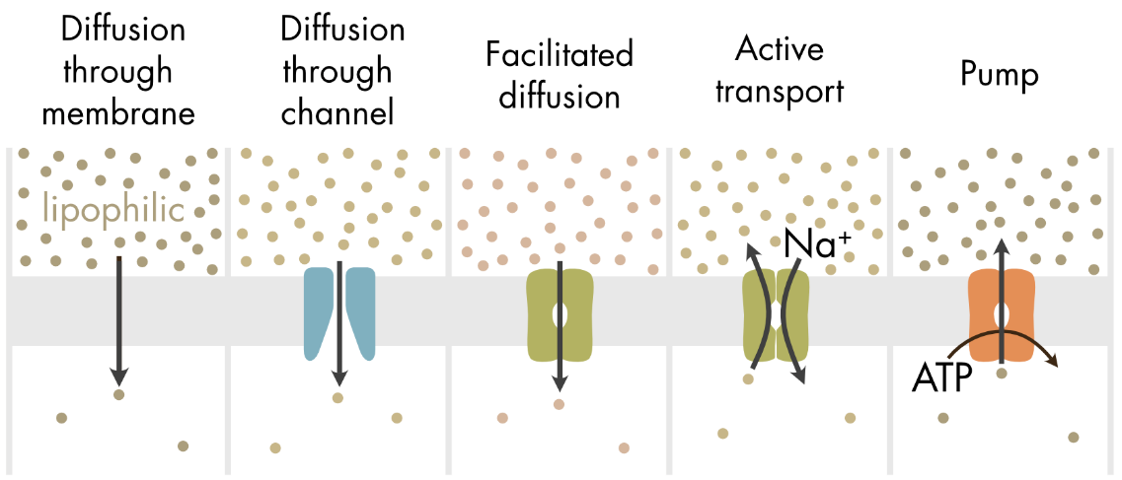
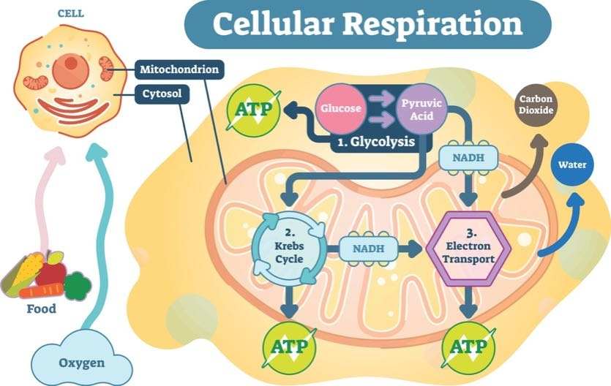
Design Implicit Layer – Flow
External Homeostasis Flow (Not maintained for free)
ATP - ADP
Our goal is make continuous Homeostatis flow! (survival)
Diffusion

Slide 20























Design Implicit Layer – Example of neuron model
$$s_{0}$$
$$g_{1}$$
$$Extracellular space$$
$$g_{i}$$
$$voltage−gate$$
$$s_{1}$$
$$g_{1}$$
$$s_{v}$$
$$g_{i}$$
$$s_{2}$$
$$g_{1}$$
$$r_{1}$$
$$g_{activated}$$
$$s_{3}$$
$$g_{1}$$
$$cell membrane$$
$$g_{running}$$
$$r_{2}$$
$$r_{3}$$
$$g_{activator}$$
$$g_{o}$$
$$s_{n}$$
$$g_{1}$$
$$g_{\begin{aligned}not− \\ activated\end{aligned}}$$
$$s_{n+1}$$
$$g_{1}$$
$$interacellular space$$
$$g_{o}$$

Slide 21










Experiment
Using HyperNEAT, it is specialized in generating graphs of repetitive, symmetrical structures, and it is expected to efficiently implement modules of the learning algorithm.
Externel
$$s_{1}$$
$$g_{1}$$
$$s_{1}$$
$$g_{2}$$
$$s_{2}$$
$$g_{1}$$
$$r_{2}$$
$$g_{3}$$
CPPN
$$s_{2}$$
$$g_{2}$$
$$r_{1}$$
$$g_{3}$$
$$g_{4}$$
$$s_{3}$$
$$g_{4}$$
$$g_{3}$$
Local
Dynamical System

Slide 22
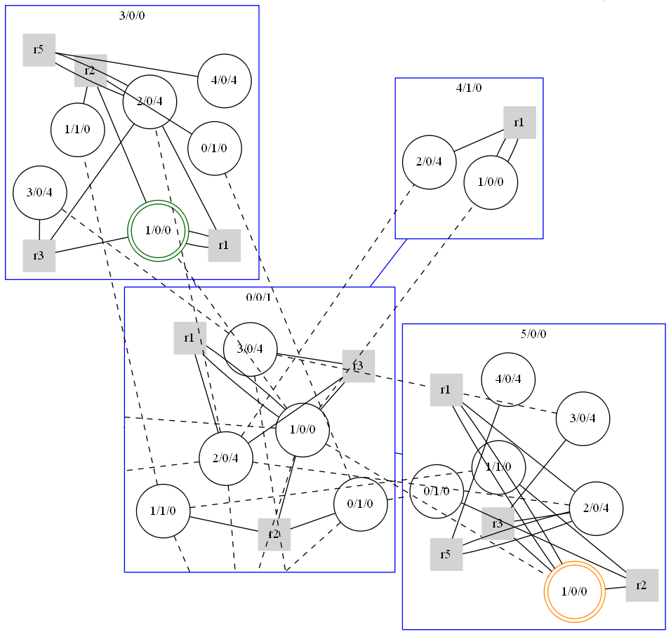
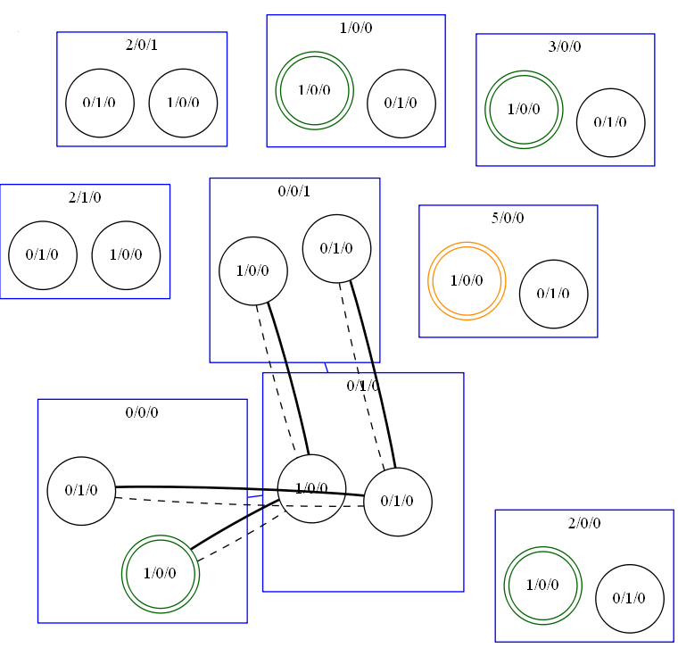
Result
Gen 1
Gen 10

Slide 23
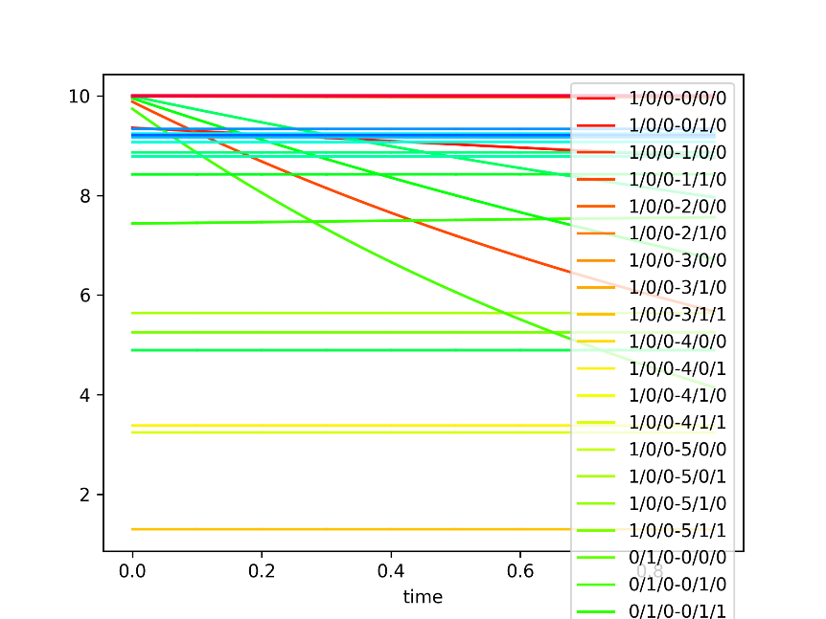
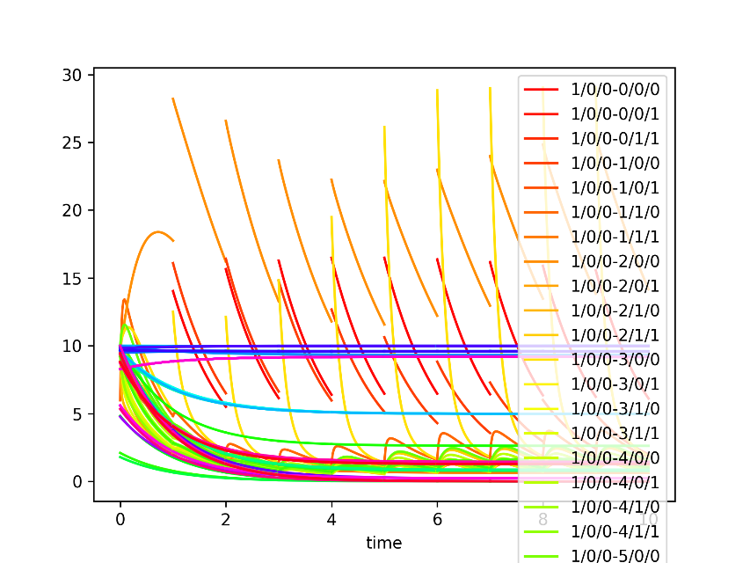
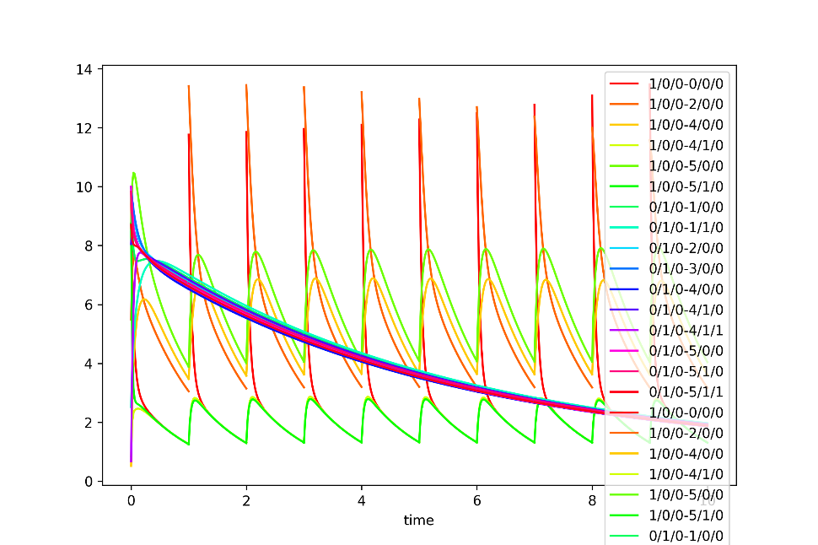
Result
With each increase in the gene, this evolution shows a firing graph similar to the adaptive leaky integrate-and-fire (LIF) model.
Gen 1
Gen 10
Gen 50

Slide 24
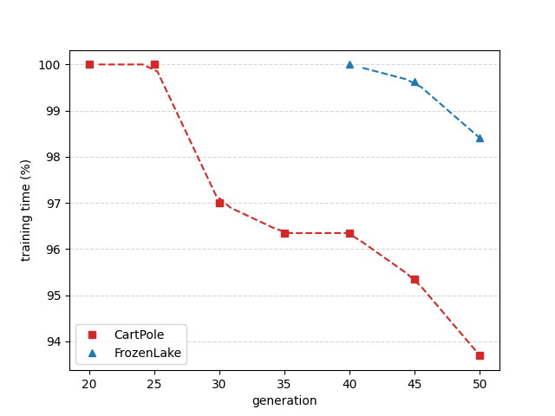
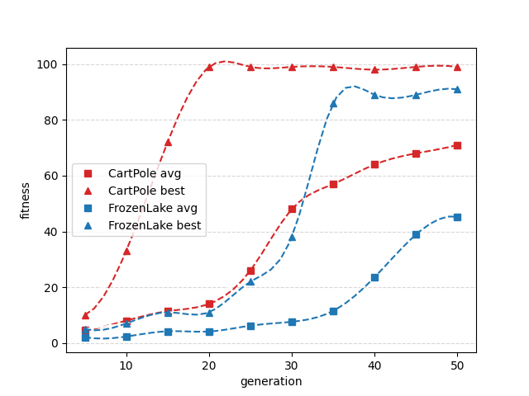
Result

Slide 25
Conclusion & Future Work
Conclusion
We explored neural biology and introduced a novel approach in ANNs where model parameters inherently encode the learning algorithm, initiating an evolutionary search for alternative training methods devoid of back-propagation.
Future Work
This evolutionary process identified learnable implicit layers through selected dynamical systems, aiming to accelerate ODE solver efficacy in discovering more efficient learning strategies for previously unsolvable problems
Acknowledge
Ji Won Yoon was supported by the MSIT(Ministey of science and ICT), Korea under the ITRC (Information Technology Research Center) support program (IITP-2023-RS-2022- 00164800) supervised by the IITP (Institute for Information & Communications Technology Planning & Evaluation)

Slide 26
Q & A
Thank you!

Slide 27
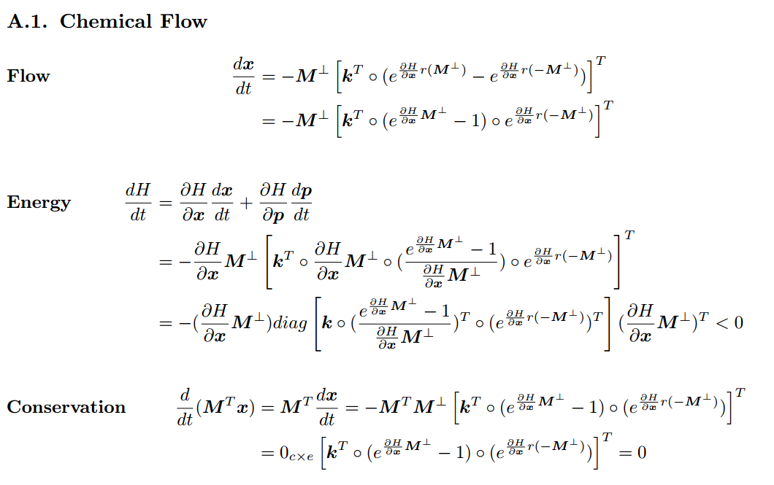
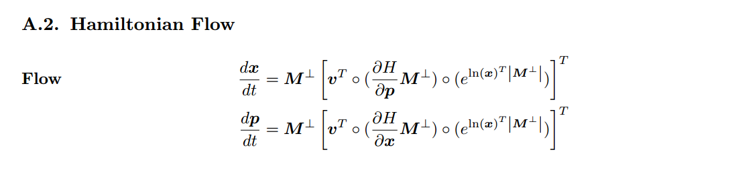
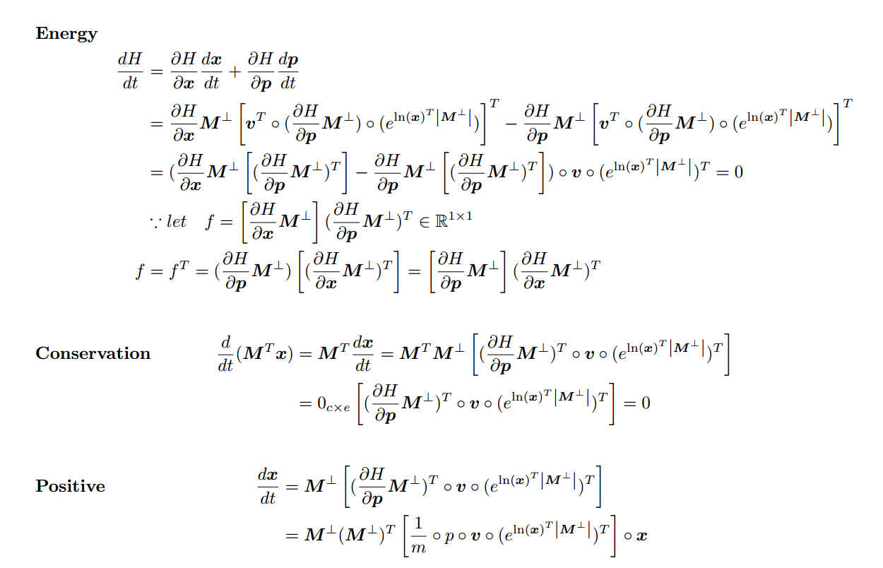
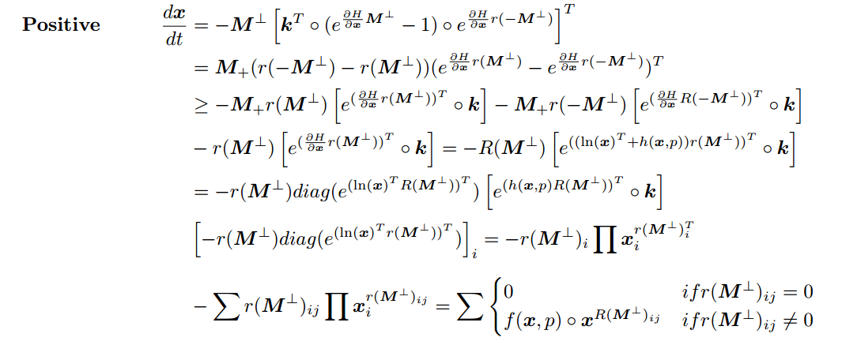
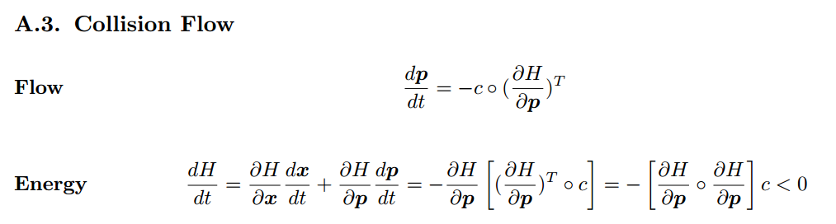
Appendix

