Slide 1
Equilibrium Point Learning
ACML 2023
Baik Dowoo , Ji Won Yoon

Slide 2
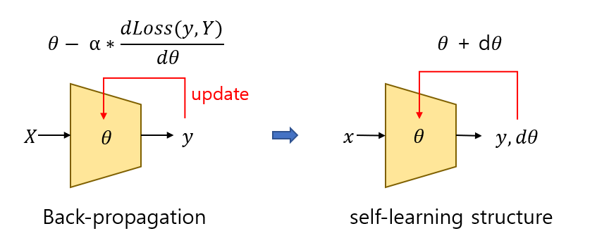
Concept
Can it be changed to a self-learning structure?

Slide 3
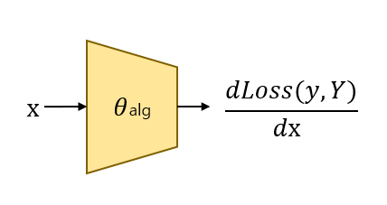
Concept
This means...
- Can the [ back-propagation algorithm , the goal(Y) ]
be represented by a parameter?
A self-learning structure just like the
"back-propagation algorithm"

Slide 4
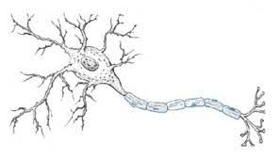
Concept
It cannot be certain.. However,.
we can find real-life examples of learning about survival,
which is a fixed goal in the DEQ model.
biological neuron "Encoding"
[ Something learning algorithm that we dont know , Survival ]
by "Parameters" that "Amount of Molecules"

Slide 5
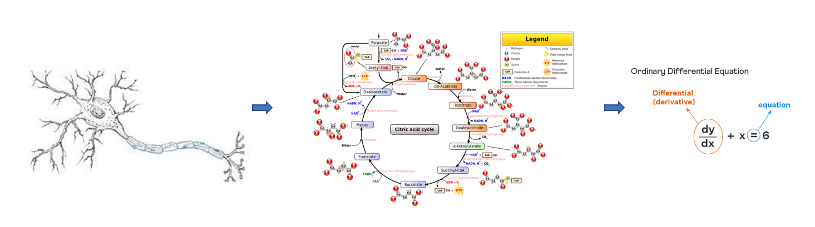
Introduction
how cat neuron can be represet to DEQ
real neuron
system biology
ODE
( ex: HH model )

Slide 6
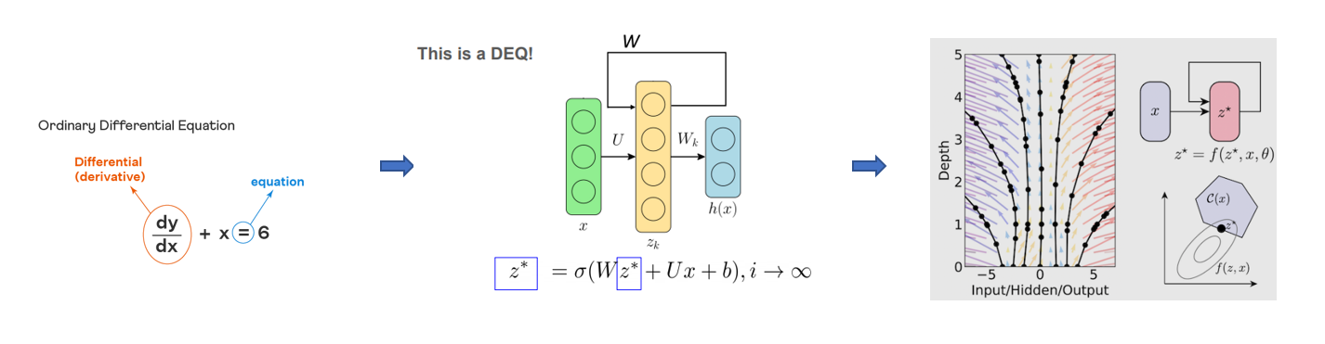
Introduction
how cat neuron can be represet to DEQ
ODE
DEQ
continuous DEQ
( neural-ODE )

Slide 7
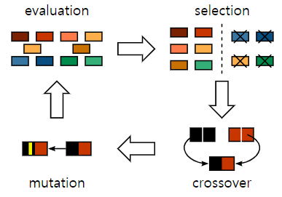
Introduction
Therefore, our goal is...
our goal is to design a DEQ (design implicit layer)
that can represent the movements of molecules in actual living organisms with parameters.
we will train the parameters of such DEQs using evolutionary methods (HyperNeat)
and this process will ultimately signify an act of searching for the optimal learning method.

Slide 8
Summary of Related Works
NIPS, 2018
Shaojie Bai et al. Neural ODE
NIPS, 2018
Shaojie Bai et al. Deep equilibrium models
IEEE,
C. Zhang et al. Training of Spiking Neural Network
IEEE,
2011
Y. Hao et al. Training of Biological Neural Network
IEEE,
X. Lin et al. HyperNeat

Slide 9
EPL Method

Slide 10
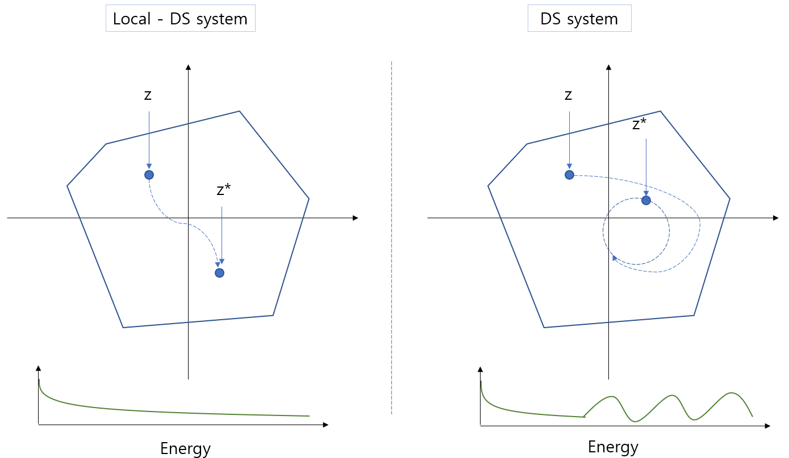
EPL Method

Slide 11
Contents of the Ph.D. Thesis
Introduction
Preliminaries
Chapter 2…
Conclusion and Future Work

Slide 12
Preliminaries

Slide 13
Overview

Slide 14
주요 내용

Slide 15
Publications
Journal Papers (2/1)
…
….
Submitted Papers (1/2)
…
…(SCI)
…NDSS Symposium 2016
Work in progress (1)
….

Slide 16
Conclusion & Future Work

Slide 17
Q & A
Thank you!

