Slide 1
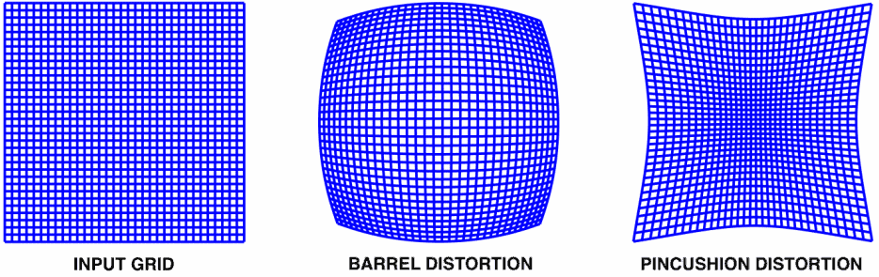

Slide 2
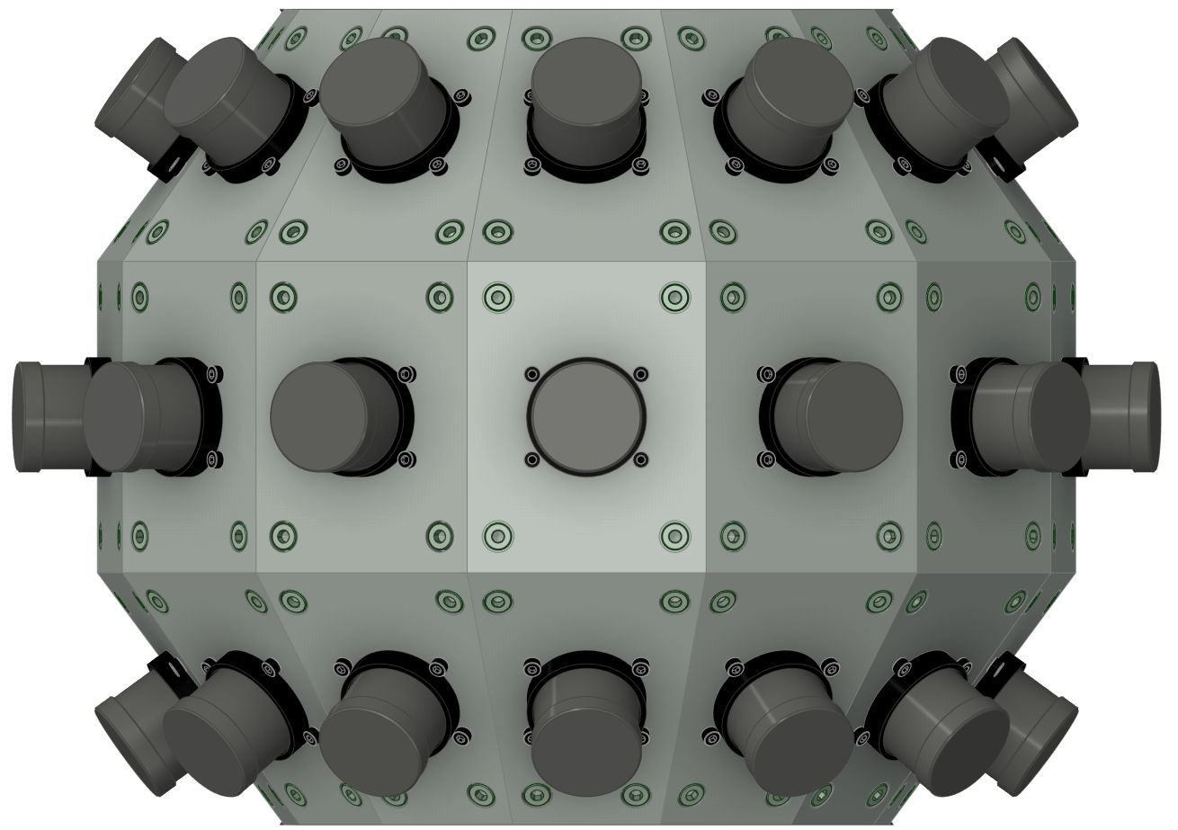
IR LEDs at known locations and different distances from the frame
2-axis rotation stage

Slide 3
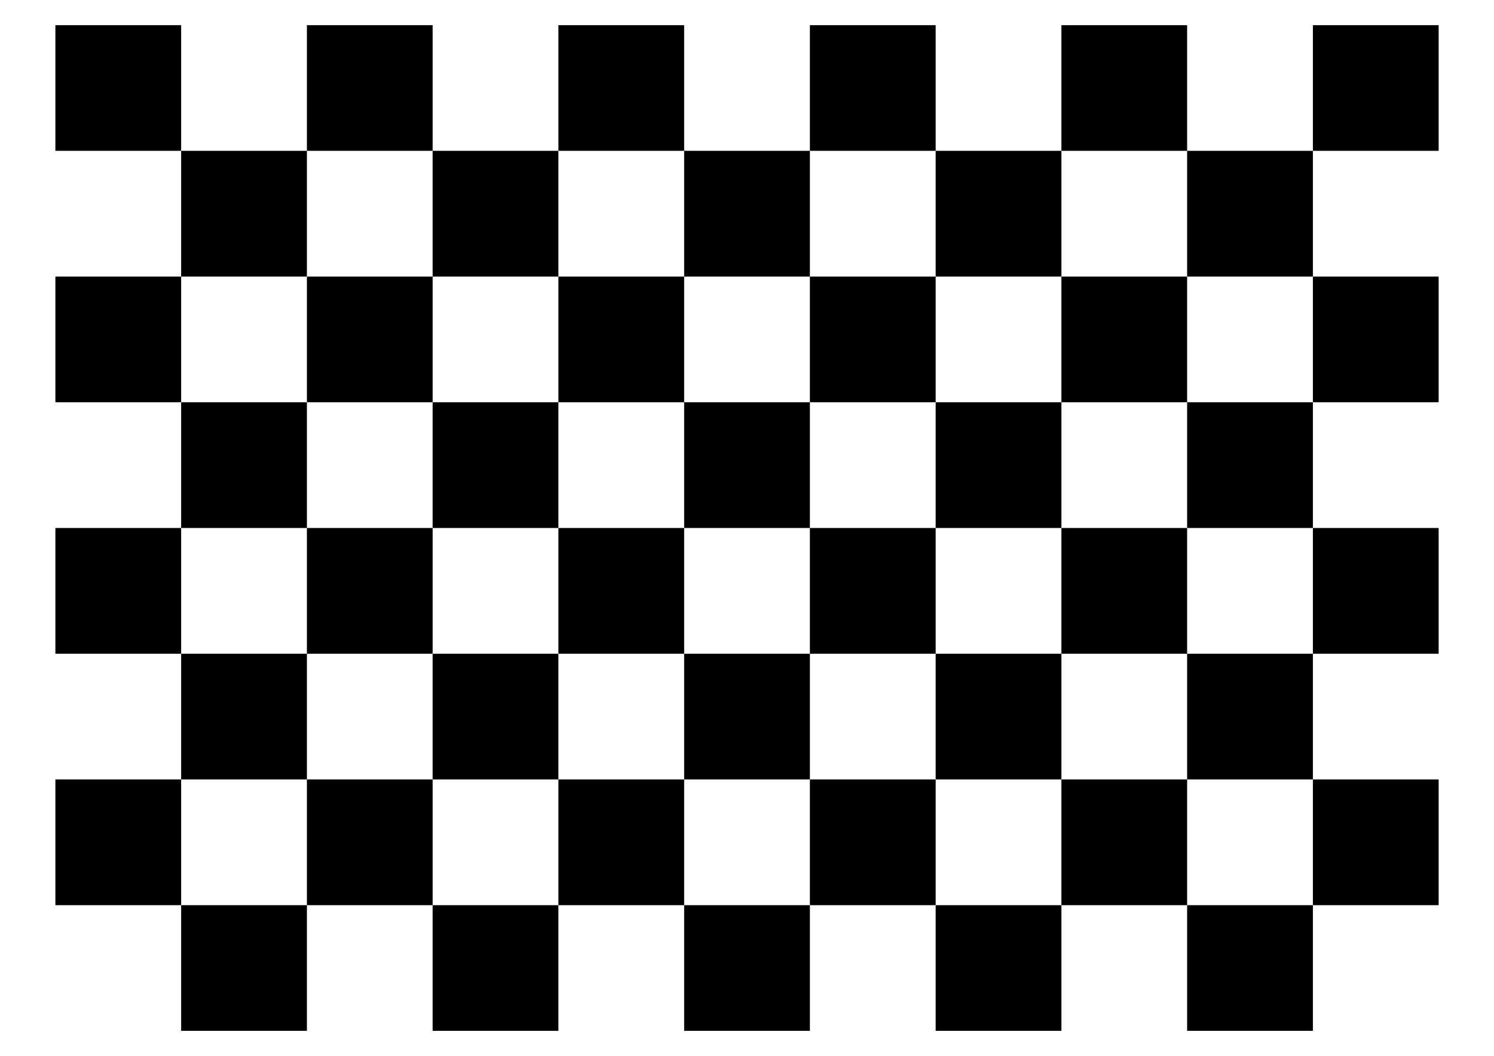
Checkerboards at fixed unknown locations and different distances from the frame
2-axis rotation stage

Slide 4
Checkerboards at fixed unknown locations and different distances from the frame
2-axis rotation stage

Slide 5

Board transformed
to neighbor space
Board seen
by neighbor
Overlap region

Slide 6
