Slide 1
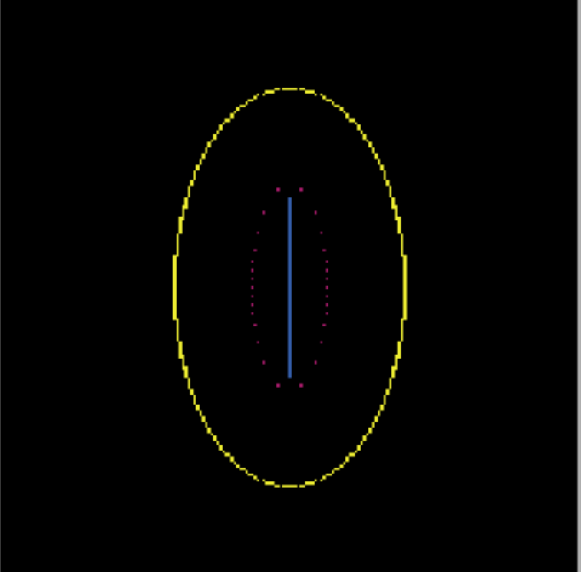
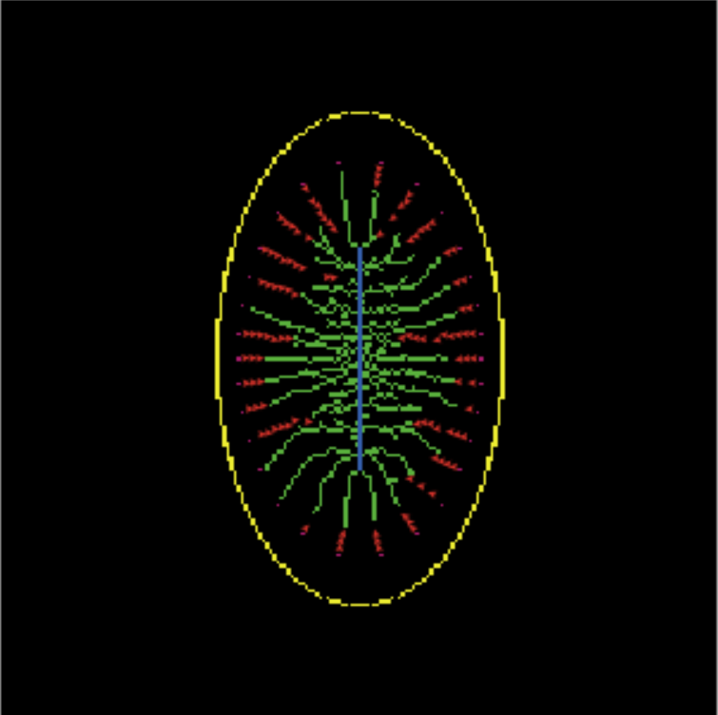
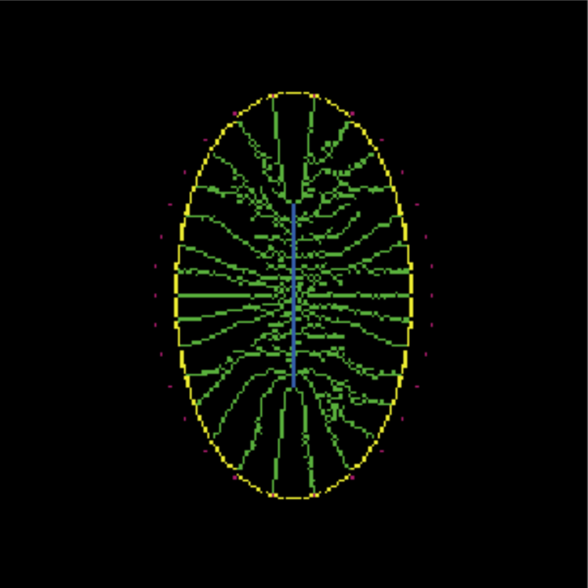

Slide 2
free-floating silica
epitheca
aggregate
silica
costae
raphe
STVs
STVs
bifurcation
t = 0
t = 50
t = 150

Slide 3
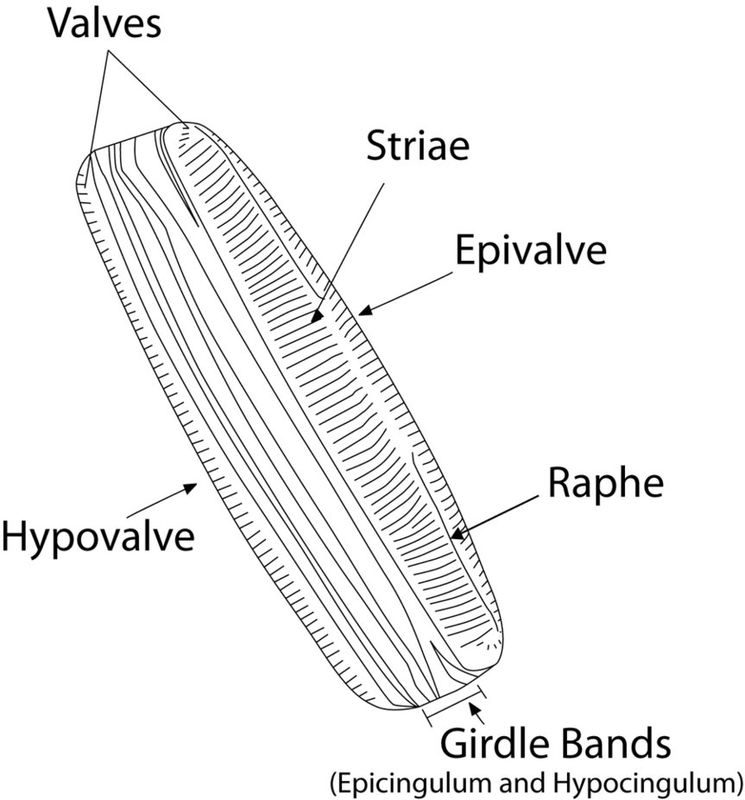
Costae
Epitheca
Hypotheca

Slide 4
SDV-aggregate margin
Epitheca
SDV growth
Raphe + initial silica
STV/Microtubule
Silica
SDV

Slide 5
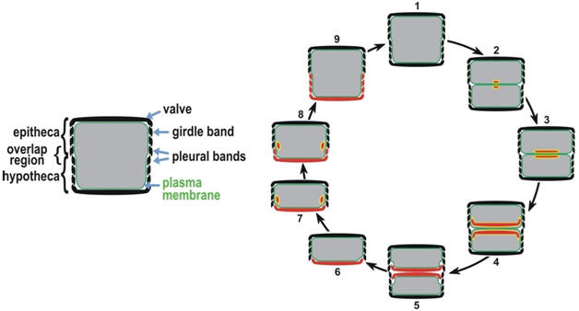
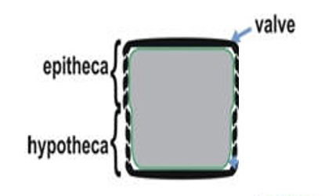
SDV

Slide 6
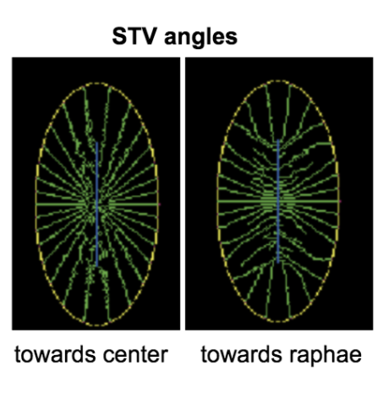
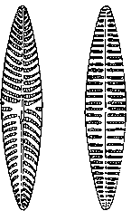
https://www.medicinalplantsarchive.us/tropical-waters/pennate-diatoms-1.html

Slide 7
