Slide 1
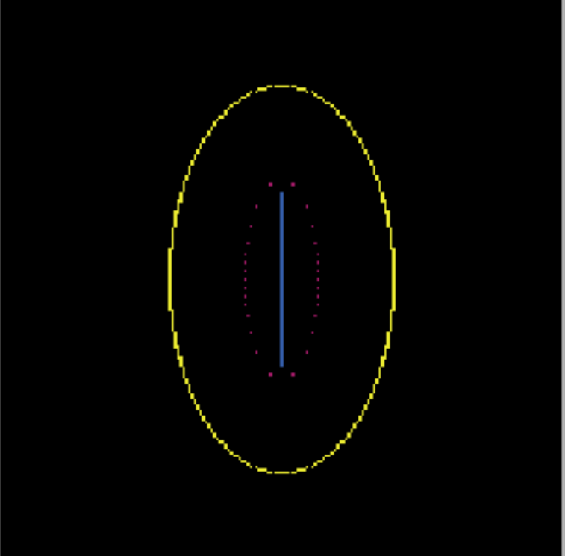
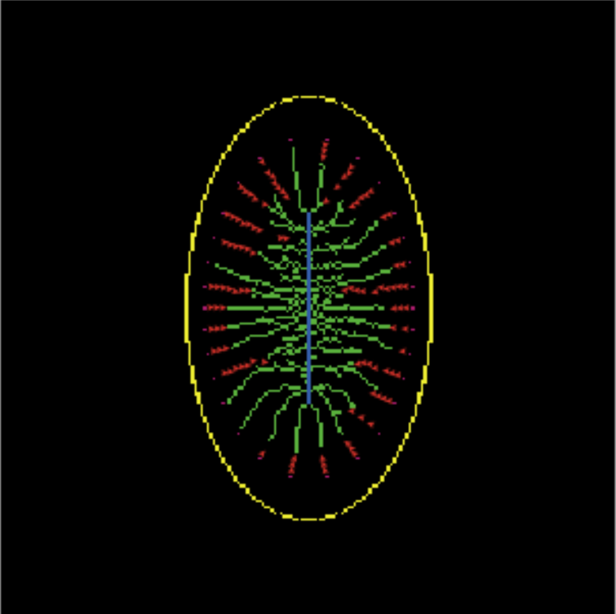
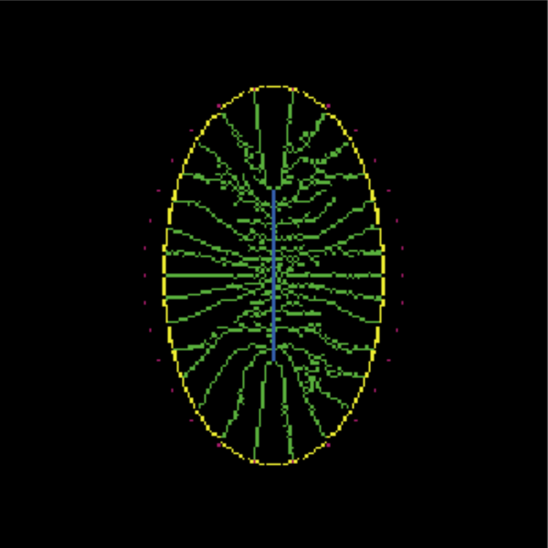

Slide 2
free-floating silica
epitheca
aggregate
silica
costae
raphe
STVs
bifurcation
t = 0
t = 50
t = 150

Slide 3
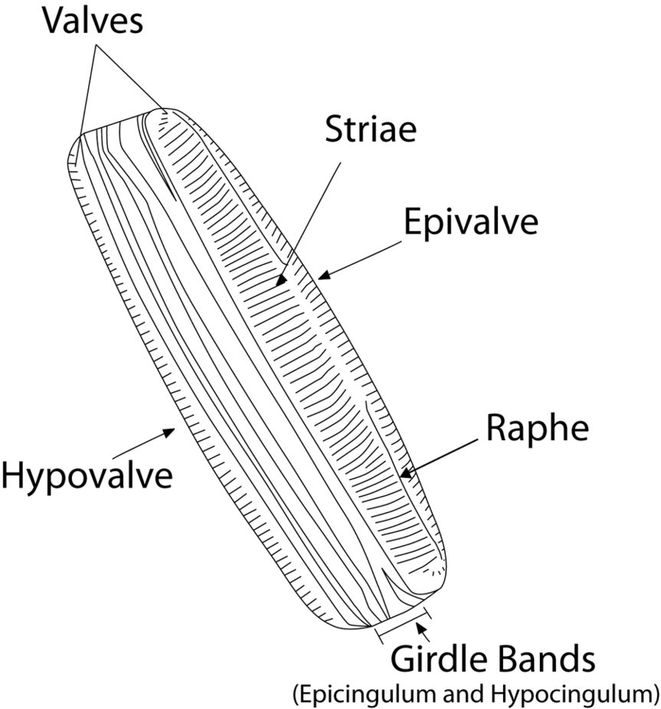
Costae
Epitheca
Hypotheca

Slide 4
SDV-aggregate margin
Epitheca
SDV growth
Raphe
STV/Microtubule
Silica
SDV

