Slide 1
Noise Removal Filters
Shizhen Li, Arjun Bawa
ECE 313, Term 2109
Dec 23, 2021

Slide 2


Problem
Digital cameras are predominant in photography
Signals are transmitted from photon sensors to local storage
This transmission, is prone to a degree of error due to noise
Photon Sensors
adc
adc
adc
Prone to Noise!
Notes:
Use the graph explain the source of noise and error
Mention that there are hardware and software solutions, the original paper and we are studying specific type of software solutions called smoothing algorithms. This naturally transit to the next slide
Briefly explain random impulse noise, say that we will elaborate later.

Slide 3

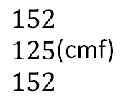
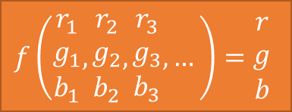
Existing Solutions
Mean Filter, Simple Median Filter, Component Median Filter, Vector Median Filter
Generally, a mask is used to pick out pixels around a certain pixel; a function is applied to these pixels to determine what the result pixel is.
Problems: creation of non-existing pixels
Problems: performs poorly on shape edges
Problems: universal replacement
Rgb rep.
111 125 30 | 151 79 46 | 103 33 241 | 211 35 60 | 178 134 103
75 35 8 | 168 125 125 | 155 110 11 | 109 57 200 | 55 199 148
131 158 160 | 30 25 253 | 77 136 176 | 152 152 152 | 66 135 123
19 211 207 | 255 255 255 | 135 98 23 | 146 213 53 | 167 203 152
0 68 99 | 84 84 168 | 239 156 188 | 125 113 179 | 85 102 236
168 125 125 | 155 110 11 | 109 57 200
30 25 253 | 77 136 176 | 152 152 152
255 255 255 | 135 98 23 | 146 213 53
Apply mask
Pass through filter
Used to replace the pixel in the result image.
$$f\left(\begin{matrix}r_{1} \\ g_{1} \\ b_{1}\end{matrix},\begin{matrix}r_{2} \\ g_{2} \\ b_{2}\end{matrix},\begin{matrix}r_{3} \\ g_{3} \\ b_{3}\end{matrix}, …\right)=\begin{matrix}r \\ g \\ b\end{matrix}$$
$\begin{matrix}152 \\ 125 \\ 152\end{matrix}$(cmf)
result
Notes:
We focus on Smoothing algorithm used by software to reconstruct original image
Talks about workflow first. (point 2 first)
Filters differ in the orange part of the graph, mean: mean on each component, cmf: median on each component, smf: rank by norms, pick the middle. vmf: calc dist from each pixel to each other pixel, find smallest.
Shape edge example: checker board.

Slide 4
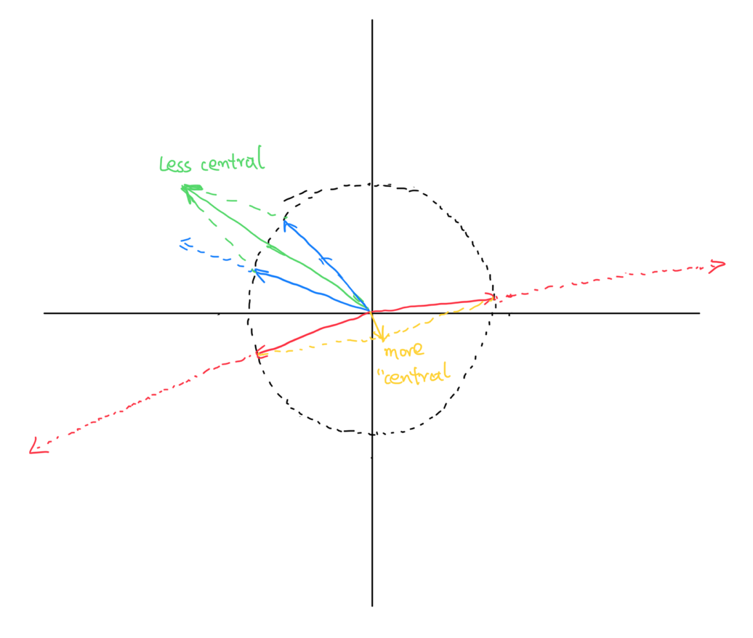
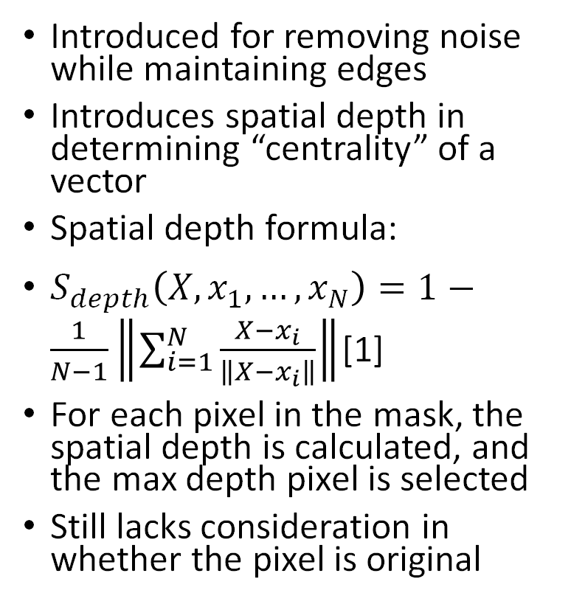
Spatial Median Filter (SMF)
Introduced for removing noise while maintaining edges
Introduces spatial depth in determining “centrality” of a vector
Spatial depth formula:
$S_{depth}\left(X, x_{1}, …, x_{N}\right)=1−\frac{1}{N−1}\left\|\sum_{i=1}^{N}{\frac{X−x_{i}}{\left\|X−x_{i}\right\|}}\right\|$[1]
For each pixel in the mask, the spatial depth is calculated, and the max depth pixel is selected
Still lacks consideration in whether the pixel is original
Notes:
Mention its similarity to VMF
Describe centrality: the spatial depth is a measurement of how well a point is surrounded by other points, as opposed to being a corner that all other points are on generally on a specific direction
Important to describe what spatial depth equation does, along with the graph

Slide 5
Modified Spatial Median Filter (MSMF)
Addressing uniform smoothing of the SMF
Introduced parameter T (Threshold)
If original pixel is listed among the top T largest spatial depth in the mask, do not replace
Special Cases:
T = 1: the same as normal SMF
T = N = num of pixels in the mask: the same as no filtering
Useful conditions:
Less corrupted pixels than corrupted ones. [1]
Similarly corrupted points undermines its performance. [1]
Notes:
The modified spatial median filter improves on one core issue the spatial median filter has, namely that the spatial median filter uniformly replaces all pixels in the image regardless if a given pixel already has very large spatial depth
In certain applications, it is unfavorable to blindly replace pixels in an image uniformly, and retaining as much original uncorrupted pixel information as possible is paramount
To remedy this issue with the spatial median filter, a threshold parameter T is introduced to indicate how sensitive the filter is to differences in spatial depth between pixels. This parameter is an estimate of how many non-noisy pixels there are under a mask
Similar to the spatial median filter, the spatial depths of each pixel under a given mask are computed. These depths are then sorted in decending order of spatial depth. If the position of the center mask point appears within the first T bins of the spatial order statistic list, then we can argue that while the center point is not the best representative point of the mask, it is still original data and should not be replaced
There are two notable subtleties of employing the use of the threshold parameter. When T = 1, the modified spatial median filter is equivalent to the spatial median filter. If T is equal to the size of the mask, it is equivalent to no filtering at all since all of the points are left unchanged
A drawback of this modified spatial median technique is when clusters of similarly-corrupted pixels exist in an image. In this situation, the modified spatial median filter incorrectly identifies similarly-corrupted pixels as original data, leaving them unchanged. This additionally implies that this filter is most optimal on salt-and-pepper noise.

Slide 6
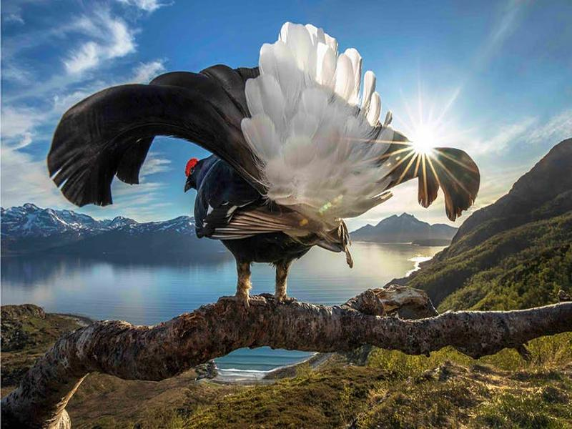
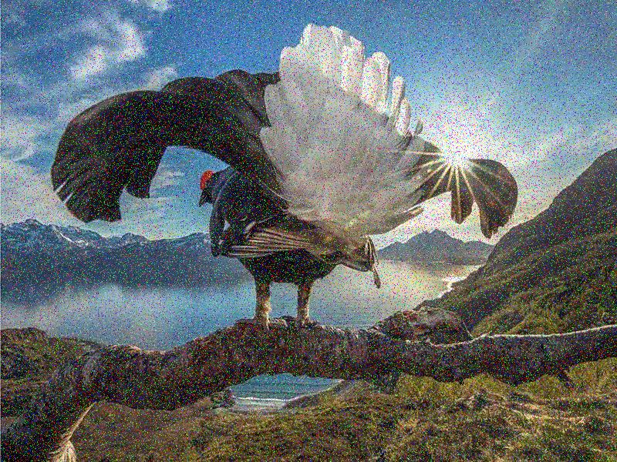
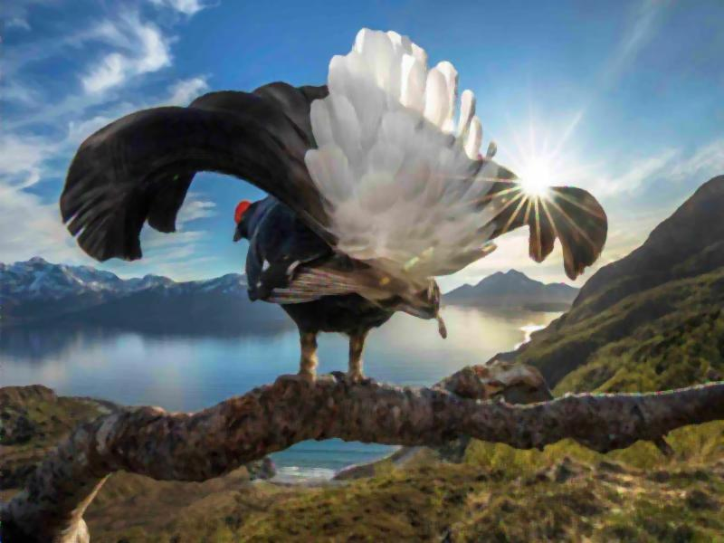
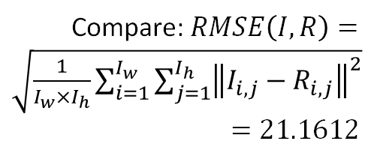
Simulation Method
Generate artificial noise
Noisy image generation
A param p is used to indicate probability of a pixel errors, the error is uniformly random assigned to each value (red, green, blue) of a pixel
Passing through filter
Each filter will acquire a mask for each pixel in the image, replace the pixel with the result pixel based on the filter rules
Compare with original image
Root Mean Squared Error (RMSE) is used to measure how different the reconstructed image is to the original image
Compare: $RMSE\left(I, R\right)=\sqrt{\frac{1}{I_{w}×I_{h}}\sum_{i=1}^{I_{w}}{\sum_{j=1}^{I_{h}}{{\left\|I_{i, j}−R_{i, j}\right\|}^{2}}}}$
$$=21.1612$$
Apply filter (here used CMF with mask size 5)
Notes:
The experimental process we implemented is as follows
Original source images were first subjected to varying levels of artificial impulse noise, creating noise-distorted images
They were then passed through each filter, generating a reconstructed image
This reconstructed image was then compared to the original source image with a root mean square error calculation, assigning a “score” to the filters’ reconstruction ability
The RMSE value does a per-pixel comparison between the original source image and the reconstructed image. The absolute error for each pixel is aggregated to a single value where a small RMSE indicates better reconstruction performance

Slide 7
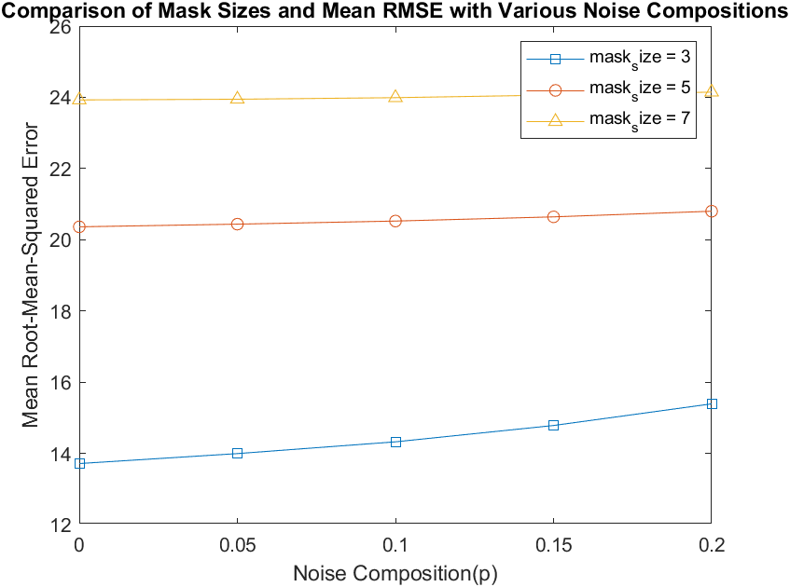
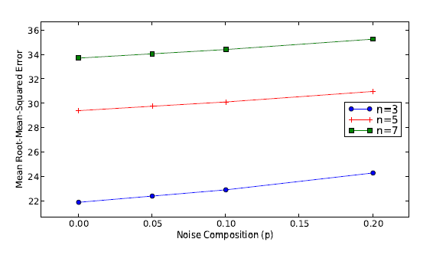
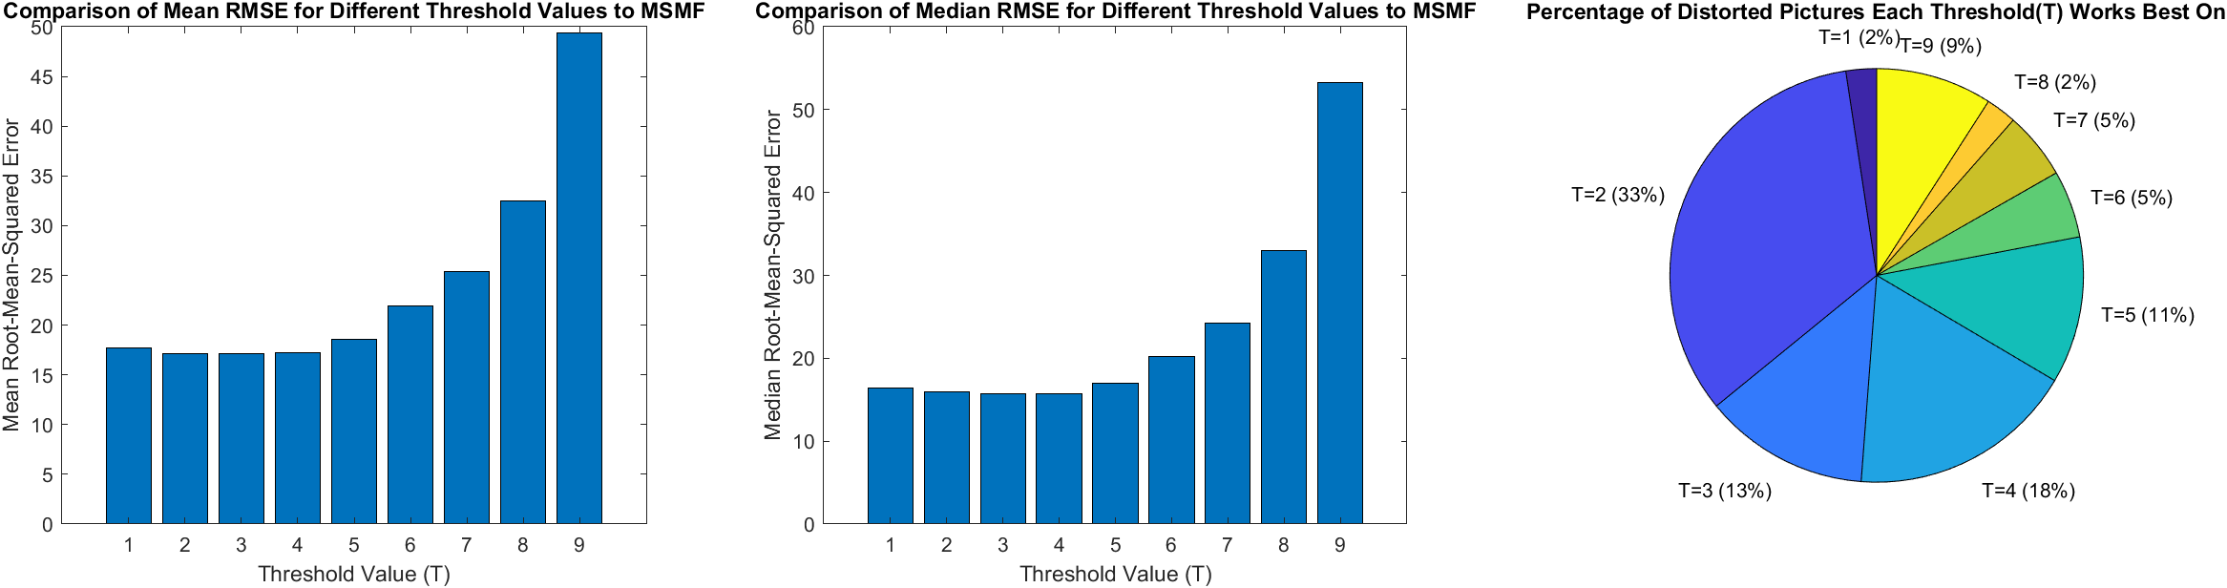
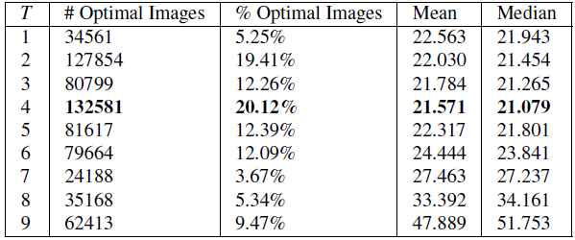
Experimental Result: Mask Size and Threshold
Our simulation
Original paper result
Choice of mask size
Choice of threshold
Choice of mask size
Choice of threshold
Notes:
From our experimental results, we observed the difference between using threshold values of 2, 3 or 4 in the modified spatial median filter to be minimal. The results suggest T = 2 to be overall the most optimal threshold for use in the Modified Spatial Median Filter. However, the results show that T = 3 exhibits the best mean RMSE while T = 4 shows the best median RMSE.
The difference in optimality between these three thresholds are numerically small, suggesting that the optimal choice of threshold isn't very straightforward. In the original paper, the choice is made for T = 4 as it leads in all three statistics, however the experimental data they presented comparing these different threshold values differed minimally as well
The choice of mask size based on our experimental results was in accordance with the conclusions from the original paper; a 3x3 window mask size consistently performs better than other mask sizes across the entire range of chosen noise levels.

Slide 8
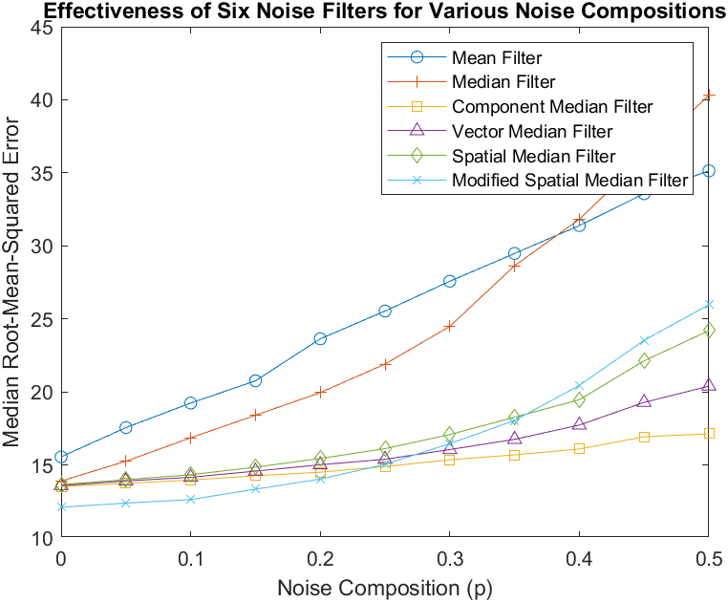
Experimental Result: Comparison between Filters
Our simulation
Original paper result
Notes:
Using the conclusions drawn for the threshold and mask size parameters, the median RMSE for all six filters were compared across different noise levels.
Our experiments show that for images containing approximately $p≤0.25$ noise composition, the modified spatial median filter is the optimal filter choice. This is in accordance with the predicted benefit of the filter as well as the original publication’s results.
At larger noise compositions, the modified spatial median filter isn’t as performant as many of the other filters, which reaffirms the predicted disadvantages of the filter.
Considering the results in totality, the Component Median Filter (CMF) and Vector Median Filter (VMF) exhibit better performance over the entire range of chosen noise levels, with the component median filter being the most optimal for high $p≈0.5$ noise compositions. These experimental results are also in accordance with the conclusions from the original paper.

Slide 9
Conclusion
Both our experiment and original paper concluded that the modified SMF with mask size of 3 and threshold 4 has the best performance on low noise levels compared to other filters.
The differences in threshold values of 2, 3, and 4.
Notes:
In conclusion, our experimental results indicated that the modified spatial median filter with a mask size of 3 and a threshold level of T = 2 to T = 4 yielded the best performance on images with low noise compositions.
We can attribute some of the discrepencies between our experimental results and the results of the original paper to a few different factors. The original paper's experiments operated on a much larger sample size of images (about 60,000 source images) than our experiments did (19 source images).
This difference in sample size is likely to have made the distinction of image reconstruction optimality more opaque in our experimental results for these threshold values.
In addition, the image dataset used for our experimental process is different to the image set used in the original paper, meaning that differences in composition of the source images could lead to differences in our experimental results compared to those of the original paper.
However, we still observe that our experimental results don't generally lead to vastly different conclusions than those derived from the original paper's experimental setup.

Slide 10
References
[1] J. C. Church, Y. Chen, and S. V. Rice, “A Spatial Median Filter for noise removal in digital images,” IEEE SoutheastCon 2008, 2008.
Notes:
On this slide we list the original 2008 paper on Spatial Median Filtering for noise removal in digital images.
Thank you!

