Slide 1

Zotonic
The Tutorial
Erlang User Conference 2013,
Stockholm
Arjan Scherpenisse - arjan@miraclethings.nl

Slide 2
Zotonic's goals
Maximise the use of hardware
Frontender friendly
Hit the ground running

Slide 3
So, what's in the box?
Multiple sites
Admin interface
User management
Page management
Menu editor
Commenting
Image management
Video embedding
Integrated e-mail sending + receiving (!)
API OAuth
i18n
SEO modules
Importer modules
Mailinglist

Slide 4
Getting technical
The data model
HTTP request flow
Modules & sites
URL dispatching
The building blocks

Slide 5
Data model: everything is a thing

Slide 6
HTTP request flow

Slide 7
Modules
Modules are self-contained:
  Dispatch rules, resources, templates, css, javascript, images, translations, template filters, actions, validators, API services, models, …
Prioritized list
File lookup mechanism
Every module can be a gen_server

Slide 8
Notification system
Is how modules extend and offer functionality
gen_event-like
Listen to notifications
Send notifications:
  notify, notify1, fold, map, first
  Both sync and async
% @doc Check if the recipient is a known user, if so redirect the received e-mail
observe_email_received(#email_received{localpart=Recipient} = Received, Context) ->
case m_identity:lookup_by_username(Recipient, Context) of
undefined ->
undefined;
Props ->
case proplists:get_value(is_verified, Props) of
true ->

Slide 9
URL dispatching
Dispatch rules per site
  (and per module)
Dispatch rules have names
e.g. this rule serves the contact.tpl on the /contact URL:
{contact,
[“contact”], controller_template, [ {template, "contact.tpl"} ]},

Slide 10
The page controller
Webmachine entrypoint for pages
404 check
Authorization check + logon redirect
Template selection

Slide 11
Template system
Extended ErlyDTL
  Expressions: {% if a + b > c %}
  Tuple and list data types
  Data access through models: {{ m.rsc[id].title }}
Templates can be made more specific by category and/or unique page name
Templates with the same name override each other
  Uses module priority

Slide 12
Template ex.: page.page_projects.tpl
{% extends "page.tpl" %}
{% block content_body %}
{% cache 7200 %}
{% for r in m.search[{archive_year cat='project'}] %}
<div class="grid_9 alpha omega">
<h2 class="year">{{ r.year }}</h2>
</div>
{% for group in m.search[{query publication_year=r.year|append:""
cat='project'
sort="-publication_start"}]|chunk:3 %}
<div class="grid_9 alpha omega">
{% for id in group %}
{% catinclude "inc/listitem.tpl" id alpha=forloop.first omega=forloop.last%}
{% endfor %}
</div>
{% endfor %}
{% endfor %}
{% endcache %}
{% endblock %}

Slide 13
Scomps — screen components
For when you need more logic than a template can handle
Erlang module
Cacheable
Example: {% menu id=id %}

Slide 14
Javascript — Event handling
Ajax postbacks
Form submits
Calls event/2 function
Communicates back to browser by sending javascript
  Inspired by Nitrogen
{% button postback={click foo=”bar”} text=”click me” %}
event({postback, {click, Args}, _Trigger, _Target}, Context) ->
z_render:wire({alert, [{text,”hello”}]}, Context).

Slide 15
Javascript — Push connections
Uses either Comet or WebSockets
Attaches to the page process
Transports Javascript to the UA

Slide 16
REST services
API method is an Erlang module
/api/mymodule/mymethod
In /services module directory
JSON input / output
Process GET and POST

Slide 17
Hands on!
Get Vagrant (version >= 1.1!)
Clone:
git clone https://github.com/arjan/zotonic-vagrant-tutorial.git
Get it running
vagrant up
… get some coffee...
Visit: http://localhost:8000
...you can also run it on your local machine, outside vagrant

Slide 18
Let's start!

Slide 19
Tutorial use case: Portfolio site
Site with information about your projects
Each project has:
  Title, text
  Slide show of large images
  List of related projects

Slide 20
Easy development
apt-get install inotify-tools
Enable mod_development
Emacs' zotonic-tpl-mode for editing templates
  … and of course erlang-mode / flymake-mode
Each step of this tutorial is a git tag! e.g.
git checkout step-0

Slide 21
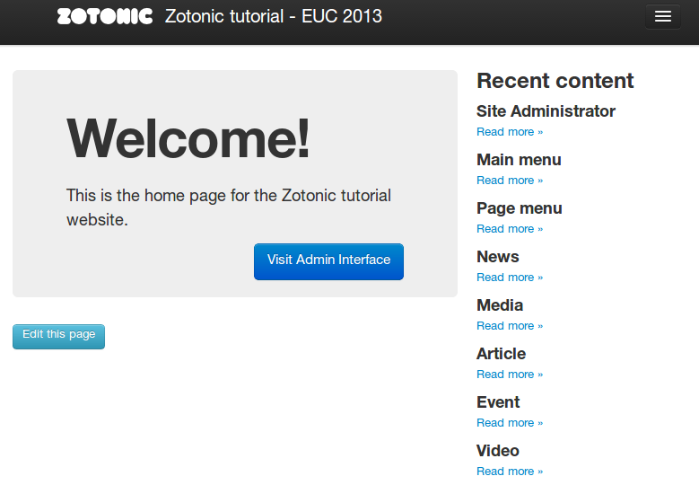
#0 – base site
This is what we started with, created using:
  zotonic addsite -L -s basesite tutorial

Slide 22
#1 – create project category
Define the our site-specific domain model: specific categories that this site uses.
In the site's module (tutorial.erl), we create manage_schema/2
Returns a #datamodel{} record
When done:
  z:m(), z:flush().
  Click “reinstall data model” button in the admin

Slide 23
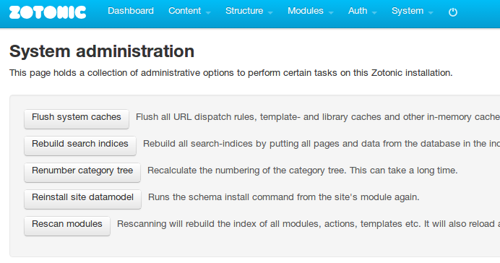

Slide 24
#2 – create project page template
Create a page specific for resources of the category project.
Template name: page.project.tpl
Loops through the list of images
Note: look at templates/tablet/page.tpl in mod_base_site to see the template block names that you can use

Slide 25
#3 – project list
A list of recent projects, ordered by their publication date
The easy way:
  Create resource with category “search query”
  Search query: “cat=project sort=-publication_start”
  Give it the page path “/projects”
  This can go in your #datamodel{}

Slide 26
#3b – alternative project list
The hard(coded) way:
  Set up new dispatch rule for /all-projects
  Create all-projects.tpl, write template code...
  (git checkout step-3b)

Slide 27
#4 – feedback form
A form which sends an email to the site administrator.
Add form to page.project.tpl
Create event handler in tutorial.erl
  Takes form data,
  Sends email
  Email is HTML; rendered from template

Slide 28
#5 – notification system
We want to make sure a project always has at least one edge of type “author”
create observe_rsc_update_done/2 in tutorial.erl
  Tip: Look in zotonic_notifications.hrl for more hooks into the system!
Add code
Test it in the admin!
  (reload after save to see the new edge)

Slide 29
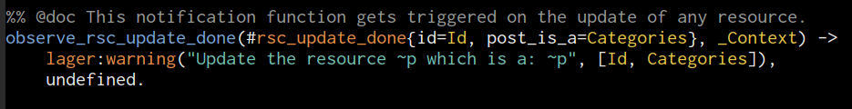

Slide 30
Thank you!
Please come to my talk on friday!
  “Making it fast” - the performance of Zotonic
  … or chat with me & Andreas :-)
Online resources:
  http://zotonic.com
  http://zotonic.com/docs
  IRC, XMPP, mailing lists
  Tutorial source code, tutorial slides

