Slide 1
Case Study: How Does a Bike-Share Navigate Speedy Success?
Presented by: Austin Janes
Last updated: May 10th, 2023

Slide 2
Table of Contents
Background
Purpose Statement
The Data
Conclusions
Appendix

Slide 3
Scenario Background
Cyclistic is a bike share company with 5,800 bicycles and 600 docking stations.
The director of marketing believes the company’s future success depends on maximizing the number of annual memberships. Therefore, your team wants to understand how casual riders and annual members use Cyclistic bikes differently.

Slide 4
Business Objective
Identify how casual riders and members utilize Cyclistic bikes differently to find digital marketing techniques to convert casual riders to members.

Slide 5
Data Insights

Slide 6


Average Ride Times/ Month
Casual riders average longer rides.
Rides are longest during summer, followed by spring.
Casual ride time more heavily affected.
***Disclaimer*** These values include docked bikes, which substantially skew casual data

Slide 7
Annual Riders
Members average more annual rides

Slide 8
Total Rides/ Month
 | May-22 | Jun-22 | Jul-22 | Aug-22 | Sep-22 | Oct-22 | Nov-22 | Dec-22 | Jan-23 | Feb-23 | Mar-23 | Apr-23
Casuals | 280414 | 369044 | 406046 | 358917 | 296694 | 208988 | 100747 | 44894 | 40008 | 43016 | 62201 | 147284
Members | 354443 | 400148 | 417426 | 427000 | 404636 | 349693 | 236947 | 136912 | 150293 | 147428 | 196477 | 279302
The total riders per month trend is similar to monthly ride times
Both casuals and members ride substantially less in the off season
The effect on casuals is greater, implying leisure use

Slide 9
Percent Casual/ Month
 | May-22 | Jun-22 | Jul-22 | Aug-22 | Sep-22 | Oct-22 | Nov-22 | Dec-22 | Jan-23 | Feb-23 | Mar-23 | Apr-23
% casual | 44.1696319 | 47.9781381 | 49.30902326 | 45.66856297 | 42.30447863 | 37.40739349 | 29.83381404 | 24.69335445 | 21.0235364 | 22.58721724 | 24.0457248 | 34.52621511
During peak months, almost half of all riders are casual.
During off season, the usage drop off much greater in casual riders

Slide 10
Weekday Preference
Annually, casual riders prefer weekends; members have a less strong preference
This implies commute or workout usage.

Slide 11
Weekday Preference Continued
Casual riders prefer weekends during the regular season, but this does not hold true in the off season.
Members consistently favor weekdays; implying commutes.
These off-season (Nov-Apr) casuals are prime member targets.
weekdays | 1 | 47468 | 37004 | 43971 | 42361 | 31051 | 27234 | 10300 | 4936 | 5698 | 6788 | 6818 | 12119
casuals | 2 | 35067 | 38819 | 41447 | 51508 | 29586 | 15694 | 15808 | 5917 | 6904 | 6853 | 9219 | 15826
 | 3 | 24066 | 48387 | 42850 | 51488 | 33504 | 20593 | 17779 | 5678 | 5978 | 4577 | 11305 | 18370
 | 4 | 33399 | 57978 | 47793 | 42351 | 45838 | 22585 | 17981 | 8177 | 5022 | 3712 | 10125 | 23506
 | 5 | 32238 | 55868 | 56504 | 56867 | 56385 | 25979 | 14538 | 7156 | 5012 | 4250 | 9362 | 25922
 | 6 | 52855 | 65137 | 95230 | 66188 | 64076 | 52222 | 11869 | 7687 | 5017 | 6881 | 7986 | 32775
 | 7 | 55321 | 65851 | 78251 | 48154 | 36254 | 44681 | 12472 | 5343 | 6377 | 9955 | 7386 | 18766 | Total rides/yr
 | Total rides | 280414.00 | 369044.00 | 406046.00 | 358917.00 | 296694.00 | 208988.00 | 100747.00 | 44894.00 | 40008.00 | 43016.00 | 62201.00 | 147284.00 | 2358253.00
 | Percent | 11.89075133 | 15.6490419 | 17.21808474 | 15.21961384 | 12.58109287 | 8.86198385 | 4.27210312 | 1.903697356 | 1.696510086 | 1.824062134 | 2.637588079 | 6.245470694
weekdays | 1 | 62061 | 46791 | 49850 | 62602 | 47422 | 58287 | 32304 | 18889 | 22649 | 24391 | 25390 | 33924
members | 2 | 59543 | 54982 | 57520 | 76718 | 57033 | 39748 | 46114 | 22108 | 29377 | 28631 | 32128 | 40491
 | 3 | 45097 | 68797 | 59611 | 76616 | 61505 | 48893 | 47448 | 20162 | 24743 | 21215 | 39751 | 43075
 | 4 | 51663 | 73500 | 61155 | 57508 | 76589 | 49238 | 39125 | 27095 | 22645 | 18140 | 35902 | 48317
 | 5 | 42310 | 57322 | 61643 | 58703 | 72329 | 45024 | 30323 | 19662 | 20109 | 17311 | 29155 | 43582
 | 6 | 44995 | 49694 | 68867 | 51881 | 54019 | 58137 | 20440 | 16879 | 14781 | 17403 | 16962 | 40365
 | 7 | 48774 | 49062 | 58780 | 42972 | 35739 | 50366 | 21193 | 12117 | 15989 | 20337 | 17189 | 29548 | Total rides/yr
 | Total rides | 354443.00 | 400148.00 | 417426.00 | 427000.00 | 404636.00 | 349693.00 | 236947.00 | 136912.00 | 150293.00 | 147428.00 | 196477.00 | 279302.00 | 3500705.00
 | Percent | 10.12490341 | 11.43049757 | 11.9240553 | 12.19754307 | 11.55870032 | 9.989216458 | 6.768550906 | 3.910983645 | 4.293220937 | 4.211380279 | 5.612498054 | 7.978450055
NOTE: 1= Monday, 7= Sunday, ETC.

Slide 12
Bike Type Annualized
Members use approx. 50/50 electric/ classic bikes
Casuals use approx. 60/40 electric/ classic bikes
This implies members are more likely to use bikes for fitness and casuals for leisure.
***Disclaimer*** this data excludes docked bikes

Slide 13
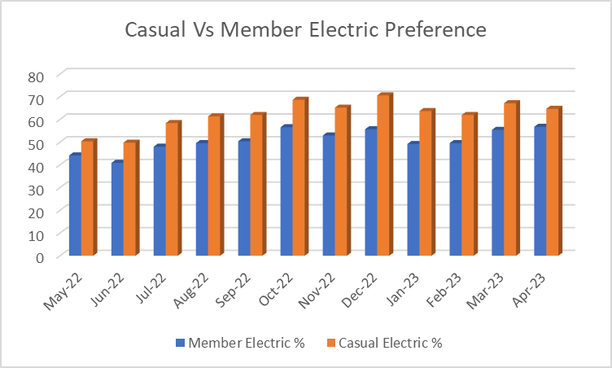
Bike Type Monthly
Members prefer classic bikes during peak seasons, electric during off seasons.
Casuals, compared to members, heavily prefer electric bikes use yet follow a similar overall seasonal trend.
***Disclaimer*** this data excludes docked bikes

Slide 14
Takeaways
-Casuals prefer weekends, electric bikes, and ideal weather. Casuals rent bikes for longer periods.
-Members prefer weekdays, are more likely to use classic bikes, and are more likely to use the service in the off season.

Slide 15
Implications and Hypotheses
-How do members and casual riders use the bikes differently?
-Correlation does not mean causation
-The data suggests that members use bikes more often for commutes and workouts than casuals, while casuals use the bikes for leisure, likely tourism.

Slide 16
Suggestions
-Target digital marketing to the off-season casual riders
-Target digital marketing to casual riders that prefer classic bikes
-Target digital marketing to those who ride during weekday work hours

Slide 17
Appendix
Data sourced here:
https://divvy-tripdata.s3.amazonaws.com/index.html
Months: May 2022- April 2023
All data used was public and data modifications included the removal of duplicates and negative trip values. No other changes to the core data were made.

