Slide 1
Protein Classification Using LLM Embedding Method
Arjang Fahim Ph.D.
California State University - Long Beach
37th Annual CSU Biotechnology Symposium

Slide 2

Download link for the presentation and data
https://github.com/arjangvt/CSUBiotechSymposium

Slide 3
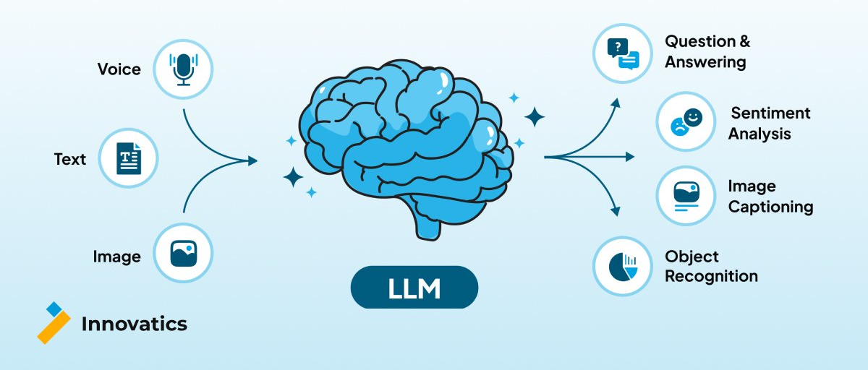
Large Language Models (LLMs)
Image credit: https://teaminnovatics.com/blogs/large-language-models-llms-overview/

Slide 4
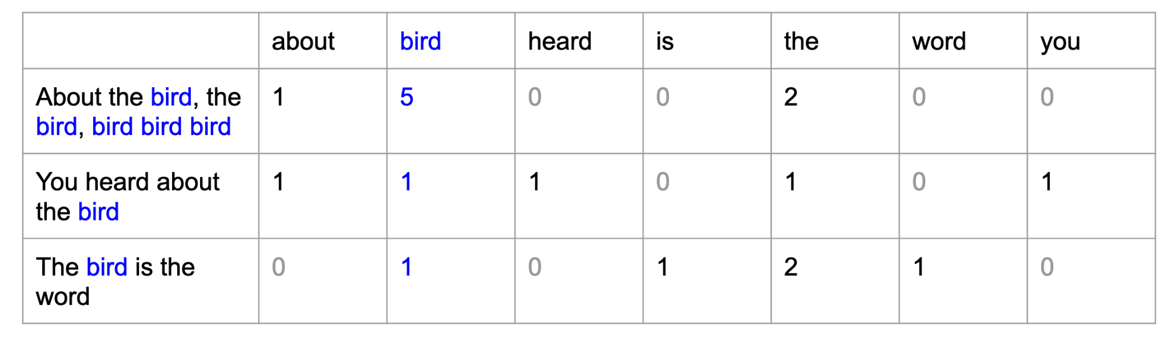
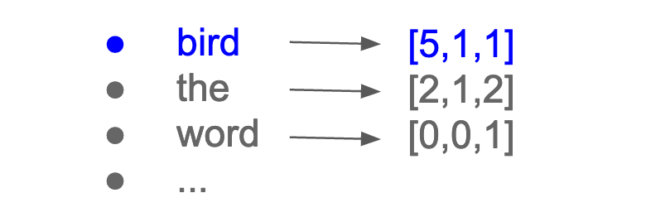
Word Embedding in Natural Language Processing (NLP)
“Word embedding” transfers a sentence to a numerical representation suitable for machine learning.
How can we utilize this technique for protein classification?
"Bag of Words" (BoW) is considered a type of word embedding, although it's a basic form that simply represents text as a collection of words without considering their order or context
Word Embedding
Feature Extraction Using Convolutional Kernel
Average/Max Pooling Layer
Flatting of Layers
Deep Neural Network for Classification
Notes:
A useful word embedding method preserves the properties of a phrase such as semantics, word frequencies etc
Here also I need to explain the classification capability of the word embedding method

Slide 5
Embedding methods for Protein Classification – Spike2Vec
Spike2Vec, is an NLP method, that was traditionally used for text (sentences) embedding.
In the context of protein structures, each protein can be considered as a sentence.
Words in a protein structure are defined as k-mers:
The sequence of AA for the protein (Ubiquitin, ~75 AA):
Notes:
There are 21 different types of amino acids (a.k.a protein alphabet)
If we consider k = 4 (k is the length of k-mer or contig), then the total count of contigs is given by 21 ^ 4 = 194,481.
This is equal to saying that the language of protein structures contains 194,481 words!

Slide 6
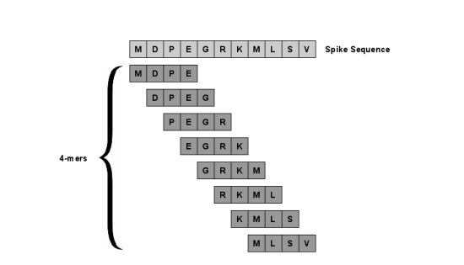
Embedding methods for Protein Classification – Spike2Vec
Spike2Vec, is an NLP method, that was traditionally used for text (sentences) embedding.
In the context of protein structures, each protein can be considered as a sentence.
Words in a protein structure are defined as k-mers:
The sequence of AA for the protein (Ubiquitin, ~75 AA):
k-mer | Probability
MDPE | 0.8
DPEG | 0.4
… | …
MLSV | 0.9
Notes:
There are 21 different types of amino acids (a.k.a protein alphabet)
If we consider k = 4 (k is the length of k-mer or contig), then the total count of contigs is given by 21 ^ 4 = 194,481.
This is equal to saying that the language of protein structures contains 194,481 words!

Slide 7
Embedding methods for Protein Classification – ELMo
ELMo (Embedding From Language Model) is a deep contextualized word representation that can model complex characteristics of words.
Conventional embedding methods, like Spike2Vec, sacrifice the complex characteristics of words such as syntax and semantics in favor of compacting datasets.
The ELMo method addresses two main issues of conventional embedding methods.
It maintains the semantics and syntaxes of a phrase.
The variety of words across linguistic contexts.
Notes:
In this method, a protein sequence is embedded into a vector known as ELMo (Embeddings from Language Models) [5].
Conventional embedding methods, like Bag of Words, sacrifice the complex characteristics of words such as syntax and semantics in favor of compacting datasets. The ELMo method was originally introduced to address two main issues of conventional embedding methods. First is the maintaining semantics and syntaxes of a phrase and the second is how words vary across linguistic contexts.
As it was mentioned above, the ELMo model consists of two bidirectional Language Models (biLMs) as a function of an internal linear model (e.g. LLSTM model). biLMs layers are pre-trained from unsupervised (unlabeled) UniRef50 [6] to produce embedding. This process is known as Sequence-to-Vector(SeqVec) and incorporates the complex sequence biochemical properties that add invaluable information to the embedding model.

Slide 8
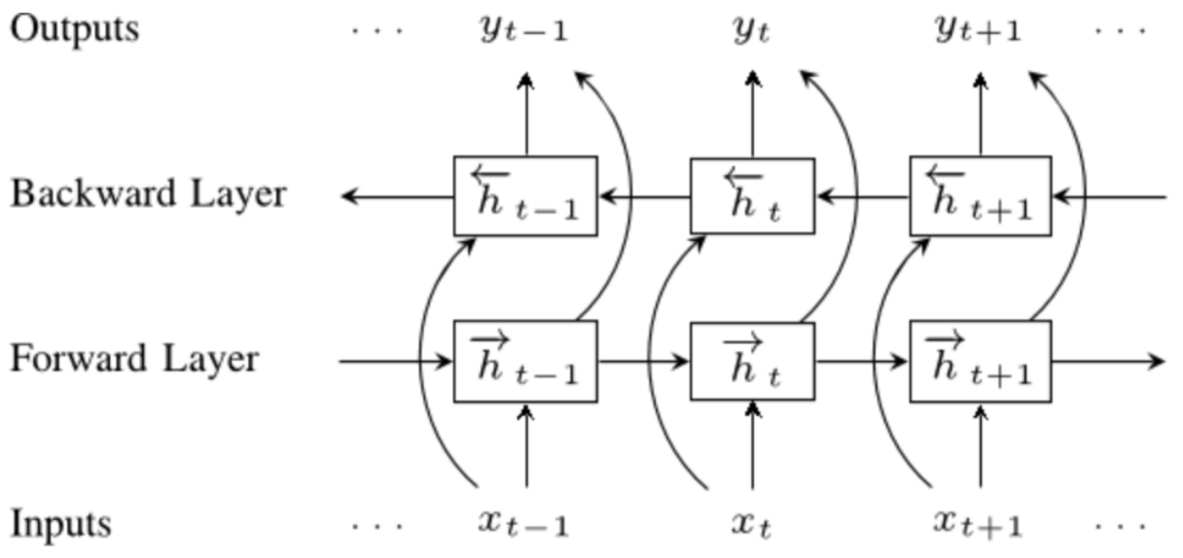
ELMo Word Embedding
The ELMo model consists of two bidirectional Language Models (biLMs). The layers are known as Backward and Forward LSTM models
Deep Contextualized Word Representation. https://arxiv.org/abs/1802.05365
Notes:
In this method, a protein sequence is embedded into a vector known as ELMo (Embeddings from Language Models) [5].
Conventional embedding methods, like Bag of Words, sacrifice the complex characteristics of words such as syntax and semantics in favor of compacting datasets. The ELMo method was originally introduced to address two main issues of conventional embedding methods. First is the maintaining semantics and syntaxes of a phrase and the second is how words vary across linguistic contexts.
As it was mentioned above, the ELMo model consists of two bidirectional Language Models (biLMs) as a function of an internal linear model (e.g. LLSTM model). biLMs layers are pre-trained from unsupervised (unlabeled) UniRef50 [6] to produce embedding. This process is known as Sequence-to-Vector(SeqVec) and incorporates the complex sequence biochemical properties that add invaluable information to the embedding model.

Slide 9
Objectives of this research
We propose a Hybrid method that utilizes feature extraction Bag-of-Words (BoW) combined with recent NLP techniques such as the ELMo word embedding method.
Aim 1: To generate datasets necessary for benchmarking experiments.
Use standard benchmarking datasets.
Obtain protein structure files from online databases like Protein Data Bank (PDB).
Clean and organize the datasets for benchmarking experiments.
Aim 2: To determine whether the ELMo word embedding method will demonstrate enhanced performance compared to BoWs.
Compare ELMO word embedding with Bag-of-Words.
Hypothesize ELMO's higher performance due to its three-dimensional information capture.
Expect ELMO to exhibit higher accuracy in large protein structures.
Aim 3: To determine whether the combination of two embedding methods the ELMo and Bag of Words enhances the performance of the classification compared to the result of Aim 2.
ELMO captures and embeds structural information over long distances.
Bag of Words is more effective for local embedding.
Combining both methods incorporates more structural information into classification models

