Slide 1
Brief Introduction to KNIME Analytics Platform
Arjang Fahim, Ph.D.
California State University Long Beach
37th Annual CSU Biotechnology Symposium

Slide 2
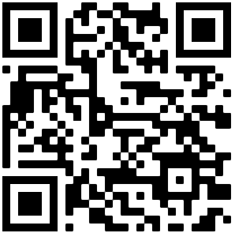
Download link for the presentation and data
https://github.com/arjangvt/CSUBiotechSymposium

Slide 3
Download and Install https://www.knime.com/downloads

Slide 4
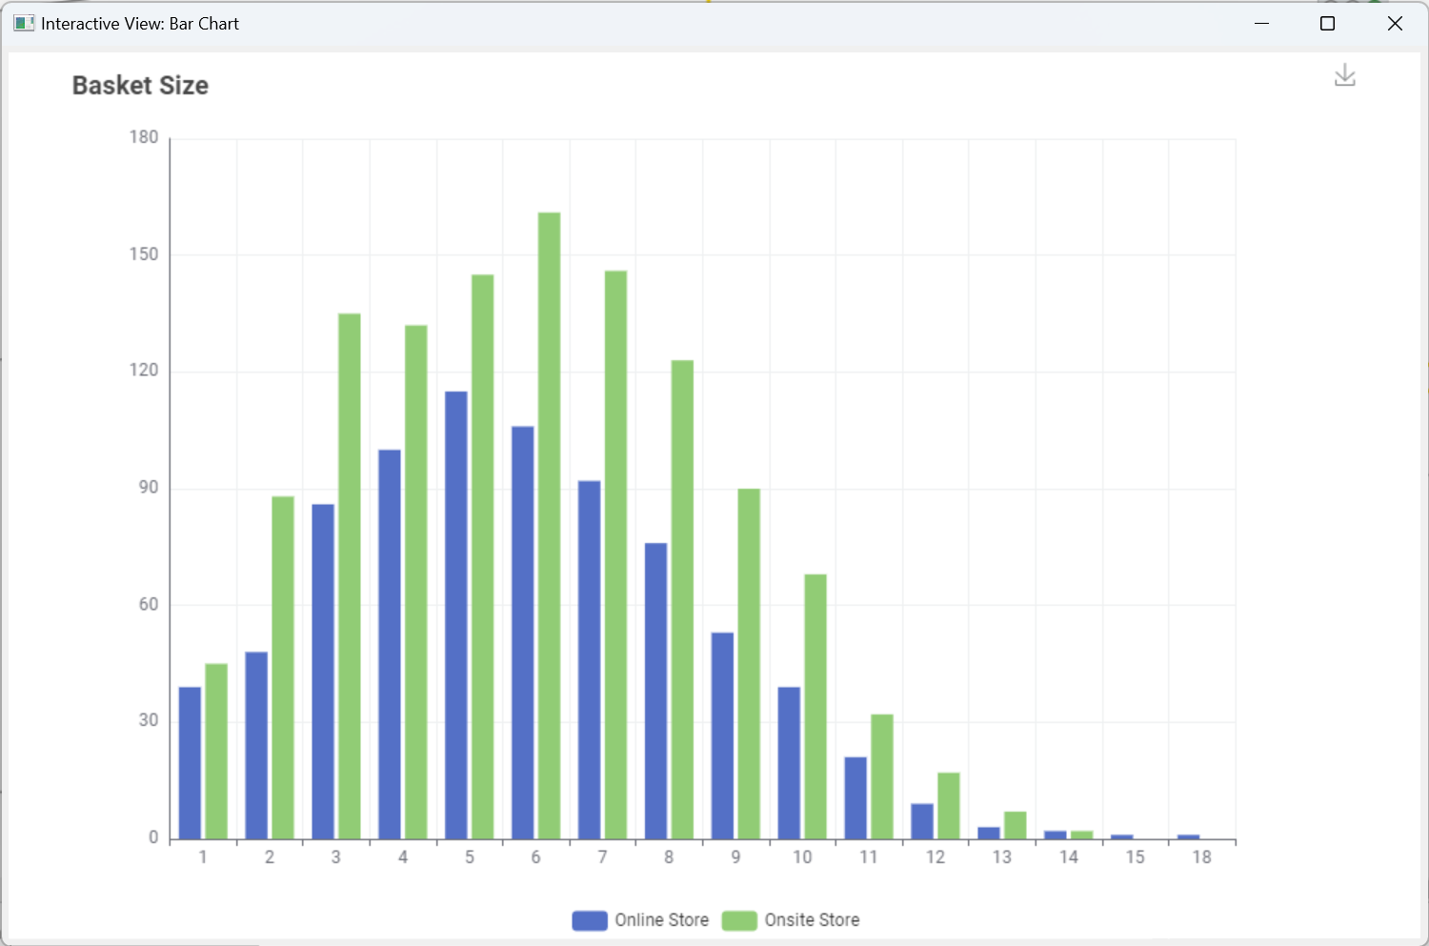
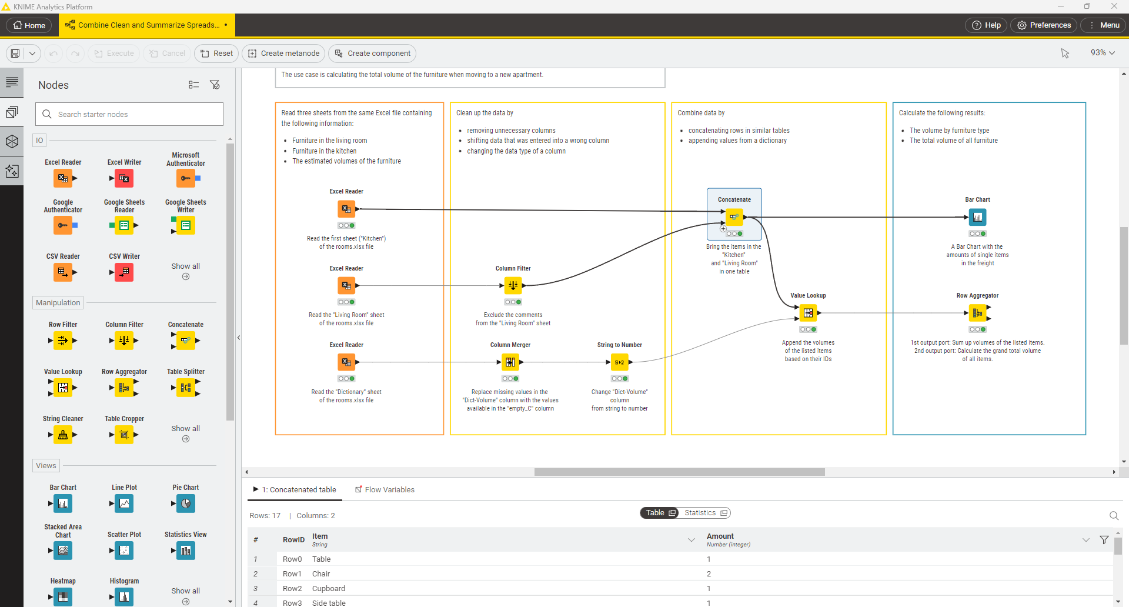
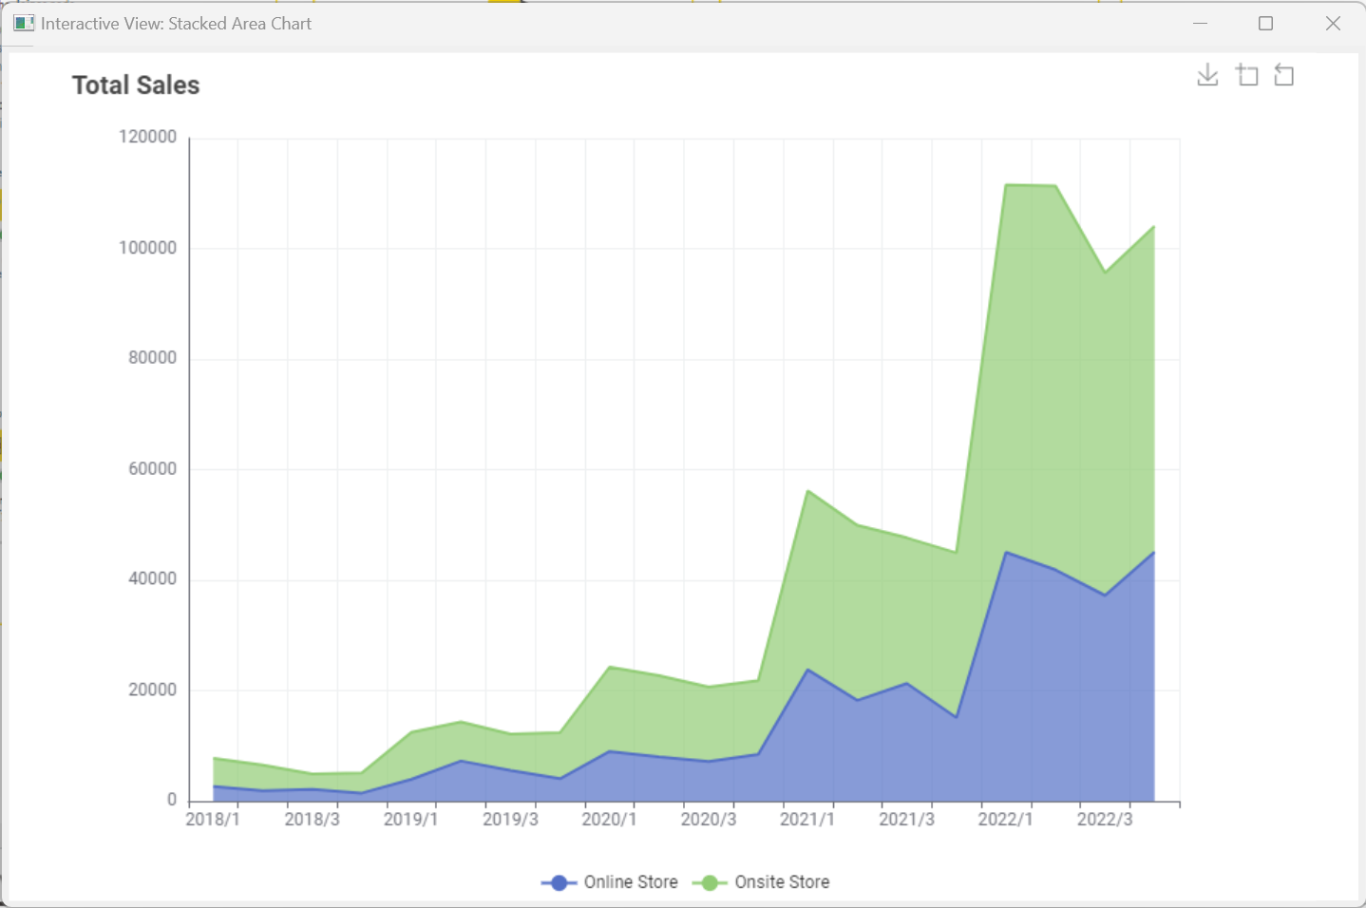
What is KNIME Analytics Platform
A tool to make sense of your data
Data analysis, Data Science, Data Engineering
Transformation, visualization, reporting
Open source
Visual programming paradigm
No coding required

Slide 5
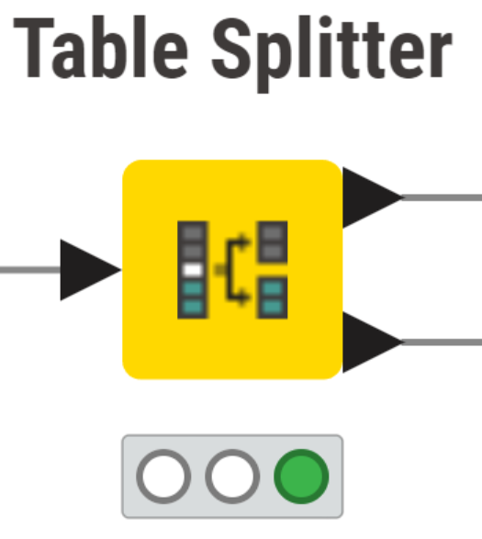




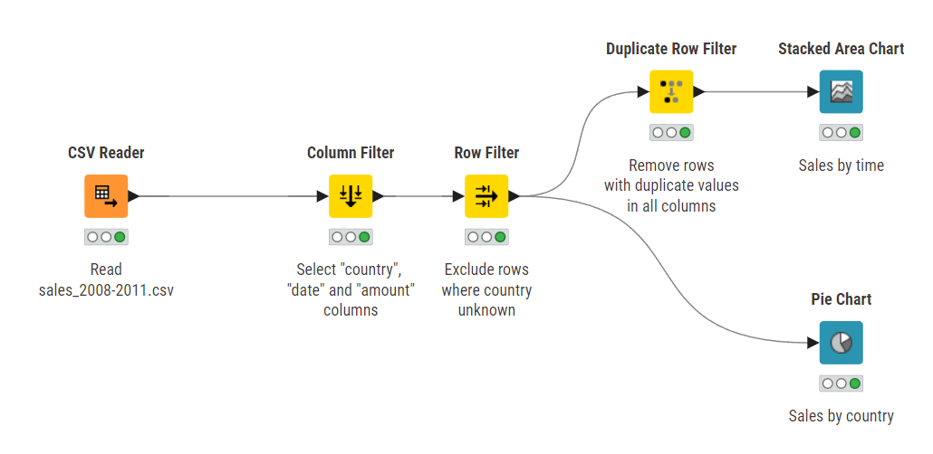
Nodes and Workflows
NODES perform tasks on data
Nodes are combined to create WORKFLOWS
Not Configured
Configured
Executed
Error
Inputs
Outputs
Status

Slide 6

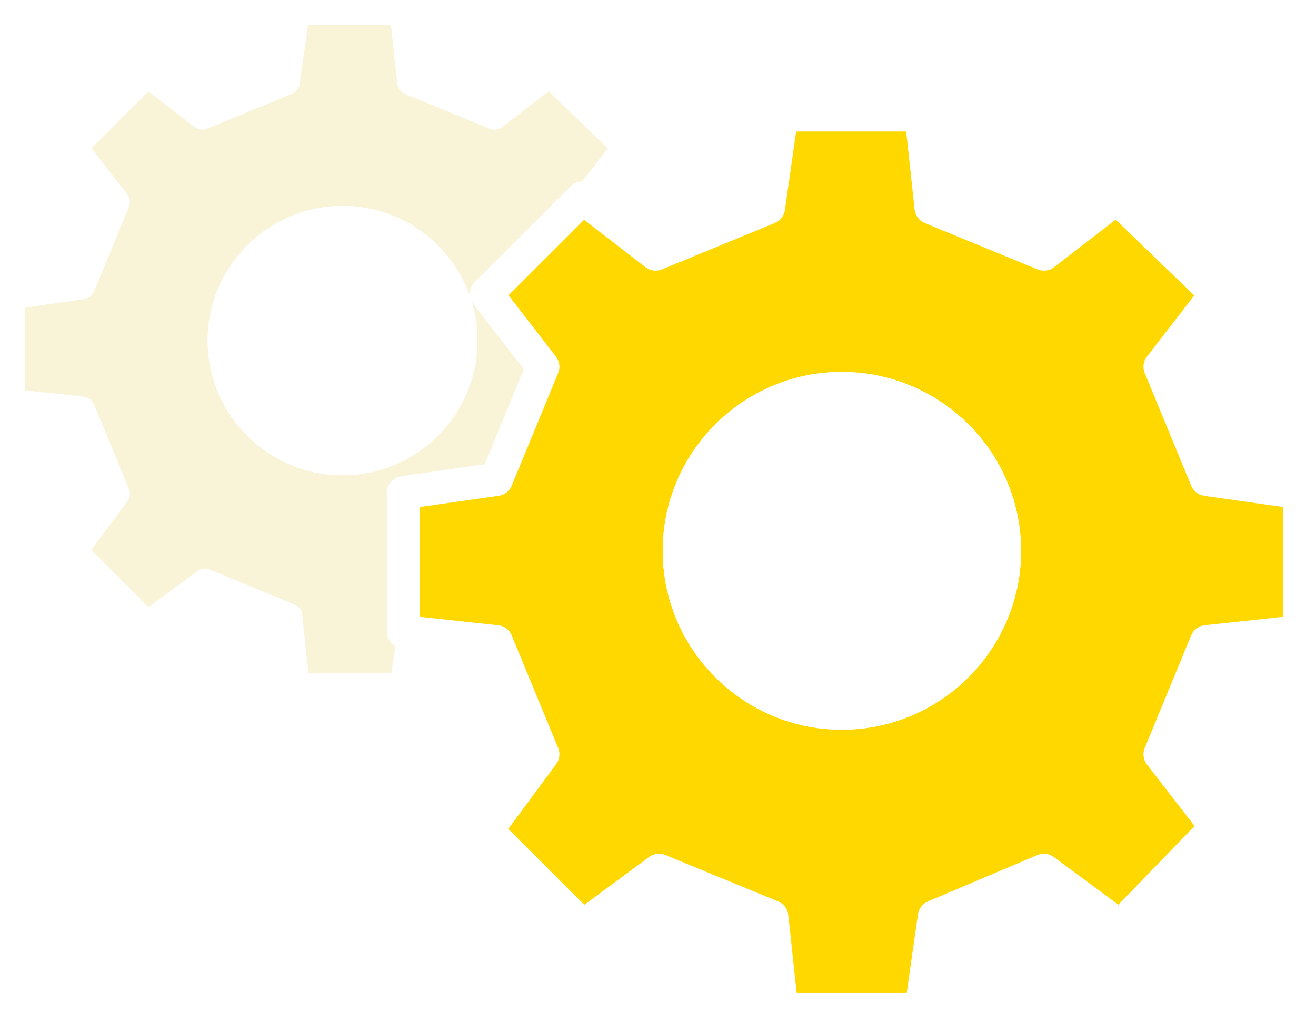
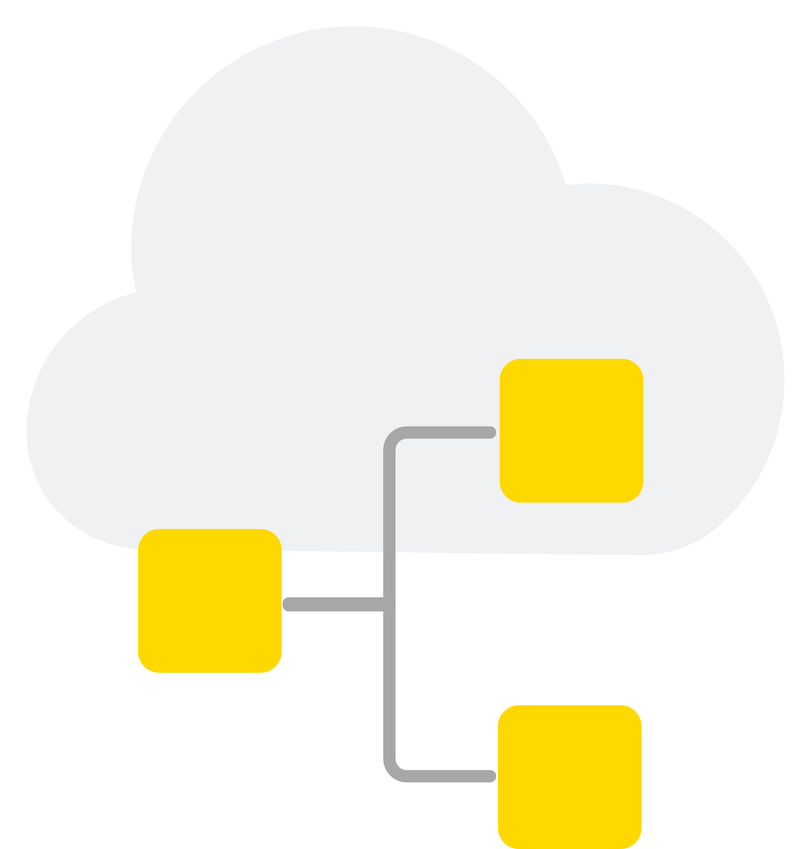
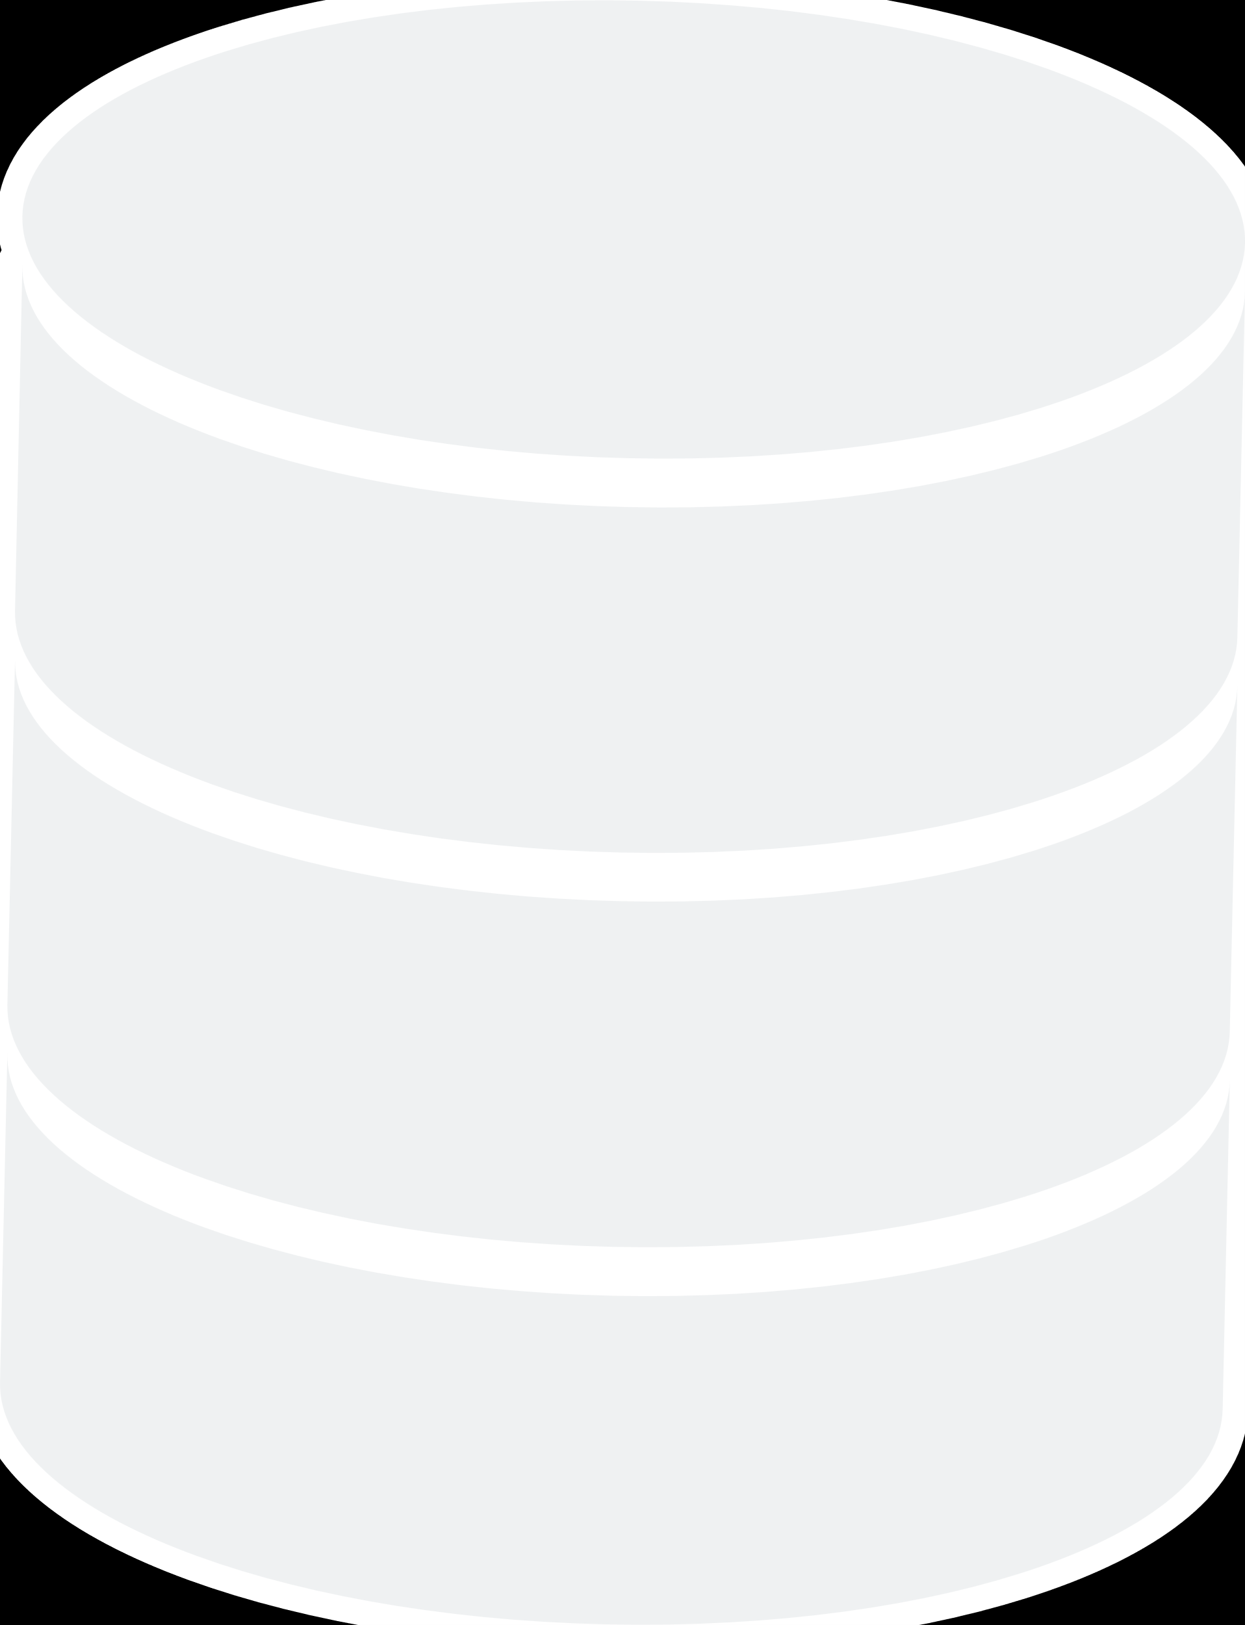
The Data Science Life Cycle
Blend & Transform
Validate & Deploy
Model & Visualize
Production
Process
Consume & Interact
Creation
Production
Optimize & Capture
Monitor & Update
KNIME Analytics Platform
Prepare & Build
KNIME Hub
Collaborate & Deploy

Slide 7
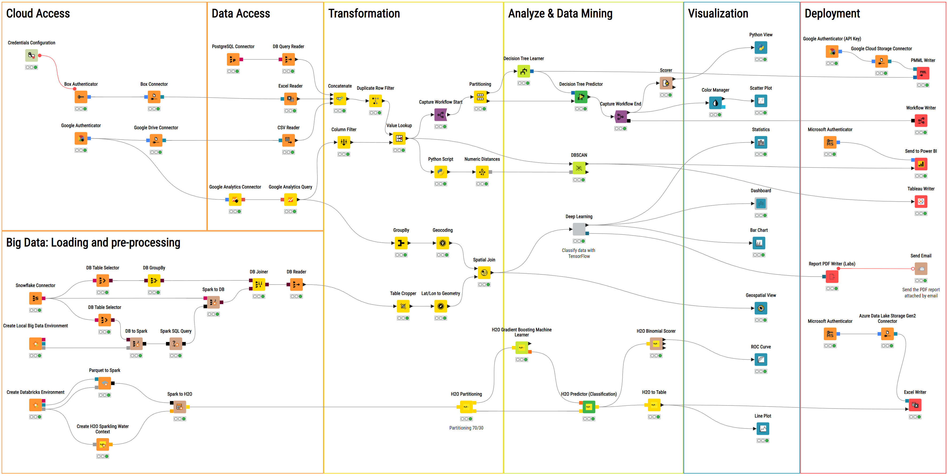
Over 4000 Nodes included

